Slide 1
Sparse Prediction with the k-Support Norm
IE 506 Course Project
Authors: Andreas Argyriou, Rina Foygel, Nathan Srebro
Presented by- Team Neural Knights
Members: Kundan Pratap (24n0454)
Sunrit Pal (24n0456)

Slide 2
Outline
Problem Statement
Approach Used in the Paper
Work Done Before Stage 1 Review
Comments in Stage 1 Review
How the team has addressed the comments
Algorithm and Code Implementation for K support Norm
Novelty Application for K support Norm
Conclusion
Contributions of Team Members
References

Slide 3
Problem Statement
We want to implement sparsity but traditional methods like Lasso can yield suboptimal results when features are corelated.
The norm may shrink too many coefficients to 0 sacrificing predictive accuracy for sparsity.
Elastic net which combines and penalty improves over Lasso, but there is definitely room for further improvement.
Our goal: Implement a new K support norm which gives a tighter and more precise approximation of true sparsity combined with penalty, aiming to improve generalization.
We seek to improve predictive performance, especially in scenarios with highly correlated features, by balancing sparsity and control more effectively.

Slide 4
Approach Used in the Paper
The paper explains why existing methods are not the best for sparse prediction, and so it introduces K-support Norm as a better alternative.
The authors provide its mathematical derivation and proved that it is the tightest convex relaxation of sparsity.
They also mention about the Dual Norm of the K support Norm.
Two Algorithms are provided: Proximity Operator and Accelerated K support Norm which implement the K support Norm technique.
Compares MSE and accuracy of K support Norm with Lasso and Elastic Net for the following 3 datasets: Synthetic Data, South African Heart Disease Data, 20 Newsgroups Data.

Slide 5


Work Done Before Stage 1 Review
Understood the theory behind sparsity and challenges of enforcing sparsity using the norm (non convex, NP hard)
Studied convex relaxation techniques, focussing on the norm as a surrogate for and identified its limitations, especially when large coefficients are present.
Understood the motivation for incorporating an constraint alongside sparsity: it improves sample complexity.
Formalized the combined constraint using the set . Analyzed the elastic net regularization and its role as a convex relaxation of .
Identified the core question: Is elastic net tighest convex relaxation of ? Defined and then derived the K support Norm associated with this convex hull. Showed that it is tighter than elastic net.

Slide 6
Comments in Stage 1 Review
We were informed to understand Algorithm-1 in detail, more specifically about gaining a proper understanding of the two inequalities that are being used to estimate the correct values of l and r.
Since we had lacked understanding of Algorithm 1 and 2, we had been unsuccessful in implementing the code.
We were also informed to write the detailed mathematical derivation of the dual of K support Norm.
For our Novelty Task, we were instructed to apply the K support Norm in a problem other than the ones mentioned in the research paper such a multiclass classification problem.

Slide 7
How the team has addressed the comments
We have understood the detailed implementation of Algorithm 1 and we have also understood how the two inequalities in the algorithm help in selecting the values of l and r.
We have understood both algorithms. We have implemented them in code and applied them to the datasets mentioned in the research paper and we have obtained results.
We have understood the derivation of the dual of K support norm and written it down in detail
For our Novelty Task, we have applied K support norm to the multiclass classification problem involving the iris dataset and have obtained positive results.

Slide 8



Derivation of the Dual
Lagrangian Formulation:
Given the primal K support Norm :
Where
Contains all subsets of {1,2,3…d} with <=k elements.
Introduce Lagrange Multiplier u for the equality constraint :

Slide 9




Derivation of the Dual (Continued)
Rewrite the Lagrangian:
Minimize over
Case 1:
For each subset I we solve :
Let
With t>0:

Slide 10




Derivation of the Dual (Continued)
Case 2:
Dual Function:
Using the Cauchy Schwarz Inequality we get :
Thus we get :
The minimum 0 us achieved when
The dual function is then given as the following expression

Slide 11

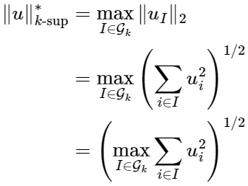
Derivation of the Dual (Continued)
Dual Norm:
Final Expression:
So we obtain the dual norm as follows
So we obtain the final expression for the k support norm as follows

Slide 12


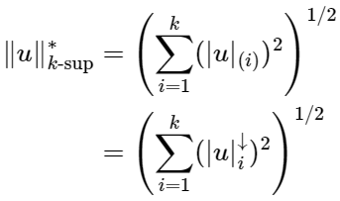
Derivation of the Dual (Continued)
Let
Be the absolute values of the components of u.
These all are basically sorted in descending order. The maximum sum is achieved by selecting k largest components.
Therefore we get

Slide 13








Understanding of Algorithm 1
Step 1: Let be the vector of absolute values of v,sorted in descending order
Step 2: We now search for indices r (from 0 to k-1) and l (from k to d) using the inequalities (7) and (8) mentioned in the research paper. Let us first define a variable theta as follows:
This theta will be used to uniformly subtract from entries
The Inequality (7) is defined as follows:
This inequality basically governs the boundary between the top group of entries from which
are scaled by a factor of and middle group of values which are shrunk by subtracting theta.
With this algorithm we are actually computing q which is actually finding the q that minimizes:
We also define:

Slide 14







Understanding of Algorithm 1(Continued)
We basically want to ensure that even after the changes (mentioned in the previous slide) have been made to the top and middle entries, when we cross the boundary between them, we still maintain the descending order logic. This means we can just look at the last element of the top entries and the first element of the middle entries to understand the boundary of transition. is the last entry of the top group and is the first entry of the middle group. We know that after the changes made the values will be basically:
In order to ensure that the descending order logic is maintained we need to ensure that
We also know that since the entries of z are in decreasing order we have , we combine these two conditions to get the upper bound of theta in inequality (7). Our goal is to get the following upper bound :
We have which gives . For now let’s assume
that the lower bound of theta is correct, this gives . Theta has to satisfy both (3) and (4) so get

Slide 15


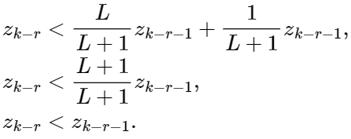
Understanding of Algorithm 1(Continued)
The upper bound in (2) is given by , this we can substitute in the condition (3) to get
Further simplification of the above gives us the following:
We know that the above is most definitely true from the previous slide where we mentioned that z is having a descending order based sorting which means that we need to have . This allows us to understand that the upper bound for theta is most definitely correct in inequality (7) since if this inequality was untrue then it would not be consistent with the descending ordering of the values of z.
Now let's take a look at the entry . Now we know that the scaling operation always gives a larger value compared to the reduction by theta operation (to preserve the monotonicity of decrease). Let’s apply both of these operations simultaneously on this entry. This would give us the following inequality-

Slide 16








Understanding of Algorithm 1(Continued)
Algebraic manipulation of the above gives the lower bound for theta in inequality (7) which is basically
Now for inequality (8) in the algorithm 1 we look at the following:
this inequality ensures a proper boundary
between entries that are thresholded and entries that are zeroed out. For the last threshold value we want to ensure that
For the first zeroed value we want
And so we obtain inequality (8). The reason for using less than equal to 0 in the above for instead of equal to 0 is that after shrinkage the algorithm is actually using the following logic - which ensures that as long as the value will be clipped to zero and so there is no need for exact equality to 0.
So now that we have the correct values of r and l we construct the proximal operator q. First of all just like before we know that theta is given as :

Slide 17
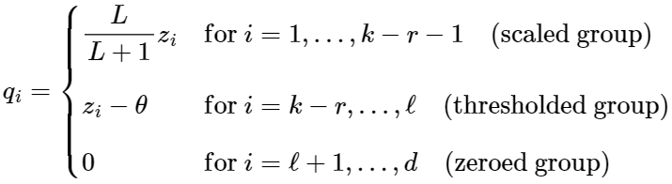
Understanding of Algorithm 1(Continued)
The entries of q are computed as follows:
After we calculate the vector q using the sorted and thresholded values, we need to make sure it matches the original input vector v. To do this, we first put the values of q back in the same order as v, because we had sorted v's absolute values earlier. Then, we also give each value in q the same sign (positive or negative) as the corresponding value in v. This final step ensures that the vector q follows the structure of v, while applying the shrinkage rules defined by the k-support norm.

Slide 18










Understanding of Algorithm 2
Step 1: We start with some initial guesses for the values of the weights and the parameter theta as follows-
Step 2: We do the update for theta as follows-
Theta actually plays a vital role in accelerating the rate of convergence from in the case of standard gradient descent to . This technique is called Nesterov Acceleration. Then we compute the following-
This is the gradient descent step. Compute the gradient and then pass the value obtained by gradient descent which is , as input to proximity operator. Assign the output of this proximity operator to update the value . Note that L is the Lipschitz constant.
Step 3: We update the value of with the following update:
The way in which the above update happens is that we add a momentum term that uses and . This step accelerates convergence by incorporating information from the previous steps.

Slide 19
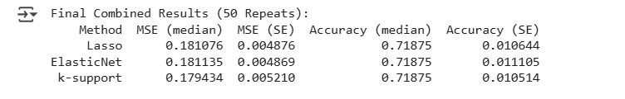

Algorithms and Code implementation of K support Norm
The implementation of the K support Norm code on the South African Heart Data has produced the following results. We can observed that we have achieved lower MSE for K support Norm compared to the other methods.
Implementation of the K support Norm code was performed on synthetically generated data, similar to the approach used in the Research Paper and lower MSE for K support Norm was obtained:

Slide 20
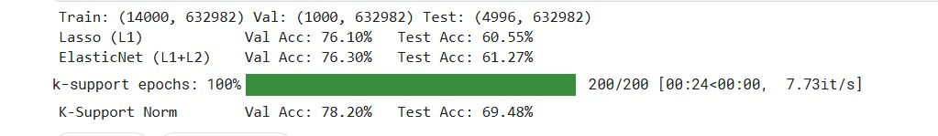
Algorithms and Code implementation of K support Norm (Continued)
We first did implementation of the K support Norm code on the entire News 20 binary dataset. This however led to problems of memory crash since the dataset is too large. It gave us the following problem:
The problem was that our algorithm needed to convert the sparse data into dense. This leads to memory runout when we do some matrix multiplications. So we asked Chatgpt to make changes in the code accordingly to avoid conversion of sparse matrix to dense. After doing so we observe following:

Slide 21

Novelty Application for K support Norm:
In the research paper, K support Norm is applied to two types of problems which are Regression and Binary Classification. However K support is basically a norm just like the L1 and L2 Norms and so it can be applied to any type of problem that uses a norm quantity. As a part of our novelty application, we have applied the K support Norm to a separate class of problem which is the multiclass Regression problem and obtained the following results:
We have applied the K support Norm on the iris dataset. This dataset contains 150 instances, 4 features and 3 classes. We have used the last two features(petal length and petal width) for our testing of the K support Norm and obtained the following results for accuracy:
As we can see that the K support Norm implementation provides exactly the same high level of accuracy that is provided by the Logistic Regression with an L1(lasso) penalty and elastic net. So in terms of accuracy, we see that K support Norm performs well. Subsequently we performed a decision boundary analysis and obtained slightly better decision boundaries in the case of K support Norm implementation compared to the Lasso and elastic net. So this is a slight achievement.

Slide 22
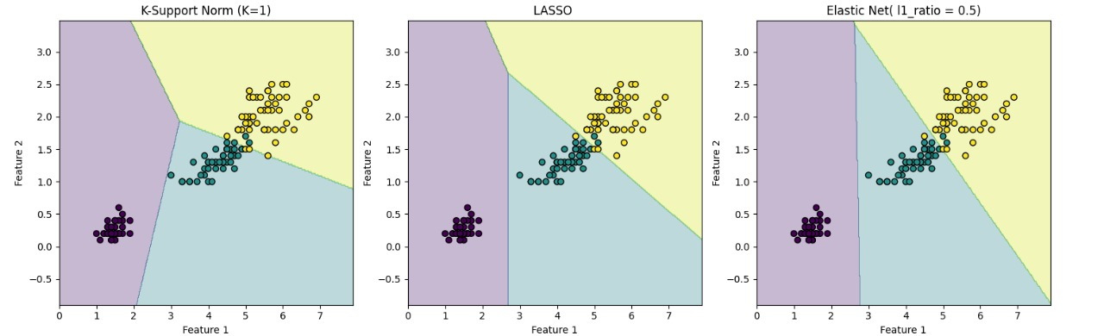
Novelty Application for K support Norm (continued):
Decision boundaries of K support Norm (taking k=1), Lasso and Elastic Net are as follows:
We observe that the length of the decision boundary between the yellow and purple region is smaller in case of L1 whereas it is larger when we apply K support Norm. As a result the split of the areas of the three regions is nearly equal for K support norm which is better for generalization.

Slide 23
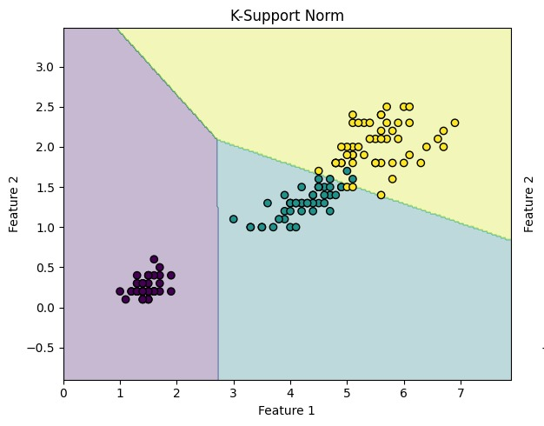
Novelty Application for K support Norm (continued):
Now let’s apply K support Norm by taking k=2 vs when we apply logistic regression for multiclass classification. This gives us the following results:
Changing K value results in the change of decision boundaries while maintaining the same accuracy.

Slide 24

Novelty Application for K support Norm (continued):
We also applied K support Norm on the Yeast dataset for multiclass classification. The Yeast dataset is a benchmark dataset widely used in bioinformatics for protein localization site prediction. It contains 1,484 protein samples, each described by 8 numerical features that capture biological signals related to protein sequences (such as membrane-spanning region scores and targeting signals). The objective is to classify each protein into one of 10 possible cellular localization sites (e.g., cytosol, nucleus, mitochondria). This dataset helps develop and test classification models aimed at understanding where proteins are likely to function within a cell. For this particular dataset we were able to obtain much better accuracy for the K support Norm compared to Lasso and Elastic Net.

Slide 25
Conclusion
Successfully understood the K support Norm, including mathematical formulation and its advantages over Lasso and Elastic Net.
Gained a thorough understanding of Algorithms 1 and 2 used to compute the K support Norm, including the logic behind selecting parameters and thresholds.
Implemented algorithms to the same three datasets as described in the paper and obtained results which show that K support Norm gives better predictive performance.
Extended the use of the K support Norm beyond the scope of the research paper by applying it to multiclass classification problems, which included the “Iris Dataset” and the “Yeast Dataset”.
Showed a visualization of the decision boundary that K support Norm provides.

Slide 26
Possible Future Directions
Explore embedding the k-support norm as a regularization layer in neural networks.
Investigate variants of the k-support norm, such as adaptive k-support where k is optimized during training rather than fixed.
Explore embedding K-support Norm as a regularizer in algorithms such as SVM.

Slide 27
Contribution of Team Members
Both team members have worked on the research paper and made the slides together.
Team member Sunrit Pal has made the following contributions:
Understood the detailed derivation of the dual Norm of the K support Norm and explained it as per the comments in Stage 1.
Provided the detailed understanding of Algorithm 1 and 2, most importantly how the two inequalities in the Algorithm 1 help in selecting the values of l and r.
Team member Kundan Pratap has made the following contributions:
Written the Code of the Algorithms for both classification and regression and implemented it on the datasets given in the paper.
Written the Code for Novelty Task(Multiclass classification) and implemented it on Iris and Yeast Dataset.

Slide 28
References
Yeast Dataset : Kenta Nakai, Paul Horton https://www.kaggle.com/datasets/samanemami/yeastcsv
Understanding regularization techniques : www.geeksforgeeks.org/lasso-vs-ridge-vs-elastic-net-ml/
For gaining understanding of dual: sites.math.washington.edu//~burke/crs/407/notes/section4.pdf

Slide 29
Use of AI
Used Chatgpt for Understanding the Research Paper
Generated Latex codes for mathematical terms
Asked suggestions on how to read data stored in LIBSVM format
Asked Chatgpt to modify the code so that it becomes compatible with sparse matrices

