Slide 1
SERVER ROOM / DATA CENTER ENVIRONMENT
A Low-Cost IoT Environmental Monitoring System
for Server Rooms Using Raspberry Pi and DHT22 Sensors
PROGRESS REPORT · ACADEMIC YEAR 2026/27
Sun WenBin (P2321251)
BSc in Computing / Artificial Intelligence
Supervisor: TBD

Slide 2
OVERVIEW
Presentation Outline
01
Problem & Motivation
Why small server rooms need affordable environmental monitoring
02
Aim & SMART Objectives
Measurable targets the project is built against
03
System Architecture
Raspberry Pi + DHT22 → Flask/SQLite → dashboard & alerts
04
Completed Work
Sensing, ingestion, dashboard, Telegram alerts
05
Big-Data Layer
Spark + Hive batch aggregation
06
Project Progress & Risk
Schedule status, risks and mitigations
COMP4299/CSAI4299 Final Year Project · Sun WenBin P2321251 · 2

Slide 3
CONTEXT
Problem & Motivation
Server rooms concentrate heat-generating IT equipment in a confined space. Temperature or humidity excursions silently accelerate hardware ageing and are among the most common causes of failure in small facilities.
Commercial BMS / DCIM platforms are accurate but expensive and closed — out of reach of universities, clinics and small businesses. Most open hardware projects stop at logging and plotting; few add alerting, an operator dashboard or durable, exportable history.
~70%
<1s
100%
of IT failures in small rooms traced to heat / humidity conditions
target response for any 30-day query window
no commercial platform targeted at the small-room budget
Proposed response: an affordable, integrated system combining proven low-cost building blocks.
COMP4299/CSAI4299 Final Year Project · Sun WenBin P2321251 · 3

Slide 4
AIM & TARGETS
SMART Objectives
01
Data collection
02
Web dashboard
Read temp (±0.5 °C) & humidity (±2 %RH) from DHT22 sensors at 1-min intervals, capture rate ≥ 99 %.
Real-time gauges + 24 h trends with Chart.js; page refresh under 2 seconds.
03
Alerting
04
Persistence
Configurable thresholds → Telegram within 10 s of a crossing, with recovery notices.
SQLite time-series store; any 30-day window queried in under 1 second.
05
Export & analytics
CSV export of any range in <5 s; Spark/Hive batch layer for history aggregation.
COMP4299/CSAI4299 Final Year Project · Sun WenBin P2321251 · 4

Slide 5
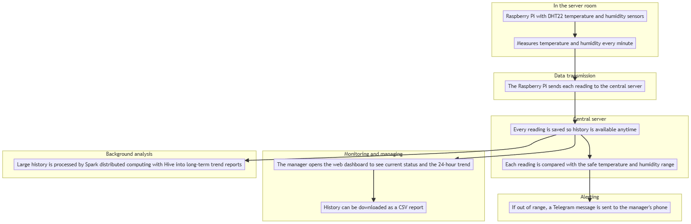
DESIGN
System Architecture
Raspberry Pi + DHT22 sensing nodes → Flask REST API → SQLite (WAL) + CSV → Chart.js dashboard, Telegram alerts, CSV export, and a Spark/Hive batch-analysis path.
COMP4299/CSAI4299 Final Year Project · Sun WenBin P2321251 · 5

Slide 6
COMPLETED WORK
From Sensor to Dashboard
1 Sensing
2 Ingestion
collector.py reads DHT22 every 60 s; invalid reads retried; offline buffer + CSV re-send guards the ≥99 % capture target.
Flask POST /api/reading validates, writes SQLite (WAL, indexed), appends CSV, evaluates thresholds inline.
3 Dashboard
4 Alerting
Chart.js gauges + 24 h trend with ASHRAE-informed threshold bands; 2 s polling; CSV export per range & sensor.
Telegram via background thread; per-condition suppression (10 min) + recovery notification when back to normal.
COMP4299/CSAI4299 Final Year Project · Sun WenBin P2321251 · 6

Slide 7
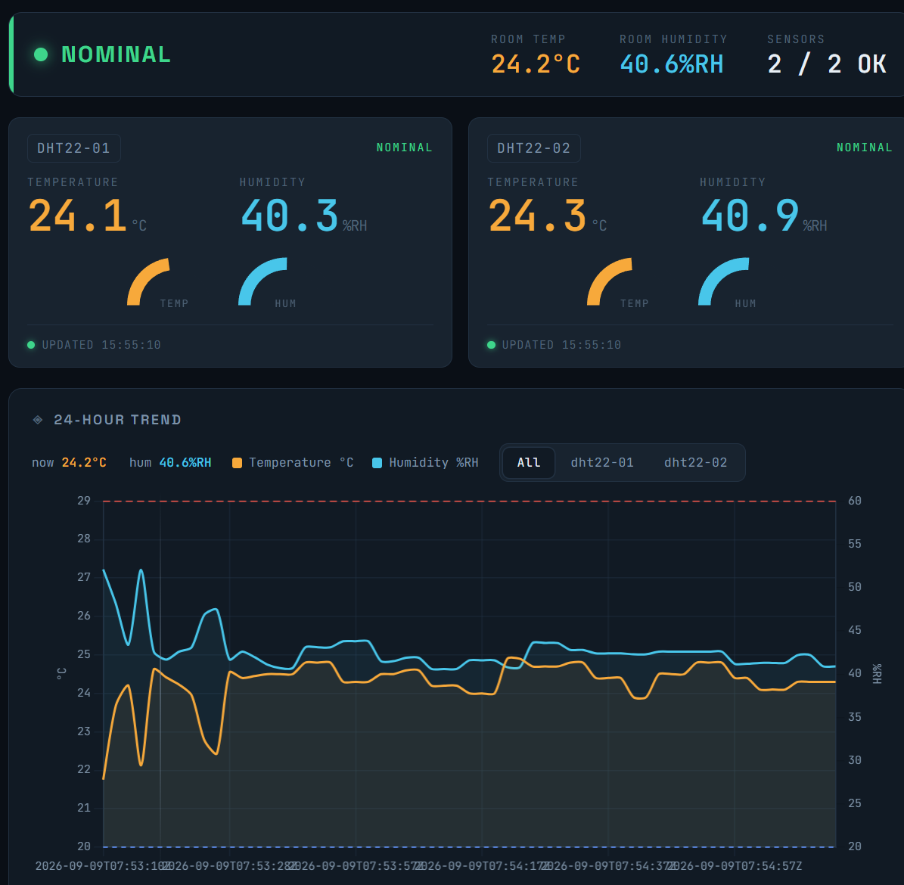
COMPLETED WORK
Live Dashboard (running system)
Real-time view
Current temp & humidity per sensor with status strip.
24-hour trends
Overlay of both sensors vs. threshold bands.
Health indicators
Connection, sensor count, nominal / alarm state.
Threshold control
Live-editable min/max values on the same page.
COMP4299/CSAI4299 Final Year Project · Sun WenBin P2321251 · 7

Slide 8
COMPLETED WORK
Threshold Alerting via Telegram
01
02
03
04
Read
Evaluate
Notify
Recover
Sensor value arrives at ingestion
Compare temp/humidity against thresholds
Telegram within 10 s (background send, retries)
Separate message when back inside limits
Verified behaviour
Manual threshold excursion fired a Telegram message on a phone inside the target latency, and a second message arrived automatically when conditions returned to normal — no message flooding thanks to per-condition suppression.
COMP4299/CSAI4299 Final Year Project · Sun WenBin P2321251 · 8

Slide 9
BIG-DATA LAYER
Spark + Hive Batch Analysis (WSL2, single-node cluster)
Environment
Pipeline
Hadoop 3.4.1 (HDFS) + Hive 4.2.1 metastore + Spark 4.0.4 (YARN), Java 21, on Ubuntu in WSL2.
readings.csv → hourly aggregates (avg/max/min temp & humidity per sensor) via PySpark → HDFS.
Query
Role
Hive external table over the aggregated output — SQL access to long-run history.
Complements the real-time Flask/SQLite path for semester-length analytics & reporting.
COMP4299/CSAI4299 Final Year Project · Sun WenBin P2321251 · 9

Slide 10
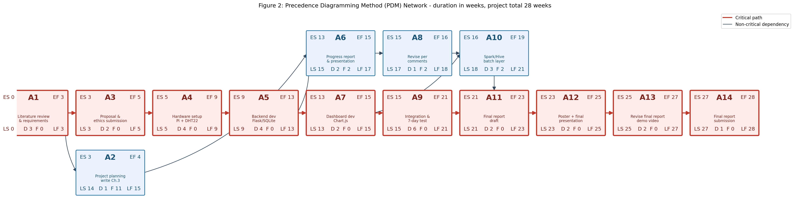
PROJECT TIME MANAGEMENT
Precedence Network (PDM) — 28 weeks, critical path in red
A1 → A3 → A4 → A5 → A7 → A9 → A11 → A12 → A13 → A14 is the critical path (28 weeks); each node shows ES / EF / LS / LF and total float.
COMP4299/CSAI4299 Final Year Project · Sun WenBin P2321251 · 10

Slide 11
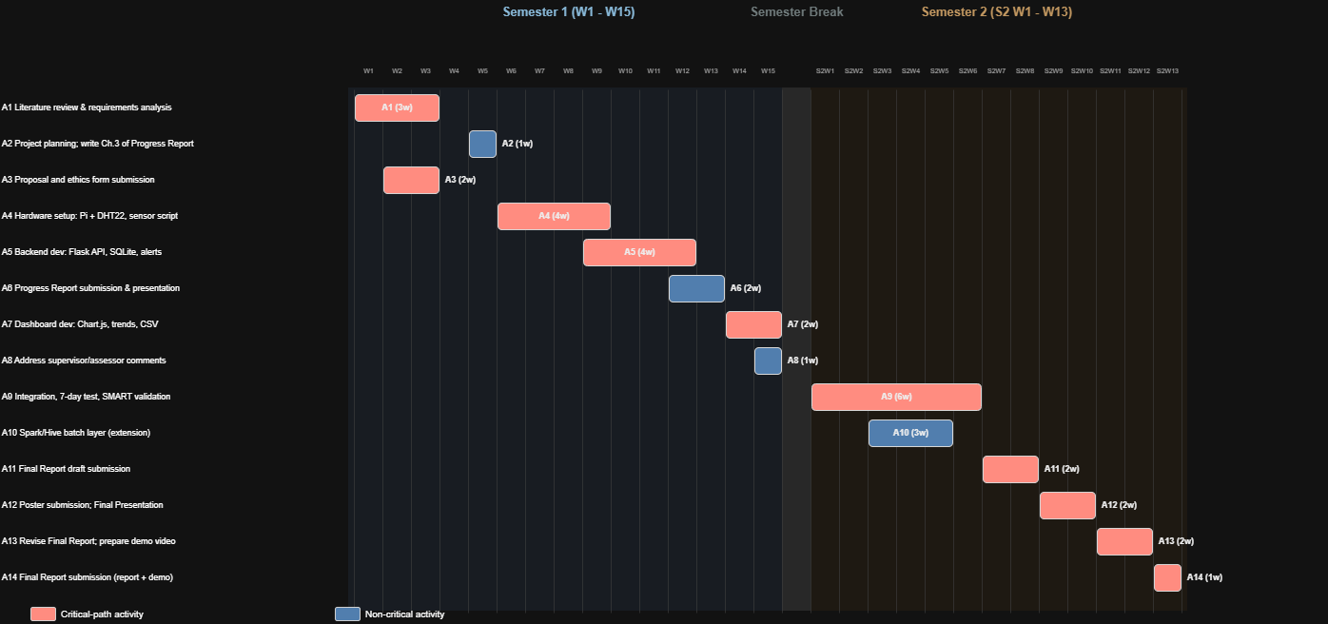
PROJECT TIME MANAGEMENT
Schedule — Gantt across two semesters
Semester 1 (W1-15) covers sensing, backend, dashboard and the progress report; Semester 2 (S2 W1-13) covers integration, validation and final delivery.
COMP4299/CSAI4299 Final Year Project · Sun WenBin P2321251 · 11

Slide 12
RISK MANAGEMENT
Top Risks & Mitigations
Network link (Med/High)
Server downtime / SQLite (Low/High)
Buffer on the Pi + retransmit; local CSV fallback.
WAL mode, scheduled backups, CSV as secondary record.
Sensor accuracy (Med/Med)
Alert delay (Low/Med)
Validate & retry reads, reject out-of-range, calibrate.
Evaluate at ingestion; retry with backoff; SMTP backup.
Query / export targets (Low/Med)
Index ts, pre-aggregate, paginate large exports.
COMP4299/CSAI4299 Final Year Project · Sun WenBin P2321251 · 12

Slide 13
Current Status & Next Steps
Sensing, Flask ingestion, SQLite persistence, dashboard, CSV export, Telegram alerts, Spark/Hive layer.
COMPLETE
7-day continuous validation of capture-rate and latency targets; calibration against a reference sensor.
IN PROGRESS
Formal SMART verification, final-report writing, demo video and poster for the final presentation.
NEXT
Thank you — Questions welcome.

