Slide 1
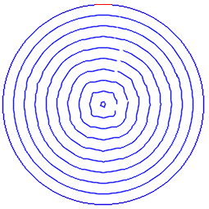
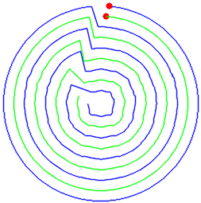
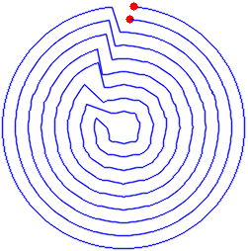
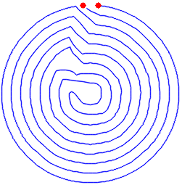
Filling 2D Region with Fermal Spiral
Find parallel contours by Angus Johnson's Clipper library
For each region, generate two spirals and connect them tail by tail, smooth and reroute each segments in the event of interference
Parallel contours
To two spirals
Connect
Re-route and smooth

Slide 2
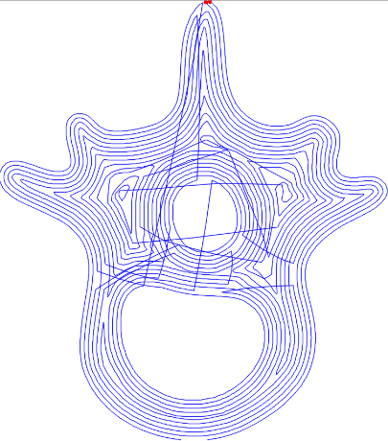
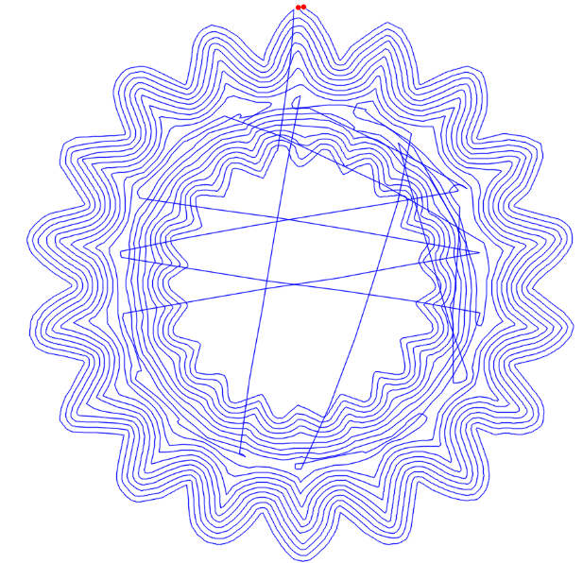
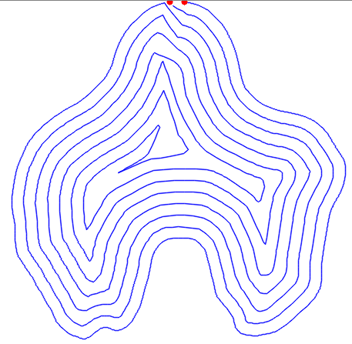
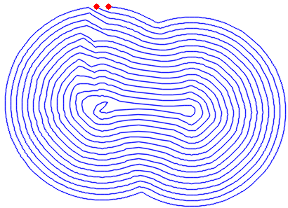
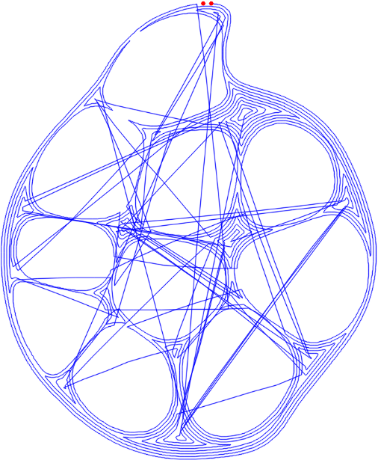
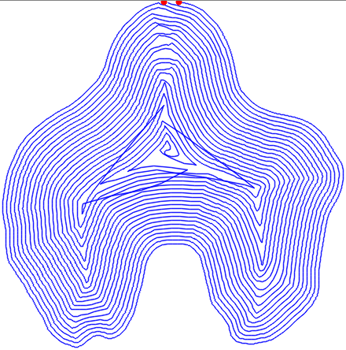
Filling 2D Region with Fermal Spiral
3. Connect all Fermat spirals via a traversal and local re-routing
Notes:
添加分区与连接算法

Slide 3
Fermal Spiral Contours to Gcode
Preprocess Code
extrusion width
temperature
Preprocess Code
Post Code
Filling patterns
G-code

Slide 4

Parameter adjustment
Offset：influence generation of parallel contours and he connection between continuous Fermat(Interference when contour linking)
E（extrusion quantity）：The extrusion quantity of filament between two points. We use absolute distances for extrusion. If the value of E is too small, the amount of extrusion will not be enough and the strength will be affected. Too much will destroy the contour. The E value between two points is determined by the following formula.
According to filament diameter print performance, we select the appropriate offset and α.

Slide 5
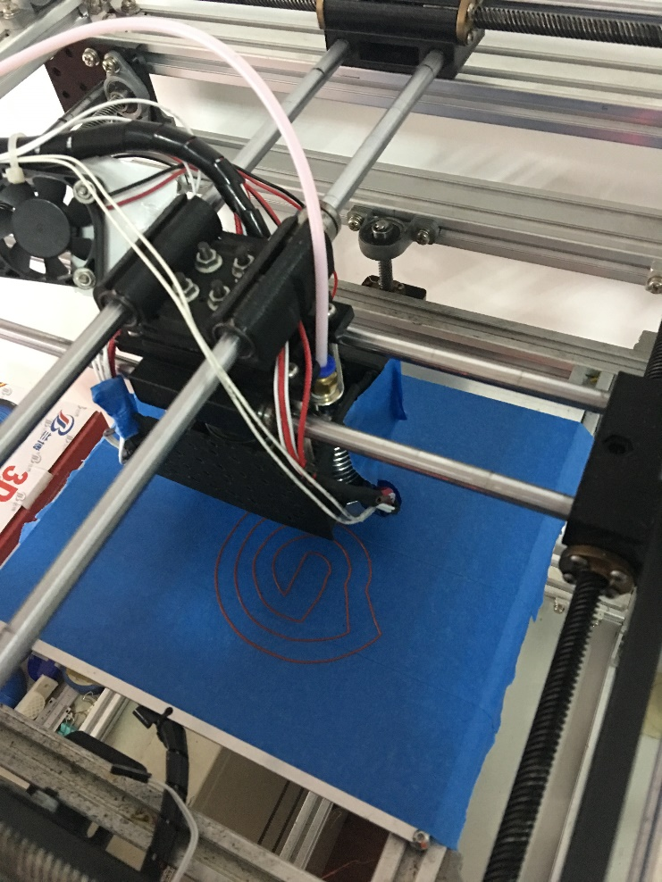
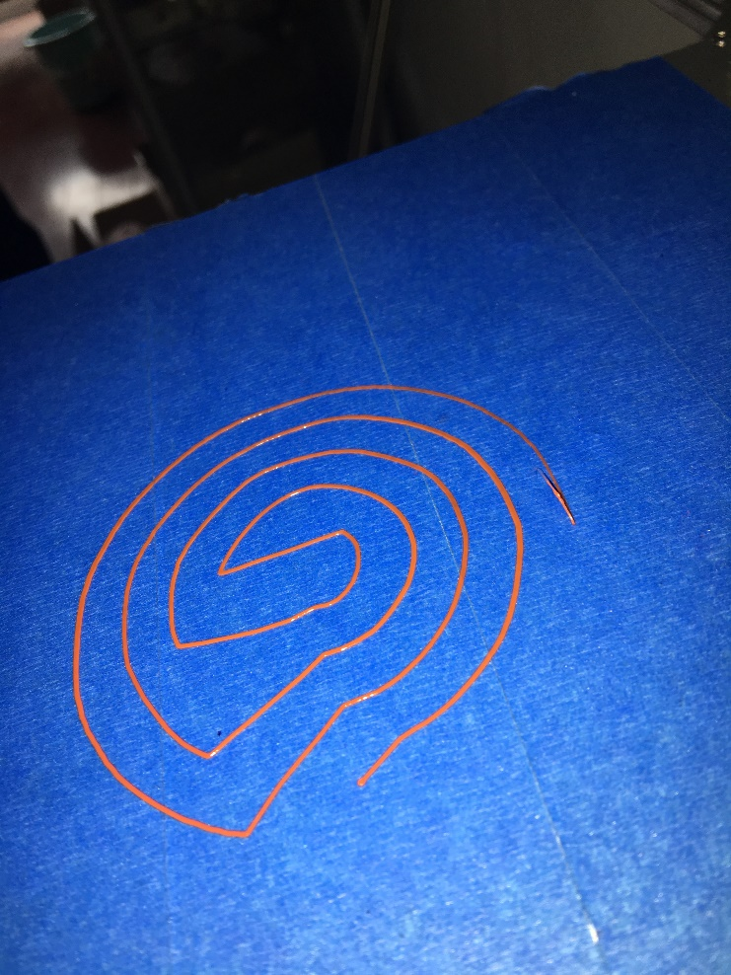
Sparse Filling plane
Offset =-8
α=0.0909
The wire spacing is too large and the extruded filament is finer
Printing process
Single layer filling

Slide 6
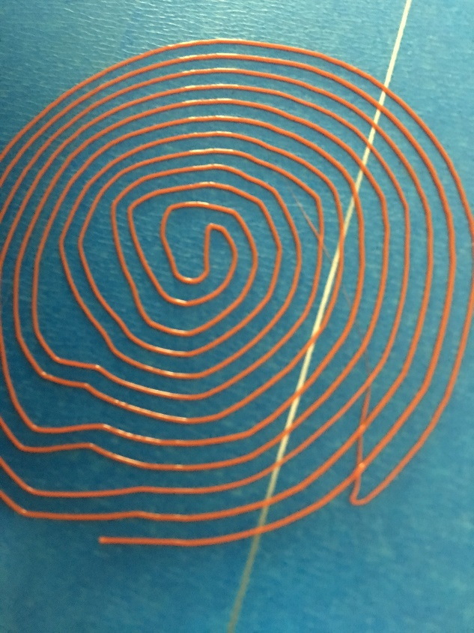
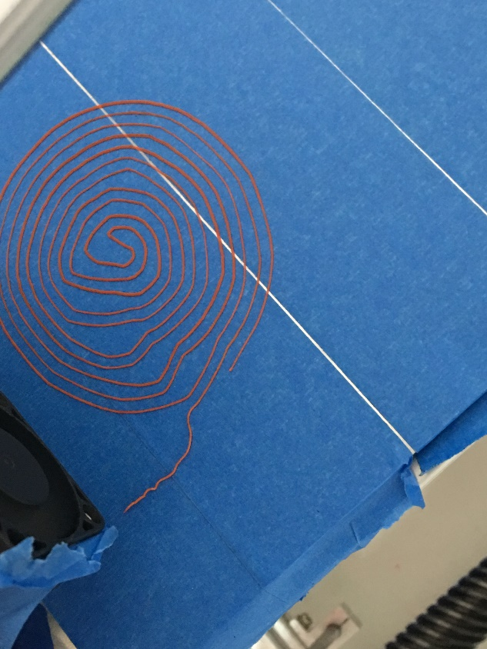
Dense filling plane
Offset =-3
α=0.0909
The wire spacing is too large and the extruded filament is finer
Offset =-1
α=0.0909
The wire spacing is too large and the extruded filament is finer
After adjusting the offset value, the filling sparsity is affected, but the Fermat spiral contour is still intact, and most of the values will not cause interference between contours, but there is a phenomenon of insufficient filling in local areas.

Slide 7
Filling 3D surface with Spiral
Introducing Fermat spirals as a 3D fill pattern
Cylindrical Surface mapping: Cylindrical Surface——Rectangular expansion surface——Extract external contour

Slide 8
Filling 3D surface with Spiral
Filling free-form 3D surface with Spiral
Free-form Surface mapping
Evaluating indicator:1、 Relative area error 2、 Relative angle error 3、 Relative length error

Slide 9
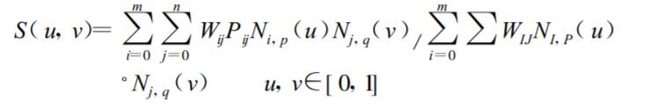
Filling 3D surface with Spiral
Filling free-form 3D surface with Spiral
Free-form Surface mapping : NURBS Surface-Undevelopable surface. method: NURBS Surface——Discrete face——Mesh——Mapping

Slide 10
G-code
; external perimeters extrusion width = 0.40mm
; perimeters extrusion width = 0.67mm
; infill extrusion width = 0.67mm
; solid infill extrusion width = 0.67mm
; top infill extrusion width = 0.67mm
M107
M190 S70 ; set bed temperature
M104 S190 ; set temperature
G28 ; home all axes
G1 Z5 F5000 ; lift nozzle
M109 S190 ; wait for temperature to be reached
G21 ; set units to millimeters
G90 ; use absolute coordinates
M82 ; use absolute distances for extrusion
G92 E0
G1 E-3.00000 F1800.00000
G92 E0
G1 Z0.350 F4800.000
G1 X74.800 Y32.200 F4800.000
G1 E3.00000 F1800.00000
G1 X74.800 Y32.200 E3.00000 F600
G1 X76.900 Y32.700 E3.19623
G1 X76.400 Y41.200 E69.04315
G1 X73.400 Y39.200 E69.37089
G1 X70.100 Y37.100 E69.72645
G1 E6.95908 F1800.00000
G92 E0
M104 S0 ; turn off temperature
G28 X0 ; home X axis
M84 ; disable motors……………………………..

