Slide 1
AI-Powered Fish Health System
Aquaculture Disease Detection Using Deep Learning
- Real-time disease classification
- 7-class disease detection
- Explainable AI & Edge Deployment

Slide 2
Problem & Solution
Challenges in Aquaculture:
Manual disease detection is time-consuming and prone to errors
Early detection is critical but expert knowledge is scarce
Real-time monitoring needed for large farms
Our Solution:
AI-powered automated detection using Computer Vision
Instant diagnosis with high accuracy (76.55%)
Explainable predictions (Grad-CAM) & Offline Edge Deployment

Slide 3
Core Objective:
Develop an explainable, real-time AI system for multi-class image classification of freshwater fish diseases.
Key Features:
✅ 7 Disease Classes: Healthy + 6 common diseases
✅ Architecture: MobileNetV2 (Transfer Learning)
✅ High Accuracy: 76.55% on test set
✅ Explainable AI: Grad-CAM visualizations
✅ Edge Deployment: TFLite (2.40 MB)

Slide 4
Disease Classes (7 Categories)
Dataset: 2,400+ images, balanced distribution
🟢 Healthy Fish (Health Status)
🔴 Aeromoniasis (Bacterial)
🔴 Gill Disease (Bacterial)
🔴 Red Disease (Bacterial)
🟡 Saprolegniasis (Fungal)
🟠 Parasitic Disease (Parasitic)
🔵 White Tail Disease (Viral)

Slide 5
Technical Architecture
Deep Learning Pipeline:
Input Image (224×224×3)
⬇ MobileNetV2 (Pre-trained on ImageNet)
⬇ Feature Extraction (Frozen layers)
⬇ Global Average Pooling & Dropout (0.3)
⬇ Dense Layer (7 classes) -> Softmax
⬇ Disease Prediction
Stack: TensorFlow/Keras 3, Adam Optimizer, Grad-CAM

Slide 6
Model Performance
Metrics (Test Set - 469 images):
🏆 Accuracy: 76.55%
🎯 Precision: 88.42%
🔍 Recall: 58.64%
⚖️ F1-Score: 76.41%
Best Performing Classes:
⭐ Healthy: 93% Recall (Critical for safety)
⭐ Gill Disease: 88% Precision

Slide 7
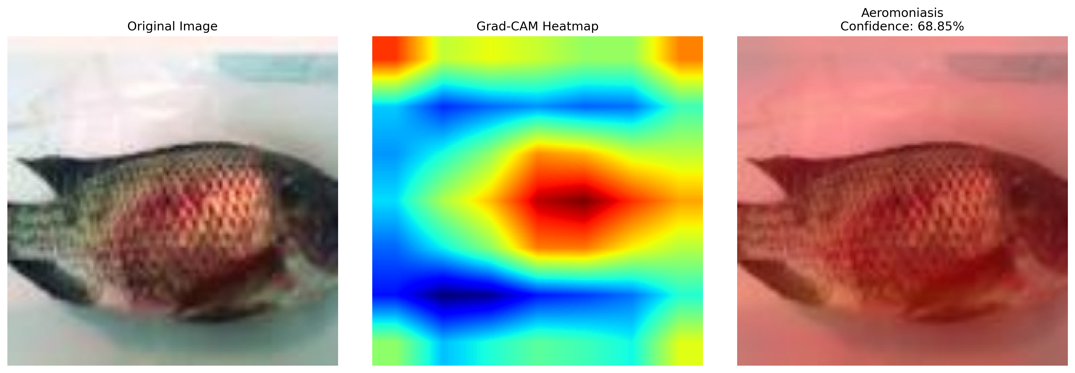
Explainable AI - Grad-CAM

Slide 8
Edge-AI Deployment
TensorFlow Lite Conversion
Original Model: ~8.65 MB
⬇ Optimized TFLite: 2.40 MB (Quantized)
⬇ 72% Size Reduction
capabilities:
✅ Offline Operation (No internet)
✅ Real-time Inference on Mobile/Edge devices
✅ Low Resource Consumption

Slide 9
Key Achievements
System Status: Fully Operational
✅ Balanced stratified dataset (7 classes)
✅ Keras 3 Compatibility & Modern UI
✅ Real-time Grad-CAM Heatmaps
✅ Edge-Ready TFLite Model (2.4MB)
✅ 76.55% Accuracy verified

Slide 10
Real-World Applications
🌊 Aquaculture Farms: Daily monitoring & disease prevention
🔬 Research: Disease pattern analysis
📱 Mobile Diagnosis: Farmers with smartphones (Offline)
🐟 Hatcheries: Quality control & breeding selection

Slide 11
Conclusion
Impact & Summary
We built a fully functional, end-to-end AI system.
Solves a critical problem in aquaculture with 76% accuracy.
Transparent decision making (Explainable AI).
Ready for real-world use on edge devices.

Slide 12
Thank You!

