Slide 1

OCN 479-001
3D Design

Slide 2
Today’s plan
Rest of semester plan
Interactive lecture
Build sensors!

Slide 3

Rest of semester plan/check-in

Slide 4
Check in/plan
How was last week’s Blue Economy/Innovation & Commercialization class?
3 more classes before fieldwork. 1 of those should be final assembly and dock testing. So today and next week for final design!!!
Progress—everyone is doing well, but going to be extremely tight with field plans. Make sure if you are not your group’s coding leader that you find other work to stay busy.
Final reports need some data—doesn’t have to be final, successful instrument, but has to have something. Talk with your team about how you will ensure inclusion of data in your final presentation and continuity report.

Slide 5
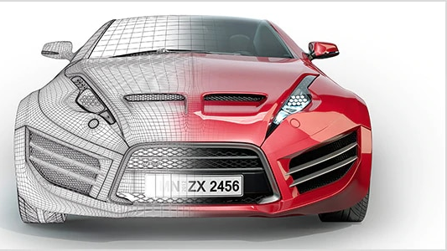
Today’s topic
3D Design

Slide 6
3D Design
Many options: some free, some extremely expensive
Some good for hobby design, some for professional
Some meant for engineering, some for art/professional design

Slide 7
3D Design Process
Measure
Measure what you have. What are you building around? E.g., sensor components, off-the-shelf PVC tubes, etc.
Sketch 2D
Sketch out what you think you want, starting with 2D
Sketch 3D
Sketch out 3D
Consider
Consider how it will be made:
3D printer?
CNC mill?
Manual lathe?
Hacksaw & hot glue?

Slide 8
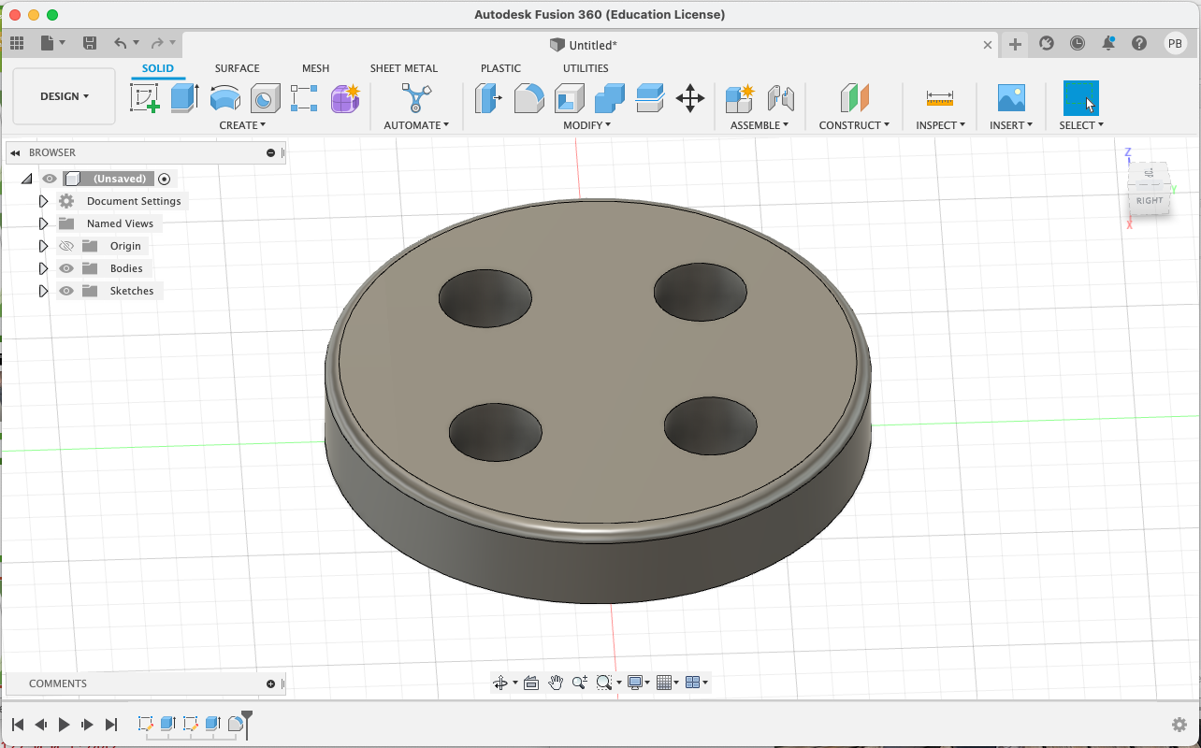
Fusion 360

Slide 9
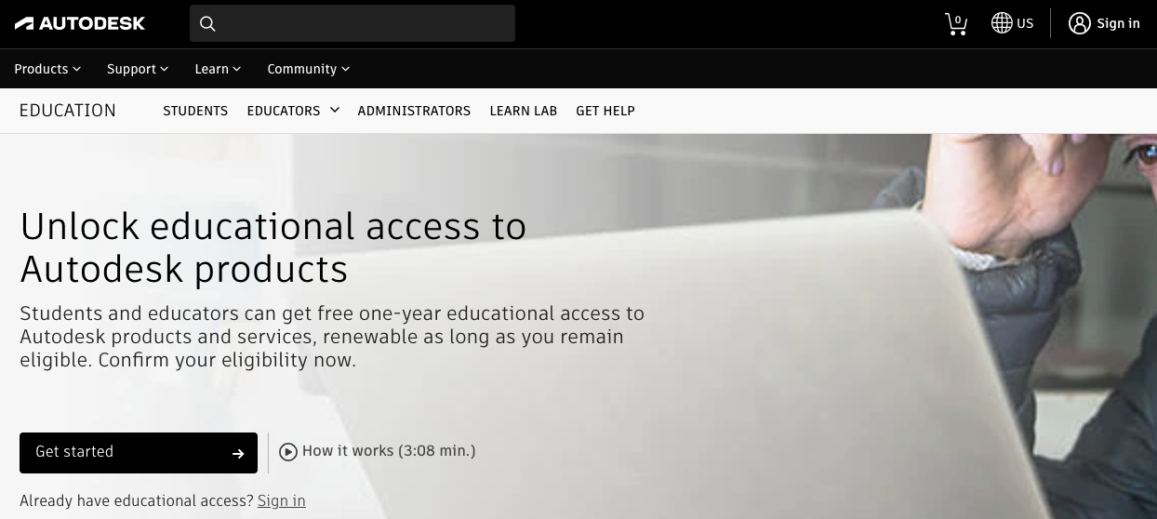

Slide 10
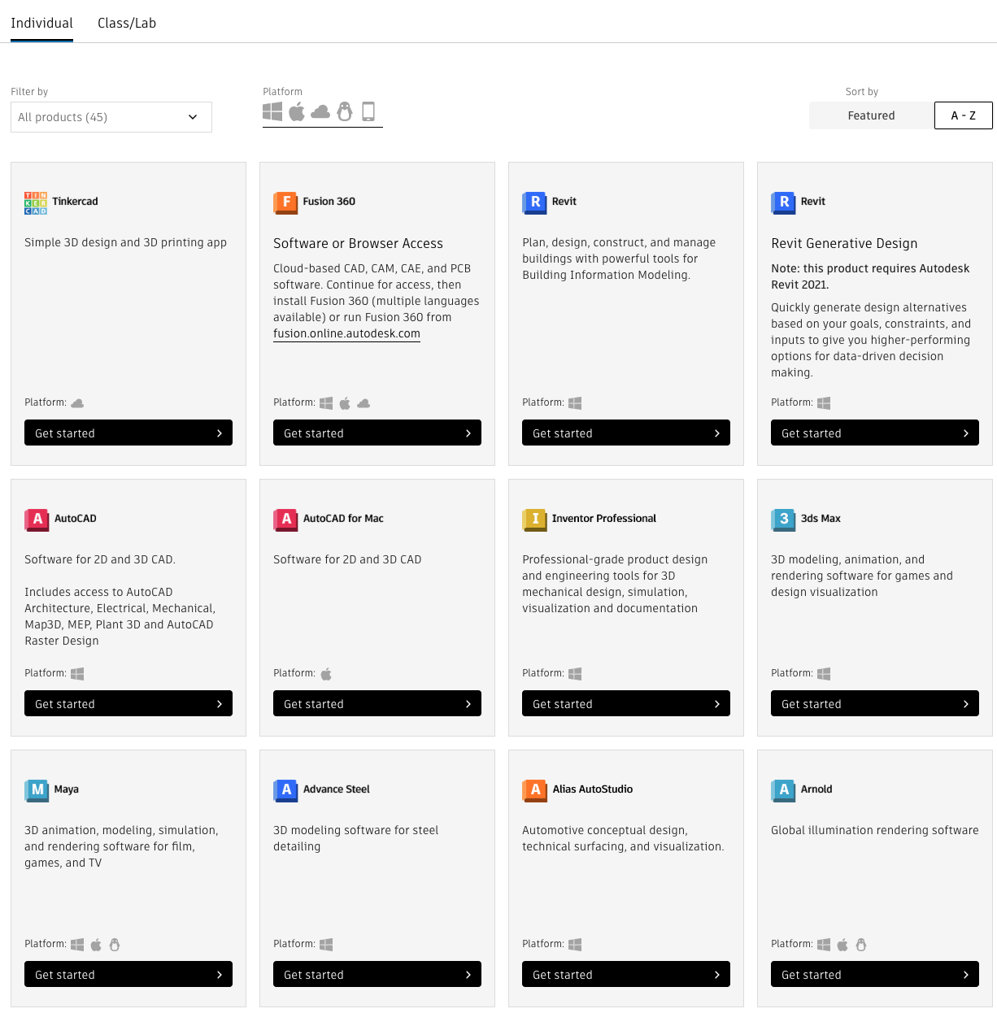

Slide 11
What to do with 2D or 3D models
Subtractive manufacturing:
Start with piece of stock material (solid brick/sheet/rod of material)
Drill, cut, lathe, sand, file, etc.
Additive manufacturing:
3D printing: start with nothing but an empty panel
Add filament or cure resin

