Slide 1
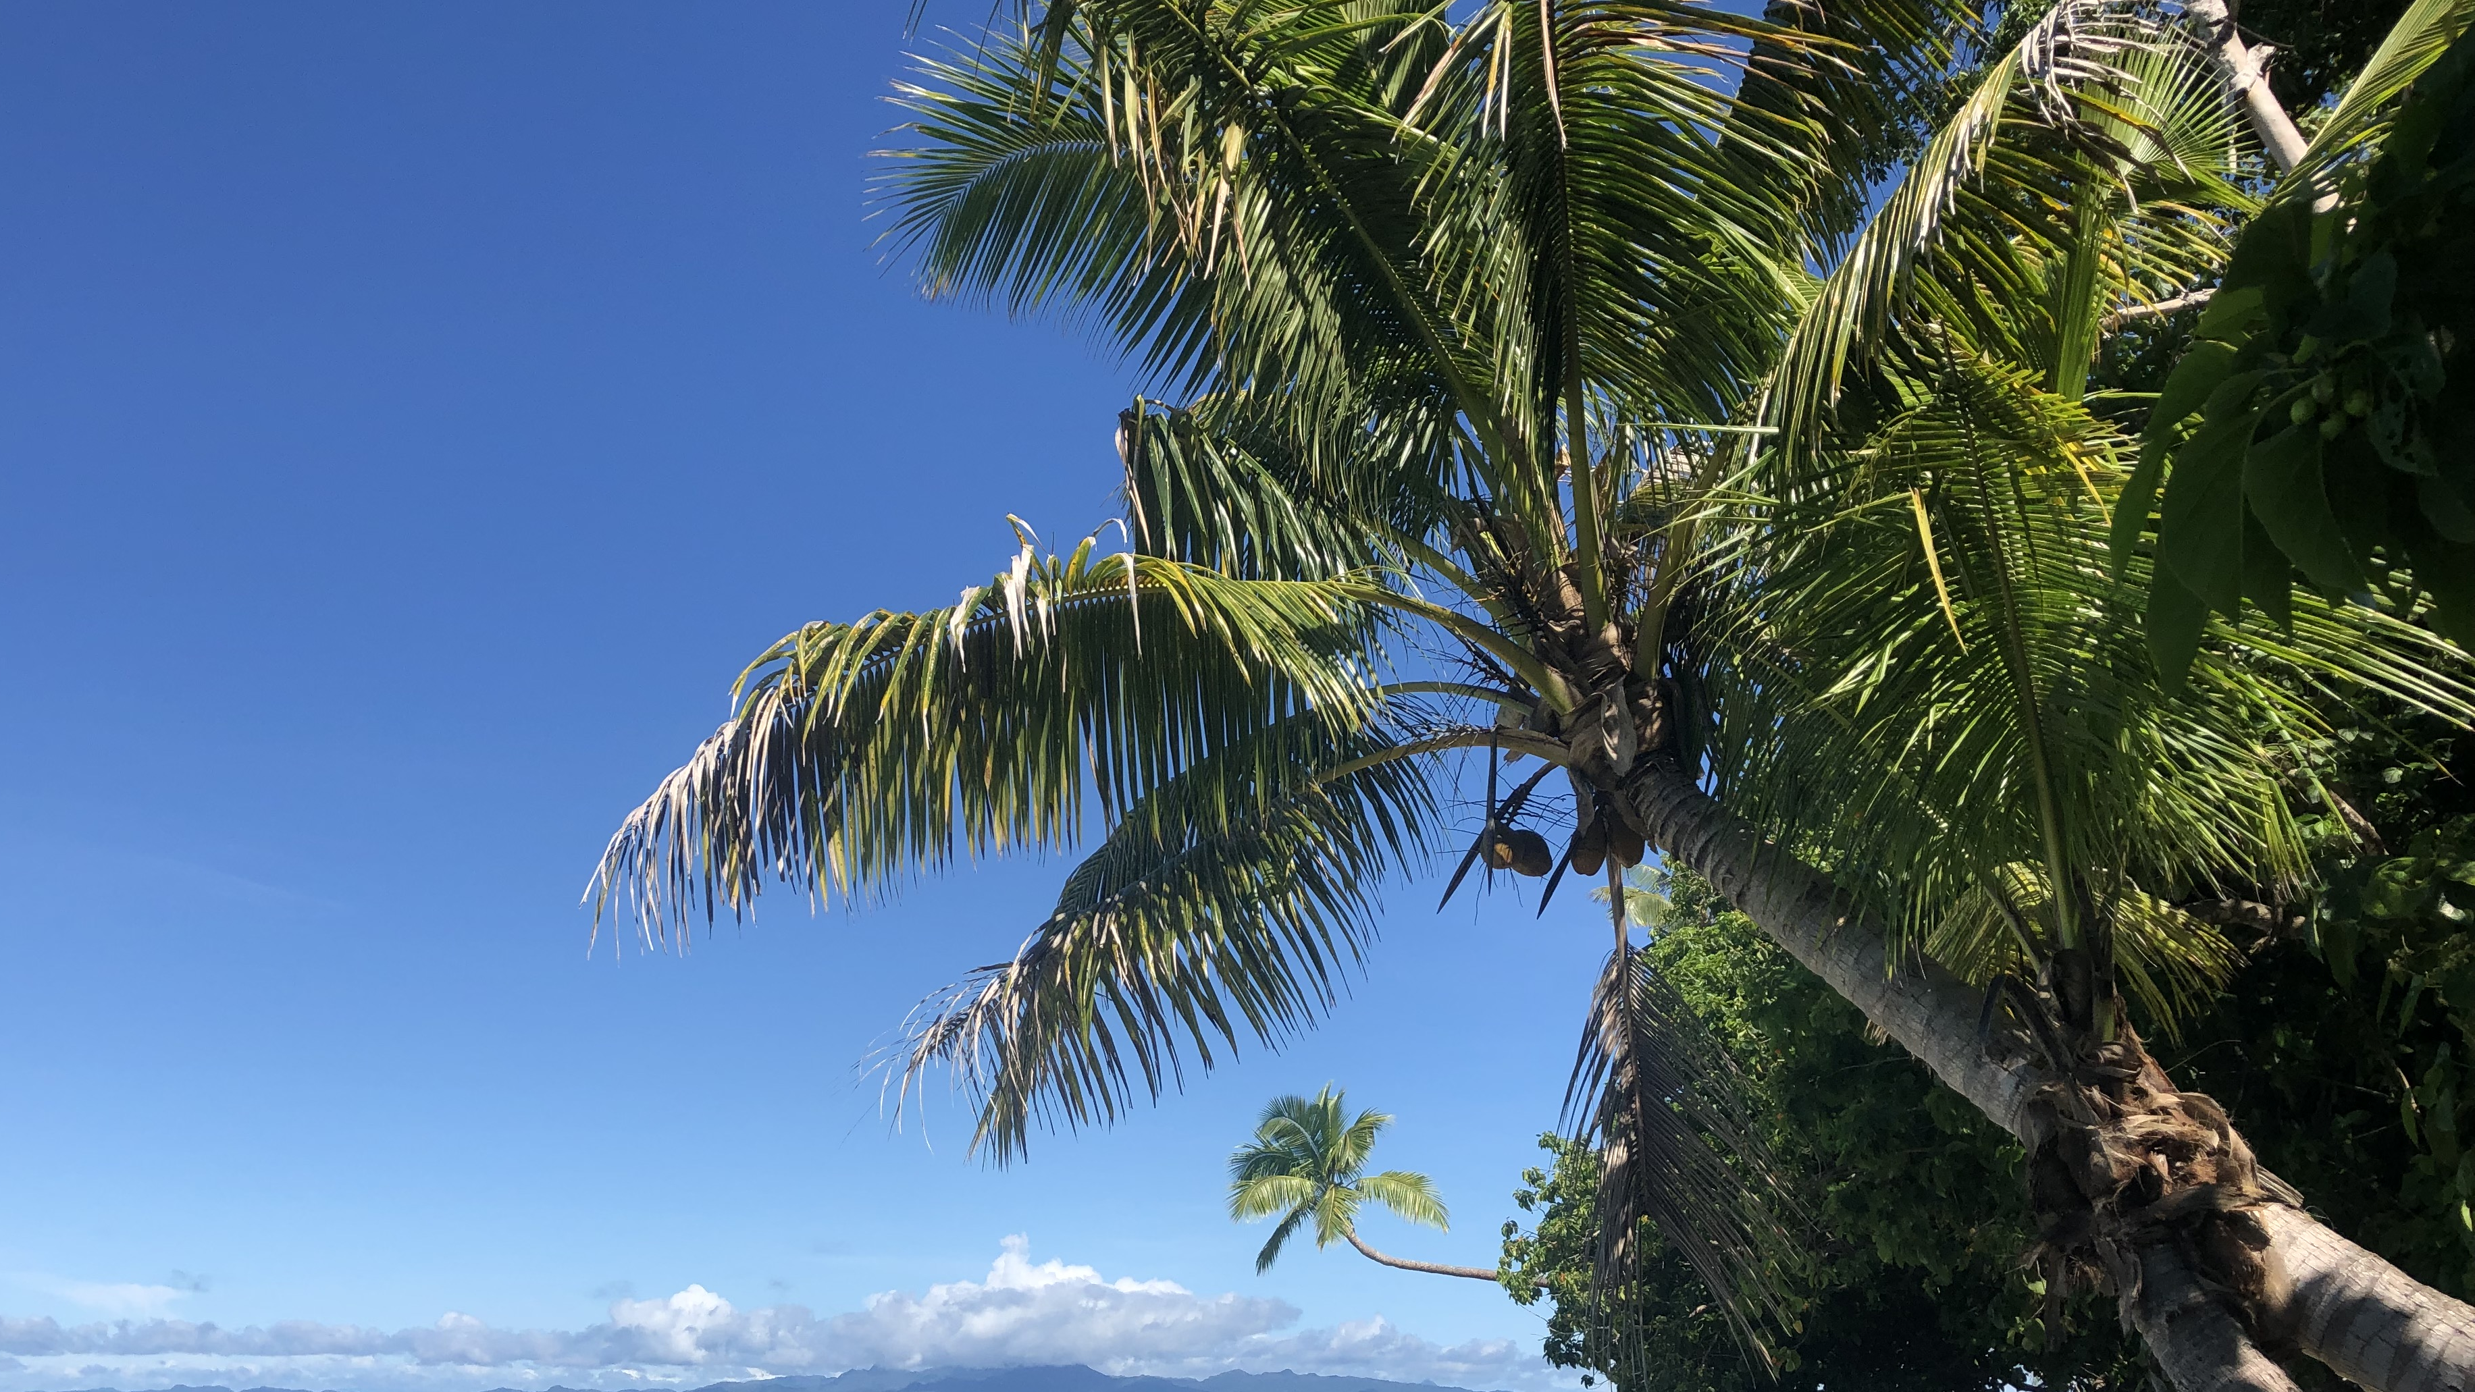
OCN 479-001
Sensor/platform presentations

Slide 2
Today’s plan
Presentations
Review issues from first two labs
Complete third lab

Slide 3
What’s the point of today’s presentations?
Familiarize yourself with cutting-edge coastal technologies and data streams
1
Connect technology with applications
2
Begin conversations about key metrics (e.g., accuracy, precision, stability, response time, endurance/lifetime, servicing intervals, technical needs)
3

Slide 4
Presentation guidelines
Team up with one other person (last week’s lab teammate) and pick your favorite dataset on https://cormp.org/. Give a short (3–5 minutes) presentation in class next week on the following:
What the parameter(s) is(are)
What they look like (e.g., time-series plot (screenshot))
How they were measured (look up sensors that measure your parameter)
What studies it would likely be used for
Important technical specifications (look up on website and/or product datasheets)
Why you picked it
Your presentation should be no more than two or three slides which you will submit on Canvas (via the Assignment post)
You will also deliver presentation in class next week or following week, time-dependent

Slide 5
Today’s plan
Presentations
Review issues from first two labs
Complete third lab

