Slide 1
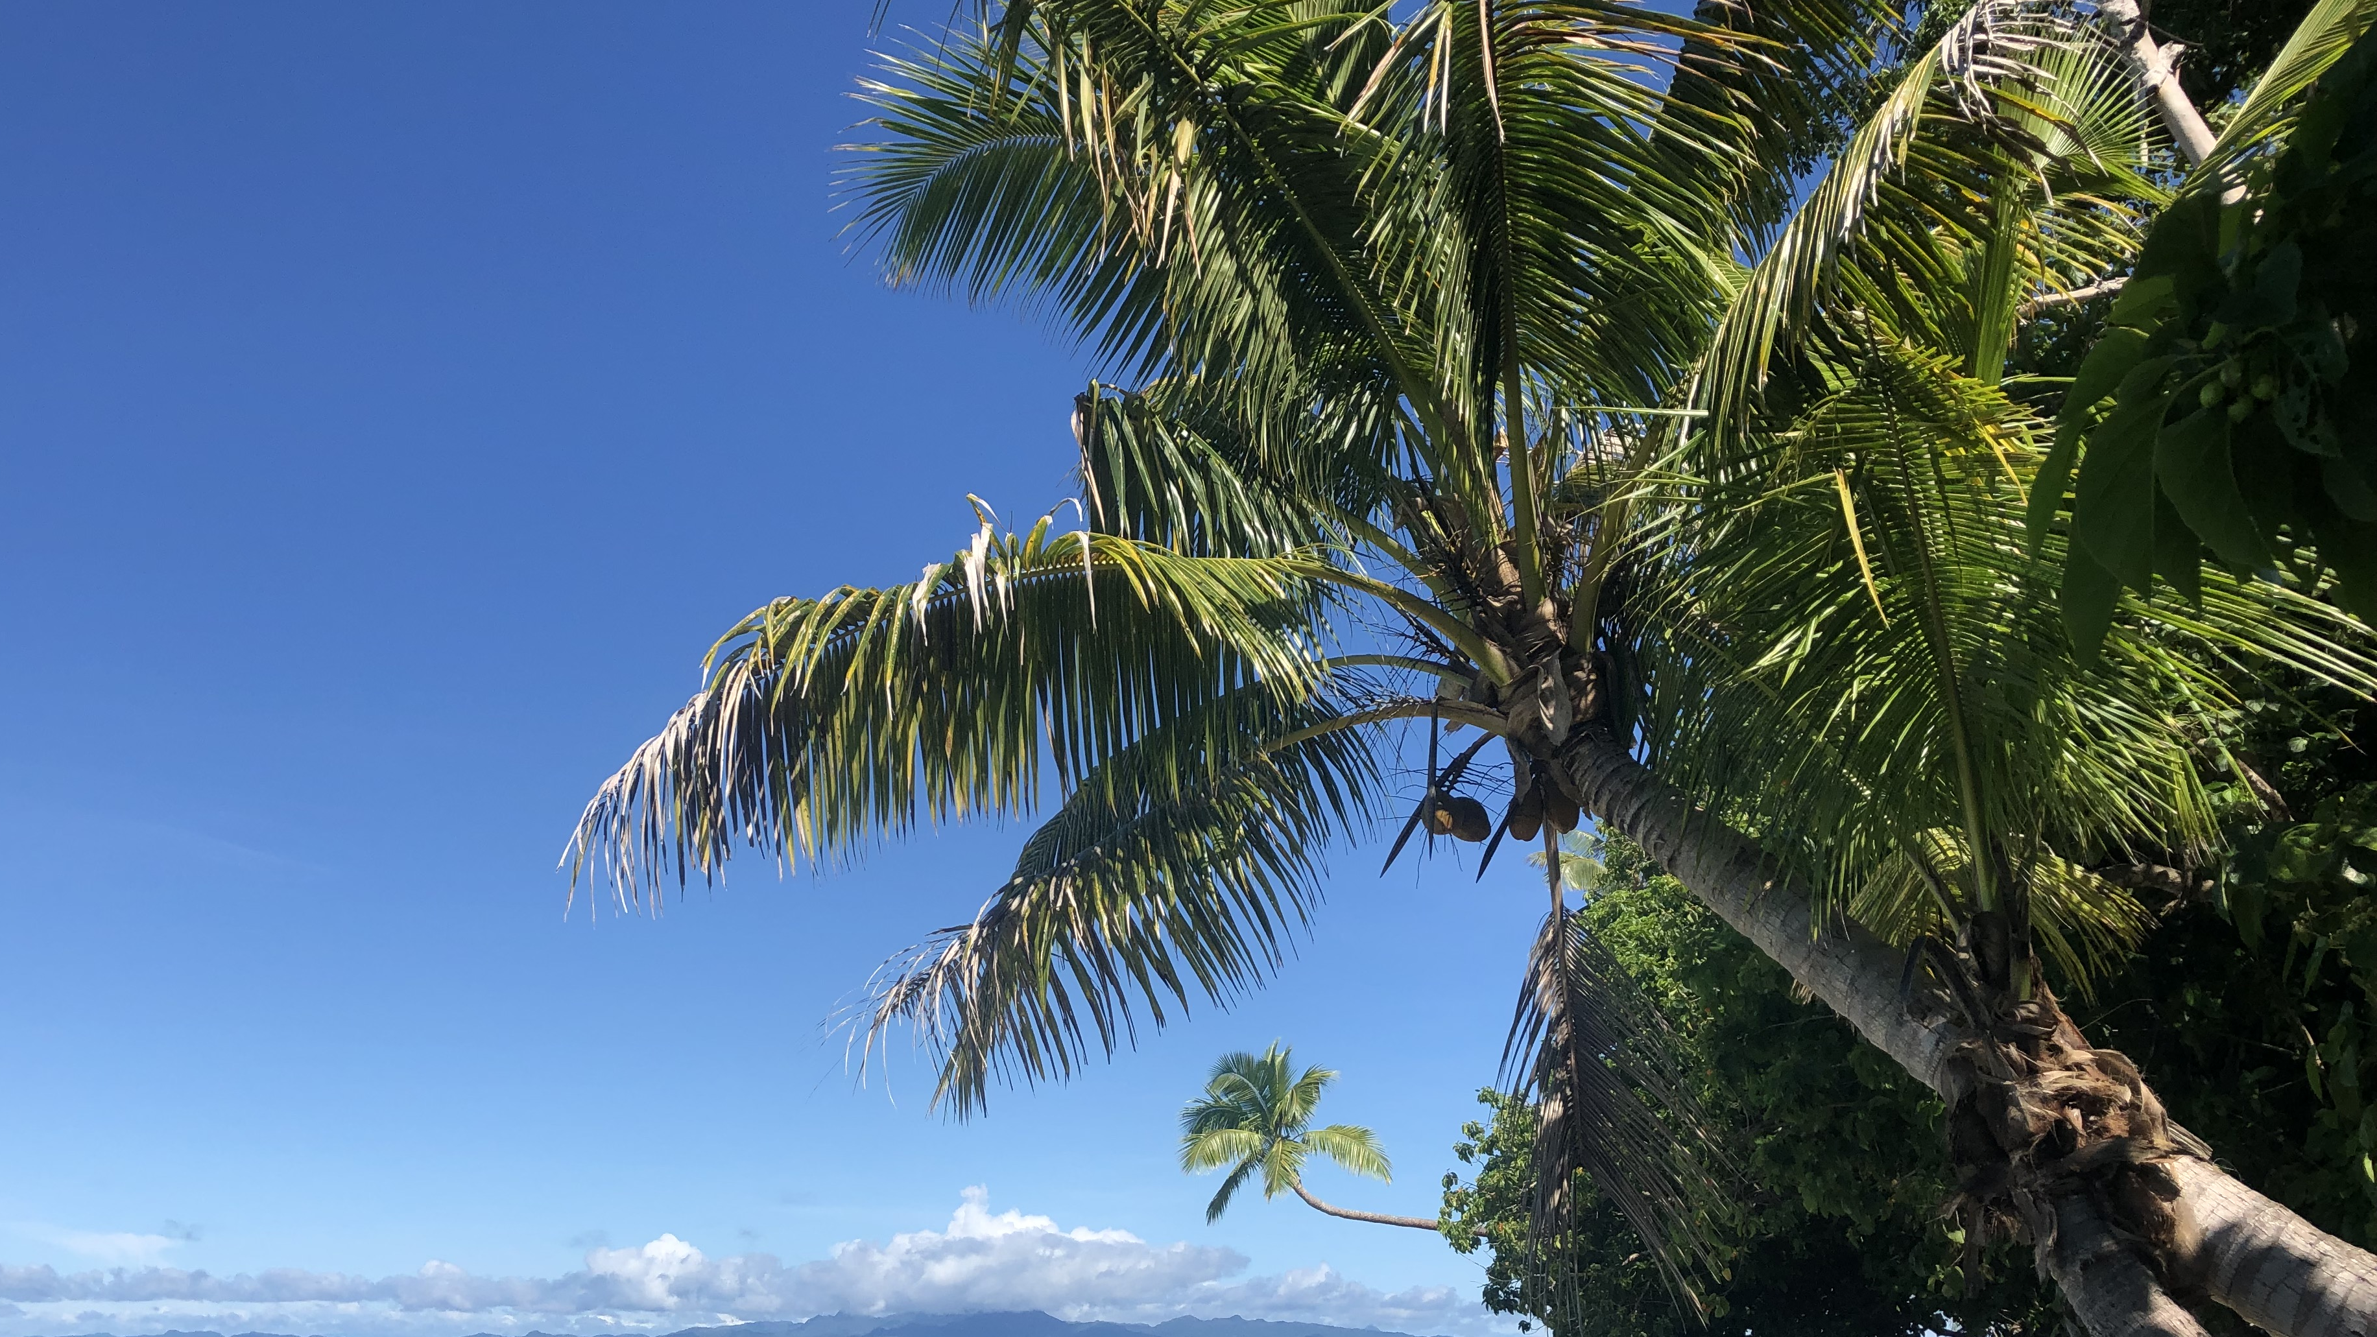
OCN 479-001
Final prep

Slide 2
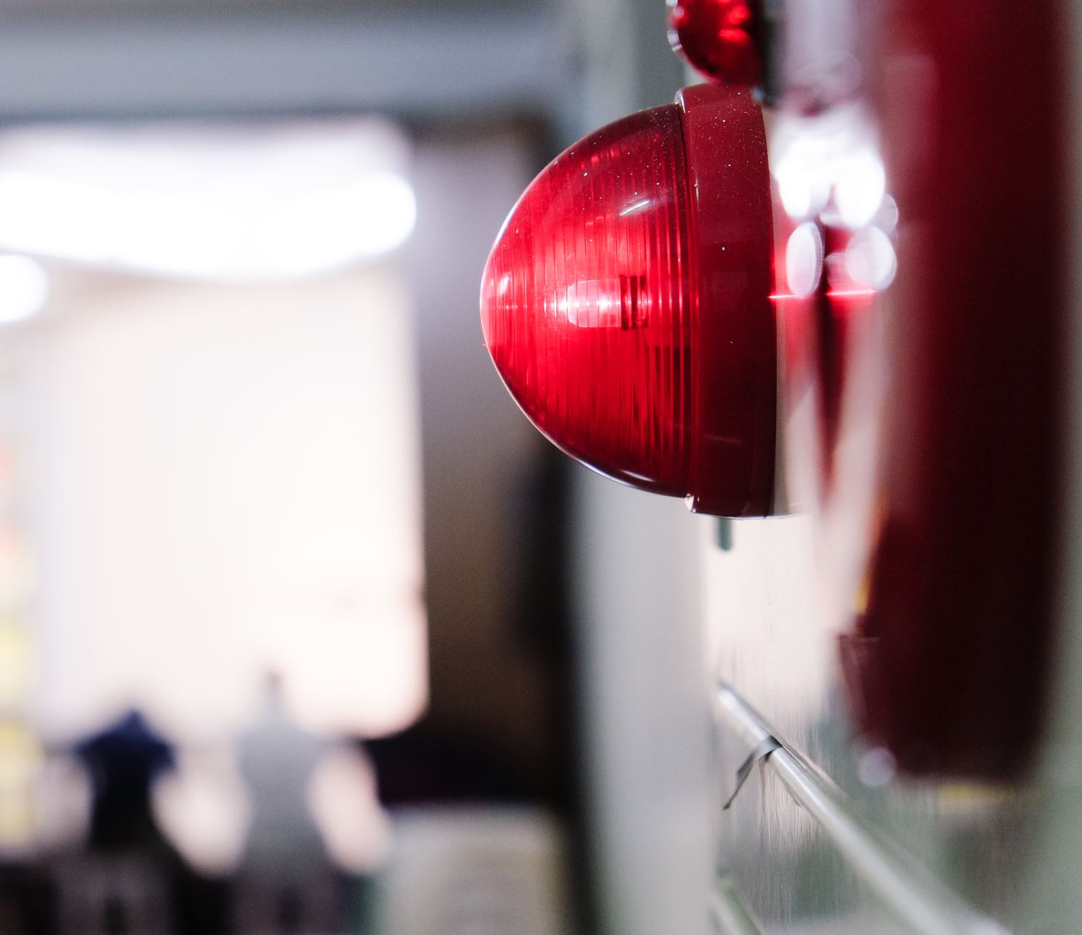
FULL VOLUME Test of emergency system at noon today

Slide 3
Today’s plan
Rest of semester plan
Quick lecture/feedback
Build sensors!

Slide 4

Rest of semester plan/ check-in

Slide 5
Check in/plan
2 more classes before fieldwork including today. No pressure ;)
Next week (Nov. 10) will be labwork only, with Jessie and Mitch running class
Following week (Nov. 17) meet at Trails End Park at 9:30 am. More details next…
Nov. 24: Thanksgiving, no class
Dec. 1: final presentations

Slide 6
Check in/plan
2 more classes before fieldwork including today. No pressure ;)
Next week (Nov. 10) will be labwork only, with Jessie and Mitch running class
Following week (Nov. 17) meet at Trails End Park at 9:30 am. More details next…
Nov. 24: Thanksgiving, no class
Dec. 1: final presentations
Finals week: submit final report/continuity report (several pages, one per group) and individual contribution paragraph (one per person).
Report: Where are you with your sensor builds and where should next group pick things up? Background on science motivation, sensor concept, principles of operation, current status of your instrument, high quality photos of your sensor, code in appendix and on GitHub. What works well, what doesn’t work yet. Where should next students pick things up and what are some important lessons learned. More on format later…

Slide 7
Check in/plan
Following week (Nov. 17) meet at Trails End Park at 9:30 am. We’ll be out of water before 12 pm to get you to next classes.
Location here: https://goo.gl/maps/38yBoesSwdrSLAjX9
Check weather! Kayak instructor and I will make call if inclement weather is forecasted.
Wear warm gear, waterproof/wetsuit material if you have it. Not asking people to buy gear; if it’s too cold, we won’t paddle.

Slide 8
Homework: Due by Tues., Nov. 15 @ 11:59 pm
Post on Canvas. One per group. Roughly two paragraphs (5–7 sentences).
What is the status of your sensor? What is working? What is not yet working?
How close is your sensor to ready to go on the water?
Have you tested it in a bucket to prove it doesn’t leak?
What data will you collect in the field so you have data to present?
What do you need from me for final prep?

Slide 9
Final Presentations
Thu. Dec. 1
15–20 mins each
Critical components:
Science background/motivation for instrumentation
How your sensor works (or should work)—remember principles of operation
How well should sensor work?
What is current status?
What would be next steps and recommendations for students with similar backgrounds (don’t recommend other prior coursework, please; we can’t change pre-reqs for this class). Where should students start?
Include relevant data. At least one map or time-series plot of local and data. Use CORMP.org or other resources from this class. Ask if you need suggestions. You must make a figure yourself (using any programming language or Excel), not copy from web.

Slide 10
Feedback for me (informal)
Formal evals in a couple weeks
Today
What parts of the class have you enjoyed?
What would have made this a better experience?
More in-depth lectures with less hands-on time? More hands-on time and less lecture?
More or fewer topics. If more, what other things do you wish you learned here? If fewer, what could be dropped?
More or fewer project options? All groups working on the same thing?
Other thoughts?

Slide 11
Potentially helpful classes if you want to explore this further
CSC 112 - Introduction to Computer Programming
CSC 121 - Programming Concepts I
CSC 131 - Introduction to Computer Science
ISE 102 - Introduction to Intelligent Systems Engineering (new program!)
ISE 250 - Embedded Systems
PHY 225 - Electronics
3D design/printing: Digital Makerspace in Randall, and https://www.autodesk.com/certification/learn/course/inventor-3d-modeling-mechanical-design-professional

