Slide 1
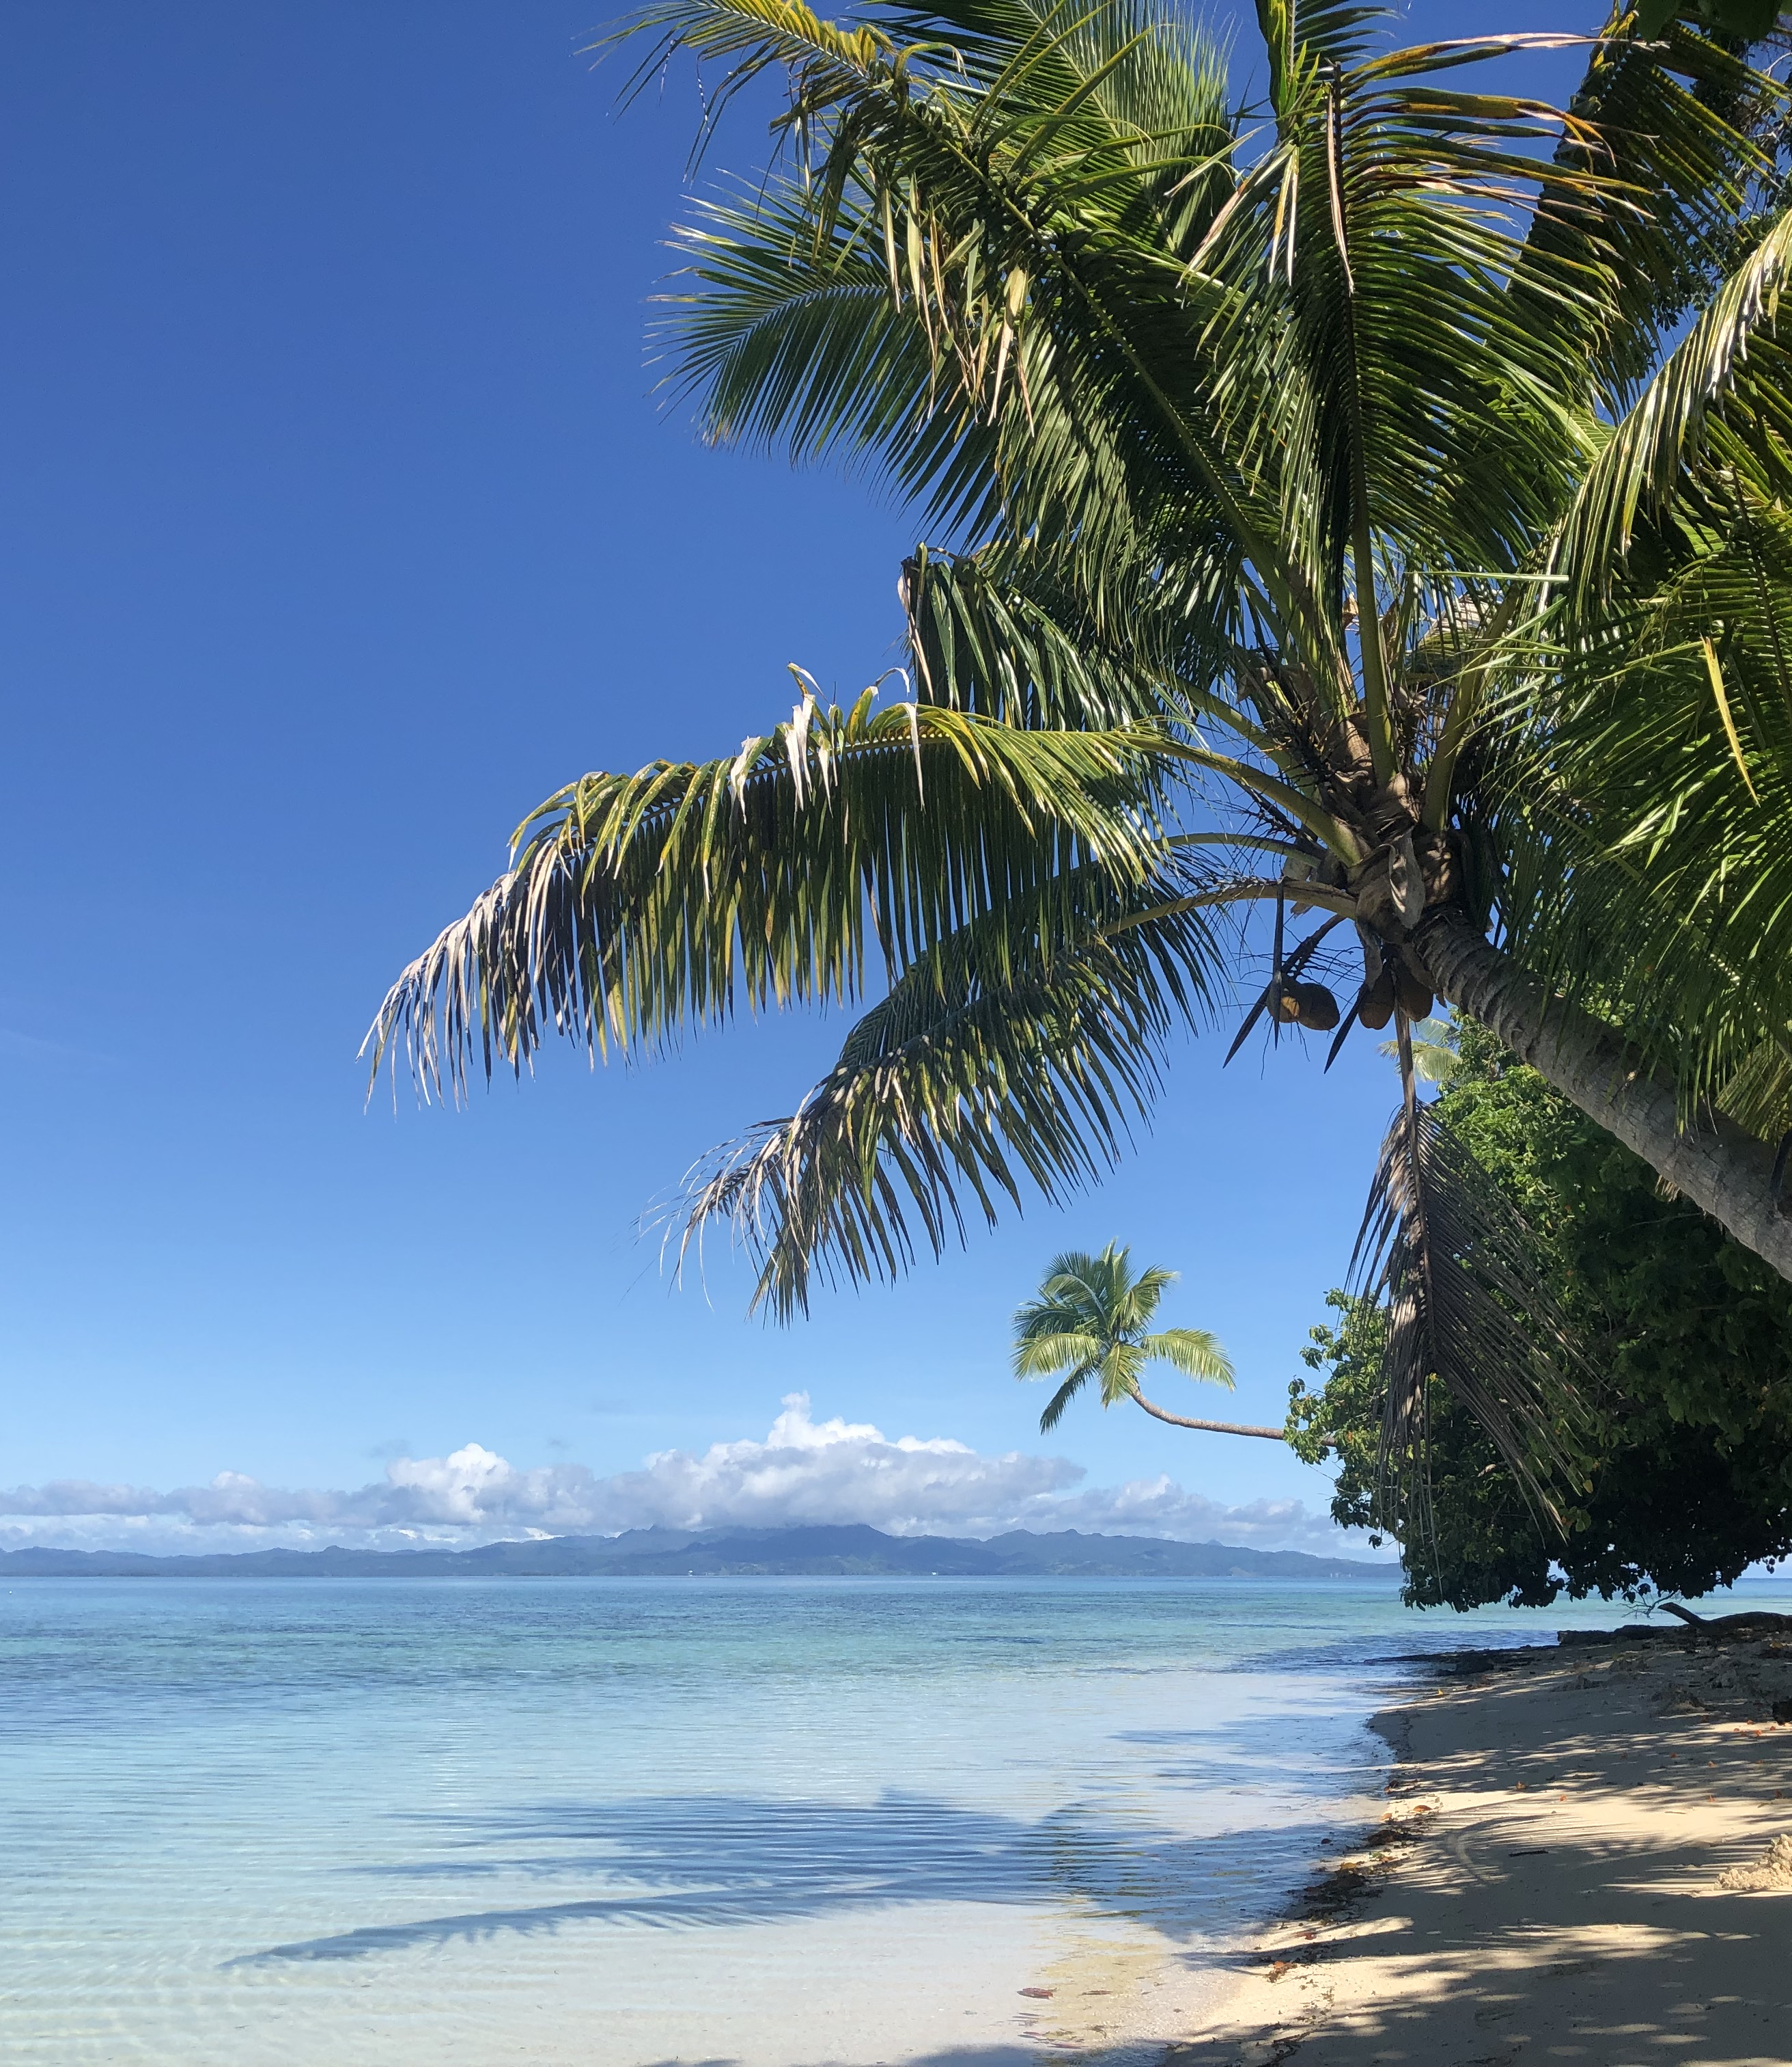
OCN 479-001
Dr. Phil Bresnahan

Slide 2
Today
Prep for tour of Ocean Instrumentation Lab
Lab: Learn git vs. GitHub and their combined capabilities
Homework: Prepare to give a short (3–5 mins) presentation next week on your data

Slide 3
Presentation guidelines
Team up with one other person (last week’s lab teammate) and pick your favorite dataset on https://cormp.org/. Give a short (3–5 minutes) presentation in class next week on the following:
What the parameter(s) is(are)
What they look like (e.g., time-series plot (screenshot))
How they were measured (look up sensors that measure your parameter)
What studies it would likely be used for
Important technical specifications (look up on website and/or product datasheets)
Why you picked it
Your presentation should be no more than two or three slides which you will submit on Canvas (via the Assignment post)
You will also deliver presentation in class next week or following week, time-dependent

Slide 4
What’s the point?
Familiarize yourself with cutting-edge coastal technologies and datasets
Connect technology with applications
Begin conversations about key metrics (e.g., accuracy, precision, stability, response time, endurance/lifetime, servicing intervals, technical needs)

Slide 5
GitHub
Introduced briefly in OCN 350; to be used extensively in OCN 479
Reinforces “open science and engineering” concepts
Enables collaborative coding with a little more code stability than something like google docs. Collaborate with…
Teammates
Rest of this class
Future classes
People anywhere/anywhen in the world
Including links to GitHub repos on resumes/CVs will be very attractive to employers/graduate schools!

Slide 6
GitHub exercise
Read this page: https://github.com/SUPScientist/Smart-Coasts/tree/main/Class-02-OILab-Tour
After reading everything, complete at least the required and ideally the optional steps

