Slide 1
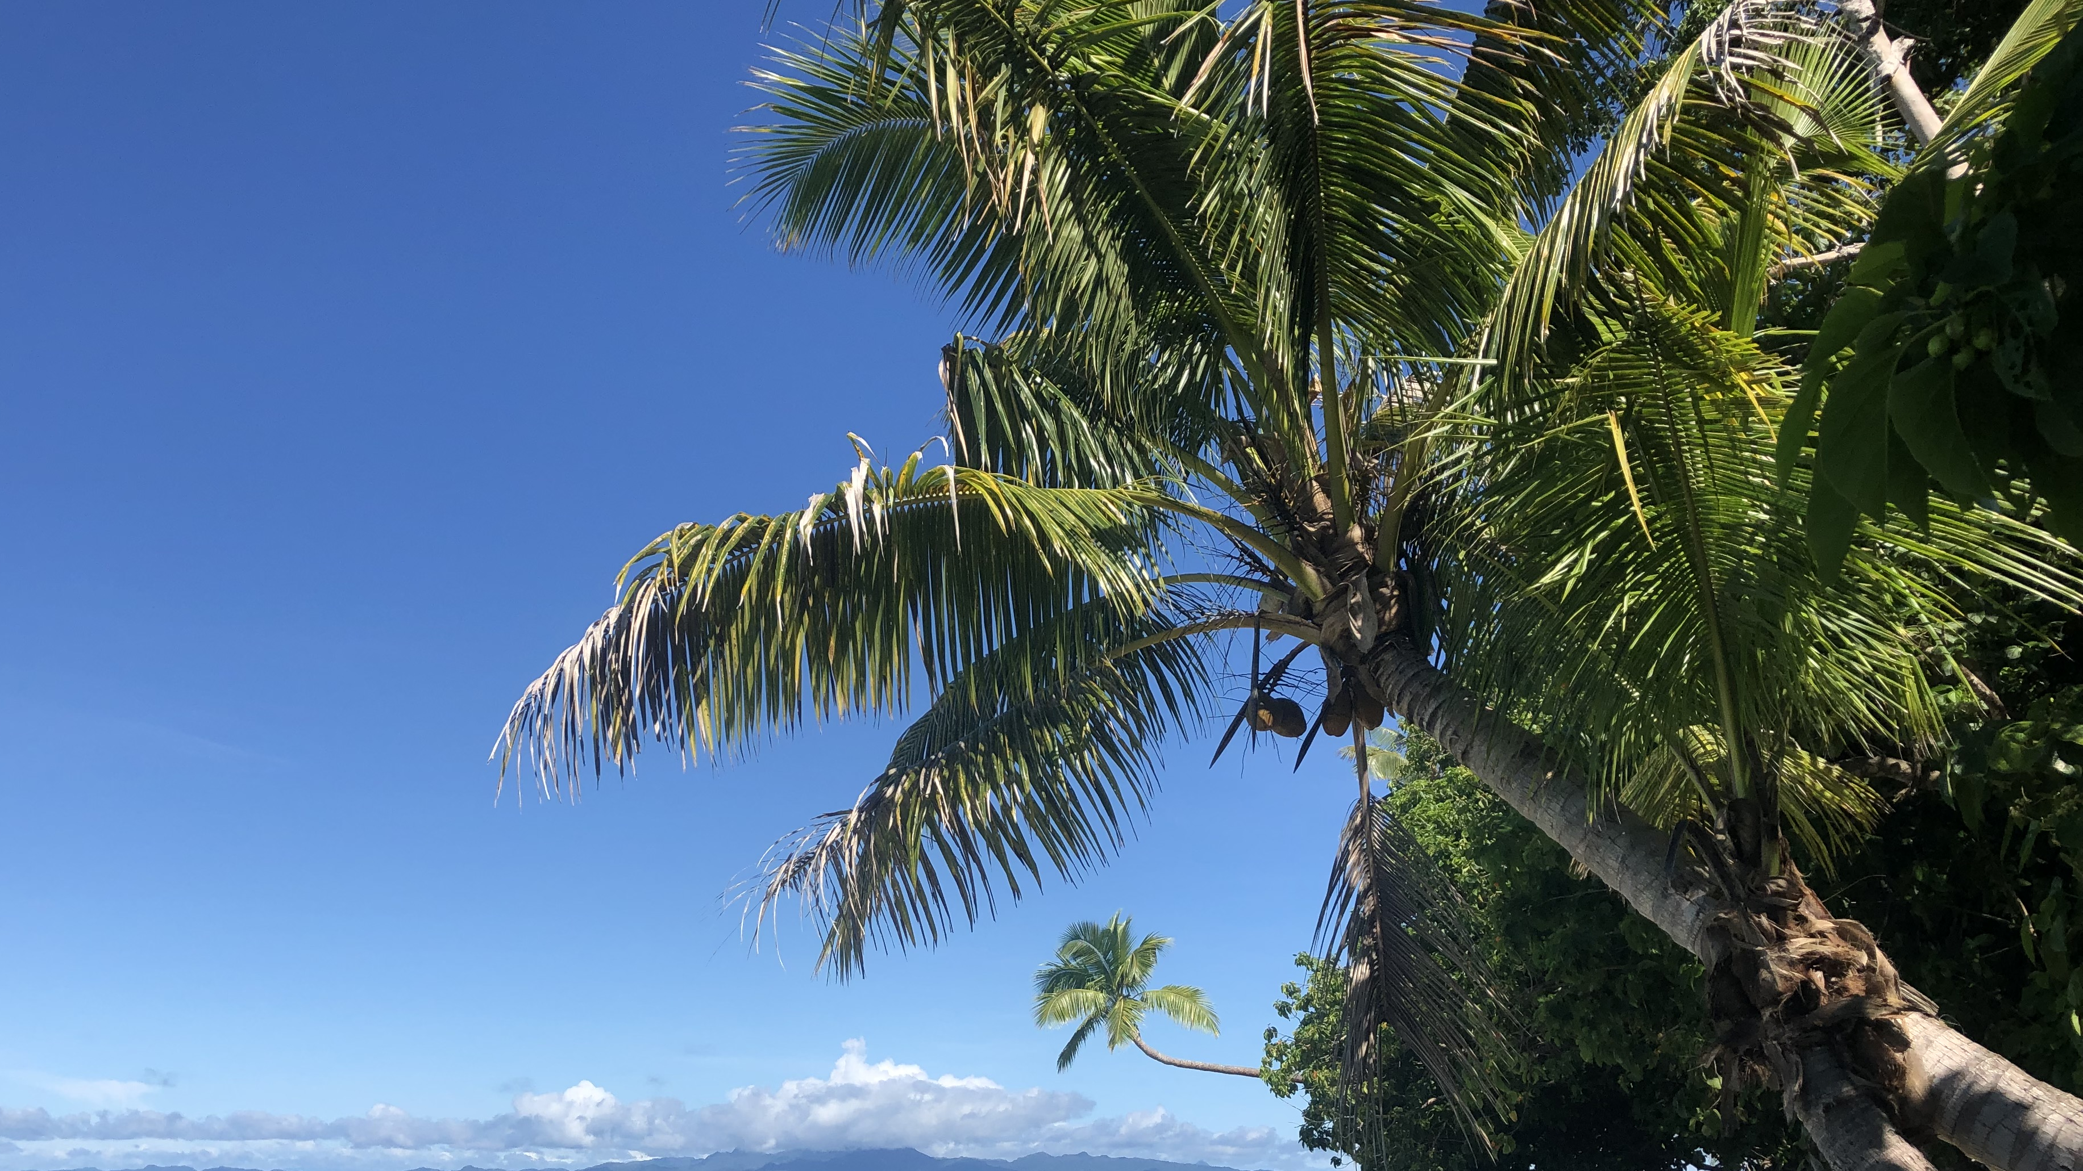
OCN 479-001
Sensor/platform presentations

Slide 2
Today’s plan
Presentations
Review issues from first lab
Complete second lab activity (building off first)

Slide 3
What’s the point of today’s presentations?
Familiarize yourself with cutting-edge coastal technologies
1
Connect technology with applications
2
Begin conversations about key metrics (e.g., accuracy, precision, stability, response time, endurance/lifetime, servicing intervals, technical needs)
3

Slide 4
Presentation guidelines
Team up with two other people (for four teams of three people) and pick your favorite instrument in the OI Lab. Give a short (three to five minute presentation) in class on Sep. 8 on the following:
What the instrument is
What it can measure
What studies it would likely be used for
Important technical specifications (look up on website and/or product datasheets)
Why you picked it
Your presentation should be no more than one or two slides which you will submit on Canvas (via the Assignment post).

Slide 5
PRESENTATION ORDER TBD…

Slide 6
Today’s plan
Presentations
Review issues from first lab
Complete second lab activity (building off first)
Start by visiting https://github.com/SUPScientist/Smart-Coasts (link also in Canvas)

