Slide 1
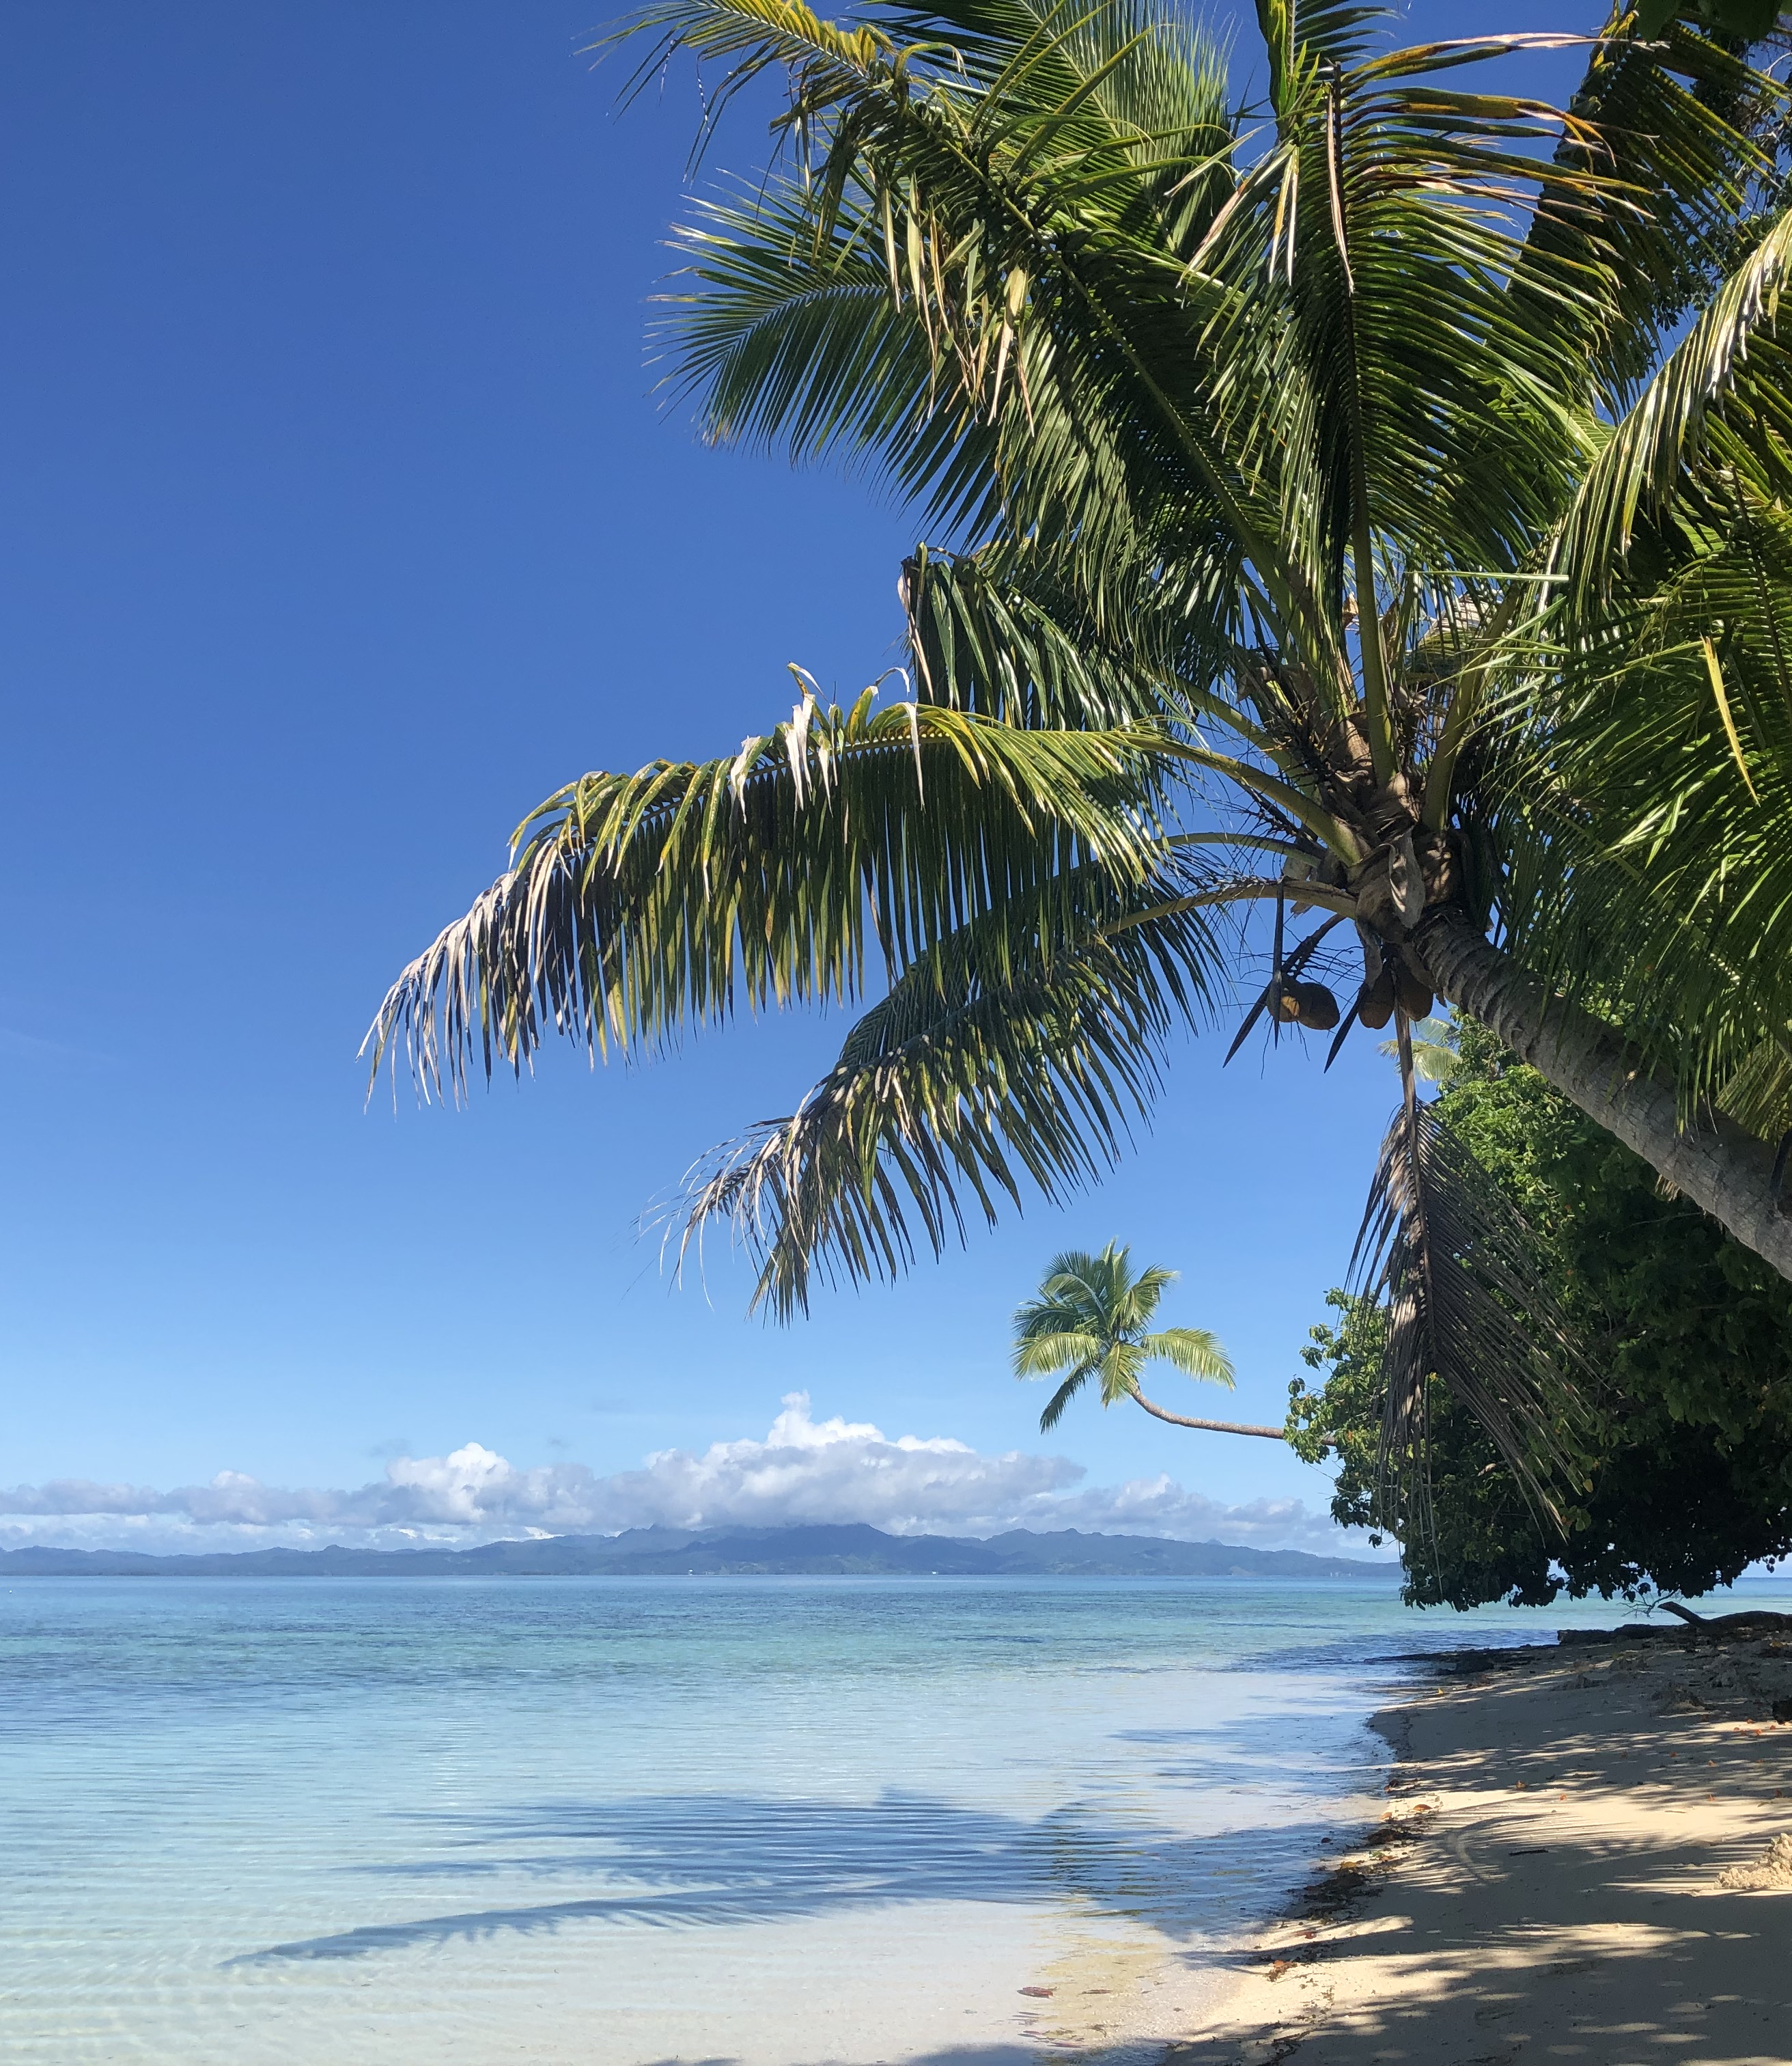
OCN 479-001
Dr. Phil Bresnahan

Slide 2
Today
Tour of Ocean Instrumentation Lab and CMS Research Pier
Pick two teammates and a sensor/platform of interest from today’s tour
Short (3–5 mins) presentation next week on your sensor/platform

Slide 3
Presentation guidelines
Team up with two other people (for four teams of three people) and pick your favorite instrument in the OI Lab. Give a short (three to five minute presentation) in class on Sep. 8 on the following:
What the instrument is
What it can measure
What studies it would likely be used for
Important technical specifications (look up on website and/or product datasheets)
Why you picked it
Your presentation should be no more than one or two slides which you will submit on Canvas (via the Assignment post).

Slide 4
What’s the point?
Familiarize yourself with cutting-edge coastal technologies
Connect technology with applications
Begin conversations about key metrics (e.g., accuracy, precision, stability, response time, endurance/lifetime, servicing intervals, technical needs)

