Slide 1
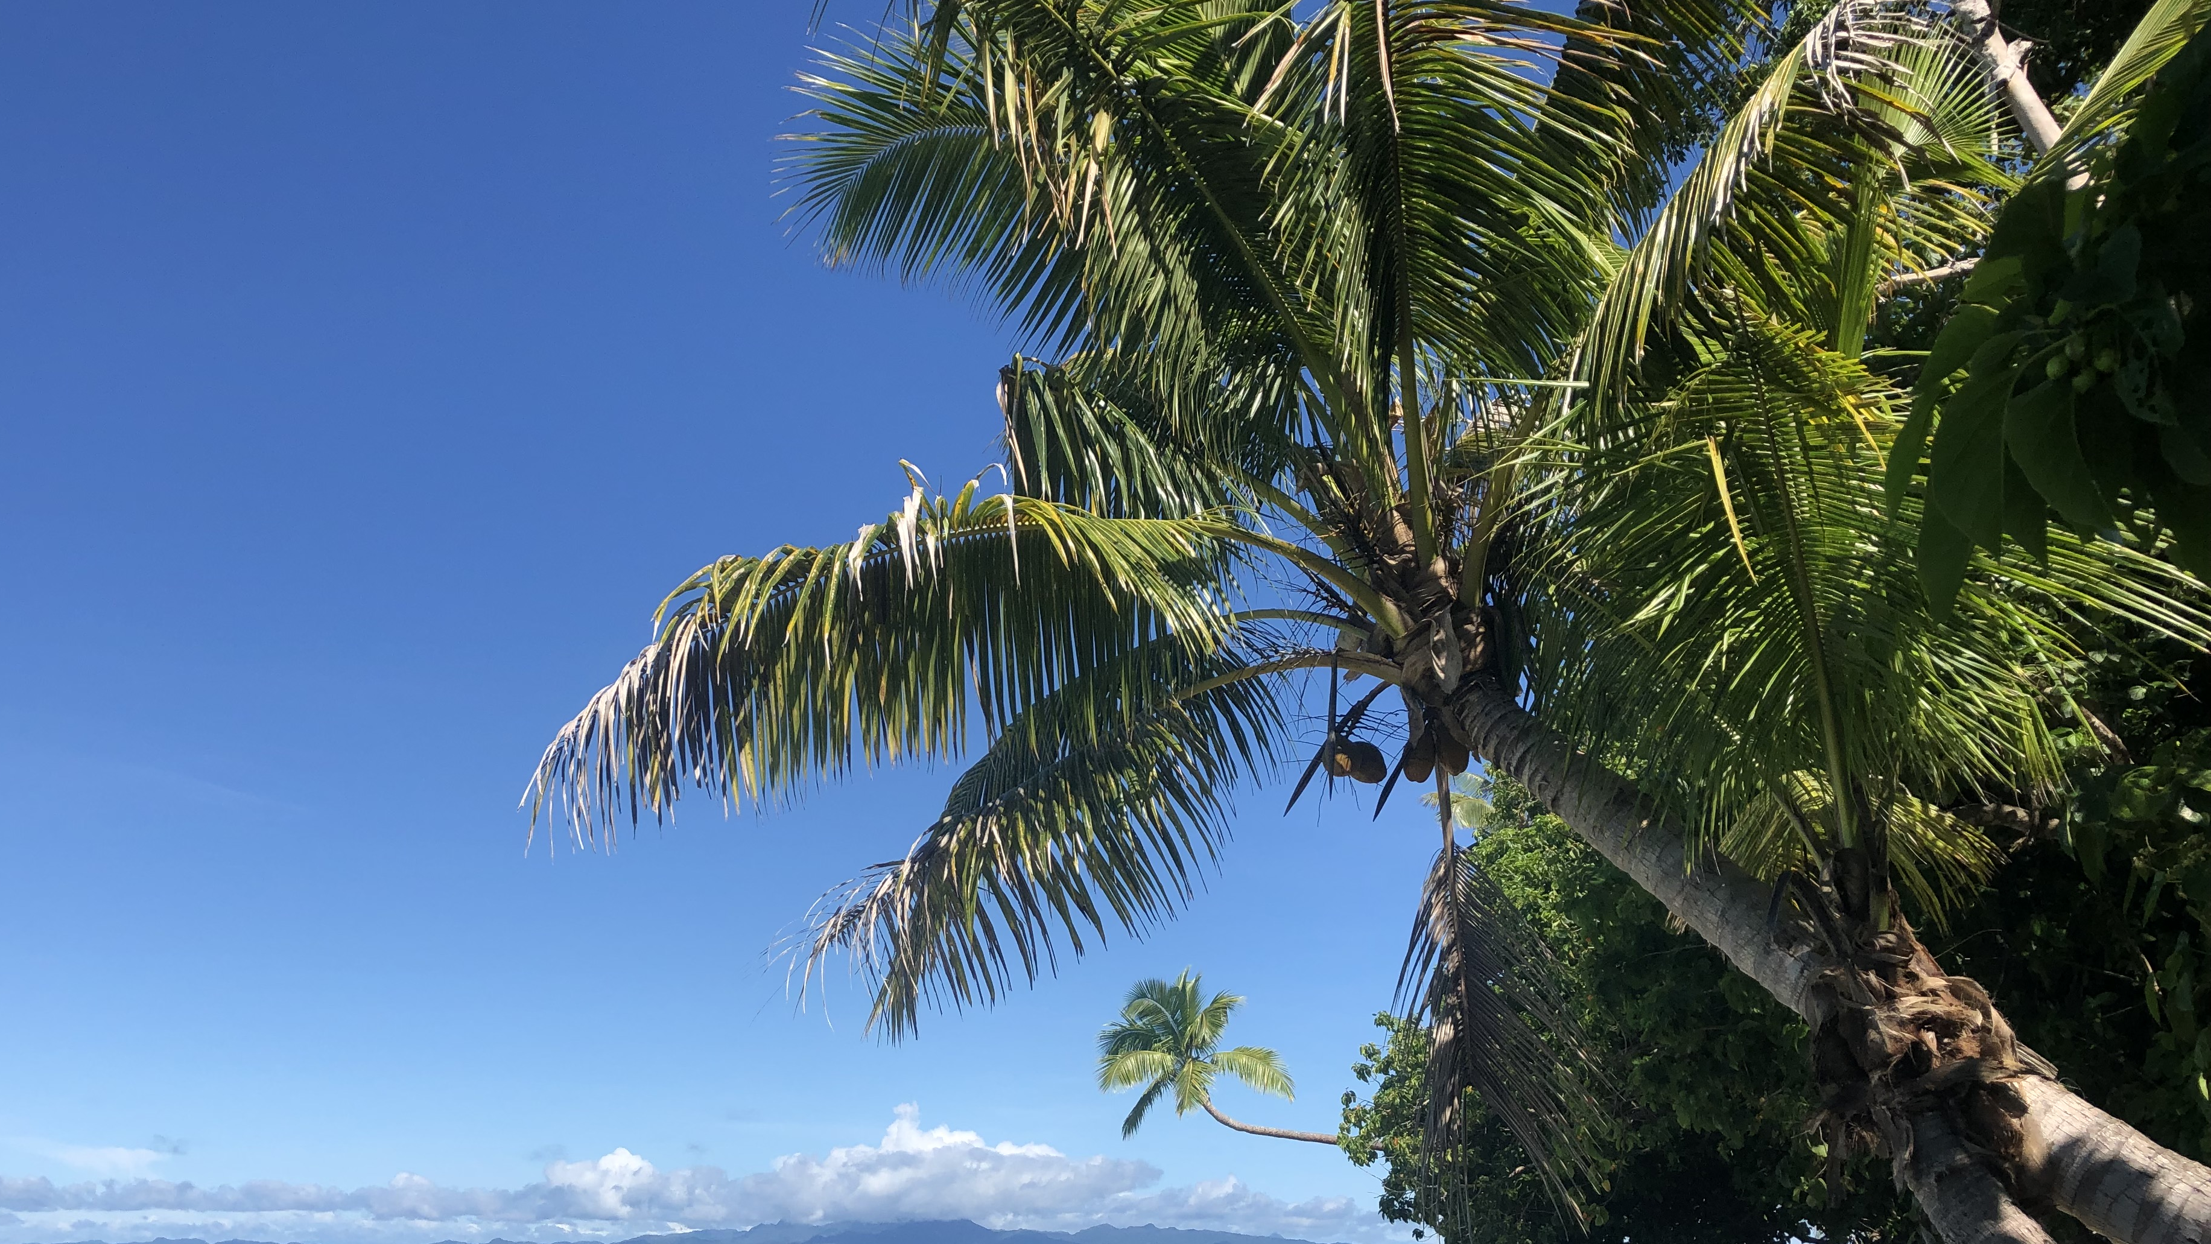
OCN 479-001
Sensor communications
(Wireless edition)

Slide 2
Today’s plan
Short group activity/lecture
Your presentations
Build sensors!

Slide 3
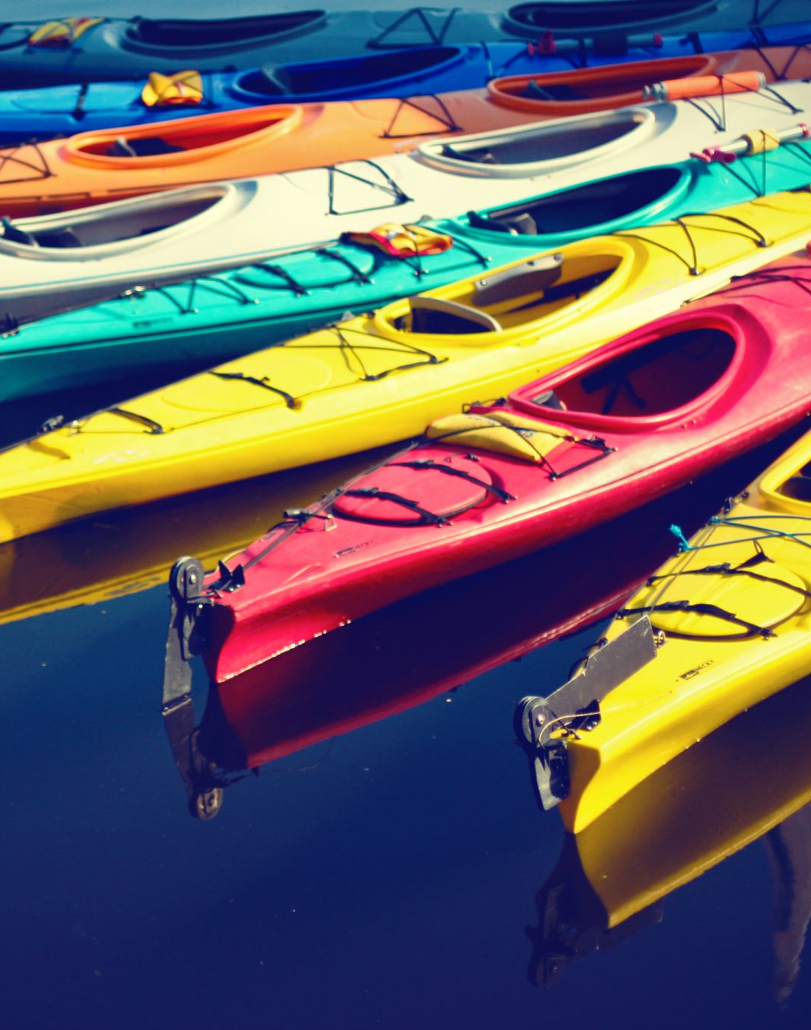
Kayaking plans Nov. 17 tentative

Slide 4
Teams
Team Chlorophyll:
Jessie
Mia
James
Team Turbidity:
Nick
Braeden
William
Team Water Level:
Ashley
Matt
Summer
Team Water Quality:
Jack
Mitch
Grace

Slide 5
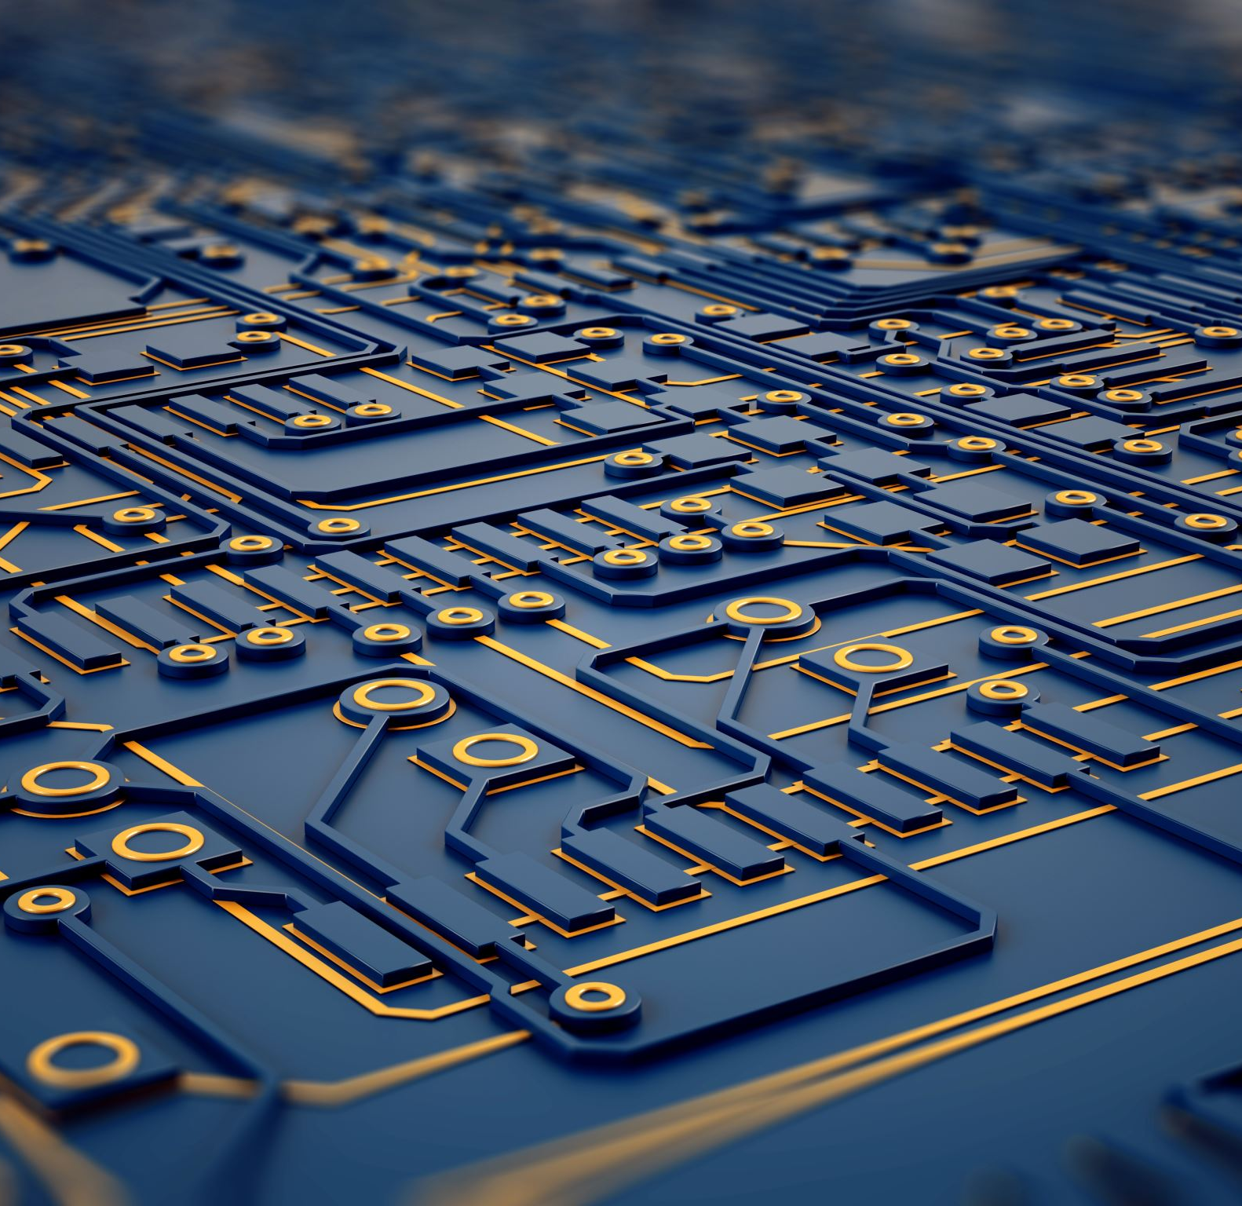
Today’s topics
Sensor Communications: (Wireless edition)

Slide 6
Think, pair, share
Think (3 mins): list out as many wireless Data transfer technologies as you can think of
Pair (3 mins): pair up with one other person and discuss
Share (5 mins): share your thoughts with the class

Slide 7
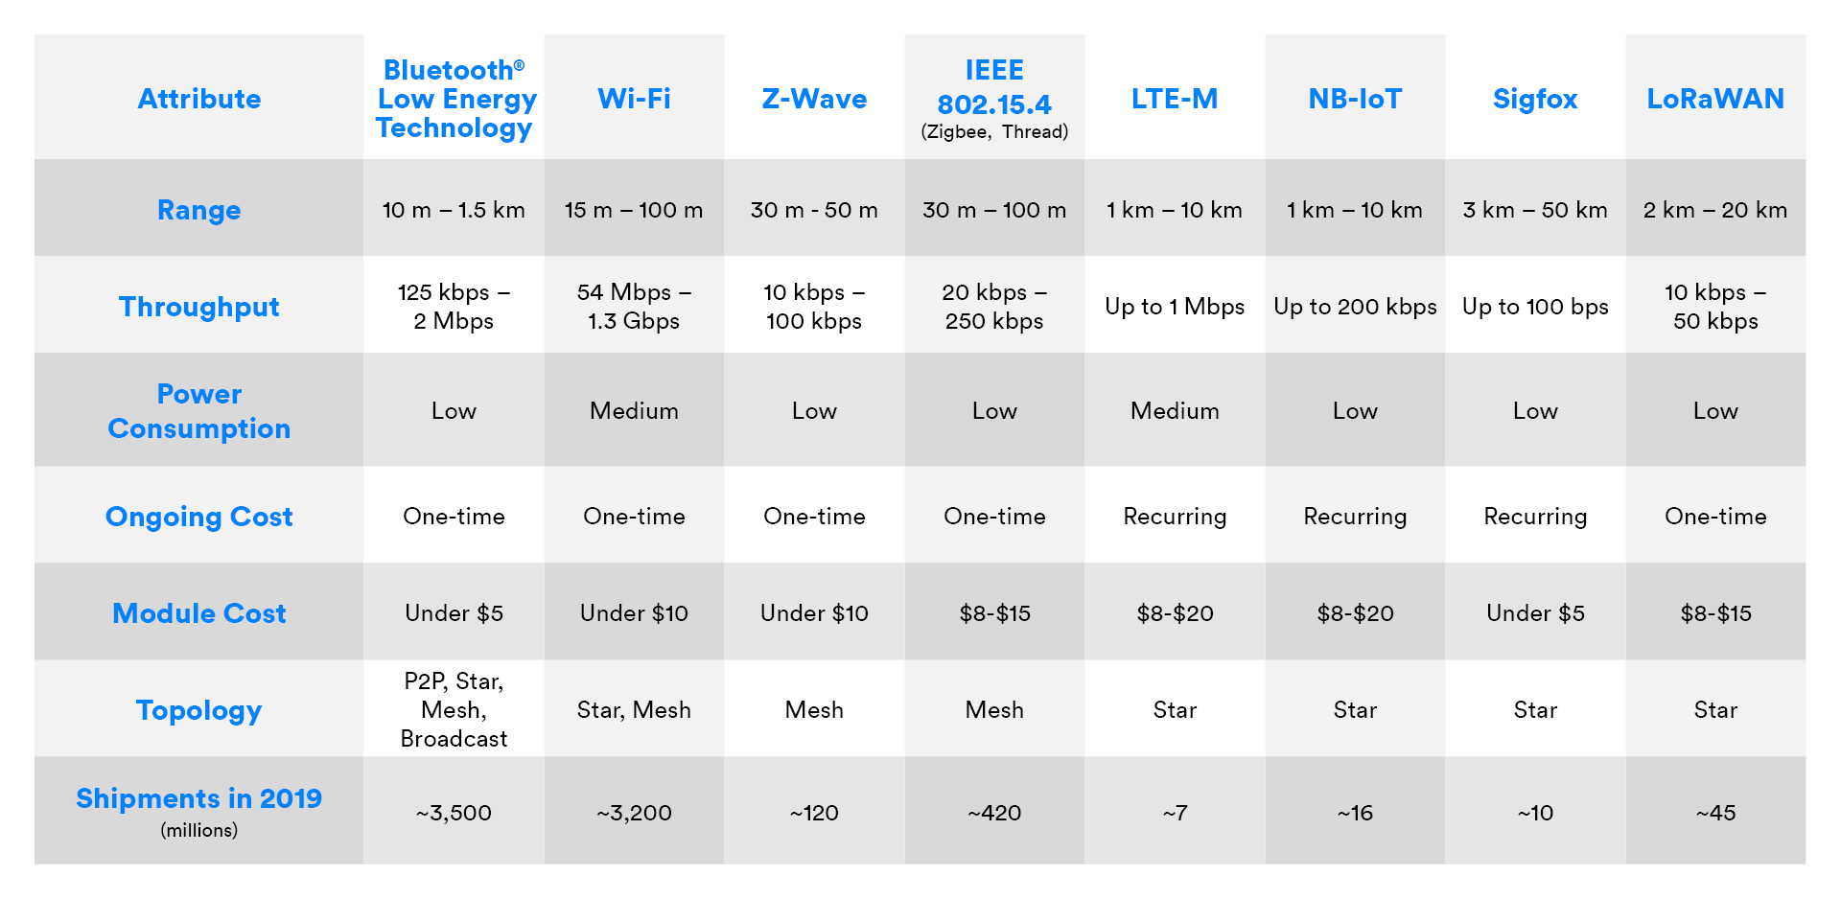
Comparison (Note the url…)
https://www.bluetooth.com/blog/wireless-connectivity-options-for-iot-applications/

Slide 8
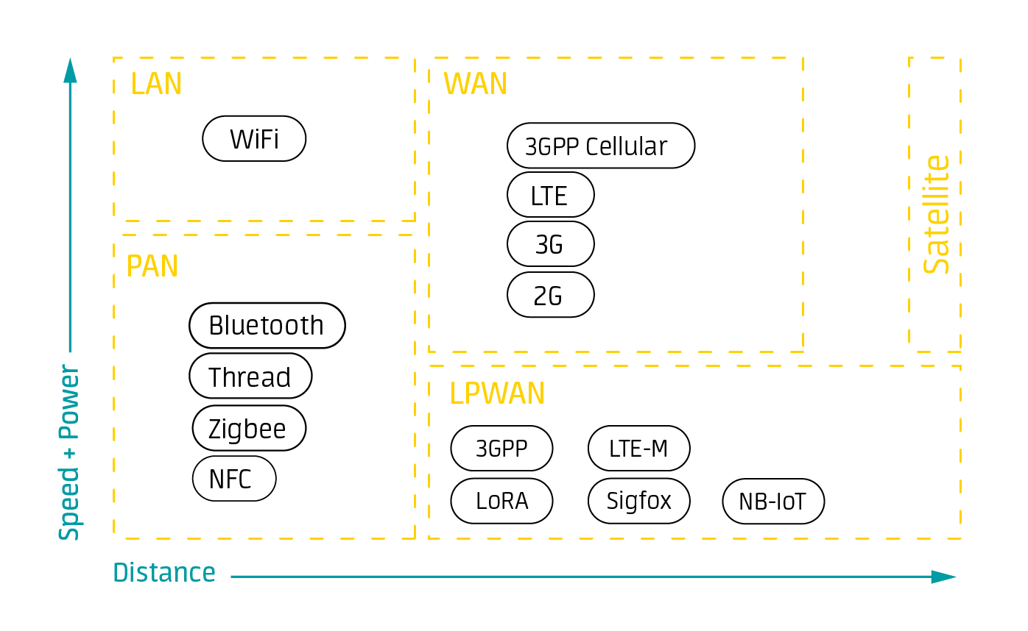
https://www.avsystem.com/blog/iot-connectivity/

Slide 9

Summary: what’s the best option? It depends…
Satellite: global coverage, more power, more $
Cellular: distributed but not truly global coverage, medium power, medium $
BLE: requires a mobile device with an app, very low power, low $
WiFi: requires a WiFi network, low power, low $
Others: typically not sufficiently available for global deployments, but can work for local needs

Slide 10
Assignment (due Sep. 29) 1 per group
Short presentation on your instrument
~5 minutes, just a couple slides
Most critical: methods/principles of operation—how does it work?!
Methods: how is it built, what does it do?
Principles of operation: how does it convert some physical (chemical, biological) quantity (e.g., conductivity) to a voltage (e.g., it transmits a voltage across the water and measures current flow, enabling the calculation of resistance and therefore conductance)?
What accuracy, precision, stability, and response time can we expect?

Slide 11
Order (alphabetical by team name, this time only)
Team Chlorophyll
Team Turbidity
Team Water Level
Team Water Quality

