Slide 1

OCN 479-001
Dr. Phil Bresnahan

Slide 2
Today
Prep for tour of Ocean Instrumentation Lab
Lab: Learn git vs. GitHub and their combined capabilities
Homework: Prepare to give a short (3–5 mins) presentation next week on your data

Slide 3
Presentation guidelines
Team up with one or two other people (last week’s lab teammates or new) and pick your favorite dataset on https://cormp.org/. Give a short (3–5 minutes) presentation in class next week on the following:
  What the parameter(s) is(are)
  What they look like (e.g., time-series plot (screenshot))
  How they were measured (look up sensors that measure your parameter)
  What studies it would likely be used for
  Important technical specifications (look up on website and/or product datasheets)
  Why you picked it
Your presentation should be no more than two or three slides which you will submit on Canvas (via the Assignment post)
You will also deliver presentation in class next week or following week, time-dependent

Slide 4
What’s the point?
Familiarize yourself with cutting-edge coastal technologies and datasets
Connect technology with applications
Begin conversations about key metrics (e.g., accuracy, precision, stability, response time, endurance/lifetime, servicing intervals, technical needs)

Slide 5

Software and Services for Smart Coasts
GitHub:
  Online/website (with some desktop tools to be discussed later).
  Create a free account if you don’t already have one at github.com!
  Copilot genAI coding tool is free for students, and we’re a Microsoft campus w/ a license to Copilot
VS Code:
  A desktop app/software used for writing/reading code or any kind of text file.
  Probably the most important software tool we’ll use this semester!
Particle:
  Particle is the company that makes the hardware (primarily Argons) we’re using
  Workbench or Particle Workbench is a special set of software tools that run inside VS Code to allow us to compile (huh?) and flash (what?) code to Particle Argons
  Create a Particle account on their website (particle.io) also

Slide 6
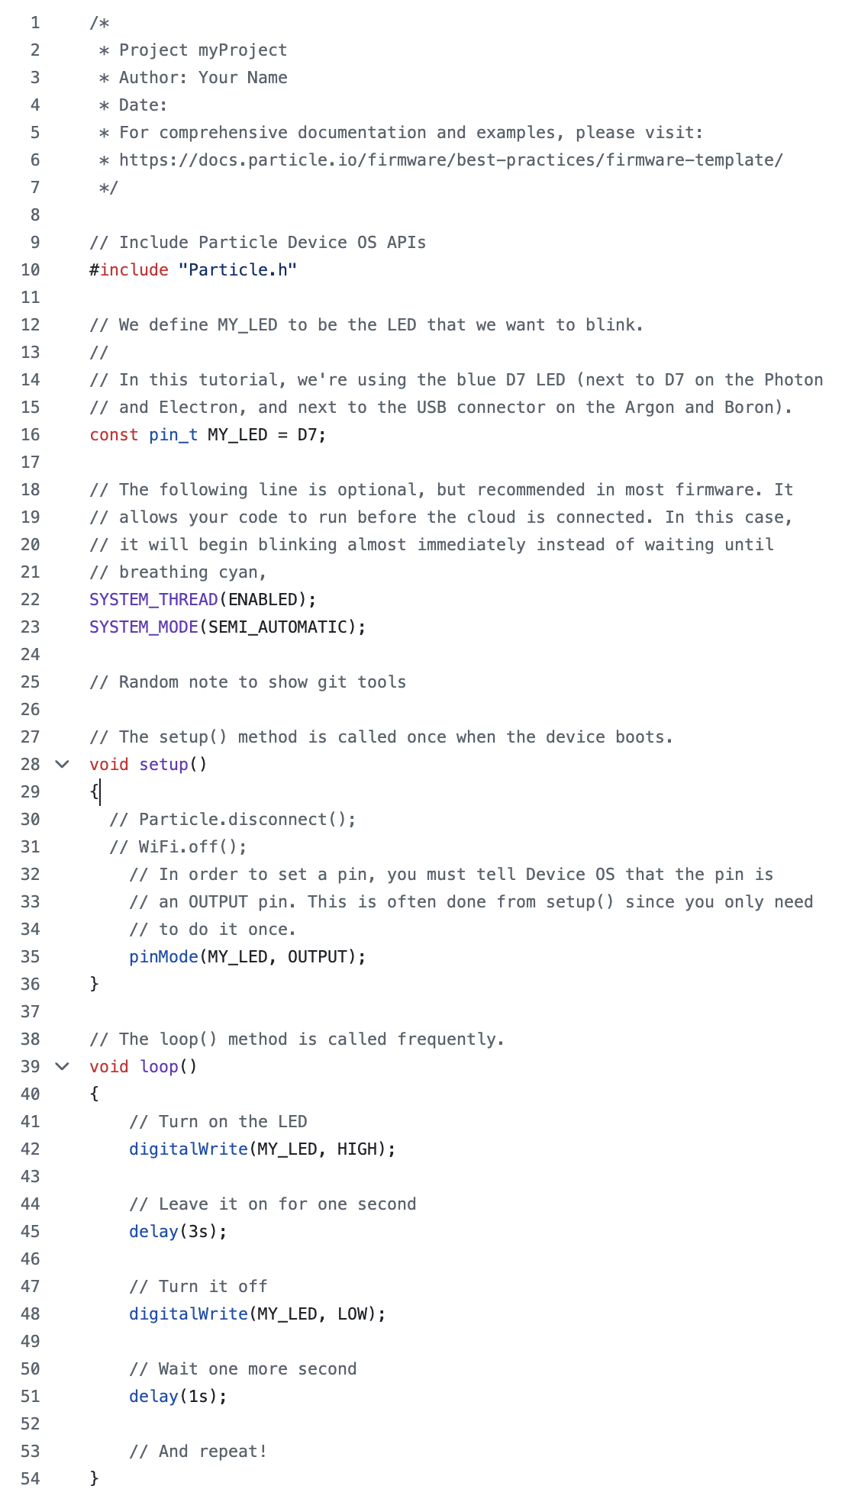
Blink_LED.cpp firmware explanation
Particle devices run C++, a “low level” compiled application development language
You don’t need to learn much about writing new C++ code for this class, but finding and integrating useful code chunks will be essential
Particle devices have a script running on them that handles stuff “under the hood” and which calls your code as well
It starts with setup(), which it executes once
It then runs loop(), which it runs in a, well, loop!
I recommend Copilot and w3schools to learn more ☺

Slide 7
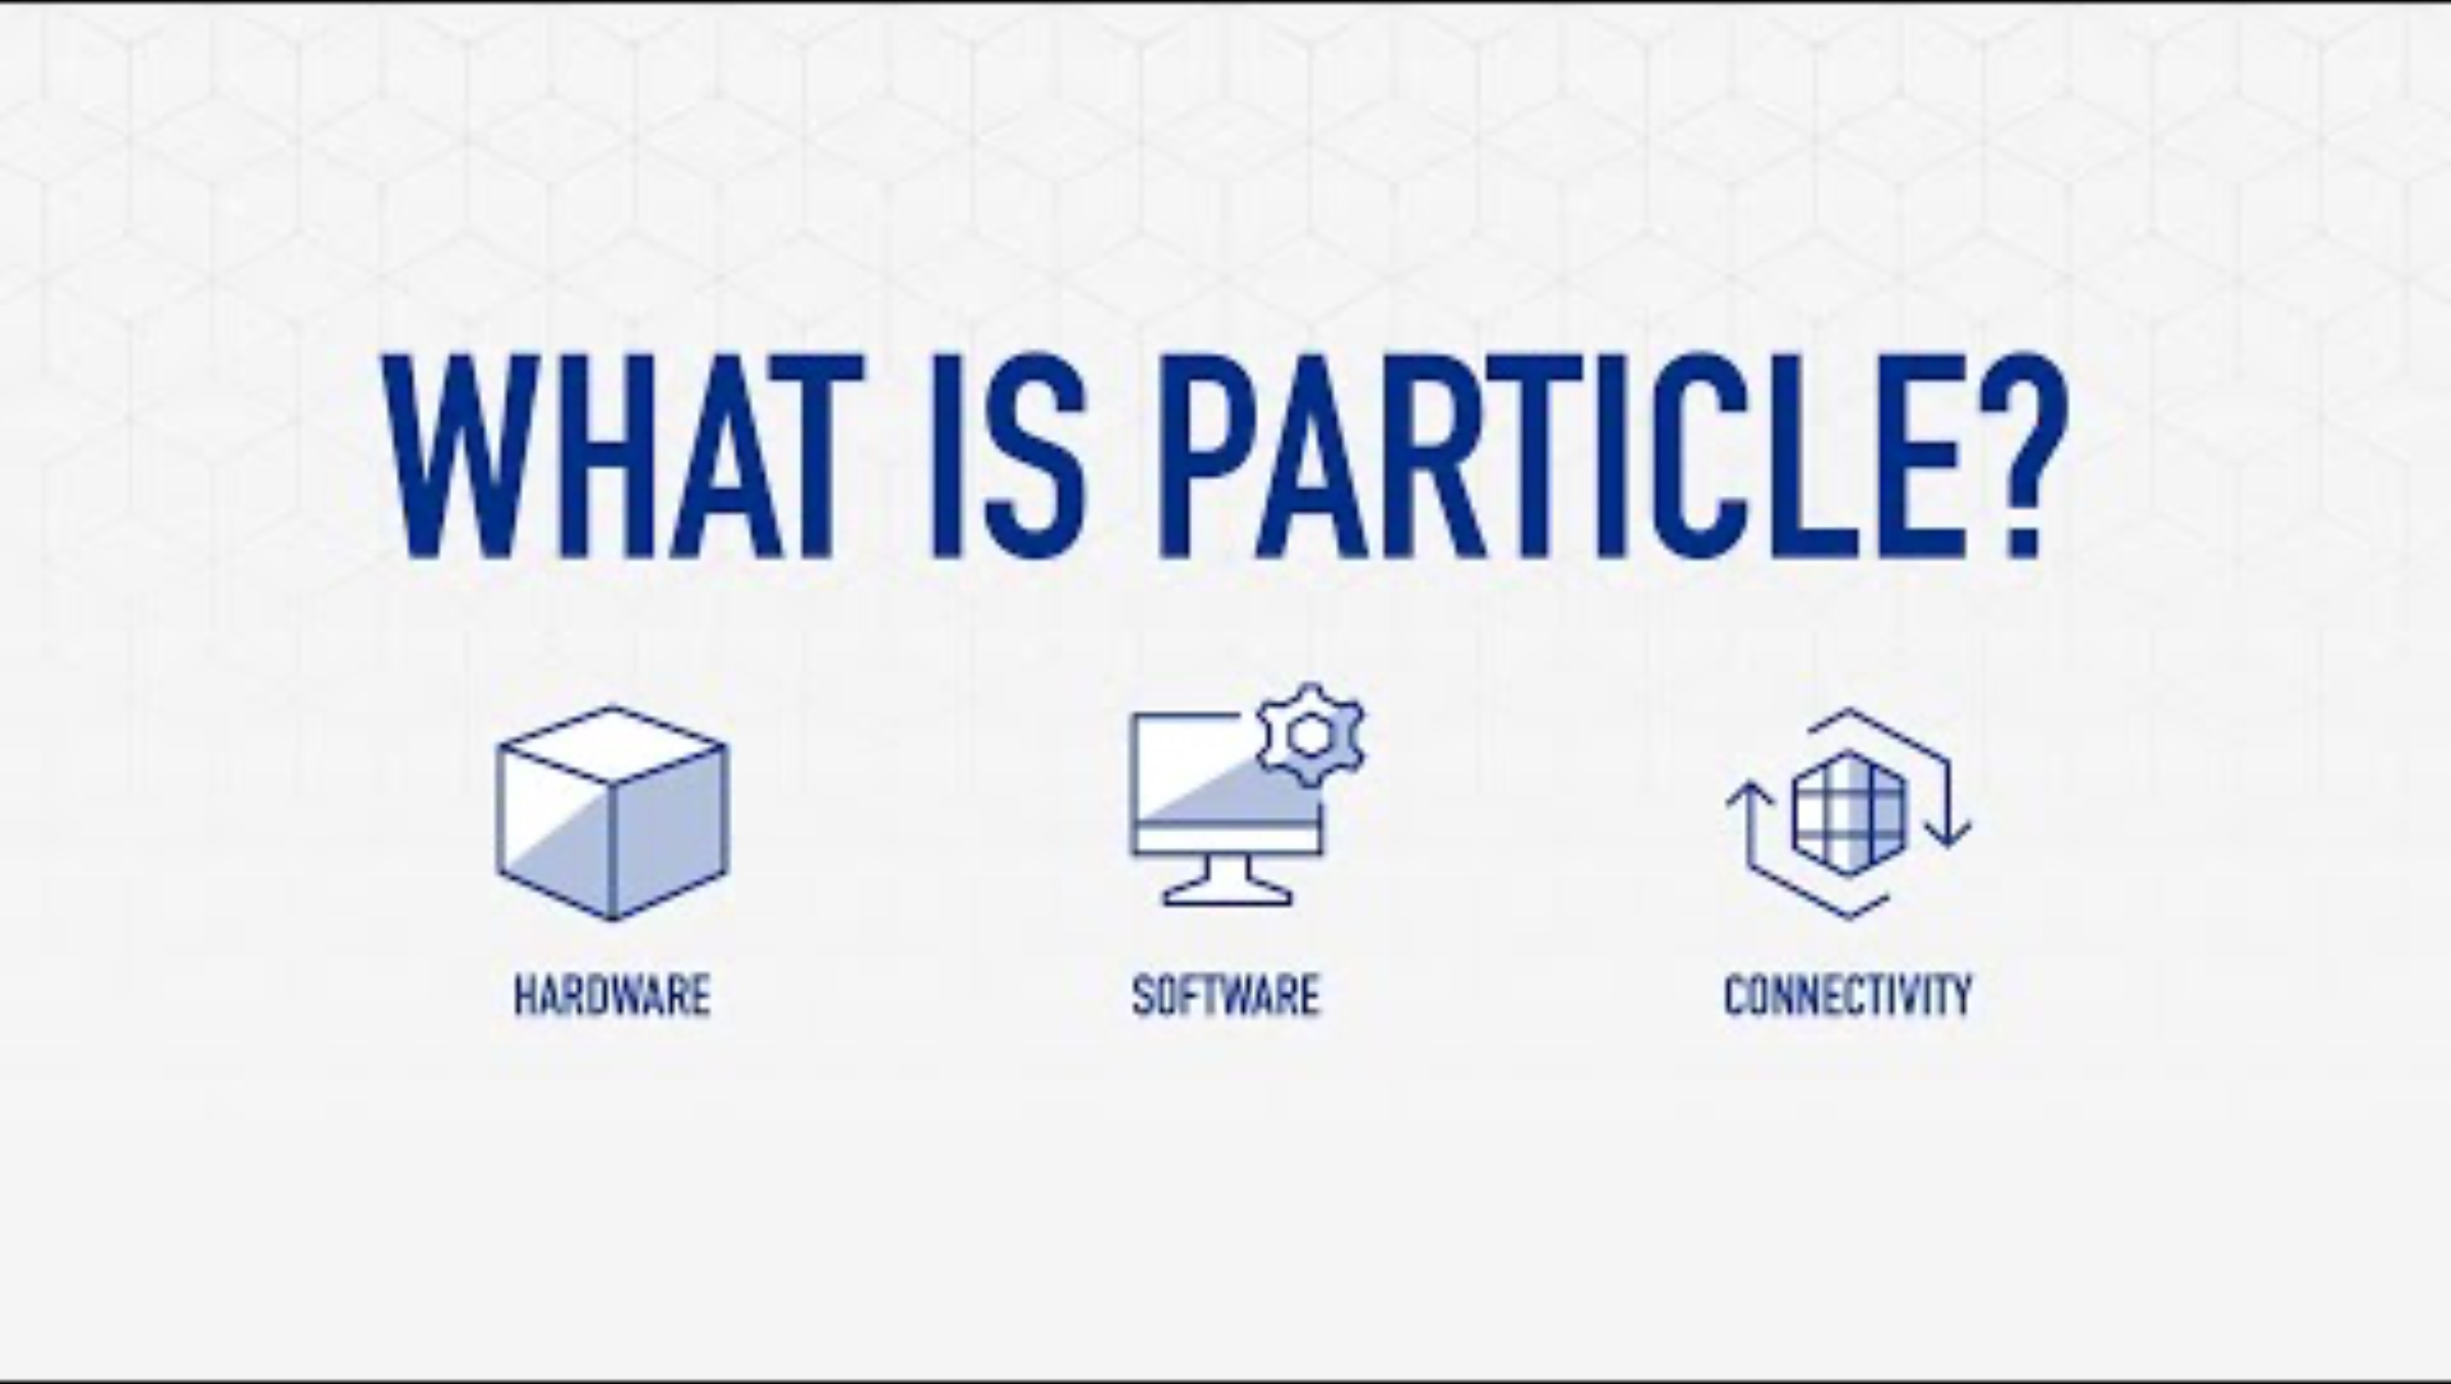

Slide 8
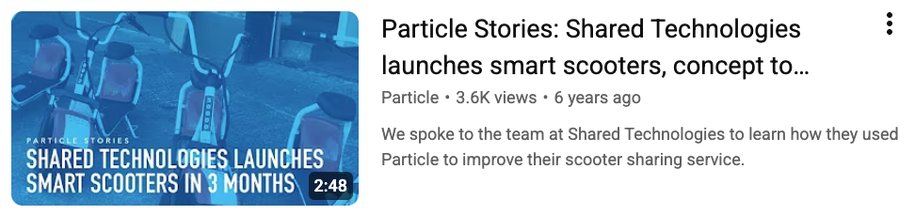
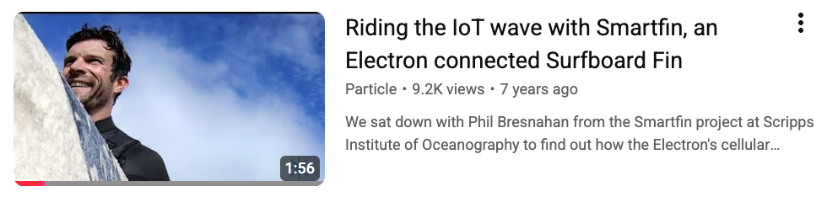
Learn about some of the other cool projects that use Particle on their website and YouTube channel…

Slide 9
GitHub
Introduced briefly in OCN 350; to be used extensively in OCN 479
Reinforces “open science and engineering” concepts
Enables collaborative coding with a little more code stability than something like google docs. Collaborate with…
Teammates
Rest of this class
Future classes
People anywhere/anywhen in the world
Including links to GitHub repos on resumes/CVs will be very attractive to employers/graduate schools!

Slide 10
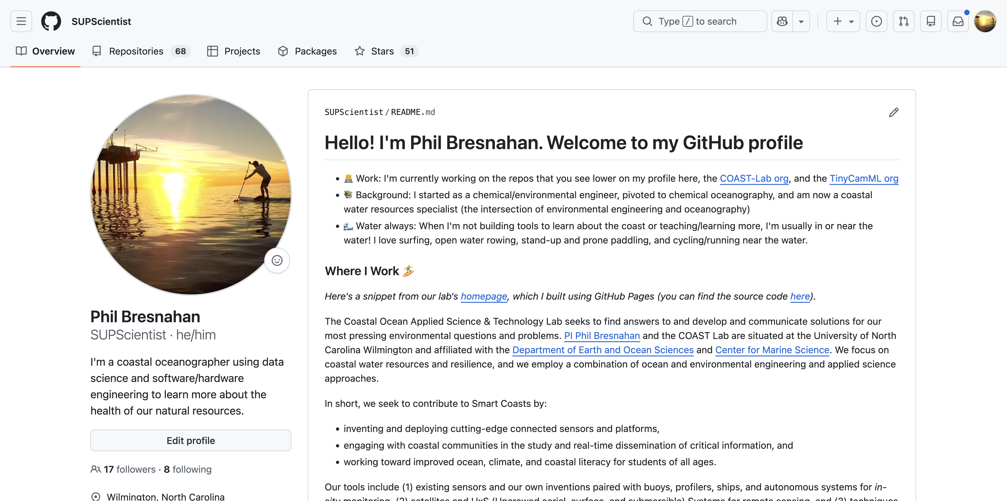
https://github.com/supscientist

Slide 11
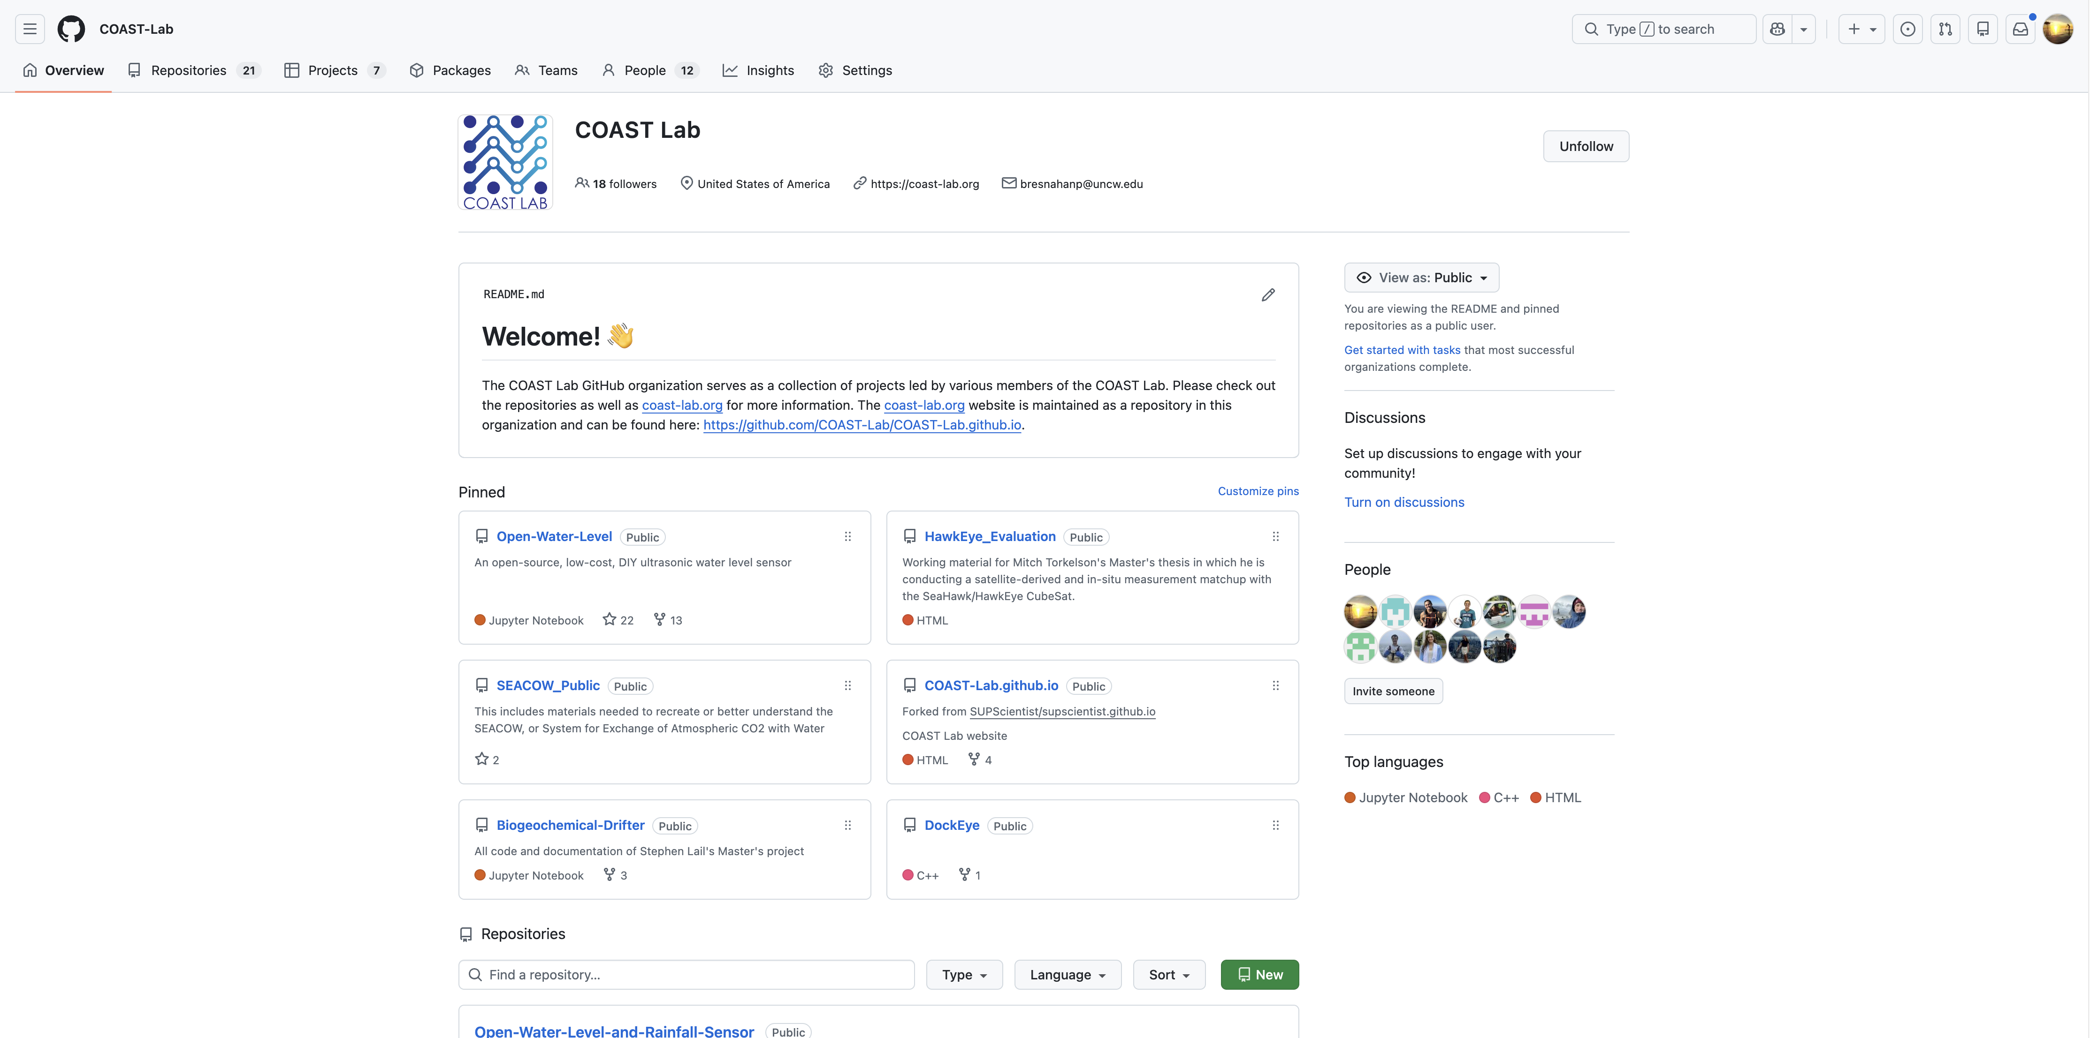
https://github.com/COAST-Lab

Slide 12
That’s a lot of new terminology…
questions?

Slide 13
GitHub exercise
Read this page: https://github.com/SUPScientist/Smart-Coasts/tree/main/Class-02-OILab-Tour
After reading everything, complete at least the required and ideally the optional steps

