Slide 1
Smart Expense Tracker
Efficiently Manage and Track Your Expenses
Ankit Kumar Agrawal 23MCA20438
Suraj 23MCA20443
Pratham Sharma 23MCA20452
Abhishek Chauhan 23MCA20546

Slide 2
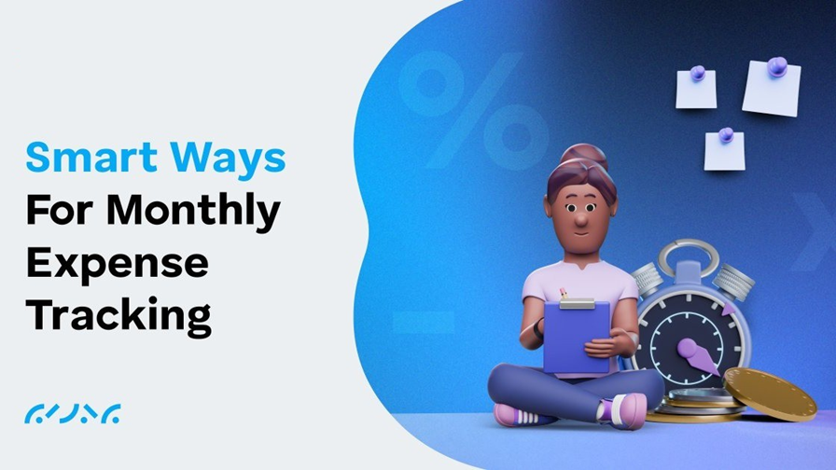
Introduction
• Definition of a Smart Expense Tracker
• Importance of tracking expenses efficiently
• Brief overview of the presentation

Slide 3
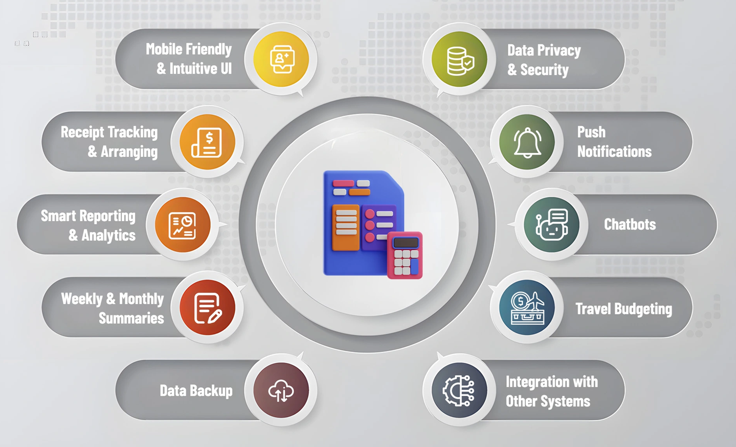
Features of the Smart Expense Tracker
• Automated expense logging
• Categorization of expenses
• Budget setting and tracking
• Notification alerts for overspending

Slide 4
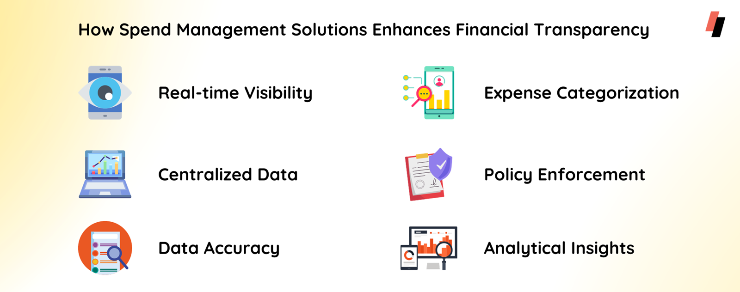
Technologies Used
• Python Basics
• Object Oriented Programming (OOPS)
• Data Analysis with Matplotlib

Slide 5
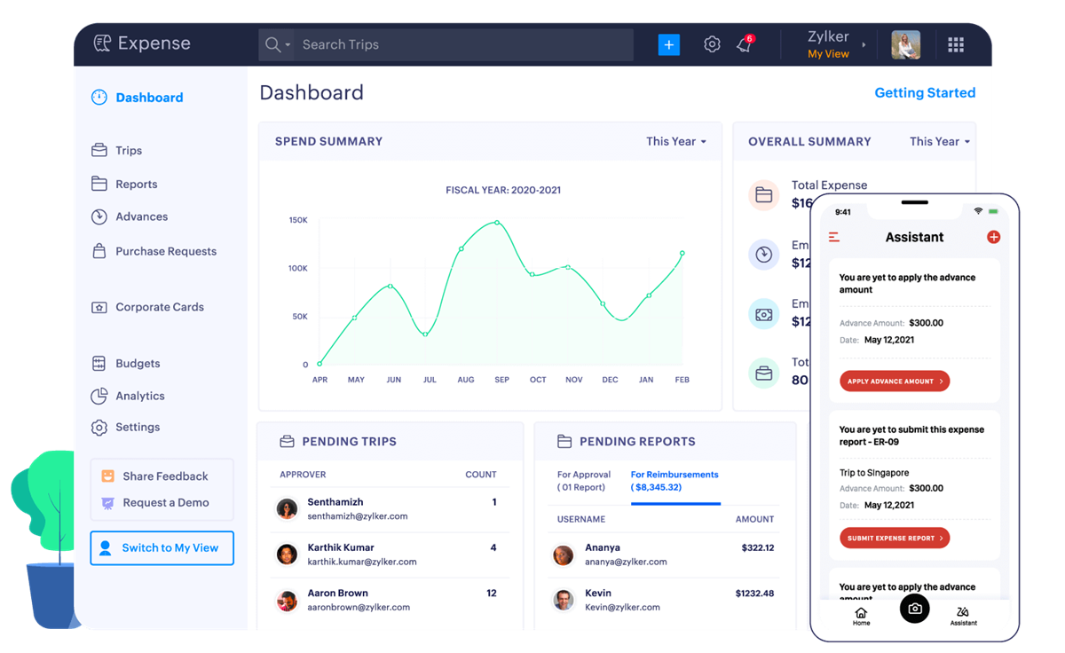
User Interface & Experience
• Clean and intuitive UI design
• Screenshots/mockups of app interfaces
• Easy data entry and visualization tools

Slide 6
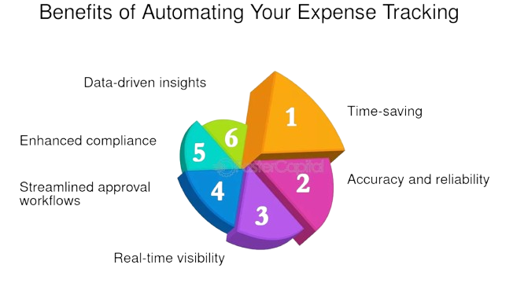
Benefits of the Smart Expense Tracker
• Time-saving aspects
• Improved financial awareness
• Helps users stay within budget
• Insights through analytics and reports

Slide 7
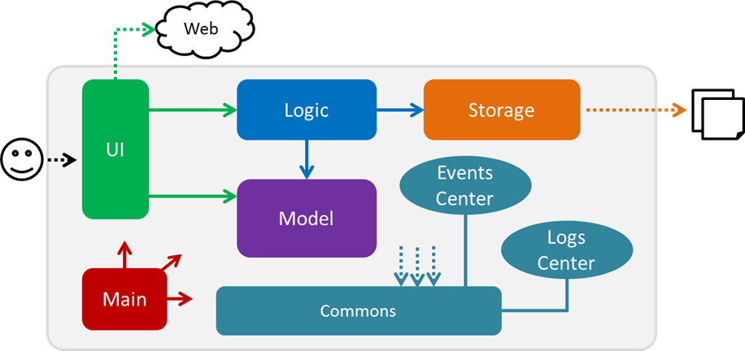
Implementation Details
• Data collection and storage methods
• User Friendly GUI
• Various Tools for Visualization

Slide 8
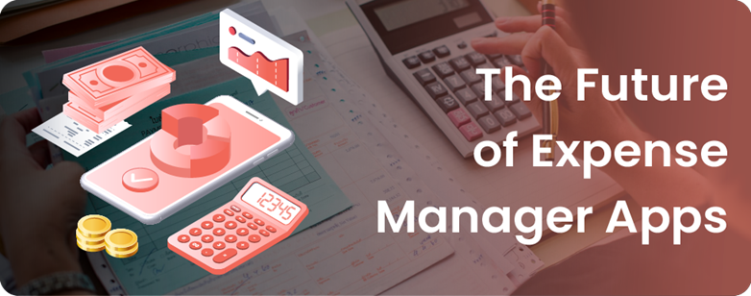
Future Enhancements
• Predictive spending analysis using AI
• Integration with banking apps
• Advanced analytics and visualization features

Slide 9
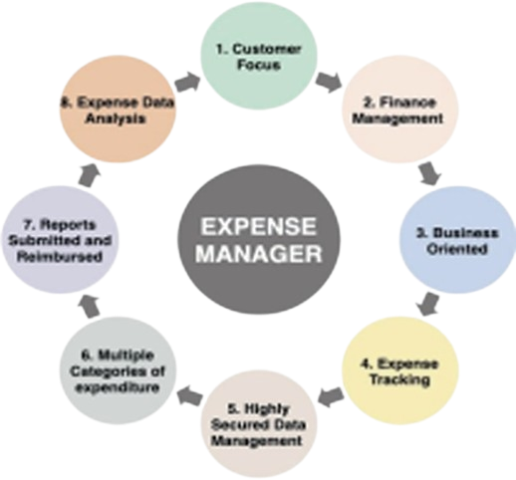
Conclusion
Discover the key benefits and standout features our solution offers to help you manage your expenses more efficiently. Experience it firsthand by exploring our free demo today. For additional details or any questions, feel free to reach out to us through our contact information.

