Slide 1
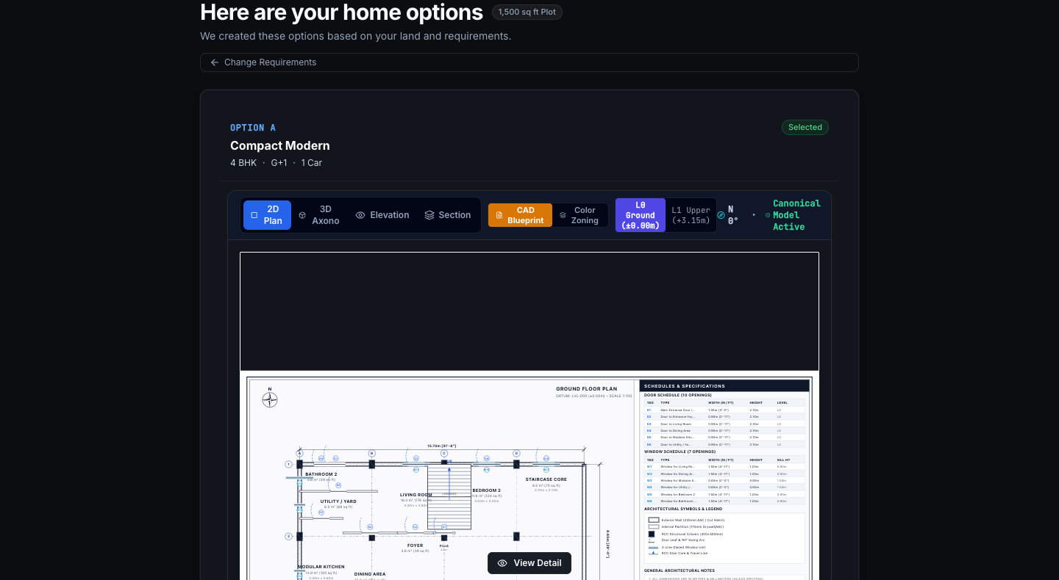
PLANWISE ENTERPRISE • INVESTOR BRIEFING
The Computational Intelligence Platform for Land-to-Home Development
Deterministic, model-linked automation connecting plot feasibility, building design, BOQ cost, and engineer review.
1. Land Intake
Boundary & Topo
→
2. Feasibility
DCPR 2034 & FAR
→
3. Parametric Design
CBM Solvers
→
4. Cost & BOQ
CPWD / IS 1200
→
5. Build Review
Constructibility
→
6. Engineer Handoff
IFC4 & G0–G8
PROBLEM & SOLUTION
• Problem: Land feasibility, design, and costing are fragmented across disconnected tools.
• Solution: One connected computational workflow linking plot geometry, zoning, 3D models, and BOQ.
planwise.enterprise / studio • Bandra CTS-1842 Benchmark (1,500 sq ft Plot)
CBM v1.4 • DCPR 2034 Verified
TECHNICAL DIFFERENTIATION (DETERMINISTIC CORE)
• Deterministic Math: CP-SAT discrete solver and watertight Manifold3D solids—zero AI hallucinations.
• Traceable BOQ: Model-linked IS 1200 quantities with automated CPWD rate analysis.
• Review Gates: Immutable G0–G8 engineering sign-off locks with cryptographic audit trail.
TARGET CUSTOMERS & PROPOSED MODEL
• Target Customers: Architects, residential developers, and structural engineering consultancies.
• Proposed Model: Proposed B2B SaaS subscription for professional project teams.
• Vision: Make land-to-home development measurable, traceable, and coordinated.
CANONICAL BUILDING MODEL (CBM) SOURCE OF TRUTH • DETERMINISTIC CP-SAT LAYOUT & DRAWING COMPILER
VERIFIED ENGINEERING BASELINE (OCTOBER 2026): 44/44 Regression Tests Passing • 8 PostGIS Migrations (34 RLS Tables) • ES256 JWKS Cryptographic Security • IFC4 OpenBIM & 9-Sheet Drawing Compiler
Stage: Controlled-pilot engineered baseline. AI is strictly advisory. Computational validation assists licensed professionals; does not replace statutory municipal permits or professional engineering seal.

