Slide 1

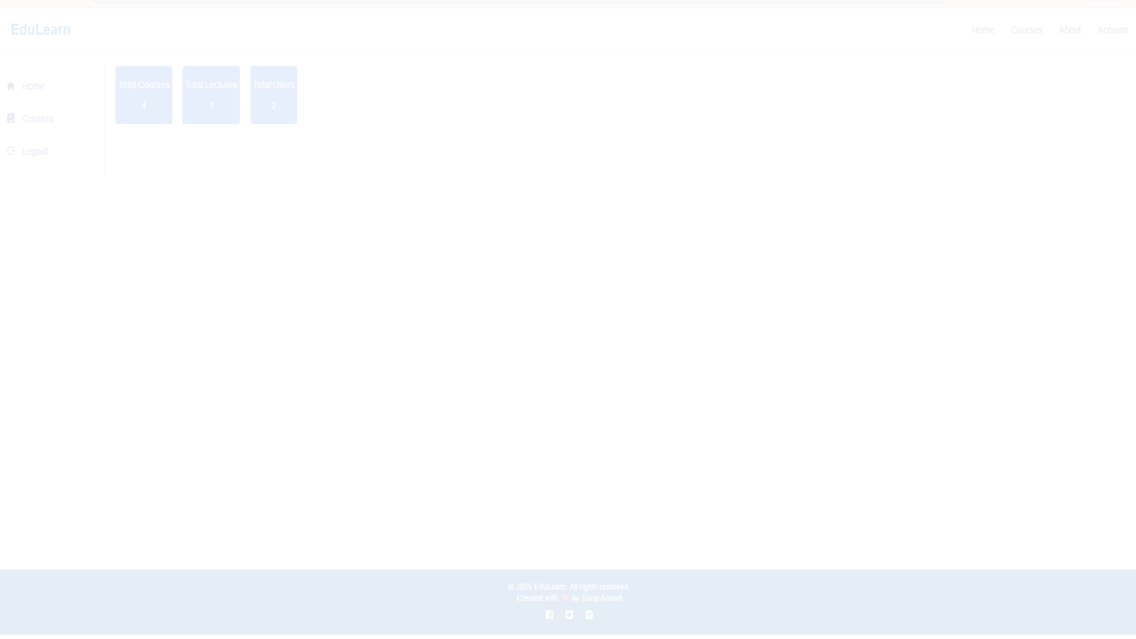
EduLearn - Learning Management System
Full-Stack MERN Application
Developed by Suraj Anand
December 2025
For Ecera System LLC Internship Screening Assignment

Slide 2
EduLearn - Project Overview
Page 2
Project Overview: EduLearn LMS
Introduction to EduLearn
EduLearn is a comprehensive e-learning platform designed to provide accessible and efficient online education. It supports two distinct user roles: Administrator and Student.
Purpose & Vision
Our goal is to bridge the gap in online learning by offering a robust platform that simplifies course management for educators and enhances the learning experience for students, ensuring secure and seamless access to educational content.
Built with MERN Stack
The platform is developed using the powerful MERN (MongoDB, Express.js, React.js, Node.js) stack, ensuring a scalable, high-performance, and responsive application.
EduLearn Project Documentation
Ecera System LLC | Internship Assignment

Slide 3




EduLearn - Problem Statement
Page 3
Addressing Key Challenges in Online Education
Need for Accessible Online Education
Many platforms lack intuitive interfaces and robust features, making quality online learning less accessible to a wider audience.
Course Management Challenges for Admins
Administrators often struggle with inefficient tools for creating, updating, and managing course content and user data.
Difficulties in Student Learning Tracking
Students and instructors need better ways to monitor progress, identify areas for improvement, and ensure effective learning outcomes.
Secure Payment Processing Requirements
A reliable and secure payment gateway is crucial for handling course enrollments and ensuring financial transactions are protected.

Slide 4






EduLearn - Tech Stack
Page 4
Technology Stack: Powering EduLearn
Frontend
Backend
Database
React.js, React Router, Axios, CSS3
Node.js, Express.js, Mongoose
MongoDB Atlas
Authentication
Additional Tools
JWT, Bcrypt, Nodemailer
Multer, Razorpay
EduLearn Project Documentation
Ecera System LLC | Internship Assignment

Slide 5


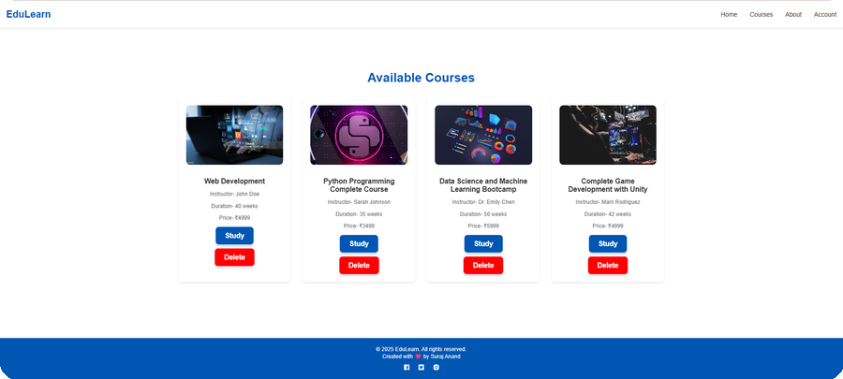


EduLearn - System Architecture
Page 5
System Architecture: Data Flow & Components
Frontend (React)
Backend (Node/Express)
MongoDB Atlas
Key Principles:
RESTful APIs for seamless communication
Token-based Authentication (JWT)
Robust File Upload System (Multer)
EduLearn Project Documentation
Ecera System LLC | Internship Assignment

Slide 6

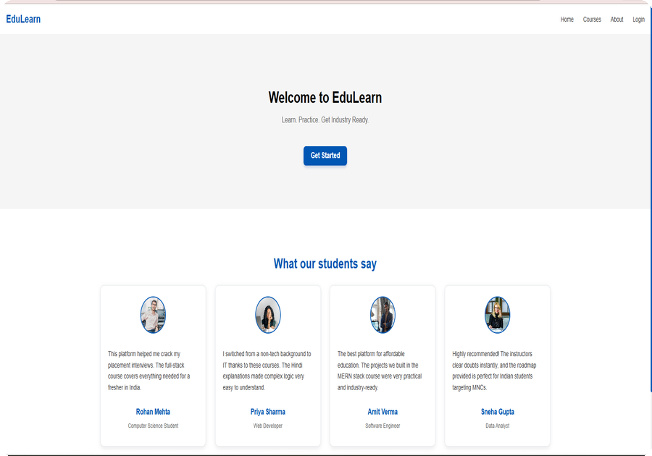


EduLearn - Admin Panel Features
Page 6
Key Features: Admin Panel
Comprehensive Admin Controls
Complete Course CRUD Operations
Video Lecture Upload & Management
User Management & Role Assignment
Dashboard Statistics (Courses, Users, Lectures)
Secure File Upload System (Multer)
EduLearn Project Documentation
Ecera System LLC | Internship Assignment

Slide 7
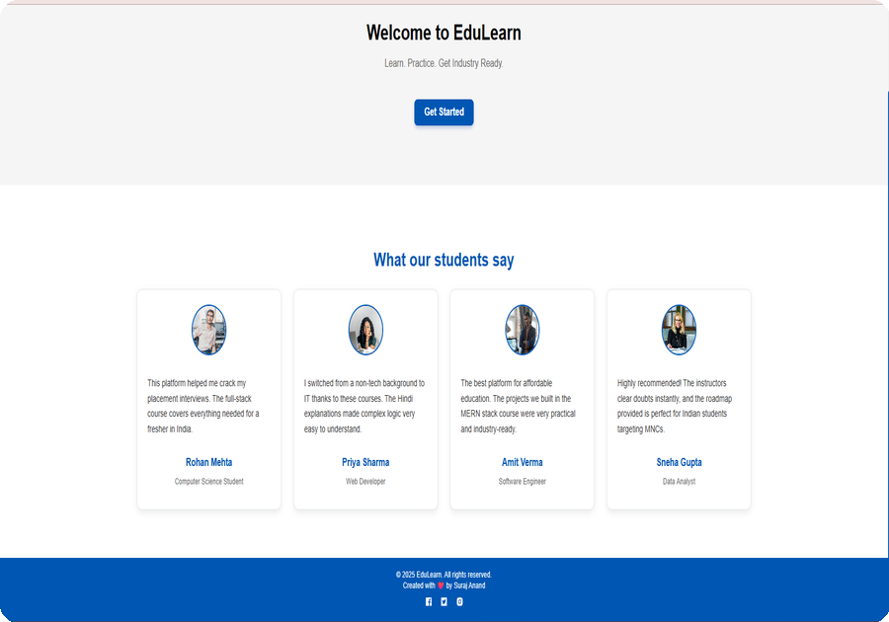



EduLearn - Student Portal Features
Page 7
Key Features: Student Portal
Enhanced Learning Experience
Course Browsing & Search Functionality
Detailed Course Information Display
Secure Enrollment & Payment (Razorpay)
Lecture Content Access with Video Player
Progress Tracking Dashboard
Personalized Learning Dashboard
EduLearn Project Documentation
Ecera System LLC | Internship Assignment

Slide 8
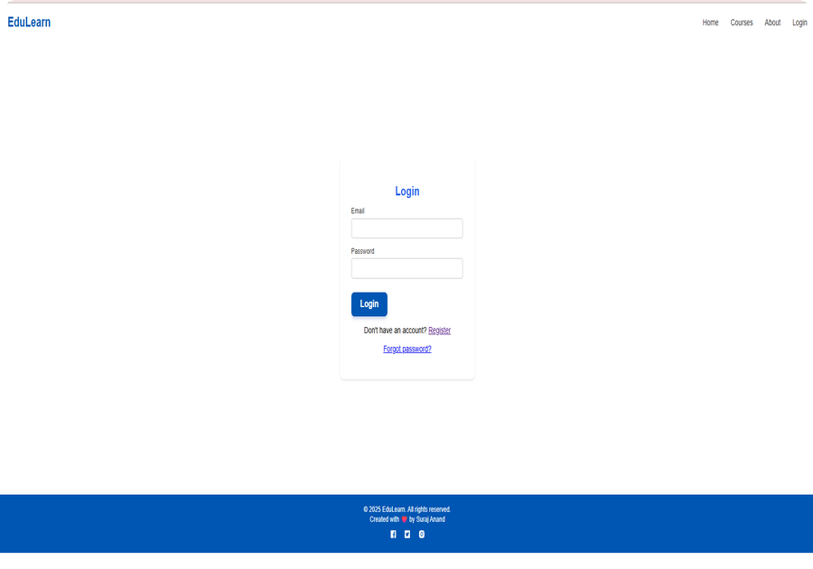





EduLearn - Authentication & Security
Page 8
Robust Authentication & Security
Security Measures Implemented
JWT-based Authentication System
Email OTP Verification via Nodemailer
Bcrypt Password Encryption with Salting
Role-Based Access Control (RBAC)
Secure Token Management with Expiration
Protected API Routes using Middleware
EduLearn Project Documentation
Ecera System LLC | Internship Assignment

Slide 9
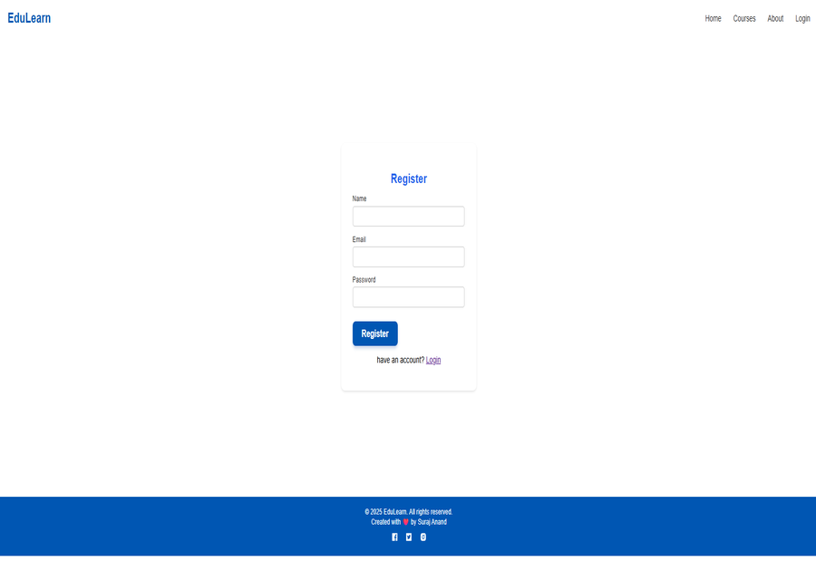

EduLearn - Database Design
Page 9
Database Design: Core Collections
5 Main Collections
Users: name, email, password, role, profile
Courses: title, description, price, instructor, thumbnail
Lectures: courseId, title, videoURL, duration, order
Payments: userId, courseId, transactionId, amount, status
Progress: userId, courseId, lectureId, completionPercentage, timestamp
EduLearn Project Documentation
Ecera System LLC | Internship Assignment

Slide 10
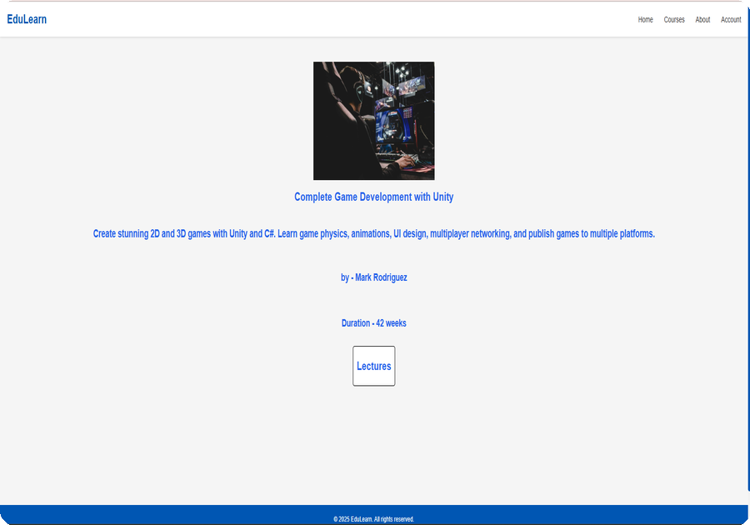

EduLearn - Payment Integration
Page 10
Seamless Razorpay Payment Integration
Razorpay Implementation Details
Secure Checkout Process with Order Creation
Backend Verification of Payment Signature
Automatic Course Enrollment Post-Payment
Transaction Records Storage in Payments Collection
Robust Error Handling for Failed Transactions
Webhook Integration for Payment Status Updates
EduLearn Project Documentation
Ecera System LLC | Internship Assignment

Slide 11
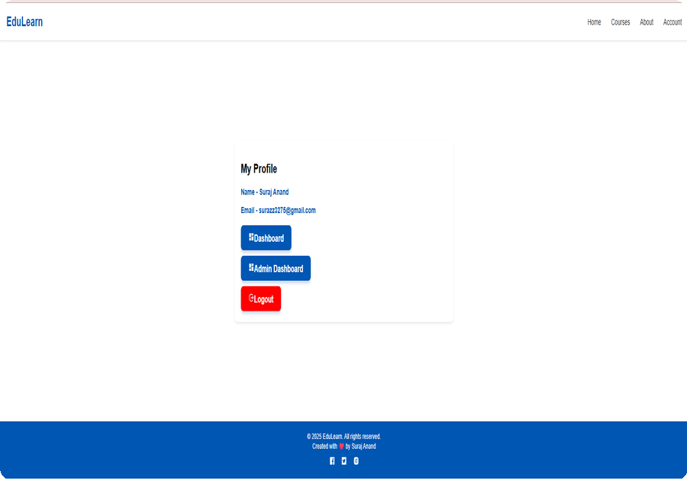




EduLearn - Project Highlights
Page 11
Project Highlights: Key Metrics
Quantifiable Achievements
20+ React Components Built
15+ RESTful API Endpoints Implemented
5 MongoDB Collections Designed
3000+ Lines of Code Written
Role-based Access for 2 User Types (Admin/Student)
Fully Responsive Design Across Devices
EduLearn Project Documentation
Ecera System LLC | Internship Assignment

Slide 12
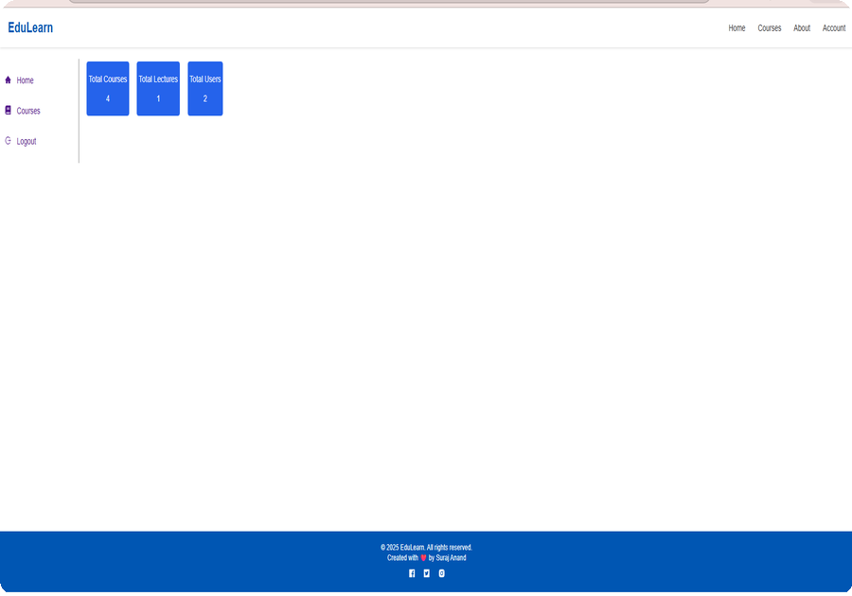

EduLearn - Development Process
Page 12
Development Process & Methodology
Key Development Phases
Database Design and ER Diagram Creation
Backend API Development with Express Routes
Frontend UI/UX Development with React Components
Authentication System Implementation
File Upload System with Multer
Payment Gateway Integration with Razorpay
Comprehensive Testing and Debugging Phases
EduLearn Project Documentation
Ecera System LLC | Internship Assignment

Slide 13
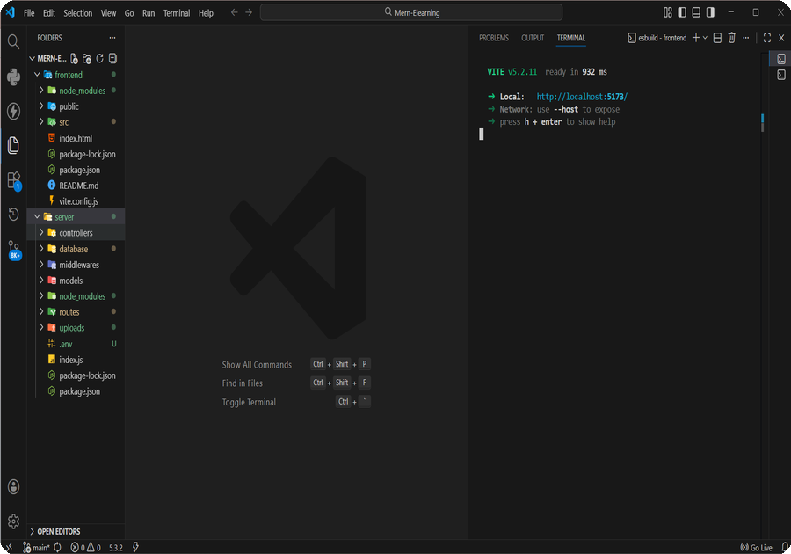

EduLearn - Challenges Overcome
Page 13
Challenges Overcome & Solutions
Technical Hurdles Addressed
File Upload Optimization with Multer
JWT Token Lifecycle Management
Email OTP System Reliability & Deliverability
Razorpay Integration Testing in Sandbox
Role-based Route Protection Middleware
Responsive Design Challenges Across Screens
EduLearn Project Documentation
Ecera System LLC | Internship Assignment

Slide 14
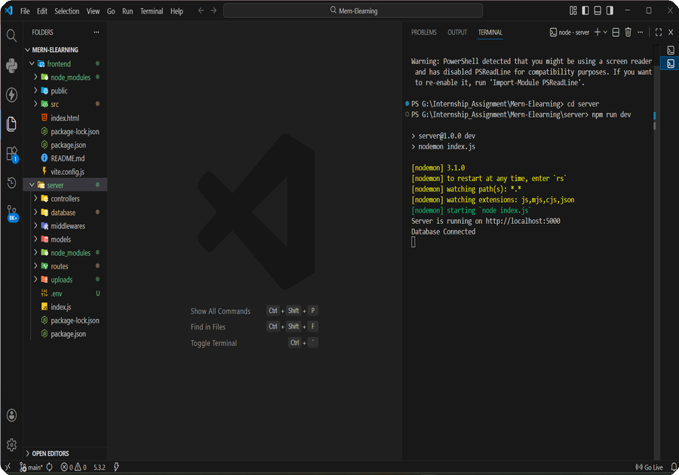



EduLearn - Future Enhancements
Page 14
Future Enhancements & Roadmap
Planned Next Steps
Real-time Chat Functionality (Socket.io)
Course Review and Rating System
Automated Certificate Generation
Advanced Analytics Dashboard
Mobile Application Development (React Native)
Live Video Streaming Integration
EduLearn Project Documentation
Ecera System LLC | Internship Assignment

Slide 15

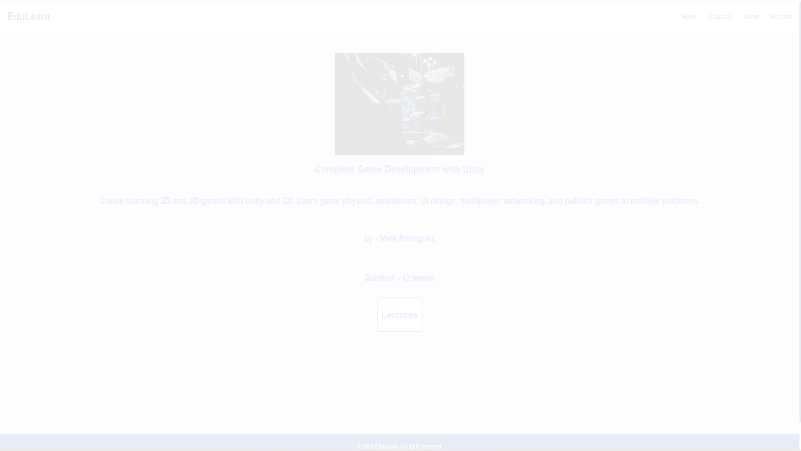
Thank You!
Contact Information
Name: Suraj Anand
Email: surazz3275@gmail.com
GitHub: https://github.com/SURAJDECODE/edulearn-lms
LinkedIn: https://www.linkedin.com/in/suraj117/
Looking forward to joining Ecera System LLC and contributing to innovative educational technology projects.

