Slide 1

VOICENAV: A VOICE-ACTIVATED WEB NAVIGATOR
PRESENTER→ANKITA BISWAS
GROUP MEMBERS- NEHAL AFSAR, SANJANA SHAW,SUPARNA KAMILA, SURAJ MAITY,ANKITA BISWAS
Department of Computer Application
SWAMI VIVEKANANDA UNIVERSITY

Slide 2
Paper outline:
INTRODUCTION
MOTIVATION
OVERVIEW
WORKFLOW OF VOICENAV
BACKGROUND STUDY
RESULT
FUTURE SCOPE
REFERENCES

Slide 3
INTRODUCTION
Human-Computer Interaction Evolution: As technology advances, the way we interact with computers is constantly changing.
Voice-Controlled Assistants:
Represent a major step toward intuitive and natural interaction.
Offer hands-free operation, making them ideal for various users, especially those with mobility challenges.
Project Focus: Development of a sophisticated voice-controlled assistant that enables:
Web browsing
Application management
System control via voice commands
Objective: To create a user-friendly, versatile interface that enhances accessibility and usability, allowing for a wide range of tasks to be performed through voice commands alone.

Slide 4
motivation
Why This Project?
The growing demand for hands-free technologies driven by accessibility needs.
Improving accessibility for users with physical disabilities or those who cannot interact with a computer using traditional input methods.
Simplifying tasks like web browsing and application launching through voice commands.
Impact:
Creates a more inclusive computing environment.
Promotes convenience and efficiency, reducing reliance on physical devices like keyboards and mice.

Slide 5
overview
This project introduces an innovative voice-controlled assistant to enhance user interaction with computers using natural language processing and speech recognition.
Key Features:
Voice-controlled web browsing
Application management across operating systems
Keyboard command execution using voice
Technologies Used:
Speech Recognition for voice input
Speech-to-Text for audio feedback
Browser Automation for web navigation

Slide 6
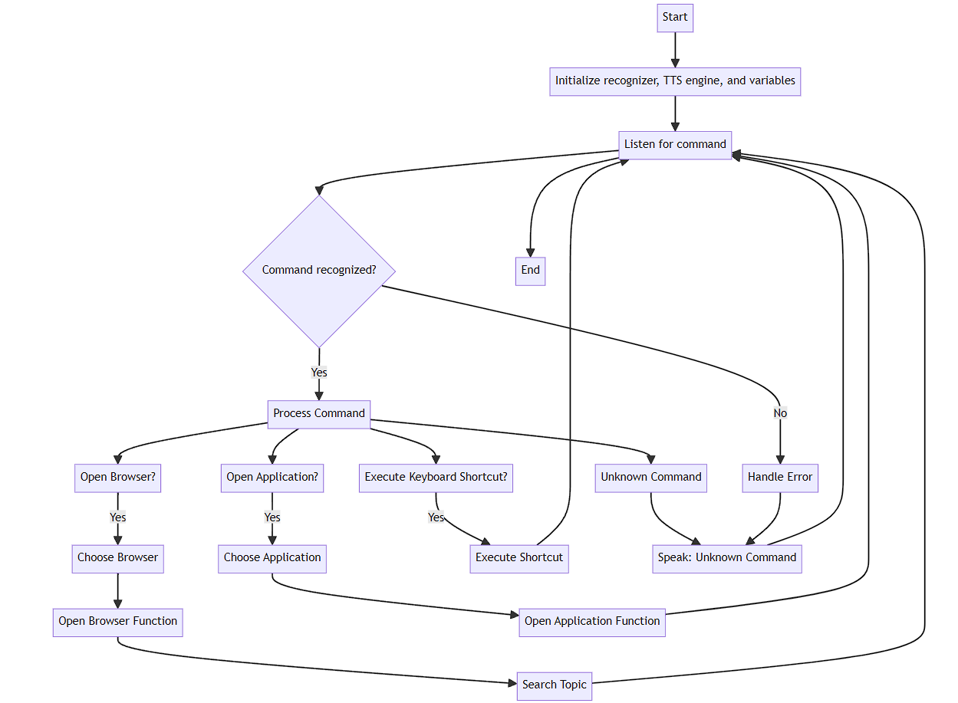
WORKFLOW OF VOICENAV

Slide 7
Background Study
Technologies Used:
Speech Recognition
Converts spoken language to text using machine learning and deep learning.
Google’s Speech Recognition API used for accurate speech-to-text conversion.
Text-to-Speech (TTS)
Provides audio feedback by converting text into spoken language.
Utilizes the pyttsx3 library for natural-sounding speech synthesis.
Browser Automation
Enables programmatic control of web browsers for automated navigation and interaction.
Selenium library used to power web browsing capabilities.
Cross-Platform Development
Ensures compatibility with Windows, macOS, and Linux.
Uses subprocess library for application management.

Slide 8
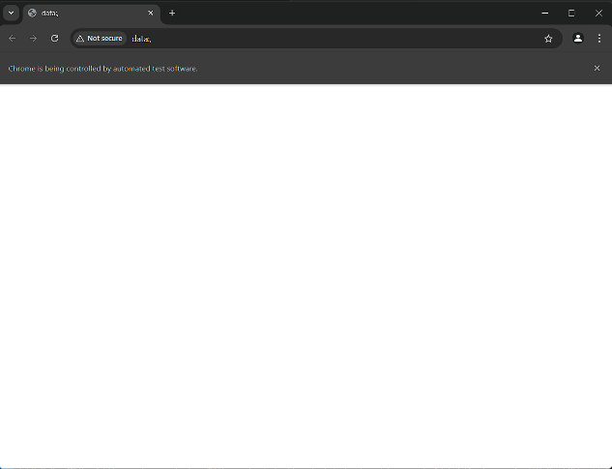
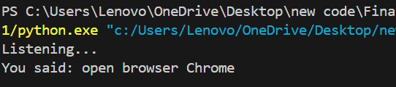
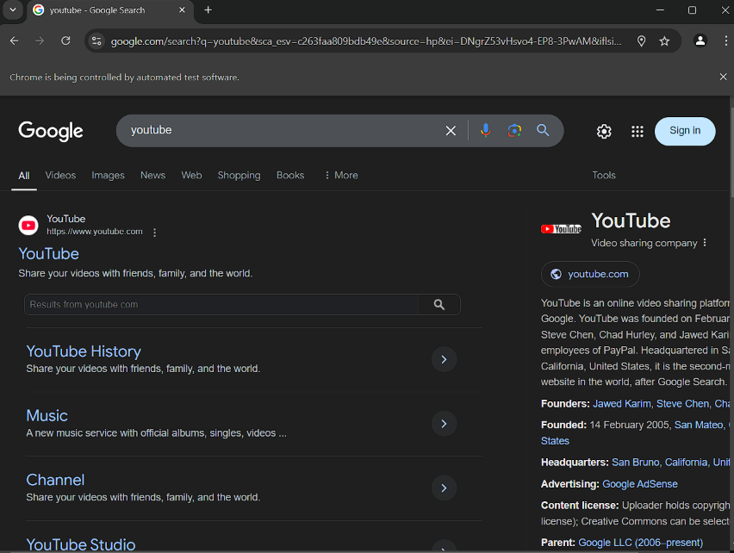
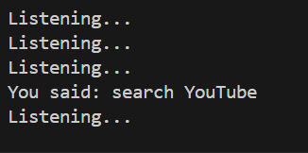
Results
*OPENS CHROME*
WHEN WE SAY OPEN BROWSER CHROME:
*SEARCHES FOR YOUTUBE
ON THE WEB*
FOR SEARCHIING WE CAN SAY: SEARCH (something)
Like- search YouTube

Slide 9
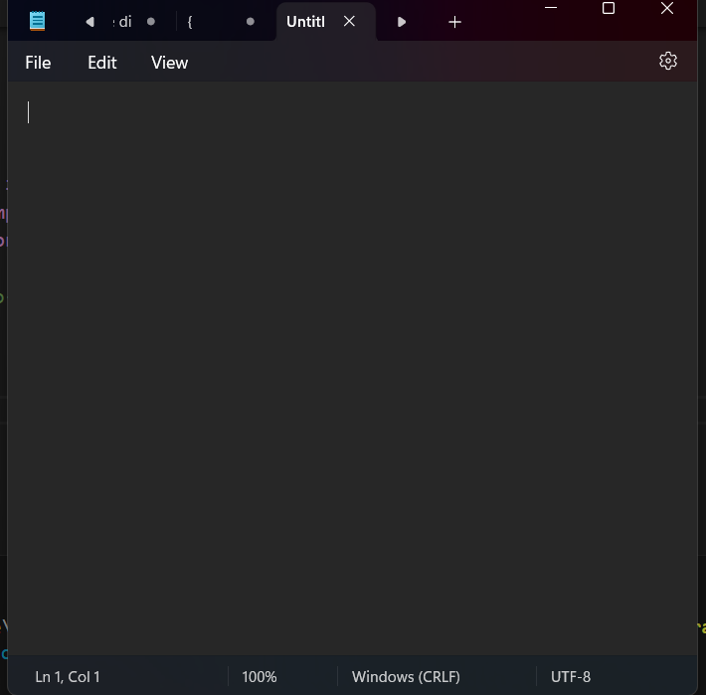
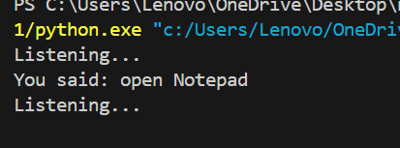
results
*OPENS NOTEPAD*
FOR OPENING NOTEPAD WE SAY-
Open Notepad

Slide 10
Future scope
Advanced Natural Language Processing (NLP): To improve command interpretation, allowing the assistant to understand more complex, conversational language.
Expansion of Supported Applications: Include more third-party applications for greater functionality across different platforms.
Multi-Language Support: Implement support for multiple languages to increase accessibility for users worldwide.
Integration with Smart Home Devices: Future versions could control smart devices (e.g., lights, thermostats) in the home through voice commands.
Improved Error Handling and User Feedback: Enhance system resilience with better error handling and more user-friendly feedback.

Slide 11
References
Google Cloud Speech-to-Text: Google Cloud. (n.d.). Speech-to-Text. Retrieved from https://cloud.google.com/speech-to-text
Pyttsx3 Documentation: Pyttsx3 Documentation. (n.d.). Retrieved from https://pyttsx3.readthedocs.io/en/latest/
Selenium Documentation: Selenium Documentation. (n.d.). Retrieved from https://www.selenium.dev/documentation/en/
Python Software Foundation: Python Documentation. (n.d.). Retrieved from https://docs.python.org/3/
Speech Recognition API: Speech Recognition Documentation. (n.d.). Retrieved from https://pypi.org/project/SpeechRecognition/

Slide 12
THANKYOU

