Slide 1
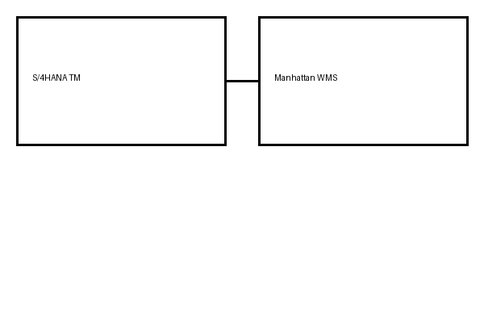
Target Architecture Overview
Acme Logistics will deploy S/4HANA TM integrated in real time with the existing Manhattan WMS via SAP Cloud Integration middleware, replacing the legacy nightly batch feed.

