Slide 1

FUTURE CHALLENGES AND OPPORTUNITIES IN SHRM
Strategic Human Resources Management
Presented By,
Suraksha J Lekshmi
1125514049
MBA - NICHE, Kumaracoil

Slide 2

AGENDA
Contents
01. What is SHRM?
02. SHRM Connects
03. Future Challenges
04. Future Opportunities
05. Challenges Vs Opportunities
06. Conclusions
1 - 2
3 - 4
5 - 6
7 - 8
9 -10
11

Slide 3

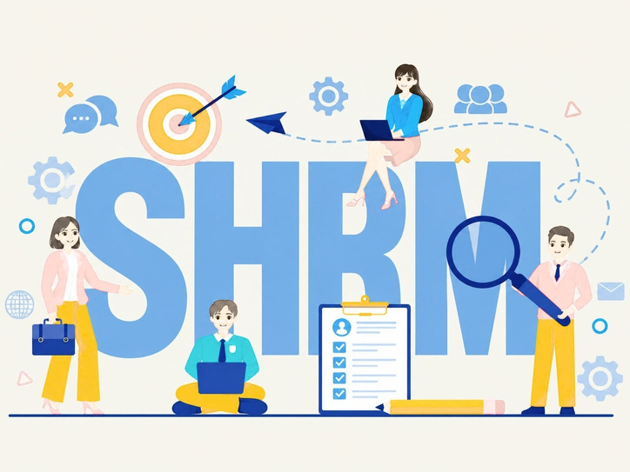
WHAT IS SHRM
Strategic Human Resource Management (SHRM) is the practice of aligning HR policies and practices with overall business strategy to achieve long-term organizational goals.
  Goes beyond traditional HR ( hiring, payroll,compliance) to focus on people as a strategic asset.
  Integrates HR planning directly into business strategy formulation
  Focuses on long-term workforce planning rather than day-to-day administration
  Treats employees as a source of competitive advantage, not just a cost center
Key elements : talent acquisition, performance management, leadership development, organizational culture, and change management.

Slide 4

SHRM CONNECTS
People
Talent, Skills
Strategy
Business goals
People: The employees and their skills are the foundation of any organization.
Strategy: The Company’s long-term goals guide how people are managed and developed.
Technology: Digital tools and data help HR make smarter, faster decisions.
Culture: Shared values and mindset shape how people behave and work together.
Business Results: When people, strategy, technology, and culture align, the company grows and succeeds.
Technology
Tools, Data
Culture
Values, Mindset
Business Results
Growth, Success

Slide 5

FUTURE CHALLENGES
Talent Shortage
Technology Dsiruption
Hybrid/Remote work management
Generational diversity
Regulatory complexity
Employee Retention
Mental health & Burnout

Slide 6
Talent Shortage
Technology Disruption
Hybrid/Remote work
Generational Diversity
Competing for skilled workers in a tightening labour market.
Automation and AI reshaping job roles and required skillsets.
Maintaining culture and productivity across distributed teams.
Managing multi-generational workforces(Genz to Boomers) with different expectations.
Regulatory Complexity
Employee Retention
Mental Health & Burnout
Keeping pace with evolving labor laws, DEI mandates, and compliance requirements.
Rising turnover costs and the “Great Resignation” aftermath
Increasing pressure to support employee wellbeing at scale.

Slide 7

FUTURE OPPORTUNITIES
HR Technoloogy & AI
Reskilling & upskilling
Employer branding
Flexible work models
DEI as strategy
Employee experience design
Global talent pools

Slide 8
HR Tecnology & AI
Reskilling & Upskilling
Employer Branding
Flexible work models
Leveraging predictive analytics for recruitment, retention, and performance.
Building internal talent pipelines instead of only external hiring.
Using strong culture and values to attract top talent.
Turning hybrid/ remote work into a competitive advantage.
DEI as Strategy
Employee Experience design
Global talent pools
Diversity and inclusion dricing innovation and better decision-making.
Treating the employee journey like a customer journey.
Remote work enabling access to talent beyond geographic limits.

Slide 9
CHALLENGES VS OPPORTUNITIES
CHALLENGES | OPPORTUNITIES
Talent Shortage | Access to global remote talent pools
Automation/AI Disruption | AI-powered HR analytics & efficiency
Hybrid work management | Flexible work as an attraction tool
Generational Diversity | Tailored engagement & mentorship programs
Regulatory complexity | Strengthened compliance = trust & reputation
High Turnover | Better retention via employee experience design
Burnout/mental health strain | Wellbeing programs as a differentiator

Slide 10

CONCLUSIONS
1
SHRM is no longer optional - it’s central to sustainable business success.
2
Organizations that align HR with strategy outperform those that treat HR as purely administrative.
3
The future belongs to companies that treat challenges (AI, remote work, generational shift) as opportunities for reinvention.
4
Continuous investment in people, technology, and culture will define competitive advantage in the next decade.

Slide 11

MESSAGE
SHRM isn’t just managing people - it’s driving the future of the organization.

Slide 12

THANK YOU

