Slide 1

St. Joseph’s College Of Engineering Chennai OMR
Department
Project Base Paper
Artificial Intelligence and Data Science
Integrating Plant Disease Detection and Growth Prediction
Crop Prediction Model Using Machine Learning Algorithms
Team Members
Surendhan.A Reg no : 31232220169
Someshwar.V Reg no : 312322201160

Slide 2
Abstract
This project aims to develop an Integrated web-based system that leverages AI and machine learning for predicting plant growth and detecting plant diseases.
The system aims to provide actionable insights into plant health, optimize agricultural practices, and improve crop yields through disease identification and growth predictions.

Slide 3
Objective and Scope
OBJECTIVE
Predict plant growth accurately based on historical data and environmental factors.
Develop models for disease detection in crops using AI and machine learning.
Provide actionable insights to farmers for better crop management.
SCOPE
Focus on major crops like wheat, rice, and maize.
Deploy the system as a cloud-based web application.

Slide 4
Existing Systems
PLANT VILLAGE
AI-powered platform for plant disease diagnosis.
Machine learning and image recognition for disease detection.
Impact: Helps farmers detect diseases like blight and rust.
CROPING SMARTFARM
Digital farming platform with data-driven agriculture solutions.
Tracks crop health, weather patterns, and yield estimates.
Impact: Enhances productivity for farmers globally.
IBM WATSON DECISION PLATFORM FOR AGRICULTURE
AI-powered tool for predictive farming.
Provides weather forecasts, crop health insights, and yield predictions.
Impact: Supports sustainable farming practices and efficient crop management.

Slide 5
Proposed System
1.INTEGRATED PLANT HEALTH SYSTEM
Combines plant Growth Prediction, Disease Detection, and Crop Yield Estimation.
Real-time insights using weather, soil data, and disease prediction APIs.
2.IMAGE-BASED DISEASE DETECTION
Utilizes advanced models (ResNet, EfficientNet, Hugging Face) for disease
Provides actionable suggestions for disease management.
3.CROP YIELD PREDICTION
Predicts yield using historical and real-time environmental data.
Uses Regression Models or Neural Networks for higher accuracy.
4.AI-POWERED CHATBOT
AI chatbot providing personalized agricultural support.
Answers queries on plant health, disease prevention, and growth optimization.
5.CENTRALIZED USER INTERFACE
Unified platform integrating plant growth predictions, disease detection models, and a chatbot.
detection.

Slide 6
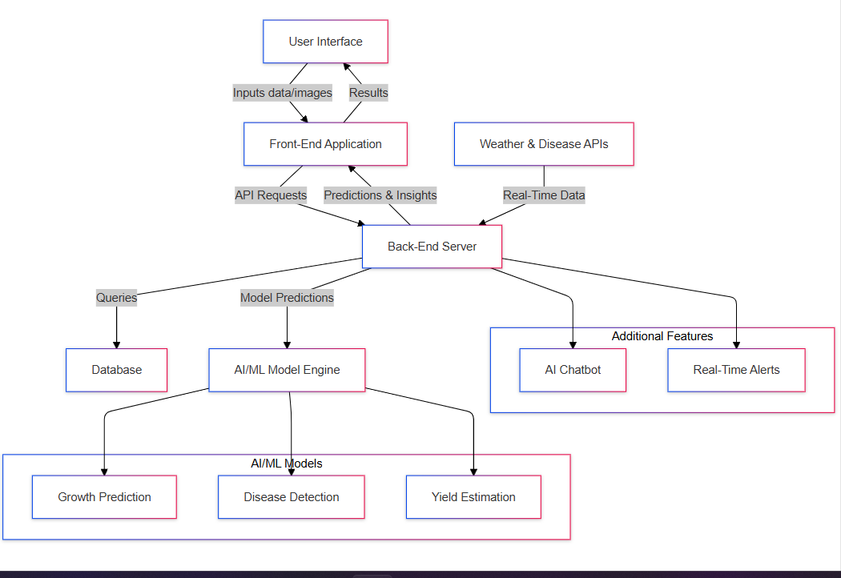
Architecture Diagram

