Slide 1



MAKE-A-THON 1.0
A N I N T E R N A L H A C K A T H O N
C R E A T E . B U I L D . I N N O V A T E
Basic Details of the Team & Problem Statement
Name of the Domain Name of the Team
Open Domain ZIRCONS
Problem Statement Title
Name of the Team Lead
AI-Powered Robotic Arm for TAMILVANAN T
Automated Object Sorting

Slide 2
Details of the Team
Team Leader Name :
Branch (B. Tech/ B.E) : Stream :
Member 1 Name : Branch (B. Tech/ B.E) : Stream :
Member 2 Name : Branch (B. Tech/ B.E) : Stream :
TAMILVANAN T
Member 3 Name :
Branch (B. Tech/ B.E) : Stream :
Member 4 Name:
Branch (B. Tech/B.E)
Stream : ADS
Name of the Mentor : Designation :
SALMAN M S
B. Tech
B. Tech
ADS
ADS
VIJAYAKUMARAN M
SUJAN P
B. Tech
: B. Tech
ADS
SURENDHAN A
Mr. Durairaji V
B. Tech
Professor
ADS
7
2

Slide 3
Technology Readiness Level (TRL) – 6
Prototype Demonstration in a Relevant Environment
Our project is at TRL 6, meaning we have developed a working prototype and tested it in a relevant environment.
The AI-powered robotic arm integrates: ✅ YOLOv8 for real-time object classification ✅ Arduino & PCA9685 for precise motor control ✅ Serial Communication for seamless data transfer
The system automates object sorting on a conveyor belt, demonstrating its real-world application.
The prototype successfully performs real-time operations, ensuring smooth pick-and-place actions with an 11-second delay mechanism for stability.

Slide 4
NO. OF. SDG COVERED
1️⃣ SDG 9 – Industry, Innovation, and Infrastructure
Implements AI and automation in industrial sorting, improving efficiency and reducing manual labour.
Demonstrates the use of advanced technology (YOLOv8, Arduino, and robotic arms) in smart manufacturing.
2️⃣ SDG 12 – Responsible Consumption and Production
Enhances resource efficiency by automating sorting, minimizing errors, and reducing waste.
Supports sustainable production by improving accuracy in industrial automation.
3️⃣ SDG 8 – Decent Work and Economic Growth
Reduces repetitive manual labour, allowing human workers to focus on higher-value tasks.
Encourages the adoption of AI-driven automation, creating opportunities in tech-driven industries.

Slide 5
AI-Powered Robotic Arm for Automated Object Sorting
Proposed Solution: AI-Powered Robotic Arm for Sorting
🔹 AI-Based Object Sorting: Uses YOLOv8 to detect and classify objects on a conveyor belt in real time.
🔹 Automated Pick-and-Place: The Arduino-controlled robotic arm moves objects to the correct location based on AI classification.
🔹 Smart & Efficient: Eliminates manual sorting, improves accuracy, reduces errors, and enhances industrial automation. 🚀
🔹 Real-Time Decision Making: The system instantly processes and responds to object detection, ensuring seamless automation.

Slide 6
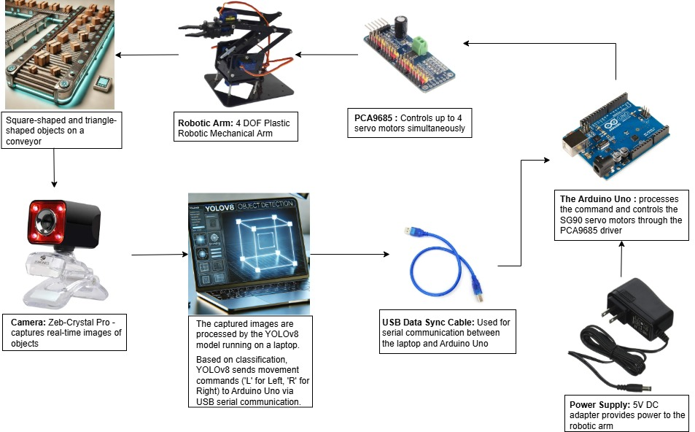
WORK FLOW DIAGRAM

Slide 7
TECHNICAL APPROACH
🔹 Technologies Used:
Machine Learning: YOLOv8 for real-time object detection
Programming Languages: Python (for AI model), Arduino C++ (for robotic arm control)
Hardware: Arduino Uno, PCA9685 motor driver, 4-DOF robotic arm, Zeb-Crystal Pro camera
Communication: USB Serial Communication between AI model and Arduino
🔹 Methodology & Implementation Process: 1️⃣ Object Detection: Camera captures real-time images, and YOLOv8 classifies objects 2️⃣ Decision Making: AI model sends sorting commands ("L" or "R") via serial communication 3️⃣ Robotic Arm Action: Arduino-controlled robotic arm moves the object accordingly 4️⃣ Process Repeats: System waits for 11 seconds before detecting the next object

Slide 8
FEASIBILITY AND VIABILITY
🔹 Feasibility Analysis: ✅ Uses readily available hardware (Arduino, Camera, Robotic Arm) ✅ Runs on YOLOv8, a proven AI model for real-time detection ✅ Simple USB-based serial communication ensures smooth AI-Arduino interaction ✅ Can be scaled for industrial automation applications
🔹 Potential Challenges & Risks: ⚠️ Latency Issues: Delays in real-time object detection and response ⚠️ Hardware Limitations: Servo motors may lack precision for high-speed sorting ⚠️ Environmental Factors: Lighting variations affecting camera accuracy
🔹 Strategies to Overcome Challenges: ✅ Optimized AI Model: Fine-tuning YOLOv8 to ensure fast and accurate predictions ✅ Motor Calibration: Proper servo tuning and using a PCA9685 driver for precise control ✅ Environmental Adjustments: Using controlled lighting or adaptive image processing

Slide 9
IMPACT AND BENEFITS
🔹 Potential Impact on the Target Audience: ✅ Industries & Manufacturing: Automates sorting, reducing human effort and errors ✅ Logistics & Warehousing: Improves efficiency in package classification and distribution ✅ Small-Scale Businesses: Provides an affordable automation solution
🔹 Benefits of the Solution: 🏭 Economic: Increases productivity, reduces labor costs, and enhances efficiency 🌱 Environmental: Reduces material waste by ensuring precise sorting 👨‍💻 Social: Minimizes repetitive manual labor, allowing workers to focus on skilled tasks

Slide 10
RESEARCH AND REFERENCES
Research & References
🔹 Technologies & Concepts Used:
YOLOv8: Real-time object detection (Ultralytics YOLOv8 Docs)
Arduino Uno & PCA9685: Microcontroller and motor driver for robotic arm control (Arduino Docs)
Serial Communication: Data exchange between AI model and Arduino (Python Serial Library)
🔹 Relevant Research Papers & Articles:
Object Detection & AI in Automation: IEEE Xplore - AI in Industrial Automation
Machine Vision in Sorting Systems: ResearchGate - Automated Sorting with AI
🔹 Project Development References:
GeeksforGeeks & GitHub: Implementation guides for AI and robotic control
Hackster.io & Arduino Forums: Community insights and troubleshooting

