Slide 1
DSCI-521 Project
Group 8 (Crime Data)
Surendra Pothuri

Slide 2
Goal
Possible use of the Philadelphia Crime Data dataset is to develop a machine learning model that can predict the type of offense based on the latitude and longitude of the incident, as well as the date, year, and month when the incident occurred.
To do this, we could use supervised learning algorithms, such as logistic regression, decision trees, or random forests.

Slide 3
Data
The Philadelphia Crime Data dataset, available on Kaggle, contains information about criminal incidents that occurred in the city of Philadelphia from 2006 to 2017. The data was sourced from the Philadelphia Police Department's Uniform Crime Reporting (UCR) program.
The dataset consists of a single CSV file, which contains over 2.2 million rows and 14 columns.

Slide 4
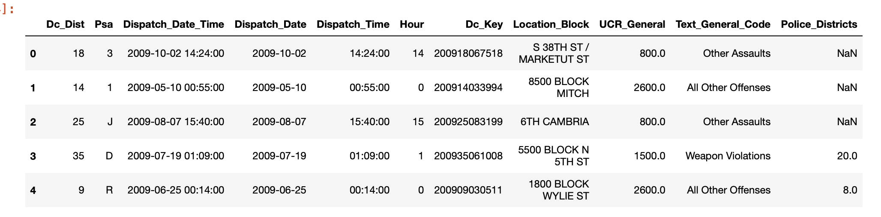
Sample Data Set

Slide 5
Intention
Once the model is trained and validated, we could use it to make predictions on new data by inputting the year, month, day, latitude, and longitude of a location, and getting the predicted type of offense in return.
This could help law enforcement agencies to allocate resources more effectively, such as by increasing police patrols in areas with high risk of crime, and help individuals to take precautions and avoid dangerous situations.

Slide 6
Approach
Data Collection
Data Preprocessing
EDA
Feature Engineering
Model Prediction

Slide 7
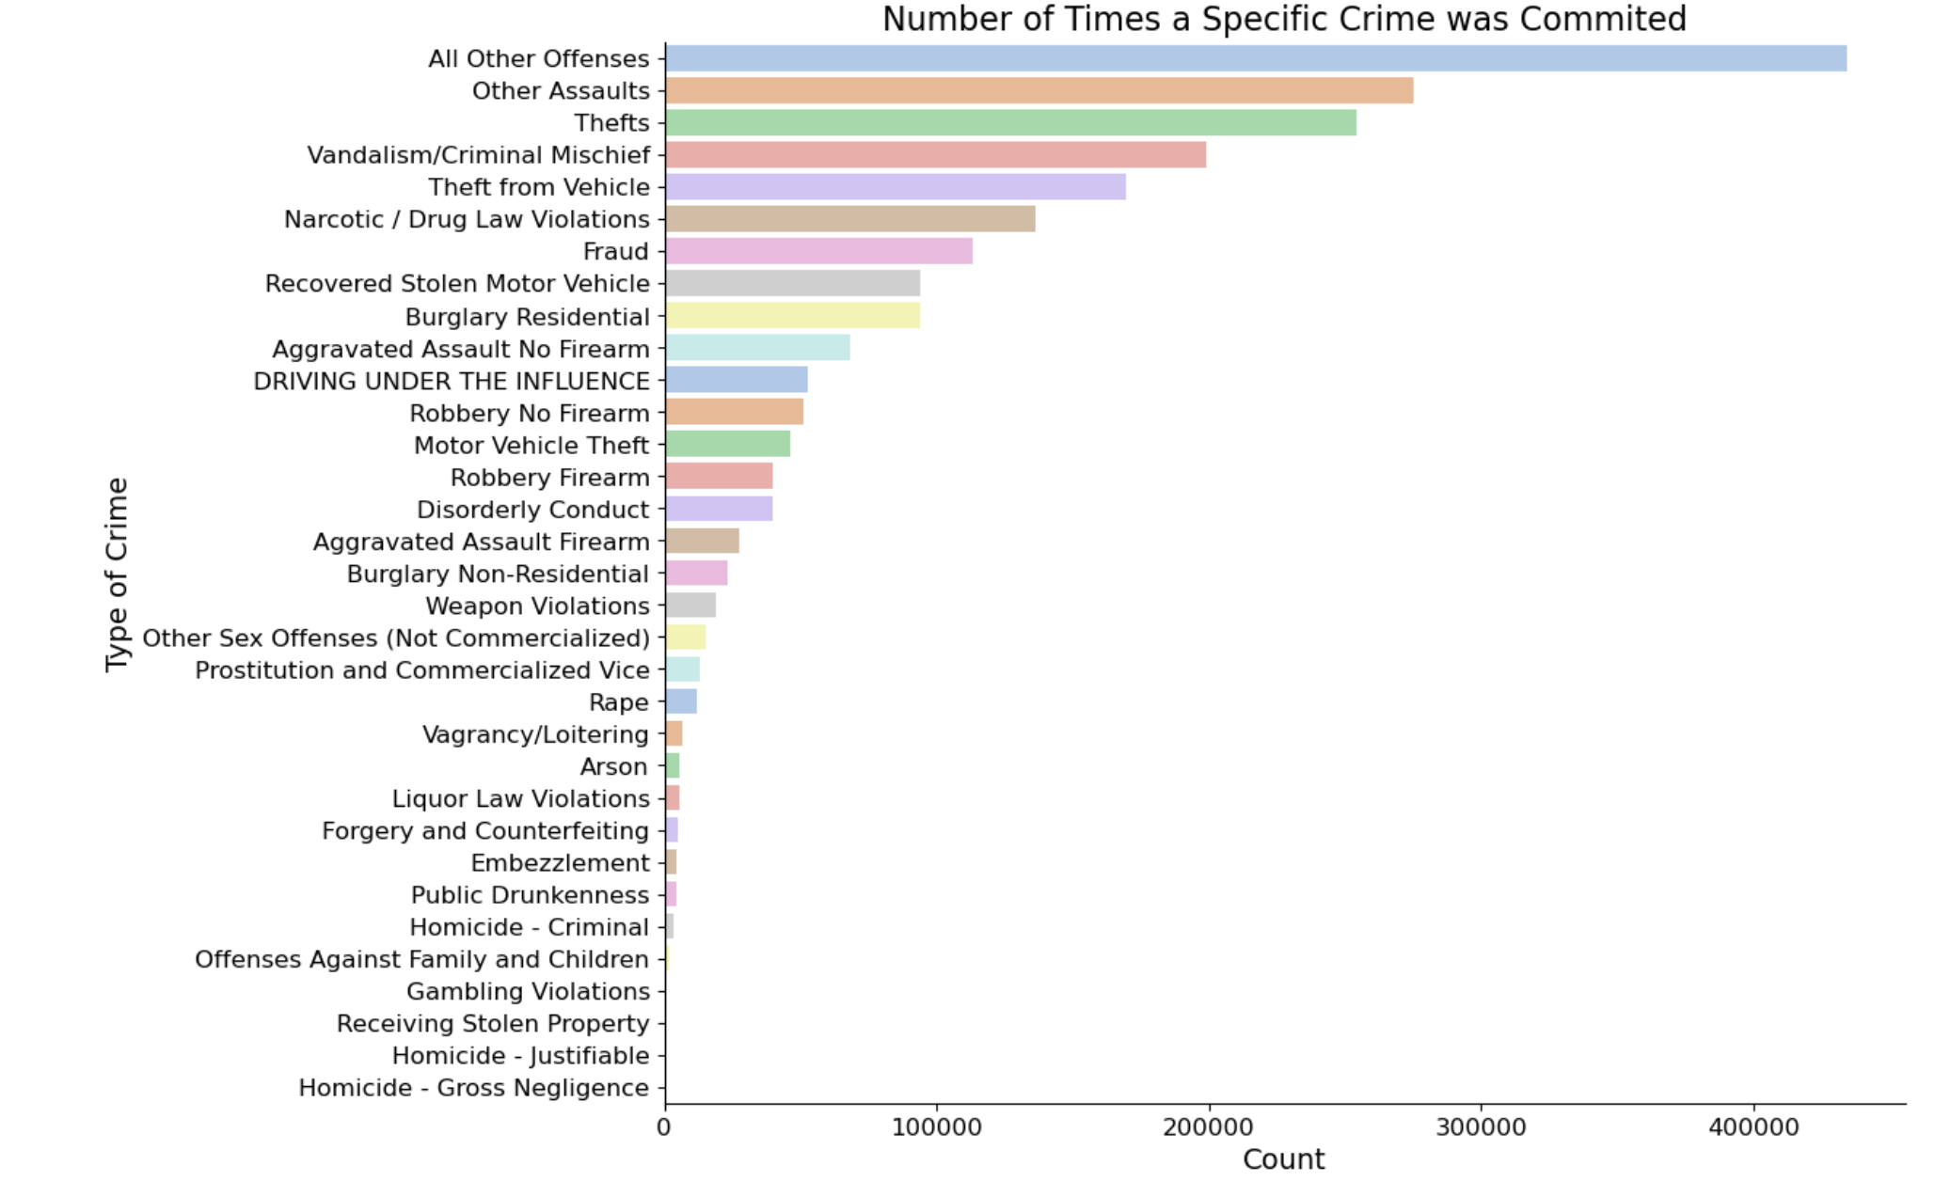
EDA

Slide 8
Machine Learning Models
LogisticRegression
DecisionTreeClassifier
RandomForestClassifier

Slide 9
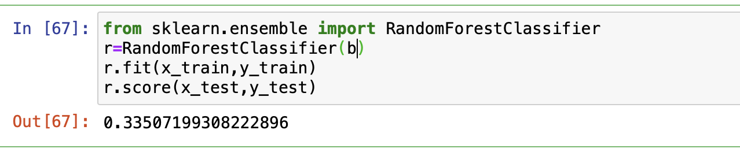
RandomForestClassifier

Slide 10
Limitations
The project is constrained by a limited number of features available to use for predicting machine learning models. This means that the models may not be able to fully capture the complexity of the underlying data and may therefore have reduced accuracy or predictive power.
The success of any machine learning model is highly dependent on the quality and quantity of features used in training the model, and with fewer features available, it may be difficult to achieve optimal performance.

Slide 11
Thank You

