Slide 1



Intro High Performance Deep Learning – October 30th 2026
GitHub: https://github.com/SURF-ML/HPML-course-materials
Trainer: Lars Veefkind
Machine Learning Advisor at SURF in HPML Team

Slide 2
Credit where credit is due
Slides stolen from:
SURF colleagues
                Caspar van Leeuwen
                Robert Jan Schlimbach
                Bryan Cardenas Guevara
PyTorch
CUDA/cuDNN

Slide 3
About EuroCC & EuroHPC JU
EuroHPC JU:
joint initiative between EU, EU member states, and private partners to develop a World Class Supercomputing Ecosystem in Europe
https://eurohpc-ju.europa.eu/
EuroCC
A key program in EuroHPC JU
EuroCC acts as gateway for industry and academia to find providers with suitable HPC expertise
EuroCC facilitates HPC-skill oriented trainings (like this one)

Slide 4
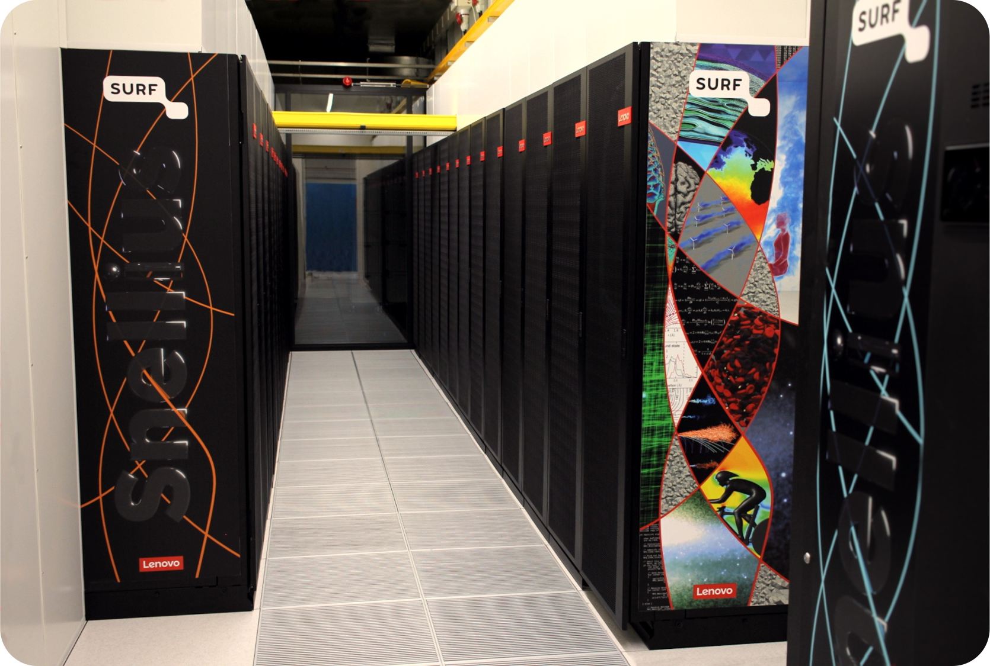
About SURF
Collaborative organization for ICT in Dutch education and research
National Competence Center in EuroCC for The Netherlands
Offers HPC services (and many others, data storage, cloud, networking, etc)

Slide 5
Course plan
Packed file formats for Machine Learning
Hardware (e.g. Tensor cores) and software features (e.g. low-level libraries for deep learning) for accelerated deep learning
Profiling PyTorch with TensorBoard
Bonus: Parallel computing for deep learning

Slide 6
Course plan
Welcome and course overview
Packed File Formats
Parallel computing for Deep Learning
Hardware and Software features to accelerate deep Learning
Break
Profiling
Questions

Slide 7
Course plan Day 2
9:30 – 10:45 Software installations on HPC systems
10:45 – 11:55 Coffee break
10:55 – 11:10 Packed file formats
11:10 – 11:30 Hands-on: Packed file formats
11:30 – 12:30 Keynote: Vlado Menkovski
12:30 – 13:15 Lunch Break
13:15 – 14:45 Hardware and software features to accelerate deep learning
14:45 – 15:00 Coffee Break
15:00 – 15:45 Parallel Computing for Deep Learning
15:45 – 16:45 Profiling to understand your neural network’s performance
16:45 – 17:00 Questions, wrap up

Slide 8
Logins
Access to the Dutch National Supercomputer (Snellius) for this course
Snellius Supercomputer (GPU-based Jupyter Notebook environment, GPU batch jobs)
  Did you get a login ‘scurXXX’?
  The e-mail contains a link to choose a password – please do so
  Log in to https://portal.cua.surf.nl/ and accept the End User Agreement
  Try to login at https://ondemand.snellius.surf.nl
Select “Jupyter”:
            Partition: gpu_course
            Select environment module version: course
            Memory: 16
            GPUs: 1
            Click “Launch”
If you did not receive a login, or starting a Jupyter session does not work: please let us know so we can resolve it during the first hands-on session.
Notes:
P

Slide 9
Logins
Access to Research Cloud for this course
Snellius Supercomputer (GPU-based Jupyter Notebook environment, GPU batch jobs)
  Did you get a login
  Try to login at https://coursemgr.advisorssrcdemo.src.surf-hosted.nl/
  Select “Jupyter”:
            Partition: gpu_course
            Cores: 2
            Memory: 4GB
            Partition: GPU shared, one of the 14 slices of a card
            Click “Launch”
If you did not receive a login, or starting a Jupyter session does not work: please let us know so we can resolve it during the first hands-on session.
Notes:
P

