Slide 1

Chapter yellow
HPC Filesystem & Packed Data Format
Lars Veefkind
High Performance Machine Learning

Slide 2
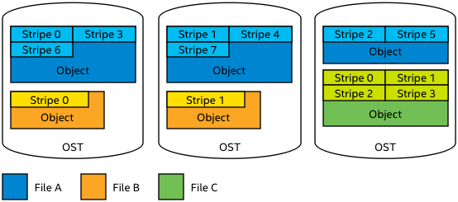
HPC File System
HPC systems typically use parallel shared file systems.
Parallel file system: one file can be distributed over many physical disks, to increase I/O bandwidth.

Slide 3
HPC File System
Two main types of parallel filesystems
Lustre
  Metadata (filename, size, location, etc) stored on separate server
  Object Storage Target (OST) stores actual file
  Striping over multiple OSTs can be managed by user
GPFS (Snellius)
  Metadata and actual file stored on the same server
  Striping is managed automatically, by file system. User has no control.

Slide 4
HPC File System
HPC file systems are optimized for bandwidth not I/O operations per second (IOPS)
E.g. Snellius GPFS: up to 10 GB/s write, 20 GB/s read
Important when e.g. a 100 node job needs to start from the same 20 GB input file…
HPC file systems are typically not good at AI / data science workloads
AI workloads are generally: reading lots of small files / parts of a file

Slide 5
HPC File System
An inode stores all information about a linux file except its name and data
  File size, last change date, file permissions, etc
On most HPC systems, you’ll have an inode quota, in addition to a size quota
  Like total size, each filesystem has a (fixed) maximum number of inodes
  It is also a way to discourage doing to many IOPS

Slide 6
HPC File System
An inode stores all information about a linux file except its name and data
  File size, last change date, file permissions, etc
On most HPC systems, you’ll have an inode quota, in addition to a size quota
  Like total size, each filesystem has a (fixed) maximum number of inodes
  It is also a way to discourage doing to many IOPS
Seems we’ll run out of inodes before we run out of space on e.g. our home1 filesystem:
$ df -ih /gpfs/home1/
Filesystem Inodes IUsed IFree IUse% Mounted on
home1 287M 161M 126M 57% /gpfs/home1
$ df -h /gpfs/home1/
Filesystem Size Used Avail Use% Mounted on
home1 121T 62T 59T 52% /gpfs/home1

Slide 7
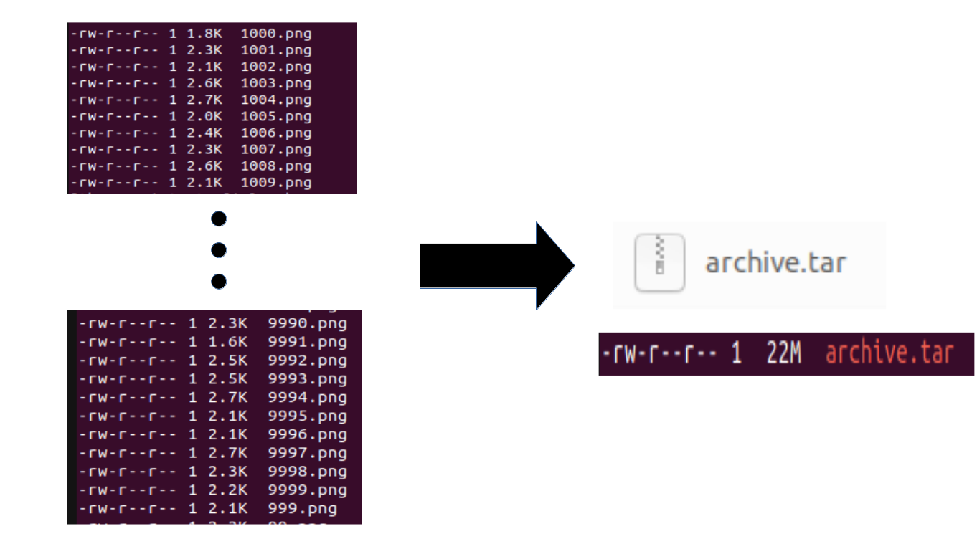
HPC File System
Suppose your dataset is 10k png files of 2k each…
Home1: 121TB, 287M inodes, so 421k per inode
  If everyone does this, the filesystem will be full of inodes, with 99.5% / 120 TB (!) storage still available…

Slide 8
HPC File System
Suppose your dataset is 10k png files of 2k each…
Home1: 121TB, 287M inodes, so 421k per inode
  If everyone does this, the filesystem will be full of inodes, with 99.5% / 120 TB (!) storage still available…
If you run 100 epochs, you’ll do 1M I/O operations
  Your sysadmin won’t like you
  Your fellow users won’t like you: everyone suffers slow I/O because of your job!
  You shouldn’t like you: your I/O might be holding back your training performance…

Slide 9
Packed Data Format
What is a ‘packed data format’?
Group multiple individual files together in a single ‘packed’/archive file

Slide 10
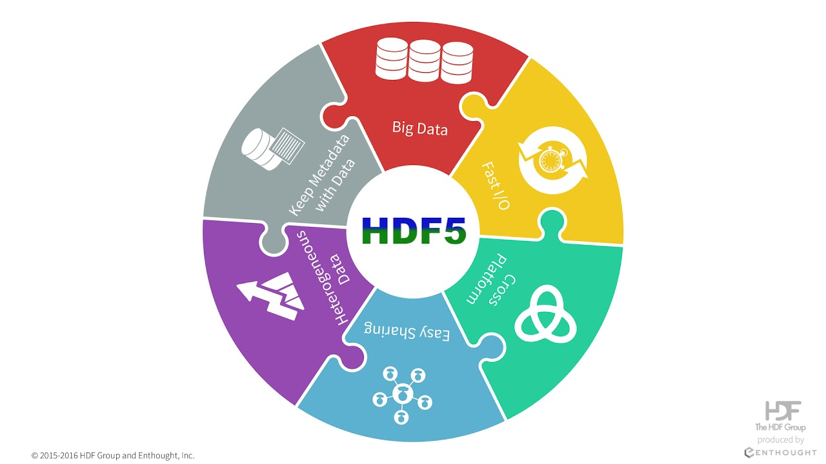
Packed Data Format
What is a ‘packed data format’?
Group multiple individual files together in a single ‘packed’/archive file
Examples of packed data formats → ZIP, TAR, LMDB, HDF5, PARQUET, zarr, etc.
Does not necessarily involve compression!
  Compression is possible, but often runs on single process, so can be slow to decompress

Slide 11
Packed Data Format
What is a ‘packed data format’?
Group multiple individual files together in a single ‘packed’/archive file
Examples of packed data formats → ZIP, TAR, LMDB, HDF5, PARQUET, etc.
Does not necessarily involve compression!
  Compression is possible, but often runs on single process, so slow to decompress
Why packed data format
HPC systems use a shared filesystem. Packed data formats…
Reduces inode consumption
Reduces number of I/O operations/s
  Reduces slowdown for yourself and other users
https://servicedesk.surf.nl/wiki/spaces/WIKI/pages/56295498/Best+Practice+for+Data+Formats+in+Deep+Learning

Slide 12
Local Scratch Disks
Some HPC systems have local disks in the nodes
On Snellius, these can be requested by adding
#SBATCH –constraint=scratch-node to your batch script
  Note: about half of our A100 and ¼ of our H100 nodes (currently reserved) have local scratch disk. You might be in the queue longer if you request scratch-node, so only do it if you think you benefit from it
  H100s have 7TB, A100 5.6TB of local scratch

Slide 13
Local Scratch Disks
Some HPC systems have local disks in the nodes
On Snellius, these can be requested by adding
#SBATCH –constraint=scratch-node to your batch script
  Note: about half of our A100 and ¼ of our H100 nodes (currently reserved) have local scratch disk. You might be in the queue longer if you request scratch-node, so only do it if you think you benefit from it
  H100s have 7TB, A100 5.6TB of local scratch
Local scratch disks can usually handle much more IOPs
Local scratch disks are shared between all users in a node
  Users on the same node may still experience some effects when you ‘hammer’ local scratch with I/O, but it’s way less bad than on a shared filesystem!

Slide 14
Local Scratch Disks
Some HPC systems have local disks in the nodes
If you really need to use individual files instead of a packed file format, use local scratch disks in the following way:
Store zip/tar on shared parallel Filesystem.
At start of job: extract to local scratch dir (for every node, if you use multiple)
Do any further I/O from that local scratch dir

Slide 15
Local RAM Disks
All Snellius nodes have system RAM (duhh)
You can access this as a ramdisk in /dev/shm (shared memory)
RAM is extremely fast (bandwidth & IO)
  +- 25GB/s (A100) to 38GB/s
  Orders of magnitude better IOPS
If your data fits on RAM, there is no reason not to load your data there before training
  H100: 768GB/node, 192GB/GPU
  A100: 512GB/node, 128GB/GPU
Store zip/tar on shared parallel Filesystem.
At start of job: extract to /dev/shm (for every node, if you use multiple)
Do any further I/O from /dev/shm

Slide 16
Want to learn more?
More info https://servicedesk.surf.nl/wiki/display/WIKI/Best+Practice+for+Data+Formats+in+Deep+Learning
https://github.com/sara-nl/Packed-Data-Formats

Slide 17
Using and benchmarking a packed file format dataloader
DEMO

