Slide 1
Parallel computing for Deep Learning
Content
benefits of parallellization
parallellization strategies
Hands-on: hyperparameter grid search on an HPC system
parallel stochastic gradient descent (SGD)
synchronous parallel SGD
communication backends
frameworks for distributed deep learning
documentation of distributed DL frameworks

Slide 2
Parallel computing for Deep Learning
Goal: understand the documentation of distributed DL frameworks.
From TensorFlow docs on “distribution strategy”:
“tf.distribute.Strategy intends to cover a number of use cases along different axes… Synchronous vs asynchronous training: These are two common ways of distributing training with data parallelism. In sync training, all workers train over different slices of input data in sync, and aggregating gradients at each step. In async training, all workers are independently training over the input data and updating variables asynchronously. Typically sync training is supported via all-reduce and async through parameter server architecture.”
“MultiWorkerMirroredStrategy currently allows you to choose between two different implementations of collective ops. CollectiveCommunication.RING implements ring-based collectives using gRPC as the communication layer. CollectiveCommunication.NCCL uses Nvidia's NCCL to implement collectives.”

Slide 3
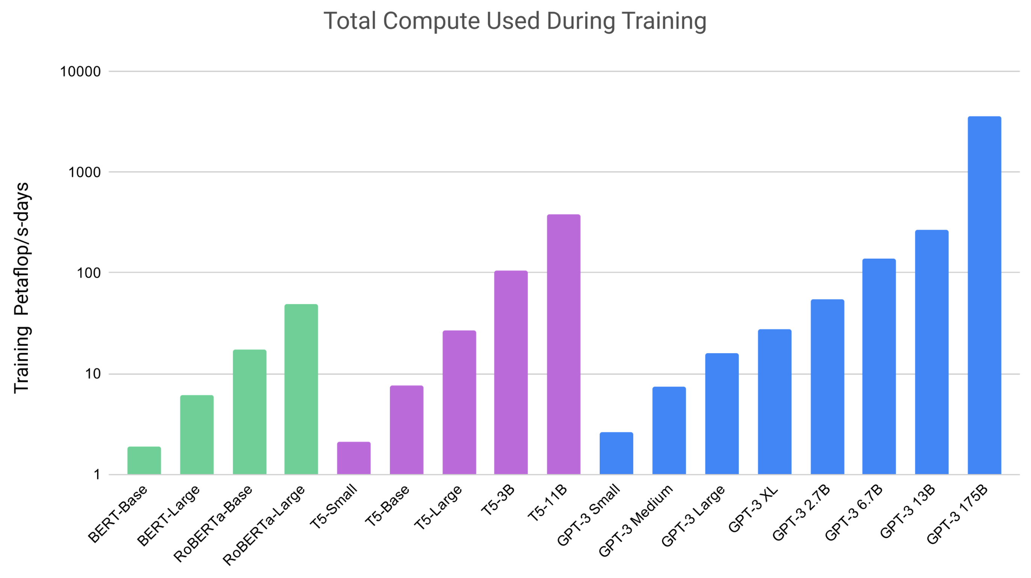
Parallelization: why?
5 years @ 1 A100 GPU

Slide 4
Parallelization: why?
Faster trainings …
Enables learning on larger datasets
Enables improved accuracy through better hyperparemeter tuning
Enables larger, more complex models
…

Slide 5
Parallelization: when?
Large
Radboud UMC
Histopathology
100Kx200K
100GB
Oil-Gas
Seismic Images (>4K^3)
10GB
MaxPlanck
MS-D CNN (BS=1), Inference, 2304x1280x1024)
Input Size
1GB
Netherlands Cancer Inst (NKI): P-GANS, (BS=1)
500x500x500
100MB
DellEMC, AI Radiologist: ResNet-59, (BS=64)
896x896
Novartis:
M-CNN, (BS=8), 1280x1024
DellEMC, AI Radiologist: AmoebaNet(2,512), (BS=64),
480x480
10MB
Model + Activations Memory
Small
10GB
Large
100MB
1GB
CERN: 3D-GANs, (BS=128), 25x25x25
100GB
1000GB
10TB
BENCHMARKS
MLPerf, others
RNet-50
DellEMC:
Transformer-LT Big (Eng-Ger),(BS=64)
BS=6
1MB
Benchmark
ImageNet: 224x224
VGG-16
GoogleNet
GENCI/CINES:
Pl@ntNet, (BS=16),
224x224
Google: Transformer-LT
Eng-French, (BS-64)
5.9B Parameters; Mem-Est
RNet-101
0.1MB
Inception-v3
Source: Kushal Datta & Vikram Saletore, AIPG, Intel
Small

Slide 6
Parallelization: the basics
What is parallel computing?
Multiple processors or computers working on a single computational problem

Slide 7
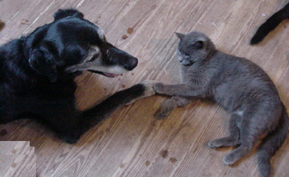

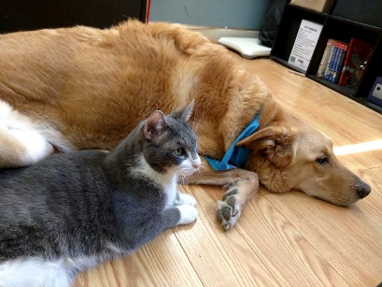





Parallelization: the basics
Serial computing
Data
Output
Apply filter()
Processor

Slide 8




Parallelization: the basics
Parallel computing
Data
Output
Apply filter()
Processor
Apply filter()
Processor
Apply filter()
Processor
Apply filter()
Processor

Slide 9
Parallelization: the basics
Benefits:
Solve computationally intensive problems (speedup)
Solve problems that don’t fit a single memory (multiple computers)
Requirements:
Problem should be divisible in smaller tasks

Slide 10
Types of parallelization
What types of parallelization exist?
Instruction level parallelism
Embarrassingly parallel
Data parallel
Model parallel:
        Pipeline parallel
        Sequence parallel
        Expert parallel
        Tensor parallel
Hybrid data/model parallelism
Increasing complexity/bandwidth

Slide 11
Types of parallelization
Instruction level parallelism
  Executing multiple instructions (e.g. additions) in parallel
  Examples: vector instructions (CPU), Tensor Cores (GPU)
  https://en.wikipedia.org/wiki/Instruction-level_parallelism
X =
1.1 | 3.7 | -1.6 | 2.3
+
=
-2.3 | 5.4 | -1.8 | 7.5
Y =
-3.4 | 1.7 | -0.2 | 5.2

Slide 12
Types of parallelization
Embarrassingly parallel
  A workload or problem where little or no effort is needed to separate into number of parallel tasks
  Examples: hyperparameter grid search, training multiple model architectures
  https://en.wikipedia.org/wiki/Embarrassingly_parallel

Slide 13
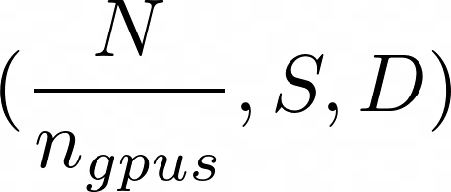
Data Parallelism
Train a single model, single set of hyperparameters, but faster
Split the batch over multiple processors (CPUs/GPUs)
Each processor holds a copy of the model
Forward pass: calculated by each of the workers
Backward pass: gradients computed (per worker), communicated and aggregated
Effective batch size is a multiple of the number of workers
Processor 1
Processor 2

Slide 14
Model parallelism
Train a single very big model, single set of hyperparameters
Split the model over multiple processors (CPUs/GPUs or a hybrid)
Each processor sees all the data
Communication needed both during forward and backward pass!
Processor 1
Processor 2

Slide 15
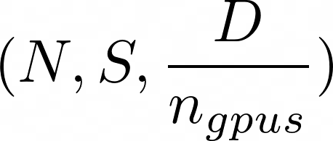
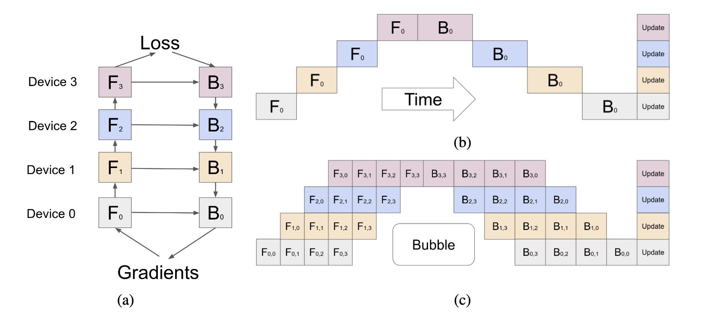
Model parallelism: Pipeline parallelism
Model parallelism, executed in a pipelined fashion over multiple micro-batches (data parallelism).
More efficient than model parallelism: hides communication with computation
See https://pytorch.org/docs/stable/distributed.pipelining.html
Huang et al. (2019, arXiv:1811.06965)

Slide 16
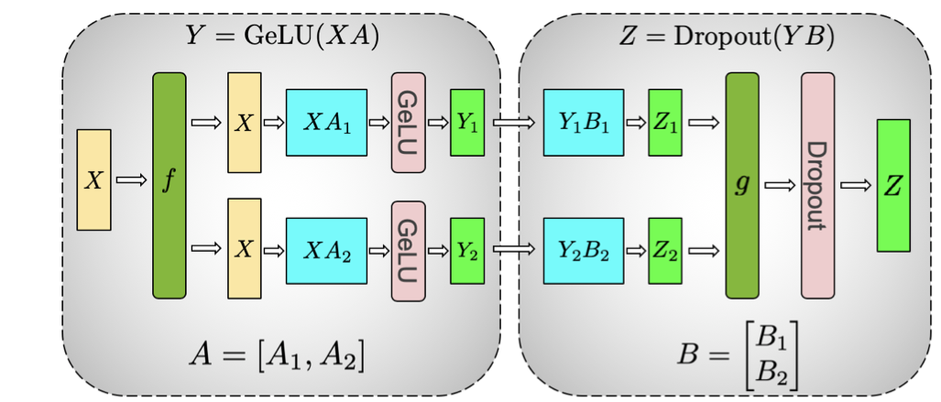
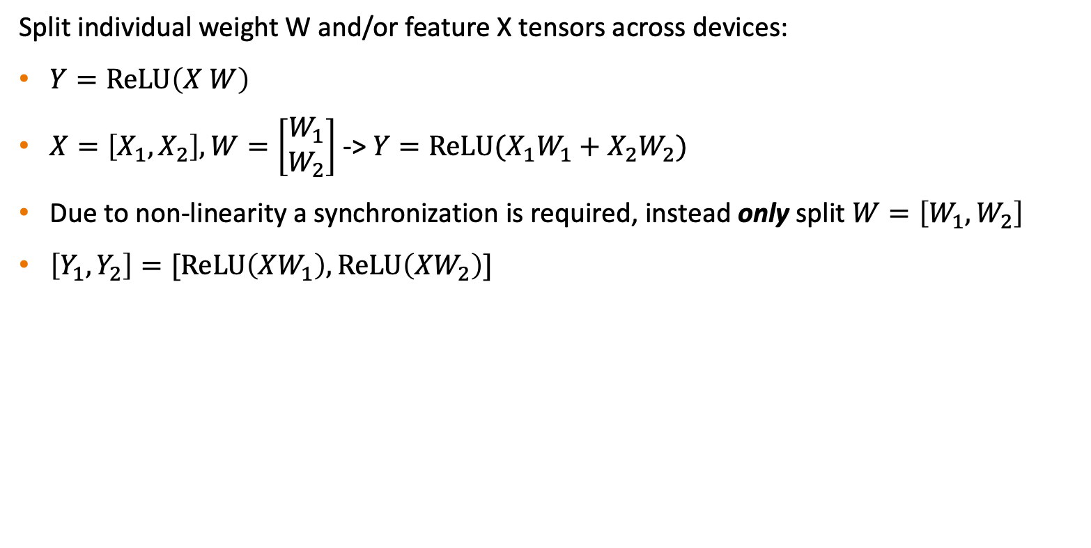
Model parallelism: Tensor parallelism
Split individual weight W and/or feature X tensors across devices:
$Y=ReLU\left(X W\right)$
$X=\left[X_{1}, X_{2}\right], W=\left[\begin{aligned}W_{1} \\ W_{2}\end{aligned}\right]$ -> $Y=ReLU(X_{1}W_{1}+X_{2}W_{2})$
Due to non-linearity a synchronization is required, instead only split $W=\left[W_{1}, W_{2}\right]$
$\left[Y_{1}, Y_{2}\right]=[ReLU\left(XW_{1}\right),ReLU\left(XW_{2}\right)]$
https://arxiv.org/pdf/1909.08053

Slide 17
Model parallelism: Tensor parallelism
Split individual weight W and/or feature X tensors across devices:
No more bubbles
Less tuning required
Very heavy communication (network) requirements
Extention: sequence parallel:
  extend tensor parallelism also over other ops: LayerNorm/dropout
https://arxiv.org/pdf/1909.08053

Slide 18
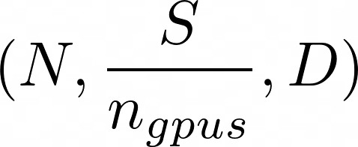
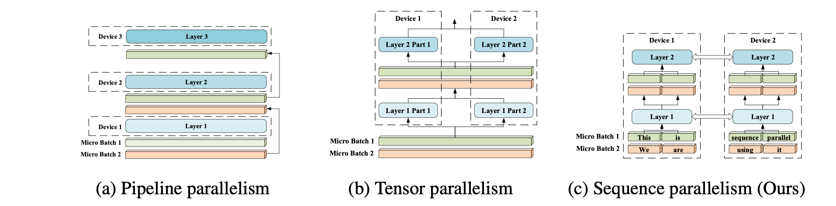
Model parallelism: Context parallel (also “sequence parallel”)
Split longer sequences (e.g. sentences) across devices.
Activation memory scales with S/n_gpus, enabling much longer sequences
Mostly abandonded due to improvements in tensor parallel
Confusingly also called sequence parallel
Li, Shenggui, et al. arXiv preprint:2105.13120 (2021).

Slide 19
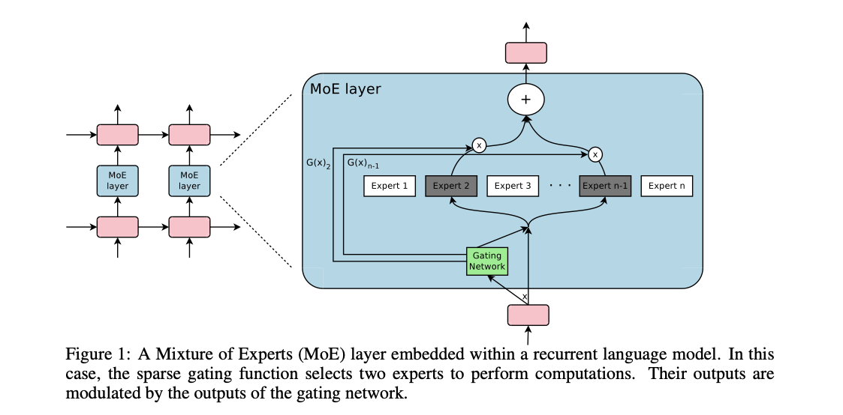
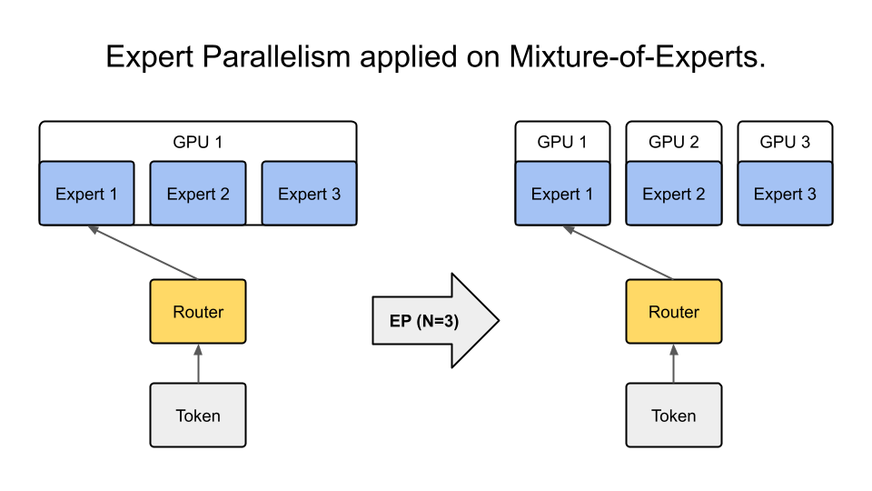
Model parallelism: Expert Parallelism
MoE (Mixture of Expert Models)
Parallelize experts over GPUs
Scales with network, not compute
Unpredictable network traffic
Source: Shazeer, Noam, et al. arXiv preprint arXiv:1701.06538 (2017).

Slide 20
Hybrid model/data parallelism
Processor 1
Processor 2
Processor 3
Processor 4

Slide 21
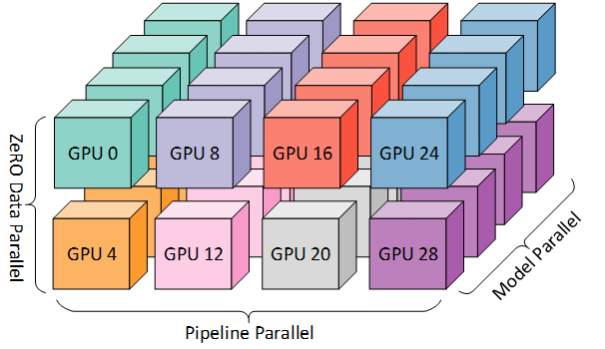
3D Parallelism
Combined Data, Pipeline, Tensor Parallel
4D: including Context parallel
5D: Including Expert parallelism
ND grid of devices
Each dimension deals with its own parallelization type
Physical location of GPUs with respect to each other matters
For example:
Tensor parallel between GPUs in node
Pipeline parallel between nodes
Data parallel between racks

Slide 22
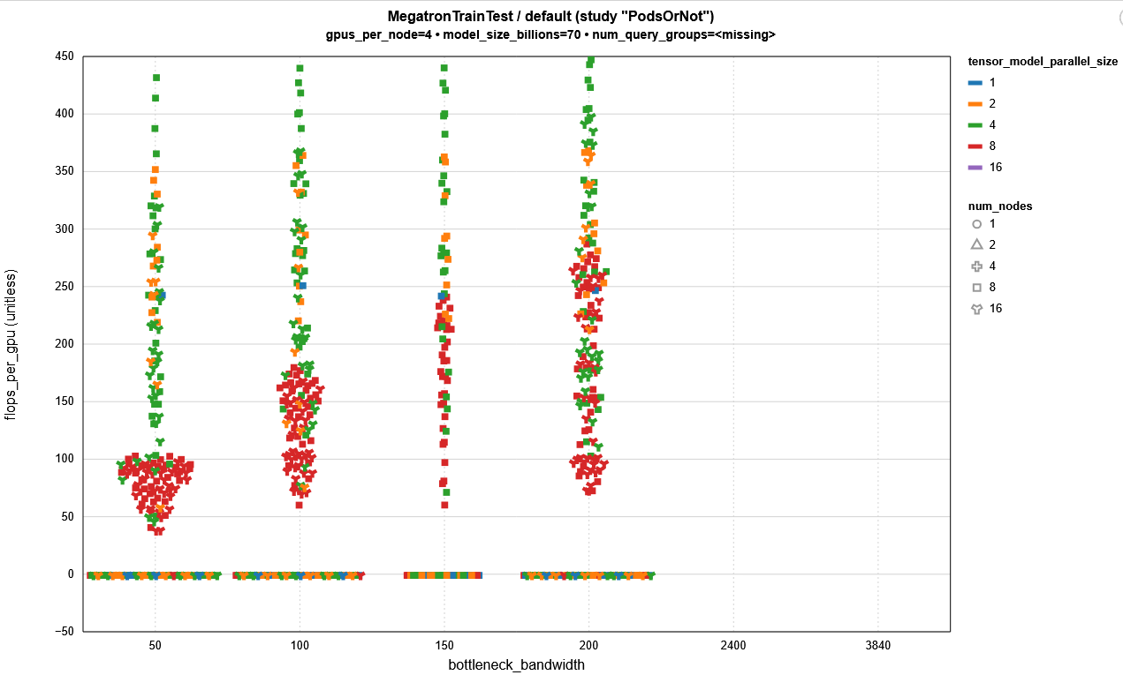

TP=4 (TP=tensor parallel) Not bottlenecked by network
TFLOPs per GPU.
TP=8 (so outside the node) clearly scaling
with network bandwidth.
Lost performance fraction
~0.45, implying in a best case at least ~400Gbps
needed per GPU to not be bottlenecked by Network,
Probably more like
~600-800Gbps per GPU
due to Amdahl’s law (not taking into account TP=8 may scale above TP=4)
- TP=4 better than TP=2, implying TP=8 may be better than TP=4 given enough bandwidth
Out of memory runs register as -1.
Different levels of GPU>GPU speed (in Gbps)

Slide 23
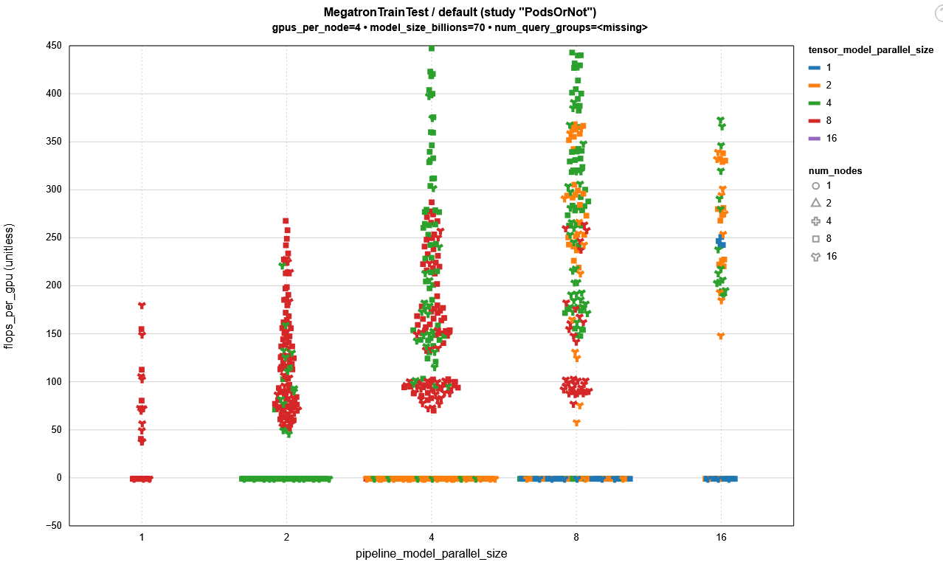
Flipping to PP (pipeline parallel) view:
TP=4 Still dominates performant codes
Again implying that TP=8 may be better given enough bandwidth

Slide 24
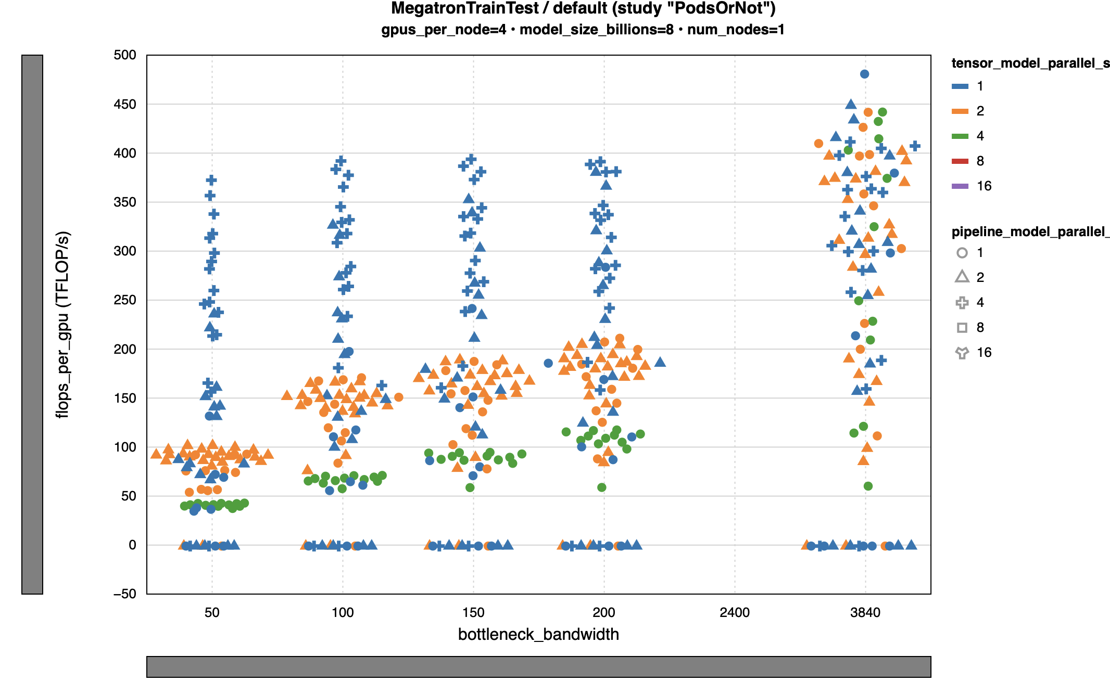
Using single node training we can show this scaling indeed continues

Slide 25
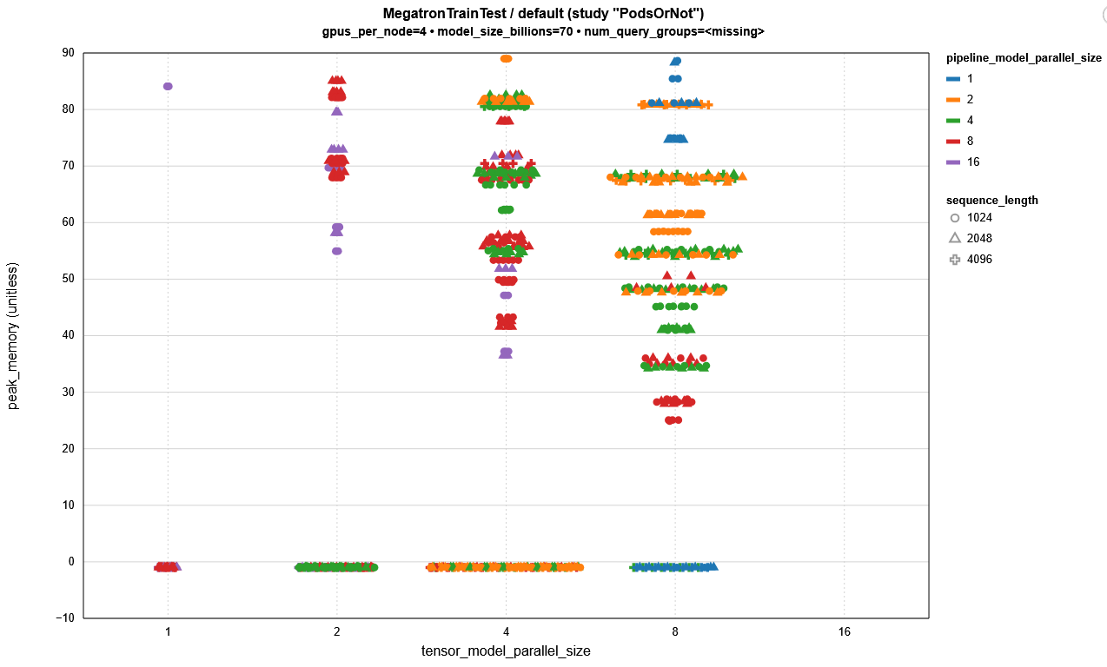
FLOPS efficiency scale with memory util
TP and PP decrease
memory util enabling scaling in model size and input size
TP typically decreases memory consumption more than PP…

Slide 26
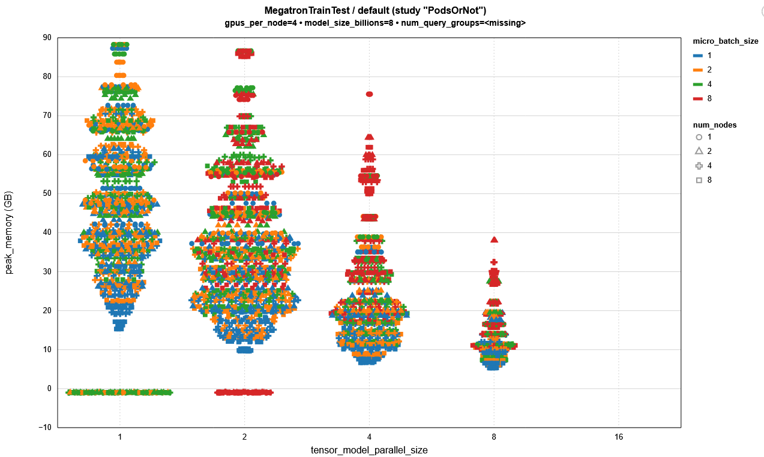






Underutilization
Of memory.
Performance of TP>=4 might have been even better with larger batch size/sequence length

Slide 27
What type of parallelism is applicable? Ease-of-implementation
Multiple (independent) training runs => Embarrassingly parallel
Single model takes too long too train => Data parallel
Single model is too big for memory?
  Within a node with fast GPU2GPU (e.g., Nvlink)? => Tensor or expert parallel
  Between nodes? => Pipeline, Expert, Sequence or Expert if required
Single model is too big for memory and takes too long to train => Hybrid parallelism
  All of the well-known, big models (GPT-X) are trained this way

Slide 28
What type of parallelism is applicable? Ease-of-implementation
Multiple (independent) training runs => Embarrassingly parallel
Single model takes too long too train => Data parallel
Single model is too big for memory?
  Within a node with fast GPU2GPU (e.g., Nvlink)? => Tensor or expert parallel
  Between nodes? => Pipeline, Expert, Sequence or Expert if required
Single model is too big for memory and takes too long to train => Hybrid parallelism
  All of the well-known, big models (GPT-X) are trained this way
Any cluster will do, no fast network needed

Slide 29
What type of parallelism is applicable? Ease-of-implementation
Multiple (independent) training runs => Embarrassingly parallel
Single model takes too long too train => Data parallel
Single model is too big for memory?
  Within a node with fast GPU2GPU (e.g., Nvlink)? => Tensor or expert parallel
  Between nodes? => Pipeline, Expert, Sequence or Expert if required
Single model is too big for memory and takes too long to train => Hybrid parallelism
  All of the well-known, big models (GPT-X) are trained this way
HPC cluster needed, i.e. with fast network and fast connections between e.g. GPUs in a single node

Slide 30
So….. What type of parallelization? Optimal performance
Data parallel (DP)
Easy to set-up.
Relatively infrequent and low-bandwidth communication (only once per forward/backwards)
Model is copied to each device, so redundancy in memory that might hamper efficiency
FSDP (fully sharded DP) partially solves this by sharding the model and retrieving the weights for a layer just-in-time. Requires more communication.
Pipeline parallel
Complicated to set-up, lots of tuning to avoid bubbles
Moderate communication (after each block of layers)
Significant memory reduction by splitting model and batches over devices
Tensor/Expert/Context parallel
More involved than DP to set-up but does not suffer from bubbles. Computationally very efficient.
Very high bandwidth requirement
Significant memory reduction. Typically even more than pipeline

Slide 31
Do I need to parallelise?
Consider alternatives:
Model pruning
Use different hardware architecture
Reduced precision datatypes
Low rank fine-tuning (LoRA/QLoRA)
Quantization (inference)

Slide 32
Parallelization tools/wrappers
torch.distributed: https://pytorch.org/docs/stable/distributed.html
tf.distribute: https://www.tensorflow.org/guide/distributed_training
Data parallel:
PyTorch Distributed Data Parallel (DDP)
Model parallel:
DeepSpeed ZeRO
Torch FullyShardedDataParallel (FSDP): https://pytorch.org/docs/stable/fsdp.html
Wrapper of ZeRO-3
Huggingface’s accelerate: https://huggingface.co/docs/transformers/main/en/accelerate
Megatron-LM (training): https://github.com/NVIDIA/Megatron-LM vLLM (inference): https://vllm.ai
  Abstracts the implementation details away
ZeRO-1: Partition optimizer state
ZeRO-2: Partition gradients
ZeRO-3: Partition Model Weights

Slide 33
Hands-on: hyperparameter grid search on an HPC system
…

Slide 34
Data parallel Stochastic Gradient Descent
Most networks are trained using stochastic gradient descent (SGD)
Distributed stochastic gradient can be done using Synchronous SGD

Slide 35
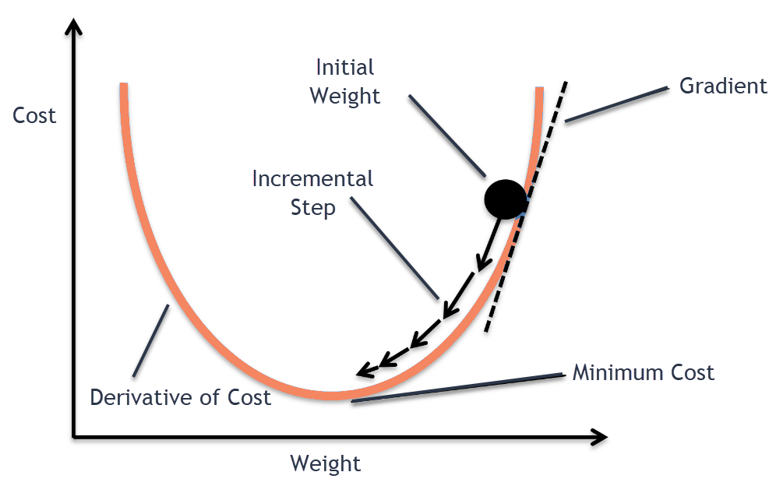
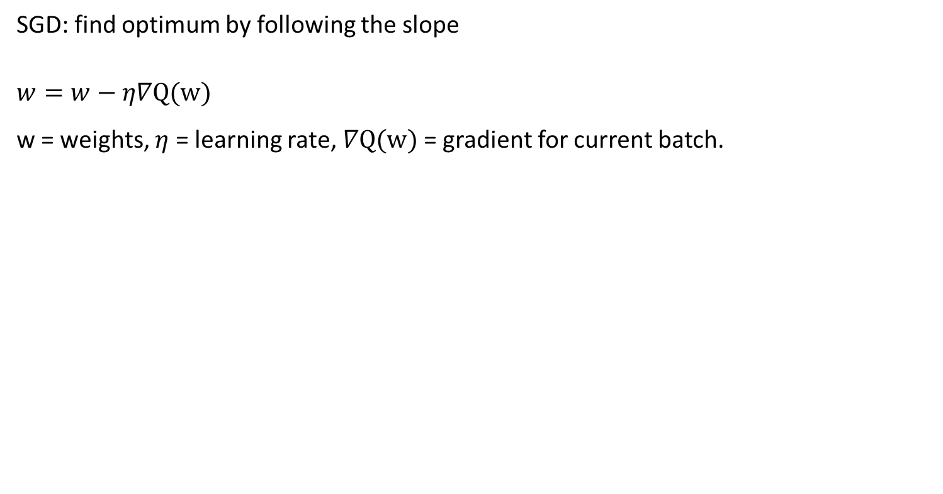
Stochastic gradient descent (SGD)
SGD: find optimum by following the slope
$$w=w−η∇Q(w)$$
w = weights, $η$ = learning rate,$∇Q(w)$ = gradient for current batch.
$$W_{1}$$
$$W_{2}$$
$$W_{3}$$

Slide 36

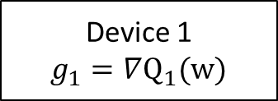

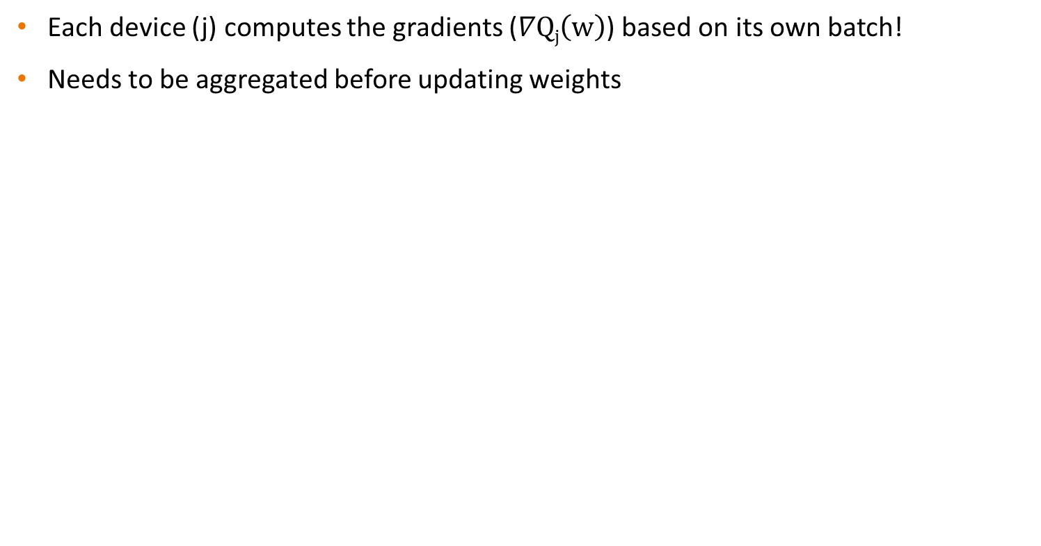
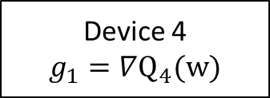
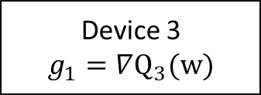
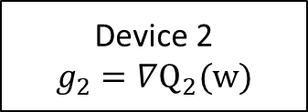
Data parallel Synchronous SGD
Each device (j) computes the gradients ($∇Qj\left(w\right)$) based on its own batch!
Needs to be aggregated before updating weights
Device 1
$$g_{1}=∇Q_{1}(w)$$
Device 2
$$g_{2}=∇Q_{2}(w)$$
Device 3
$$g_{1}=∇Q_{3}(w)$$
Device 4
$$g_{1}=∇Q_{4}(w)$$
$$∇Q\left(w\right)=\sum_{j}{∇Qj\left(w\right)}$$
$$w=w−η∇Q(w)$$

Slide 37
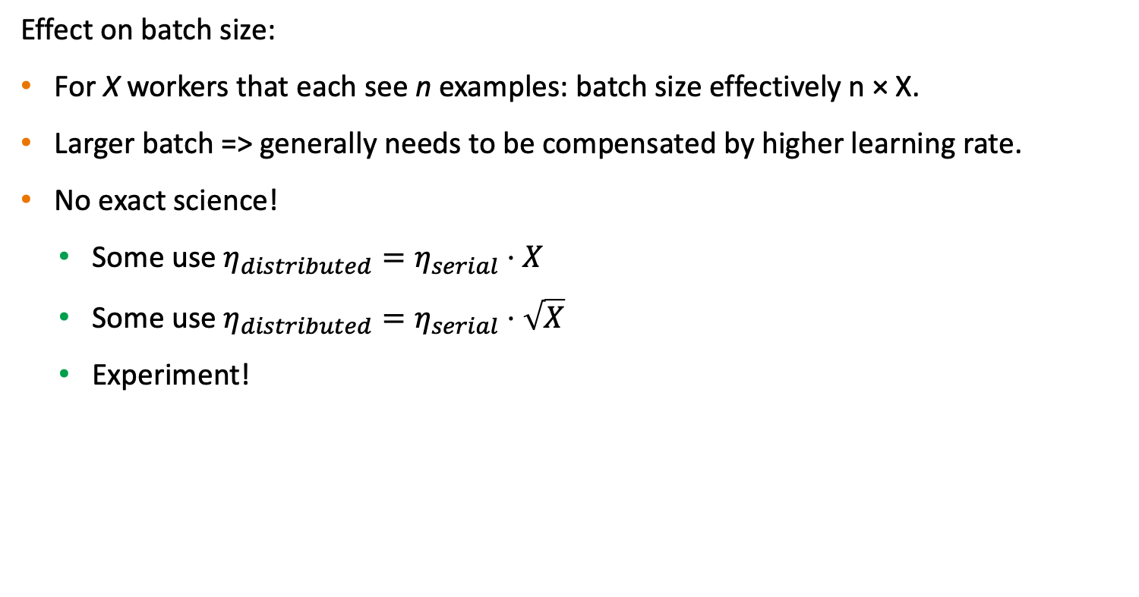
Data parallel Synchronous SGD
Effect on batch size:
For X workers that each see n examples: batch size effectively n × X.
Larger batch => generally needs to be compensated by higher learning rate.
No exact science!
  Some use $η_{distributed}=η_{serial}⋅X$
  Some use $η_{distributed}=η_{serial}⋅\sqrt{X}$
  Experiment!

Slide 38
Data parallel Synchronous SGD
Pro tip:
- Overlap communication and computation (don’t waste compute cycles waiting for communication!)
- Most (distributed) DL frameworks already take care of this for you ☺
A different view…
Time
Synchronization
barrier
Pro tip 2:
Penalty for synchronous SGD: you have to wait for the slowest worker, before next iteration.
Make sure all workers are equally fast!
Worker 1
N
N-1
…
1
N
N-1
…
1
N
N-1
…
1
Forward pass
Worker 2
N
N-1
…
1
N
Backward pass,
compute gradient of layer N
N
Backward pass,
communicate gradient N
Wait

Slide 39









Decentralized data parallel Synchronous SGD
Gradients are communicated and aggregated by all workers
$$∇Q1+∇Q2+∇Q3$$
$$∇Q1+∇Q2+∇Q3$$
$$∇Q1$$
Worker 1
Worker 2
$$∇Q2$$
$$∇Q3$$
$$∇Q3$$
$$∇Q1$$
$$∇Q2$$
Worker 3
$$∇Q1+∇Q2+∇Q3$$

Slide 40







Centralized data parallel Synchronous SGD
There is also an alternative, where a parameter server is used to aggregate the gradients, and distribute the updated model:
Worker 1
Worker 2
$$w$$
$$w$$
$$∇Q1$$
$$∇Q2$$
Parameter server
$$∇Q1+∇Q2+∇Q3$$
$$w$$
$$∇Q3$$
Worker 3

Slide 41
Centralized vs decentralized
Centralized approach can be difficult to scale: parameter servers create a communication bottleneck
More info, see e.g. https://arxiv.org/pdf/1705.09056.pdf

Slide 42
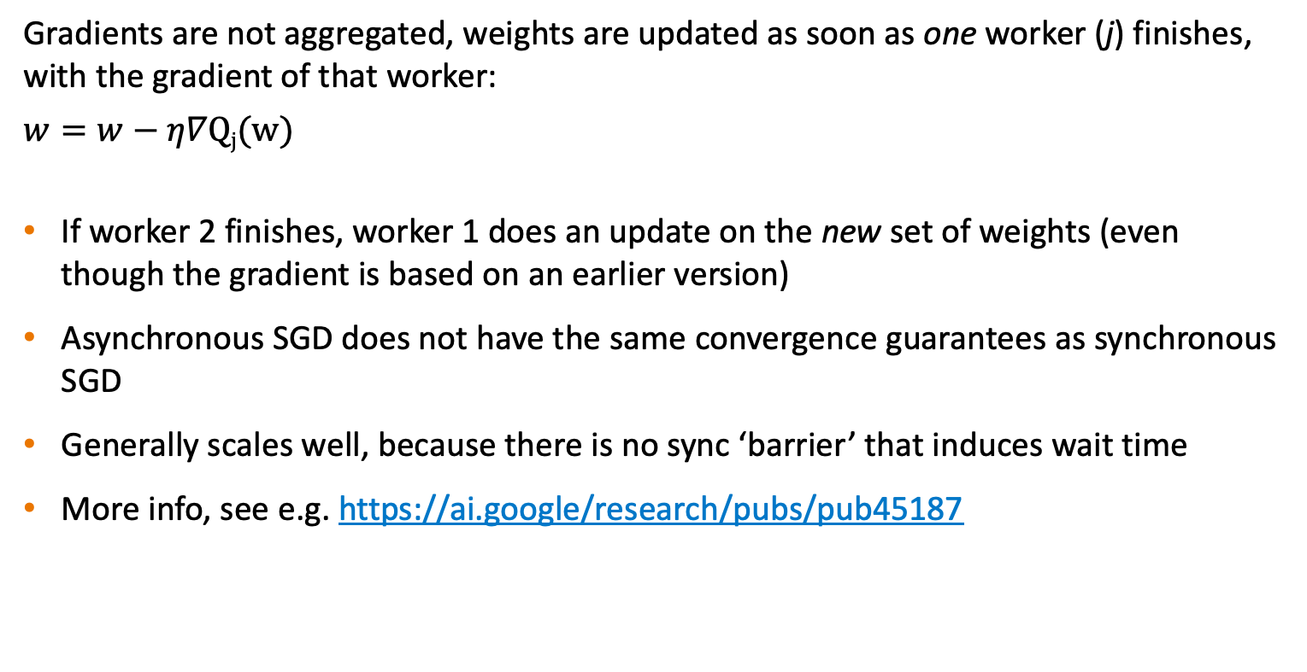
Data parallel asynchronous SGD
Gradients are not aggregated, weights are updated as soon as one worker (j) finishes, with the gradient of that worker:
$$w=w−η∇Qj(w)$$
If worker 2 finishes, worker 1 does an update on the new set of weights (even though the gradient is based on an earlier version)
Asynchronous SGD does not have the same convergence guarantees as synchronous SGD
Generally scales well, because there is no sync ‘barrier’ that induces wait time
More info, see e.g. https://ai.google/research/pubs/pub45187

Slide 43
Data parallel asynchronous SGD
Time
Worker 1
1
N
N-1
…
1
2
N
N-1
…
1
N
N-1
…
1
N
N-1
…
1
Parameter server
M₁
M₂
M₃
M₄
N
N-1
…
1
N
N-1
…
1
Worker 2
1
N
N-1
…
1
2
N
N-1
…
1
i
Forward pass, iteration i
M_{j}
Model state, update j
N
Backward pass, compute gradient of layer N
N
Backward pass, communicate gradient N

Slide 44
Data parallel SGD
Word of warning:
Data parallel asynchronous SGD is an active area of research
Data parallel synchronous SGD is well understood and is currently the accepted and advised approach

Slide 45
Communicating gradients…
… but how do distributed deep learning frameworks aggregate their gradients/outputs in such parallel set-ups?

Slide 46
A bit of history
‘Traditionally’ a lot of machine learning was not done in an HPC context. As a result:
Most frameworks had little focus on distributed learning
Most frameworks that offered distributed learning were based on parameter servers
Most AI experts probably never heard of MPI (Message Passing Interface)...

Slide 47
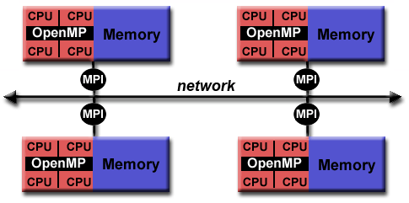
The Message Passing Interface (MPI)
MPI is a standard for parallelization on a distributed memory system
Distributed memory system: processors can’t access each other’s memory
Explicit communication (over a network) is required between one memory and another to work on the same task
MPI is the ‘language’ of this communication
MPI is the de facto standard for traditional HPC applications

Slide 48
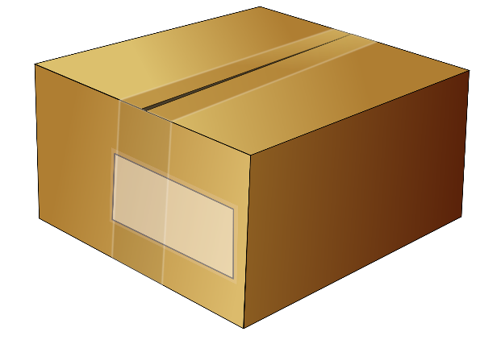
The Message Passing Interface (MPI)
MPI has routines to send data between individual workers…
From: Node 0
To: Node 1

Slide 49
The Message Passing Interface (MPI)
But also to broadcast data to other workers…
From: Node 0
To: everyone

Slide 50
The Message Passing Interface (MPI)
And most importantly (for deep learning): apply collective operations, such as ‘allreduce’. This operation is widely used in distributed deep learning to aggregate gradients!
P0
A
B
C
D
P0
A+B+C+D
A+B+C+D
A+B+C+D
A+B+C+D
P1
AllReduce
P1
P2
P2
P3
P3

Slide 51
The Message Passing Interface (MPI)
MPI is a standard: it defines what AllReduce should do, not how it should be done.
MPI libraries implement MPI functions. These libraries decide how it should be done.
Example: an inefficient allreduce operation could implemented like this:
P0
A
B
C
D
P0
A+B+C+D
A+B+C+D
A+B+C+D
A+B+C+D
A+B+C+D
P0
P1
P1
P2
P2
P3
P3

Slide 52
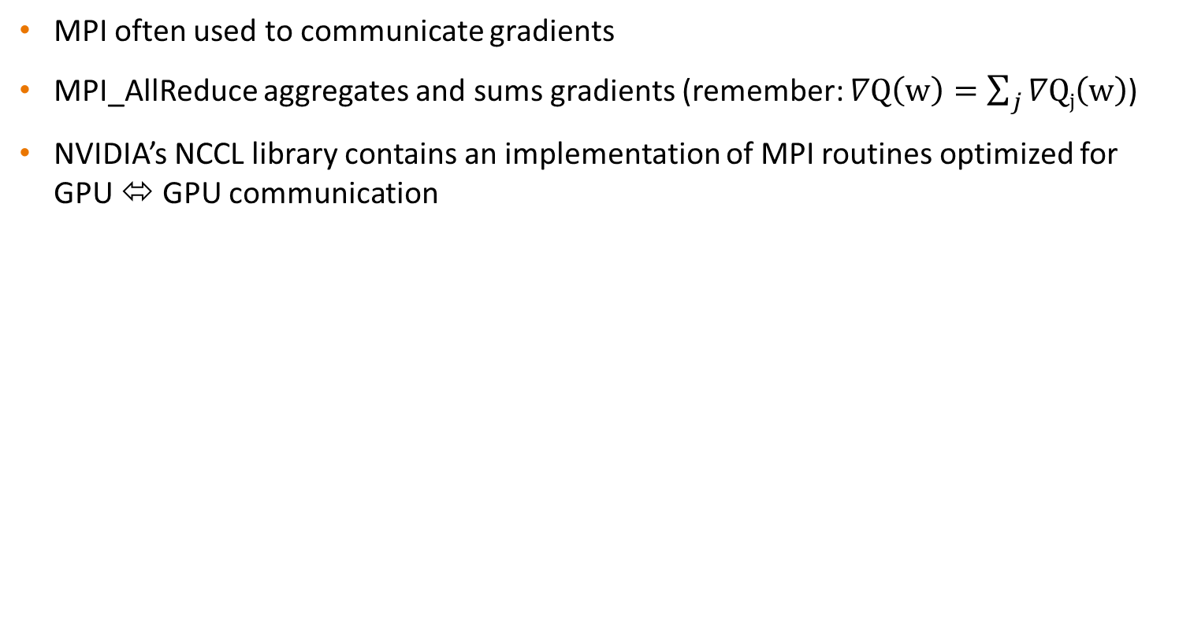
MPI / NCCL
MPI often used to communicate gradients
MPI_AllReduce aggregates and sums gradients (remember: $∇Q\left(w\right)=\sum_{j}{∇Qj\left(w\right)}$)
NVIDIA’s NCCL library contains an implementation of MPI routines optimized for GPU ⬄ GPU communication
P0
A
B
C
D
P0
A+B+C+D
A+B+C+D
A+B+C+D
A+B+C+D
P1
MPI_AllReduce
P1
P2
P2
P3
P3
Notes:
This is slide is for “the short version”, we can use the other slides explaining MPI for the long version.

Slide 53
Relevance of MPI for distributed deep learning
Why is this relevant?
Distributed DL frameworks often support multiple communication backends for their collective allreduce operations
It is important to pick an efficient backend implementation
The most efficient implementation may vary per hardware!
Example: NVIDIA’s NCCL library is highly optimized for NVIDIA GPUs.

Slide 54
Frameworks for distributed learning
TensorFlow’s tf.distribute: quite tricky to program. Lot’s of code changes needed from serial to distributed (https://www.tensorflow.org/guide/distributed_training)
TensorFlow + Horovod: serial => distributed with minimal code changes (https://horovod.readthedocs.io/en/stable/tensorflow.html)
PyTorch’s torch.distributed (https://pytorch.org/tutorials/intermediate/dist_tuto.html)
PyTorch + Horovod: serial => distributed with minimal code changes (https://horovod.readthedocs.io/en/stable/pytorch.html)
PyTorch Lightning: hides a lot of boiler plate code (also nice for serial training). Very little changes needed between serial & parallel execution, especially on a SLURM cluster (https://pytorch-lightning.readthedocs.io/en/latest/clouds/cluster.html#slurm-managed-cluster)

Slide 55
Recap of goal: understand docs of DL frameworks
From TensorFlow docs on “distribution strategy”:
“tf.distribute.Strategy intends to cover a number of use cases along different axes… Synchronous vs asynchronous training: These are two common ways of distributing training with data parallelism. In sync training, all workers train over different slices of input data in sync, and aggregating gradients at each step. In async training, all workers are independently training over the input data and updating variables asynchronously. Typically sync training is supported via all-reduce and async through parameter server architecture.”
“MultiWorkerMirroredStrategy currently allows you to choose between two different implementations of collective ops. CollectiveCommunication.RING implements ring-based collectives using gRPC as the communication layer. CollectiveCommunication.NCCL uses Nvidia's NCCL to implement collectives.”

Slide 56
Practical tips & take home messages
If increased throughput is the goal, use data parallelism
If a large model is the goal, use model (or hybrid or pipeline or tensor) parallelism, but consider the consequences (slower training) and alternatives (model pruning, CPU-based training, etc)
Account for the difference in convergence behavior of data parallel SGD, e.g. by adjusting & experimenting with the learning rate.
Use an efficient backend for collective communications (e.g. NCCL)

Slide 57
Further reading
Distributed TensorFlow using Horovod: https://towardsdatascience.com/distributed-tensorflow-using-horovod-6d572f8790c4
Demystifying Parallel and Distributed Deep Learning: An In-Depth Concurrency Analysis: https://arxiv.org/pdf/1802.09941.pdf
Prace best practice guide for Deep Learning: http://www.prace-ri.eu/IMG/pdf/Best-Practice-Guide-Deep-Learning.pdf
Technologies behind Distributed Deep Learning: https://preferredresearch.jp/2018/07/10/technologies-behind-distributed-deep-learning-allreduce/
PyTorch Distributed: https://pytorch.org/tutorials/beginner/dist_overview.html and https://pytorch.org/docs/stable/distributed.html

Slide 58
Hands-on: data parallel with torch.distributed and PyTorch Lightning
…

