Slide 1

Chapter yellow
Snellius SLURM
Bryan Cardenas
Robert Jan Schilmbach
High Performance Machine Learning

Slide 2
Module environment
HPC systems are shared between many users. How to offer several versions of the same software?
Module environment
modules: module av
We build a module environment every year. Load 2024: module load 2024
module av Python
module show Python/3.11.3-GCCcore-12.3.0
Modules set environment variables like PATH, LD_LIBRARY_PATH, etc. These are used by the Linux OS to find binaries, libaries, etc

Slide 3
Module environment
Why using software from the module environment is a good idea
Convenient!
All dependencies are provided by our module environment
Optimized for our specific hardware
  Difference is most pronounced for CPU-based codes. CUDA binaries are typically (but not always!) optimized for a wide range of GPU models
One software stack to debug in case of problems (easier to debug then when users each have their own software installations!)
Many users use the same installation => bigger chance of spotting problems. Only have to solve them once, and they’ll be solved for everyone.
Less duplication (save disk space, reduce amount of files)

Slide 4
Combining virtual environment with modules
What do you do if you need additional Python packages?
Load whatever you can/want to use from the module environment
Create a virtual environment with python –m venv <venv-name>
Activate the virtual environment, and pip-install your additional package
Module load 2023 Python/3.11.3-GCCcore-12.3.0 Python -m venv .llm source .llm/bin/activate pip install transformers pip install bitsandbytes

Slide 5
More on the module environment
See https://servicedesk.surf.nl/wiki/display/WIKI/Environment+Modules
module avail / module av: show what modules can be loaded
module spider <modulename>: show what modules can be loaded after other modules (e.g. 2023) are loaded first
module load <modulename>: load a module
module display / module show <modulename>: prints the lua script that a ‘module load’ will execute
module unload <modulename>: unload a module
module list: show currently loaded modules
module purge: unload all modules

Slide 6
Why is conda used so much?
Anaconda is used widely accross scientific domains. Why?
Python virtual environments is limited to managing Python packages. Conda also manages non-Python installations (e.g. CUDA)
  This leads to better reproducibility and less issues with missing libraries, particularly for novice users
Many instructions for software installation reference conda
Conda does proper dependency resolution (pip doesn’t) to figure out if all packages in an environment are compatible.
  If package A is used as dependency by packages B and C, and those package have version requirements A < 2.0 and A > 2.5, conda will simply error out and tell you it’s impossible to satisfy both requirements. Pip will install A < 2.0 and then overwrite with A > 2.5.

Slide 7
Conda
So, why is conda bad on HPC systems?
Conda uses generically optimized binaries => (potentially) bad for performance
Conda makes incorrect assumption about the location of system libraries => Still issues at runtime
Conda virtual environments produce enormous amounts of files, easily half your file quotum on an HPC system
Conda modifies the .bashrc file, which can easily cause conflicts or unintended effects
Conda environments are hard to support
  Each conda environment is a full software stack. Each user might have multiple conda environments (i.e. multiple complete stacks). We simply cannot support all of those
See e.g. https://docs.alliancecan.ca/wiki/Anaconda/en

Slide 8
Containers…
https://docs.alliancecan.ca/wiki/Singularity
Containers are ok-ish on HPC systems. Some remarks
Containers are nice for HPC file systems, since they save file I/O
Containers generally have generically optimized binaries, so same performance issues apply as to conda / any binary install (Nvidia GPU performance ok, CPU may or may not be ok)
Like conda, it is a software stack on its own. We can’t help debug.
Very static software environments, hard to add one package => Container rebuild needed
Need to pull in full container to use one small script
Multinode use with MPI applications can be difficult

Slide 9
Best practices: software on HPC (1/2)
Use software from the module environment whenever you can
  Build on top of the module environment when you have to
Never use system installations of Python/GNU compilers/Perl/etc
If you need additional Python packages: built a virtual environment on top of software from the module environment
  Load the modules first, then create / load the virtual environment

Slide 10
Best practices: software on HPC (2/2)
Avoid using conda
  But if you do, install everything with conda. Don’t combine with modules.
  Expect little support from us
Use containers with care
  Optimization usually ok for GPU, but may be poor for CPU
  Expect little support from us
  Multinode can be tricky (if MPI is used)

Slide 11
File System

Slide 12
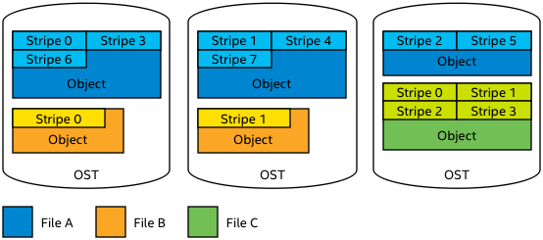
HPC File System
HPC systems typically use parallel shared file systems.
Parallel file system: one file can be distributed over many physical disks, to increase I/O bandwidth.
GPFS (Snellius)
  Metadata and actual file stored on the same server
  Striping is managed automatically, by file system. User has no control.

Slide 13
HPC File System
HPC file systems are optimized for bandwidth not I/O operations per second (IOPS)
E.g. Snellius GPFS: up to 10 GB/s write, 20 GB/s read
Accessing small files means many metadata operations; network communication overhead
Metadata operations are latency sensitive
Important when e.g. a 100 node job needs to start from the same 20 GB input file…
Hence, HPC file systems are typically not good at AI
AI workloads are generally: reading lots of small files / parts of a file

Slide 14
HPC File System
An inode stores all information about a linux file except its name and data
  File size, last change date, file permissions, etc
On most HPC systems, you’ll have an inode quota, in addition to a size quota
  Like total size, each filesystem has a (fixed) maximum number of inodes
  It is also a way to discourage doing to many IOPS
Seems we’ll run out of inodes before we run out of space on e.g. our home1 filesystem:
$ df -ih /gpfs/home1/
Filesystem Inodes IUsed IFree IUse% Mounted on
home1 287M 141M 146M 50% /gpfs/home1
$ df -h /gpfs/home1/
Filesystem Size Used Avail Use% Mounted on
home1 121T 56T 66T 46% /gpfs/home1

Slide 15
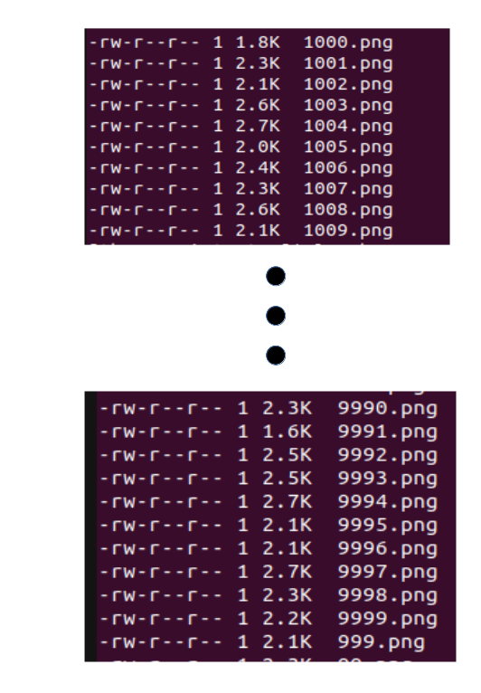
HPC File System
Suppose your dataset is 10k png files of 2k each…
Home1: 121TB, 287M inodes, so 421k per inode
  If everyone does this, the filesystem will be full of inodes, with 99.5% / 120 TB (!) storage still available…
If you run 100 epochs, you’ll do 1M I/O operations
  Your sysadmin won’t like you
  Your fellow users won’t like you: everyone suffers slow I/O because of your job!
  You shouldn’t like you: your I/O might be holding back your training performance…

Slide 16
Packed Data Format
What is a ‘packed data format’?
Group multiple individual files together in a single ‘packed’/archive file
Examples of packed data formats → ZIP, TAR, LMDB, HDF5, PARQUET, etc.
Does not necessarily involve compression!
  Compression is possible, but often runs on single process, so slow to decompress
Why packed data format
HPC systems use a shared filesystem. Packed data formats…
Reduces inode consumption
Reduces number of I/O operations/s
  Reduces slowdown for yourself and other users
Best Practice for Data Formats in Deep Learning - SURF User Knowledge Base

Slide 17
Local Scratch Disks
Some HPC systems have local disks in the nodes
On Snellius, these can be requested by adding
#SBATCH –constraint=scratch-node to your batch script
  Note: about half our GPU nodes have local scratch disk. You might be in the queue longer if you request scratch-node, so only do it if you think you benefit from it
Local scratch disks can usually handle much more IOPs
Local scratch disks are shared between all users in a node
  Users on the same node may still experience some effects when you ‘hammer’ local scratch with I/O, but it’s way less bad than on a shared filesystem!

Slide 18
Local Scratch Disks
Some HPC systems have local disks in the nodes
If you really need to use individual files instead of a packed file format, use local scratch disks in the following way:
Store zip/tar on shared parallel Filesystem.
At start of job: extract to local scratch dir (for every node, if you use multiple)
Do any further I/O from that local scratch dir
Snellius filesystems - SURF User Knowledge Base

Slide 19
Chapter yellow
Example SLURM

Slide 20
SLURM Simple commands
Slurm is an open-source workload manager to schedule and manage jobs on HPC (High Performance Computing) clusters.
It allocates compute resources (CPUs, GPUs, memory, etc.)
Resource allocation: jobs run only when the requested resources are available.
Job queuing: slurm decides when/where to run them.
Monitoring and control: track job status, usage, and can enforce time/memory limits.
Creating and running jobs - SURF User Knowledge Base

Slide 21
SLURM Simple commands
Slurm is an open-source workload manager to schedule and manage jobs on HPC (High Performance Computing) clusters.
It allocates compute resources (CPUs, GPUs, memory, etc.)
Information
sinfo: View available resources/partitions.
squeue: View running/pending jobs.
scancel: Cancel jobs.
scontrol: Advanced control over jobs and nodes.
Creating and running jobs - SURF User Knowledge Base

Slide 22
SLURM Simple commands
Slurm is an open-source workload manager to schedule and manage jobs on HPC (High Performance Computing) clusters.
It allocates compute resources (CPUs, GPUs, memory, etc.)
Allocation
sbatch: Submit a job for batch processing.
salloc: Interactive session on a compute node
srun: Launch tasks.
Creating and running jobs - SURF User Knowledge Base

Slide 23
SLURM Simple commands
Slurm is an open-source workload manager to schedule and manage jobs on HPC (High Performance Computing) clusters.
Live Monitoring
squeu -u $USER
sstat / scontrol show job
nvidia-smi (after ssh’ing into a node)
Creating and running jobs - SURF User Knowledge Base

Slide 24
SLURM Simple commands
Slurm is an open-source workload manager to schedule and manage jobs on HPC (High Performance Computing) clusters.
Module
module avail
Module spider <modulename>
Module show <modulename>
Module purge
Module list
Module unload <modulename>
Module load <modulename>
show what modules can be loaded
show what modules can be loaded after other modules
load a module
prints the lua script that a ‘module load’ will execute
unload a module
show currently loaded modules
unload all modules
Creating and running jobs - SURF User Knowledge Base

Slide 25
Sbatch Example
#!/bin/bash #SBATCH --job-name=my_job #SBATCH --nodes=1 #SBATCH --time=00:10:00 #SBATCH --partition gpu_a100 #SBATCH --gpus 1 #SBATCH --ntasks 1 #SBATCH --cpus-per-task 8 # load environment source ./venv/bin/activate module load 2024 module load cuDNN/9.5.0.50-CUDA-12.6.0 cd ./ml/algorithms/esmfold/ cmd_args="--fastas_folder ./outputs/proteinmpnn/seqs/ --output_folder ./outputs/esmfold/" # run algorithm python esmfold.py ${cmd_args}
Interactive Allocation Equivalent:
salloc --time 00:10:00 --nodes 1 --partition gpu_a100 --gpus 1 --ntasks 1 --cpus-per-task 8 --job-name my_job
Creating and running jobs - SURF User Knowledge Base

Slide 26
Sbatch notebook Example
#!/bin/bash #SBATCH -t 1:00:00 #SBATCH -N 1 #SBATCH -p thin #SBATCH -o jupyter-notebook-job.out # Make sure the jupyter command is available, either by loading the appropriate modules, sourcing your own virtual environment, etc. module load 2022 module load IPython/8.5.0-GCCcore-11.3.0 module load JupyterHub/3.0.0-GCCcore-11.3.0 # Choose random port and print instructions to connect PORT=`shuf -i 5000-5999 -n 1` LOGIN_HOST=${SLURM_SUBMIT_HOST}-pub.snellius.surf.nl BATCH_HOST=$(hostname) echo "To connect to the notebook type the following command into your local terminal:" echo "ssh -N -J ${USER}@${LOGIN_HOST} ${USER}@${BATCH_HOST} -L ${PORT}:localhost:${PORT}" echo echo "After connection is established in your local browser go to the address:" echo "http://localhost:${PORT}" jupyter notebook --no-browser --port $PORT
Jupyter Notebooks on Snellius - SURF User Knowledge Base

Slide 27
Sbatch notebook Example
Modify the previous notebook contents depending on your setup. Run the notebook on a login node, not a GPU node. Use:
sbatch notebook.job.
You will obtain an output, e.g. slurm-5065147. This file will tell you how to connect to your notebook
Connect to the notebook follow the command (from the output slurmfile) from a new local terminal. e.g.:
ssh -J bryanc@int6-pub.snellius.surf.nl bryanc@tcn1113.local.snellius.surf.nl -L 5994:localhost:5994
Open a browser and copy paste what the terminal is telling you, e.g.:
http://localhost:5994/tree?token=9514f7a3f5d21e9cb959203e6e26d62896f371375711da84
Jupyter Notebooks on Snellius - SURF User Knowledge Base

Slide 28

Small or Large NWO Grant
2. Mail us!
https://www.surf.nl/en/research-it/apply-for-access-to-compute-services
https://servicedesk.surf.nl/wiki/pages/viewpage.action?pageId=30660193
https://servicedesk.surf.nl/wiki/display/WIKI/NWO+grants
bryan.cardenasguevara@surf.nl
damian.podareanu@surf.nl
matthieu.laneuville@surf.nl
hpml@surf.nl
https://www.surf.nl/en/consultancy-on-it-solutions-for-researchers
Apply for consultancy hours!

