Slide 1

Chapter yellow
AI in Medicine HPML
Bryan Cardenas
High Performance Machine Learning

Slide 2

What are we doing @SURF?
01.
02.
03.
Histopathology
Detecting cancer and
Precursor lesions
Protein Design
Assist with protein design for vaccines
Hereditary
How to use Neural Networks in multi modal data environments across multiple labs in the EU.

Slide 3
Chapter orange
Histopathology
High Performance Machine Learning Group

Slide 4
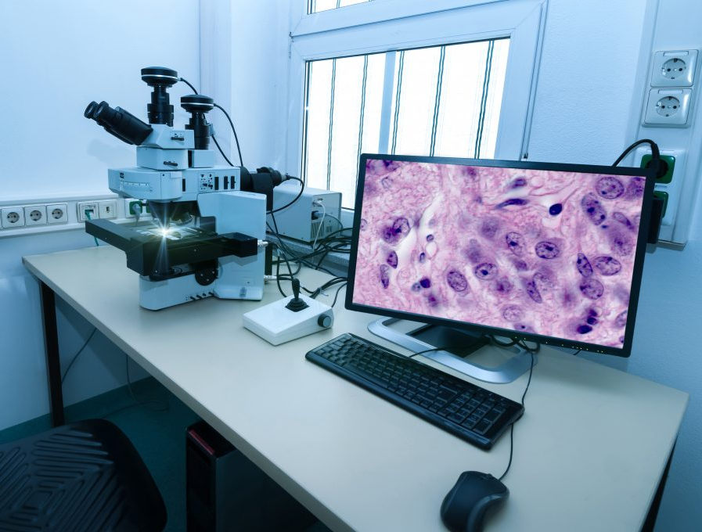
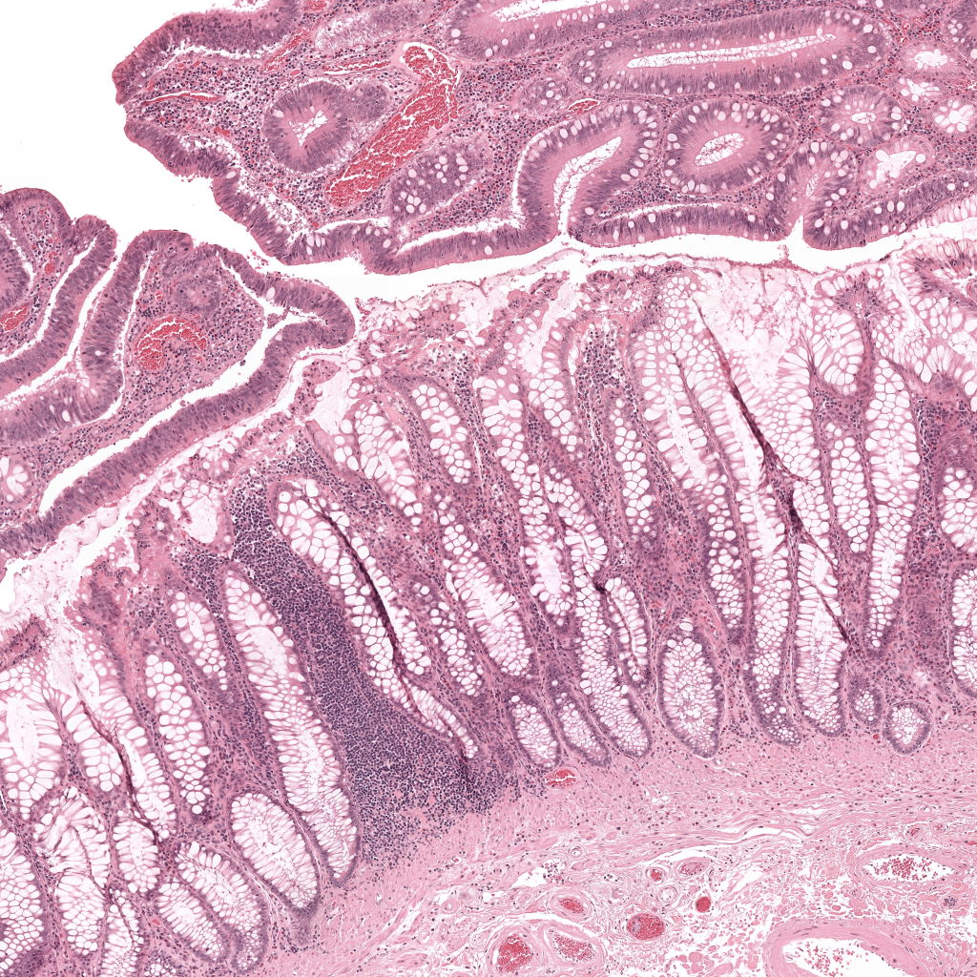
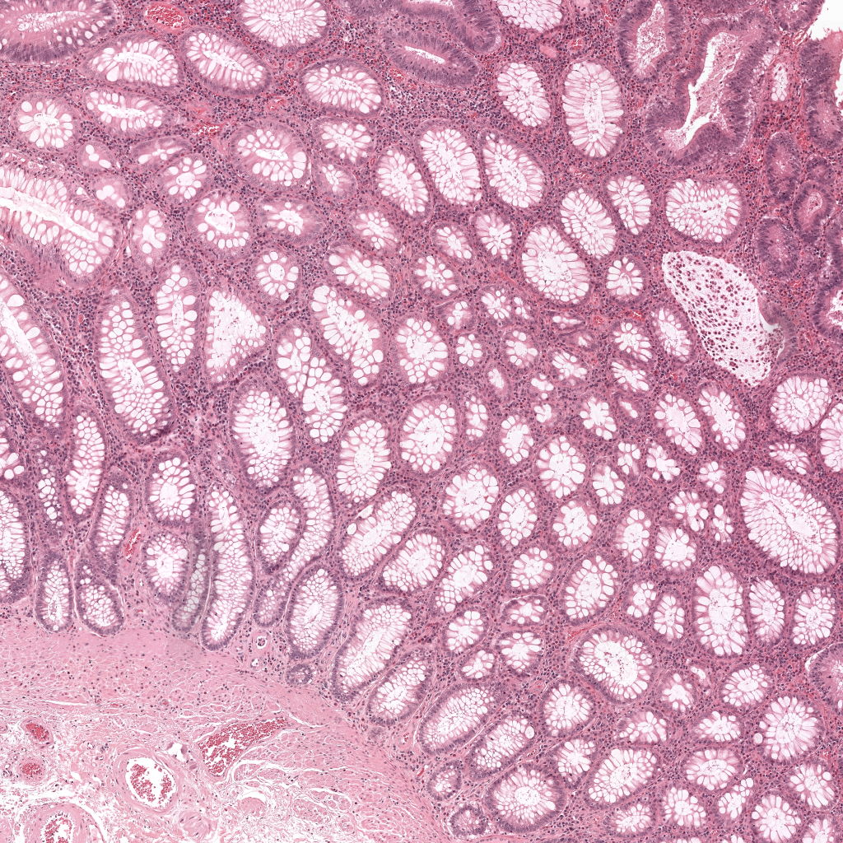
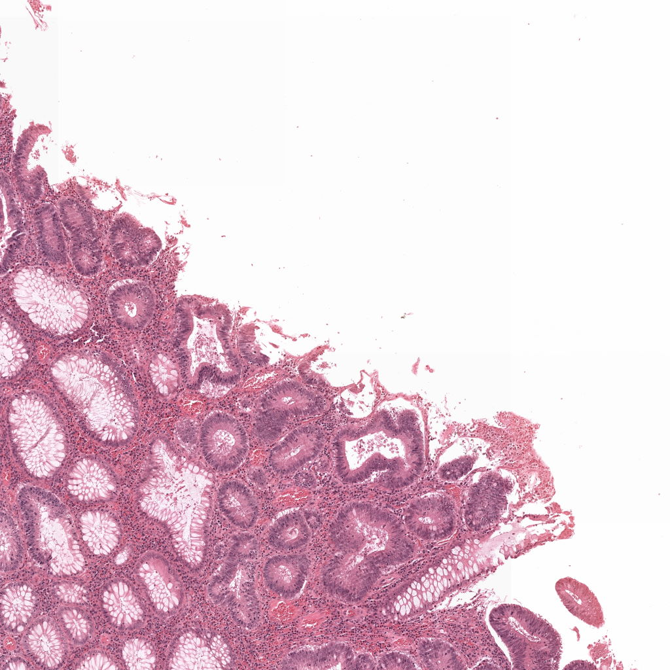
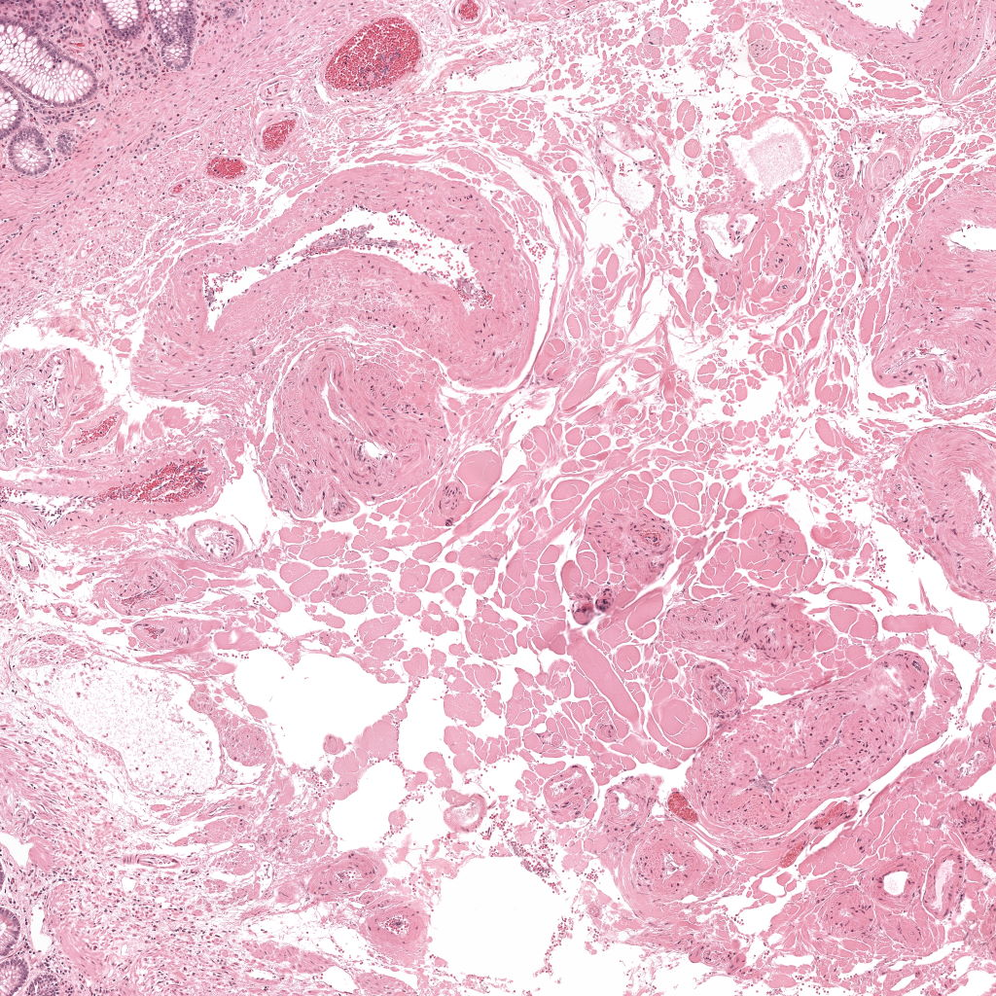
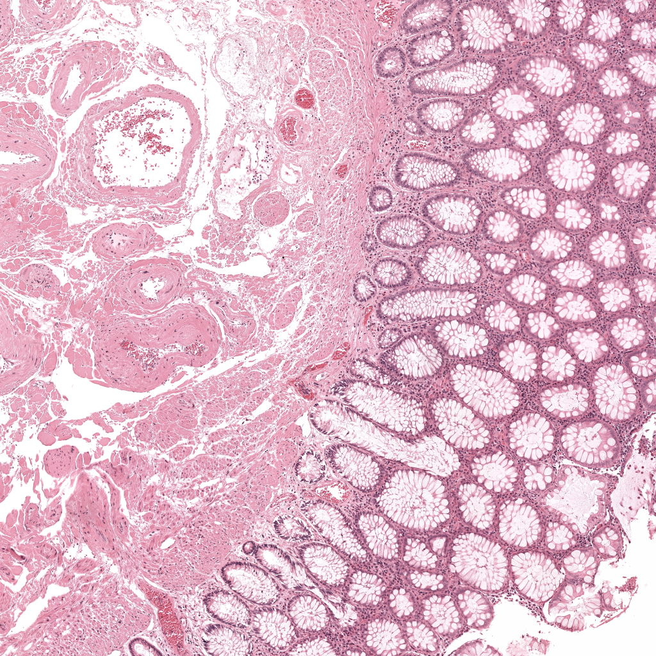
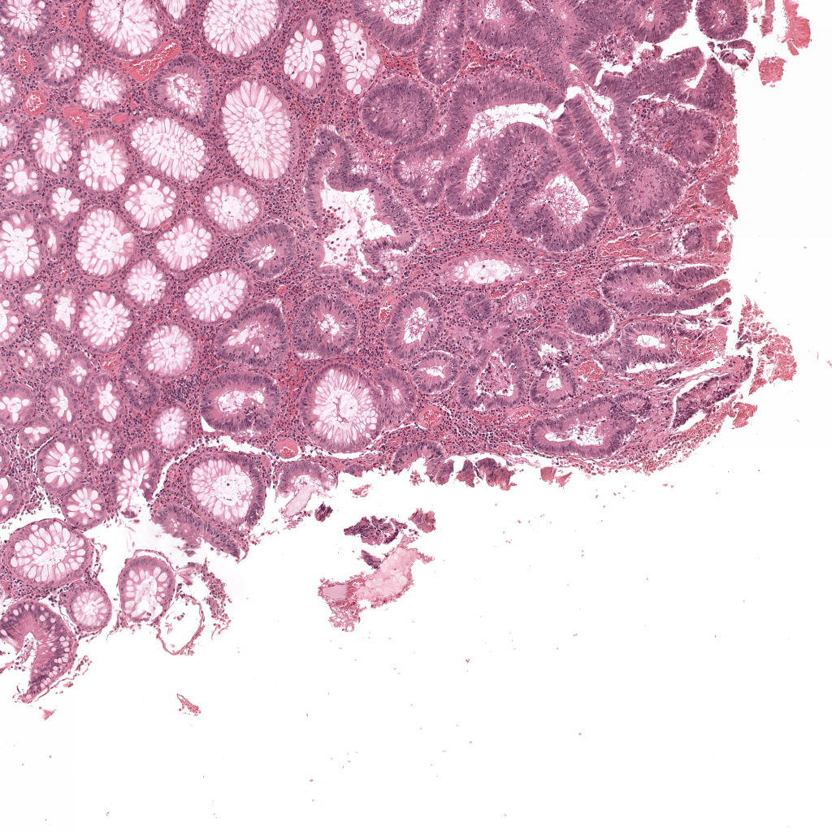
Histopathology Data Collection

Slide 5
Histopathology Data: Images and Diagnostic Reports
“Colonbiopt 21-25 cm en 15 cm: in beide subrieken adenocarcinoma metastase, morfologisch en immuunhistochemisch geschikt voor het al bekend primaire ovariumcarcinoom van de patiënt.”
2 - adenoma tubulare con displasia bassa, focalmente, alto grado (moderato, focalmente grave)

Slide 6
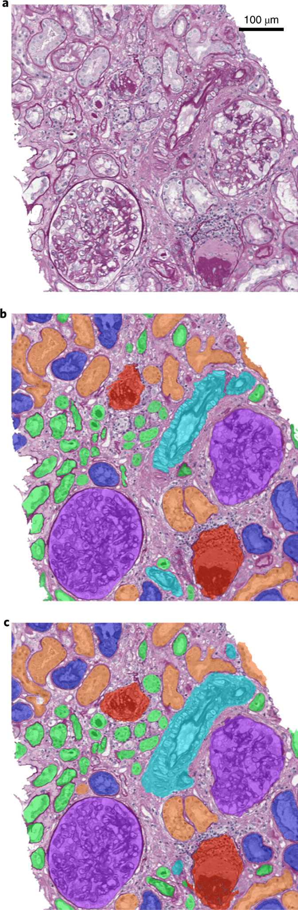
Histopathology Data: Images and Diagnostic Reports
“Colonbiopt 21-25 cm en 15 cm: in beide subrieken adenocarcinoma metastase, morfologisch en immuunhistochemisch geschikt voor het al bekend primaire ovariumcarcinoom van de patiënt.”
2 - adenoma tubulare con displasia bassa, focalmente, alto grado (moderato, focalmente grave)

Slide 7
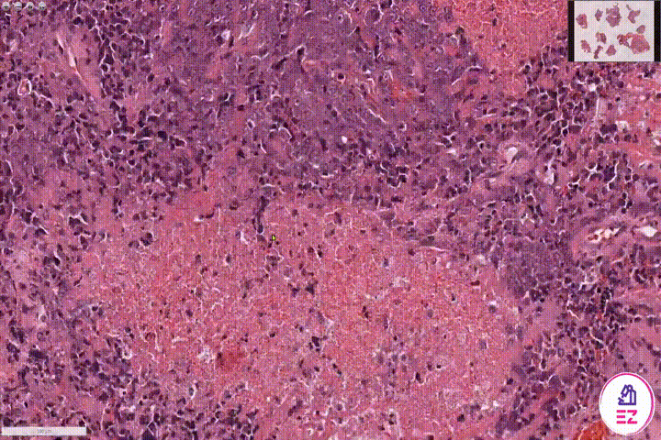
Histopathology Data: Images and Diagnostic Reports
“Colonbiopt 21-25 cm en 15 cm: in beide subrieken adenocarcinoma metastase, morfologisch en immuunhistochemisch geschikt voor het al bekend primaire ovariumcarcinoom van de patiënt.”
2 - adenoma tubulare con displasia bassa, focalmente, alto grado (moderato, focalmente grave)
https://huggingface.co/docs/transformers/model_doc/marian

Slide 8


Examode
01.
02.
03.
Classification, Segmentation,
Multimodal Representation Learning
Data Management
HPC Consultancy

Slide 9


Histopathology
Conditioned Language Modelling
LLM

Slide 10
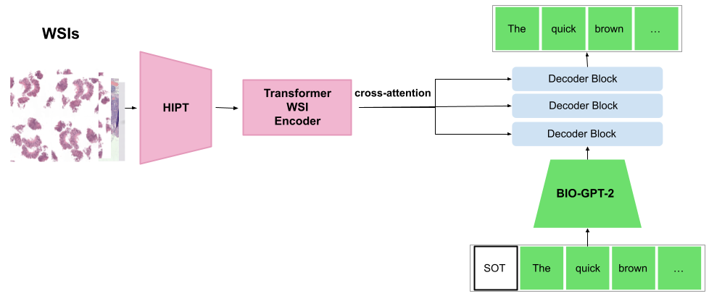
Histopathology
Conditioned Language Modelling
01.
02.
Data Management
Fitting generated text

Slide 11
Chapter green
Protein Folding & Design
High Performance Machine Learning Group

Slide 12
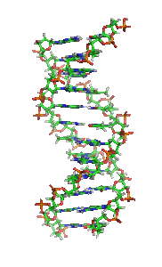
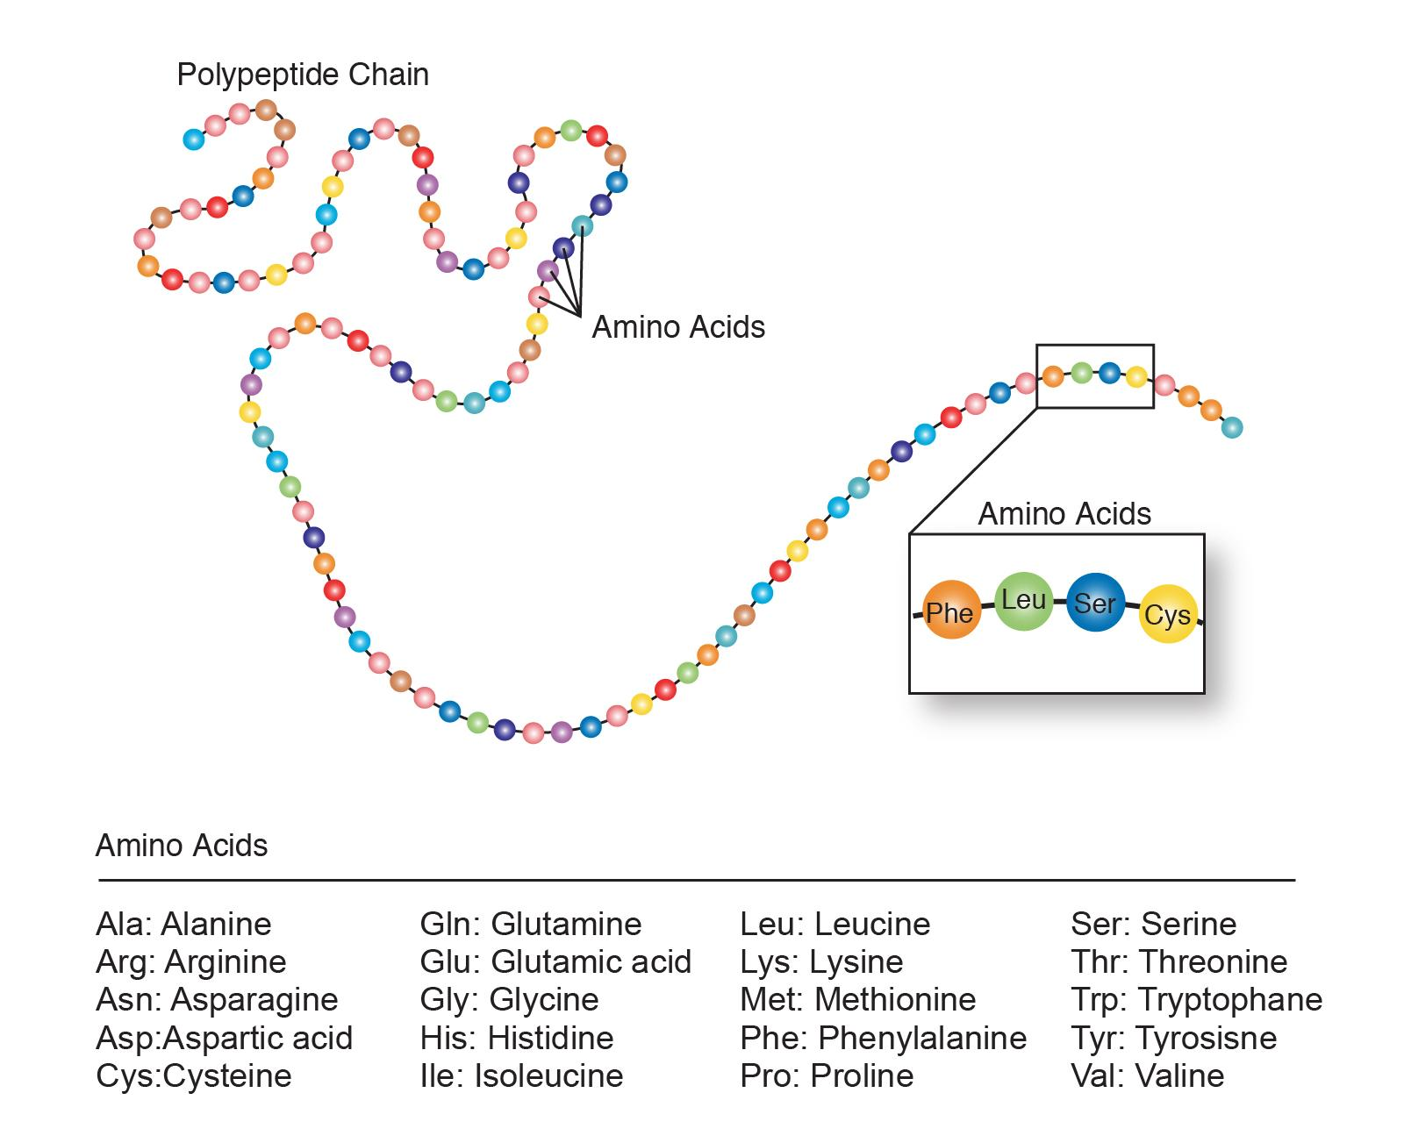
ACTG

Slide 13

ACTG

Slide 14


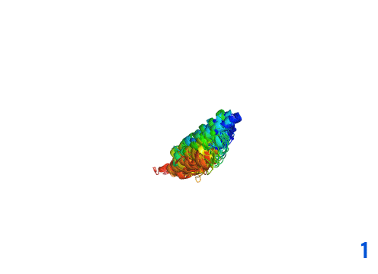
AlphaFold2

Slide 15
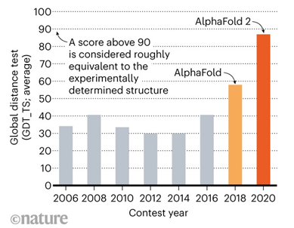
AlphaFold2

Slide 16
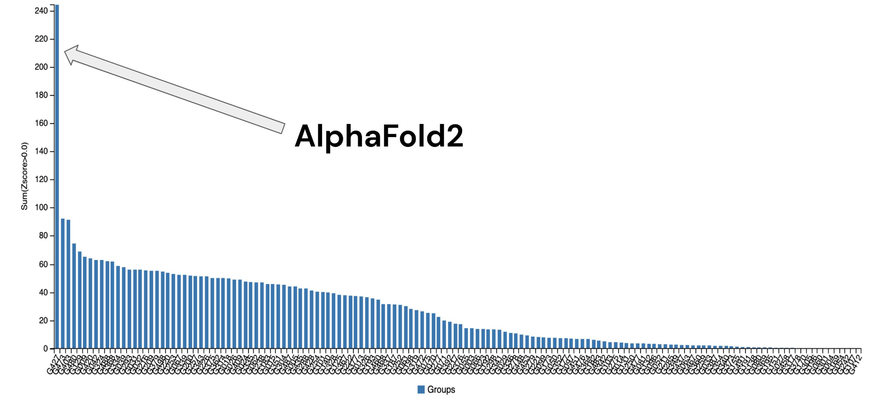
AlphaFold2

Slide 17
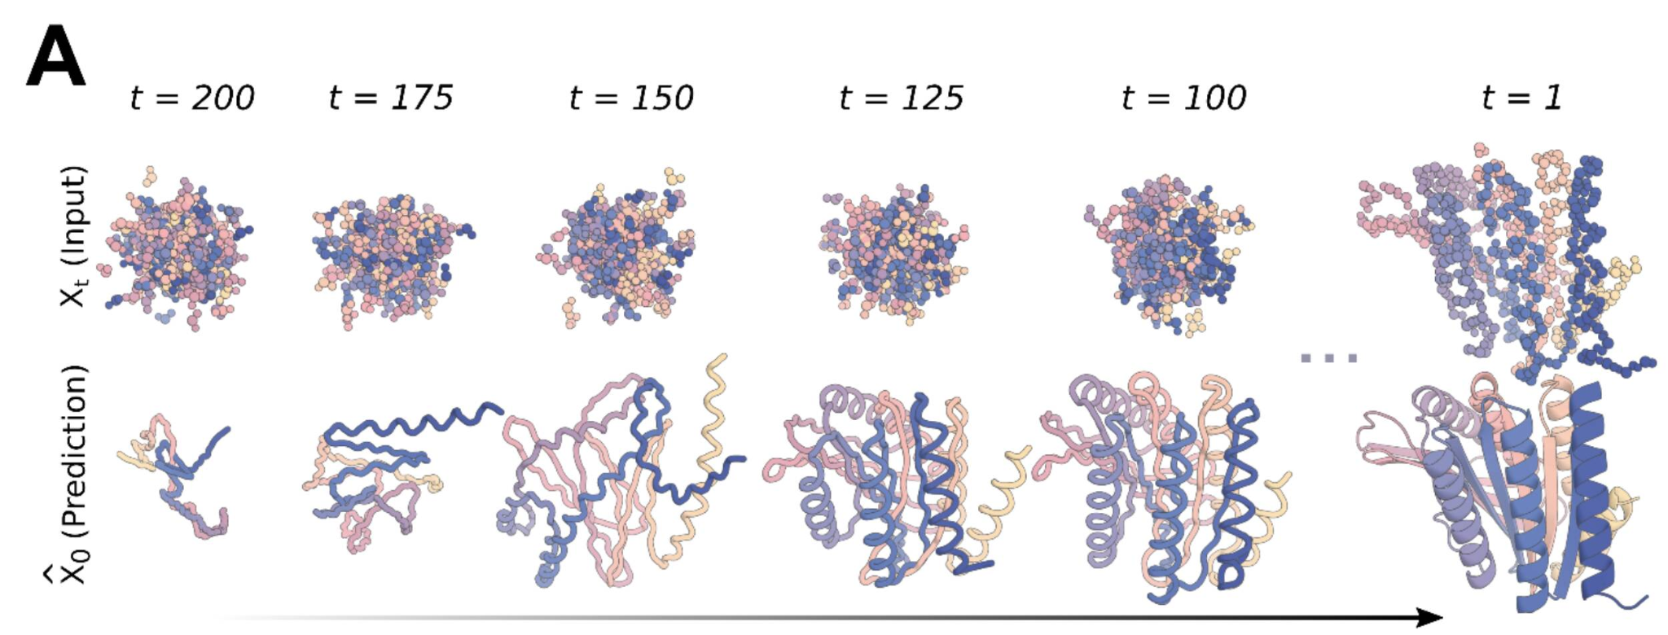
AlphaFold2

Slide 18
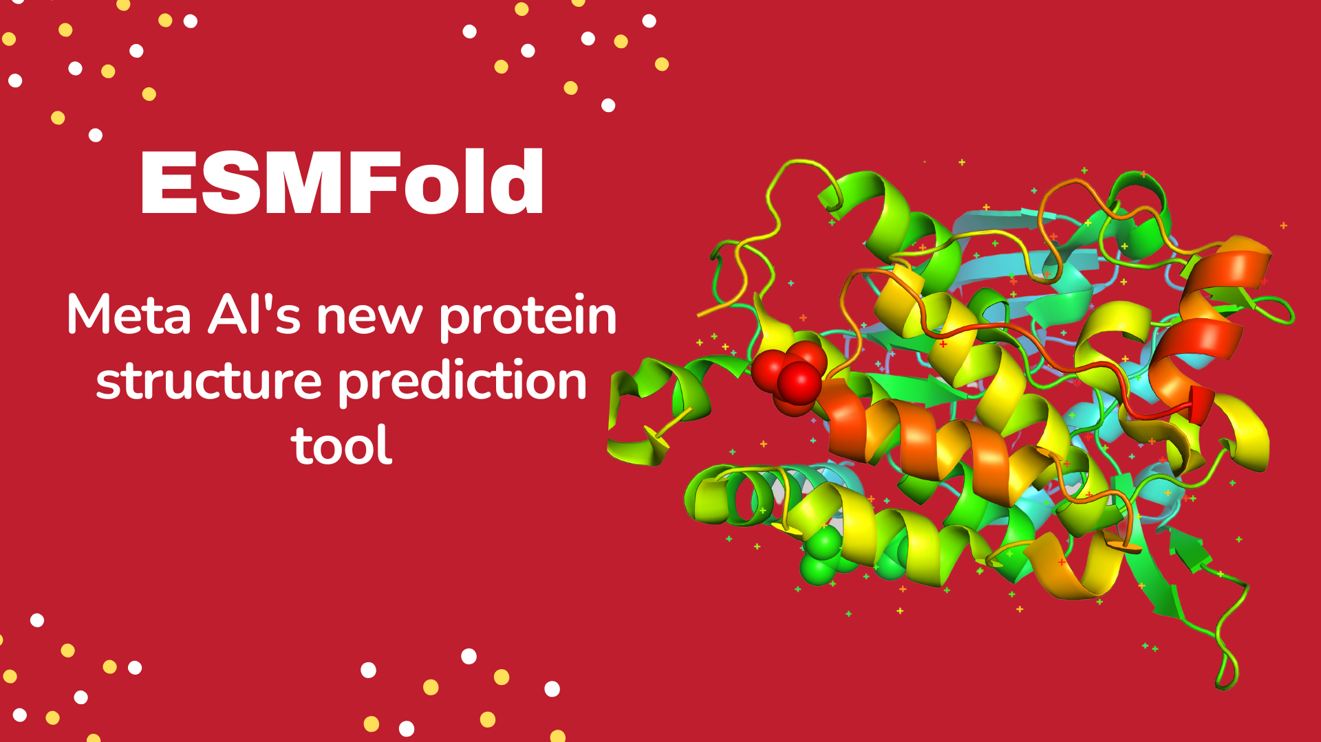
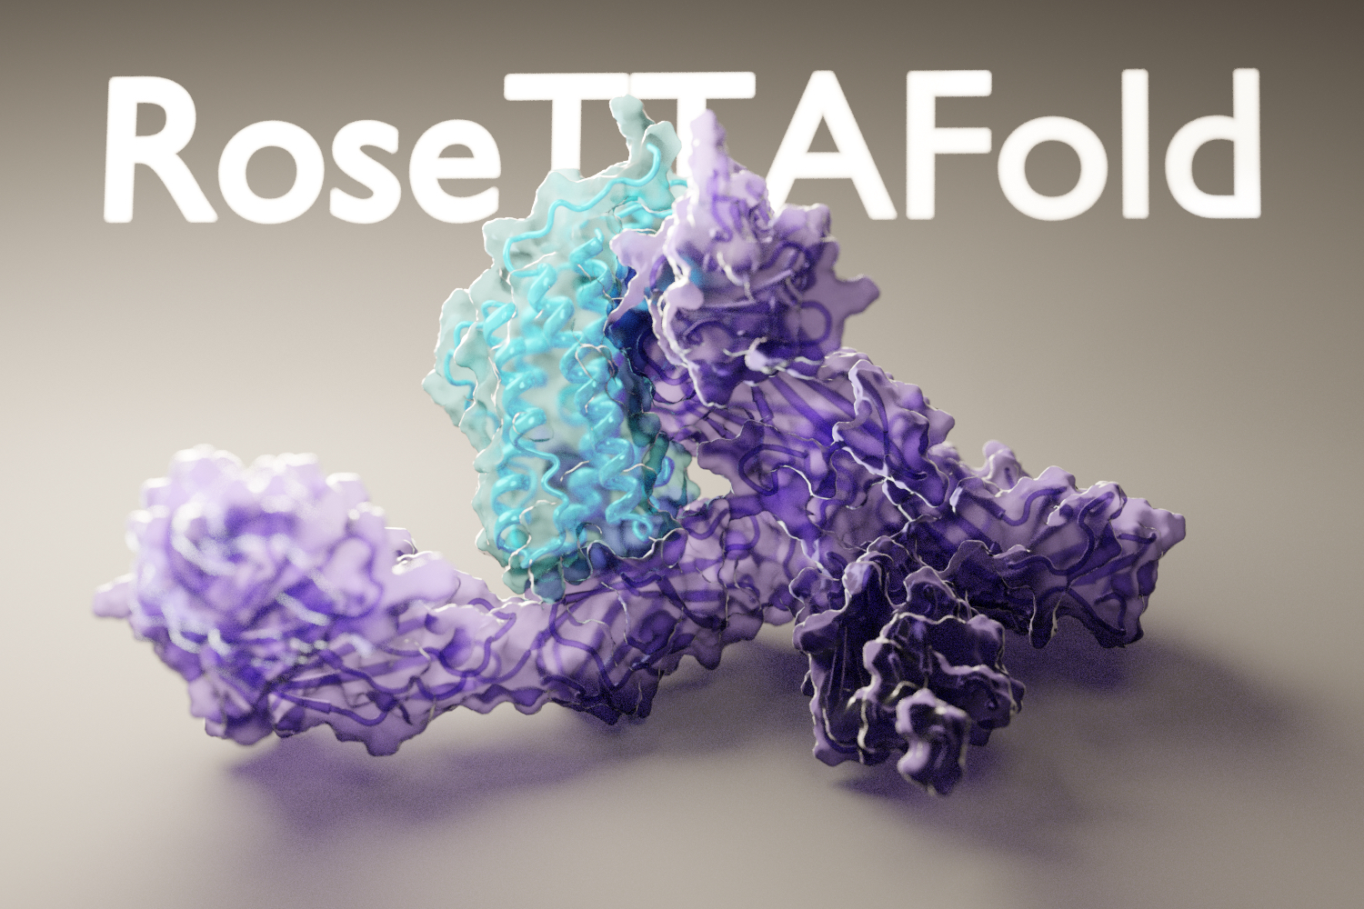
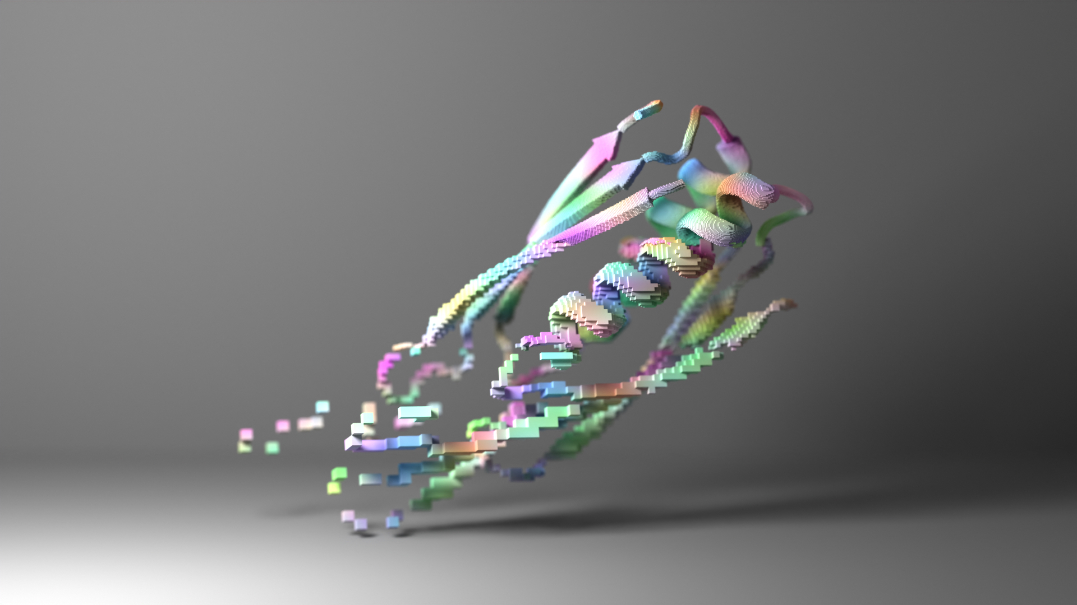
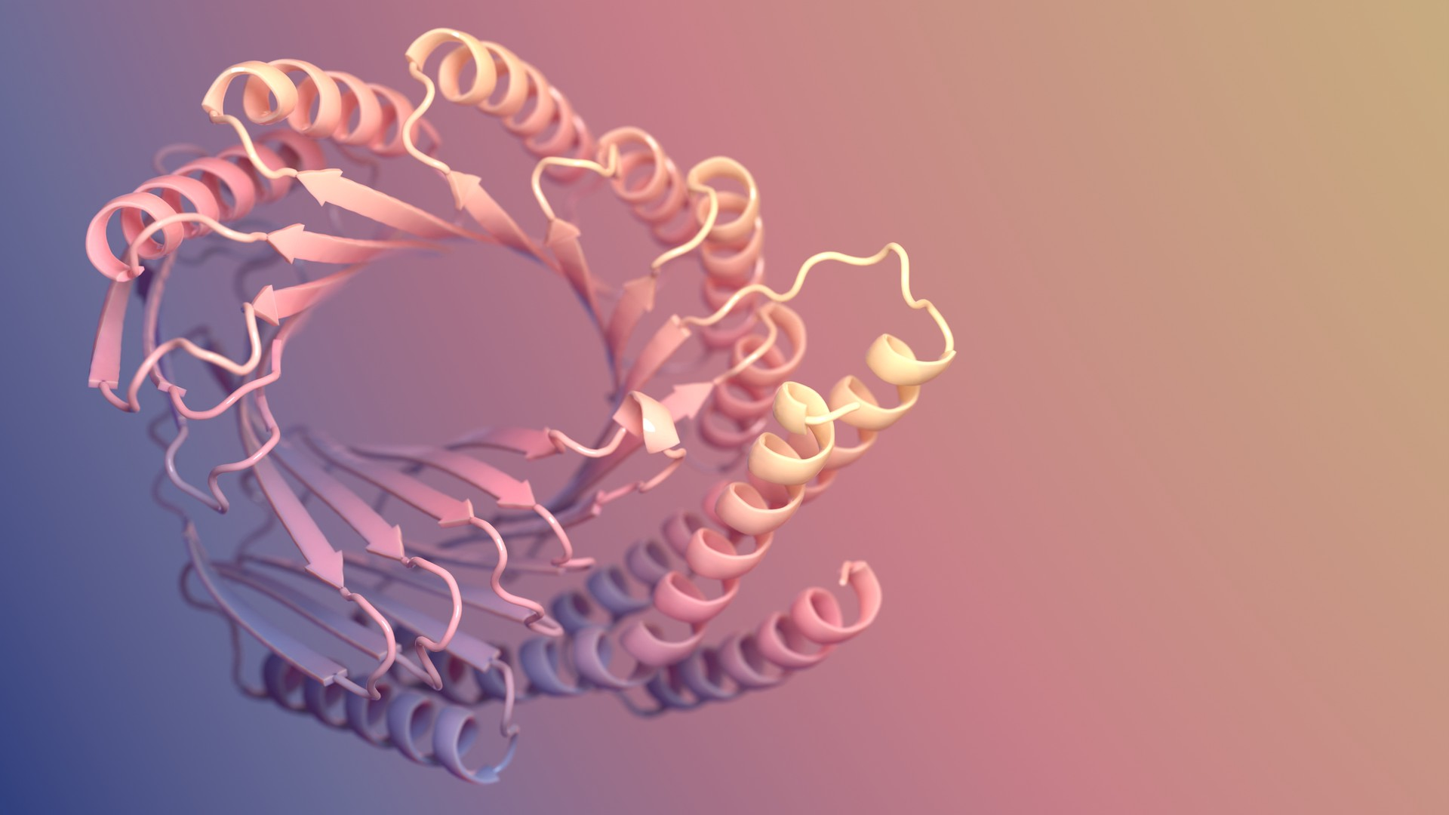
Suite of Protein Models
ProteinMPNN
Diffusion

Slide 19
11/01/2023
Experimental vaccinology@AMC
High Performance Machine Learning Group

Slide 20
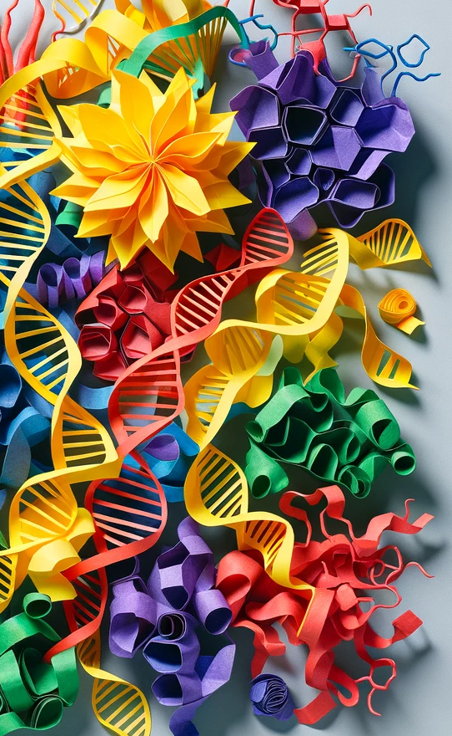
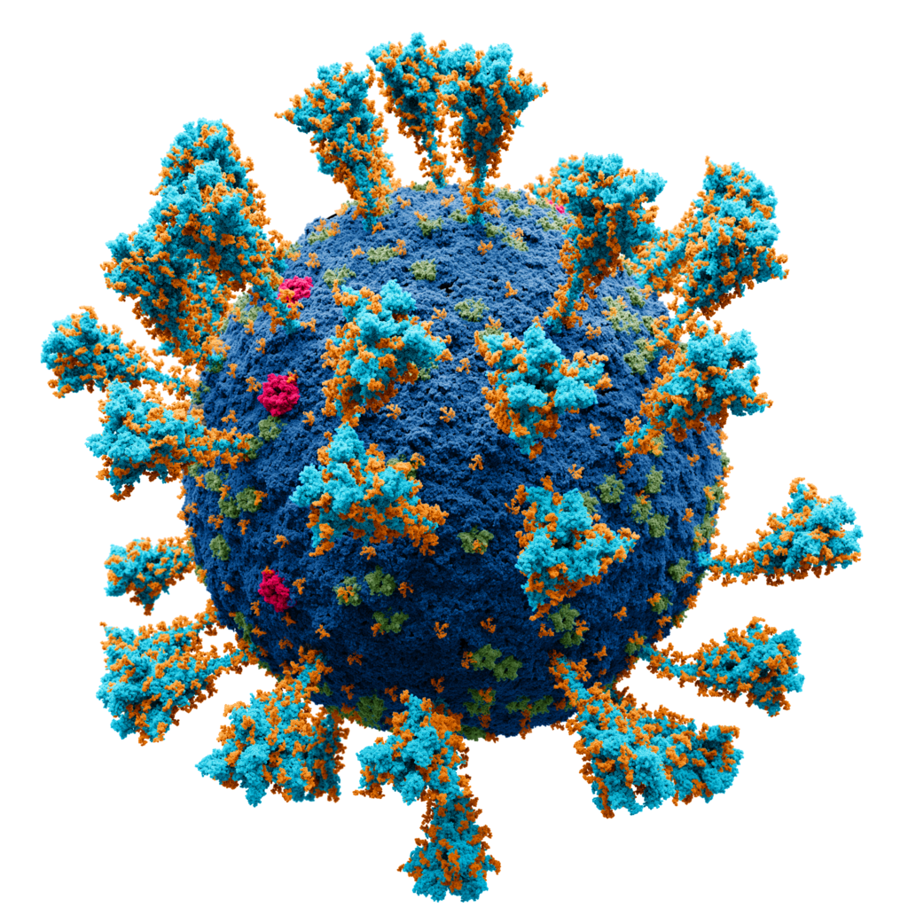
SARS-COV-2

Slide 21
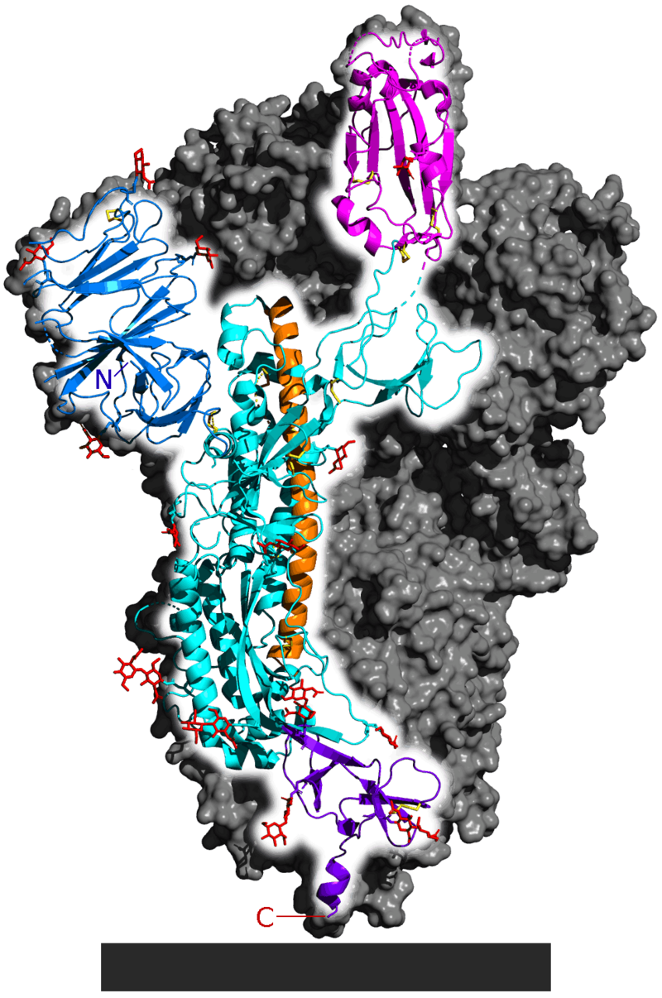
SARS-COV-2
Spike Protein

Slide 22
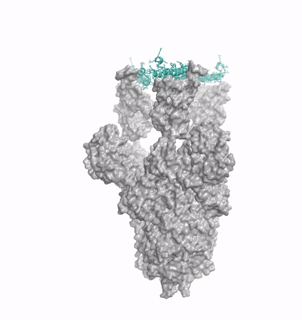
SARS-COV-2
Spike Protein

Slide 23

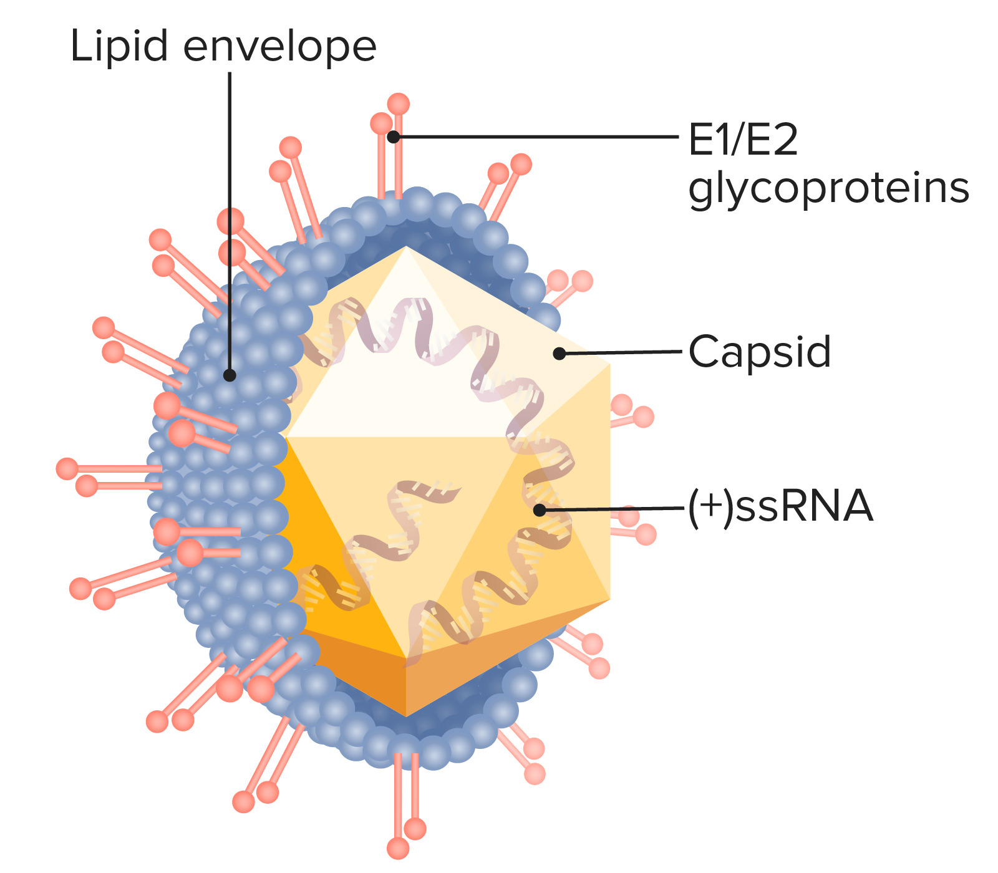
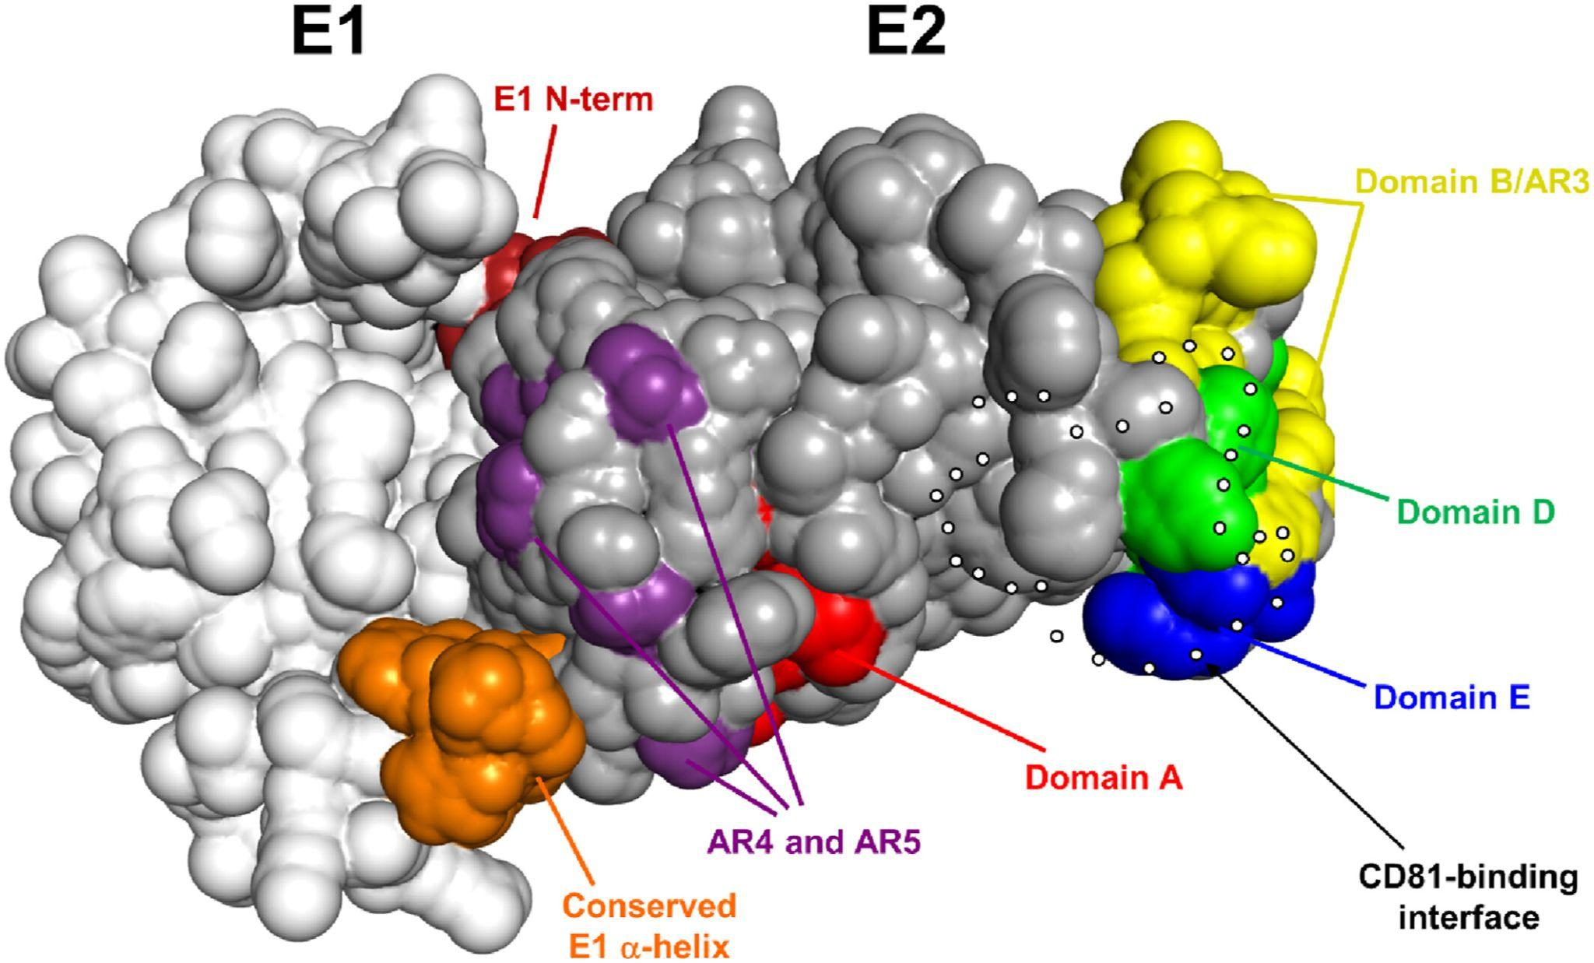
Experimental vaccinology@AMC
Hepatitis C Virus

Slide 24
Recipe for Assistance
01.
02.
03.
04.
Provide hardware & storage
Run software
Efficiency
Think of a new way to tackle the problem

Slide 25
Chaining Predictions
Generation
RFDiffusion
02. Predict Sequence
ProteinMPNN
03. Confirm Structure
ESMFold, ColabFold,
AlphaFold, OmegaFold,
RoseTTaFold

Slide 26
Chapter yellow
Hereditary
High Performance Machine Learning Group

Slide 27

Hereditary
01.
02.
03.
Federated Learning
Provide compute
& HPC support
Train Models on multiple modalities
04.
Security & Compliance monitoring System

Slide 28







Hereditary Data Types

Slide 29

Federated Learning
Improve diagnostic accuracy but maintain privacy!
Make data comply with privacy and ethics
Multiple centers benefit!

Slide 30


Gut-Brain Interplay
01.
Neurological Diseases
02.
Gut Microbiome Disorders
Multi-Modality Data Assembly Multi-Linguality Privacy & Security

Slide 31
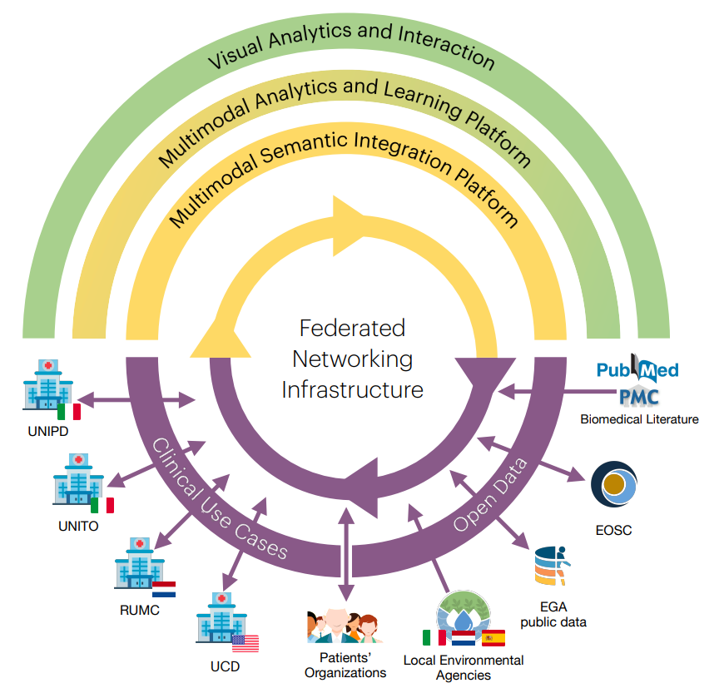
The Call & Objectives
Secure & lawful federated access to linked multimodal data across Europe
Healthcare data normalization
Multimodal Ontologies
Federated Polystore for querying
Federated Learning Models
Analytics platform for aggregation and discovery from multiple sources
Patient Recommendations

Slide 32
Thanks!
Mail me for Questions:
bryan.cardenasguevara@surf.nl
High Performance Machine Learning Group

