Slide 1
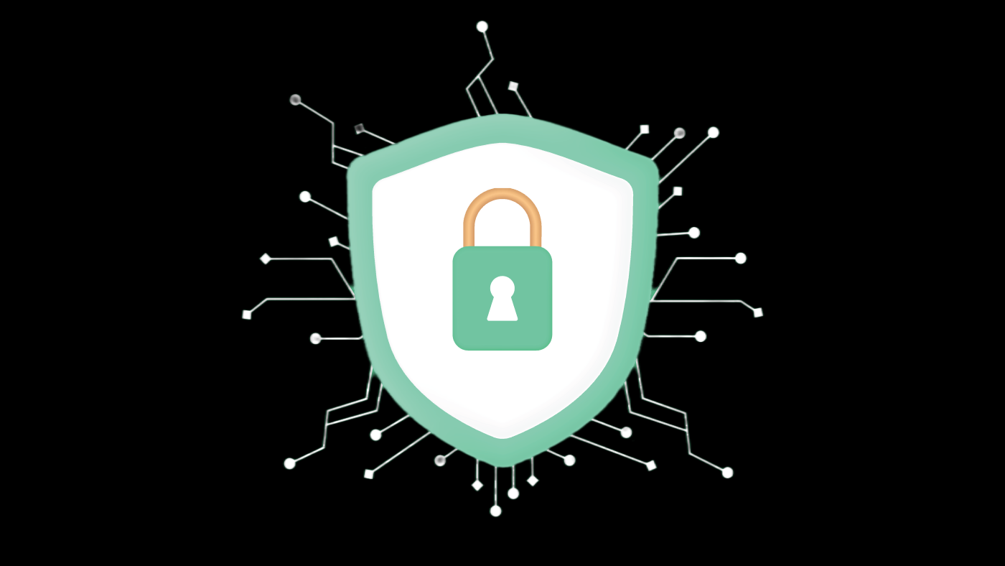

Chapter yellow
Differential Privacy
In Federated Learning
Bryan Cardenas
High Performance Machine Learning

Slide 2
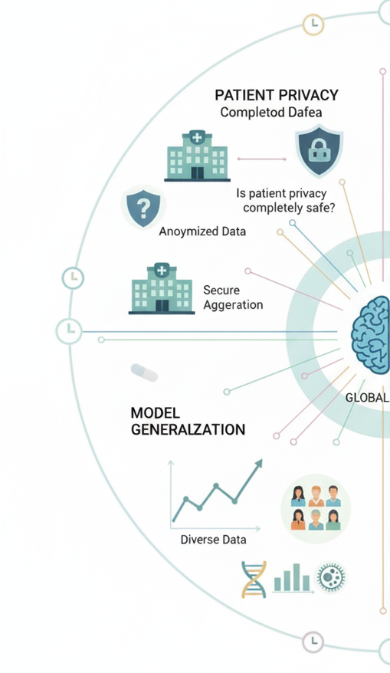
Beyond Encryption
Privacy not entirely safe with Secure Aggregation
  Data flows into the models and the model is able to memorize PII data
  Even if individual updates are protected, final aggregated model can leak information

Slide 3
Beyond Encryption
Privacy not entirely safe with Secure Aggregation
  Data flows into the models and the model is able to memorize PII data
  Even if individual updates are protected, final aggregated model can leak information
Differential Privacy
  How to obscure individual updates?
    PII detection and redaction
    Psuedoanonymization
    Aggressive Dropout
    Federated Averaging

Slide 4
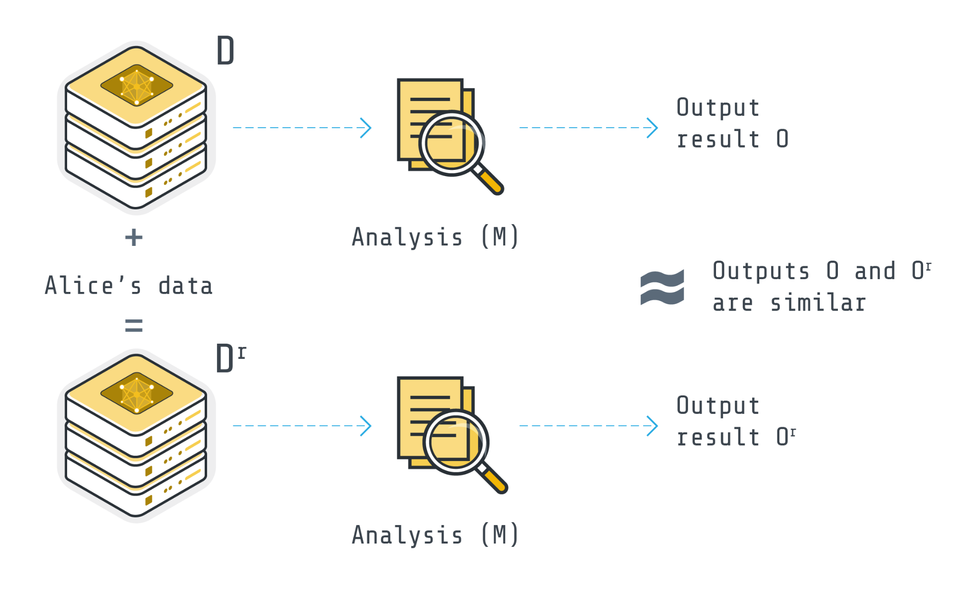

Differential Privacy
Analysis is not altered by presence or absence of specific data points

Slide 5
Differential Privacy
Analysis is not altered by presence or absence of specific data points
Data level DP
Any model trained on this data will also be differentially private
Model Training DP
Most common, if the model is differentially private, then the outputs are also differentially private.
Label only
Full training
Predictions only DP

Slide 6
Differential Privacy
Analysis is not altered by presence or absence of specific data points
Data level DP
Hardest; think of synthetic data
Model Training DP
Label only; looser bound than full training, think of protecting users who clicked on an ad
Full training; core subject
Predictions only DP
Easiest; only share model with trusted users
Perturb outputs

Slide 7
Differential Privacy
Analysis is not altered by presence or absence of specific data points
Full Model Training DP; Gradient based
Inject Noise to pretrained weights
Or add noise at the end of training to the weights
Perturb or modify the loss/objective
Gradient Noise Injection
DP-SGD (Abadi et al., 2016); Moments accountant and tighter privacy bounds

Slide 8
Differential Privacy
Analysis is not altered by presence or absence of specific data points
Full Model Training DP; Gradient based
Inject Noise to pretrained weights
Or add noise at the end of training to the weights
Perturb or modify the loss/objective
Gradient Noise Injection
DP-SGD (Abadi et al., 2016); Moments accountant and tighter privacy bounds
Per example gradient L2-norm clipping
Add noise (Gaussian or Laplacian) to the gradients

Slide 9
Differential Privacy
Gradient Noise Injection
Per example gradient L2-norm clipping
Add noise (Gaussian or Laplacian) to the gradients

Slide 10
Differential Privacy
Gradient Noise Injection
Per example gradient L2-norm clipping
Add noise (Gaussian or Laplacian) to the gradients
M is considered epsilon-differentially private if for two datasets differ by one datapoint
Such that the probability of producing a specific output is (nearly) the same

Slide 11
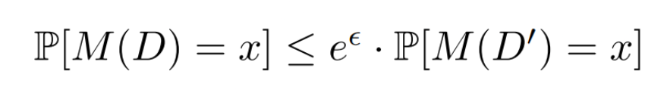
Differential Privacy
Gradient Noise Injection
Per example gradient L2-norm clipping
Add noise (Gaussian or Laplacian) to the gradients
M is considered epsilon-differentially private if for two datasets differ by one datapoint
Such that the probability of producing a specific output is (nearly) the same

Slide 12
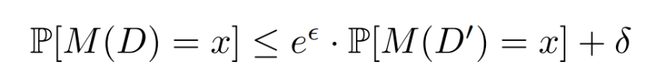
Differential Privacy
Gradient Noise Injection
Per example gradient L2-norm clipping
Add noise (Gaussian or Laplacian) to the gradients
M is considered epsilon-differentially private if for two datasets differ by one datapoint
Such that the probability of producing a specific output is (nearly) the same

Slide 13
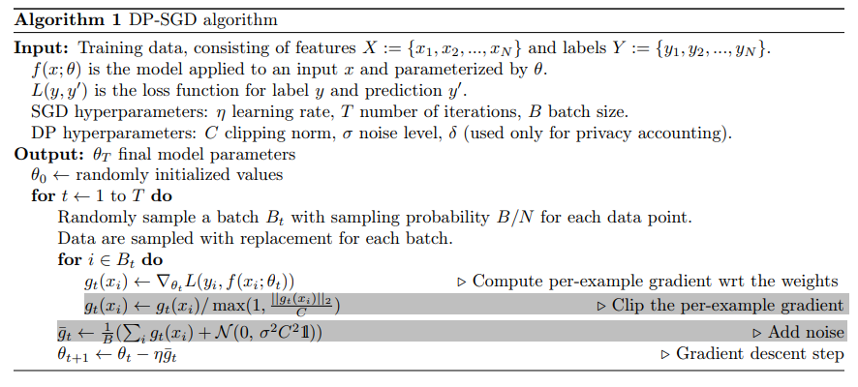
Differential Privacy
Gradient Noise Injection
Per example gradient L2-norm clipping
Add noise (Gaussian or Laplacian) to the gradients

Slide 14
Differential Privacy
Mainly Two Guarantees
Forward pass on a private output remains private
Privacy budget is cumulative; we can track the total amount of privacy used over the model’s training

Slide 15


Differential Privacy
Gradient Noise Injection
Per example gradient L2-norm clipping
Add noise (Gaussian or Laplacian) to the gradients
Caveats
Not easy to process per-example gradients for clipping; auto-diff libraries don’t really like this
Inefficient per-example gradient clipping can make model training slow
Loss of utility; loss of performance
More to tune; epsilon and delta

Slide 16
Differential Privacy
Mainly Two Guarantees
Forward pass on a private output remains private
Privacy budget is cumulative; we can track the total amount of privacy used over the model’s training

Slide 17

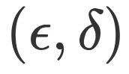
Differential Privacy
Mainly Two Guarantees
Forward pass on a private output remains private
Privacy budget is cumulative; we can track the total amount of privacy used over the model’s training
Accounting
represents the maximum privacy budget we are willing to spend about any specific data point
Every datapoint interaction with the model incurs privacy loss
In -differential privacy we define the bounds a low epsilon (<1.0) is privacy strict, while a larger epsilon is more permissive

Slide 18
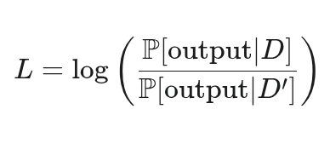
Differential Privacy
Mainly Two Guarantees
Forward pass on a private output remains private
Privacy budget is cumulative; we can track the total amount of privacy used over the model’s training
Accounting
represents the maximum privacy budget we are willing to spend about any specific data point
Every datapoint interaction with the model incurs privacy loss
In -differential privacy we define the bounds a low epsilon (<1.0) is privacy strict, while a larger epsilon is more permissive

Slide 19
Differential Privacy
Mainly Two Guarantees
Forward pass on a private output remains private
Privacy budget is cumulative; we can track the total amount of privacy used over the model’s training
Accounting
represents the maximum privacy budget we are willing to spend about any specific data point
Every datapoint interaction with the model incurs privacy loss
In -differential privacy we define the bounds a low epsilon (<1.0) is privacy strict, while a larger epsilon is more permissive
Moments accountant keeps a running total by considering the privacy loss at every batch training step as a random variable
  Noise injection
  Mini-batch sampling

Slide 20

Differential Privacy
Mainly Two Guarantees
Forward pass on a private output remains private
Privacy budget is cumulative; we can track the total amount of privacy used over the model’s training
Accounting
represents the maximum privacy budget we are willing to spend about any specific data point
Every datapoint interaction with the model incurs privacy loss
In -differential privacy we define the bounds a low epsilon (<1.0) is privacy strict, while a larger epsilon is more permissive
Moments accountant keeps a running total by considering the privacy loss at every batch training step as a random variable
  Noise injection
  Mini-batch sampling
ϵ is the maximum possible value that the privacy loss random variable can take

Slide 21
Differential Privacy
Mainly Two Guarantees
Forward pass on a private output remains private
Privacy budget is cumulative; we can track the total amount of privacy used over the model’s training
Accounting
represents the maximum privacy budget we are willing to spend about any specific data point
Every datapoint interaction with the model incurs privacy loss
In -differential privacy we define the bounds a low epsilon (<1.0) is privacy strict, while a larger epsilon is more permissive
Moments accountant keeps a running total by considering the privacy loss at every batch training step as a random variable
  Noise injection
  Mini-batch sampling
So don’t just add the epsilon values that’s the worst case privacy loss, we want a tighter bound!
Use a moment generating function (MGF)

Slide 22
Differential Privacy
Mainly Two Guarantees
Forward pass on a private output remains private
Privacy budget is cumulative; we can track the total amount of privacy used over the model’s training
Accounting
represents the maximum privacy budget we are willing to spend about any specific data point
Every datapoint interaction with the model incurs privacy loss
In -differential privacy we define the bounds a low epsilon (<1.0) is privacy strict, while a larger epsilon is more permissive
Moments accountant keeps a running total by considering the privacy loss at every batch training step as a random variable
  Noise injection
  Mini-batch sampling
How to DP-fy ML: A Practical Guide to Machine Learning with Differential Privacy
https://arxiv.org/abs/2303.00654

Slide 23
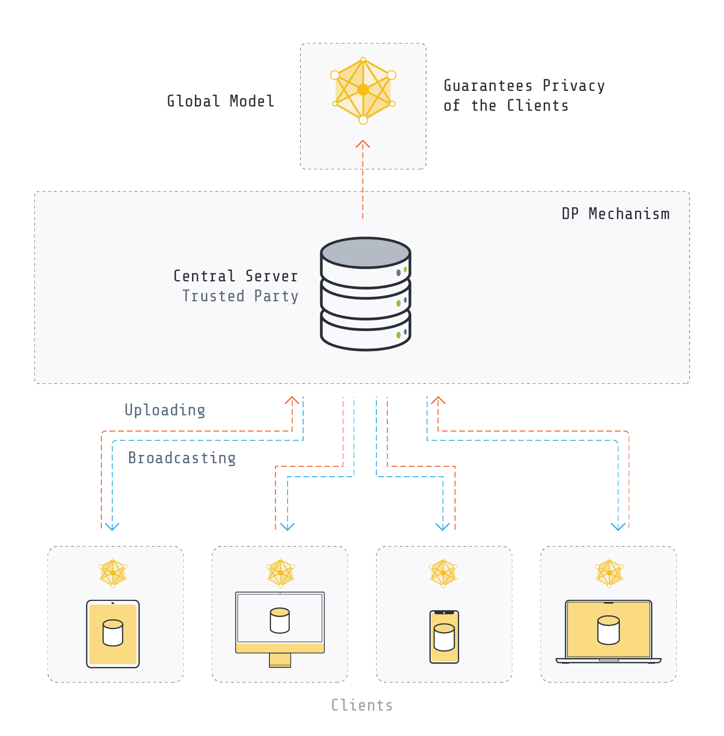
Differential Privacy in FL
Two Types of DP in FL
Central DP

Slide 24
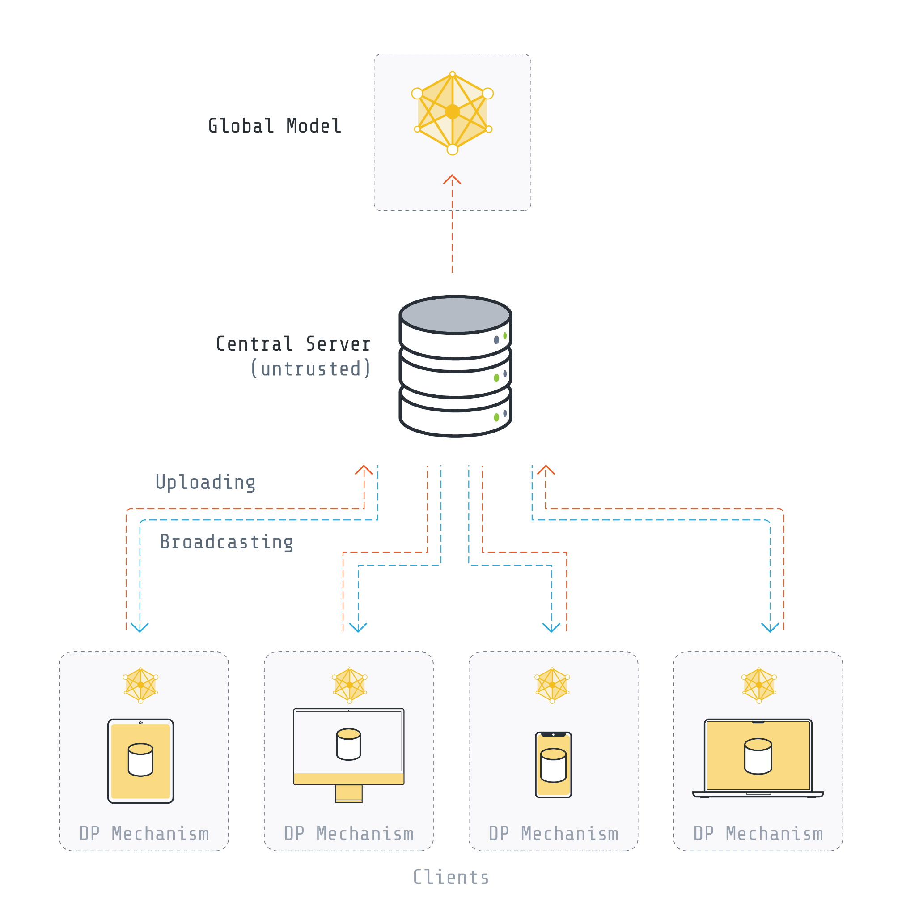
Differential Privacy in FL
Two Types of DP in FL
Central DP
Local DP

Slide 25
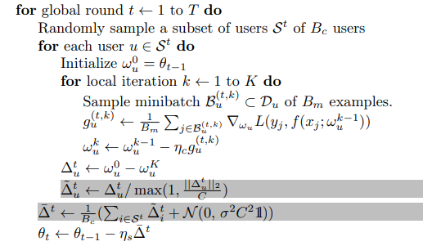
Differential Privacy in FL
Two Types of DP in FL
Central DP
Local DP
User-Level DP; Protect the client

Slide 26
Chapter green
Privacy-Utility Trade Off
High Performance Machine Learning Group

Slide 27
VaultGemma
https://research.google/blog/vaultgemma-the-worlds-most-capable-differentially-private-llm/
For a given compute budget, privacy budget, and data budget, what is the optimal training configuration to achieve the lowest possible training loss?
VaultGemma was trained with a sequence-level DP guarantee of (ε ≤ 2.0, δ ≤ 1.1e-10), where a sequence consists of 1024 consecutive tokens

Slide 28
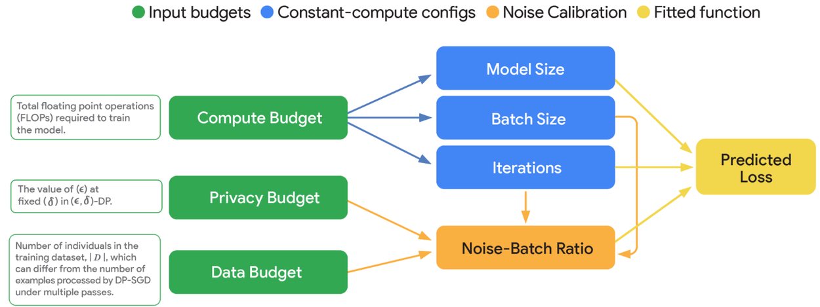
https://research.google/blog/vaultgemma-the-worlds-most-capable-differentially-private-llm/
VaultGemma
For a given compute budget, privacy budget, and data budget, what is the optimal training configuration to achieve the lowest possible training loss?
VaultGemma was trained with a sequence-level DP guarantee of (ε ≤ 2.0, δ ≤ 1.1e-10), where a sequence consists of 1024 consecutive tokens

Slide 29
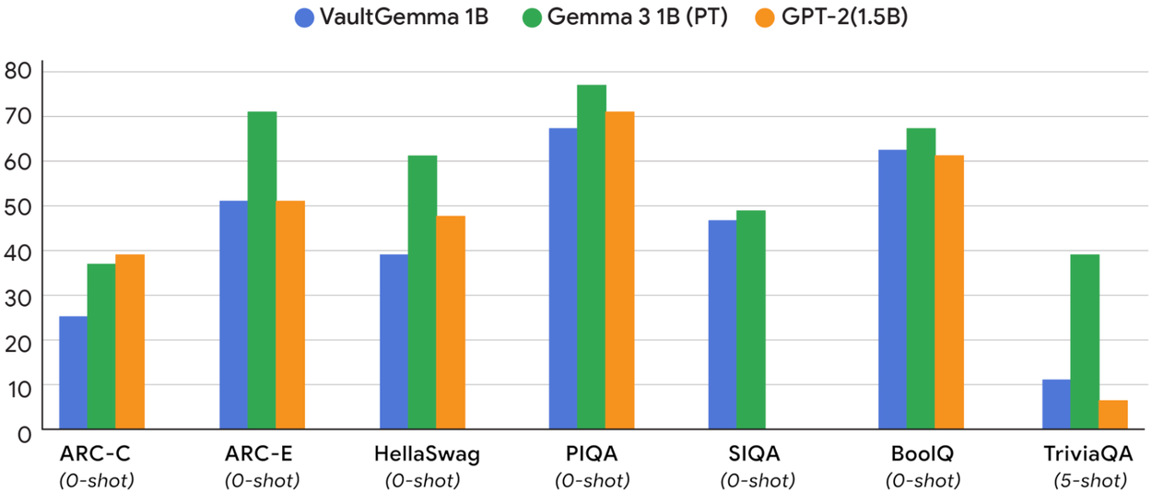
https://research.google/blog/vaultgemma-the-worlds-most-capable-differentially-private-llm/
VaultGemma
For a given compute budget, privacy budget, and data budget, what is the optimal training configuration to achieve the lowest possible training loss?
VaultGemma was trained with a sequence-level DP guarantee of (ε ≤ 2.0, δ ≤ 1.1e-10), where a sequence consists of 1024 consecutive tokens

Slide 30
https://research.google/blog/vaultgemma-the-worlds-most-capable-differentially-private-llm/
VaultGemma
For a given compute budget, privacy budget, and data budget, what is the optimal training configuration to achieve the lowest possible training loss?
VaultGemma was trained with a sequence-level DP guarantee of (ε ≤ 2.0, δ ≤ 1.1e-10), where a sequence consists of 1024 consecutive tokens
Data filter in VaultGemma
Unwanted or unsafe utterances
Personal information or other sensitive data
Decontaminate evaluation sets from the pretraining data mixture
Reduce the risk of recitation by minimizing the proliferation of sensitive outputs

Slide 31
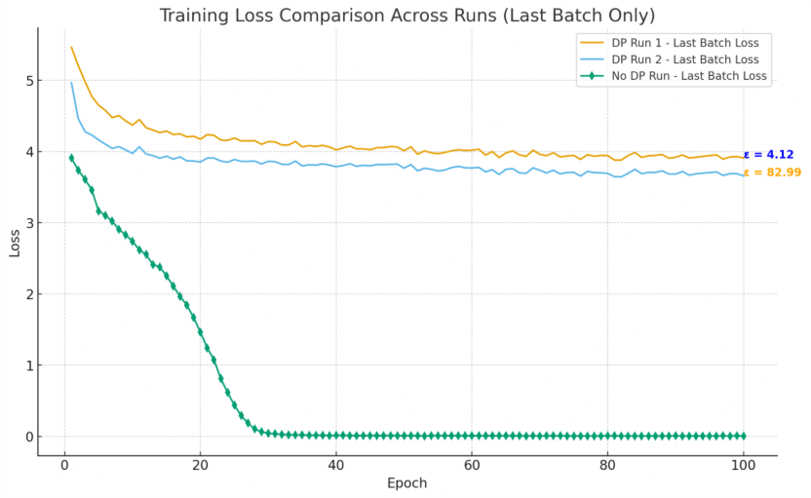
Locally trained DP-SLM
Very Difficult to tune the model
Maybe try only fine tuning on private data
finding a set of hyperparameters that yields a model with both a meaningful privacy guarantee (a low ε) and acceptable task performance is a non-trivial task.
Utility gap will always exist

Slide 32
Chapter yellow
Questions?
High Performance Machine Learning Group

Slide 33
Chapter yellow
U

