Slide 1

Chapter yellow
SigLIP in Federated Learning
Bryan Cardenas
Douwe van der Wal
High Performance Machine Learning

Slide 2
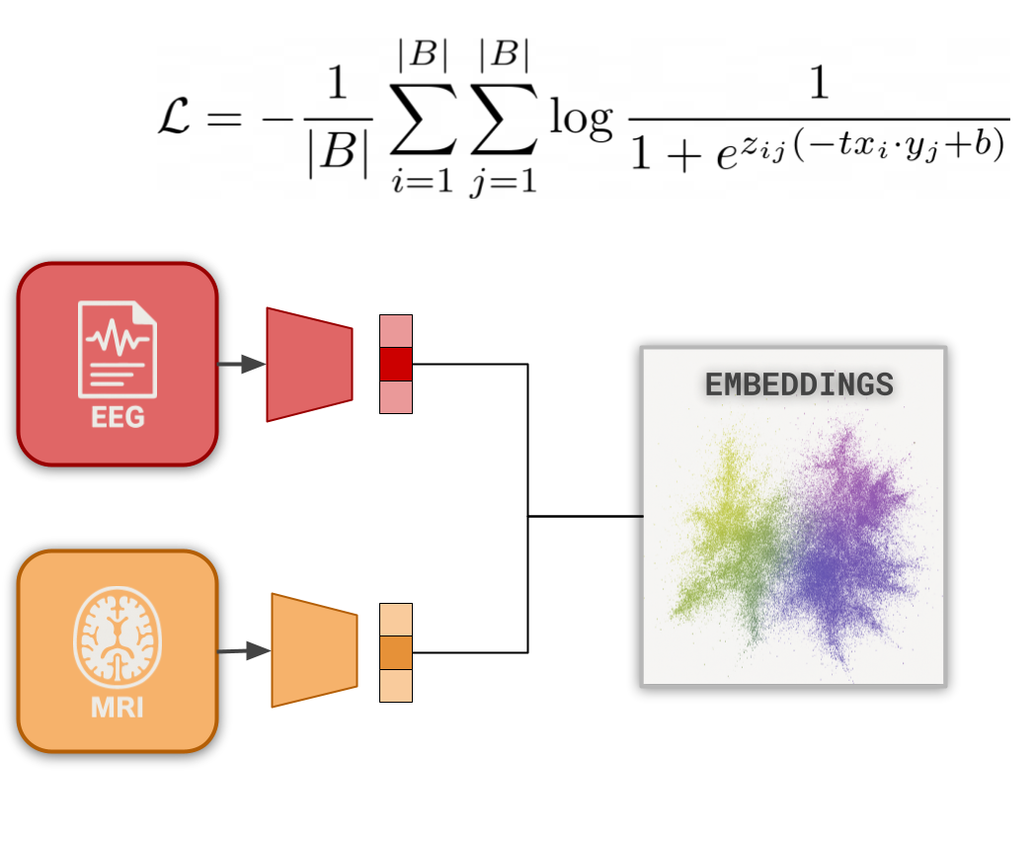
SigLIP Training of Embeddings
Based on CLIP with Sigmoid Loss
Modality Specific Encoder
Create a shared embedding space
Distributing SigLIP model relatively straightforward
[2303.15343] Sigmoid Loss for Language Image Pre-Training

Slide 3
SigLIP Training of Embeddings
Based on CLIP with Sigmoid Loss
Modality Specific Encoder
Create a shared embedding space
Distributing SigLIP model relatively straightforward
[2303.15343] Sigmoid Loss for Language Image Pre-Training

Slide 4
How to Federate?
01.
02.
03.
04.
Not all clients have the same patient data
Data distribution varies a lot
Not all clients have the same modalities
Vertical modalities
Not the same amount of data
One representation type would dominate over the others
How to partition
the model?
How to share or break up the
model for the benefit of all?

Slide 5

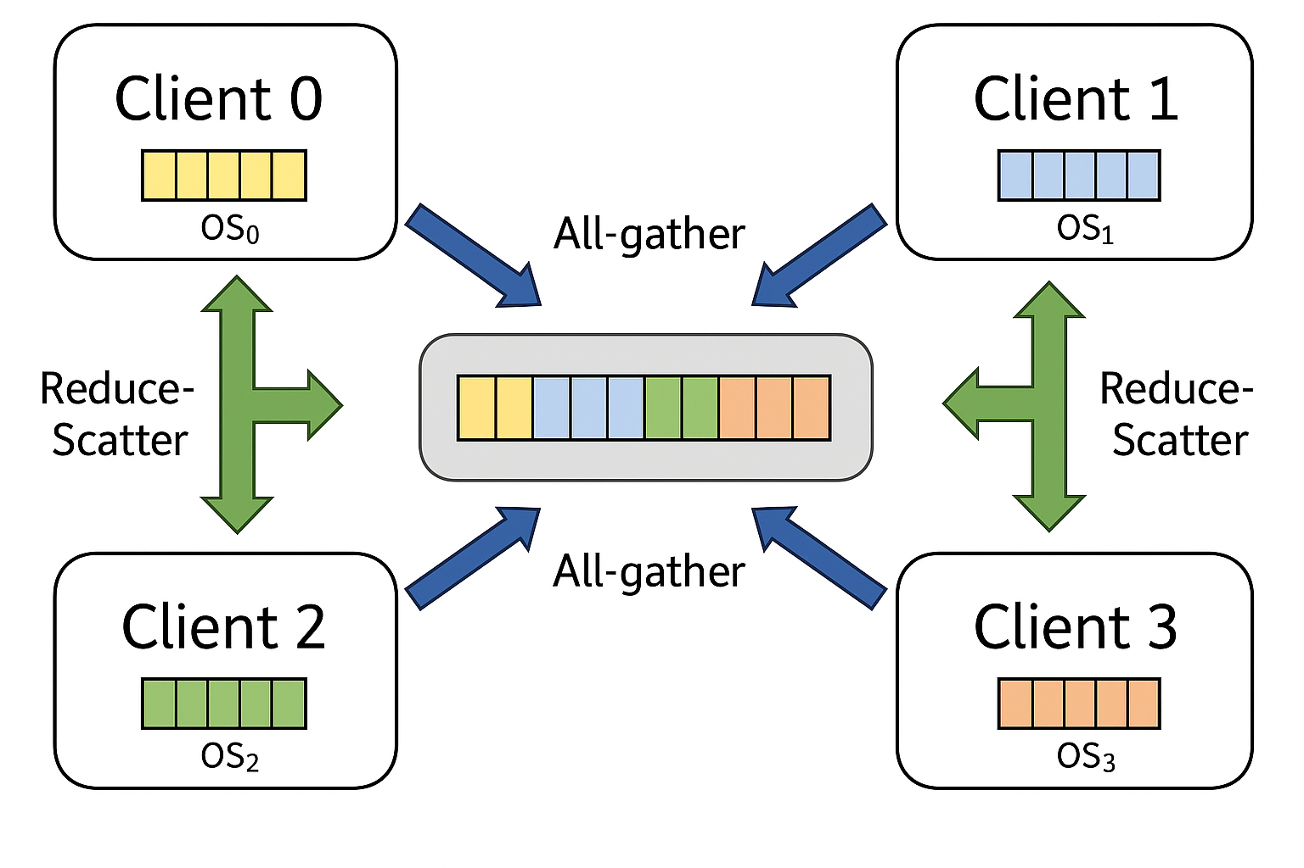

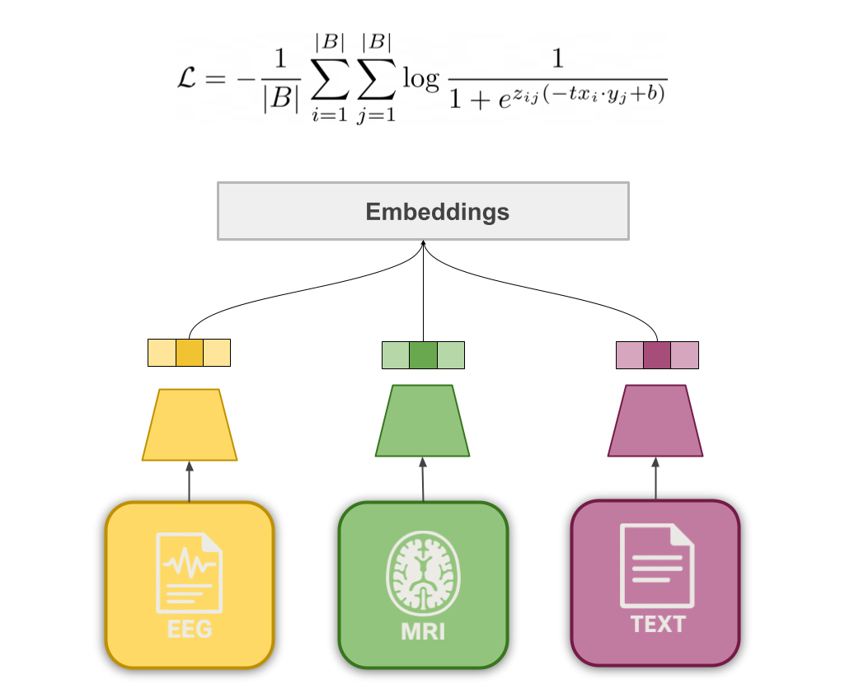
Federated SigLIP: Assume no shared (patient) data points
Distribute the Encoders
Unified Encoder and One Shared Modality
Communicating parts of the Network
Each client gets a different “specialized” encoder
Share the embeddings or the loss?
Communicate gradients? Losses? Embeddings? Or merge them in the global client? How many updates?
Every client should have one modality present at all times, for instance, text.

Slide 6
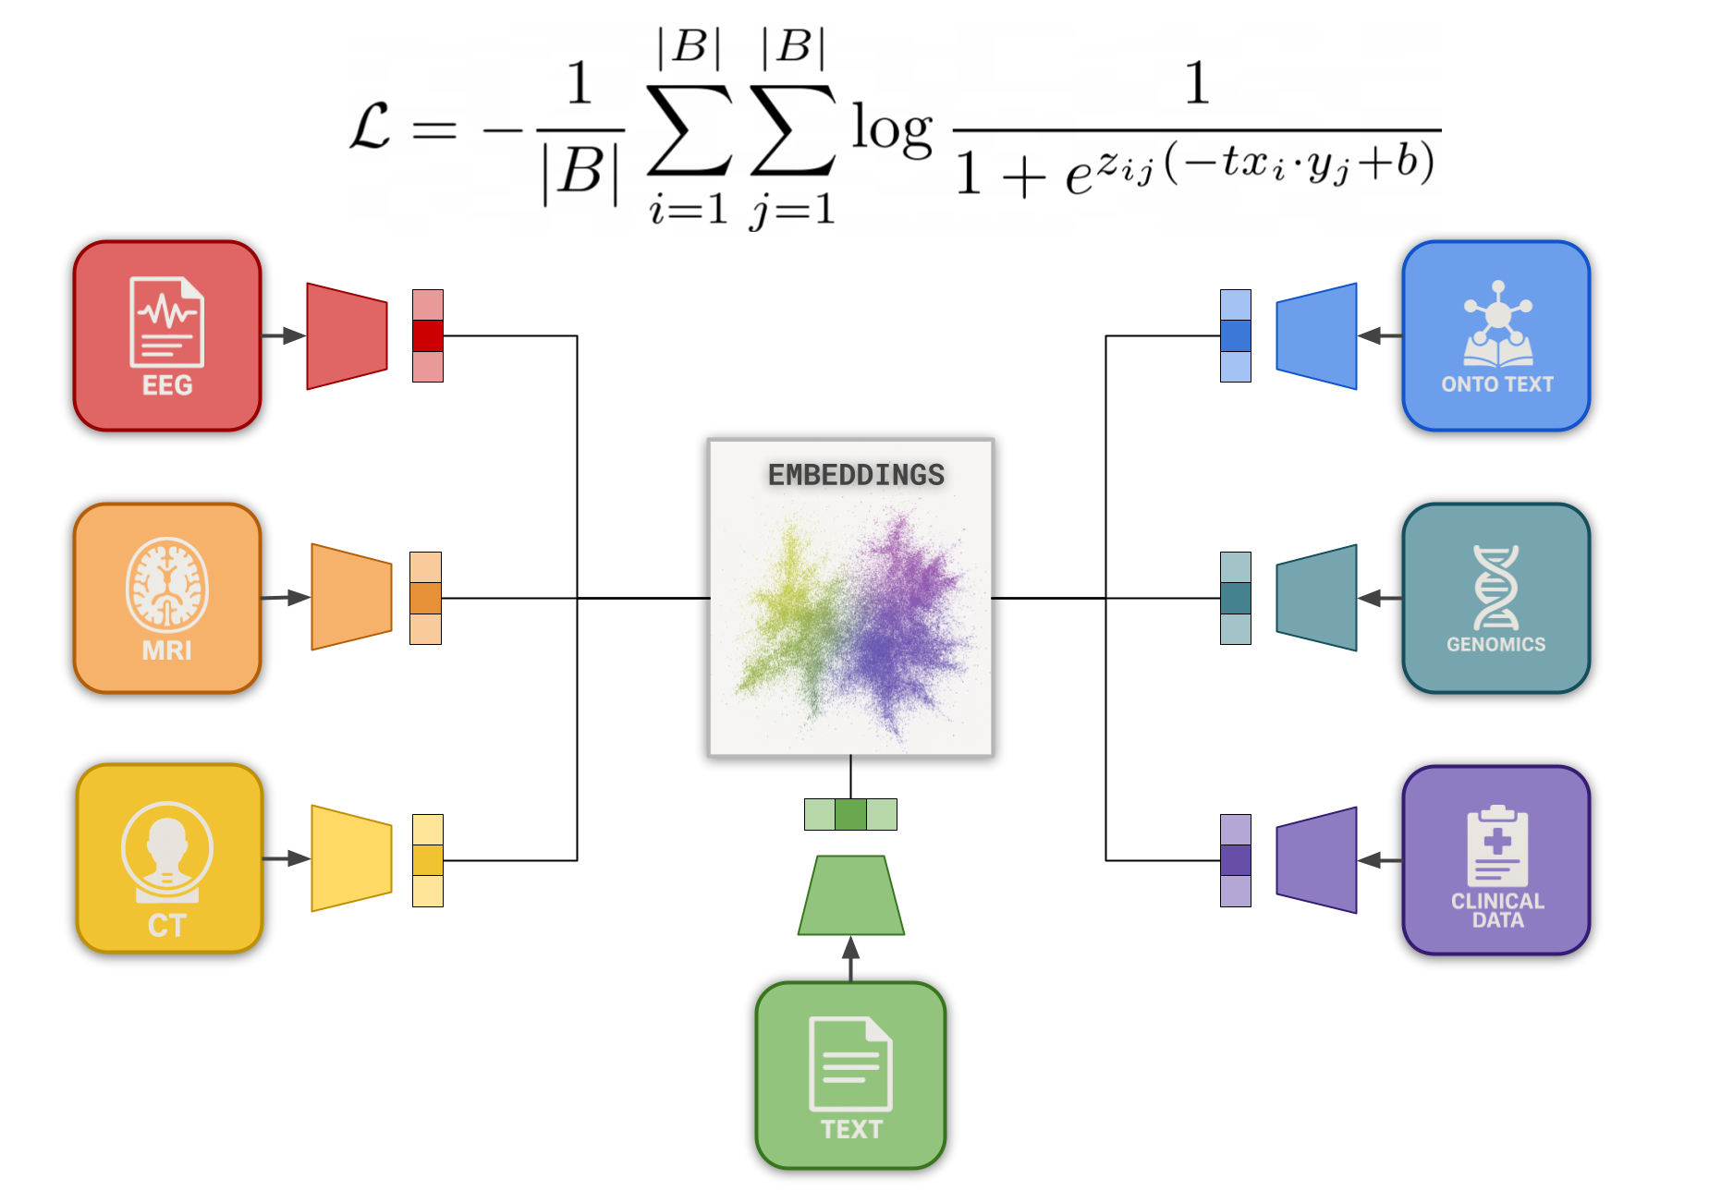
SigLIP for True Multi Modality
Best if there is one “binder” modality
Modality Specific Encoders
Best with bigger batch sizes

Slide 7
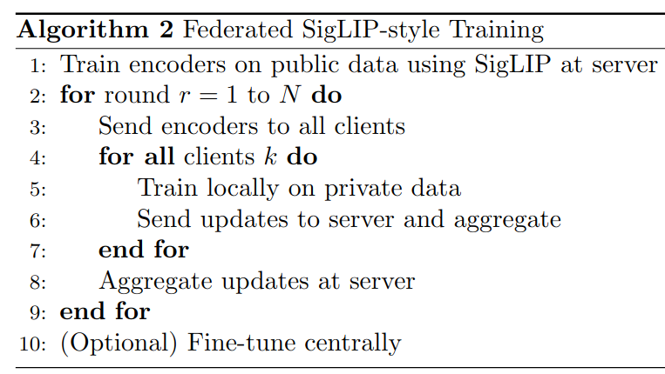

SigLIP for True Multi Modality
EMBEDDINGS

Slide 8
SigLIP for True Multi Modality
EMBEDDINGS

Slide 9
SigLIP for True Multi Modality
EMBEDDINGS

Slide 10
SigLIP for True Multi Modality
EMBEDDINGS

Slide 11
SigLIP for True Multi Modality
EMBEDDINGS

Slide 12
SigLIP for True Multi Modality
EMBEDDINGS

Slide 13
SigLIP for True Multi Modality
EMBEDDINGS

Slide 14
SigLIP for True Multi Modality
EMBEDDINGS

Slide 15
SigLIP for True Multi Modality
Pretrain
Federate
Posttrain

Slide 16
SigLIP for True Multi Modality
Pretrain
Federate
Posttrain

Slide 17
Suggestions?

