Slide 1
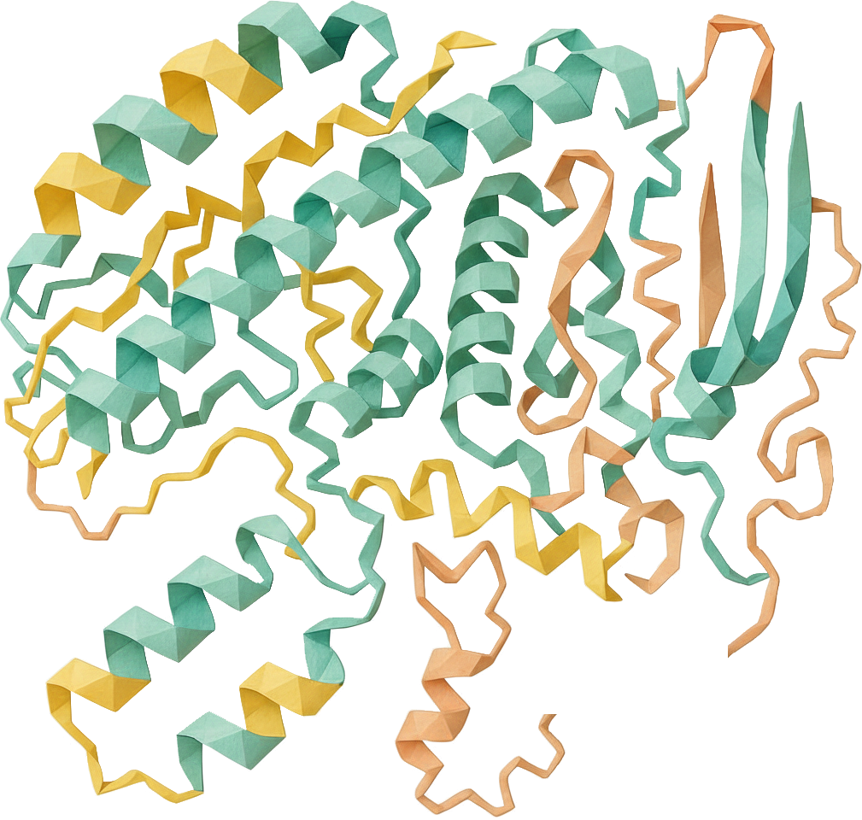

Chapter yellow
Protein Folding & Design
Bryan Cardenas
High Performance Machine Learning

Slide 2
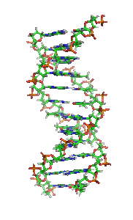
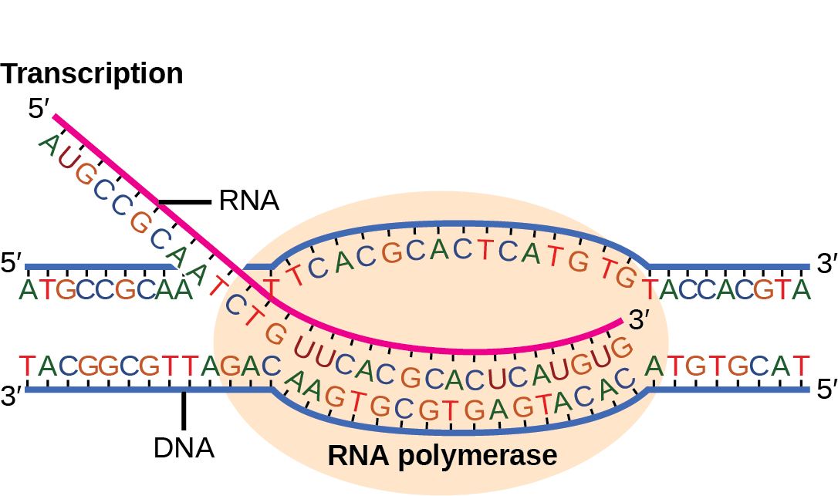

ACTG

Slide 3
Transcription
Open, read, copy (mRNA)
Translation
read, fetch (tRNA), create protein
Generate protein until stop codon
ACTG

Slide 4
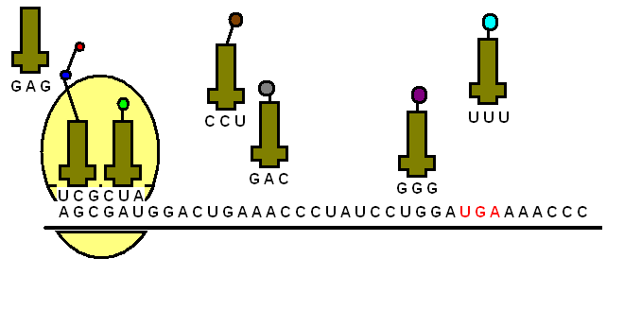
Transcription
Open, read, copy (mRNA)
Translation
read, fetch (tRNA), create protein
Generate protein until stop codon
ACTG

Slide 5
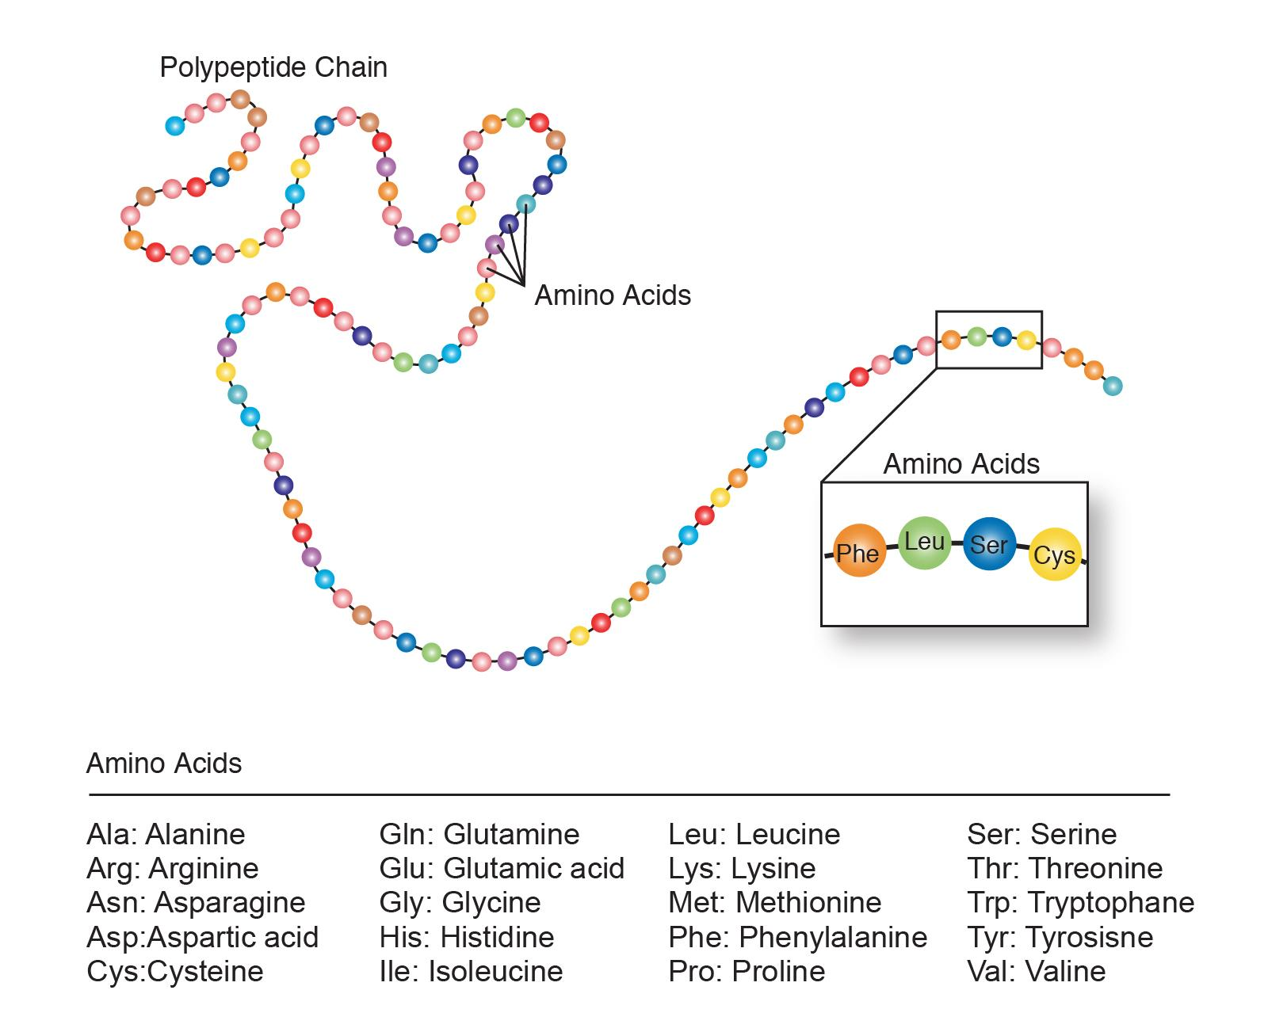
Transcription
Open, read, copy (mRNA)
Translation
read, fetch (tRNA), create protein
Generate protein until stop codon

Slide 6
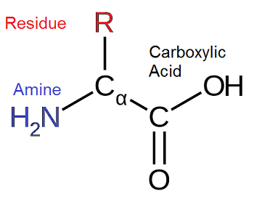

Slide 7

ACTG

Slide 8
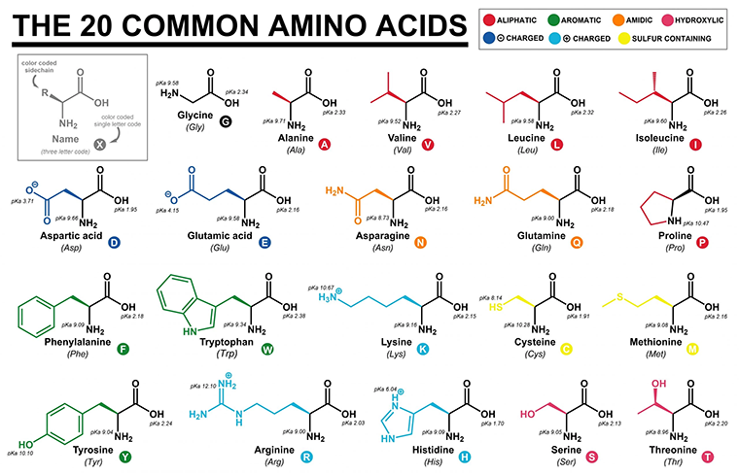
ACTG

Slide 9
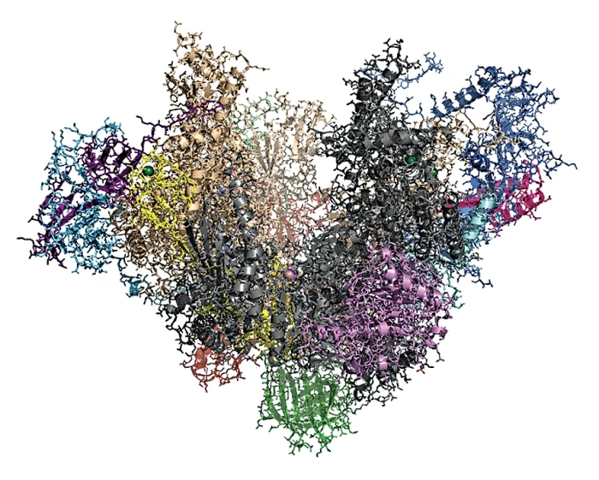
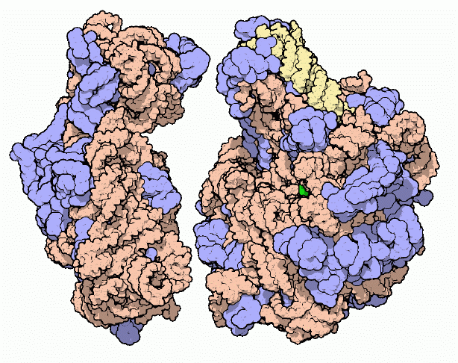
RNA Polymerase
Ribosome

Slide 10
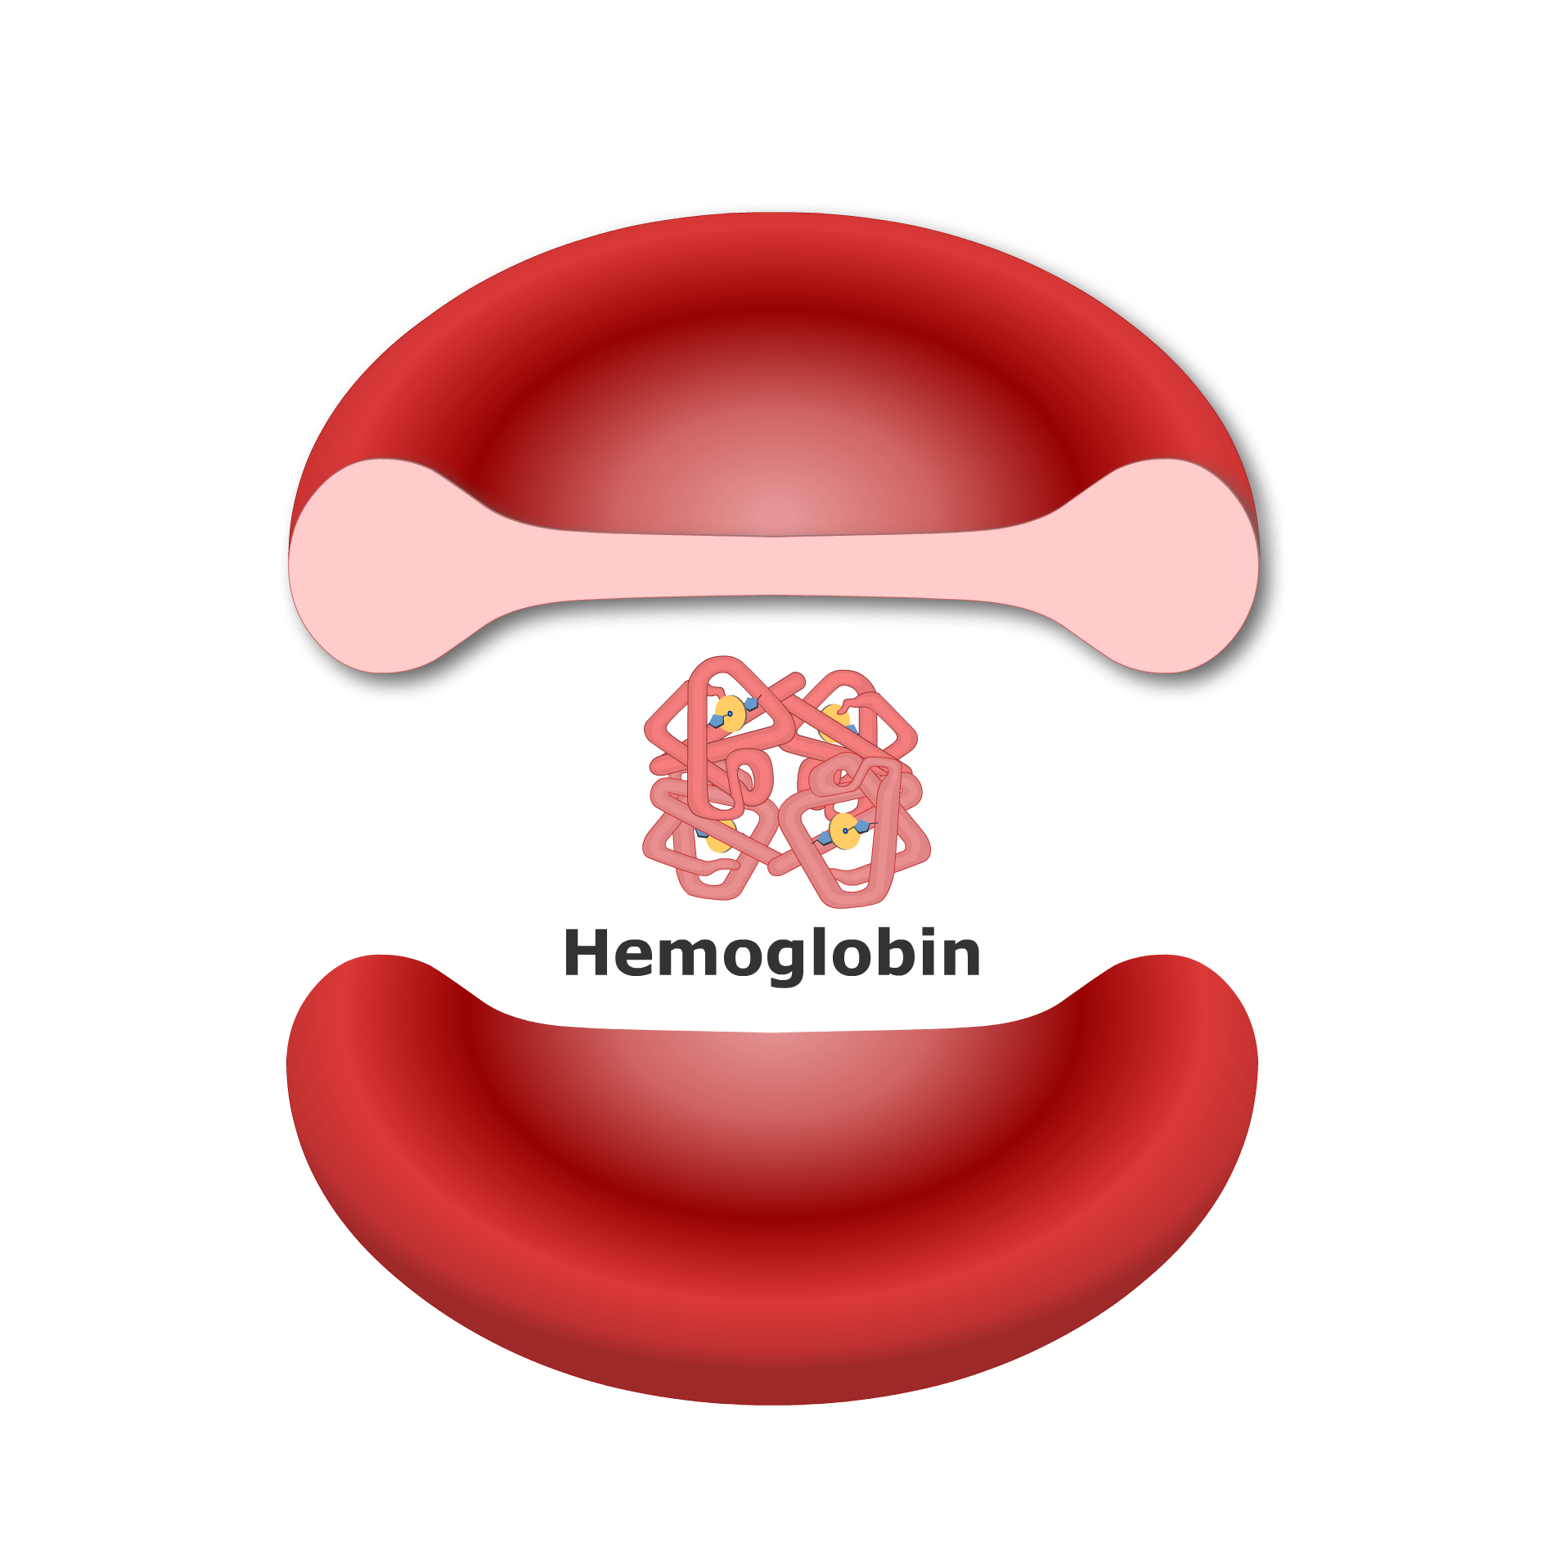
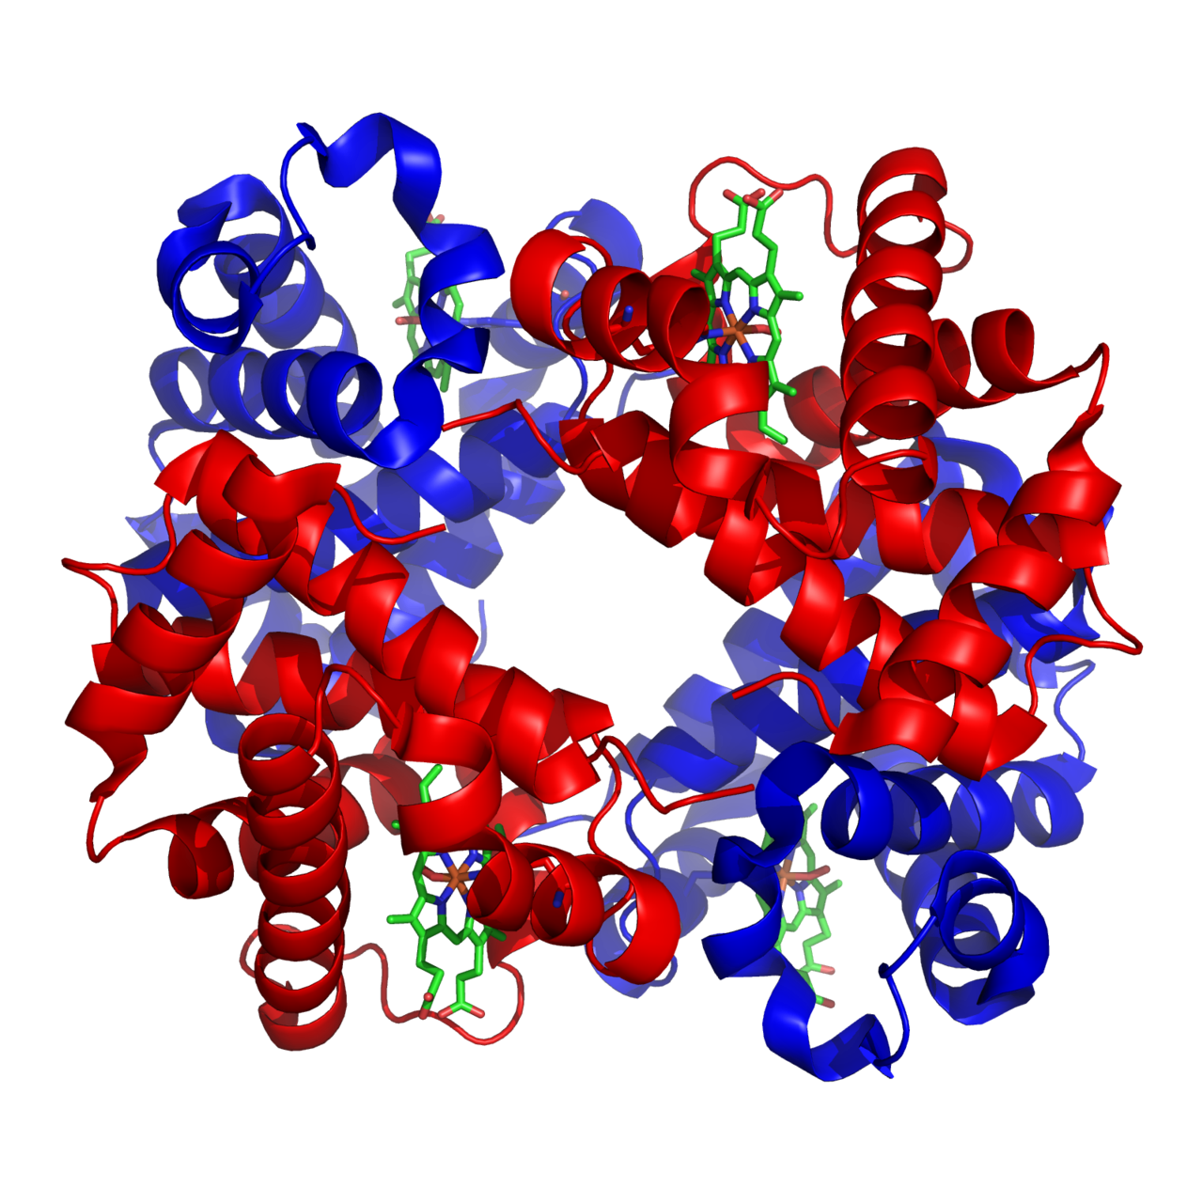
Hemoglobin
Heterotetramer

Slide 11
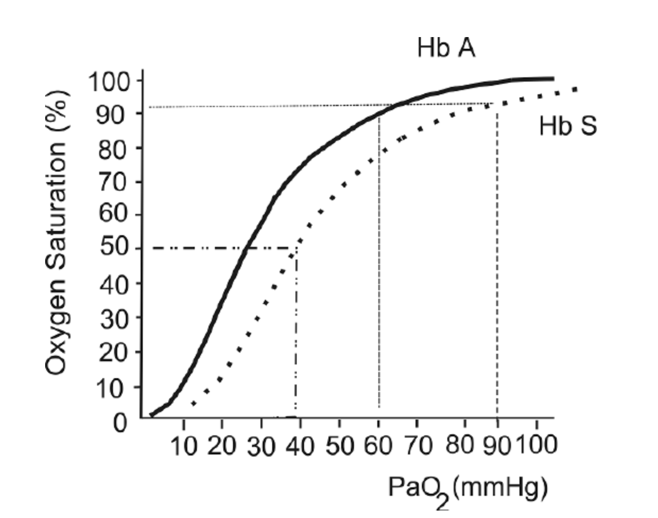
Hemoglobin
Heterotetramer

Slide 12
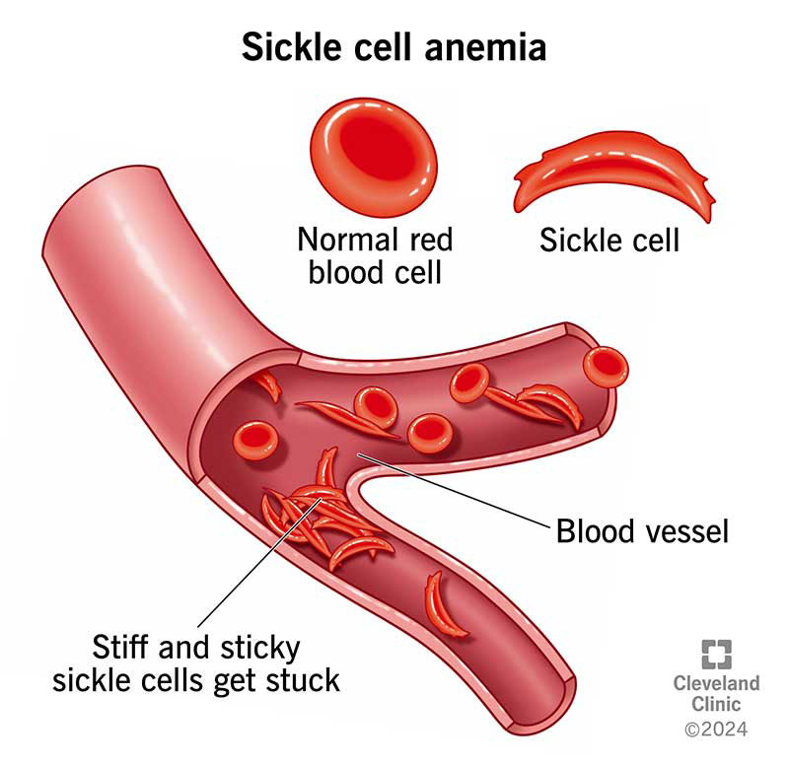
Hemoglobin
Heterotetramer

Slide 13
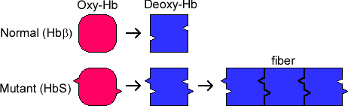
Hemoglobin

Slide 14
Hemoglobin
Heterotetramer

Slide 15
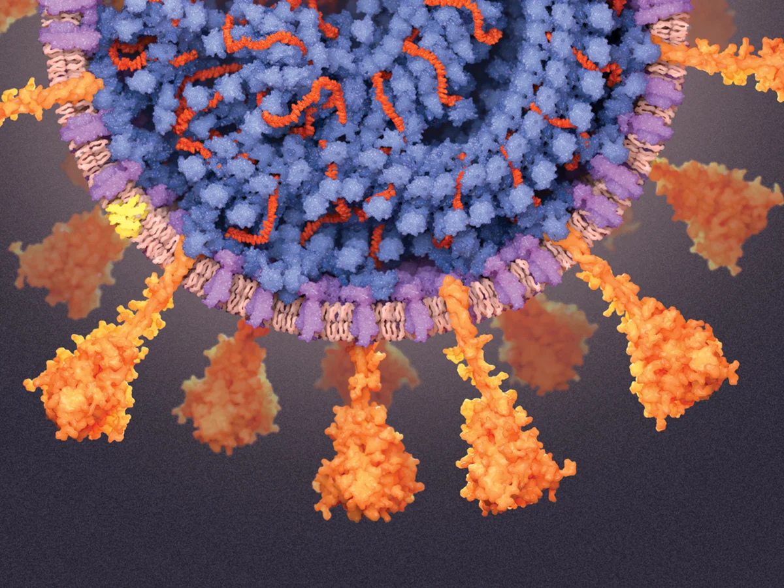
SARS-COV-2 Spike glycoprotein homotrimer

Slide 16
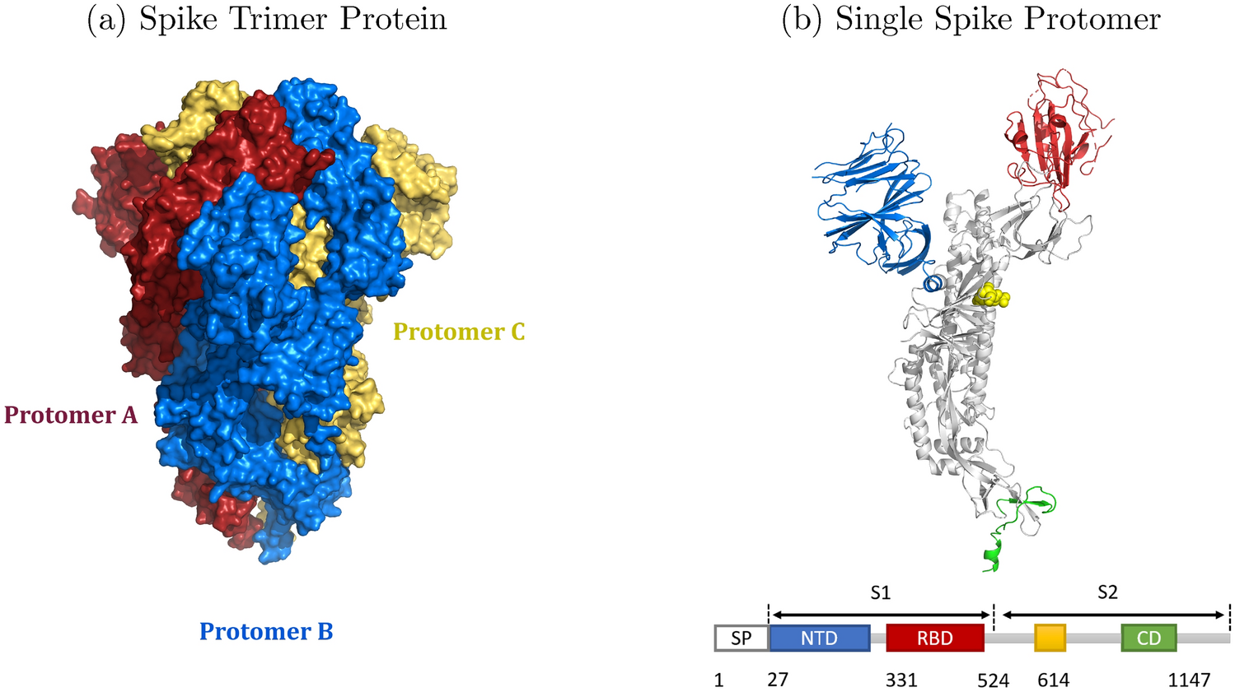
SARS-COV-2 Spike glycoprotein homotrimer

Slide 17
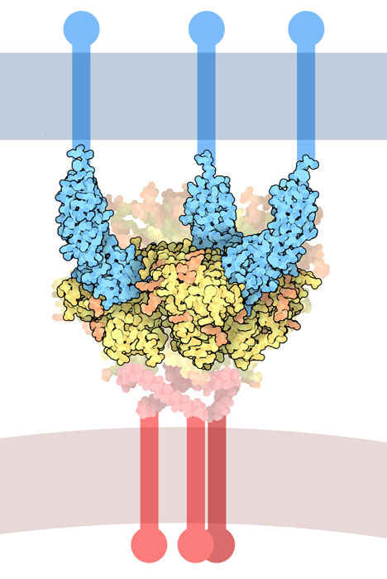
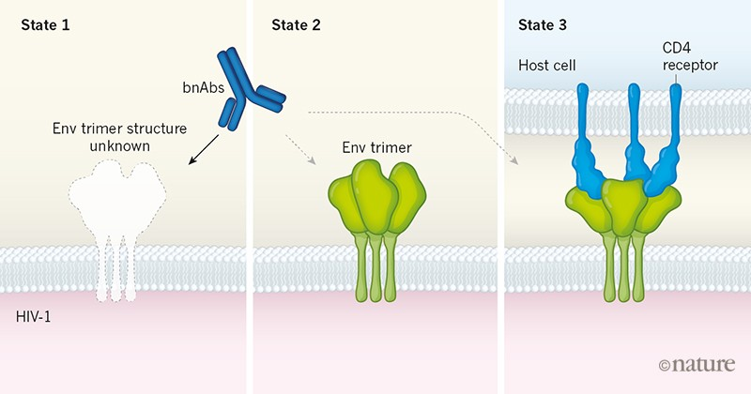
Hiv-1 Env Glycoprotein trimer
Trimer

Slide 18
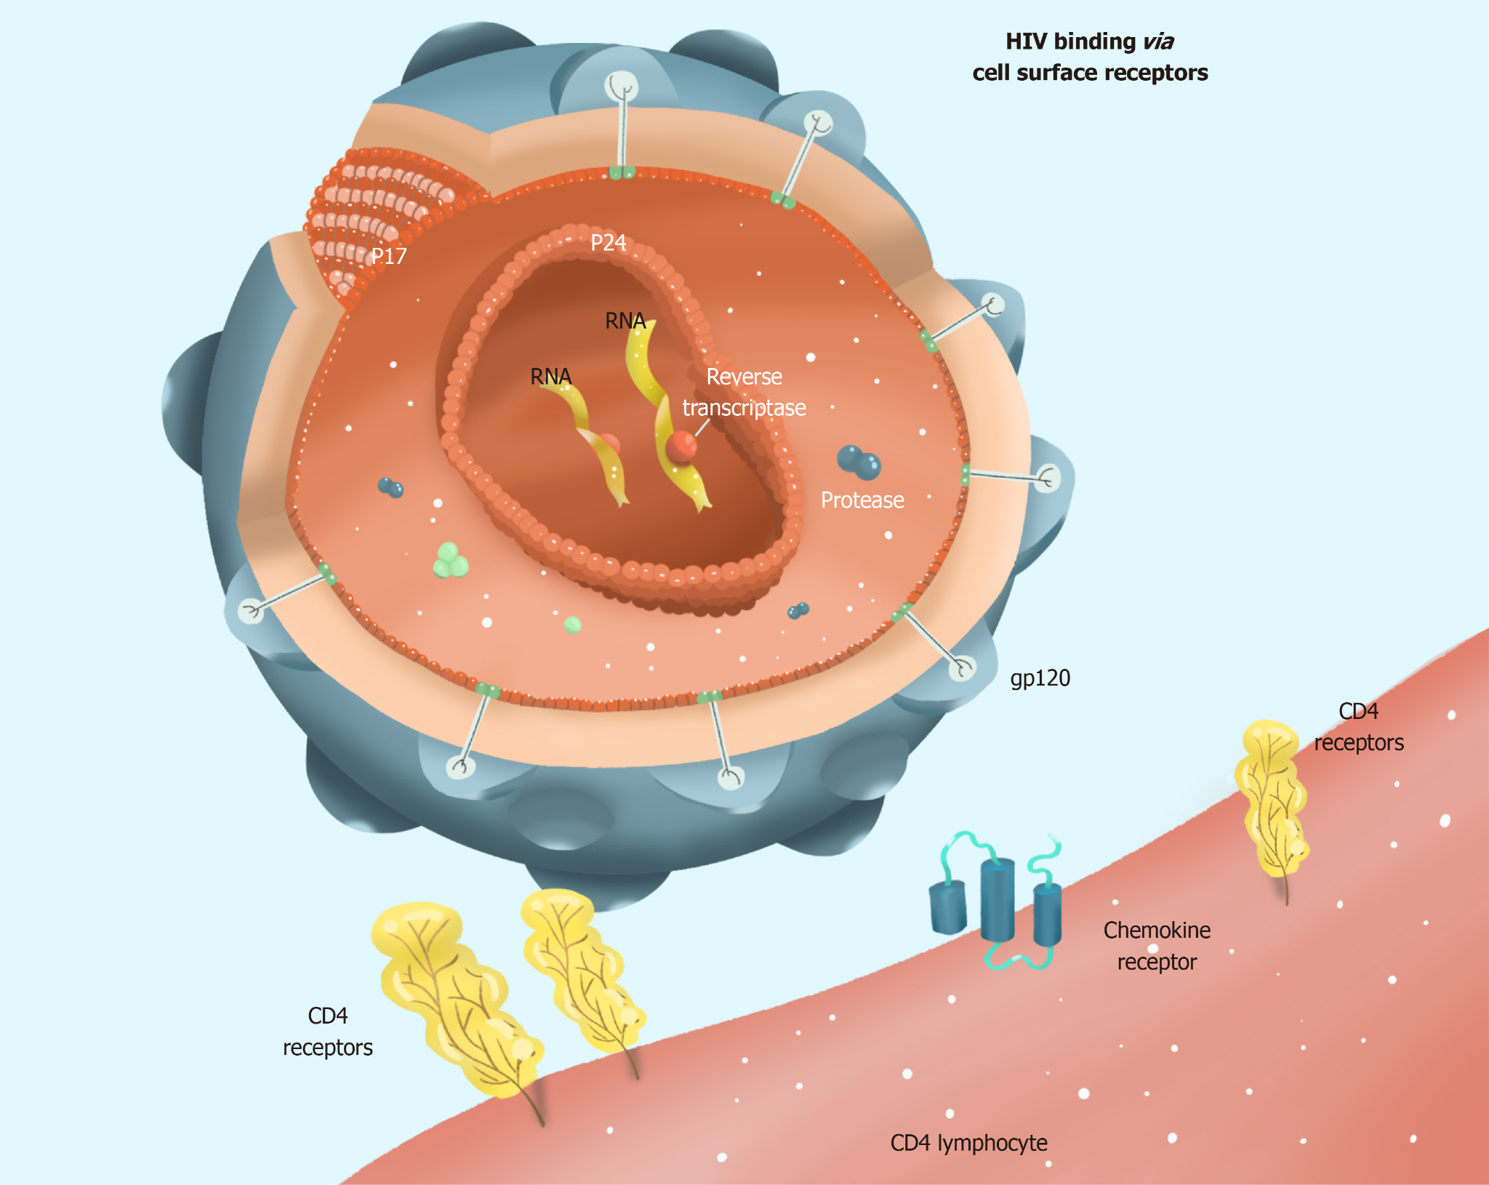
Hiv-1 Env Glycoprotein trimer
Trimer

Slide 19
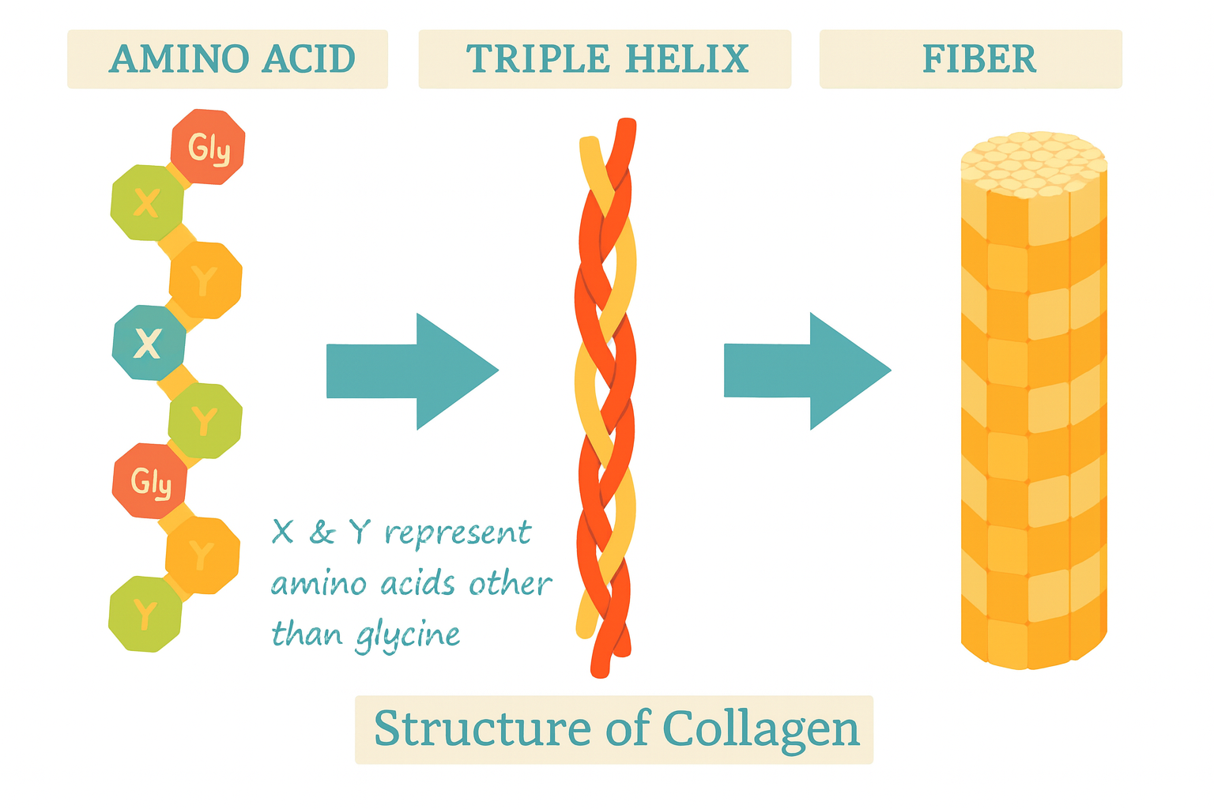
Structure of Collagen

Slide 20
Chapter orange
Evolution of Structure
High Performance Machine Learning Group

Slide 21
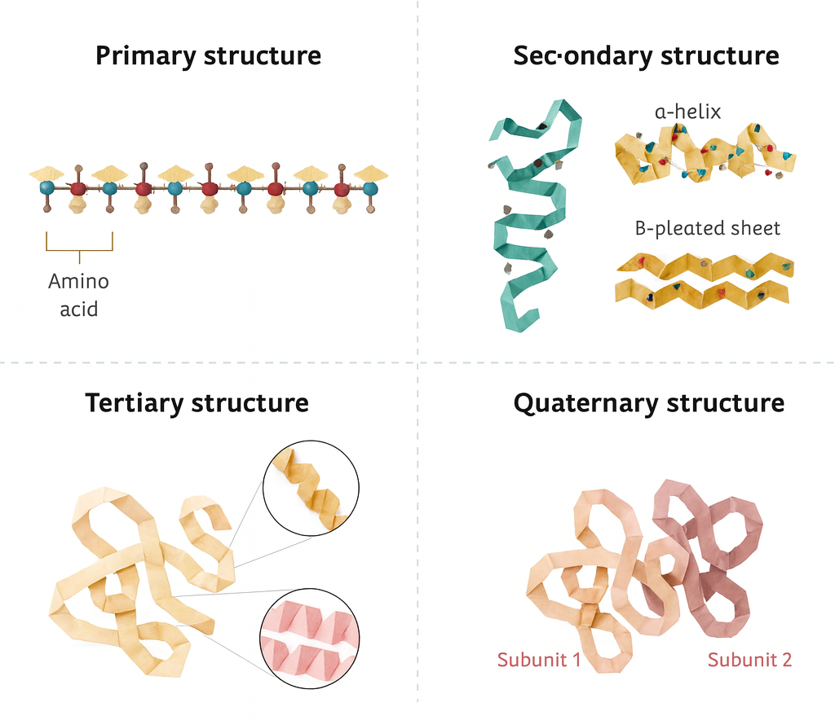
Hierarchy of Structure

Slide 22
Hierarchy of Structure

Slide 23
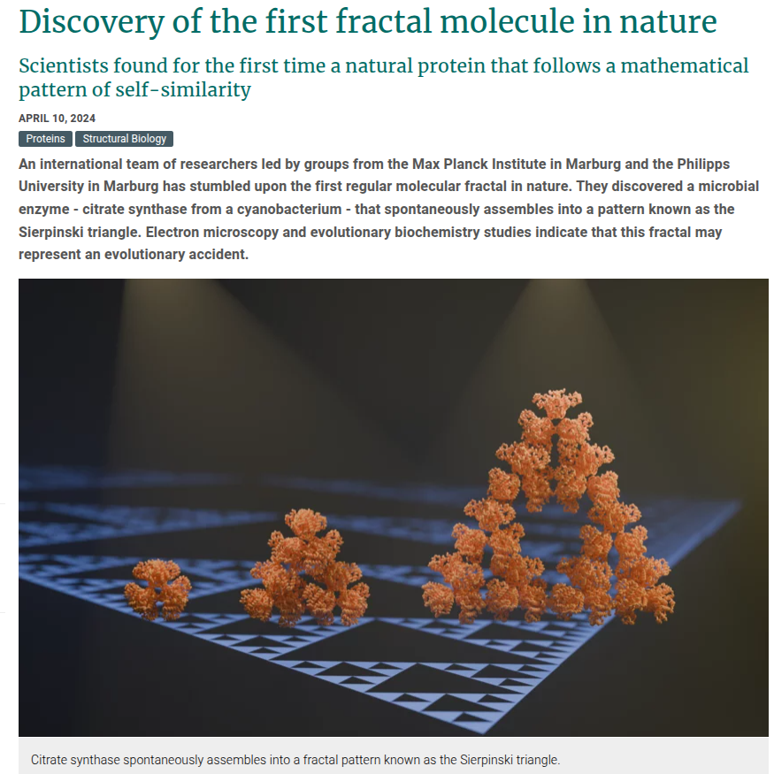

Slide 24
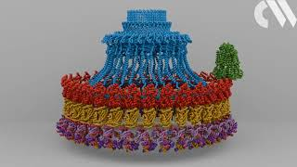

Slide 25
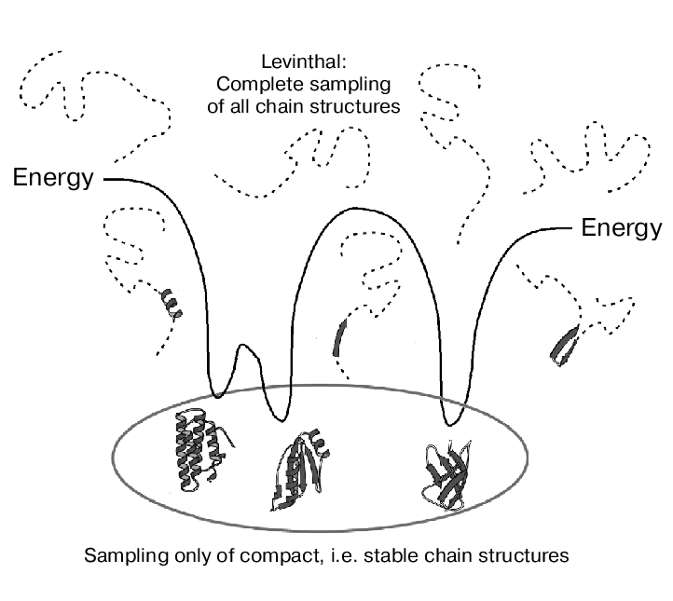
Levinthal’s paradox
Proteins can fold in a astronomical number of different ways

Slide 26
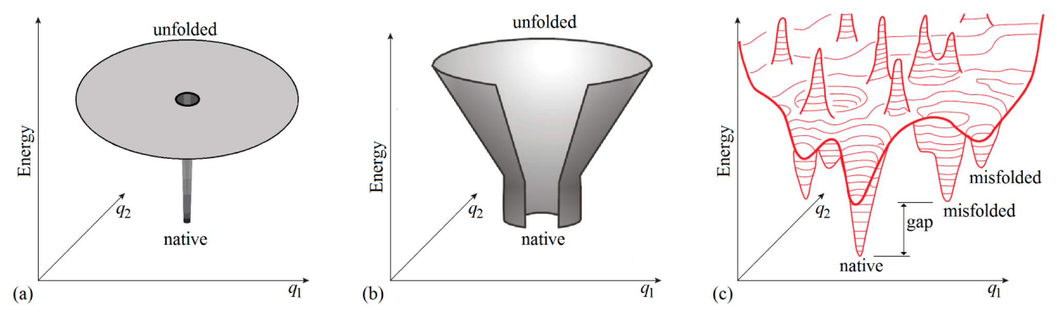
Levinthal’s paradox
Proteins can fold in a astronomical number of different ways
Protein always finds a stable minimum of the folding landscape

Slide 27
Levinthal’s paradox
Proteins can fold in a astronomical number of different ways
Protein always finds a stable minimum of the folding landscape
Sequential process along a biased energy funnel

Slide 28
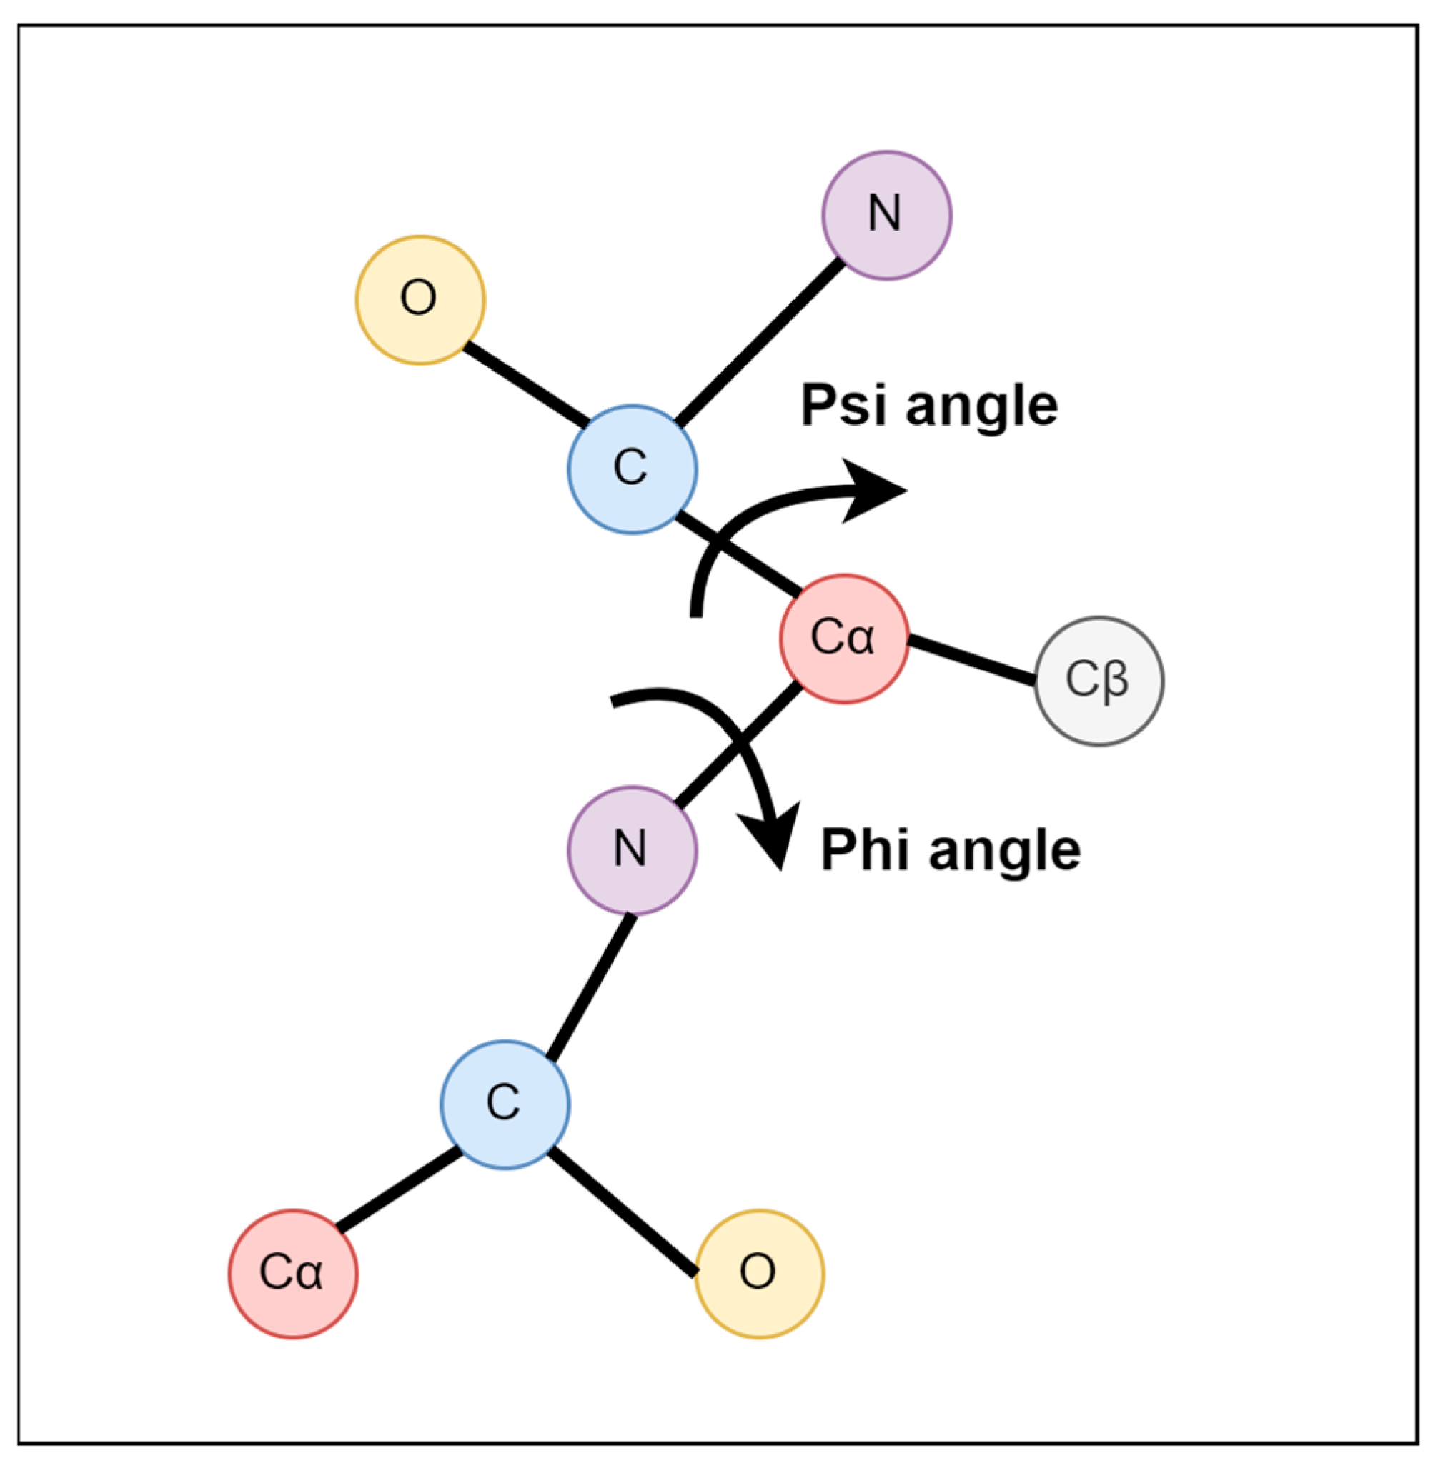
Levinthal’s paradox
Proteins can fold in a astronomical number of different ways
Protein always finds a stable minimum of the folding landscape
Sequential process along a biased energy funnel

Slide 29
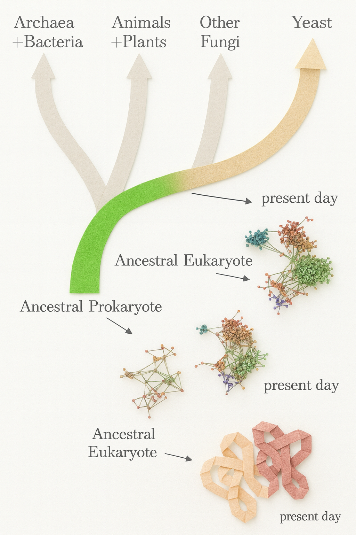

Slide 30
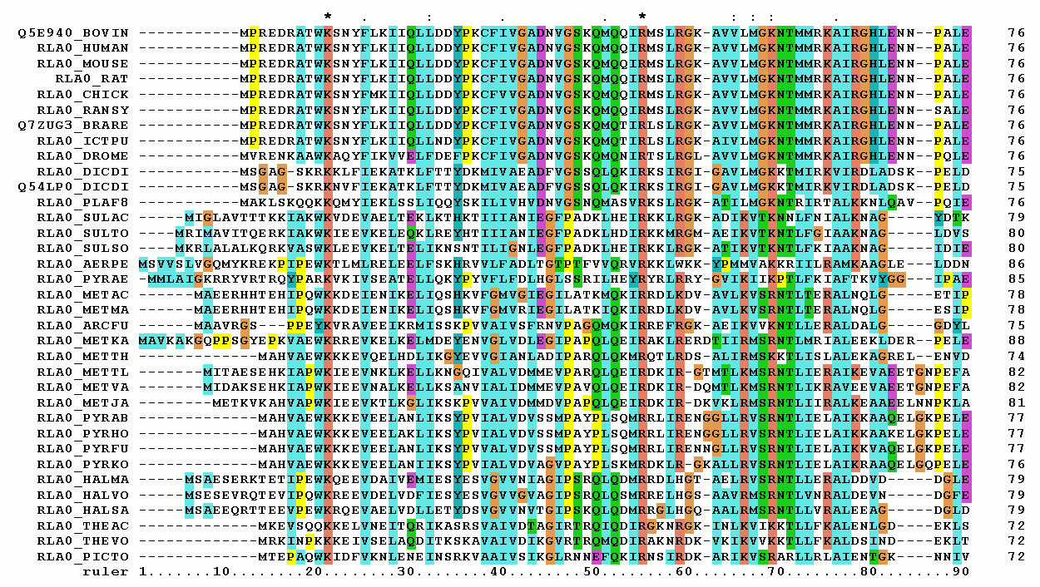
Multiple Sequence Alignment

Slide 31
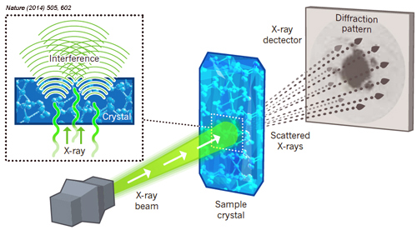
Guide to Obtain the Structure
X-Ray Crystallography
Gold Standard
Problems:
crystallize the proteins
Requires a Synchrotron
Synchrotron usage: 150k
Multi-year Project per protein
Some proteins don’t crystallize

Slide 32
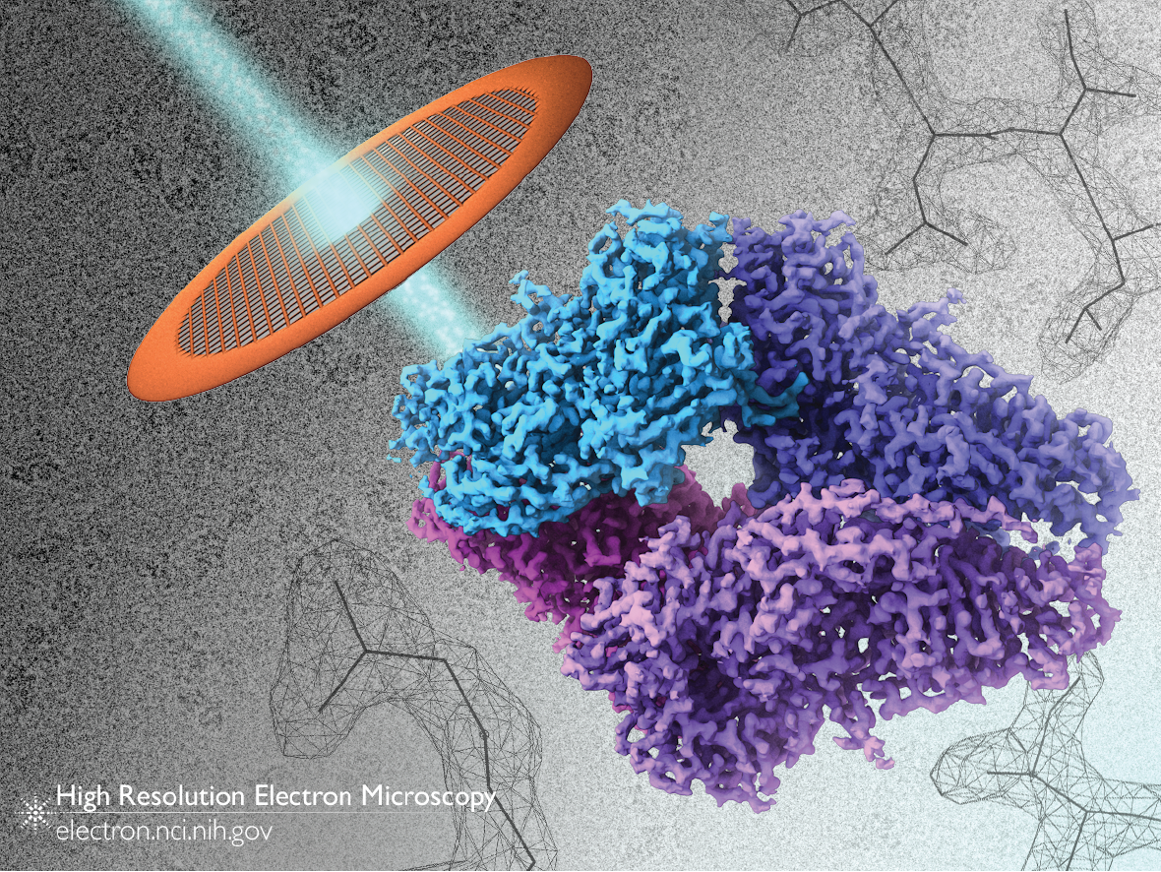
Guide to Obtain the Structure
2. Cryo-EM
Problems:
Expensive (5-10m)
Maintenance
5-20k a day operation costs
Not so good for small proteins

Slide 33
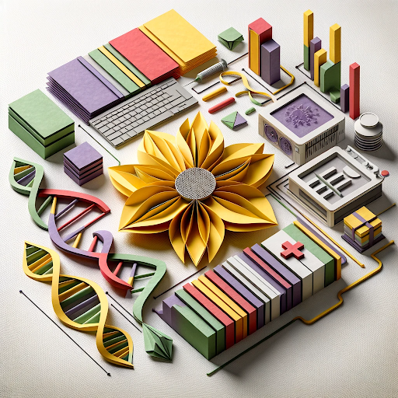
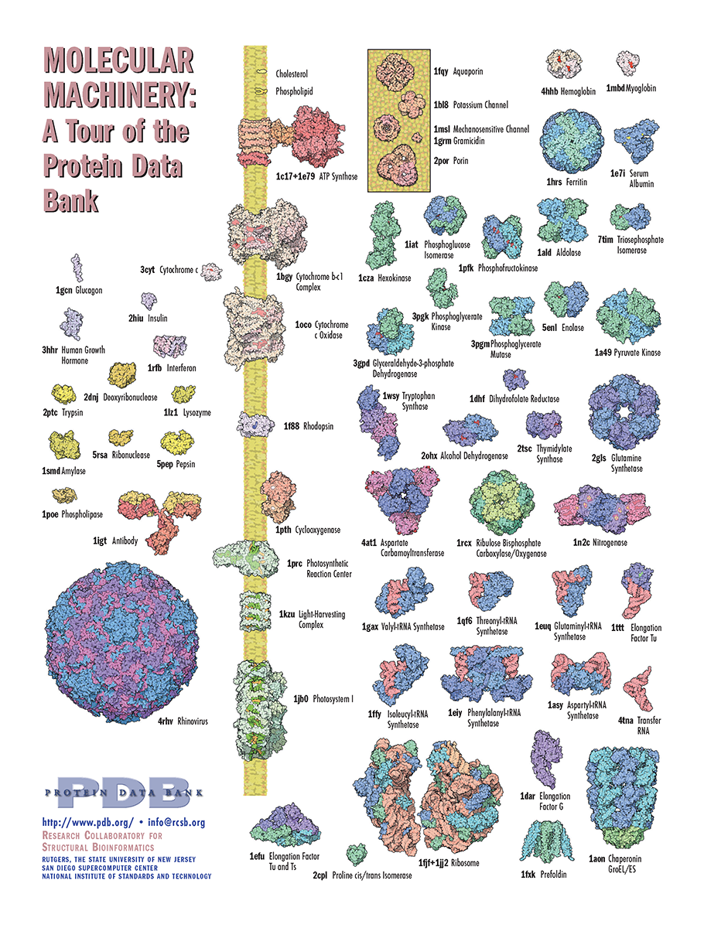
Protein Data Bank (PDB)

Slide 34
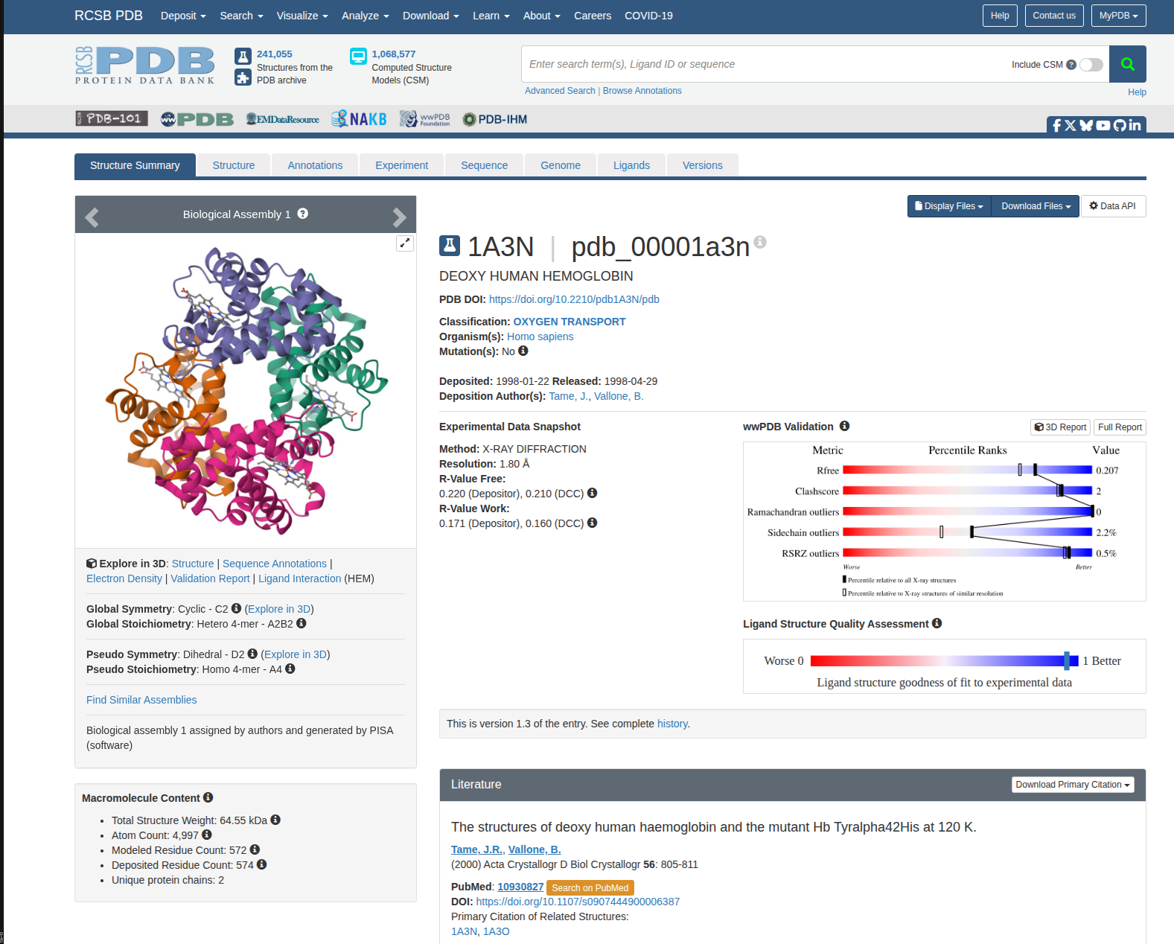

Slide 35
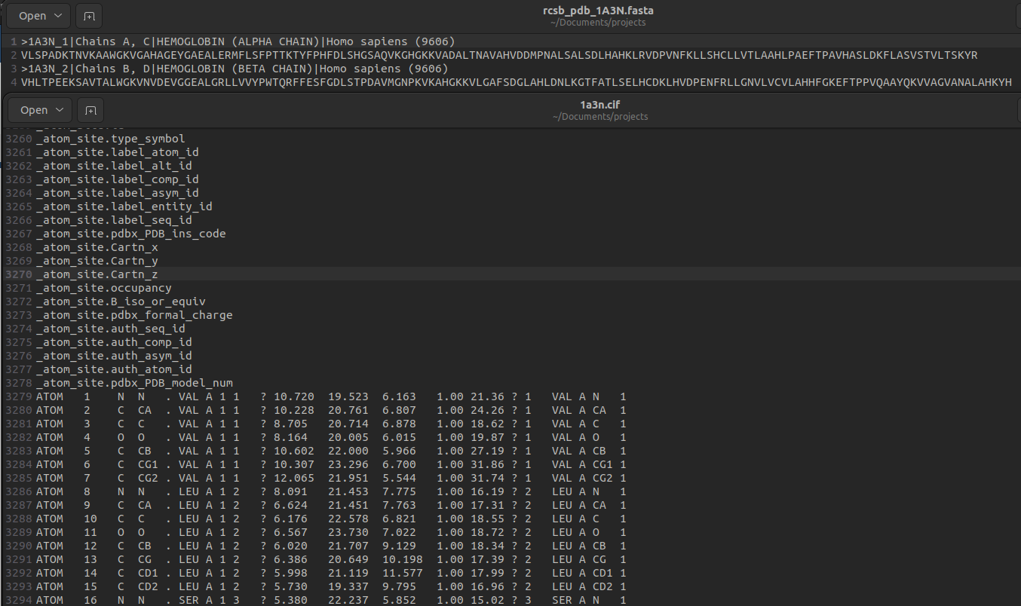

Slide 36
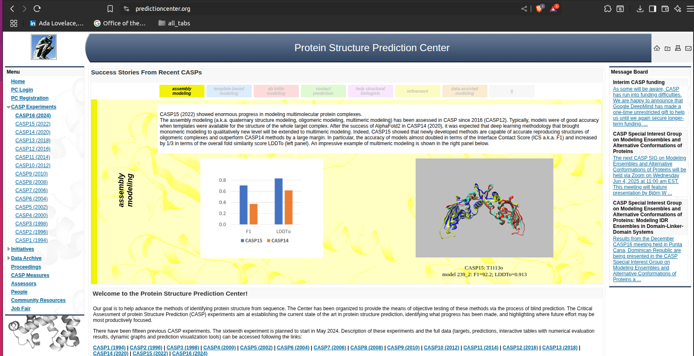
CASP Competition
Critical Assessment of Structure Prediction

Slide 37
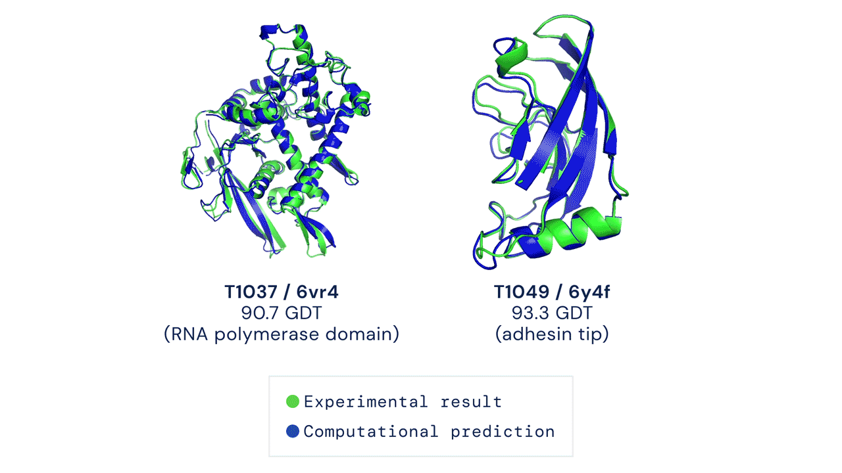
Local Distance Difference Test (LDDT)
Global Distance Test (GDT)
U
CASP data is double-blind, unpublished and X-ray Crystallography obtained
Hard and expensive to replicate

Slide 38
Chapter green
Solving Folding
High Performance Machine Learning Group

Slide 39
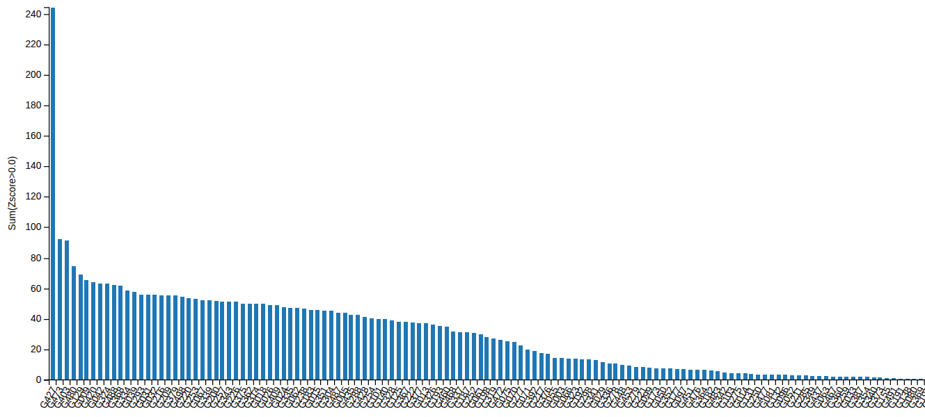
Competition Results

Slide 40
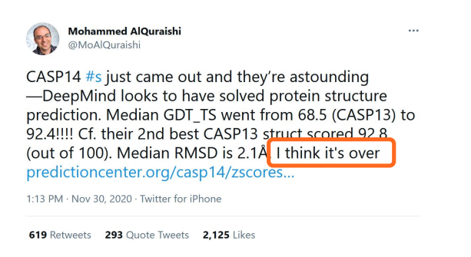
Competition Results

Slide 41
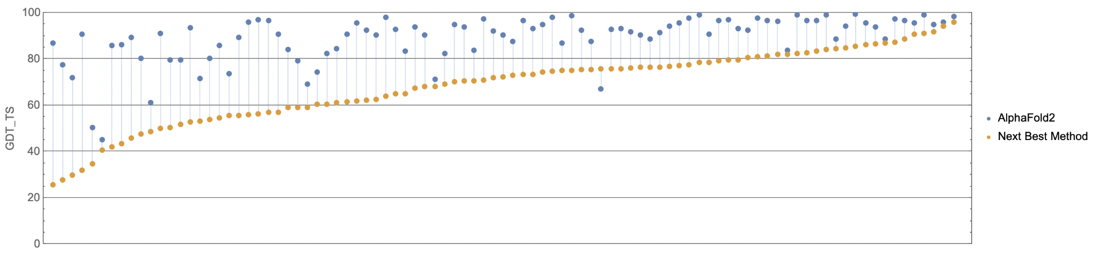
Competition Results

Slide 42
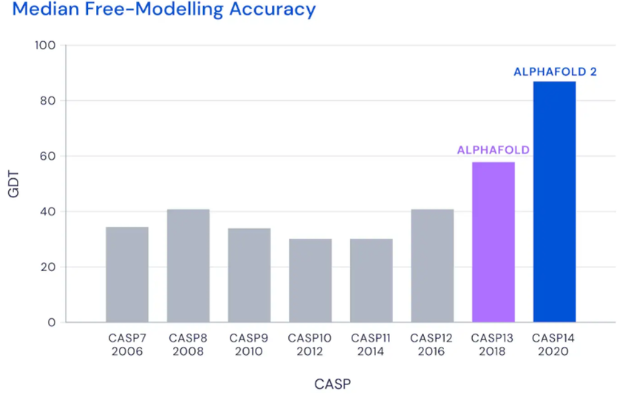
Competition Results

Slide 43
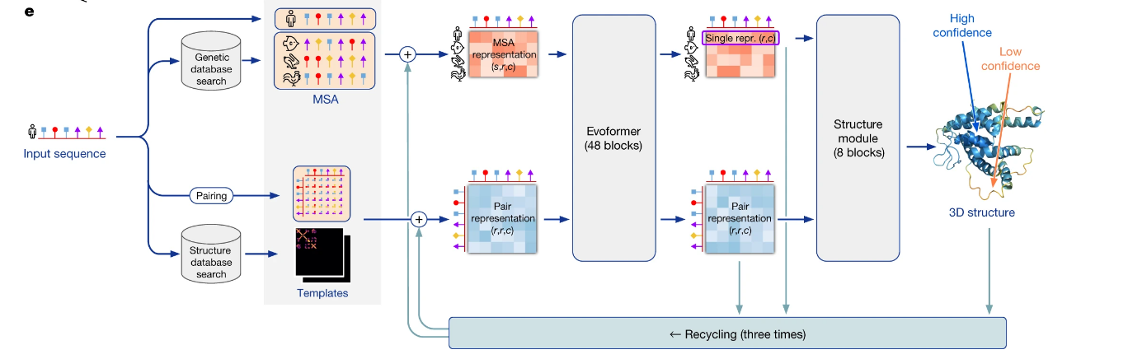
AlphaFold-2

Slide 44
AlphaFold-2
Multiple Sequence Alignment
Aligned Residues
Structural Templates for Sequence

Slide 45
AlphaFold-2
Search similar sequences and templates
Hhblits
JackHmmer
Search over sequence databases:
UniPro
MGnify
BFD

Slide 46
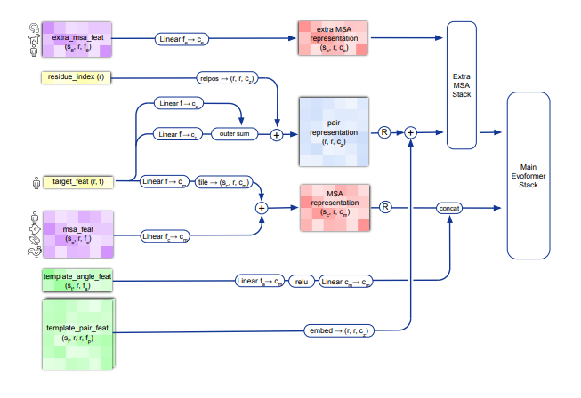
AlphaFold-2

Slide 47
AlphaFold-2

Slide 48
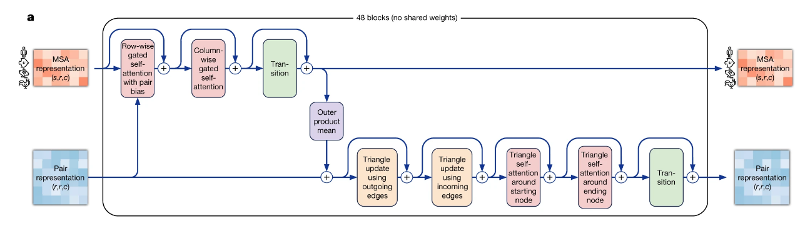
AlphaFold-2: EvoFormer

Slide 49
AlphaFold-2: EvoFormer
Extract information from similar sequences
2. Learn spatial relations between amino acids

Slide 50
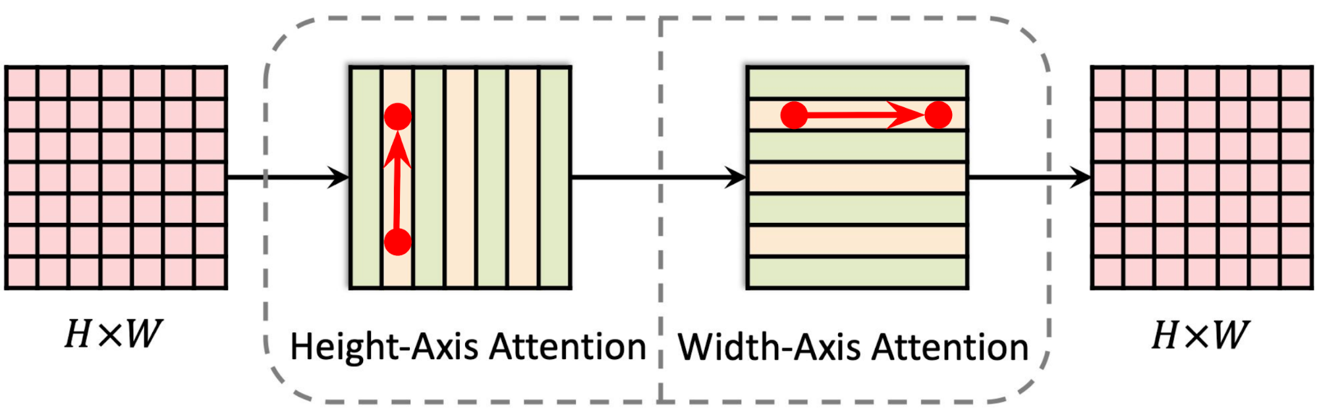
AlphaFold-2: EvoFormer

Slide 51
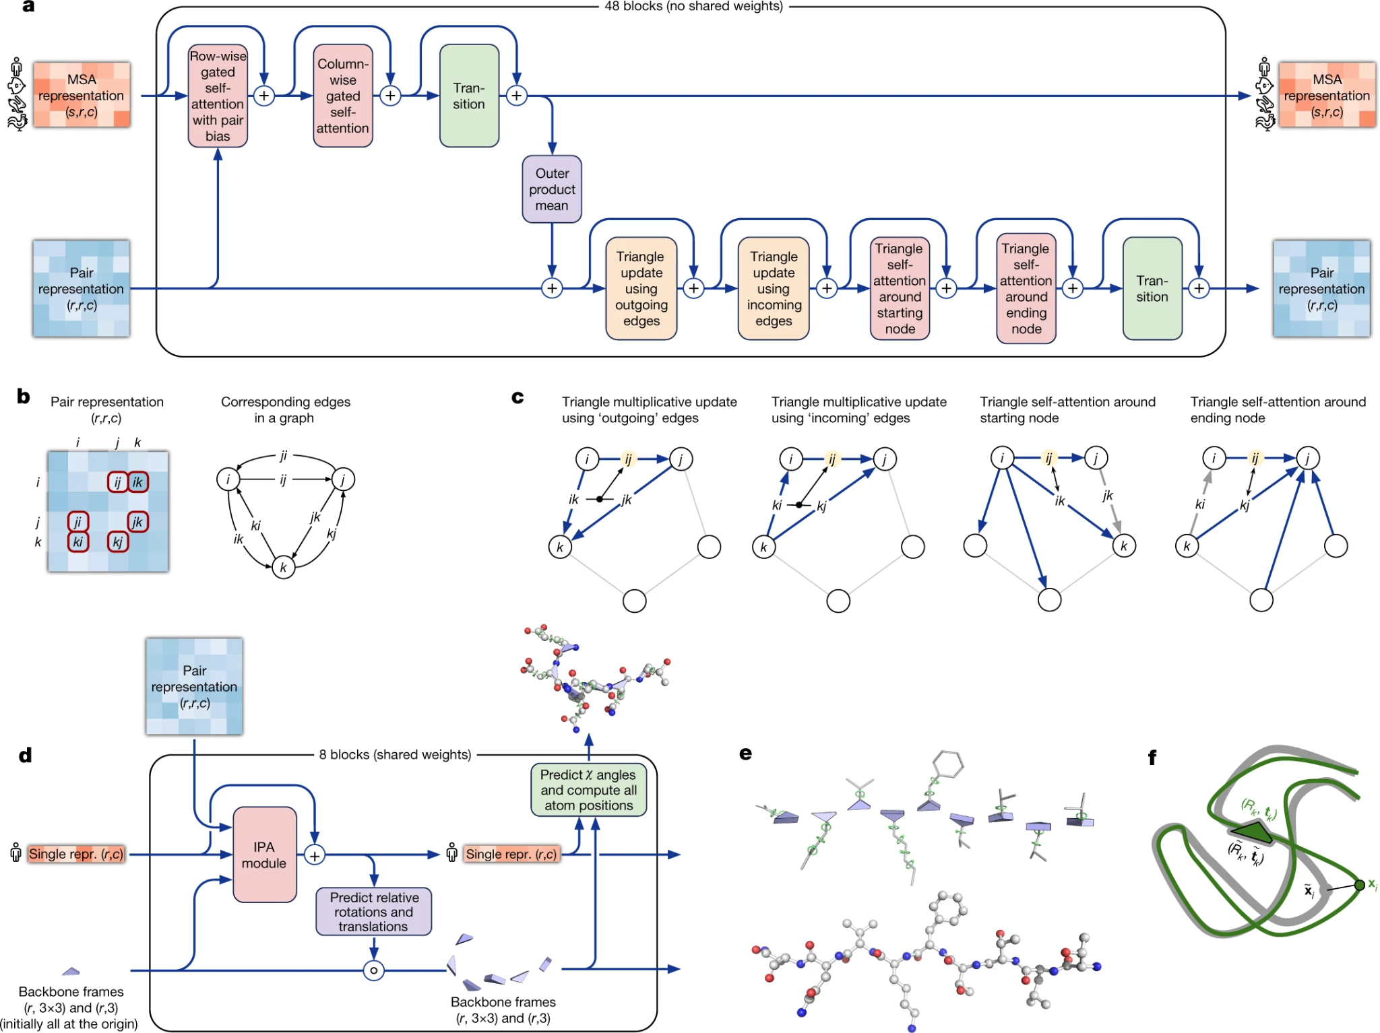
AlphaFold-2: Triangle Inequality

Slide 52
AlphaFold-2

Slide 53
AlphaFold-2

Slide 54
AlphaFold-2: Invariant Point Attention
From representations to concrete 3D coordinates
Parameterize torsion angles for each amino-acid
Don’t learn rotations or translations in space

Slide 55
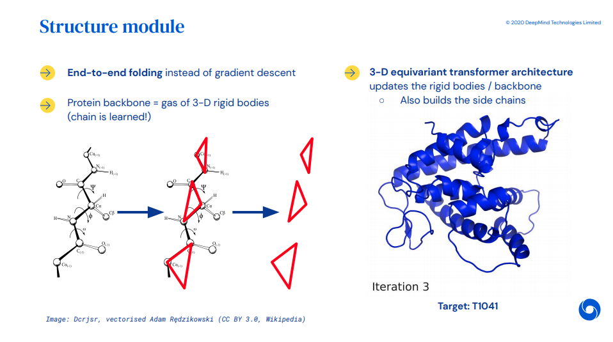
AlphaFold-2: Invariant Point Attention
From representations to concrete 3D coordinates
Parameterize torsion angles for each amino-acid
Don’t learn rotations or translations in space

Slide 56
AlphaFold-2: Invariant Point Attention
From representations to concrete 3D coordinates
Parameterize torsion angles for each amino-acid
Don’t learn rotations or translations in space

Slide 57
AlphaFold-2

Slide 58
AlphaFold-2

Slide 59
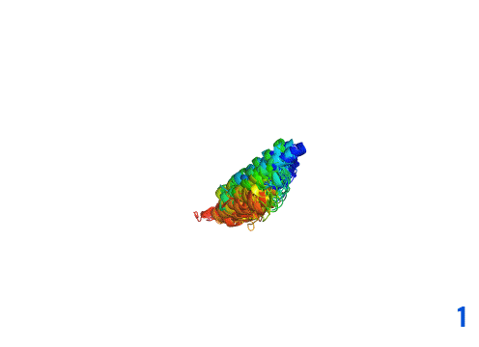
AlphaFold-2
List of tricks to make AF2 work
Filtering of Data
self-distillation
Ensembling multiple models
Recurrence
Auxiliary losses (MLP heads) for regularization
AMBER Relaxation
Masked language modeling training
Model confidence predictions (plddt and ptm)
Gradient Checkpointing

Slide 60
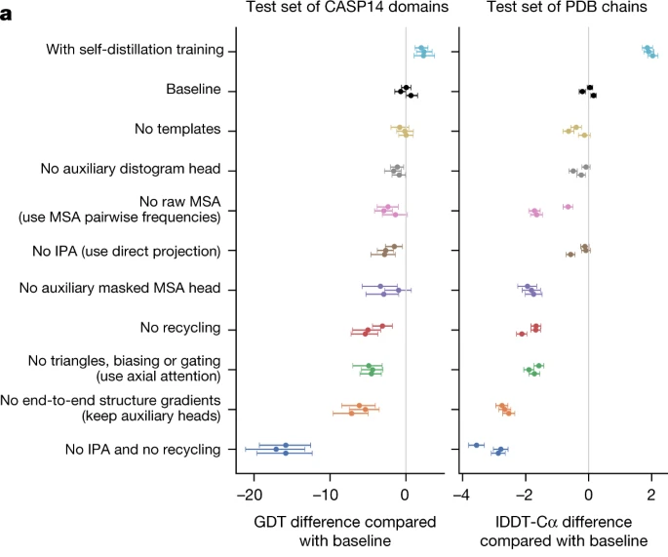
AlphaFold-2: prediction time (A100)

Slide 61
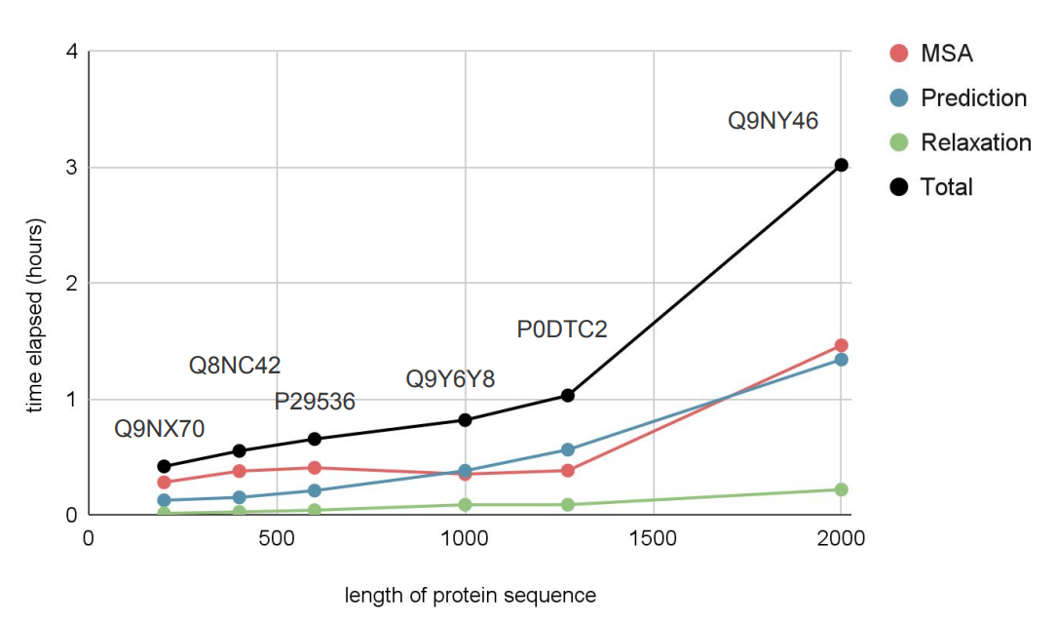
AlphaFold-2: prediction time (A100)

Slide 62
Chapter green
Suite of Models
High Performance Machine Learning Group

Slide 63
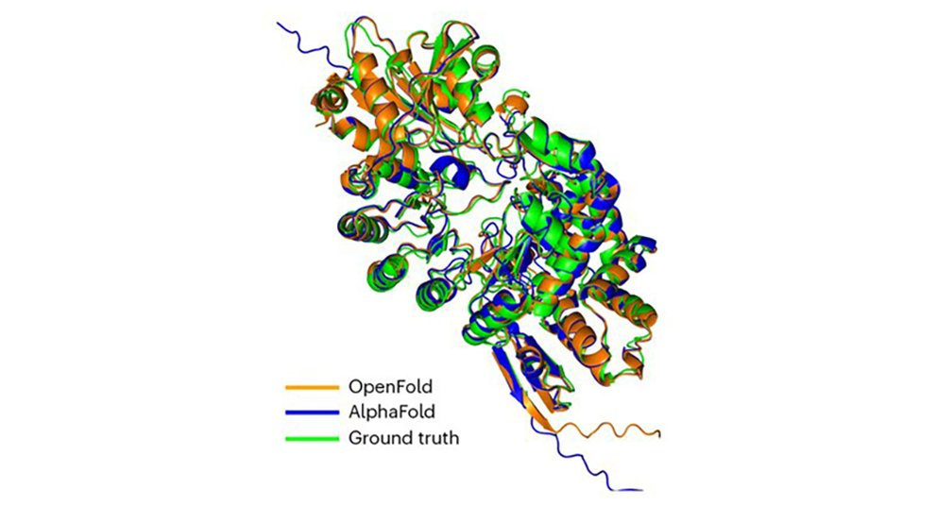
OpenFold

Slide 64


RosettaFold
RFDiffusion

Slide 65

RosettaFold

Slide 66

RosettaFold Diffusion

Slide 67


RFDiffusion

Slide 68

https://elanapearl.github.io/blog/2024/the-illustrated-alphafold/
AlphaFold 3

Slide 69
AlphaFold 3
Modeling Interactions
Protein-Nucleic Acid (DNA/RNA)
Protein-Ligands
Protein-Protein

Slide 70
AlphaFold 3
Modeling Interactions
Protein-Nucleic Acid (DNA/RNA)
Protein-Ligands
Protein-Protein
How does proteins interact with DNA; how is it synthesized?
Genome Editing (CRISPR-CAS9)
Protein interacting with smaller molecules
Antigen-antibody Understand how the body reacts to pathogens

Slide 71

Evolutionary Scale Fold (ESM 1-2)

Slide 72

ESM3: Simulating Evolution
Reason over Sequence, Structure, Function
Simpler LLM
Simple prompting
Biological Fidelity
Better generalizing

Slide 73

ESM3: Simulating Evolution
Reason over Sequence, Structure, Function
Simpler LLM
Simple prompting
Biological Fidelity
Better generalizing

Slide 74

ESM3: New Fluorescent Protein
In vitro creation of new Green Fluorescent Proteins (jellyfish)
Use CoT to generate candidate proteins
Similarity of only 58%
500 million years of evolution removed from the closest known protein

Slide 75

ESM3: New Fluorescent Protein
In vitro creation of new Green Fluorescent Proteins (jellyfish)
Use CoT to generate candidate proteins
Similarity of only 58%
500 million years of evolution removed from the closest known protein

Slide 76

AlphaFold Protein Data Bank

Slide 77

AlphaMissense
Missense: Mutation in DNA that leads to slightly different protein synthesis
Single letter substitution
Classify 71 million missense mutations: Pathogenicity

Slide 78


AlphaProteo: Drug Design and Disease Understanding

Slide 79

AlphaProteo: Drug Design and Disease Understanding

Slide 80
Chapter orange
Shape of things to come
High Performance Machine Learning Group

Slide 81

AlphaProteo: Drug Design and Disease Understanding

Slide 82



Experimental vaccinology@AMC
Hepatitis C Virus

Slide 83
Chaining Predictions
Generation
RFDiffusion
02. Predict Sequence
ProteinMPNN
03. Confirm Structure
ESMFold, ColabFold,
AlphaFold, OmegaFold,
RoseTTaFold, OpenFold

Slide 84
Chapter yellow
Thanks!
High Performance Machine Learning Group

Slide 85
Chapter yellow
U

