Slide 1
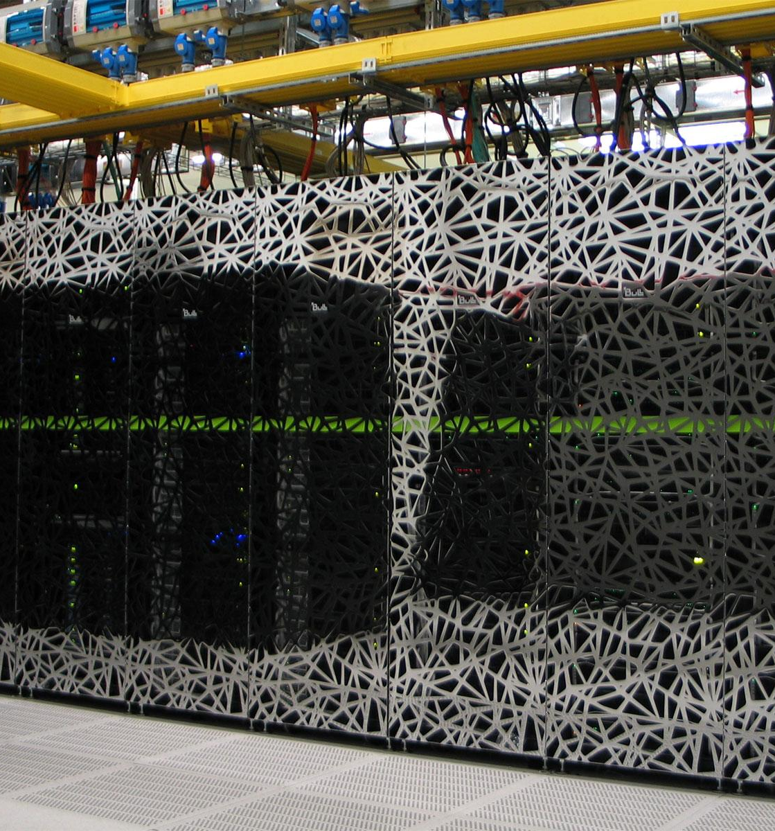

SURF AI & Large scale computing
Amsterdam UMC
September 2025

Slide 2

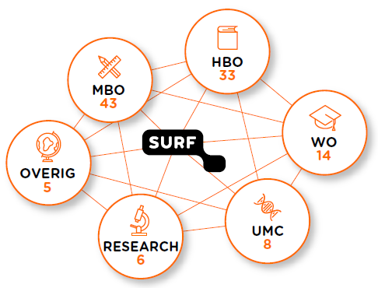
Driving IT innovation in education and research
Together with our members, we ensure that the education and research community has access to the best and latest IT facilities for top-level research and talent development.
Notes:
‹#›

Slide 3
SURF Research services
Compute
Data
We provide accessible and economical computing capabilities for researchers
We help researchers organize, store, preserve and share data
High performance computing
Data Processing
(HTC)
Cloud Computing
Sync & Share
General Storage
Long-term Storage
Research Data Management
NL supercomputer Snellius
SPIDER
SURF Research Cloud
Research Drive
Object Store
Data Archive
Yoda Hosting
LUMI petascale supercomputer
GRID
HPC Cloud
SURF Drive
dCache
RDM Scale-out
Jules Verne exascale supercomputer
Public Clouds
SURF FileSender
iRODS hosting
NL AI Factory
ICE
SANE / Confidential Research Cloud
OSSC / Confidential computing
Consultancy on HPC, HTC, AI / ML, Cloud & Visualization
Consultancy on Storage, Preservation & Research Data Management
We help both high demand, large scale users through Snellius, Spider and GRID, as well as provide accessible plug-and-play services through Research Cloud and Public Cloud providers.
We provide trustworthy, secure & economical data storage for researchers through Research- & SURF Drive, Object Store and Data Archive. And promote data management according to the FAIR principles.
In production
In development
Consultancy

Slide 4

How do I compute with data?
I want to compute in a flexible and user-friendly environment either on public clouds or on SURF’s cloud
I want to run complex parallel computations, simulations or train AI models on a large scale
I want to run complex parallel computations, simulations or train AI models on a very large scale
I want to process large volumes of (instrument) data on an ongoing basis
I want to run my research environment on SURF own cloud infrastructure
I need help designing cloud applications or with maintenance support
Research Cloud
HPC Cloud
Snellius
LUMI
Cloud Consultancy
Data Processing
Notes:
A snapshot of our compute services

Slide 5
Where do I store data?
I work in an institution with an implemented FAIR policy, use metadata and want a tool that makes RDM simpler.
I want to store research data, collaborate freely and then publish/archive data.
I want to store inactive data of more than 10TB with an average file size of a few gigabytes.
None of the other services meet my needs, and I need a storage facility that is highly scalable.
I want to send or receive files up to 1TB securely.
I want to store and share personal data up to 1TB.
SURF filesender
SURFdrive
Research Drive
Yoda Hosting
Data Archive
Object Store
Notes:
A snapshot of our data services
With Yoda, you can securely store, add metadata to, analyse, publish and archive data. You can also collaborate easily, even outside your institution. By having Yoda hosted at SURF, you do not need to know as much about the technology behind it, and you can use our data storage solutions.

Slide 6



Bespoke environments: The Alzheimer’s Genetics Hub
The AGH is a clone of Spider with significant extra security
Data providers can only upload (not download!) data into the storage system
The cluster is disconnected from the “normal” internet
Files in and out go through an auditable “airlock”
  Airlock runs on Research Drive
  Storage in the airlock is not big enough for raw data
  More info: https://holstegelab.eu/launch-of-the-alzheimer-genetics-hub/
External
Researcher
Alzheimers Genetics Hub
Data
Airlock
Raw data
Data releases
AUMC data
ADES-ADSP
Inserm data
Data Provider
Data Provider
Data Provider
Notes:
Purpose: The AGH is a secure environment where researchers can collaborate on data without having to worry about GDPR (cant share w/ US), international researchers or collaborators do not have permission to downoad the raw data.
This is of course supported with a consortia and usage agreement

Slide 7
Working with sensitive data on our Compute services
Solution | Use case | Features | Suitable for sensitive data?
SURF Research Cloud | Small to medium scale computation, storage and exploration | VM’s on SURF private cloud VM’s on public clouds User friendly interface Collaboration tools Shared application catalogue ISO27001 | Maybe SRC can be used for sensitive data, if you take certain measures and precautions. Read more.
Data Processing | High-throughput computing | Large scale high throughput capacity Data intensive workloads Customizable and dedicated environments Distributed processing (embarrassingly parallel) ISO27001 | Maybe By default, we do not recommend using Data Processing for sensitive data. However, dedicated and customized ‘trusted’ clusters can be created to support sensitive data.
National Supercomputer | High performance computing | High performance, large scale parallel computation Large variety of CPU, GPU and storage types. Extensive software library ISO27001 | Maybe By default, we do not recommend using Snellius for sensitive data unless you take specific measures. Read more. For large, frequently used datasets, we can also establish permanent secure enclaves on the National Supercomputer (see below).
SANE on SURF Research Cloud | Small scale compute and exploration for sensitive data | Data provider keeps control of data. Supports interactive and non-interactive analysis (blind). Leverage SRC catalogue items. Limited to one VM and limited access options. | Yes
OSSC on the National Supercomputer | Secure HPC enclave to work with CBS microdata | High performance, large scale parallel computation Dedicated environment for CBS microdata. Access via CBSRA | Yes
OSCAR on the National Supercomputer | Secure HPC enclave dedicated to other frequently used sensitive datasets | High performance, large scale parallel computation. Dedicated environment for particular dataset. Needs to be funded, configured and maintained long-term (5+ years). Only when there are 100s of potential applications or users. | Yes

Slide 8







Access routes to research services
*Large Scale Defined:
+1.00.000 CPU of GPU SBU Snellius Supercomputer
+50.000 CPU core-hours HPC Cloud (Research Cloud)
+5.000 GPU-hours HPC Cloud (Research Cloud)
+500.000 CPU core-hours Grid/Spider
+10.000 GPU-hours Grid/Spider
+100.000 CPU core-hours Cloud Research Consultancy (MS4/CCS)
+10.000 GPU hours Cloud Research Consultancy (MS4/CCS)
Incl. varying amounts of disk-, tape-storage, research drive and support.
SBU = System Billing Unit
Direct contracts Give organisations direct access to SURF compute facilities on a contract basis.
Small NWO grants To run a pilot project (1/year), you can apply for limited amounts of compute, storage and support directly via SURF.
Large NWO grants for large scale* research projects need to apply via NWO.
Open calls for public cloud access.
Direct contracts
Small NWO grants
Large NWO grants
Open Calls
Notes:
‹#›

Slide 9

Chapter green
AI infrastructure
that can be trusted
Image by Vectorportal.com
Notes:
Power socket analogy
Afspraken: Beschikbaarheid / vast voltage / aardlekschakelaar
Multiple applications: was machine tot drillboren.
Beschikbaar stellen; niet opwekken (training vs inference)
Ervaring voor developer is ongeveer gelijk aan openAI gebruik.
Trust
Keep workflows and data secure
Balance benefits of cloud without becoming overly depended
That you use models that are inline with regulations and company policies.

Slide 10

AI Hub: sovereign platform for AI-inference
Students, staff, researchers
Applications
Knowledge assistants
EduGenAI
AI hub
middleware connector
AI Factory
OpenEuro
LLM
GPT-NL
Other open models
Commercial models
Compute Backends:
On Premise (SURF, …)
Compute Backends:
Public Cloud
(Azure OpenAI / Kubernetes)
Notes:
Oranje laag: scheiding tussen modellen en waar die draaien en gebruikers
boven: applicaties gericht op business cases -> EduGenAI, maar we gaan ook koppeling met nextcloud onderzoeken
Onder: modellen + waar die draaien
onderhandelen terwijl workflow processen niet veranderen: Finance, support, IT inrichting:
Voordeel: peak loads vs batch + slim schedulen. De hardware efficient benutten
Ingewikkeld: voor developers even eenvoudig als openAI; en we hebben de basis al werkend.

Slide 11






What can we do in the pilot phase
Modalities
text, images, sound
Always-on models
Llama 3.3 70b & 3.1 8B / Whisper / Qwen 2.5 coder & VL
On-premises
Compute workflow completely in SURF datacenters
On-demand models
Actively loaded, e.g.: deepseek, phi, gemma, …
200-400 concurrent users
Active users can be a factor 100 higher
RAG / Embeddings
Using external sources in your AI workflow
Notes:
We are a service: This is what we can offer.
Fingers crossed:
Working out details with KIJ. Framework for accessing models
Hardware installed and ready
What we are not:
No training
No finetuning
No frontend

Slide 12
Simplified summary: where to go?
For ease of use and plug and play compute: go to Research Cloud.
For very powerful parallel computing; go to Snellius.
For extremely large (parallel) computations, go to LUMI.
For structurally processing very large amounts of data: go to Spider.
For easy storage and data sharing; go to Research Drive.
For cheap long-term storage; go to Data Archive.
For AI and Machine learning support; to our AI expertise center.
For advice and POC’s on public clouds; go to our Cloud Consultancy team.
For sovereign AI-inference platform; go to the AI Hub.

Slide 13
SURF HPML Group
Bryan Cardenas
September 2025

Slide 14

RR
Recipe for Assistance
Provide Hardware & Storage
Run Software On Snellius
Program Efficiency
Algorithmic Design

Slide 15
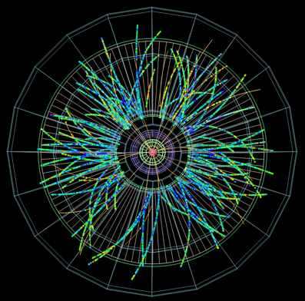
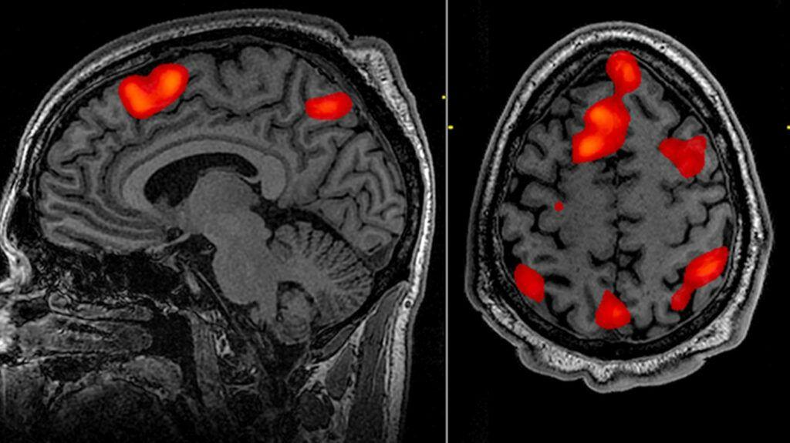

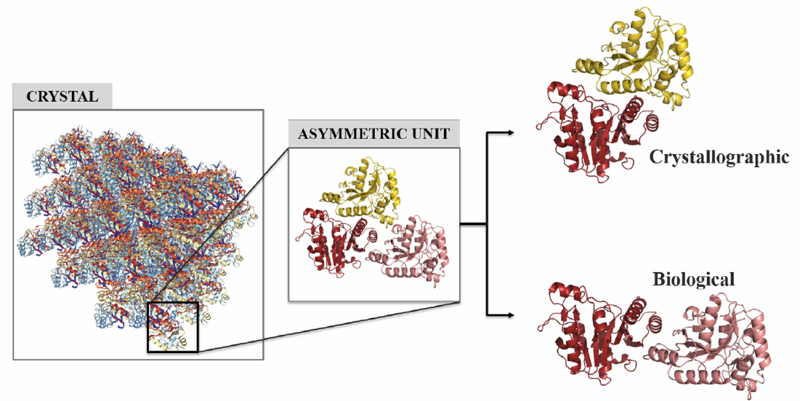
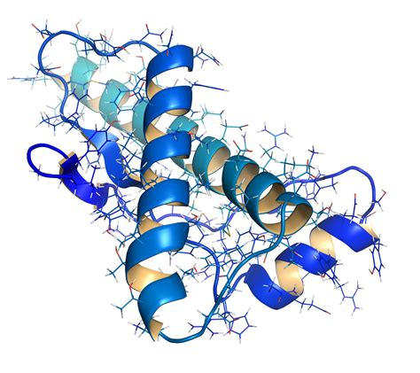
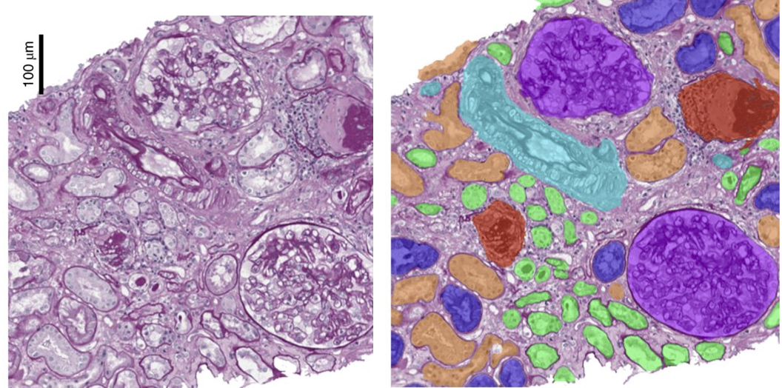
HPML Projects
DL models for High Energy Particle Physics
FMRI & EEG
Agents for BioChemistry Research Papers
CERN
AMC
UMC
Biomolecular interfaces from crystal artifacts
Multimodal analysis and model training for histopathology
Protein Folding & Design
Universiteit Utrecht
Radboud & AMC
Intel & AMC

Slide 16
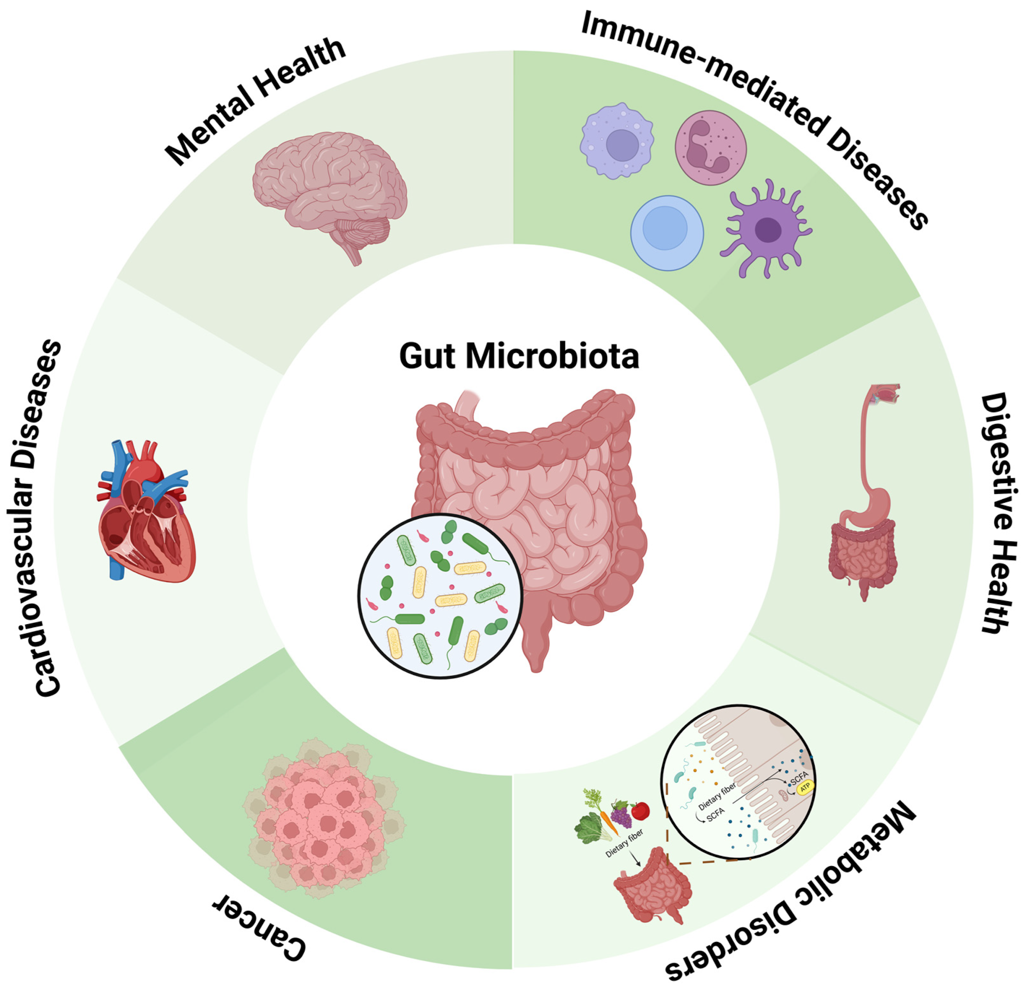
Hereditary
Gut-Brain Interplay
1
01.
Neurological Diseases
02.
Gut Microbiome Disorders
Multi-Modality Data Assembly
Multi-Linguality Privacy & Security

Slide 17

Hereditary Data Types
Gut-Brain Interplay
1

Slide 18
Federated Learning
Gut-Brain Interplay
1
01.
Improve diagnostic accuracy
Make data comply with privacy and ethics
Multiple centers benefit!
02.
03.

Slide 19
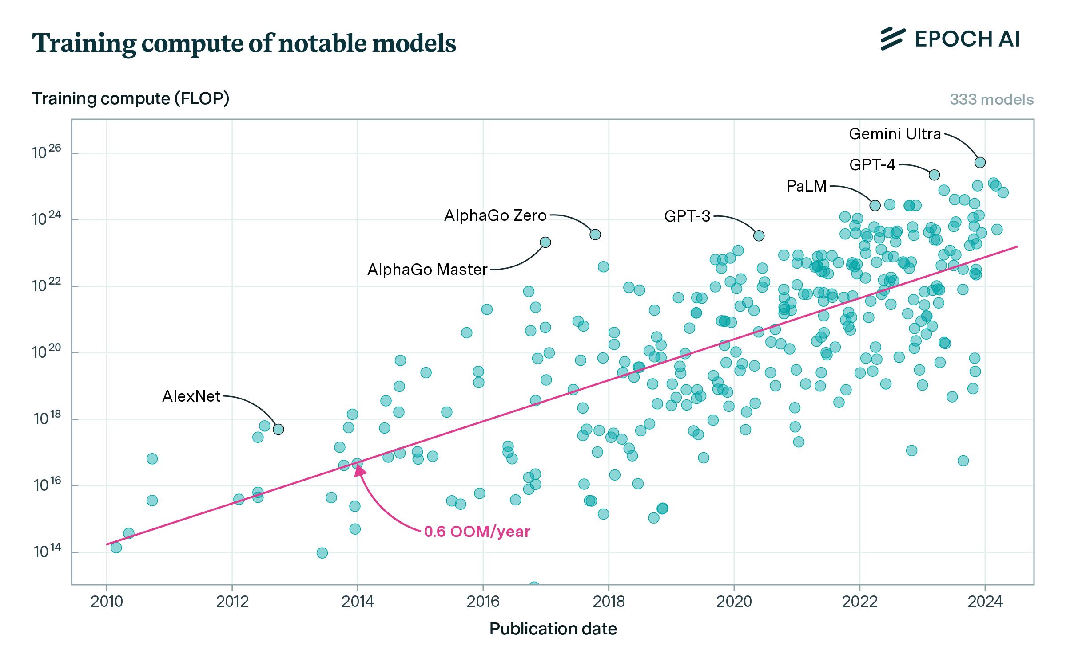
HPML Projects

Slide 20
Q&A

