Slide 1
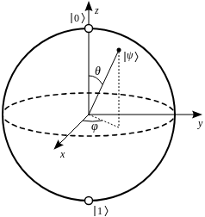

Chapter yellow
Quest for QML Advantage
In Medicine
Bryan Cardenas
High Performance Machine Learning

Slide 2
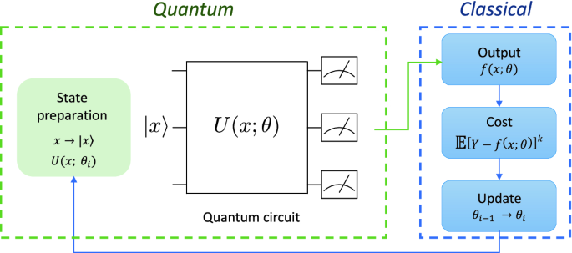

NISQ-Era
Noisy Intermediate-Scale Quantum is defined by hardware constraints
  Limited qubits
  High Noise & Decoherence
Stochasticity
  Non-computational Basis State (frequencies of outcomes)
  Trade-off between precise measurement of single state vs the less precise many
Employ a Hybrid Quantum-Classical Algorithmic Approach
  Use Variational Quantum Algorithms
CANNOT RELY ON ANY TYPE OF ERROR CORRECTION

Slide 3

The Quest
The Goal
Find where quantum advantage lives in the intersection QML and Medicine
Strategy
Employ a hybrid classical-quantum model for feature extraction; see in what ways we have an advantage over CML

Slide 4
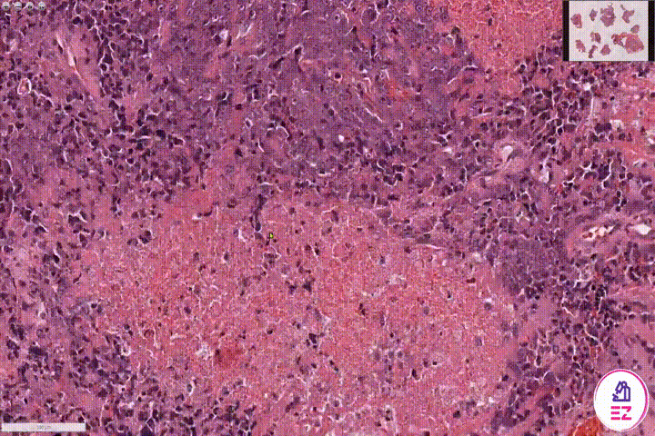
Histopathology Example
Data Dimensionality
Input can be extremely large
Complex Features
A lot of (local) features remain unseen for the pathologist
Can a VQC’s access to high-dimensional Hilbert Space lead to more more complex decision boundaries?

Slide 5
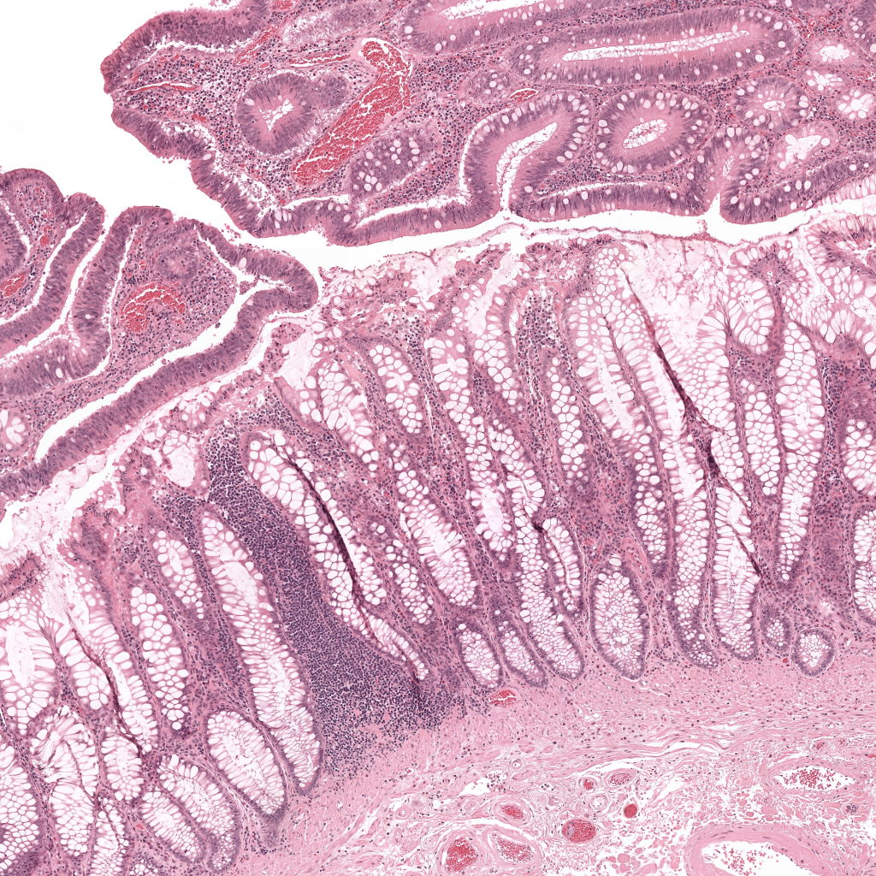
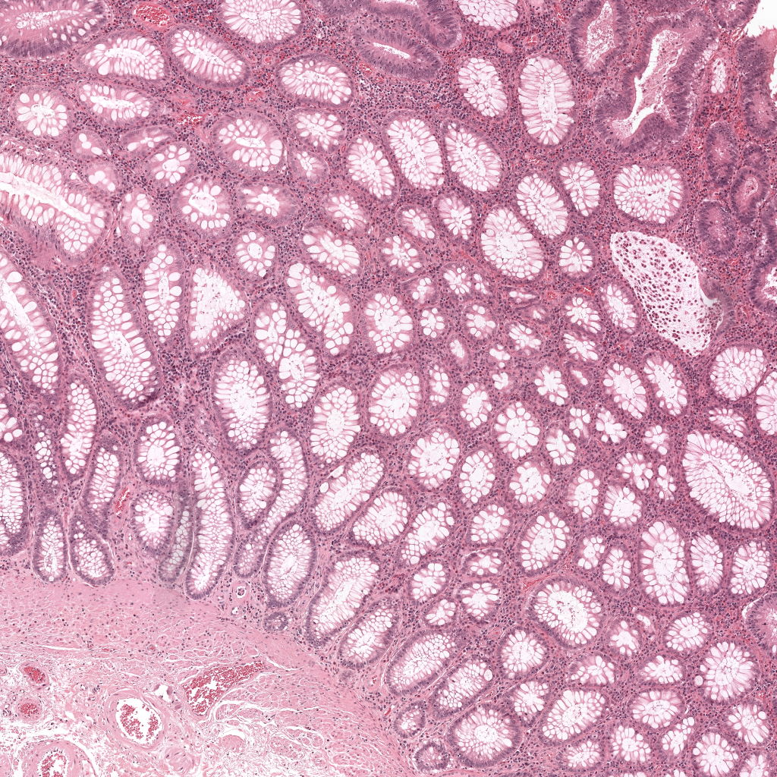
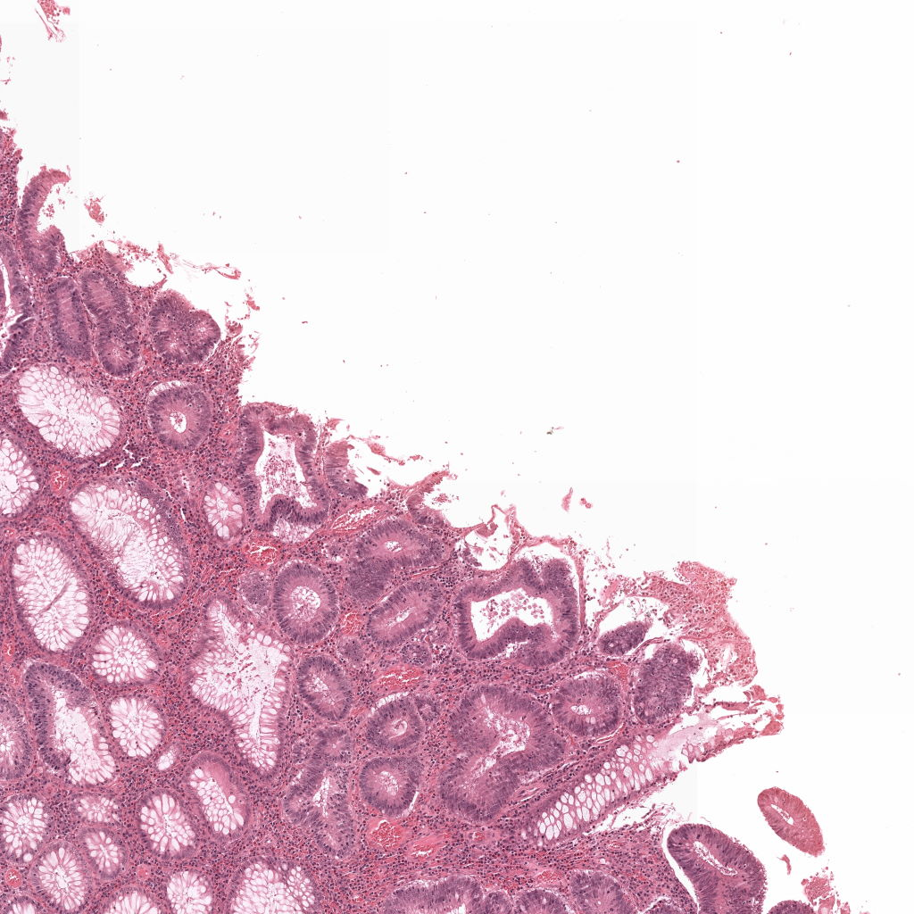
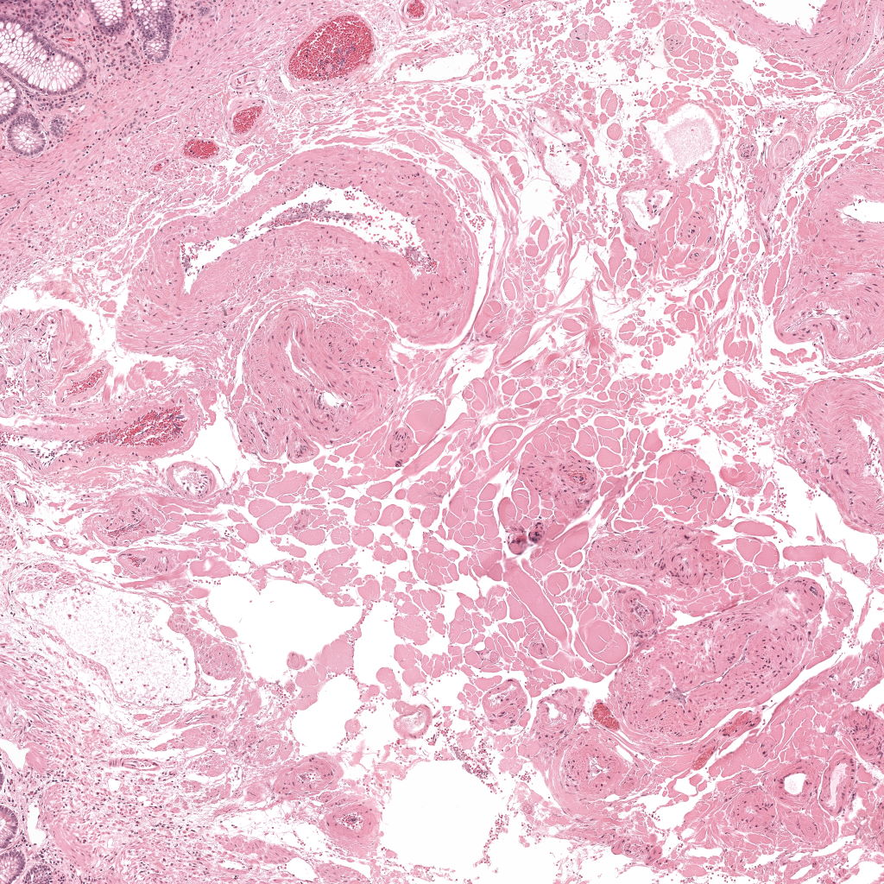
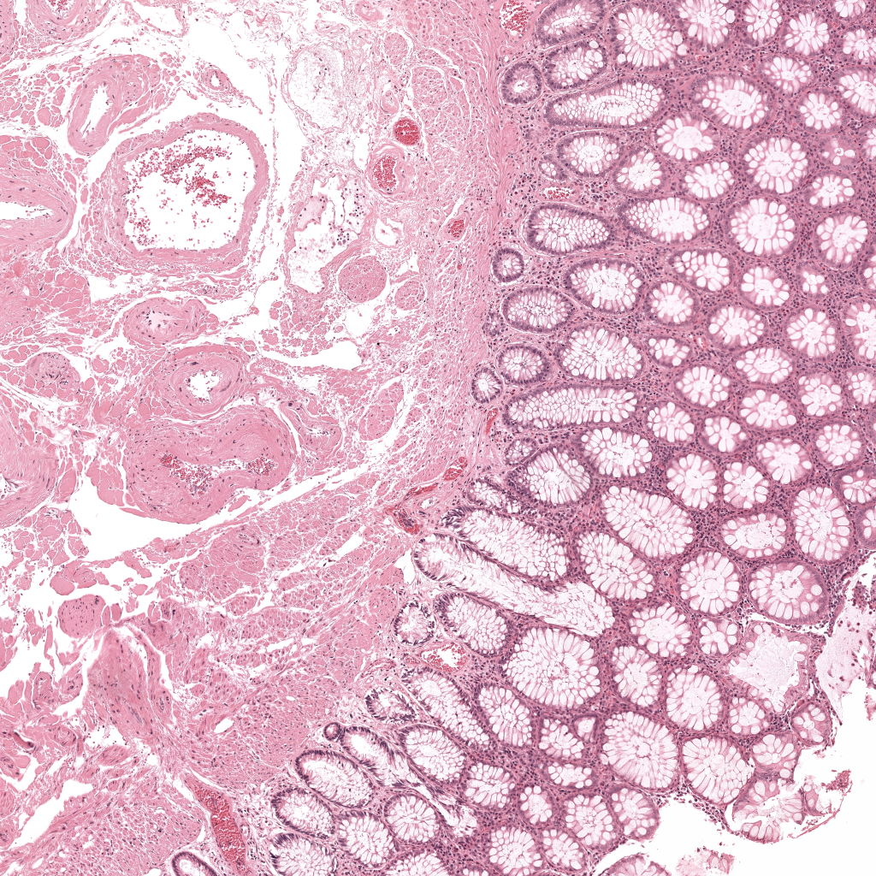
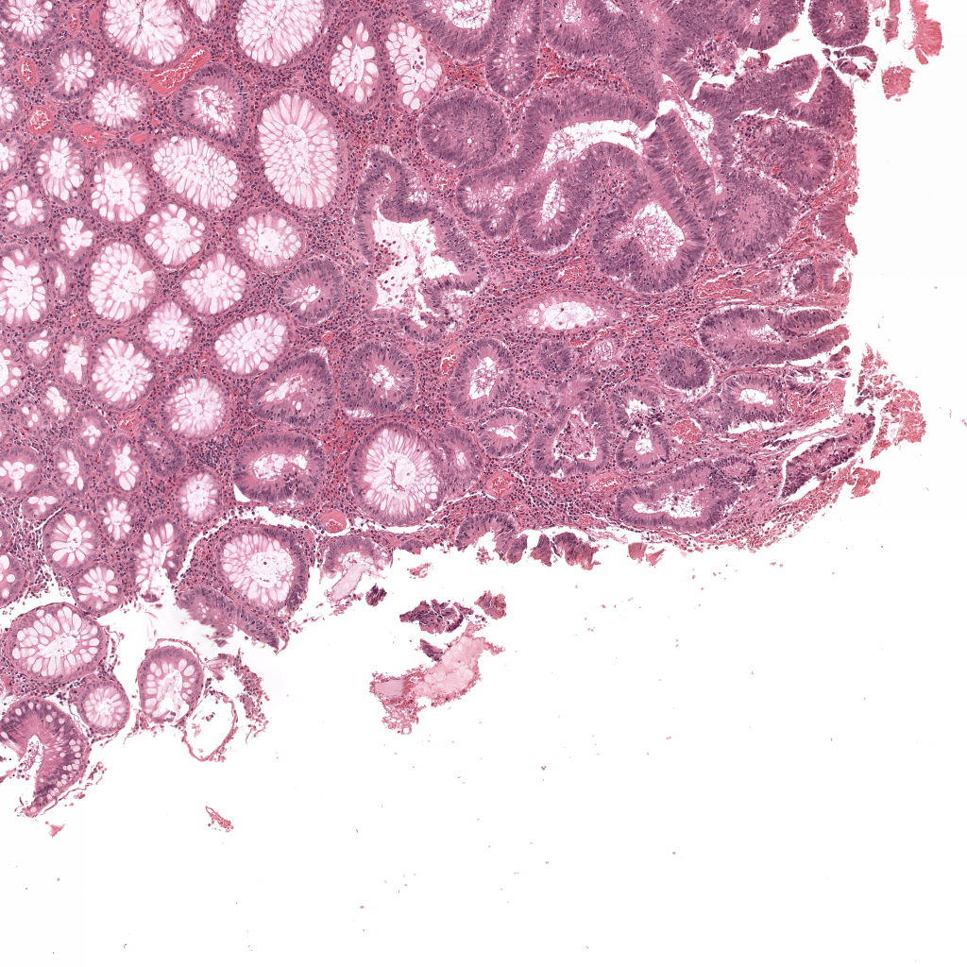
Histopathology Example
Data Dimensionality
Input can be extremely large
Complex Features
A lot of (local) features remain unseen for the pathologist
Can a VQC’s access to high-dimensional Hilbert Space lead to more more complex decision boundaries?

Slide 6





Histopathology Classical ML
Encoder
Decoder
0 1 3 1 5 9 0 3 4 5 8 9 1 2 9 8 2 1 4 4 4 2 1 1 4 7 8 8 8 1 1 9 9 9 1 2
Convs
Convs
Convs
Convs
Latent Space

Slide 7

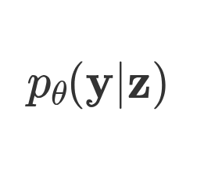
Histopathology Classical ML
Encoder
Decoder
0 1 3 1 5 9 0 3 4 5 8 9 1 2 9 8 2 1 4 4 4 2 1 1 4 7 8 8 8 1 1 9 9 9 1 2
Convs
Convs
Trans
Trans
Latent Space

Slide 8
Histopathology Classical ML
Encoder
Classifier
0 1 3 1 5 9 0 3 4 5 8 9 1 2 9 8 2 1 4 4 4 2 1 1 4 7 8 8 8 1 1 9 9 9 1 2
Cancer?
Convs
Convs
Convs
Linear
Latent Space

Slide 9
Histopathology Hybrid QML Model
Classical
Encoder
0 1 3 1 5 9 0 3 4 5 8 9 1 2 9 8 2 1 4 4 4 2 1 1 4 7 8 8 8 1 1 9 9 9 1 2
Convs
Convs

Slide 10

The Breadcrumbs
Convergence Speed
  Sample complexity
Time/Space Complexity
Model Expressivity (Accuracy)
  Latent Space Entanglement
Data Encoding Efficiency
Trainability

Slide 11

The Breadcrumbs
Convergence Speed
  Sample complexity
Time/Space Complexity
Model Expressivity (Accuracy)
  Latent Space Entanglement
Data Encoding Efficiency
Trainability

Slide 12
The Breadcrumbs
Convergence Speed
  Sample complexity
Time/Space Complexity
Model Expressivity (Accuracy)
  Latent Space Entanglement
Data Encoding Efficiency
Trainability
Fault Tolerant QC

Slide 13
Chapter orange
Data and QML
High Performance Machine Learning Group

Slide 14
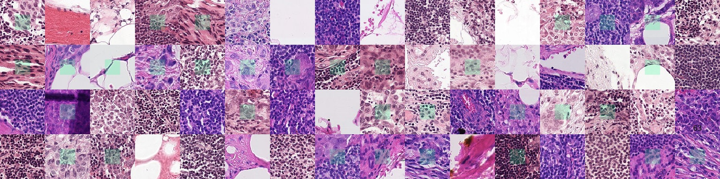
PatchCamelyon (PCam)
Not too easy, like MNIST, sufficiently complex
96x96x3 dimensional images
Binary Labelled (metastatic tissue)
https://github.com/basveeling/pcam?tab=readme-ov-file

Slide 15
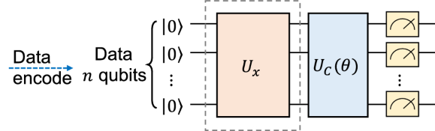
PatchCamelyon (PCam)

Slide 16
Classical Classifier
Classical
Classifier
Encoder
0 1 3 1 5 9 0 3 4 5 8 9 1 2 9 8 2 1 4 4 4 2 1 1 4 7 8 8 8 1 1 9 9 9 1 2
Linear
Cancer?
Convs
Convs

Slide 17
Hybrid Classifier
Classical
Encoder
0 1 3 1 5 9 0 3 4 5 8 9 1 2 9 8 2 1 4 4 4 2 1 1 4 7 8 8 8 1 1 9 9 9 1 2
Convs
Convs

Slide 18
Hybrid Classifier
Classical
Encoder
0 1 3 1 5 9 0 3 4 5 8 9 1 2 9 8 2 1 4 4 4 2 1 1 4 7 8 8 8 1 1 9 9 9 1 2
Convs
Convs
Cancer?

Slide 19
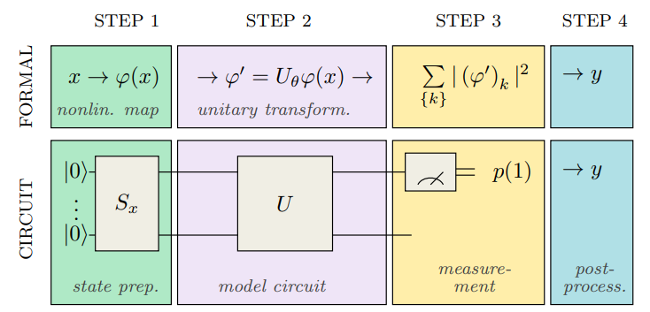
Encoding the Data
0 1 3 1 5 9 0 3 4 5 8 9 1 2 9 8 2 1 4 4 4 2 1 1 4 7 8 8 8 1 1 9 9 9 1 2

Slide 20
Encoding the Data
0 1 3 1 5 9 0 3 4 5 8 9 1 2 9 8 2 1 4 4 4 2 1 1 4 7 8 8 8 1 1 9 9 9 1 2

Slide 21
Encoding the Data
0 1 3 1 5 9 0 3 4 5 8 9 1 2 9 8 2 1 4 4 4 2 1 1 4 7 8 8 8 1 1 9 9 9 1 2
Angle Encoding
Amplitude Encoding

Slide 22
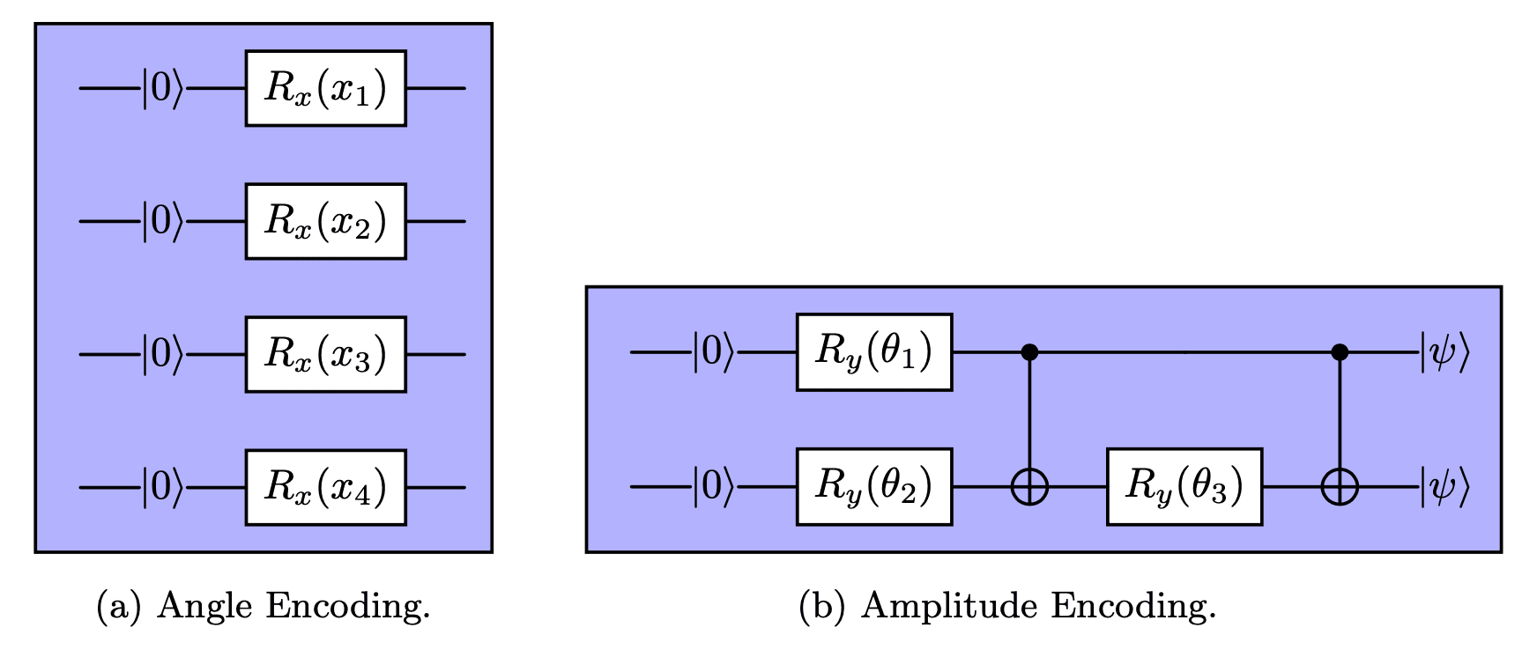
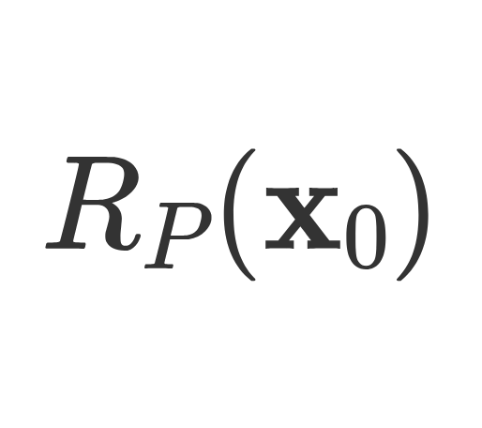
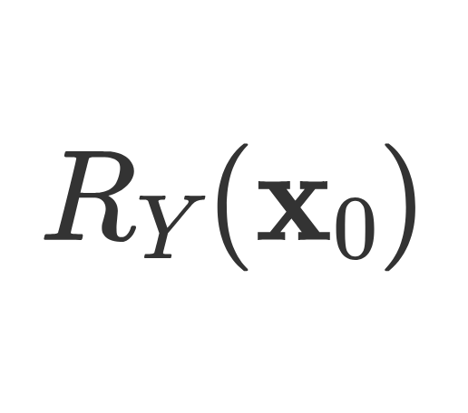
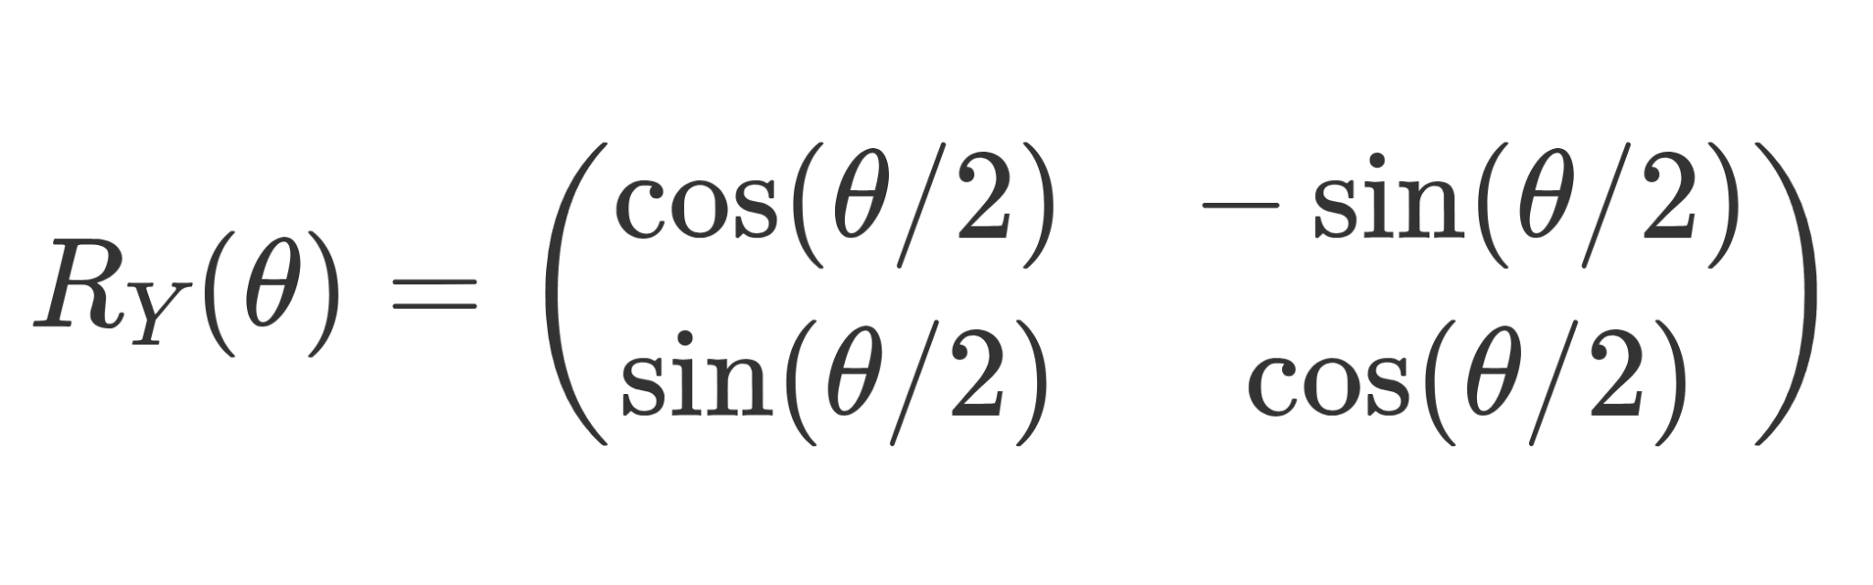
Encoding the Data
Angle Encoding
  For each datapoint apply a rotation gate
  If we rotate around the Pauli-Y axis we keep the state vector in the real plane
  Requires N qubits
0 1 3 1 5 9 0 3 4 5 8 9 1 2 9 8 2 1 4 4 4 2 1 1 4 7 8 8 8 1 1 9 9 9 1 2

Slide 23
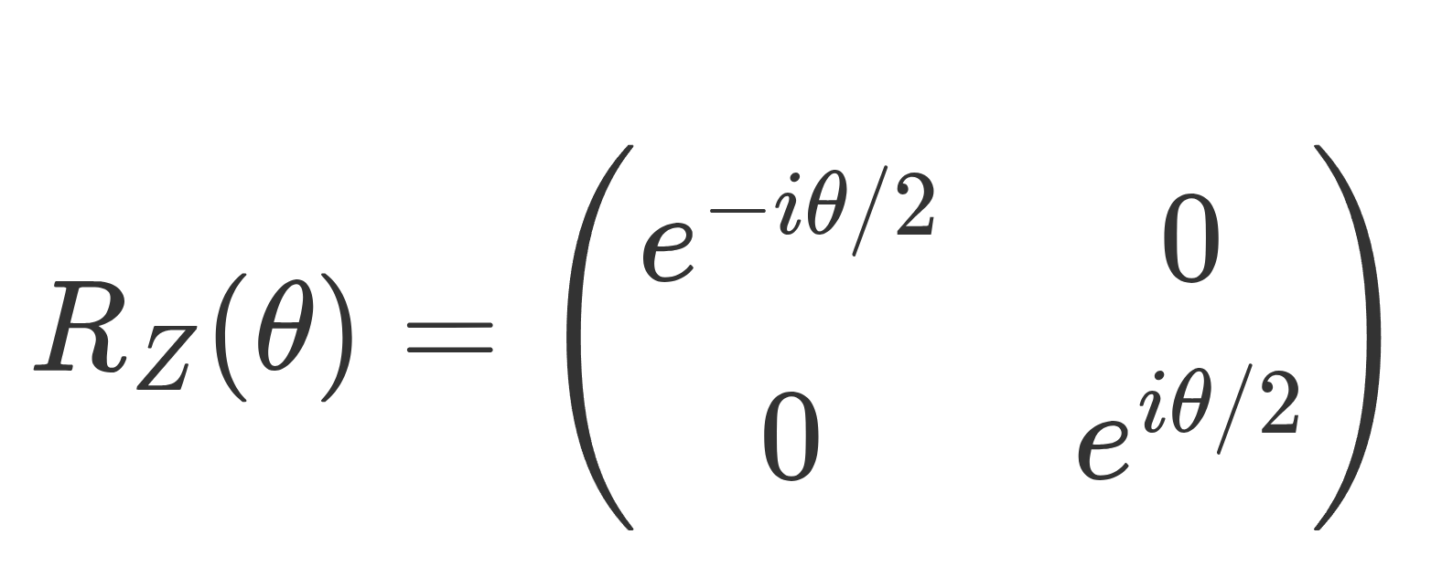
Encoding the Data
Angle Encoding
  For each datapoint apply a rotation gate
  If we rotate around the Pauli-Z axis we keep the state vector in the real plane
  Can come in handy if data has phase relationships
0 1 3 1 5 9 0 3 4 5 8 9 1 2 9 8 2 1 4 4 4 2 1 1 4 7 8 8 8 1 1 9 9 9 1 2

Slide 24
Encoding the Data
Amplitude Encoding
Encode the data vector into the amplitudes of the quantum state
Map the data to an N-dimensional Hilbert Space
State preparation has a non-negligible cost (on NISQ can negate benefit of qubit compression)
Encoded information is not directly accessible

Slide 25
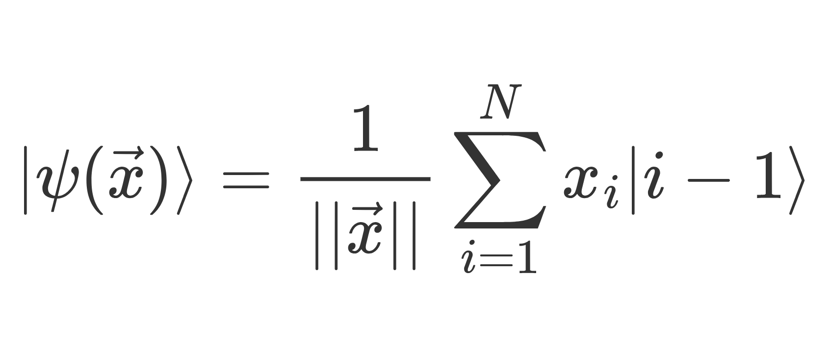
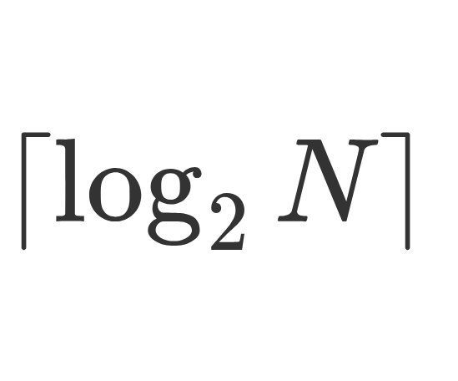
Encoding the Data
Amplitude Encoding
Encode the data vector into the amplitudes of the quantum state
Map the data to an N-dimensional Hilbert Space
Qubits needed

Slide 26
Training on the Data
0 1 3 1 5 9 0 3 4 5 8 9 1 2 9 8 2 1 4 4 4 2 1 1 4 7 8 8 8 1 1 9 9 9 1 2

Slide 27
Training on the Data
Two Types of Entangling for Training
Basic Entangling
Strongly Entangling
Apply a rotation gate with trainable parameter to each qubit
Apply a CNOT gate between adjacent qubits
VS
Apply a CNOT gate between every qubit and every other qubit

Slide 28
Training on the Data
Two Types of Entangling for Training
Basic Entangling
Strongly Entangling
Apply a rotation gate with trainable parameter to each qubit
Apply a CNOT gate between adjacent qubits
VS
Apply a CNOT gate between every qubit and every other qubit

Slide 29
Chapter green
Results
High Performance Machine Learning Group

Slide 30
Parameters
Map to a small latent dimension, vary classical model hyperparameters
AmplitudeEmbedding vs AngleEmbedding
Experiment with Strongly and Basic Entangler Layers
Classical ML
Encoder - Classifier Model on PCAM
Hybrid QML
Encoder - VQC Model
U
Make it hard for the classical model to extract good features
Reduce (or increase) the number of trainable quantum parameters

Slide 31
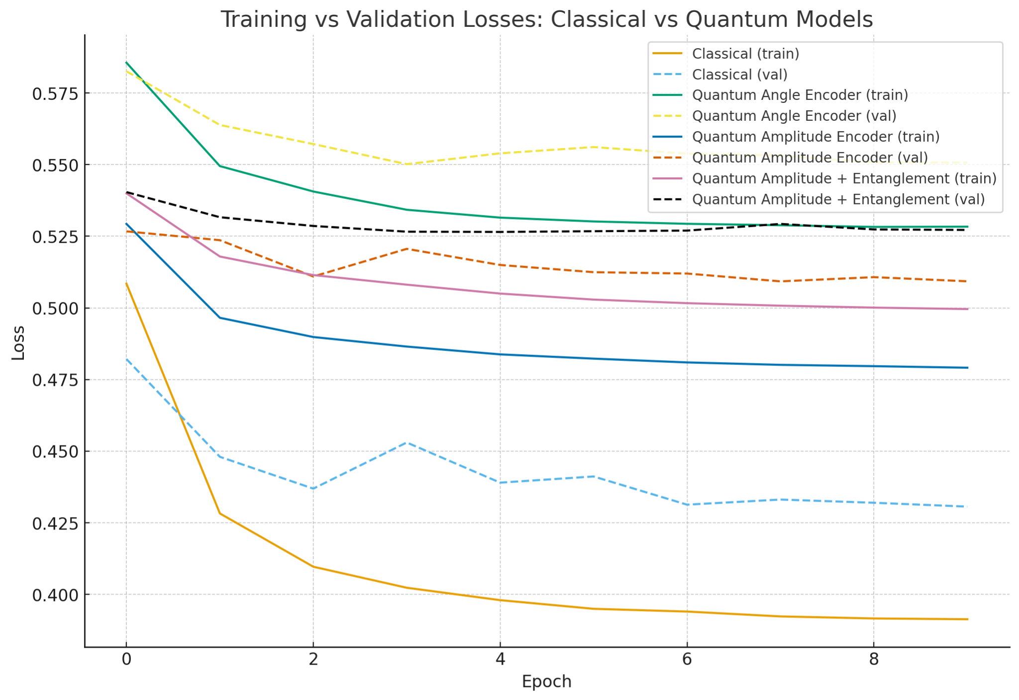
Results: PCAM

Slide 32
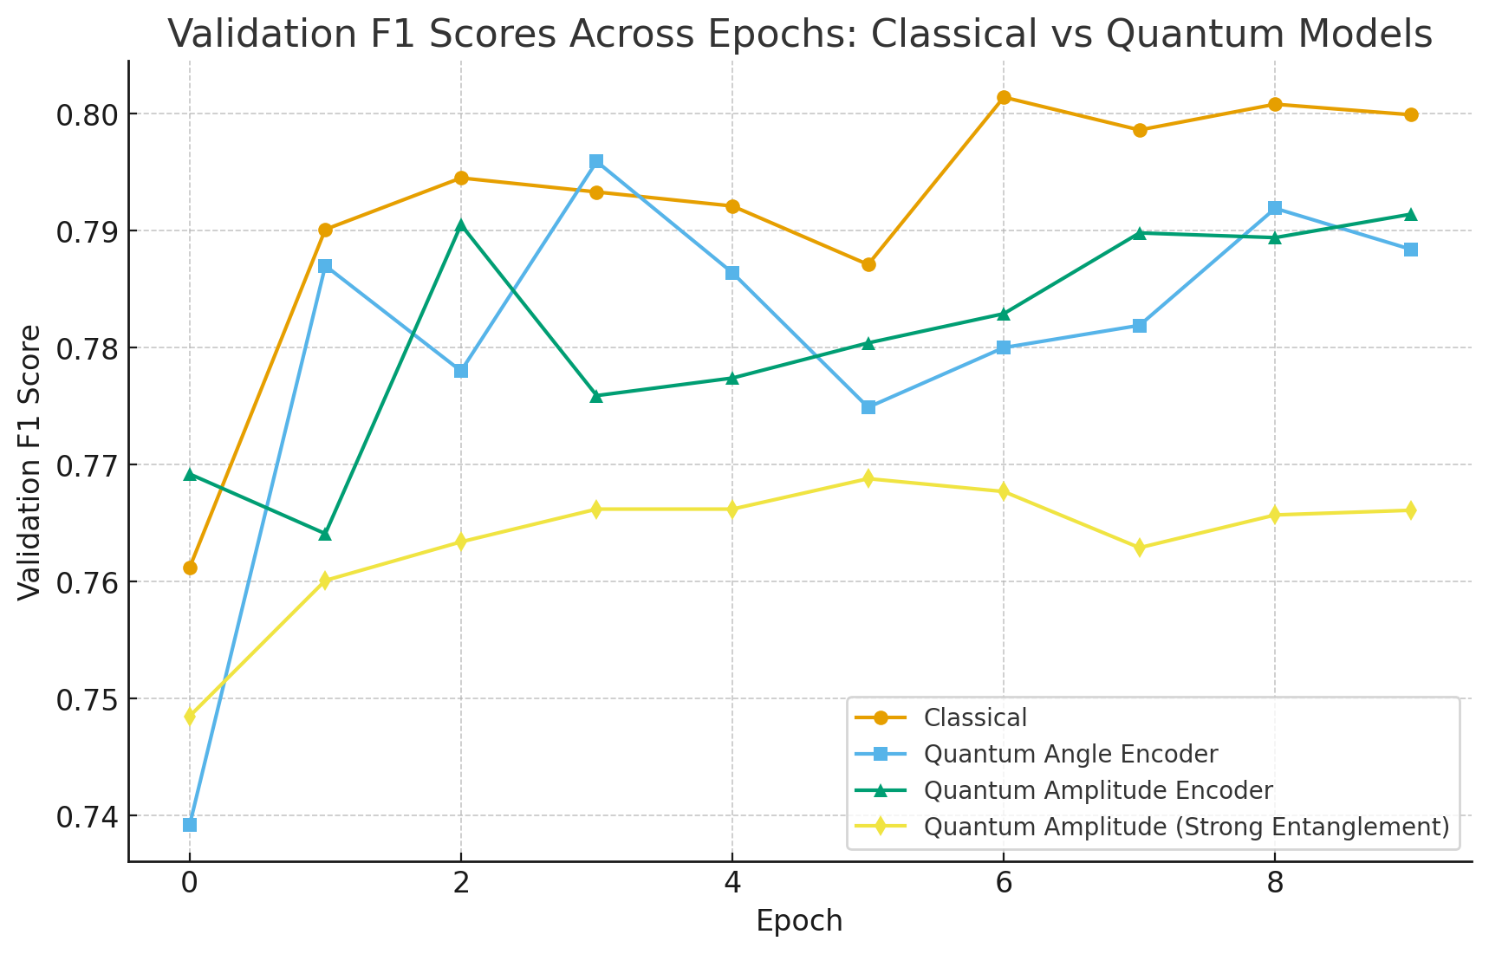
Results: PCAM

Slide 33
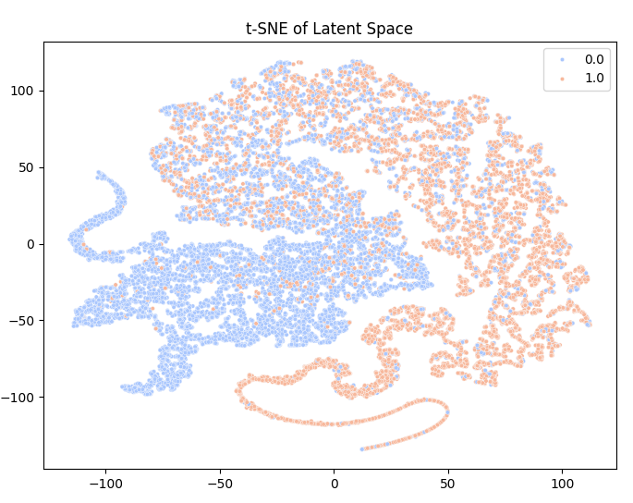
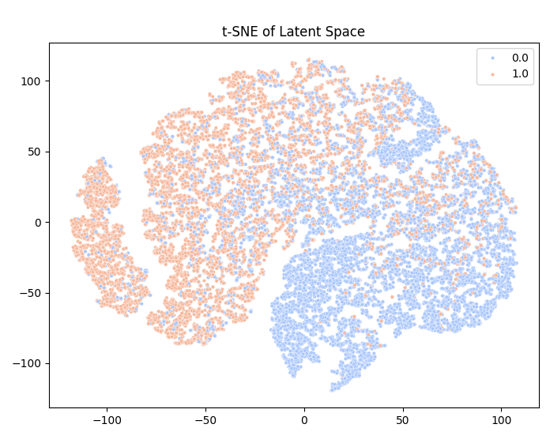
Results: PCAM
Classical Classifier
Amplitude Embedding

Slide 34
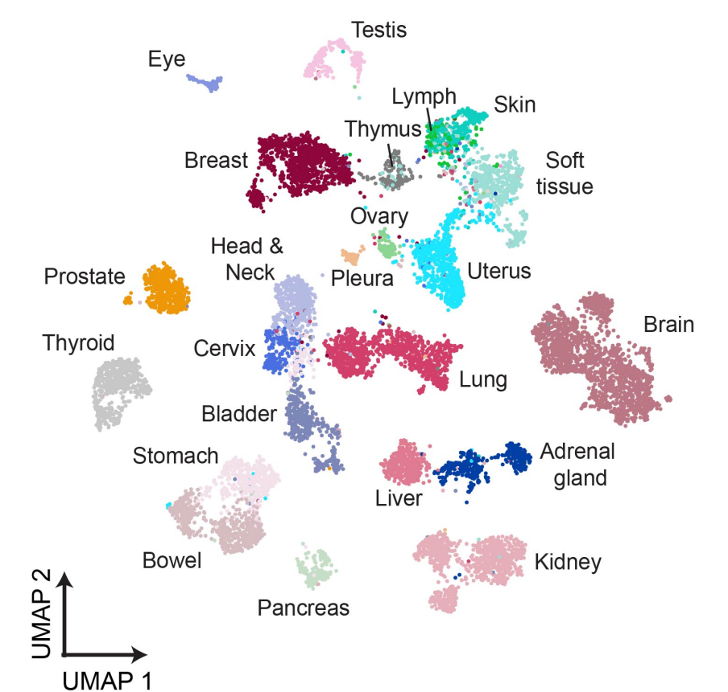
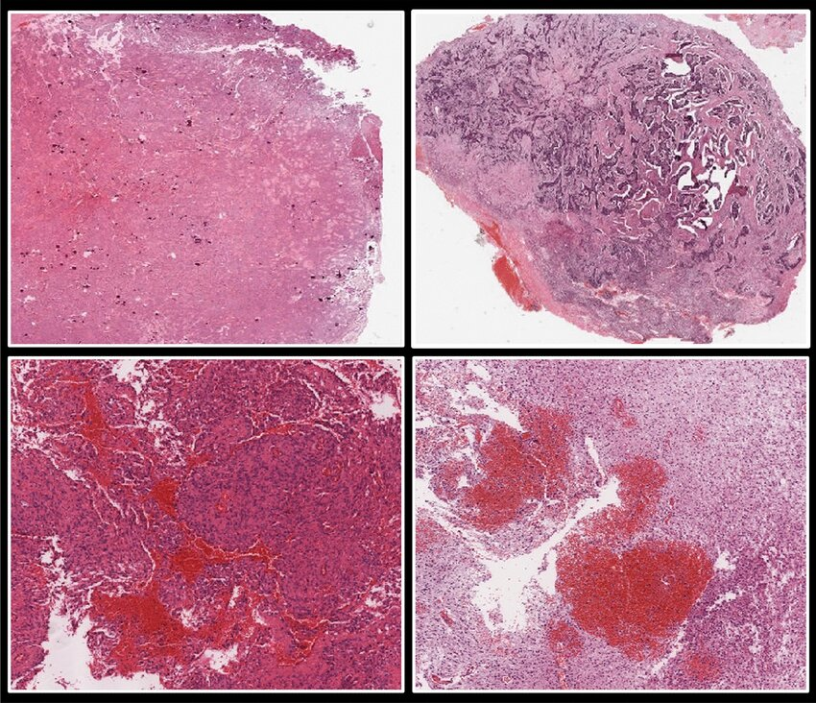
Results: TCGA
TITAN Classical Encoder Embeddings

Slide 35
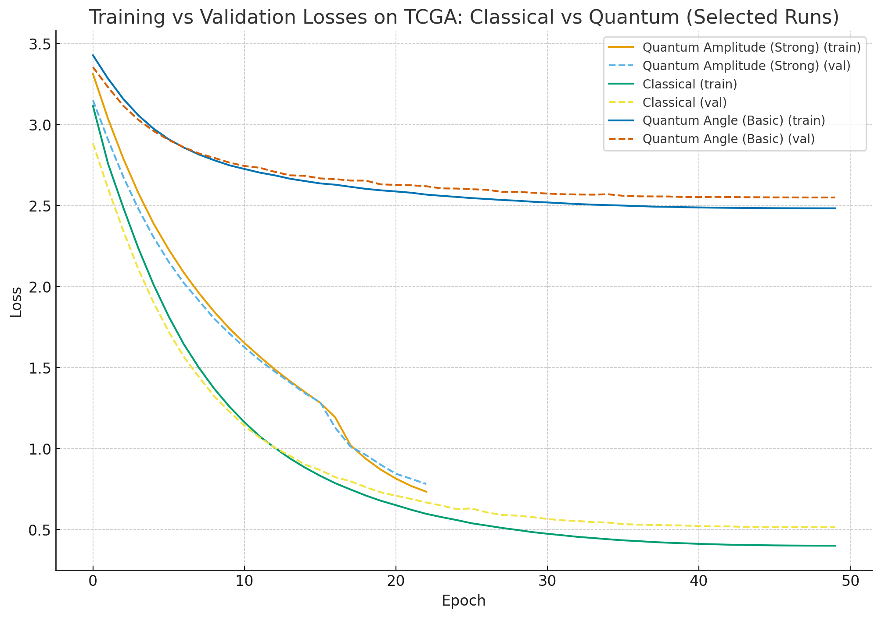
Results: TCGA

Slide 36
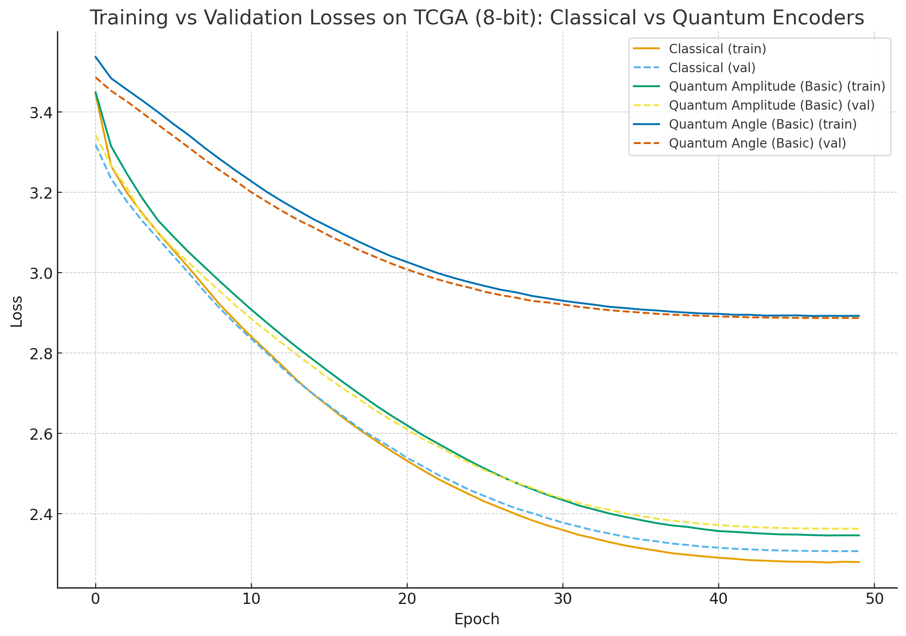
Results: TCGA

Slide 37
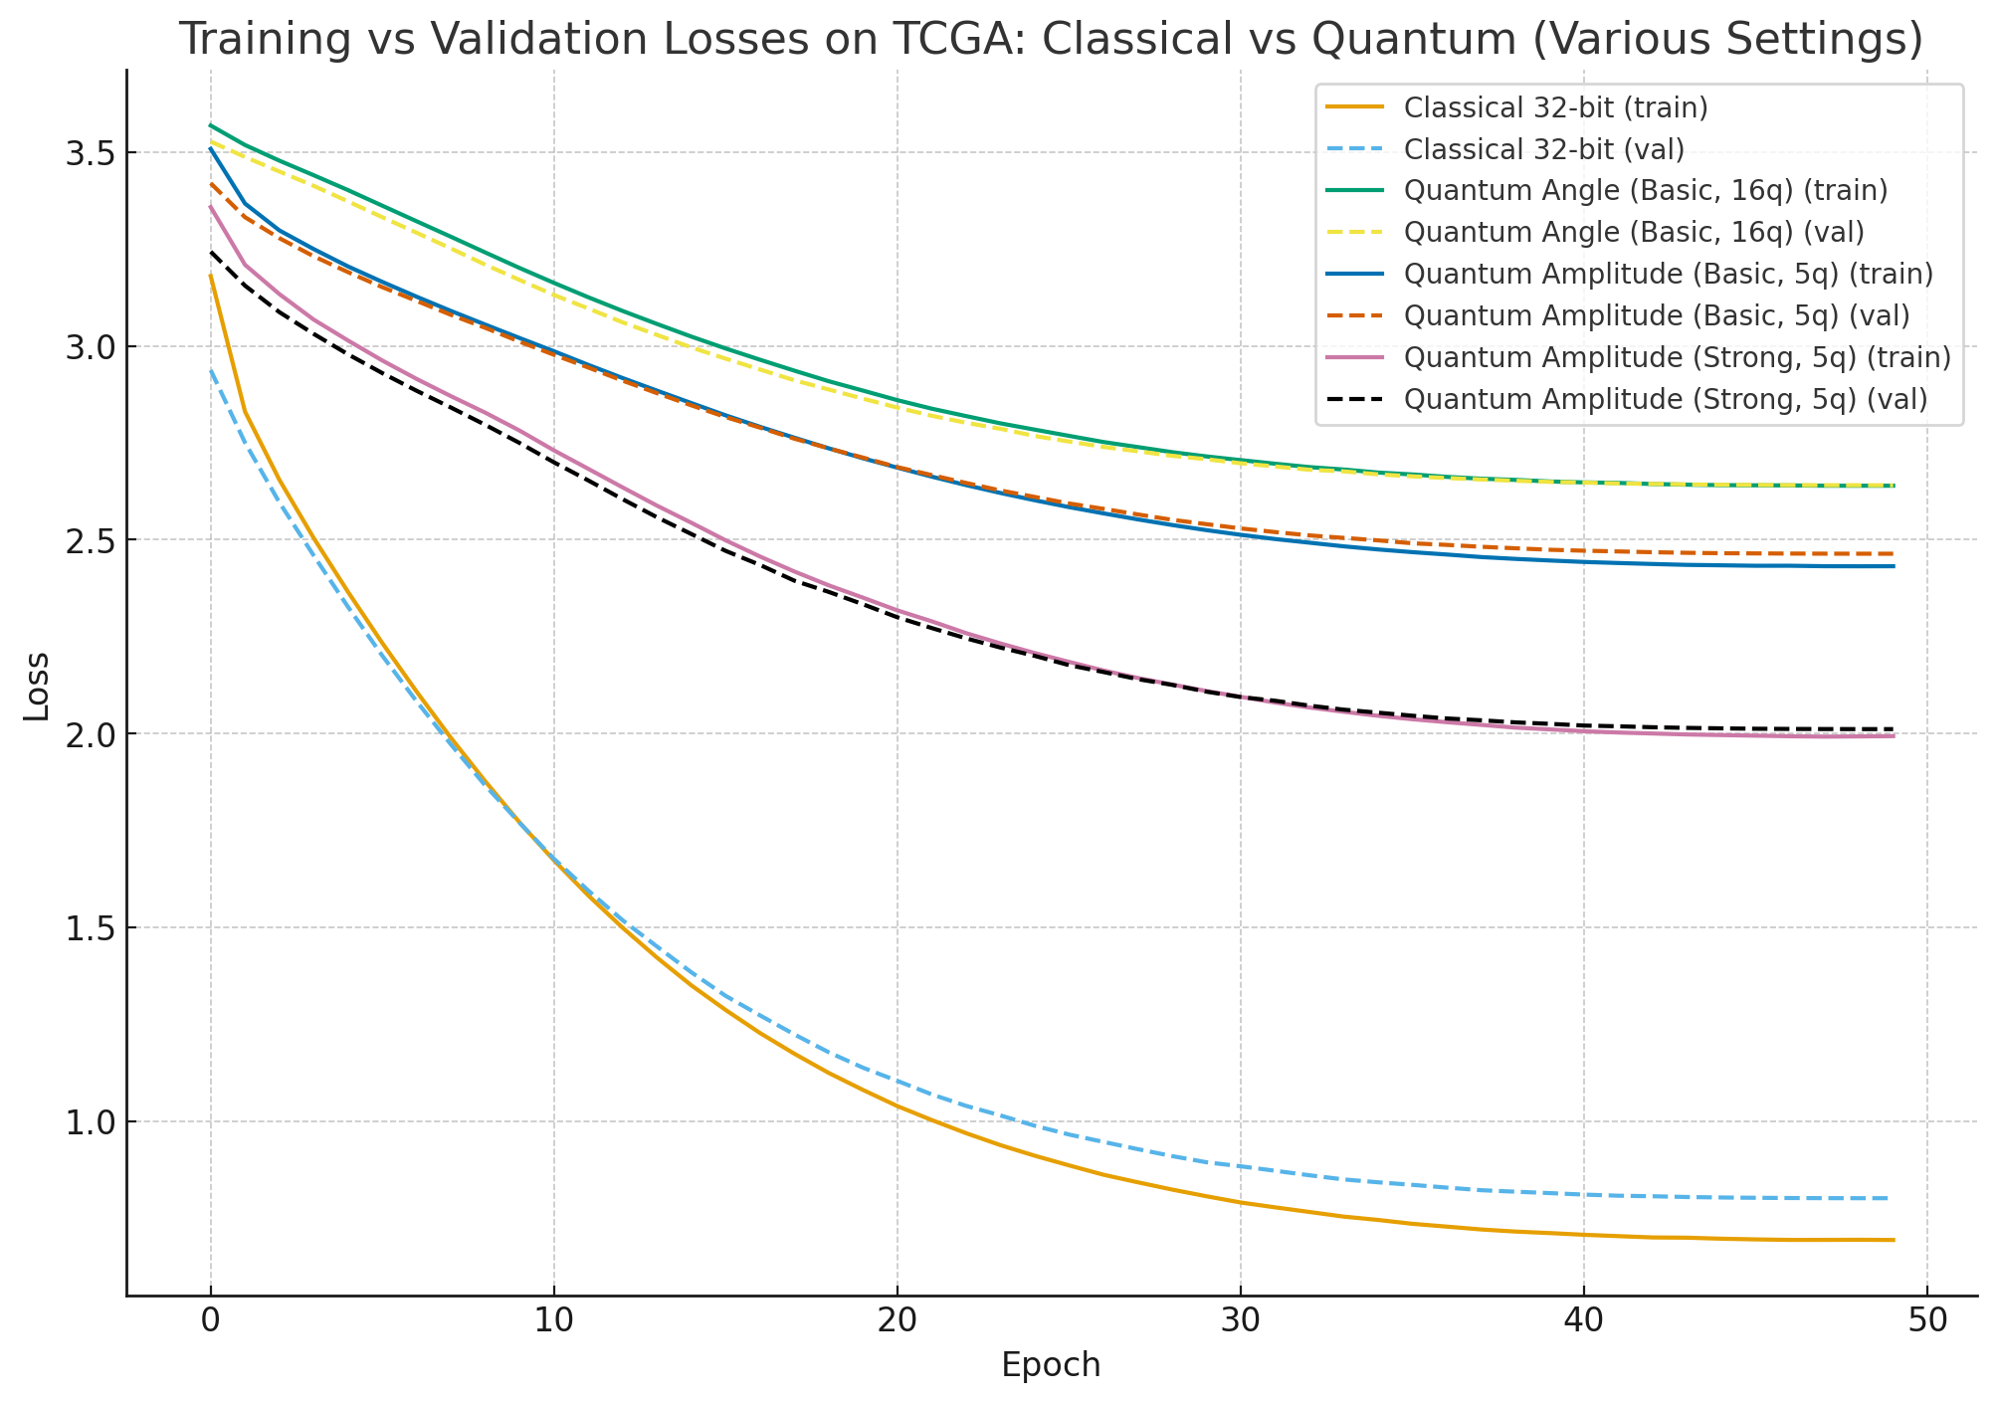
Results: TCGA

Slide 38
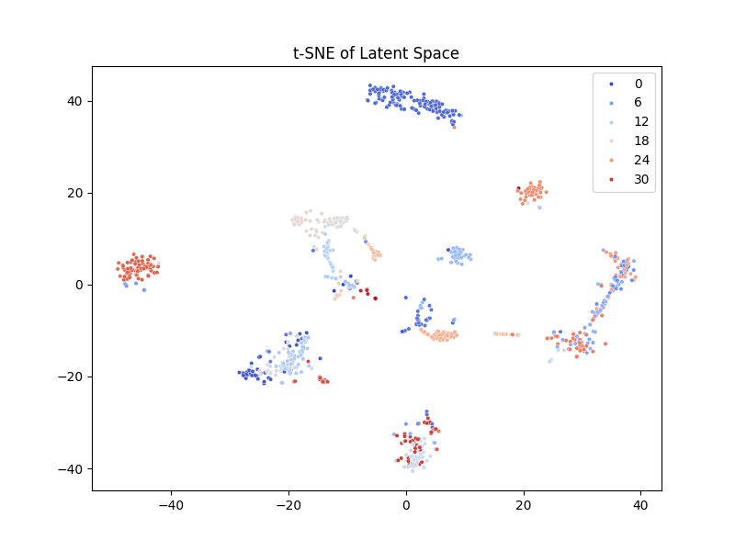
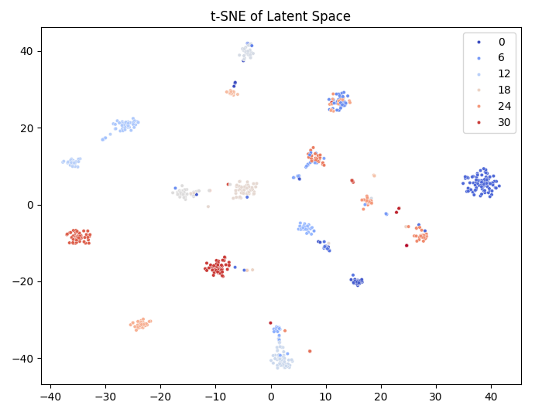
Results: TCGA
Classical Classifier
Amplitude Embedding

Slide 39
Chapter orange
Importance of Inductive Bias
High Performance Machine Learning Group

Slide 40
Core Concept
Linear Models
Assume relationship between features and outcome is a hyperplane
CNNs
Bias for locality and translation invariance
RNNs
Bias for sequences and features through time
Self-Attention
Bias for sequences but permutation invariant

Slide 41
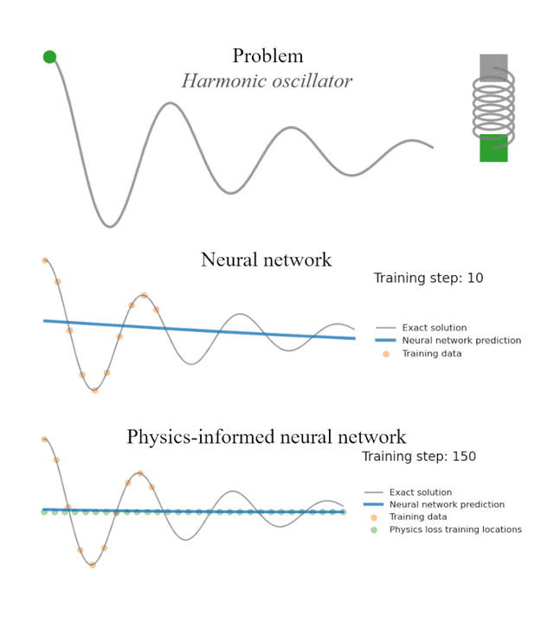
Core Concept
Linear Models
Assume relationship between features and outcome is a hyperplane
CNNs
Bias for locality and translation invariance
RNNs
Bias for sequences and features through time
Self-Attention
Bias for sequences but permutation invariant

Slide 42
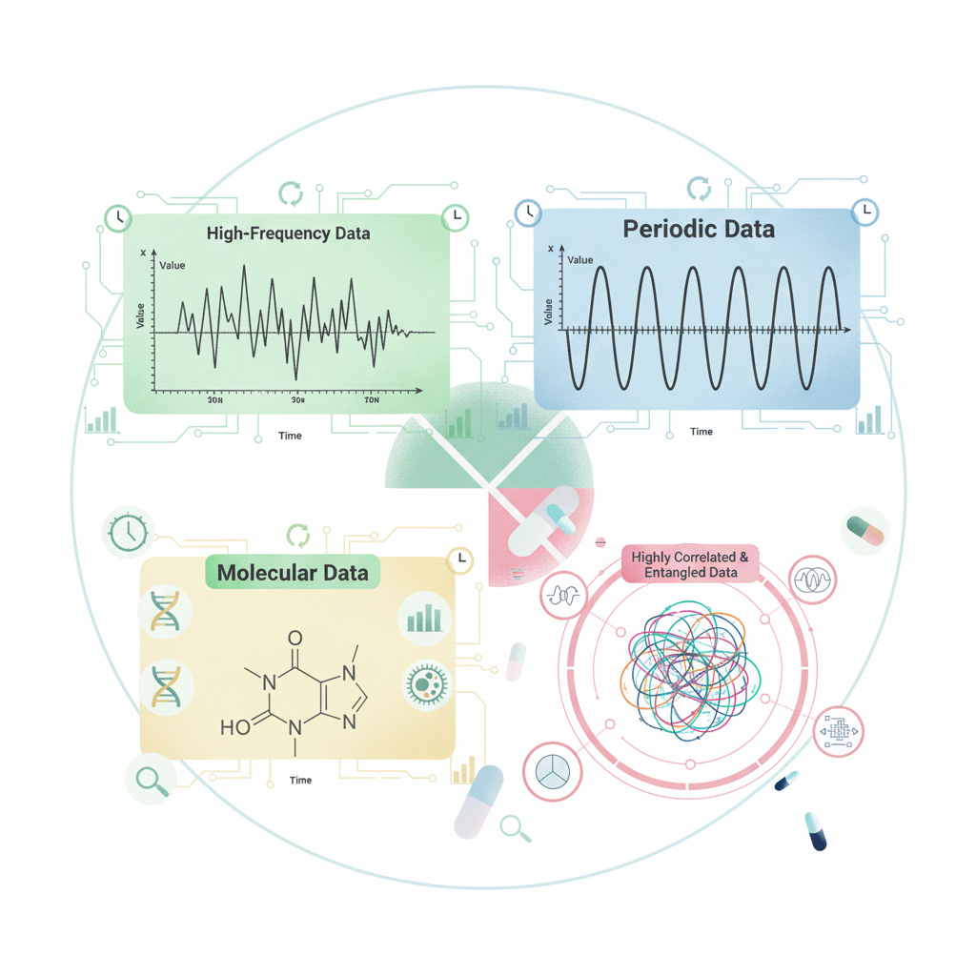
Quantum Inductive Bias
Periodicity & Oscillatory
VQC is fundamentally a sequence of rotation gates (Rx, Ry, Rz), output is a Fourier series
Entangled Correlations
Model non-local correlations

Slide 43
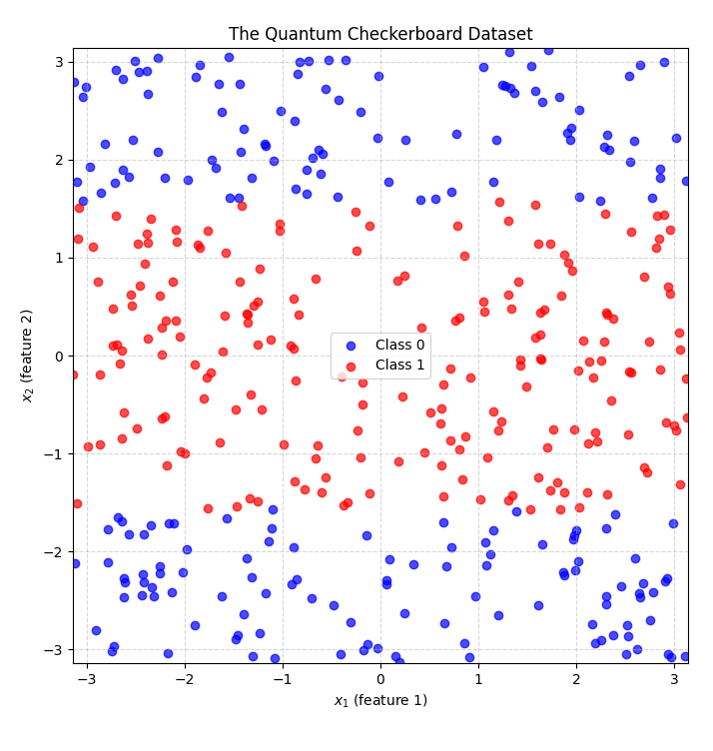
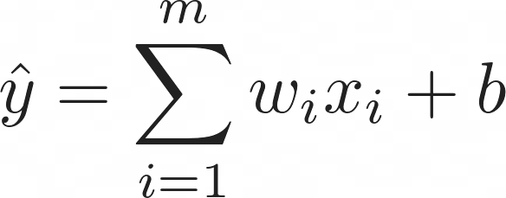
The Checkerboard Problem
Linear Model
Will try to separate the data
Angle Encoding + BasicEntangling
Inherently non-linear trigonometric mapping

Slide 44
The Checkerboard Problem
Linear Model
Will try to separate the data
Angle Encoding + BasicEntangling
Inherently non-linear trigonometric mapping

Slide 45
The Checkerboard Problem
Linear Model
Will try to separate the data
Angle Encoding + BasicEntangling
Inherently non-linear trigonometric mapping

Slide 46
The Checkerboard Problem
Linear Model
Will try to separate the data
Angle Encoding + BasicEntangling
Inherently non-linear trigonometric mapping

Slide 47
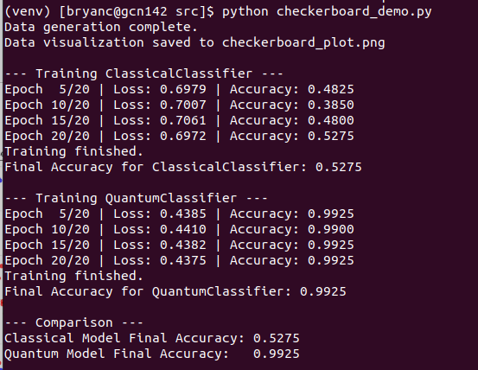
The Checkerboard Problem

Slide 48
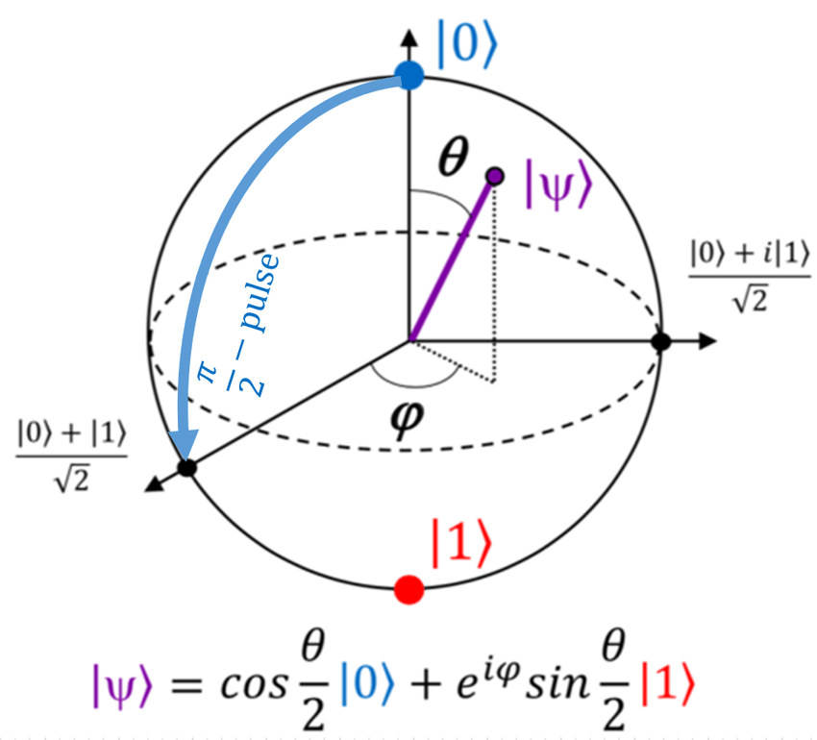
The Checkerboard Problem

Slide 49
The Checkerboard Problem
Rotate state vector around X, Y, Z axis of the bloch sphere
Before entanglement both qubits are independent
After entanglement data has been encoded to combined 4-dimensional complex vector space
U

Slide 50
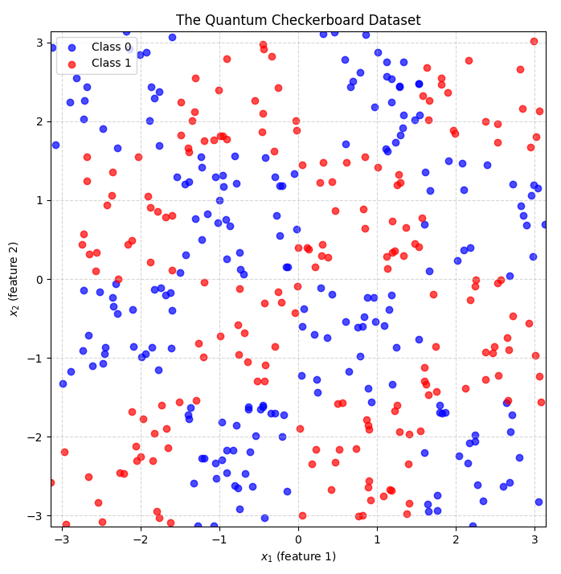
Can we make it work for the checkerboard?

Slide 51
Chapter green
Lessons from literature
High Performance Machine Learning Group

Slide 52
Lessons from Literature
Image (hybrid) classification models
Achieves parity but no clear advantage
Inductive bias proliferates
Advantage appears when data fits quantum friendly formats
When data is too “easy”
No advantage, classical reigns supreme
No broad advantage
Current advantages are incremental

Slide 53
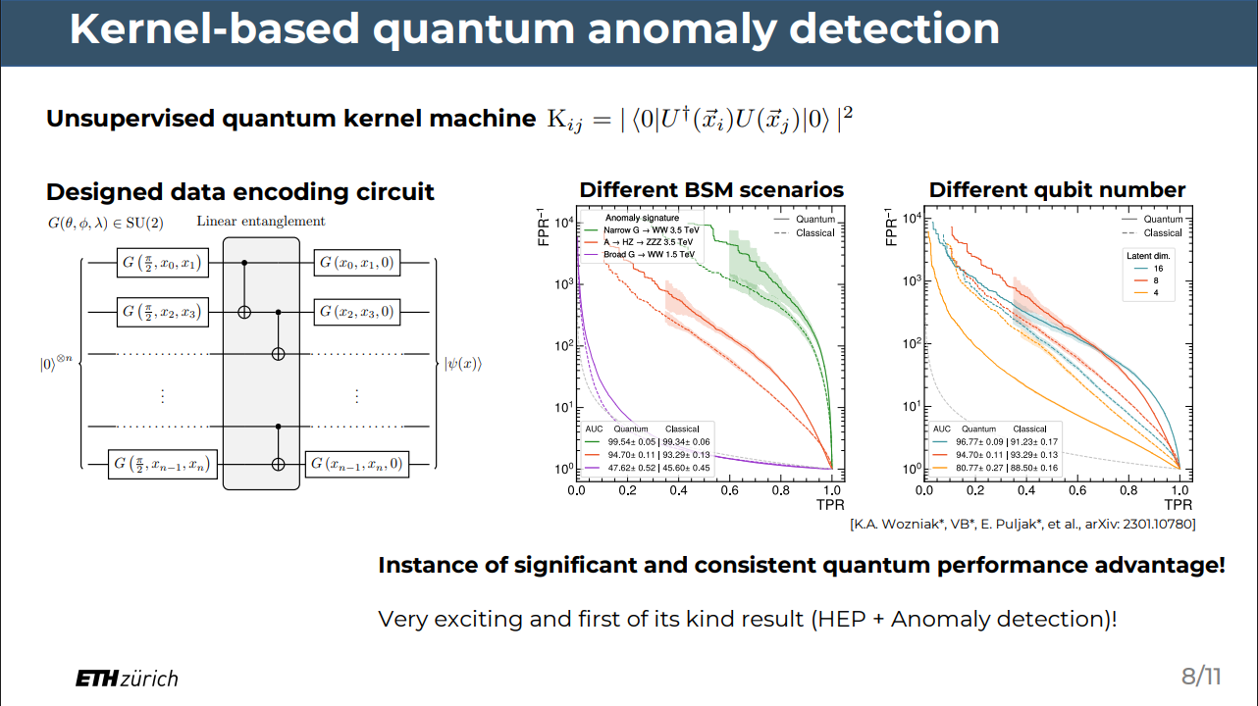
https://quantum.cern/sites/default/files/2023-05/Quantum%20Algorithms%20for%20anomaly%20detection%20at%20the%20LHC.pdf

Slide 54
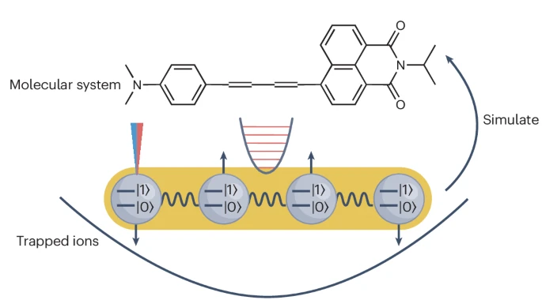
Simulating Compounds
https://www.nature.com/articles/s41570-024-00595-1

Slide 55
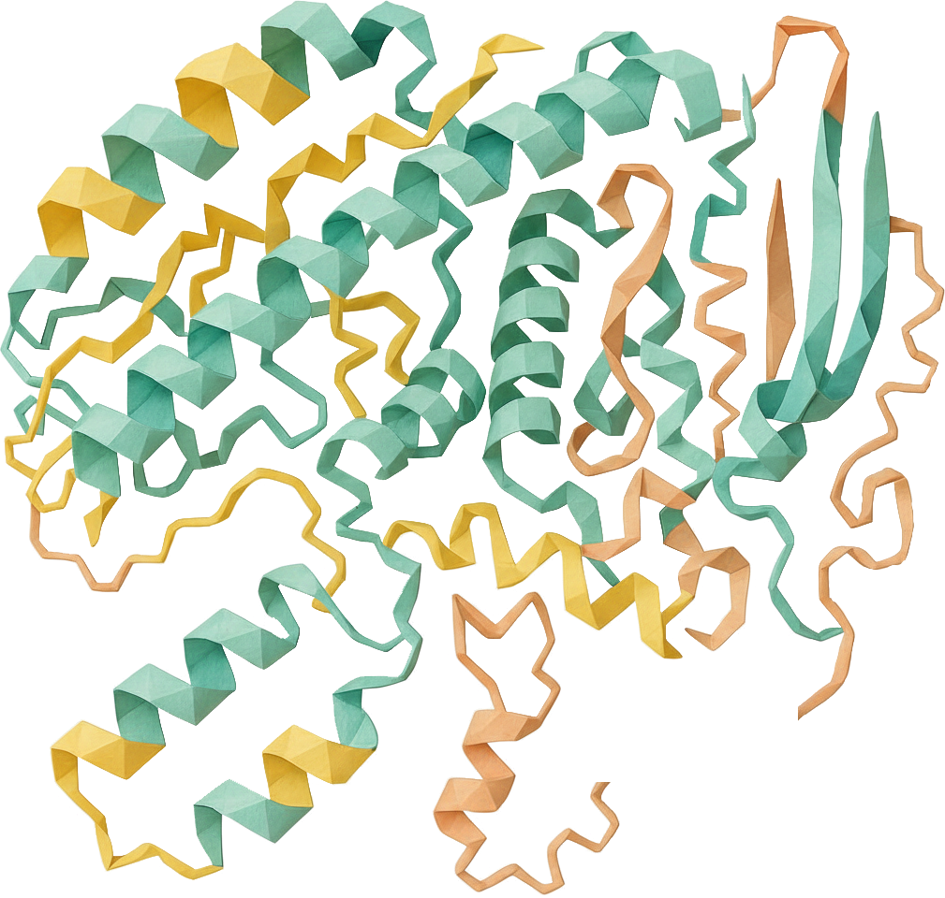
Chapter orange
What can we do?
High Performance Machine Learning Group

Slide 56
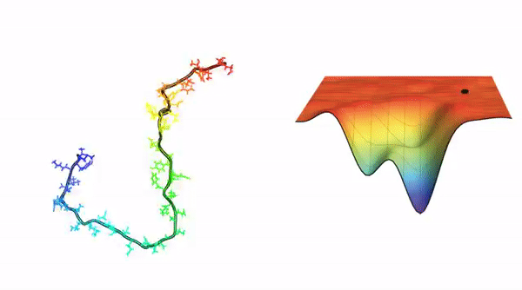
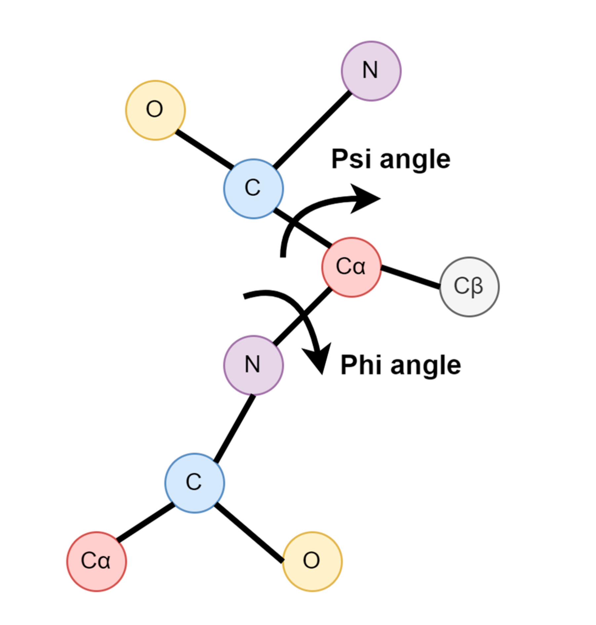
Torsion Angles

Slide 57
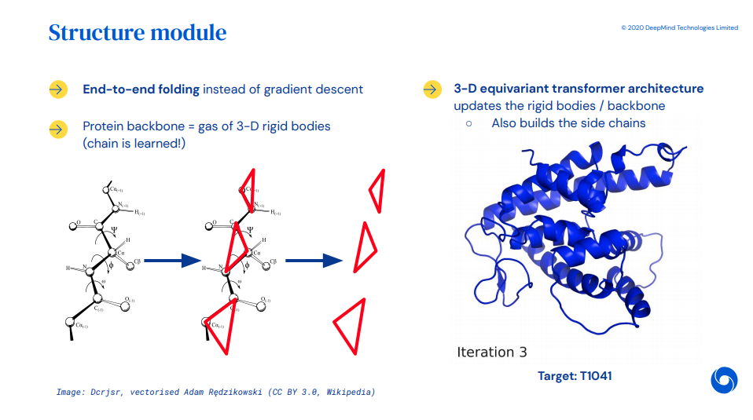
AlphaFold-2: Invariant Point Attention
From representations to concrete 3D coordinates
Parameterize torsion angles for each amino-acid
Don’t learn rotations or translations in space

Slide 58
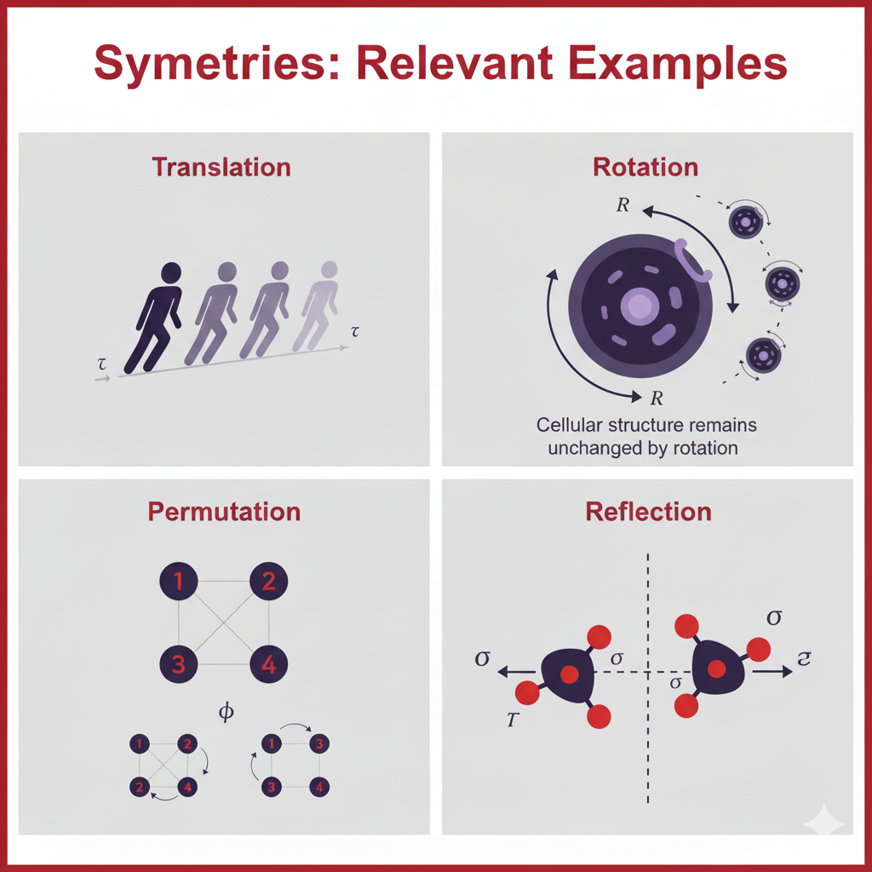
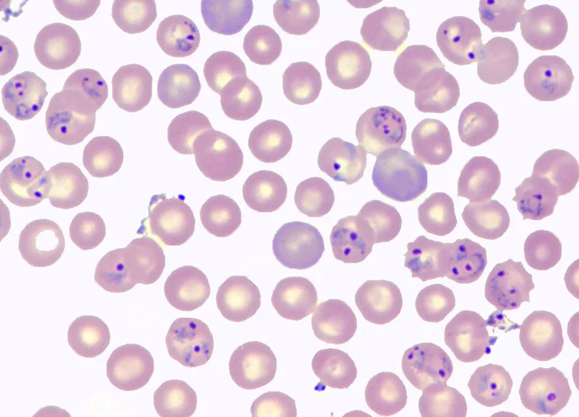
Medical Images: Invariances

Slide 59
Chapter yellow
Thanks!
High Performance Machine Learning Group

Slide 60
Chapter yellow
U

