Slide 1
Classifying Viral Hosts
Based on Metagenomic Features
IBS-2

Slide 2
Introduction
Objective
Context
To predict viral hosts using metagenomic features
Utilization of machine learning algorithms on a dataset of viral genomes

Slide 3

01
Introduction

Slide 4

What is Metagenomics?
Metagenomics is a branch of molecular biology.
It involves studying genetic material extracted directly from environmental samples.
The focus is on analyzing the collective genomes of microbial communities.
It does not require isolating and culturing individual organisms.
Provides insights into genetic diversity, functional capabilities, and ecological roles of microbial populations.
Helps understand microbial community dynamics and interactions with their environments.

Slide 5
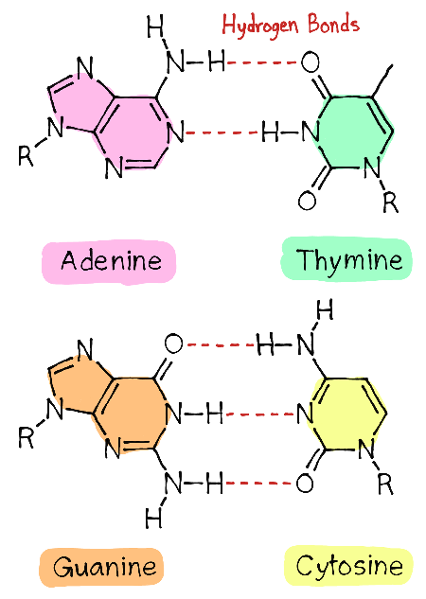
GC Content (%)
GC percentage to the proportion of guanine (G) and cytosine (C) bases within the genome
calculated as the sum of G and C bases divided by the total number of bases
this is used to infer genomic stability, adaptation to environmental conditions, and evolutionary relationships among viruses.

Slide 6
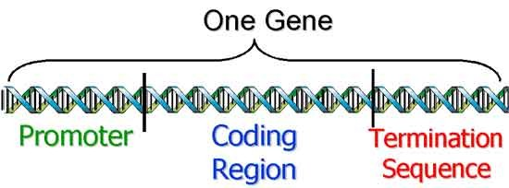
CDS (Coding Sequence)
represents the regions of the genome that are transcribed and translated into proteins.
It is calculated from genome annotation by identifying and count these protein-coding regions based on known gene sequences.
the number of CDS is used to understand the functional complexity of the virus, its potential virulence, and its ability to interact with host organisms.

Slide 7
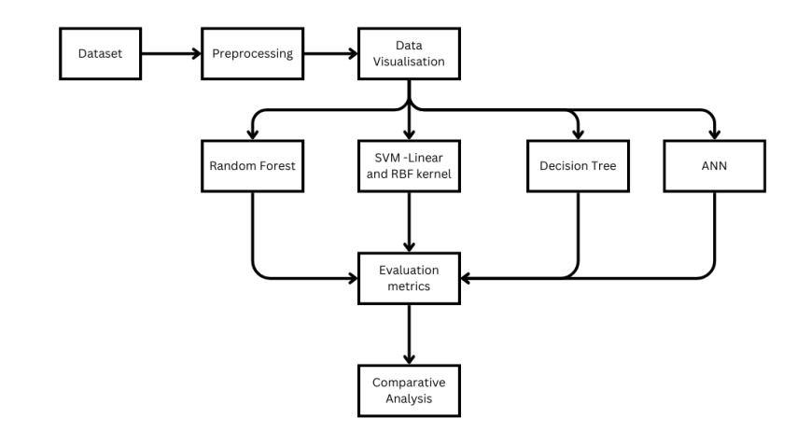
Methodology

Slide 8
Data Overview
01
02
03
04
Host
Size (in Mb)
GC Content (%)
CDS (Coding Sequence)

Slide 9
Data Preprocessing
Steps Taken:
Handling missing values
Feature scaling
Encoding categorical variables

Slide 10
Feature Engineering
Extraction of Features
Normalization and Scaling
Any derived features that were created to enhance model performance.
Techniques used to prepare data for modeling.

Slide 11
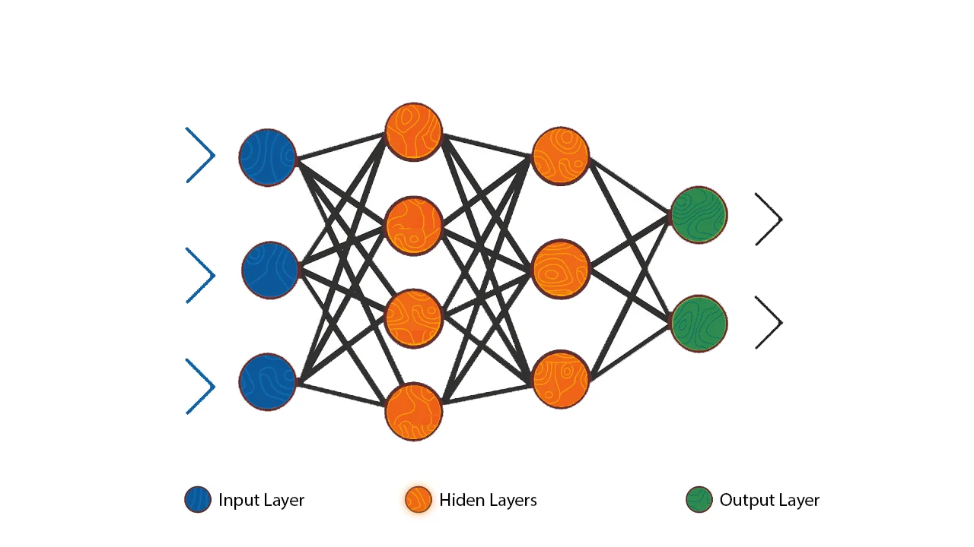
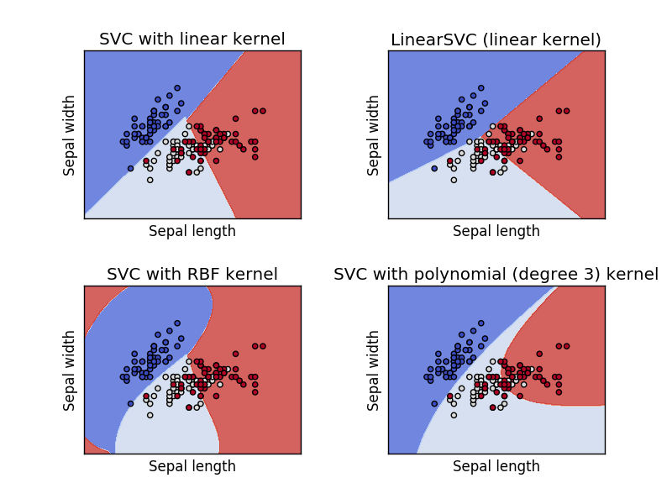
Models
Support Vector Machine
SVM is a supervised machine learning algorithm used for classification and regression tasks. It finds an optimal hyperplane that best separates classes in high-dimensional space.
Sequential MLP
Sequential MLP refers to a type of neural network architecture where neurons are arranged in layers, and each layer is fully connected to the next. It's commonly used for various machine learning tasks, especially in deep learning contexts for its ability to learn complex patterns.

Slide 12
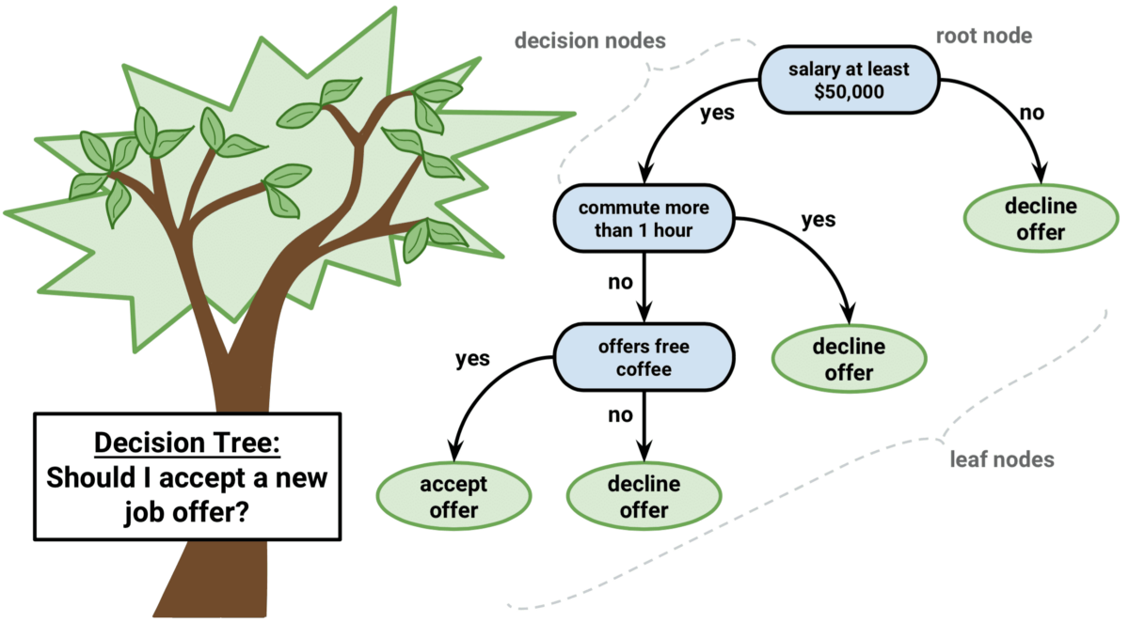
Decision Tree
A decision tree is a supervised learning algorithm that partitions data into subsets based on features, creating a tree-like model of decisions. It's intuitive and can handle both classification and regression tasks.

Slide 13
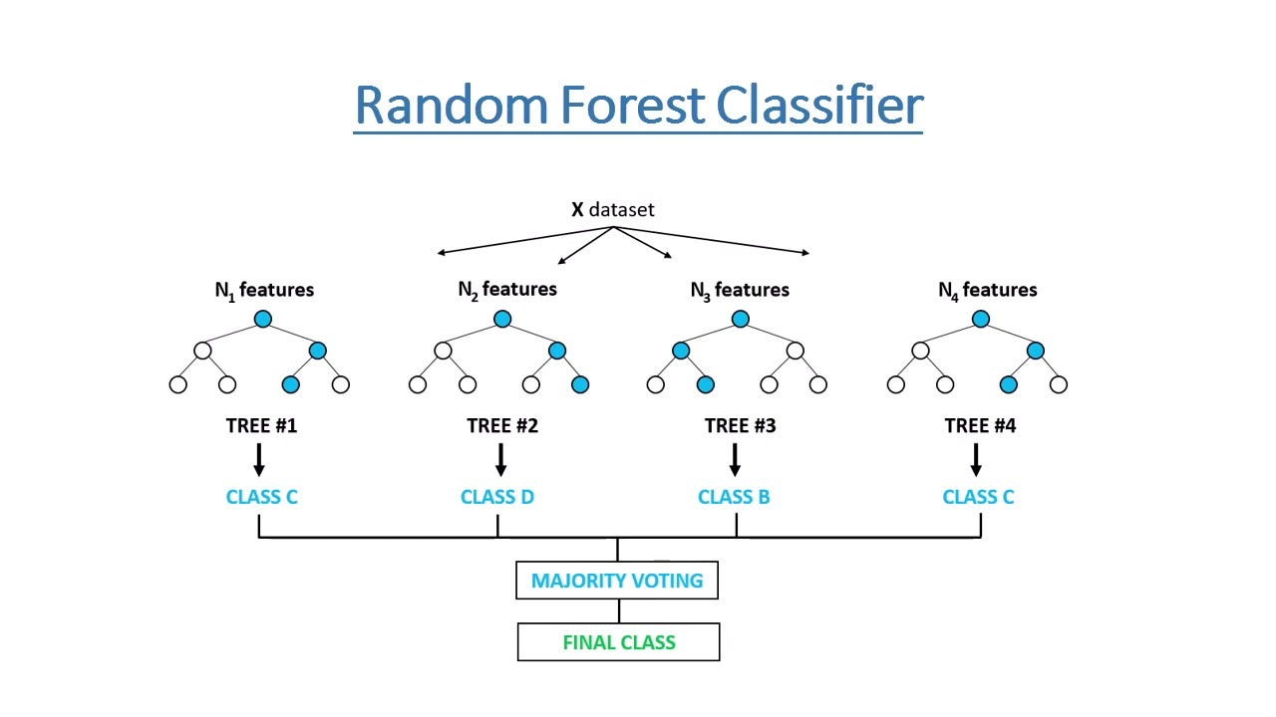
Random Forest
Random Forest is an ensemble learning method that constructs multiple decision trees during training and outputs the mode of the classes (classification) or average prediction (regression) of the individual trees.

Slide 14
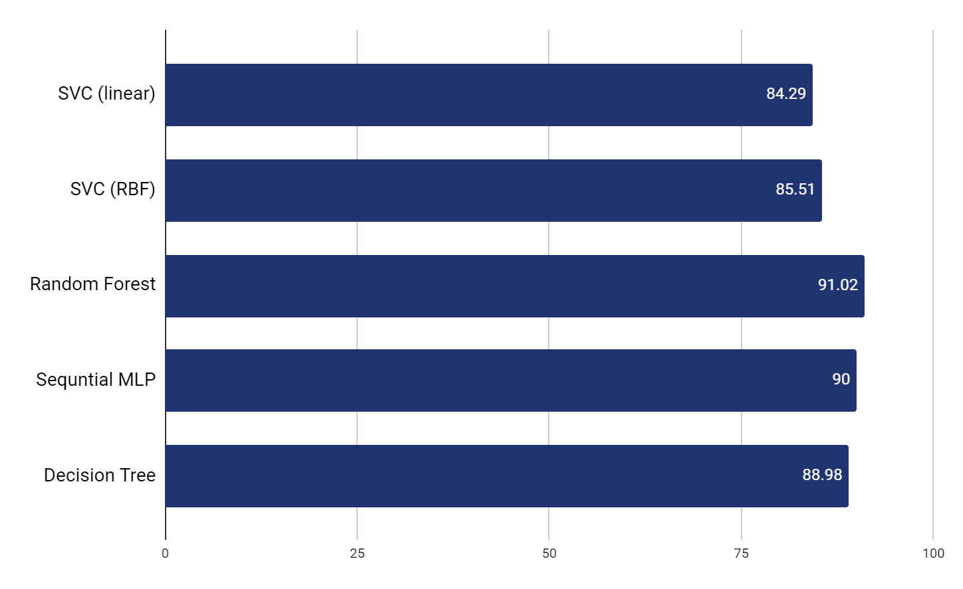
Result
Based on accuracy results
Random Forest: Highest accuracy, robust for complex datasets due to ensemble nature.
Sequential MLP: Effective for learning intricate patterns but requires more computational resources.
Decision Tree: Provides simplicity and interpretability with reasonable accuracy.
SVC (RBF Kernel): Handles non-linear relationships but was outperformed by Random Forest and MLP in accuracy.

Slide 15
Thanks
DURAI SINGH K
CB.EN.U4AIE22167
I V SRICHANDRA
CB.EN.U4AIE22165
K P SURIYA
CB.EN.U4AIE22164
Credit: Guided by Dr. Harishchander A.

