Slide 1
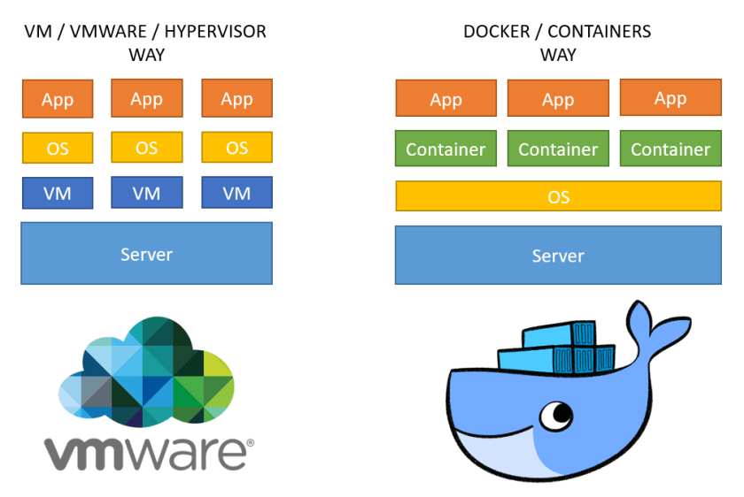
Docker

Slide 2
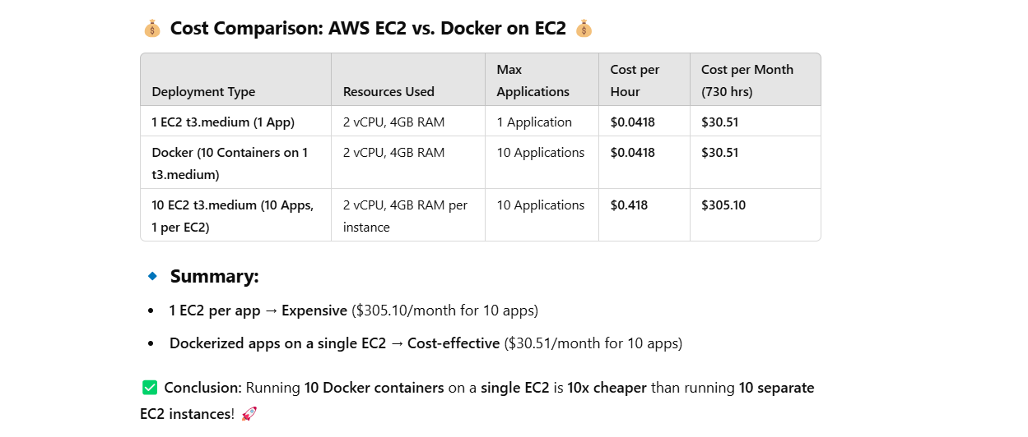

Slide 3
What is Docker?
Docker is an open-source containerization platform that allows you to package applications with all their dependencies into lightweight, portable containers. These containers ensure that the application runs consistently across different environments (development, testing, production).
Why use Docker?
✅ Portability – Runs on any system with Docker installed (no dependency issues). ✅ Lightweight – Uses less memory and resources compared to Virtual Machines (VMs). ✅ Faster Deployment – Containers start in seconds, unlike VMs which take minutes. ✅ Scalability – Easily scale applications using Kubernetes and Docker Swarm. ✅ CI/CD Integration – Works seamlessly with Jenkins, GitHub Actions, etc.
Feature | Virtual Machine (VM) | Docker Container
Startup Time | Slow (minutes) | Fast (seconds)
Size | Large (GBs) | Lightweight (MBs)
Performance | Needs more CPU, RAM | Uses fewer resources
Isolation | Runs a full OS per VM | Shares OS kernel, lightweight
Portability | Works only on specific OS (Hypervisor required) | Works anywhere with Docker
Scalability | Slow & heavy | Fast & easy

Slide 4
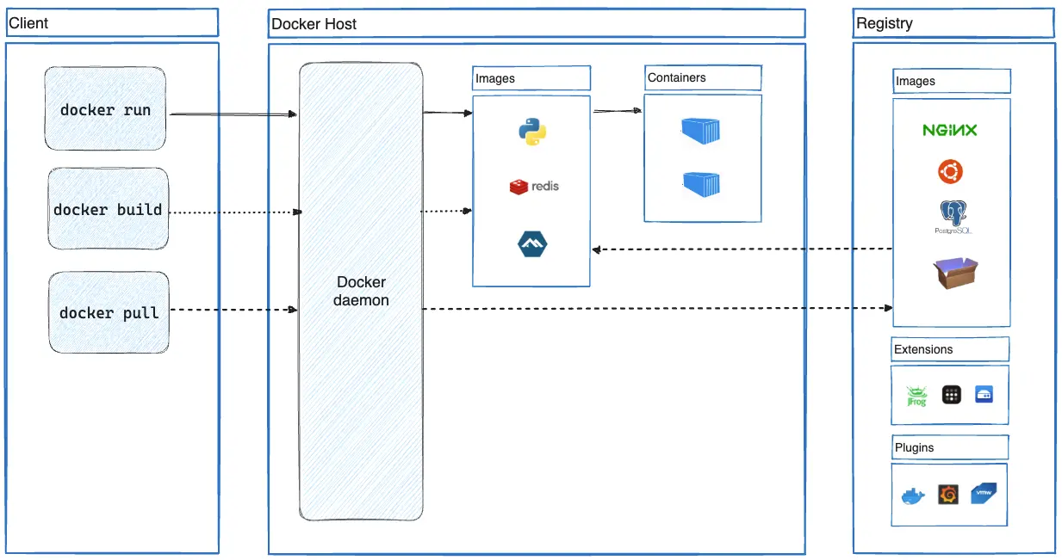
Docker Architecture
Docker HUB
AWS E C R

Slide 5
What is a Docker Image?
A Docker Image is a lightweight, standalone, and executable package that contains everything needed to run an application—code, runtime, libraries, dependencies, and system tools.
Images are read-only (immutable).
You can create multiple containers from a single image.
Stored in Docker Hub (public) or a private registry. ECR
> docker pull nginx
> Rename-Item -Path "dockerfile.txt" -NewName "Dockerfile"
What is a Container?
A Docker Container is a running instance of a Docker Image.
It is lightweight and isolated from the host system.
Containers share the host OS kernel, unlike Virtual Machines.
Can be easily started, stopped, and removed without affecting other containers.
> docker run -d -p 8080:80 nginx

Slide 6
11 To create a docker image from a dockerfile
docker build -t image_name .
12 To create an image from a customised container
docker commit container_id/container_name image_name
Working on docker containers
==================================
13 To see the list of running containers
docker container ls
14 To see the list of all containers (running and stopped)
docker ps -a
15 To start a container
docker start container_id/container_name
16 To stop a container
docker stop container_id/container_name
17 To restart a container
docker restart container_id/container_name
To restart after 10 seconds
docker restart -t 10 container_id/container_name
18 To delete a stopped container
docker rm container_id/container_name
19 To delete a running container
docker rm -f container_id/container_name
20 To stop all running container
docker stop $(docker ps -aq)
23 To get detailed info about a container
docker inspect container_id/container_name
24 To see the logs genearated by a container
docker logs container_id/container_name
25 To create a docker container
docker run image_name/image_id
run command options
---------------------
--name: USed to give a name to the container
--restart: Used to keep the container in runnign condition
-d: Used to run the container in detached mode in background
-it: Used to open interactive terminal in the container
-e: Used to pass environment varibales to the container
-v : Used to attach an external device or folder as a volume
--volumes-from: Used to share volume between multiple containers
-p : Used for port mapping.It will link the container port with
host port.Eg: -p 8080:80 Here 8080 is host port(external port)
and 80 is container port(internal port)
-P: Used for automatic port mapping where the container port is
mapped with some host port that is greate than 30000
--link : Used to create a link between multiple containers to create a
microservices architecture.
--network: Used to start a container on a specific network
-rm : Used to delete a container on exit
-m: Used to specify the upper limit on the amount of memeory that
a container can use
-c: Used to specify the upper limit on the amout of cpu a container can use
-ip: Used to asssign an ip to the container
26 To see the ports used by a container
docker port container_id/container_name
27 To run any process in a container from outside the container
docker exec -it container_id/container_name process_name
Eg: To run the bash process in a container
docker exec -it container_id/container_name bash
28 To come out of a container without exit
ctrl+p,ctrl+q
29 To go back into a container from where the interactive terminal is running
docker attach container_id/container_name
Working on docker images
===============================
1 To pull a docker image
docker pull image_name
2 To search for a docker images
docker search image_name
3 To upload an image into docker hub
docker push image_name
4 To see the list of images that are downloaded
docker images
or
docker image ls
5 To get detailed info about a docker image
docker image inspect image_name/image_id
6 To delete a docker image that is not linked to any container
docker rmi image_name/image_id
7 To delete a image that is linked to a container
docker rmi -f image_name/image_id
8 To save the docker image as a tar file
docker save image_name
9 To untar this tar file and get image
docker load tarfile_name
10 To delete all image
docker system prune -af

Slide 7
# Layer 1: Base image (Existing Layer from Docker Hub)
FROM ubuntu:latest
# Layer 2: Updates the package list
RUN apt update
# Layer 3: Installs Nginx
RUN apt install -y nginx
# Layer 4: Copies files from the host to the container
COPY index.html /var/www/html/
# Layer 5: Exposes port 80
EXPOSE 80
# Layer 6: Sets the default command
CMD ["nginx", "-g", "daemon off;"]
1️⃣ FROM → First layer (base image) 2️⃣ RUN → Creates a new layer each time a command runs 3️⃣ COPY/ADD → Adds files as a new layer ADD? Tar and untar the remote files 4️⃣ EXPOSE, CMD, ENTRYPOINT → Are metadata, don’t create new layers
> docker run -d --network mynetwork --name my-container my-image
> docker run -d -p 8080:80 -v /host/path:/usr/share/nginx/html my-nginx
-v mydata:/app/data → Persistent Docker-managed volume
-v /host/path:/container/path → Bind mount (host folder to container)
--tmpfs /container/path:size=100m → Temporary in-memory storage
--network mynetwork → Connect container to a custom network

Slide 8
Any Questions…….??

Slide 9
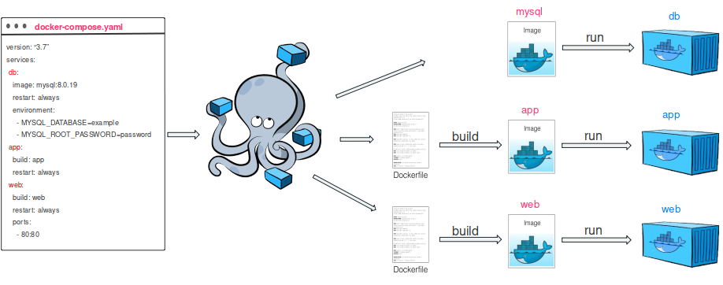
What is Docker Compose?
Docker Compose is a tool used to define and manage multi-container applications using a simple YAML file (docker-compose.yml).
Run multiple dependent containers (e.g., an app + database)
Define networking, volumes, and environment variables easily
Start all services using a single command (docker-compose up)
👉 Example Use Case: You have a web app (nginx), a database (MySQL), and a backend (Python). Instead of managing each manually, Docker Compose handles them all at once.

Slide 10
version: "3.8"
services:
frontend:
build: ./frontend
ports:
- "3000:80" # Expose frontend on host
depends_on:
- backend
networks:
- app_network
volumes:
- frontend_data:/usr/share/nginx/html # Persist frontend files
restart: always
backend:
build: ./backend
ports:
- "5000:5000" # API exposed only to frontend
depends_on:
- db
environment:
- DATABASE_HOST=db
- DATABASE_USER=root
- DATABASE_PASSWORD=rootpassword
- DATABASE_NAME=mydb
networks:
- app_network
volumes:
- backend_logs:/app/logs # Store logs persistently
restart: always
db:
image: mysql:8.0
restart: always
environment:
- MYSQL_ROOT_PASSWORD=rootpassword
- MYSQL_DATABASE=mydb
ports:
- "3306:3306" # Expose MySQL only to internal services
volumes:
- db_data:/var/lib/mysql # Persist database
networks:
- app_network
volumes:
frontend_data:
backend_logs:
db_data:
networks:
app_network:
driver: bridge # Isolated private network

Slide 11
Command Description
docker-compose up -d Start all services in background
docker-compose up --build -d Rebuild & start fresh
docker-compose down Stop & remove containers
docker-compose logs View logs for all services
docker-compose exec <service> bash Enter a running container
docker-compose restart Restart all services
# Follow logs in real-time
docker-compose logs -f
# Open a shell in a running container
docker-compose exec backend sh
# Run a command inside a container (e.g., list files)
docker-compose exec frontend ls -l
# Scale a service (e.g., run 3 instances of backend)
docker-compose up --scale backend=3 -d
# Start only a specific service (e.g., frontend)
docker-compose up -d frontend
# Remove unused containers, images, and networks
docker system prune -f
# Full clean-up and restart everything
docker-compose down && docker system prune -f && docker-compose up --build -d
# Start all containers in detached mode
docker-compose up -d
# Start & force rebuild containers
docker-compose up --build -d
# Start containers in foreground (shows logs)
docker-compose up
# Stop and remove all containers, networks, and volumes
docker-compose down --volumes
# Stop containers without removing volumes
docker-compose down
# Restart all containers
docker-compose restart
# Restart a specific service (e.g., backend)
docker-compose restart backend
# View running containers
docker-compose ps
# View logs for all containers
docker-compose logs
# View logs for a specific container
docker-compose logs frontend

Slide 12
Docker Networking
📌 Network Types in Docker
Bridge (Default)
Containers can communicate within the same bridge network.
Use case: Local development.
Command:
> docker network create my_bridge
> docker network connect my_bridge my_container
2 Host
Removes network isolation; the container shares the host’s network.
Use case: Performance-sensitive apps (like Nginx).
Command:
docker run --network host nginx
3 None
Completely disables networking.
Use case: High-security applications.
Command:
> docker run --network none alpine
4 Overlay
Allows multi-host communication in Docker Swarm.
Use case: Distributed microservices.
Command:
> docker network create -d overlay my_overlay
docker network disconnect my_network my_container
docker network ls
docker network connect my_network my_container

Slide 13
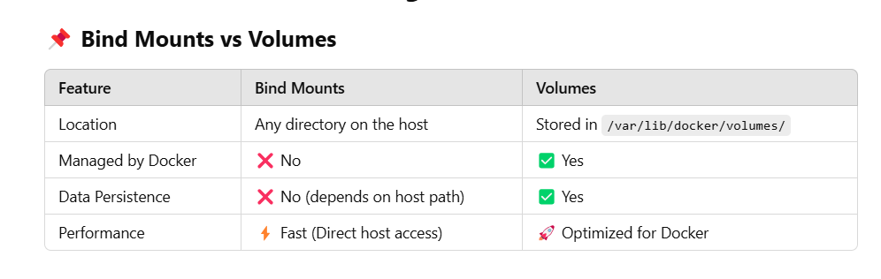
# List all volumes
docker volume ls
# Inspect a volume
docker volume inspect my_volume
# Remove a volume
docker volume rm my_volume
# Remove all unused volumes
docker volume prune
🔹 Persistent Storage for Containers
🔹 Using Volumes (Recommended)
docker volume create my_volume
docker run -d --name my_container -v my_volume:/app nginx
The /app directory inside the container now uses my_volume.
Using Bind Mounts
docker run -d --name my_container -v /path/on/host:/app nginx
The /app directory inside the container is now mapped to /path/on/host.

Slide 14
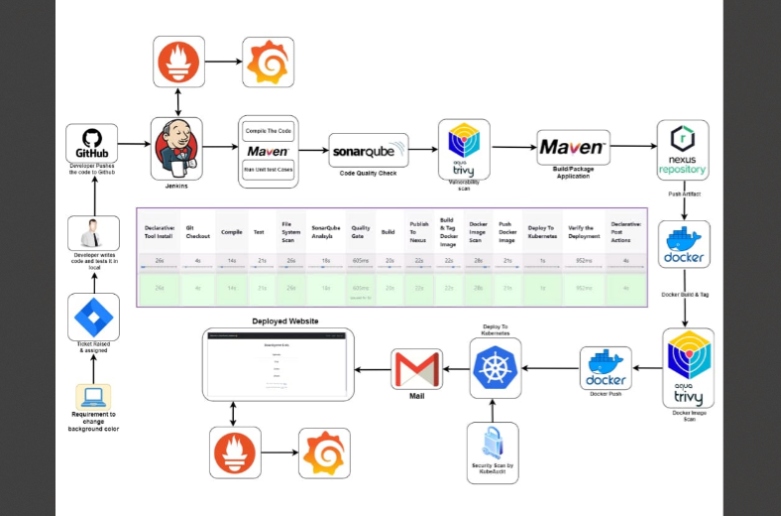
CI CD Process

Slide 15
THANK YOU……………. !!

