Slide 1


MDP Concept Presentation Group 4 By Lucie Bonenberger Surya Manusani Aravind Palakkal Arun Ravindranath Ajinkya Sathe Giorgia Tognazzi

Slide 2
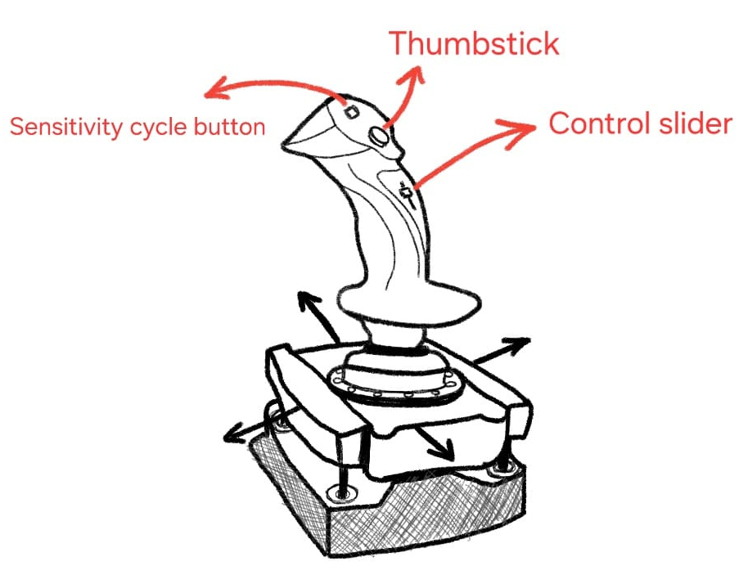
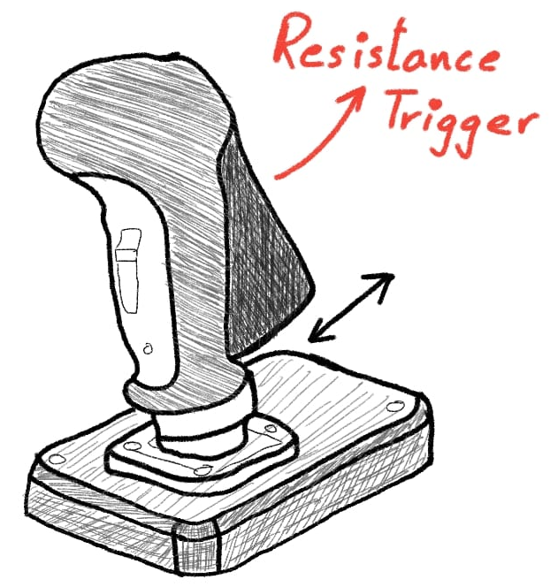
Description
Dual Stick Interface
Movement and closing end-effector seperate
Control slider to switch between modes
Resistance Trigger contains worm gear assembly
Joystick is mounted on suspended platform
Motion of joystick (5 DOF detected by Hall-Effect sensor
Thumbstick for Translational Z-axis
Connects to computer via USB C (Data and Power)

Slide 3
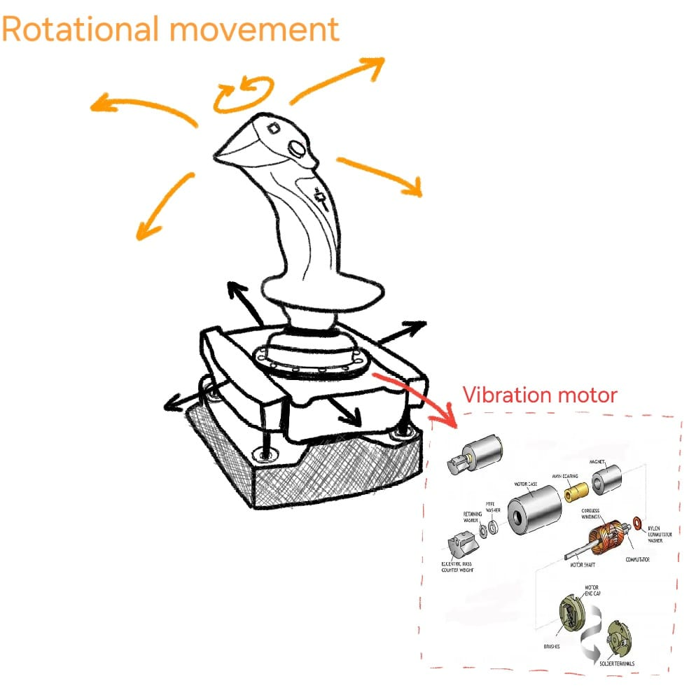
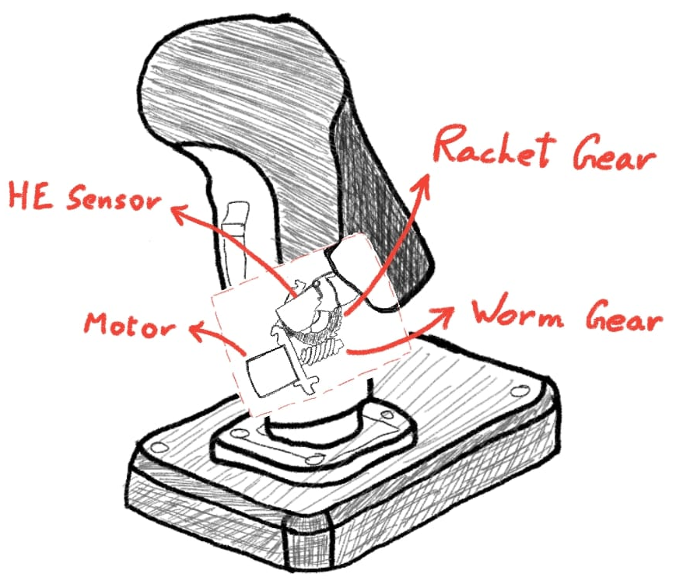
Description
Translational movement

Slide 4
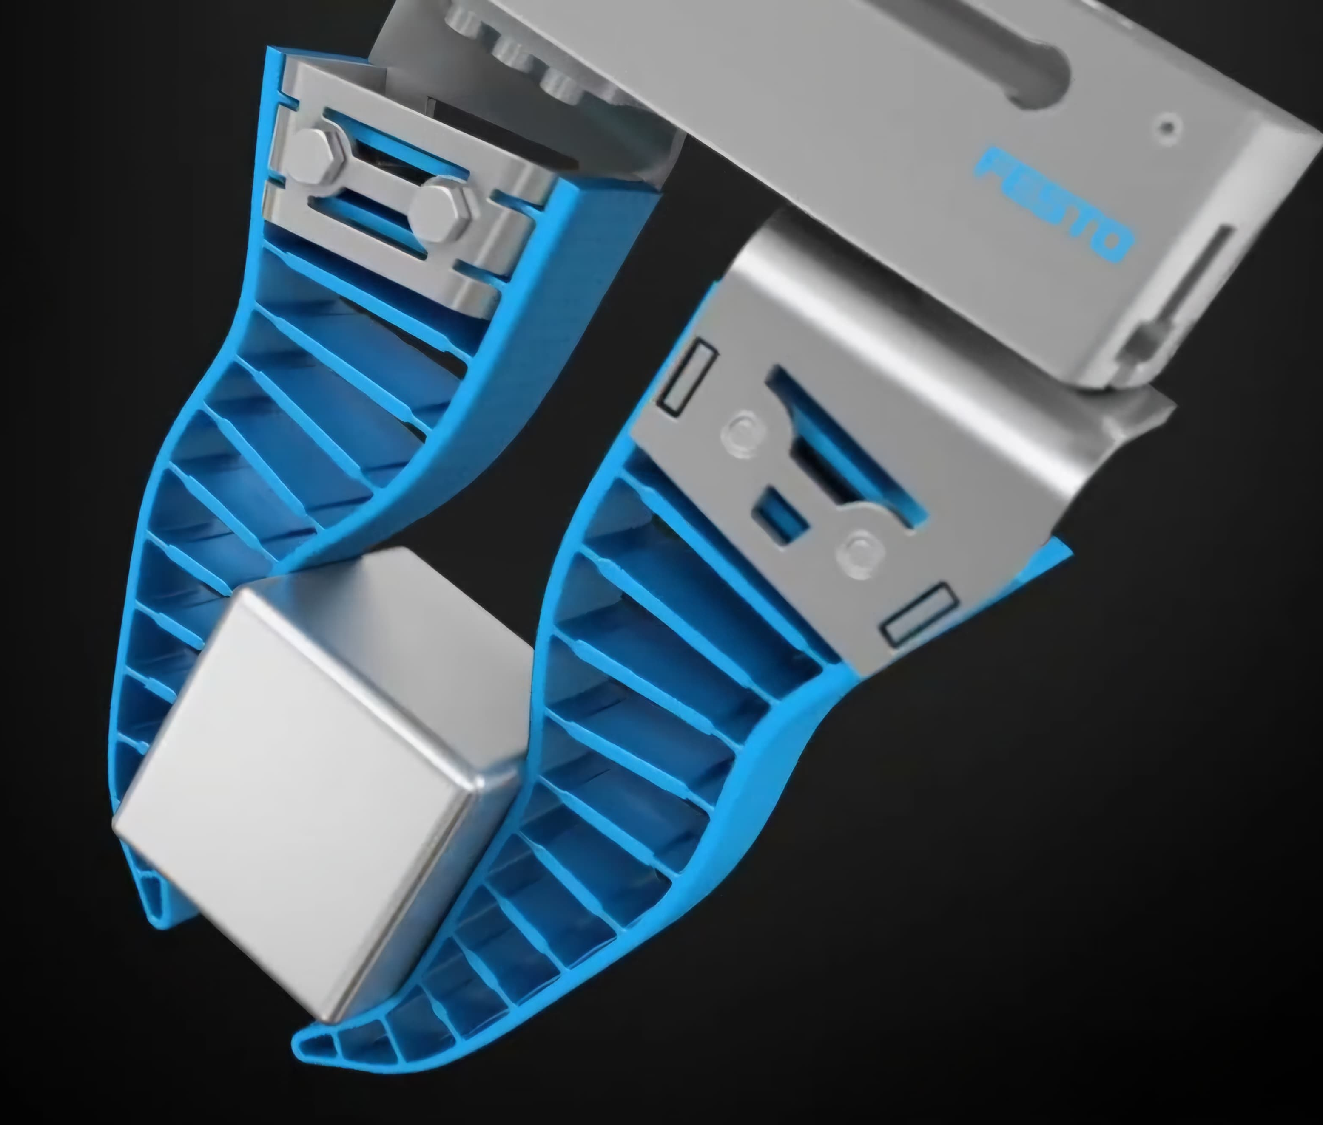
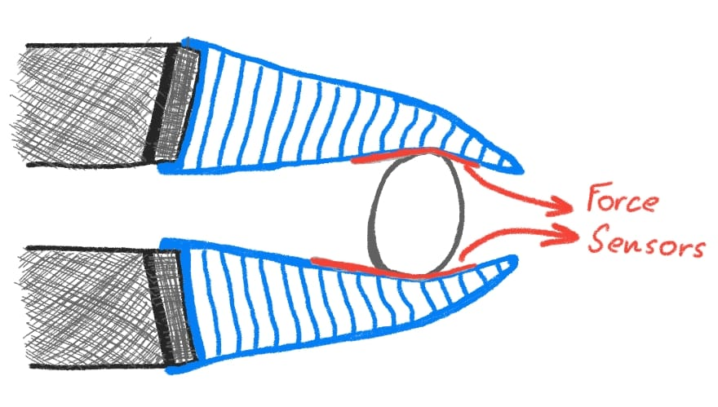
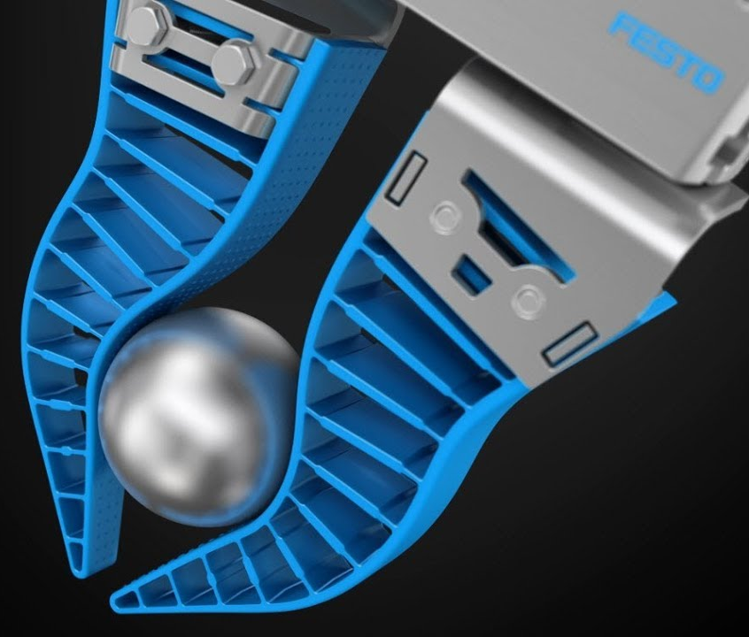
Description
End-effector
Soft robotics to enable delicate handling
Material: Polyurethane
Force sensors located mid-length on inside surface of the gripper
Data from force sensor gives input to worm gear assembly
Gripper adapts to geometry of the target object
(Festo North America 2020)

Slide 5
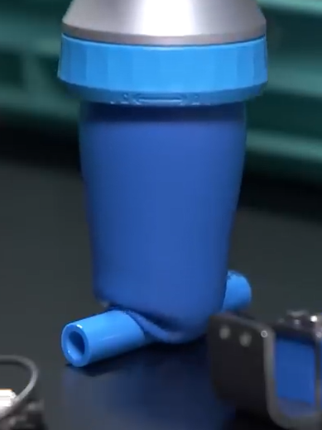
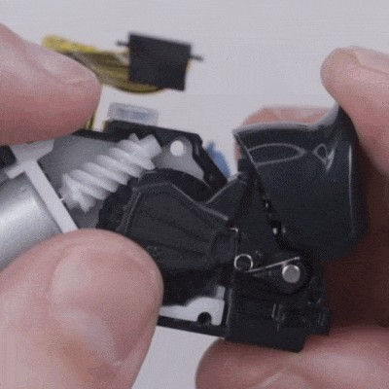
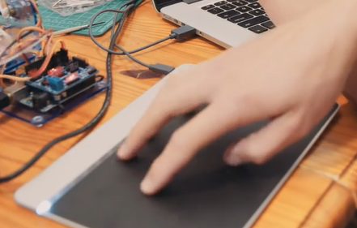
Motivation & Initial Ideas
Motivation
Symmetrical setup to enable use of dominant hand
Familiarity and ease of use
cost effective due to ease of additive manufacturing
improved operational efficiency due to better workspace awareness.
Initial Ideas
Car cell layout
Pinch controllers (Sensel)
Gaming controller (Papp)
Other vacum end-effectors (Festo)
(Sensel)
(Papp 2021)
(Festo 2019)

Slide 6
Literature (APA style references)
Festo. (2024). Buy Adaptive gripper finger DHAS online | Festo DE. Festo.com. https://www.festo.com/de/en/p/adaptive-gripper-finger-id_DHAS_GF/
Festo North America. (2020, October 29). Adaptive Gripper Fingers. YouTube. https://www.youtube.com/watch?v=JAyPTIIpFiA
Festo. (2019, April 16). Festo - The adaptive shape gripper DHEF. YouTube. https://www.youtube.com/watch?v=c1vxuhYwPKY
Papp, D. (2021, September 13). How The PS5’s Genuinely Clever Adaptive Triggers Work. Hackaday. https://hackaday.com/2021/09/13/how-the-ps5s-genuinely-clever-adaptive-triggers-work/
‌Sensel. (2016, December 29). Sensel Morph Controlling a Robot Arm: with Developer Ray Kampmeier. YouTube. https://www.youtube.com/watch?v=rDos7Of9P08
TheNOOBIFIER1337. (2020, October 26). 6 DOF In One Hand - First Look at Sublight Dynamics Joystick. YouTube. https://www.youtube.com/watch?v=nTtHbY-I8lg

