Slide 1


MDP Final Presentation Group 4
By Lucie Bonenberger Surya Manusani Aravind Palakkal Arun Ravindranath Ajinkya Sathe Giorgia Tognazzi

Slide 2
Agenda
01
Description
02
Motivation
03
Kinematic Analysis
04
List of Materials
05
Conclusion and outlook

Slide 3
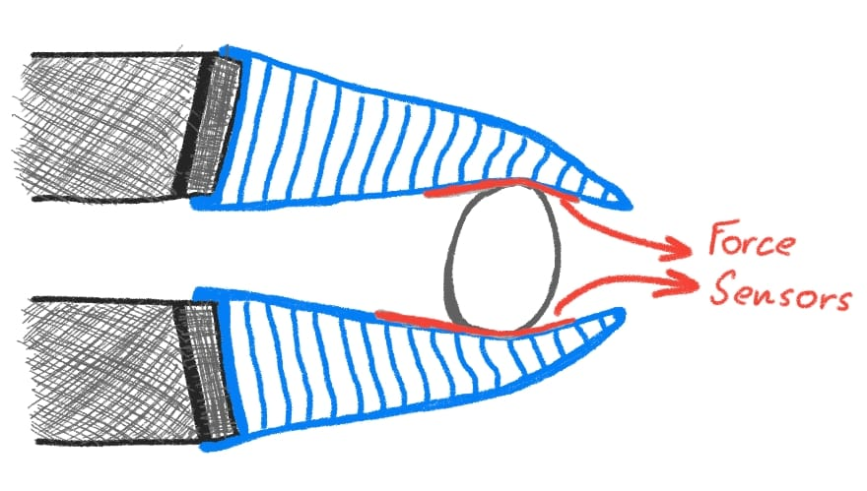
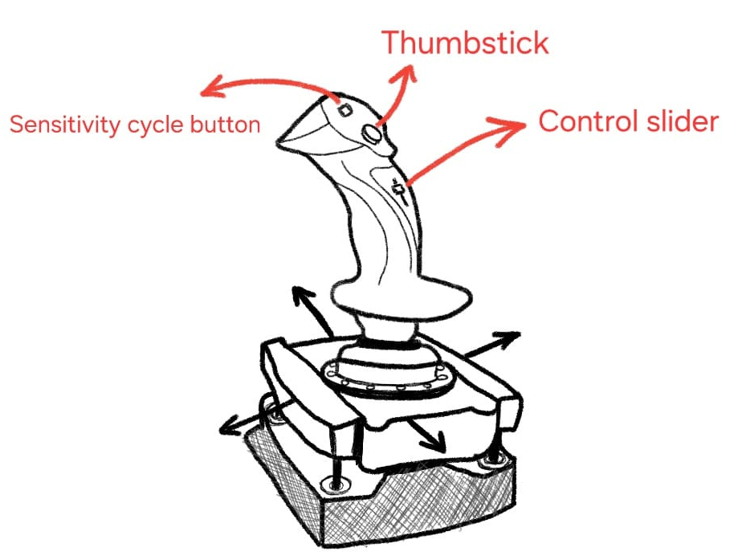
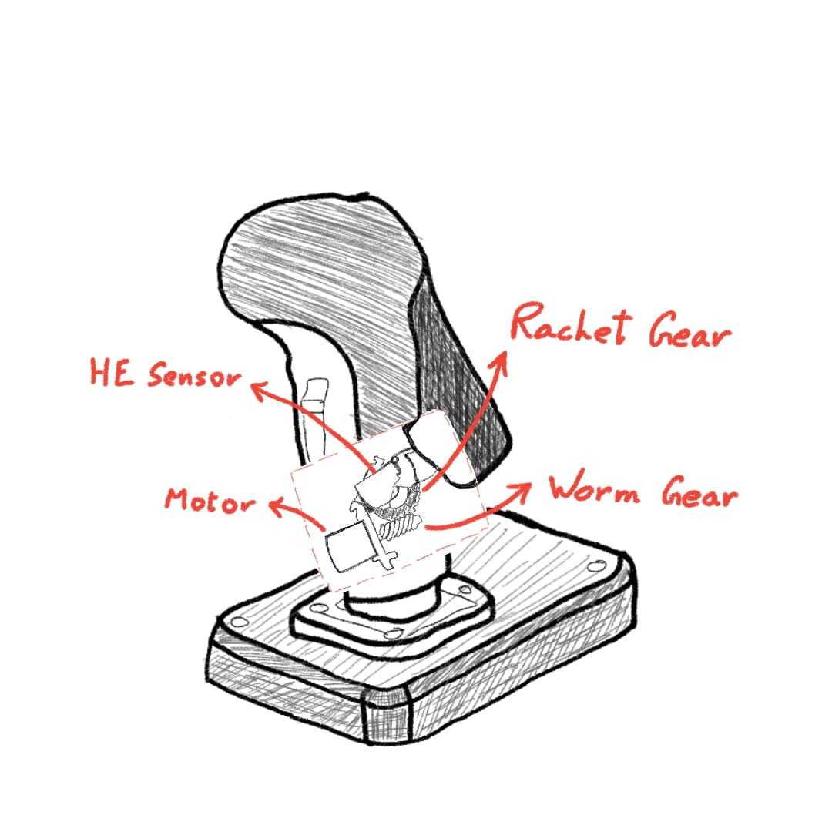
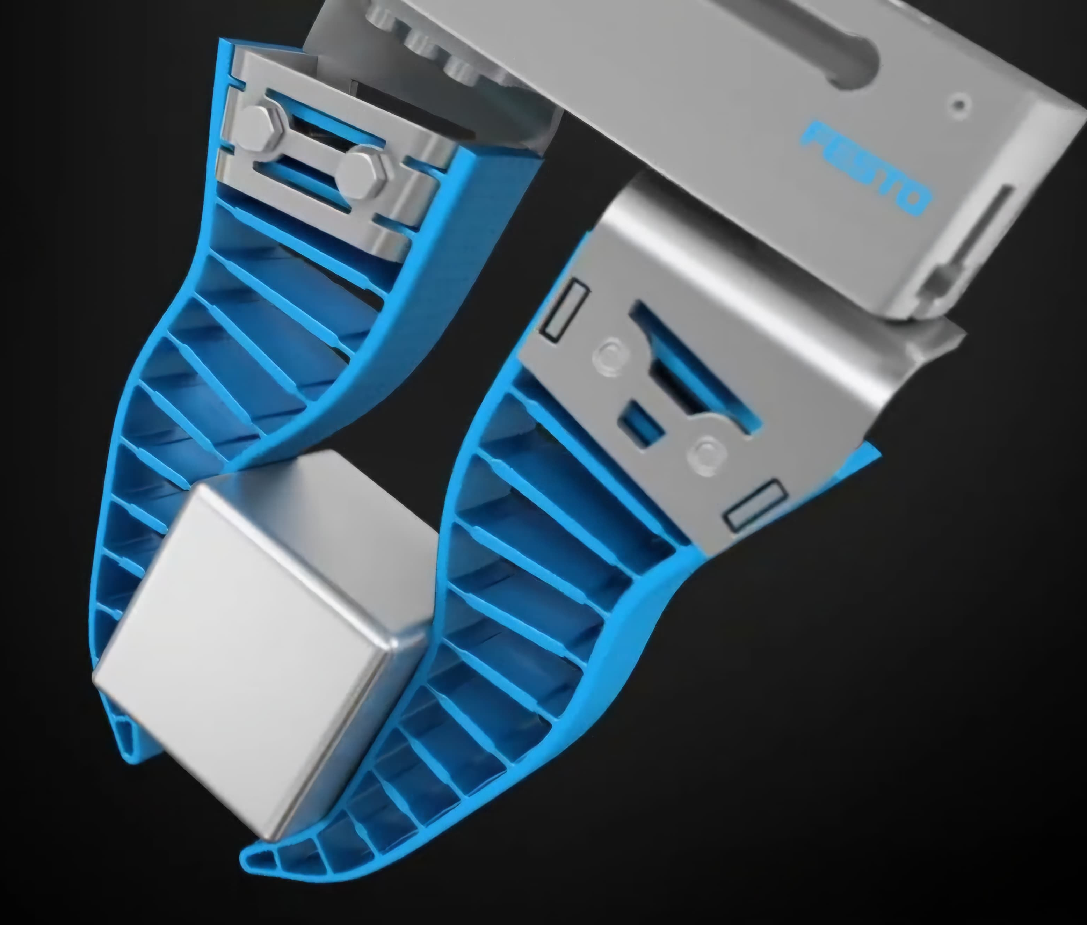
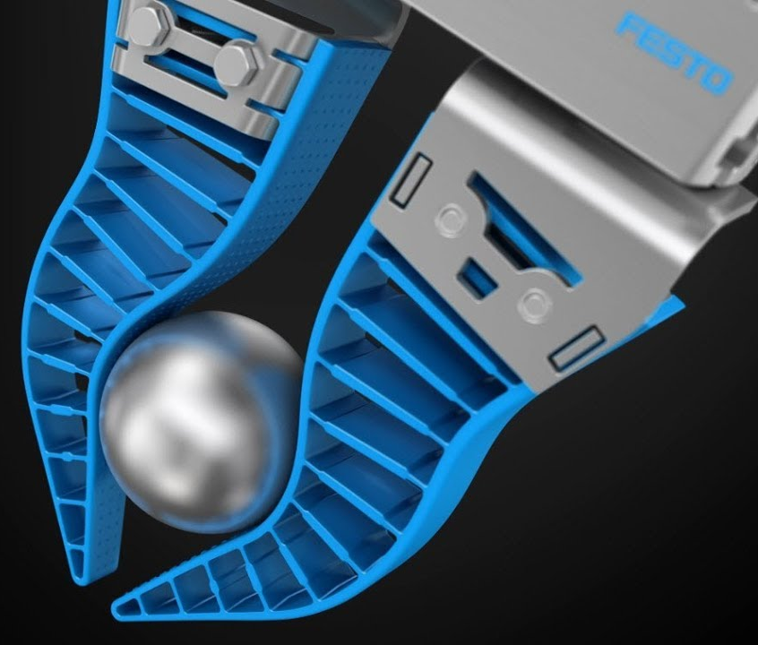
Description
Dual Stick Interface
Dual Stick Interface
Movement and closing end-effector seperate
Control slider to switch between modes
Resistance Trigger contains worm gear assembly
Joystick is mounted on suspended platform
Motion of joystick (5 DOF detected by Hall-Effect sensor
Thumbstick for Translational Z-axis
Connects to computer via USB C (Data and Power)
End-effector
Soft robotics to enable delicate handling
Force sensors located mid-length on inside surface of the gripper
Data from force sensor gives input to worm gear assembly
Gripper adapts to geometry of the target object
(Festo North America 2020)

Slide 4
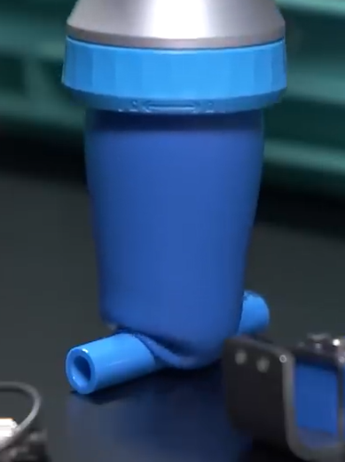
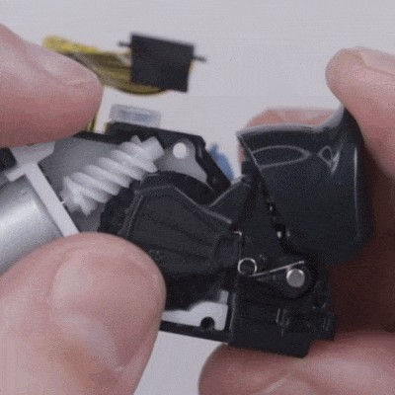
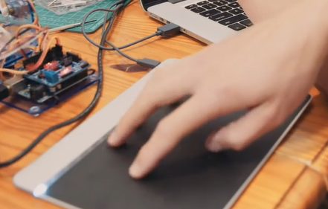
Motivation
Motivation
Symmetrical setup to enable use of dominant hand
Familiarity and ease of use
cost effective due to ease of additive manufacturing
improved operational efficiency due to better workspace awareness
(Sensel)
(Papp 2021)
(Festo 2019)

Slide 5
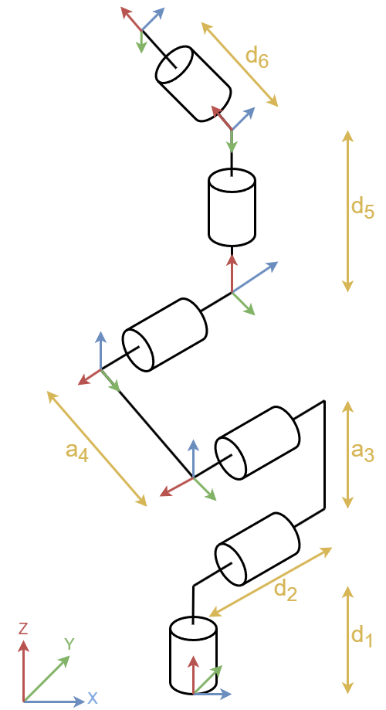
Kinematic analysis
Frame assignments and DH parameters
UR5e
Kinematics | theta [rad] | a [m] | d [m] | alpha [rad]
Joint 1 | 0 | 0 | d₁ [0.1625] | π/2
Joint 2 | 0 | a₃ [0.425] | 0 | 0
Joint 3 | 0 | a₄ [0.392] | 0 | 0
Joint 4 | 0 | 0 | d₂ [0.1333] | π/2
Joint 5 | 0 | 0 | d₅ [0.0997] | -π/2
Joint 6 | 0 | 0 | d₆ [0.0996] | 0
DH - Parameters
Frame assignments (based on UR5e Lightweight)

Slide 6
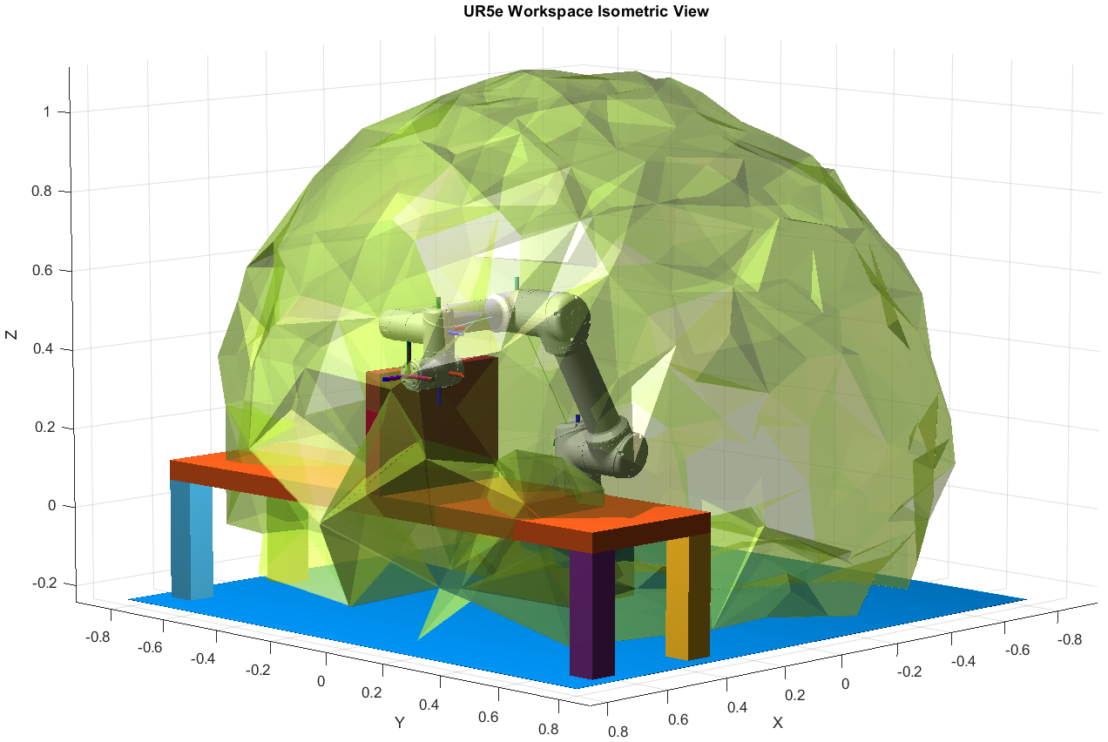
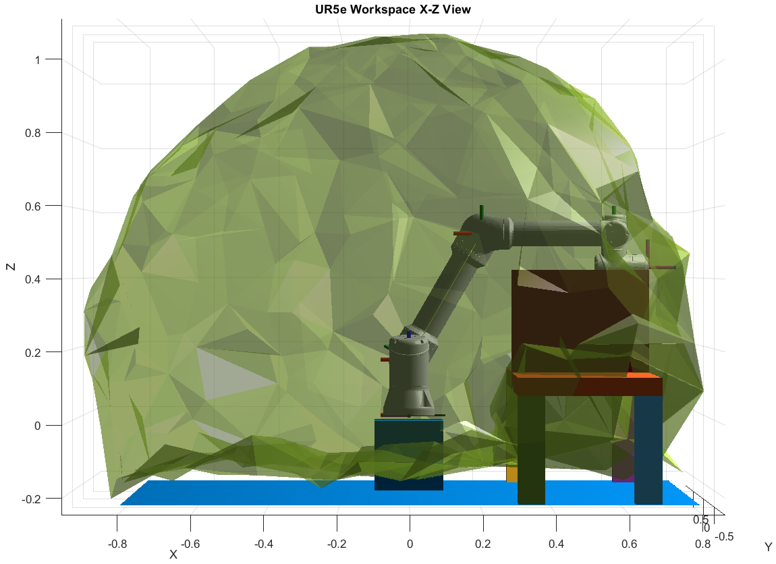
Kinematic analysis
Workspace analysis
(MATLAB Robotics System Toolbox)

Slide 7
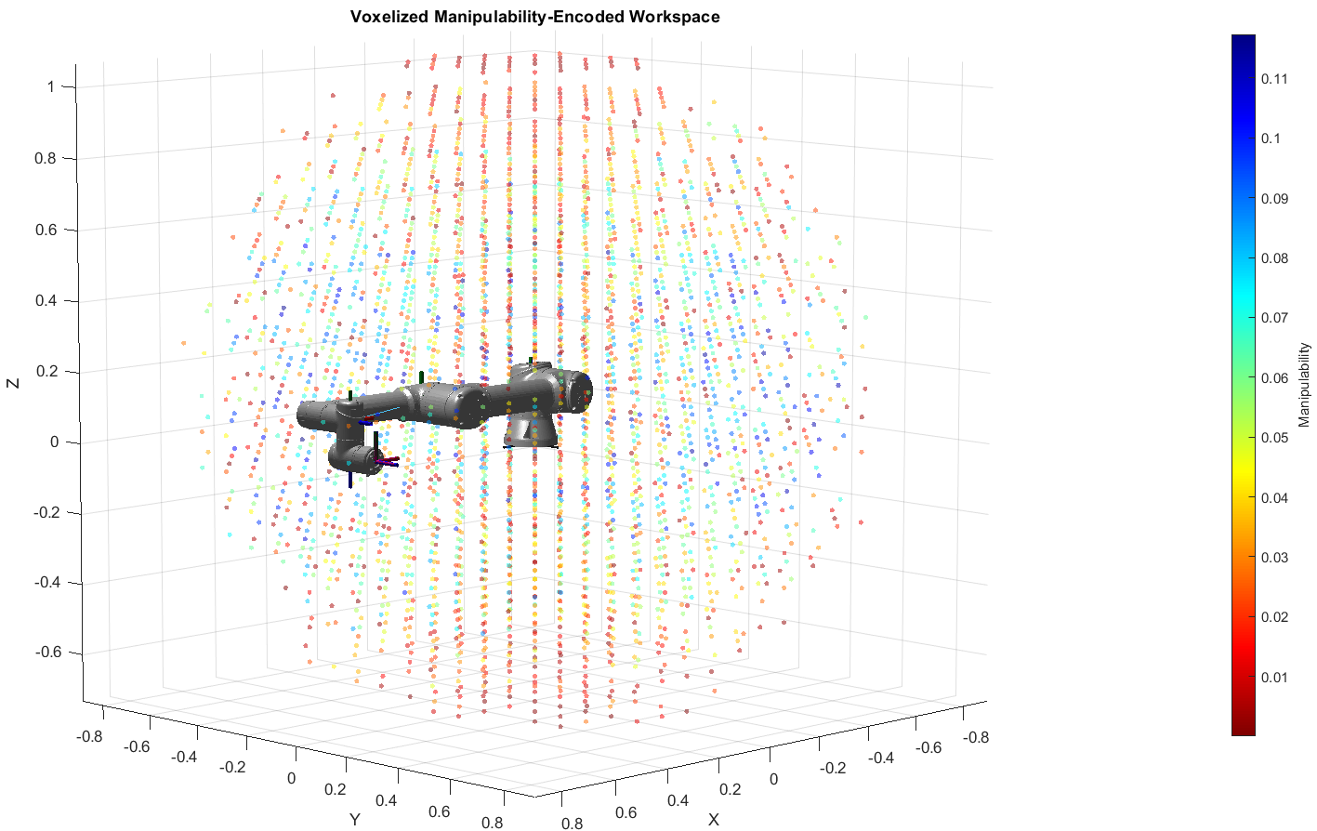
Kinematic analysis
Manipulability analysis
(MATLAB Robotics System Toolbox)

Slide 8
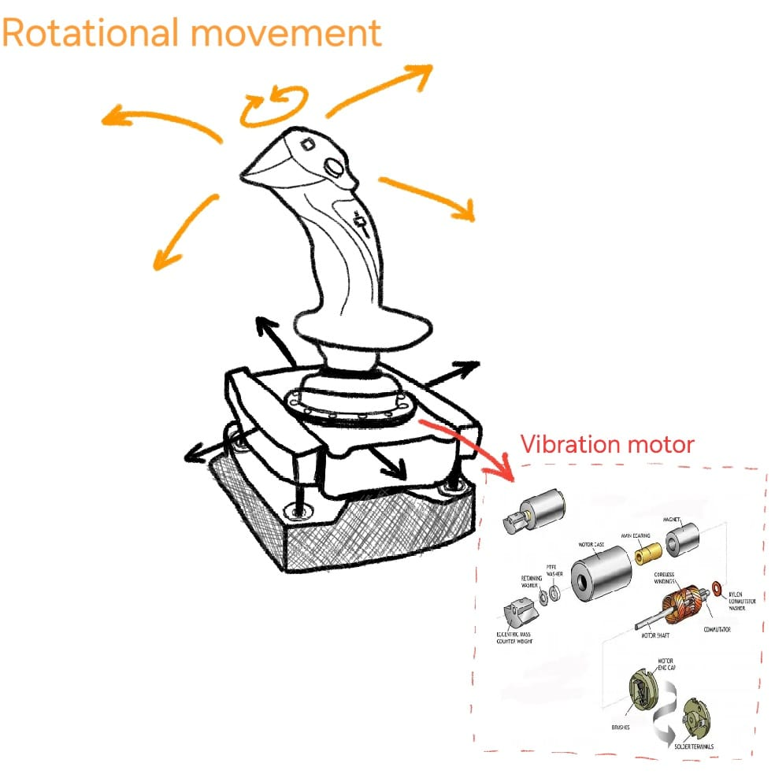
Kinematic analysis
Interface
Open-loop Cartesian velocity control of the end-effector
$$Percentage Displacemen= \frac{(Output Voltage−Minimum Voltage​)}{Maximum Voltage−Minimum Voltage}×100$$
$$Speed=Max Speed × \frac{Output Voltage−Neutral Voltage}{Range Voltage}$$
Use of the Jacobian matrix (J) to map joystick inputs (Cartesian velocity) to joint velocities
$$θ=J^{−1}.V$$
Mapping between gripping force and haptic feedback
The robot’s 6DOF motion include
3 translational DOFs: X, Y, Z (movement in Cartesian space).
3 rotational DOFs: Roll, Pitch, Yaw (orientation changes)
Software Implementation
Gripper Sensor Data Processing
Collect data from:
Force/tactile sensors for F_{grip}.
Strain sensors for gripper deformation.
Preprocess data (filtering, smoothing).
Transmit processed data to the joystick controller

Slide 9
List of materials
Item | Description | Quantity | Total Cost (€) | Link
Microcontroller | Raspberry Pi Pico (RP2040 chip) | 2 | 7.98 | https://www.reichelt.de/de/de/shop/produkt/raspberry_pi_pico_rp2040_cortex-m0_microusb-295706?PROVID=2788&gad_source=1&gclid=Cj0KCQiAy8K8BhCZARIsAKJ8sfQRIj-yV0EhjMp3X10St5zID9GdWauB1hJSzA_qddlCi2q4mrwvIJQaAujgEALw_wcB
Worm Gear Set | 0.5 module, 50 teeth, reduction ratio 1:50 | 1 | 13.99 | https://www.amazon.de/-/en/Module-Brass-Worm-Shaft-Diameter/dp/B07G5811RT
Resistance Motor | Stepper Motor (Nema 17 stepper motor) | 1 | 25 | https://www.amazon.de/STEPPERONLINE-Schrittmotor-Bipolar-42x60mm-DRUCKER/dp/B00PNEQUZ2/ref=asc_df_B00PNEQUZ2?mcid=c2c8e7497e663b6ea5ff1e4b24dcd21f&th=1&psc=1&tag=googshopde-21&linkCode=df0&hvadid=696220738956&hvpos=&hvnetw=g&hvrand=8464291935581426735&hvpone=&hvptwo=&hvqmt=&hvdev=c&hvdvcmdl=&hvlocint=&hvlocphy=9042740&hvtargid=pla-571612450275&psc=1&gad_source=1
Pressure Sensor | Force-sensitive resistor (0 to 30kg, 30 mm diameter) | 2 | 18.18 | https://www.amazon.de/Kraftempfindlicher-Widerstand-D%C3%BCnnfilm-Drucksensor-Durchmesser/dp/B07PY443HS/ref=asc_df_B07PY443HS?mcid=02cc195113273ad1b7e1f790e7a8fe47&th=1&psc=1&hvocijid=6153946777069426747-B07PY443HS-&hvexpln=75&tag=googshopde-21&linkCode=df0&hvadid=696184104678&hvpos=&hvnetw=g&hvrand=6153946777069426747&hvpone=&hvptwo=&hvqmt=&hvdev=c&hvdvcmdl=&hvlocint=&hvlocphy=9042740&hvtargid=pla-2281435176378&psc=1&gad_source=1
Hall Effect Sensor | AS5600 Magnetic Rotatory Encoder | 1 | 5.06 | https://www.amazon.de/Kraftempfindlicher-Widerstand-D%C3%BCnnfilm-Drucksensor-Durchmesser/dp/B07PY443HS/ref=asc_df_B07PY443HS?mcid=02cc195113273ad1b7e1f790e7a8fe47&th=1&psc=1&hvocijid=6153946777069426747-B07PY443HS-&hvexpln=75&tag=googshopde-21&linkCode=df0&hvadid=696184104678&hvpos=&hvnetw=g&hvrand=6153946777069426747&hvpone=&hvptwo=&hvqmt=&hvdev=c&hvdvcmdl=&hvlocint=&hvlocphy=9042740&hvtargid=pla-2281435176378&psc=1&gad_source=1
Linear Potentiometer | Bourns 3006P-1-103LF, 10k ohm | 4 | 7.6 | https://eu.mouser.com/ProductDetail/Bourns/3006P-1-103LF?qs=nlUCIKN74UBewXtW9dljOA%3D%3D&srsltid=AfmBOop92G1XLOc5W2I9tuMhyPEdD5Fx3PE6vP46MsbGVgkjg-G9g5s3
Rotational Potentiometer | 10k ohm precision Potentiometer | 3 | 32.97 | https://www.amazon.de/Taiss-Rotationsdraht-Pr%C3%A4zisionspotentiometer-einstellbarer-3590S-2-103L/dp/B07H8XJDY8/ref=asc_df_B07H8XJDY8?mcid=3f4a688386093aa18333ebd8b200d635&th=1&tag=googshopde-21&linkCode=df0&hvadid=696220738998&hvpos=&hvnetw=g&hvrand=6874676557218374694&hvpone=&hvptwo=&hvqmt=&hvdev=c&hvdvcmdl=&hvlocint=&hvlocphy=9042740&hvtargid=pla-800378977809&gad_source=1
Ball Bearing | Stainless steel Radial Ball Bearing, 8x16x4 mm | 1 | 3.2 | https://www.kugellager-express.de/edelstahl-miniatur-kugellager-ss-688-w4-offen-geoelt-8x16x4-mm?gad_source=1&gclid=Cj0KCQiAy8K8BhCZARIsAKJ8sfT0VZub1hruac4Bdbs5CfHw9zL035wtjk_mAdU1adBFN_J5ClmEVXoaAnnVEALw_wcB
Jumper Wires | Jumper Wire 40x 20cm, Male Female | 120 | 5.94 | https://www.amazon.de/Female-Female-Male-Female-Male-Male-Steckbr%C3%BCcken-Drahtbr%C3%BCcken-bunt/dp/B01EV70C78/ref=asc_df_B01EV70C78?mcid=577ab32c1aff39f7a63b311a6b4c9d61&th=1&psc=1&tag=googshopde-21&linkCode=df0&hvadid=696220738236&hvpos=&hvnetw=g&hvrand=813044981401130210&hvpone=&hvptwo=&hvqmt=&hvdev=c&hvdvcmdl=&hvlocint=&hvlocphy=9042740&hvtargid=pla-362913641420&psc=1&gad_source=1
Body of Joystick and resistance trigger | Polylactic acid (PLA), 1.75 mm tough filament | 1.2 Kg | 22.68 | https://3d-printmaster.de/PLA-Flashforge-Schwarz-10kg-175mm?gad_source=1&gclid=Cj0KCQiAy8K8BhCZARIsAKJ8sfQ2Z3yy8U_ZxiNA5iMFW5Gp7-PwhW9R9gEOrx6F_ZNGMSdxYwkMiLIaArRfEALw_wcB
Total Cost: €142.6

Slide 10
Conclusion & outlook
Conclusion
Dual Hand use possible
Requires a training period (not intuitive)
Not interacting “through” the interface
Outlook
Replace not 3D printing Manufacture casing with mold, for increased production
Applicable to different environments, with different reaches and situations (depending on end effector)

Slide 11
Literature
Festo North America. (2020, October 29). Adaptive Gripper Fingers. YouTube. https://www.youtube.com/watch?v=JAyPTIIpFiA
TheNOOBIFIER1337. (2020, October 26). 6 DOF In One Hand - First Look at Sublight Dynamics Joystick. YouTube. https://www.youtube.com/watch?v=nTtHbY-I8lg
UR5e Lightweight, versatile cobot. (2024). Universal-Robots.com. https://www.universal-robots.com/products/ur5e/
Universal Robots - DH Parameters for calculations of kinematics and dynamics. (n.d.). https://www.universal-robots.com/articles/ur/application-installation/dh-parameters-for-calculations-of-kinematics-and-dynamics/
Plot Workspace of Robot manipulator. MathWorks. (n.d.). https://de.mathworks.com/help/robotics/ref/generaterobotworkspace.html

