Slide 1
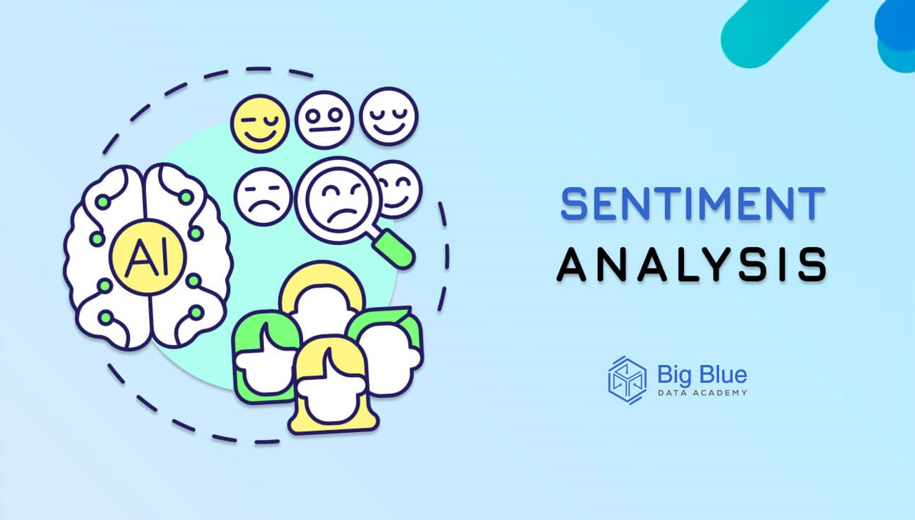
SENTIMENT ANALYSIS
PROJECT ON

Slide 2
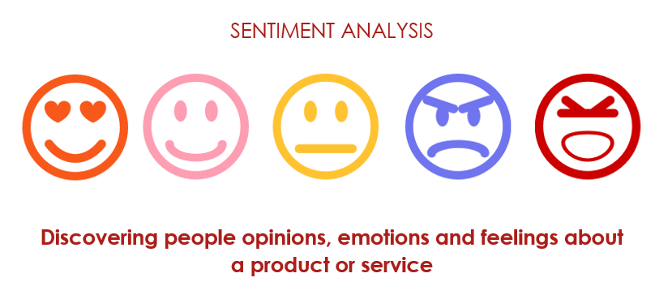
PROJECT TITLE: PRESENTED BY: NAME : LOSETTY SURYA NAGA ANANTHA SWAMY COLLEGE NAME : ADITYA COLLEGE OF ENGINEERING,SURAMPALEM,ANDHARA PRADESH. INTERNSHIP DOMAIN : ARTIFICIAL INTELLIGENCE & MACHINE LEARNING.

Slide 3
OUTLINE
Problem Statement (Should not include solution)
Proposed System/Solution
System Development Approach (Technology Used)
Algorithm & Deployment
Result
Codes and outputs
Conclusion
Future Scope
References

Slide 4
PROBLEM STATEMENT
Example: Restaurants face a significant challenge in manually sifting through vast amounts of online reviews to extract meaningful insights. This manual process is not only time-consuming but also prone to human error and subjectivity. There is a need for an automated solution that can efficiently analyze these reviews and categorize them into sentiments (positive, negative, or neutral). Such a solution would allow restaurant managers to quickly and accurately gauge customer satisfaction levels and address issues proactively.
Objective: This project aims to develop a sentiment analysis model to classify food reviews as positive, negative, or neutral. This will help restaurants gain actionable insights from customer feedback, enabling them to improve their services and address issues effectively.

Slide 5
PROPOSED SOLUTION
The proposed system aims to address the challenge of Different food reviews that which are given by the customers so goal is to design and implement a machine learning-based sentiment analysis system that can analyze textual data from food reviews. The system should be capable of::
Data Collection:
A dataset of food reviews from online platforms, containing the review text and corresponding sentiment labels (positive, negative, neutral).
gather additional metadata such as the date of the review, reviewer's username or profile information (if available), restaurant name, location, and rating given by the reviewer.
Data Preprocessing:
Clean and preprocess the collected data to handle missing values, outliers, and inconsistencies.
Handling misspellings, slang, and diverse writing styles in review texts.
Machine Learning Algorithm:
Implement a naïve bayes to food reviews to Improve Restaurant Customer Satisfaction
Use techniques like TF-IDF, word embeddings, or sentiment lexicons to extract features from the text.

Slide 6
Deployment:
Develop a user-friendly interface for restaurant managers to input reviews and get sentiment analysis results.
Choose the best-performing model from your experiments, ensuring it balances accuracy, speed, and interpretability.
Evaluation:
Assess the model's performance using appropriate metrics such as accuracy.
Result:

Slide 7
SYSTEM APPROACH
The "System Approach" section outlines the overall strategy and methodology for developing and implementing sentiment analysis on reviews as positive or negative. Here's a suggested structure for this section:
In Restaurant, understanding customer sentiment is crucial for improving food delivery. A tech-powered approach unlocks valuable insights from various sources. Open-ended survey responses, online reviews, and social media discussions within customer support groups all offer a wealth of data.
Natural Language Processing (NLP) plays a key role. This technology breaks down text, removes irrelevant information like typos, and identifies key phrases. Machine learning then takes center stage. By analyzing vast amounts of processed text, trained algorithms can classify sentiment – positive, negative, or neutral.
This analysis provides Restaurant providers with a deeper understanding of customer satisfaction with care. It reveals areas for improvement, allowing them to address specific concerns and prioritize resources effectively. Ultimately, by harnessing technology to understand customer voices, restaurant institutions can foster better patient engagement and deliver a more positive experience.
However, Restaurant sentiment analysis presents unique challenges. Food erminology and the sensitive nature of food experiences require specialized techniques. NLP algorithms must be trained on Restaurant-specific datasets to accurately understand the context and nuances of customer language. Additionally, ethical considerations are paramount. Data anonymization and customer privacy must be strictly adhered to throughout the entire process.
Despite these challenges, the potential benefits of restaurant sentiment analysis are undeniable. By leveraging technology to understand customer voices, restaurant providers can build stronger relationships with their customers, improve the quality of care delivery, and ultimately contribute to a more positive experience for everyone involved.

Slide 8
System requirements:
Processor: 12th Gen Intel(R) Core(TM), i7 Generation.
Library required to build the model:
word_tokenize, pandas ,matplotlib, seaborn, numpy, stopwords , WordNetLemmatizer, emoji such library functions are used in the sentiment analysis.

Slide 9
ALGORITHM & DEPLOYMENT
In the Algorithm section, describe the machine learning algorithm chosen for to food reviews to Improve Restaurant Customer Satisfaction
Here's an example structure for this section:
Algorithm Selection
The Naive Bayes algorithm can be highly useful for sentiment analysis of food reviews due to its simplicity, efficiency, and effectiveness in text classification tasks..
Data Input:
Use techniques such as TF-IDF (Term Frequency-Inverse Document Frequency) or bag-of-words to convert textual data into numerical features that can be fed into the Naive Bayes classifier..
Training Process:
Training Data: Split the data into training and testing sets.
Model Selection: Use the Multinomial Naive Bayes classifier, which is well-suited for text data.
Training: Fit the Naive Bayes model on the training data.
Prediction Process:
Using Naive Bayes for sentiment analysis of food reviews is advantageous due to its simplicity, efficiency, and effectiveness with text data. It can quickly provide valuable insights into customer sentiments, helping restaurants to improve their services and enhance customer satisfaction.

Slide 10
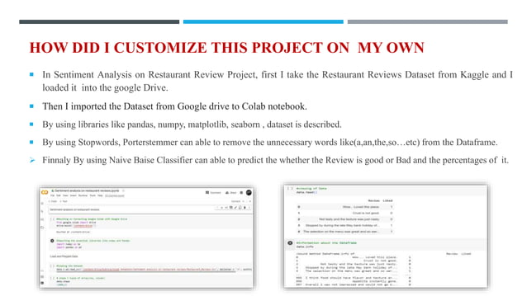

Slide 11
RESULT
Present the results of the machine learning model in terms of its accuracy and effectiveness the result of sentiment analysis in the context of food reviews is a categorical label indicating the sentiment expressed in the review, helping restaurants understand customer feedback at a glance..
Given the text of a food review, a sentiment analysis model will process the text and output one of the sentiment categories
Positive Review:
Review Text: "The food was amazing! The pasta was perfectly cooked and the sauce was rich and flavorful. Highly recommend this restaurant!"
Sentiment: Positive
Negative Review:
Review Text: "I had a terrible experience. The service was slow, and the food was cold and bland. I won't be coming back."
Sentiment: Negative
Neutral Review:
Review Text: "The food was okay, nothing special. The ambiance was nice, but I’ve had better dining experiences elsewhere."
Sentiment: Neutral

Slide 12
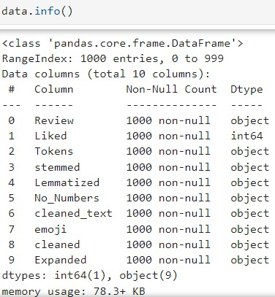
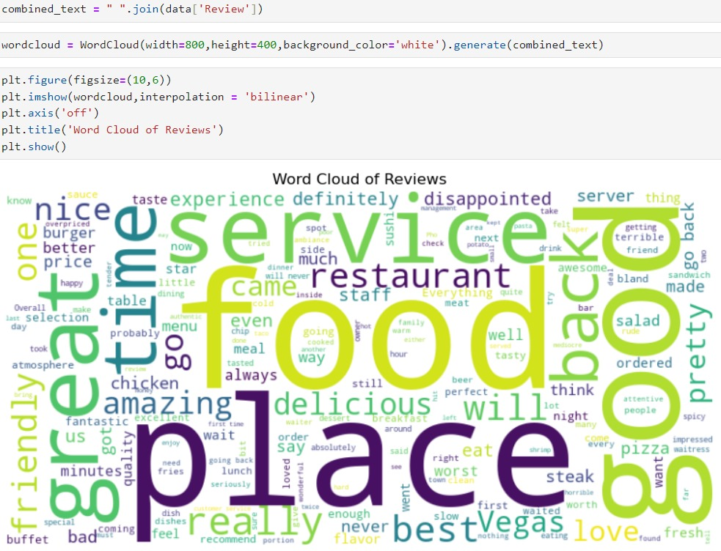
CODES & OUTPUTS

Slide 13
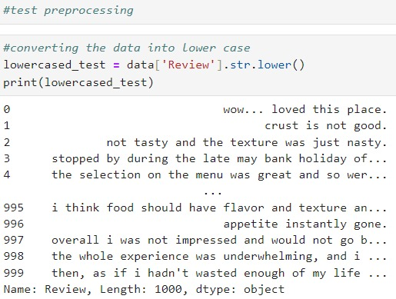
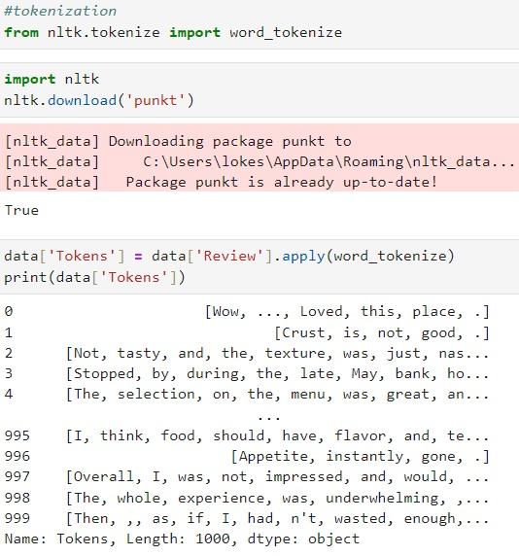
Codes and outputs
Test preprocessing Tokenization

Slide 14
CONCLUSION
From the above study, an attempt has been made to classify sentiment analysis for restaurant reviews using machine learning techniques. Two algorithms namely Multinomial Naive Bayes and Bernoulli Naive Bayes are implemented.
Evaluation metrics used here are accuracy, precision and recall.
Using Multinomial Naive Bayes,
Accuracy of prediction is 77.67%.
Precision of prediction is 0.78.
Recall of prediction is 0.77.
Using Bernoulli Naive Bayes,
Accuracy of prediction is 77.0%.
Precision of prediction is 0.76.
Recall of prediction is 0.78.
Using Logistic Regression,
Accuracy of prediction is 76.67%.
Precision of prediction is 0.8.
Recall of prediction is 0.71.

Slide 15
Future scope
Discuss potential enhancements and expansions for the system. This could include incorporating additional data sources, optimizing the algorithm for better performance, and expanding the system to cover multiple cities or regions. Consider the integration of emerging technologies such as edge computing or advanced machine learning techniques.
Enhanced Personalization: Utilize sentiment analysis to personalize customer interactions and delivery plans based on individual preferences and feedback.
Real-Time Feedback Mechanisms: Implement real-time feedback systems to capture and analyze customer sentiments instantly, enabling immediate service improvements.
Integration with AI and IoT: Integrate sentiment analysis with AI and IoT devices to monitor customer emotions and experiences in real-time, enhancing proactive restaurant delivery.
Predictive Analytics: Develop predictive models using historical sentiment data to anticipate patient needs and optimize resource allocation and service planning.
Cross-Institutional Benchmarking: Establish benchmarks for sentiment analysis across customer institutions to compare performance and identify best practices for continuous improvement.

Slide 16
REFERENCES
[1] M. Govindarajan, “Sentiment Analysis of Restaurant Reviews Using Hybrid Classification Model,” IRF International Conference, 2014. [ D. V. N. Devi, C.K. Kumar and S. Prasasd “A feature Based Approach for Sentiment Analysis by Using Support Vector Machine”.
Y. Woldemariam, “Sentiment analysis in a cross-media analysis framework,” Hangzhou, 2016. [4] E. Boiv and M. F. Moens, “A machine learning approach to sentiment analysis in multilingual Web texts,” Belgium: Springer- Information Retrieval Journals, 2008.[5] A.B. Pawar, M.A. Jawale and D.N. Kyatanavar, “Fundamentals of Sentiment Analysis: Concepts and Methodology”, An Environment of Computation Intelligence, Springer International Publishing Switzerland 2016, pp. 25-35.[6] Peter Koncz and Jan Paralic, “An approach to feature selection for sentiment analysis”, 15th International Conference on Intelligent Engineering Systems, June 23 –25, 2011, Poprad, Slovakia.[7] S.Vidhya, D.Asir Antony Gnana Singh and E.Jebamalar Leavline, “Feature Extraction for Document Classification”, International Journal of Innovative Research in Science, Engineering and Technology, Vol. 4, Special Issue 6[8] B.Pang and L.Lee, “Opinion mining and sentiment analysis,” vol. 3, no. 1-2, 2008.

Slide 17


