Slide 1
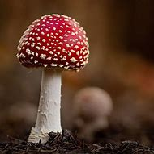
Mushroom Classification Project

Slide 2
Objective:
Development of a predictive model for classifying mushrooms as either edible or poisonous based on their features. The model will determine whether a given mushroom is safe to consume or not.

Slide 3
Purpose
1. Identification of poisonous mushrooms: The model can help in detecting potentially harmful mushrooms and prevent incidents of poisoning.
2. Improved safety for mushroom enthusiasts: The classification model can provide valuable information to mushroom collectors and enthusiasts, enabling them to make informed decisions about the mushrooms they encounter.

Slide 4

Data Loading
Connected the Mongodb database.
We read source csv file and loaded the data into the Mongodb database
Read the data from the database and converted to raw.csv for further data split process

Slide 5
Data Ingestion:
Read raw.csv and it was split into train and test data using Scikit Learn.
The Split data then created as train.csv and test.csv.
Returned path of the train.csv and test.csv for further step

Slide 6
Exploratoratory Data Analysis(EDA
Read the data using pandas and analyse the count of each variable using count plot.
Checked the missing values and found some categories are missing and it was added as “?” in the data.
Conducted Chi-Square test for all the columns to find the important feature and find the relation between the columns using cross tab.

Slide 7
Data Transformation:
Created preprocessing pipeline to follow imputation and transformation for all the categorical columns using simple imputer and Ordinal Encoding techniques
Passed train and test columns separately to column transformer. It was transformed without any data leakage
Saved the preprocessor pickle which will help to transform the unseen data.
Returned transformed train and test array to further step.

Slide 8
Model Training:
Transformed data is moved to model training.Training is conducted on train data.
Decision tree, Logistic Regression, Kneighbors Classifier, Random Forest Classifier and Gradient Boosting Classifier.
is used to train and validated the model on test data.
By using “F1 macro” metrics best model is found and saved as picked file which then can be used to predict the unseen data

Slide 9
Decision tree :
A decision tree is one of the most powerful tools of supervised learning algorithms used for both classification and regression tasks. It builds a flowchart-like tree structure where each internal node denotes a test on an attribute, each branch represents an outcome of the test, and each leaf node (terminal node) holds a class label. It is constructed by recursively splitting the training data into subsets based on the values of the attributes until a stopping criterion is met, such as the maximum depth of the tree or the minimum number of samples required to split a node.
During training, the Decision Tree algorithm selects the best attribute to split the data based on a metric such as entropy or Gini impurity, which measures the level of impurity or randomness in the subsets. The goal is to find the attribute that maximizes the information gain or the reduction in impurity after the split.

Slide 10
Logistic Regression classifier:
Logistic regression is a supervised machine learning algorithm mainly used for classification tasks where the goal is to predict the probability that an instance of belonging to a given class or not. It is a kind of statistical algorithm, which analyze the relationship between a set of independent variables and the dependent binary variables. It is a powerful tool for decision-making. For example email spam or not.

Slide 11
KNeighborsClassifier:
KNeighborsClassifier is a supervised learning algorithm that makes classifications based on data neighbors. It takes a parameter n_neighbors that specifies how many nearest neighbors to consider for the prediction. It can be used for both classification and regression problems. It has methods such as fit, predict, and predict_proba that can be used to train the model and make predictions. It can also generate a sparse graph of the k-nearest neighbors using the kneighbors graph method.

Slide 12
RandomForestClassifier:
Random forest is a machine learning technique that combines the output of multiple decision tress to reach a single result. It is a supervised algorithm that can handle both classification and regression problems. It is one of the most used algorithms due to its accuracy. Simplicity and flexibility. It is applied to various industries and domains.
GradientBoostingClassifier:
Gradient boosting classifier is a set of machine learning algorithms that include several weaker models to combine them into a strong big one with highly predictive output. Models of a kind are popular due to their ability to classify datasets effectively. Gradient boosting classifier usually uses decision trees in model building.

Slide 13
Prediction:
Created separate prediction pipeline to predict the unseen data. Model saved as picked file which then loaded. It is used to predict the unseen data based on the client input and displayed on the web
Interface.

Slide 14
Web User Interface
User Interface was created using Flask, HTLM and CSS. When the client entered the respective details on website. It passed to the prediction pipeline where it predicts type of mushroom either it is edible or poisonous with a probability of the classification. Web interface has home page and predict page. Home page has all the details of the mushroom to select. Once the predict button is used it will redirect to the predict page where it shows the result of the classification. Created train route which will train the model if train is updated.

Slide 15
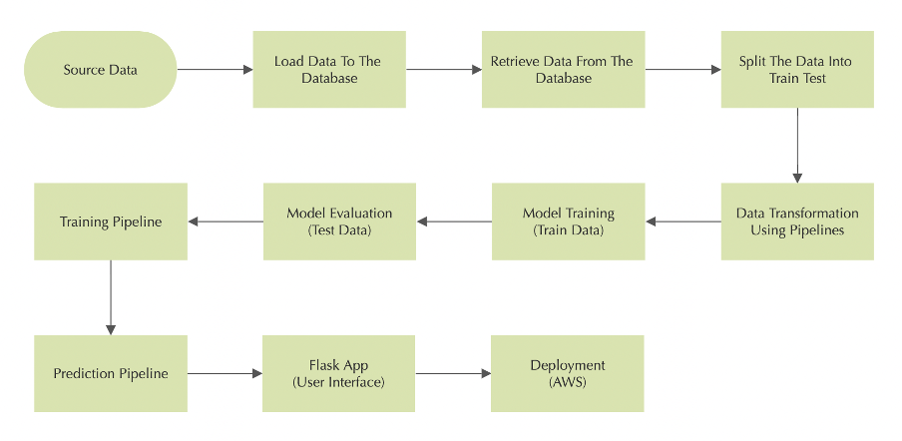
Architecture

Slide 16
THANK YOU

