Slide 1
INCOME PREDICTION
BY
AKASH THOTA FALL 2024 UNDER CHAOJI WANG

Slide 2
Introduction
Problem Statement
The goal of this project is to predict whether an individual’s income exceeds $50,000 based on various demographic and employment-related features. This type of classification problem has practical applications in fields like personal finance, labor market analysis, and social studies.
Objective
Develop a machine learning model to predict income levels based on input features.
Understand the most significant factors that influence income.
Notes:
The goal of this project is to predict whether an individual’s annual income exceeds $50,000 based on demographic and employment-related attributes. This is a binary classification problem with real-world applications in areas such as personal finance, labor market analysis, and social policy-making. Through this project, I aim to build a robust machine learning model that not only predicts income accurately but also identifies the key factors influencing income levels."

Slide 3
Dataset
Dataset Overview
Source: UCI Machine Learning Repository
Size: 48,842 rows, 15 columns
The dataset contains various attributes related to demographic and employment information. These attributes include features like age, education, occupation, and hours worked per week.
Target Variable
Income: Categorized as <=50K or >50K (binary classification).
Notes:
The dataset for this project is sourced from the UCI Machine Learning Repository and contains 48,842 rows and 15 columns. It includes various demographic and employment-related features such as age, education level, marital status, occupation, hours worked per week, and more. The target variable, Income, categorizes individuals into two classes: those earning <=50K and those earning >50K annually. This dataset provides a rich set of attributes for understanding the factors that impact income levels.

Slide 4
Key Variables and Target Variables
Key Variables (Features):
Age: Age of the individual in years.
Workclass: Type of employment (e.g., Private, Self-employed).
Education: Education level (e.g., Bachelors, Masters).
Occupation: Type of job (e.g., Tech Support, Sales).
Hours per Week: Number of hours worked per week.
Race: Race category (e.g., White, Black).
Gender: Male or Female.
Target Variable:
Income: Classifies individuals into income categories:
<=50K (lower income)
>50K (higher income)

Slide 5
Data Preprocessing
Handling Missing Data:
Dropped rows with missing values in critical columns like Workclass, Occupation, and Native Country.
Encoding Categorical Features:
Used Label Encoding for categorical variables (e.g., Gender, Education) to convert them into numerical values for model compatibility.
Scaling Numerical Features:
Applied MinMaxScaler to standardize numerical features (e.g., Age, Hours per Week) ensuring that they are within a similar range, which improves model performance.

Slide 6
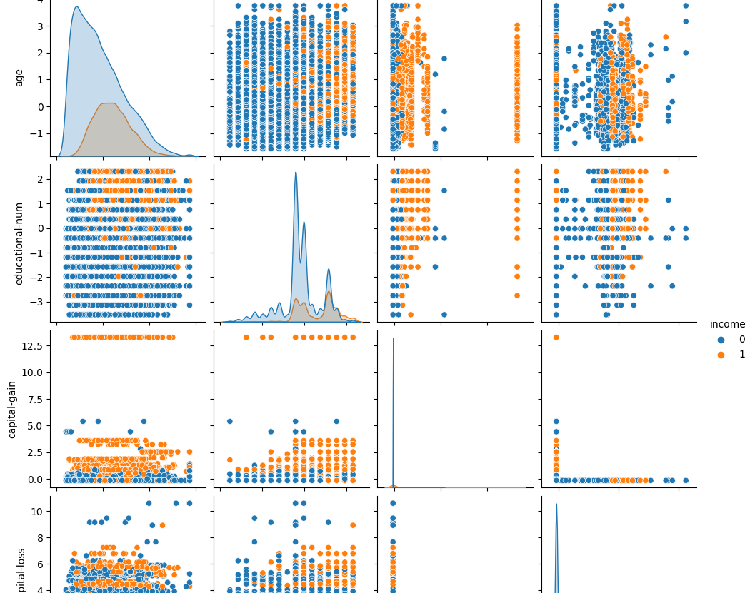
EDA - Visualizing Relationships Between Variables
Objective: Explore the relationships between different features and the target variable (Income) to understand how each feature affects income levels.
Key Insights: Features such as Education and Hours worked per week have strong relationships with income levels, suggesting they are significant predictors.

Slide 7
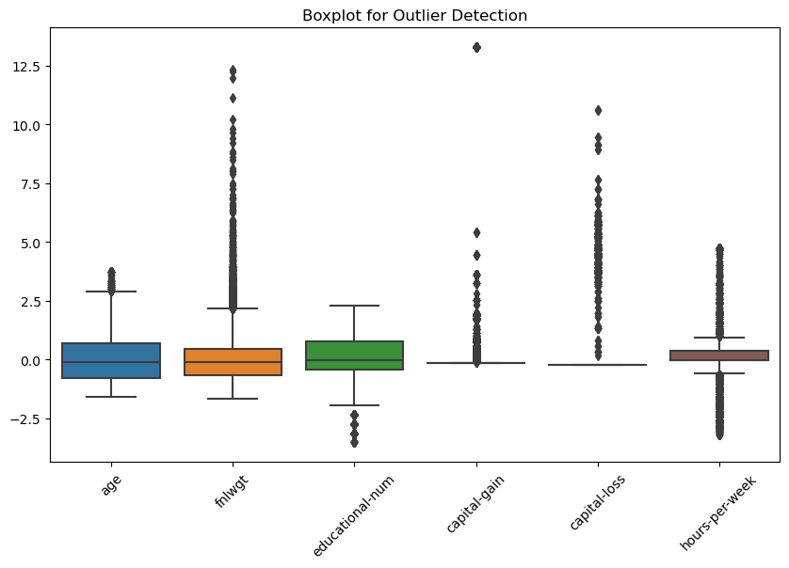
EDA - Boxplot for Outlier Detection
Objective: Detect outliers in numerical features that could negatively impact model performance.
Key Insights: Age and Hours per Week contain outliers, indicating potential influence on model predictions that may need to be handled (e.g., through capping or removal).

Slide 8
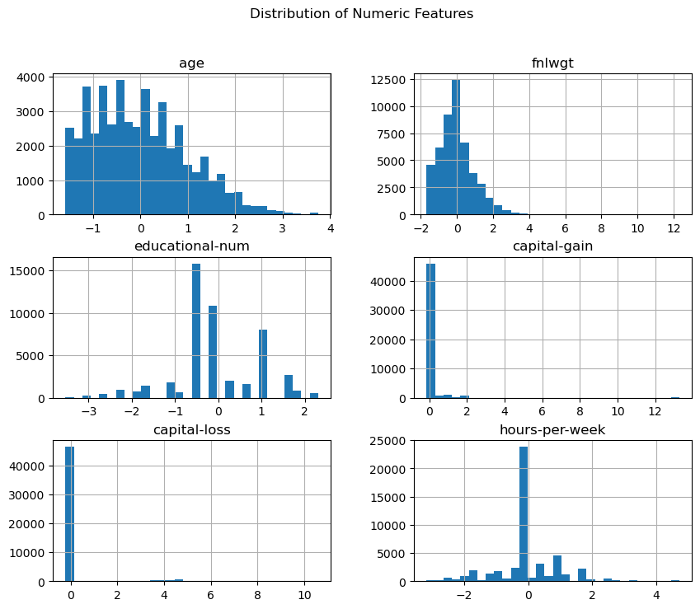
EDA - Distribution of Numeric Features
Objective: Visualize the distribution of numeric features like Age and Hours per Week to identify skewness or non-normality.
Key Insights: Age follows a normal distribution, while Hours worked per week is skewed, suggesting potential need for transformation or feature engineering.

Slide 9
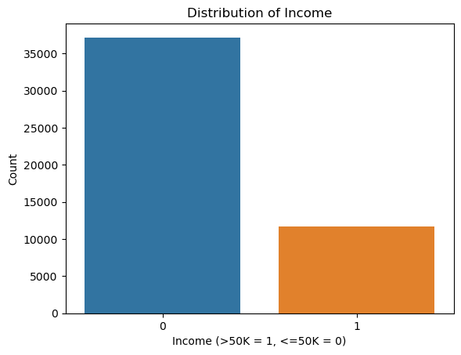
EDA - Distribution of Income
Objective:
Analyze the distribution of the target variable Income to identify class imbalance.
Key Insights:
The dataset is imbalanced, with more individuals falling under the <=50K category, indicating the need for techniques like SMOTE or undersampling to balance the data.

Slide 10
Feature Selection
Key Features Chosen:
Age, Education, Occupation, Hours per Week, Gender.
Reasoning:
These features were identified as the most influential based on both model results and domain knowledge.

Slide 11
Model Selection
Models Used:
Logistic Regression: A baseline model for binary classification tasks.
Random Forest Classifier: A robust ensemble model that works well with both categorical and numerical data.
Support Vector Machine (SVM): A powerful classifier for high-dimensional data.
XGBoost Classifier: A gradient-boosting algorithm known for its performance in structured data tasks.
Best Model:
XGBoost was chosen due to its high accuracy, precision, and recall scores.

Slide 12
Model Training
Approach:
Train-Test Split: The dataset was split into training (80%) and test (20%) sets.
Hyperparameter Tuning:
GridSearchCV was used to tune hyperparameters such as the number of estimators and maximum depth for Random Forest and XGBoost.

Slide 13
Model Evaluation
Model Results:
Logistic Regression: Accuracy: 85.70%, Precision: 73.71%, Recall: 60.61%, F1-Score: 66.52%
Random Forest: Accuracy: 85.96%, Precision: 72.90%, Recall: 63.80%, F1-Score: 68.05%
SVM: Accuracy: 85.73%, Precision: 74.94%, Recall: 58.78%, F1-Score: 65.88%
XGBoost: Accuracy: 87.50%, Precision: 76.42%, Recall: 67.51%, F1-Score: 71.69%
Confusion Matrices:
Key insight: XGBoost performed best, showing high precision and recall.

Slide 14
Prediction Accuracy
Best Model Performance:
XGBoost showed the highest accuracy (87.50%) and balanced performance across precision and recall.
Confusion Matrix:
True Negatives: 7002
False Positives: 477
False Negatives: 744
True Positives: 1546
Evaluation:
The model correctly predicted 87.50% of instances.

Slide 15
Streamlit
Streamlit App:
Developed an interactive Streamlit app to allow users to input their data and predict income class (<=50K or >50K).
Features:
User Input: Age, Education, Occupation, etc.
Model Output: Predicted income class (<=50K or >50K).
Benefits: Easy-to-use web interface for real-time predictions.

Slide 16
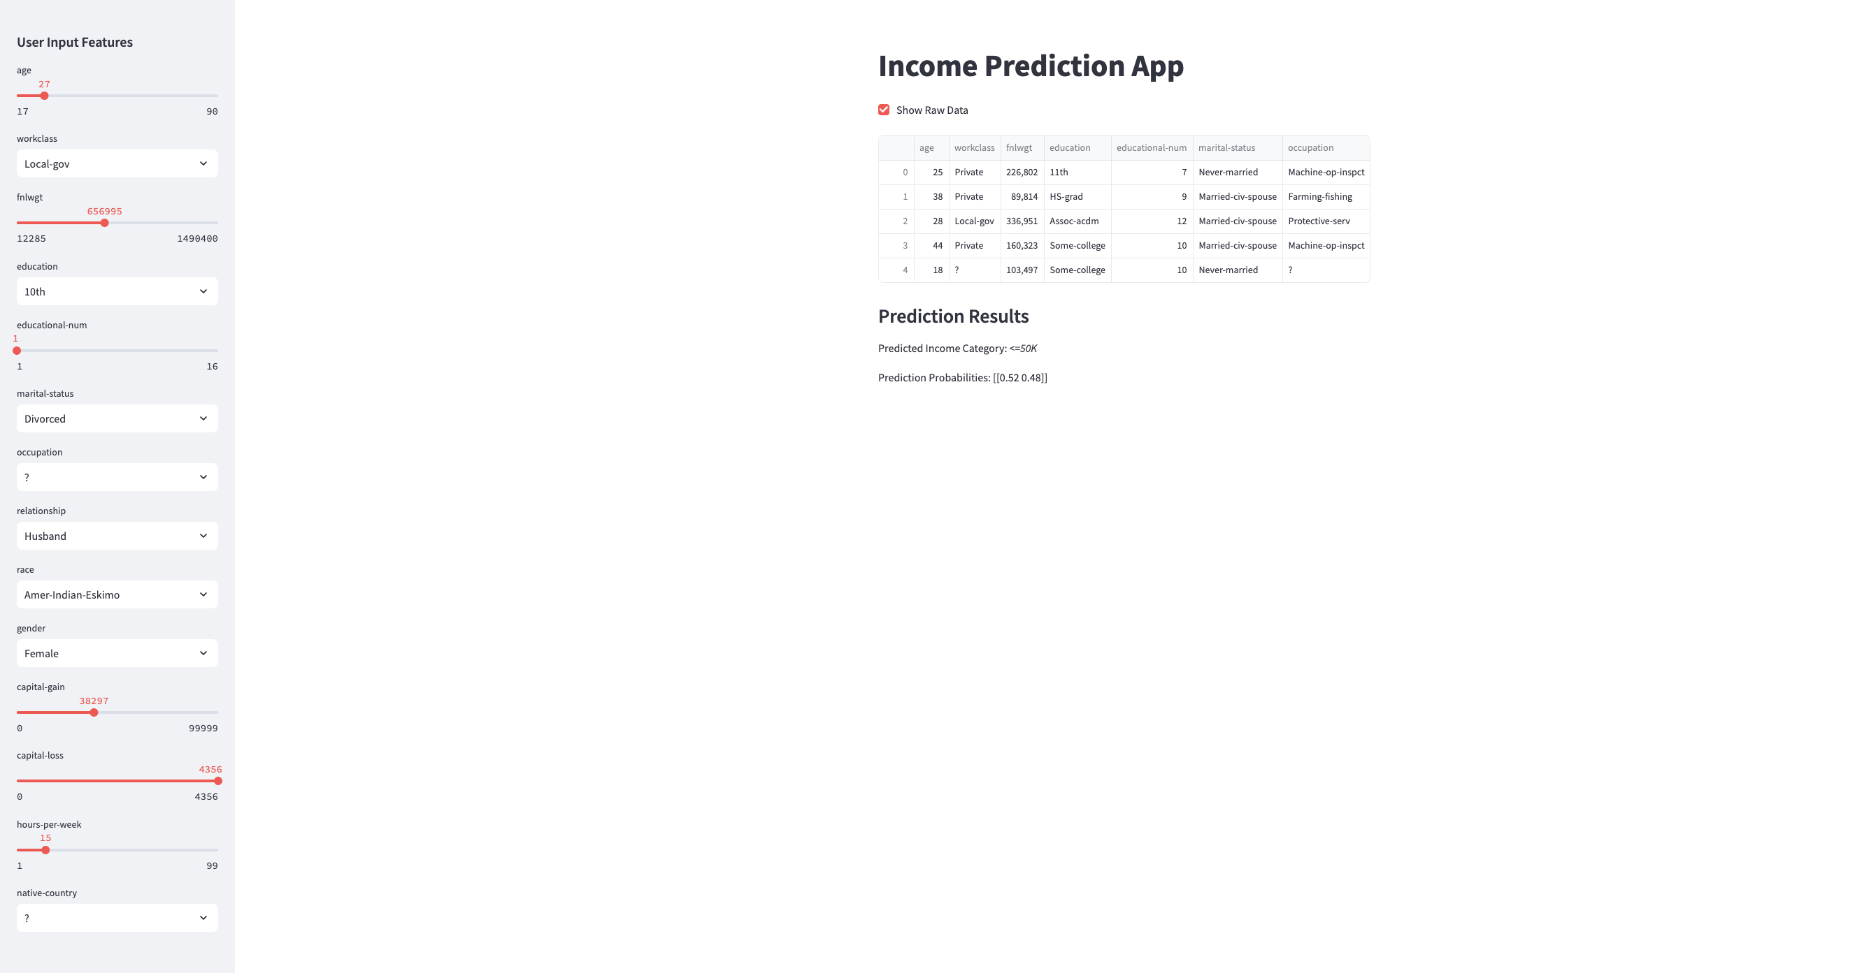

Slide 17
Conclusion
Summary:
The XGBoost Classifier was the most accurate model with 87.50% accuracy and robust performance across different evaluation metrics.
Key Features: Age, Education, Occupation, Hours worked per week, and Gender were found to be critical in predicting income.
Future Work:
Experiment with other advanced models like Neural Networks.

Slide 18


