Slide 1
Attribute selection: Gini Index & Entropy

Slide 2
Introduction
In Decision tree terminology ‘Feature’ or a ‘Column’ is called an ‘Attribute’
There are mainly two algorithms to control the splitting conditions in a decision tree
Information gain (Entropy)
Gini index

Slide 3
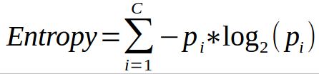
Entropy
Similar samples in Subset - Homogenous
If all samples in a subset are of the same type (Target) , then the entropy of that split is 0.
If the entropy keeps decreasing , then we keep increasing the Split in the direction where the entropy decreases

Slide 4
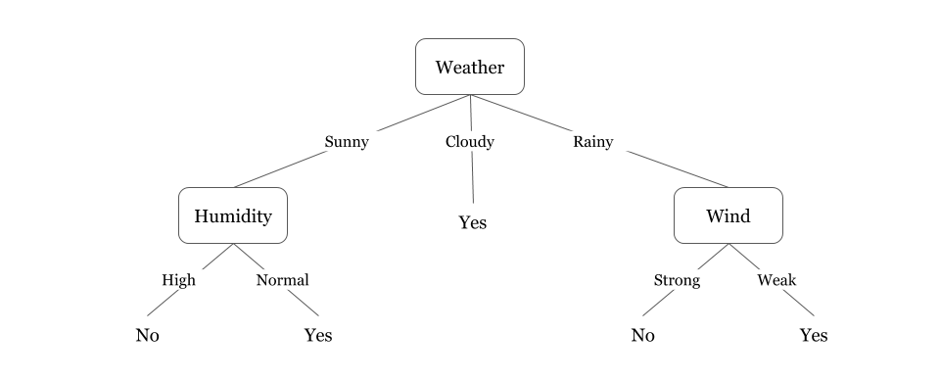
Entropy

Slide 5
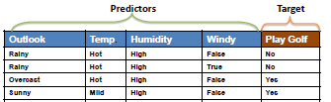
Let’s take an Example

Slide 6
Let’s solve it
Predict whether we would go out to play golf based on 'Outlook' , 'Temperature' , 'Humidity' and 'Wind'
Step 1 - calculate the entropy of the predictive column (play golf)
9 - ‘yes’ , 5 - ‘no’
Entropy=-p(y)log(p(y))-p(n)log(p(n))
p(y) = 9/14 , p(n) = 5/14
After solving , Entropy = 0.942

Slide 7
Solution continued
For 'sunny' , play (3 yes) and didn’t play (2 no),
E(sunny) = -3/5 log 3/5 - 2/5 log 2/5 = 0.971
Play when it's overcast (homogeneous)
E(overcast) = -1log1 - 0log0 = 0
For rainy (2 yes) and (3 no),
E(rainy) = -2/5 log 2/5 -3/5 log 3/5 = 0.971

Slide 8
Entropy
E(outlook) = P(sunny)*E(sunny)+P(overcast)*E(overcast)+P(rainy)*E(rainy)
P(sunny) = 5/14
P(overcast) = 4/14
P(rainy) = 5/14
⇒ E(outlook) = 5/14 * 0.971 + 4/14 * 0 + 5/14 * 0.971 = 0.693
Information Gain(outlook) = 0.942 - 0.693 = 0.249

Slide 9
Entropy
Similarly,
Gain(temp) = 0.029,
Gain(humidity) = 0.152,
Gain(windy) = 0.048
We have highest information Gain for outlook , so let’s make Outlook column as the Root node.
The Next place in the tree would be for Humidity
And so on.

Slide 10
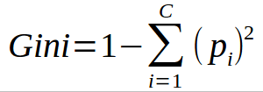
Gini index
The lesser the impurity , the better it is to split on that column .

Slide 11
Continue with the same example
If sunny (3 yes) and (2 no),
gini_impurity(sunny) = 1 - (3/5)^2 - (2/5)^2 = 12/25.
If overcast (4 yes)
gini_impurity(overcast) = 1 - (4/4)^2 - (0/4)^2 = 0 (pure leaf node)

Slide 12
If rainy (2 yes) and (3 no),gini_impurity of rainy would be : 1 - (2/5)^2 - (3/5)^2 = 12/25
Gini impurity(outlook) = P(sunny)*gini_impurity(sunny) + P(overcast)*gini_impurity(overcast) + P(rainy)*gini_impurity(rainy)
Gini_impurity(outlook) = 5/14 * 12/25 + 4/14 * 0 + 5/14 * 12/25 = 0.3428

Slide 13
Similarly,
Gini_impurity(Outlook) = 0.3428 ,
Gini_impurity(Temp) = 0.4403 ,
Gini_impurity(Humidity) = 0.3673
Gini_impurity(windy) = 0.4285
Gini Impurity is least for 'outlook' column so, we will put outlook column at the Root Node.

