Slide 1
STOCK MARKET ANALYTICS
Presented by Group-2

Slide 2
GROUP DETAILS
Eshan Dipak Chaudhari
Raiyana Reyaz
Rohan Shinde
Lavankula Mohan Surya Pavan Kumar
Dasari Leela Lokesh
Manohar B

Slide 3
PROJECT SUMMARY
Objective:
The project aims to analyze historical stock market data to identify trends, evaluate market behavior, and generate insights that support data‑driven investment decisions.
Data Collection & Preparation:
Multi‑year stock price data (open, high, low, close, volume) is gathered from reliable financial sources, cleaned for missing values, and structured for time‑series analysis.
Analytical Methods:
Techniques such as moving averages, volatility analysis, correlation studies, and time‑series forecasting models are applied to understand price movements and predict future trends.
Visualization & Dashboarding:
Interactive charts and dashboards highlight key metrics like trend lines, sector performance, risk indicators, and forecasted price trajectories to simplify interpretation.
Insights & Outcomes:
The analysis reveals market patterns, identifies potential investment opportunities, and provides actionable insights that help investors manage risk and optimize portfolio decisions.

Slide 4
KPI LIST
Total Market Capitalization = Σ (Share Price × Outstanding Shares)
Average Daily Trading Volume = Avg(Trading Volume)
Volatility = Std Dev of Daily Returns
Top Performing Sector = Sector with highest average return
Portfolio Value = Σ (Quantity Held × Latest Share Price)
Portfolio Return % = (Current Value – Initial Value) ÷ Initial Value × 100
Dividend Yield = (Annual Dividend per Share ÷ Share Price) × 100
Sharpe Ratio = (Portfolio Return – Risk-Free Rate) ÷ Volatility
Order Execution Rate = (Executed Trades ÷ Orders Placed) × 100
Trade Win Rate = SUM(win_flag) / COUNT(*)
Trader Performance (P&L) = Σ (Sell Value – Buy Value)

Slide 5
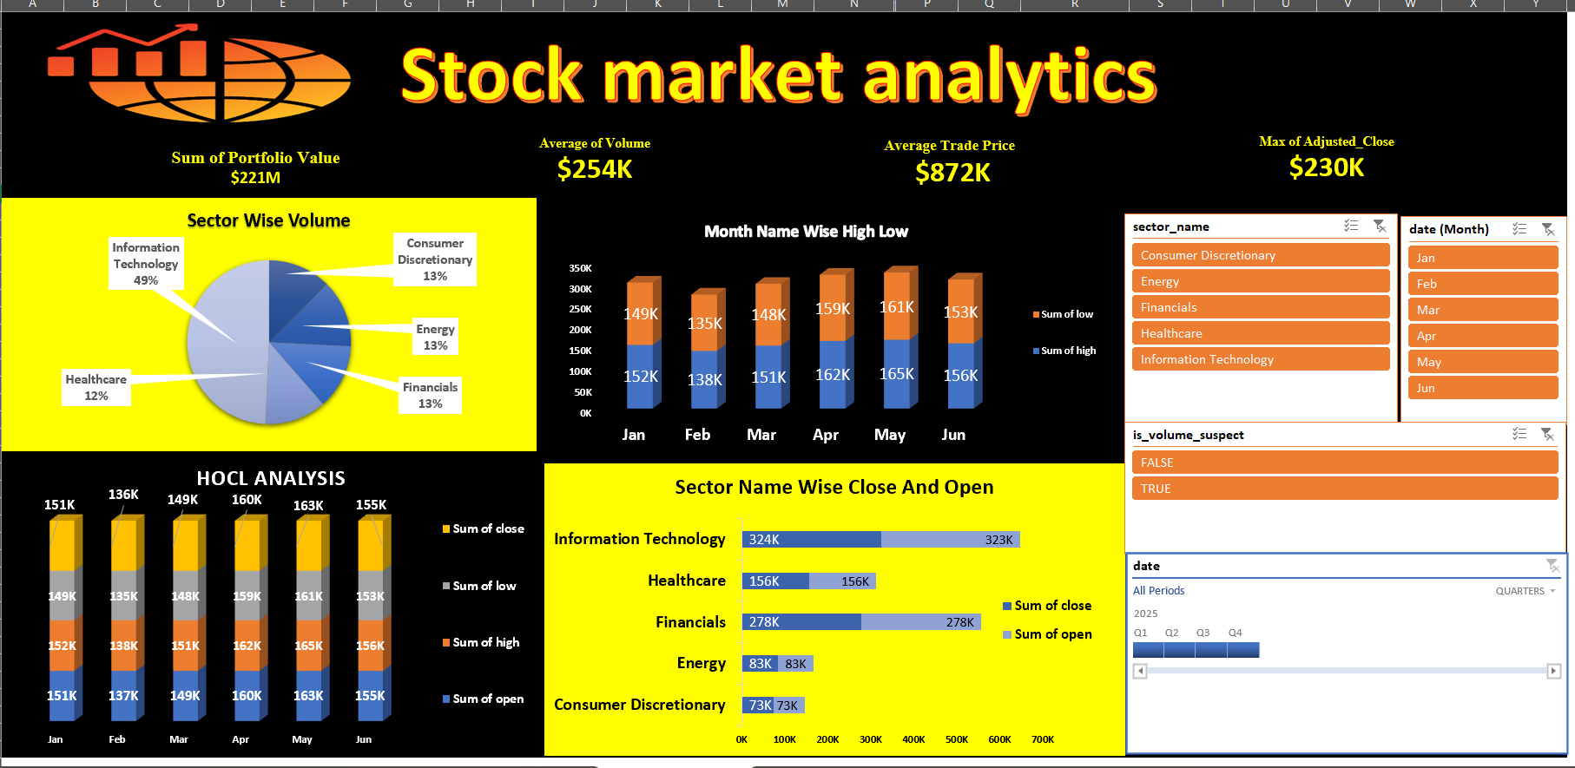
EXCEL DASHBOARD

Slide 6
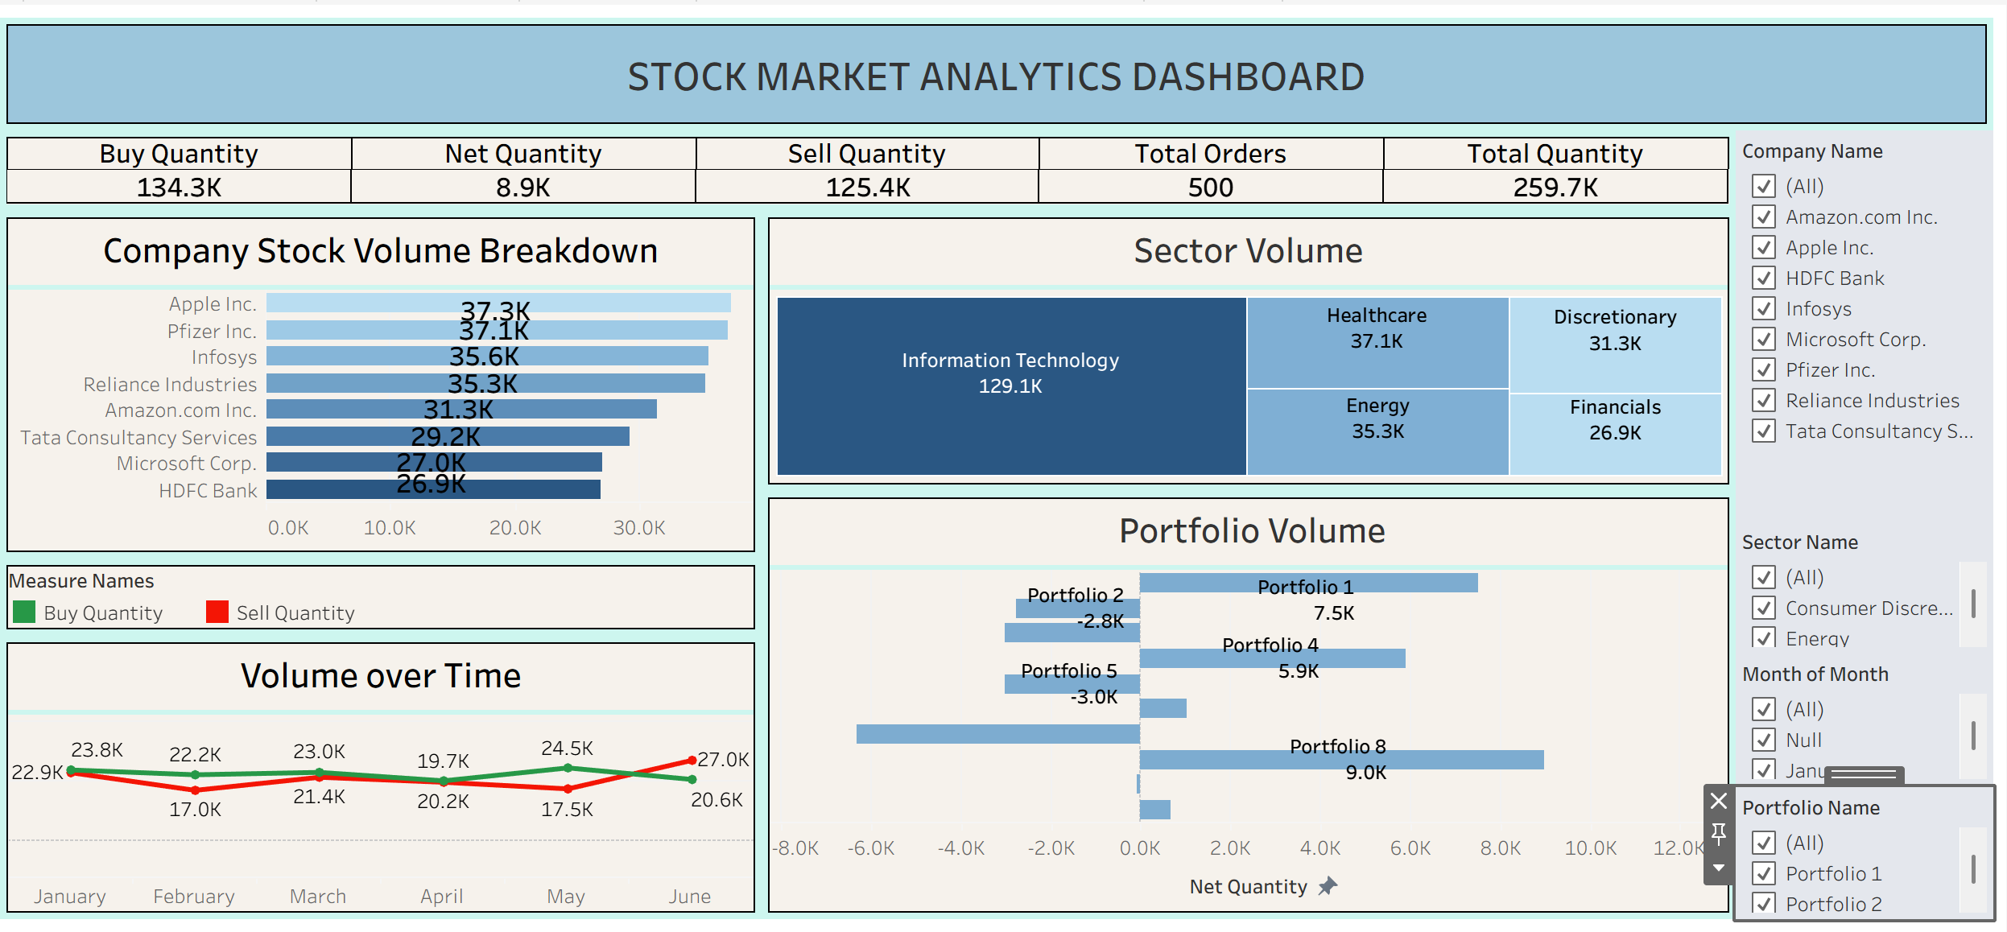
TABLEAU DASHBOARD

Slide 7
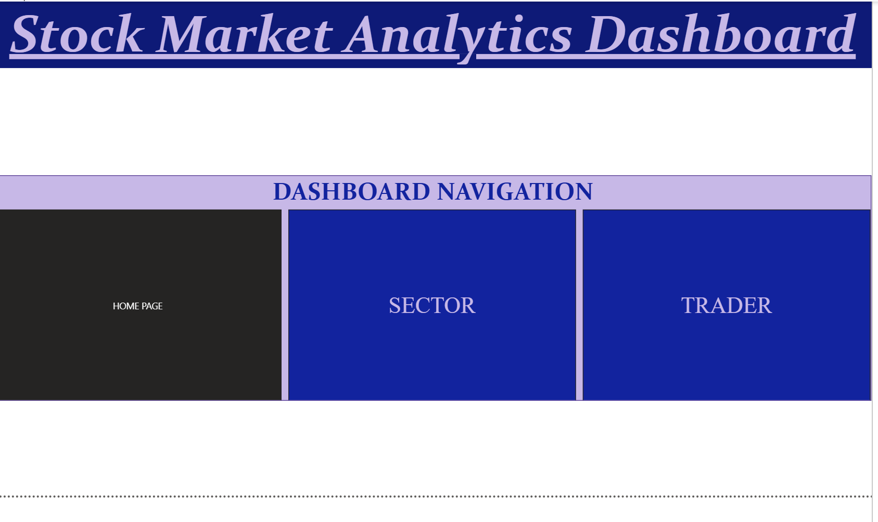
POWER BI DASHBOARD

Slide 8
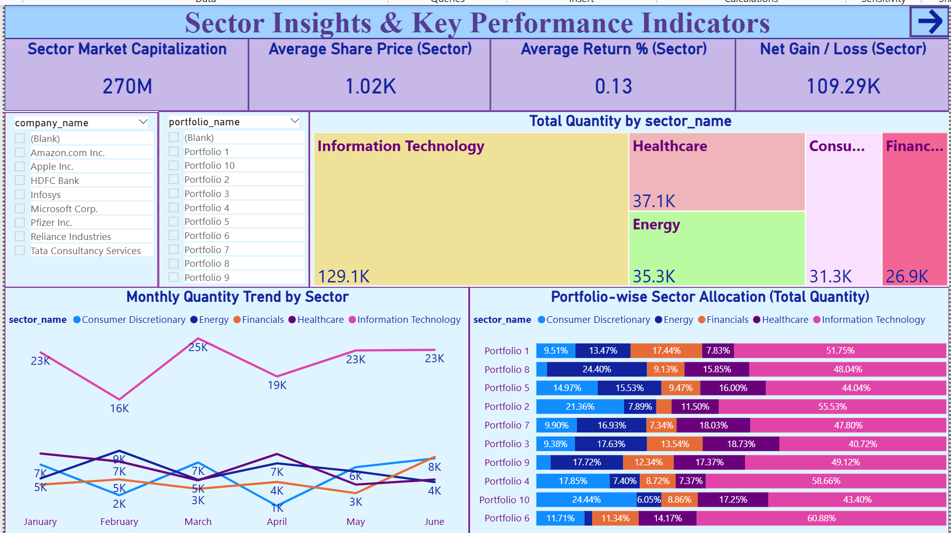
POWER BI DASHBOARD

Slide 9
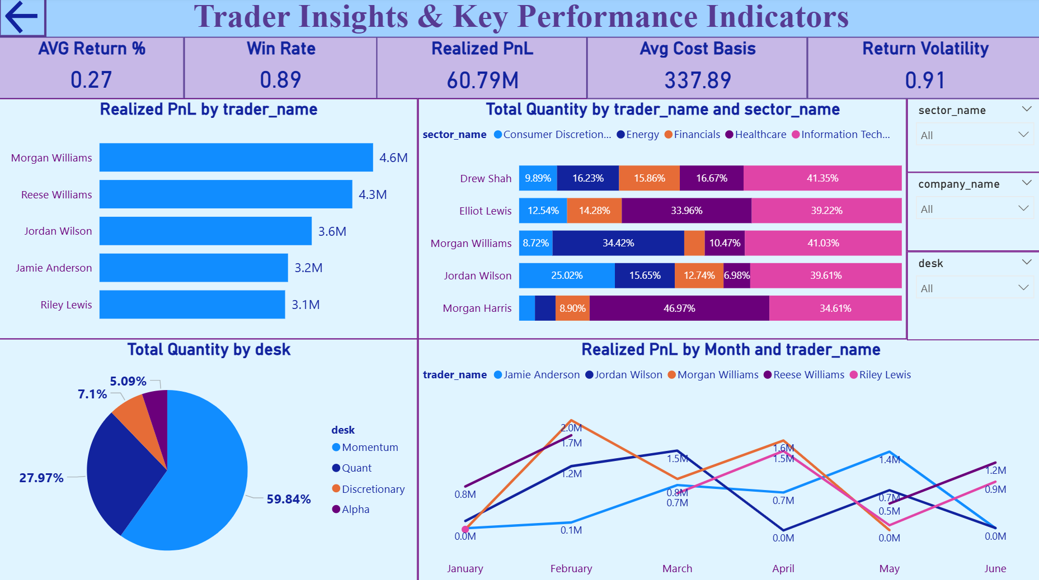
POWER BI DASHBOARD

Slide 10
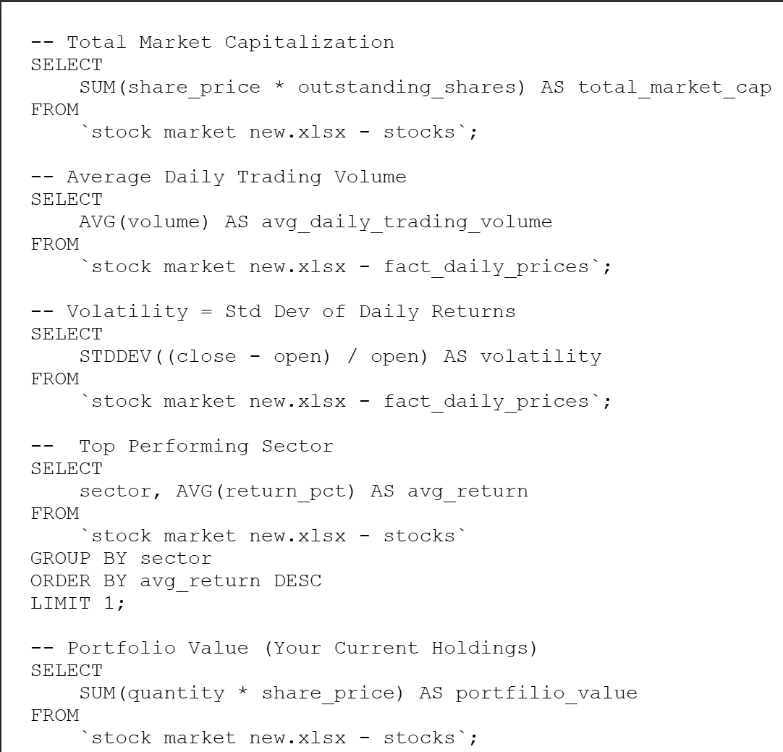
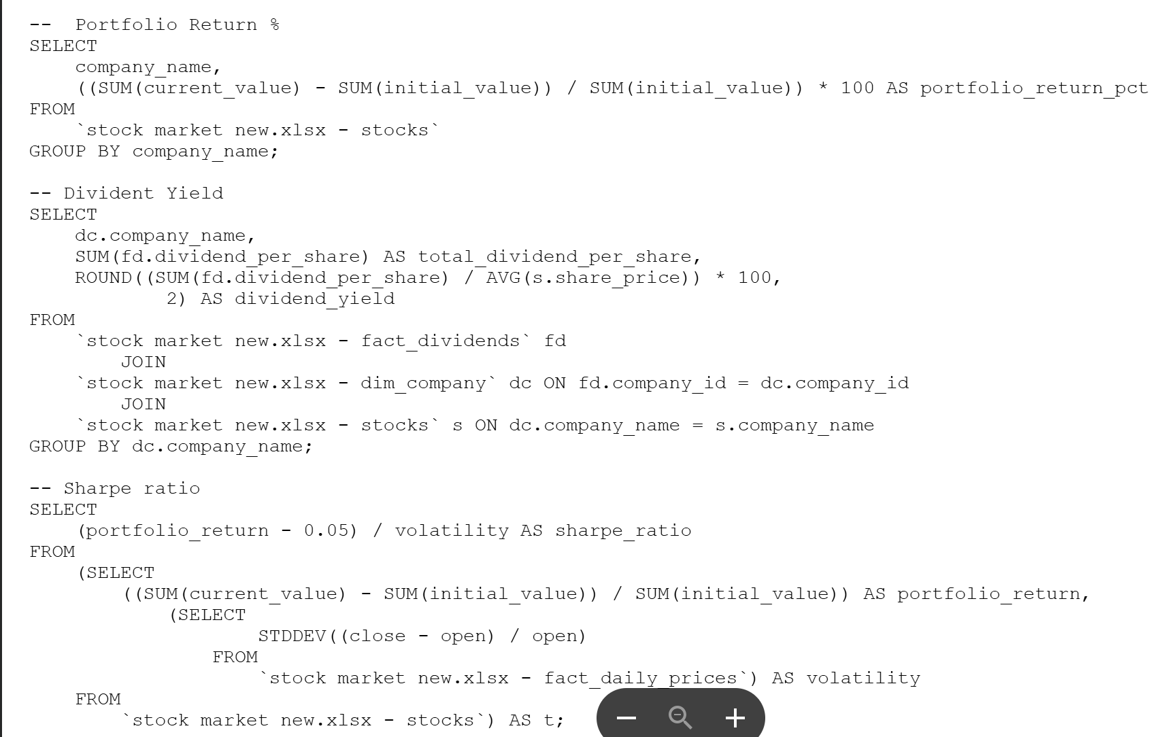
SQL QUERIES

Slide 11
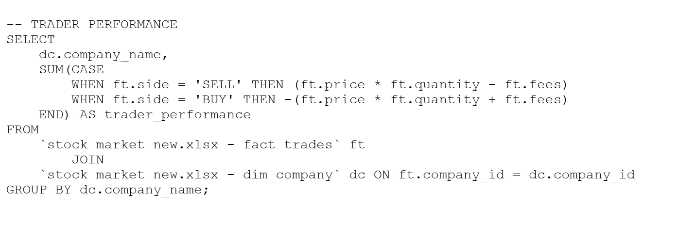
SQL QUERIES

Slide 12
KEY TAKEAWAYS
Executive Summary & High-Level KPIs
Strong Portfolio Performance: Total realized PnL stands at $60.79M with an exceptionally high win rate of 0.89.
Core Portfolio Value: The total portfolio value is $221M, supported by a sector market capitalization of $270M.
Trading Efficiency: Average returns remain positive at 0.27% despite a return volatility of 0.91.
Sector & Asset Allocation
IT Dominance: Information Technology is the primary driver and the highest average trade prices.
Portfolio Diversification: All portfolios show a heavy tilt toward, followed by Healthcare and Energy.
Stable Sector Distribution: While IT leads, there is a balanced distribution among other sectors.

Slide 13
KEY TAKEAWAYS
Trader Performance & Desk Activity
Top Performers: Morgan Williams leads in total realized PnL ($4.6M.
Desk Strategy: The Momentum desk is the primary volume driver, responsible for nearly 60% of total quantity traded.
Market Dynamics & Volume Trends
Trading Balance: The market shows healthy liquidity with 134.3K buy quantity versus 125.4K sell quantity.
Monthly Momentum: Total quantity traded remained steady between 20K–25K monthly, with a noticeable peak in March for the IT sector.

Slide 14
THANK YOU

