Slide 1
MINI-PROJECT REVIEW – 2
AI FARM OPERATIONS COMMAND CENTRE (AFOCC)
A Unified Natural-Language Operational Orchestration Layer for Smart Agriculture
Surya M S
Reg. No: 22MIA1098
Department of Computer Science and Business Analytics
Guide: Dr. VIVEKANANDAN M
Date: August 2026

Slide 2
1. Problem Statement & Existing Challenges
Existing Smart Farming Fragmentation
• Isolated Applications: Farmers must open separate mobile apps for soil sensors, weather forecasts, disease checking, and pump control.
• Human-as-Data-Router: Farmers bear heavy cognitive load manually cross-referencing multi-source data before making operational decisions.
• Lack of Contextual Intelligence: Individual sensor platforms lack high-level natural language reasoning and dynamic tool orchestration.
Operational Safety & Usability Gap
• Unvalidated Actuation Risks: Existing automated systems lack safety verification gates to prevent dry-running pumps when water reserves are low.
• Chatbot Limitations: Current AI chatbots offer text Q&A advice but cannot interact with IoT devices or trigger farm tools.
• Core Objective: Provide a single, safe natural-language command centre that connects farmer intent with live farm operations.

Slide 3
2. Proposed Solution — AFOCC Overview
AI FARM OPERATIONS COMMAND CENTRE (AFOCC)
AFOCC provides a unified operational orchestration layer that translates farmer natural language questions into context-aware decisions, safety checks, and supported farm actions.
✔ Natural Language Command Console: Talk to the farm using everyday English via OpenAI tool-calling agent.
✔ Modular Tool Suite: 7 Python tools fetching live soil moisture, water tank levels, and live OpenWeather API data.
✔ Rule-Based Decision Engine: Explainable threshold rules (Soil <30%, Tank >20%, Rain <60%) recommending actions.
✔ Safety Validation Layer: Active hazard block preventing pump damage if water tank reserve is critically low (<=10%).
✔ Interactive Farmer Confirmation: Prompts the farmer with a confirmation modal ('Yes/No') before executing pump actuation.
✔ Persistent Audit Logging: Stores all commands, decisions, and system executions in SQLite operation_logs.

Slide 4
3. Systematic Literature Review (22 Papers Summary)
1. IoT & Hardware Surveys
Prakash '23; Katkoori '25; Mowla '23
Analyzes WSN protocols, ESP32 MCUs, and sensors. Lacks AI reasoning & natural language.
2. ML & XAI Decision Support
Khaliq '25; Martin '24; Mohyuddin '24
Delivers high accuracy predictions (99.13%). Isolated from physical actuator execution.
3. Edge AI & Automation
Elijah '24; Sitharthan '23; Raouhi '23
Reduces cloud latency via edge rules. Lacks agentic tool selection & confirmation.
4. Real-Time Sensing & AI Assist
Sharma '24; Reddy '25; Jeya '24
Provides real-time sensor fusion & Q&A advice. Cannot trigger physical farm tools.
5. IoT Web Dashboards
Villa-Henriksen '24; Al-Fuqaha '25
Visualizes live microclimate telemetry cards. Lacks natural-language tool orchestration.
6. Proposed System (AFOCC)
Surya M S (2026)
Integrates Natural Language + Tool Calling + Decision Engine + Safety Gate + Dashboard.

Slide 5
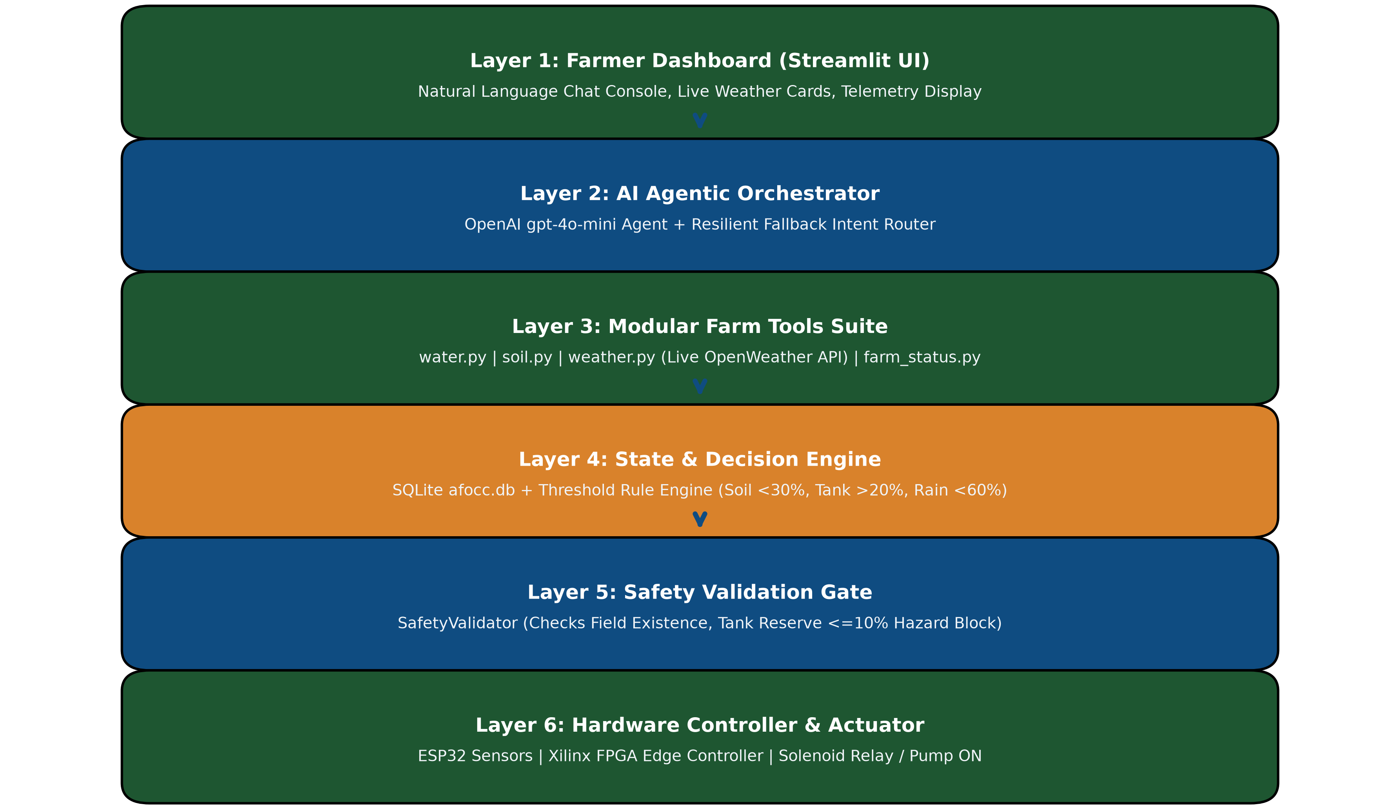
4. Multi-Tiered System Architecture

Slide 6
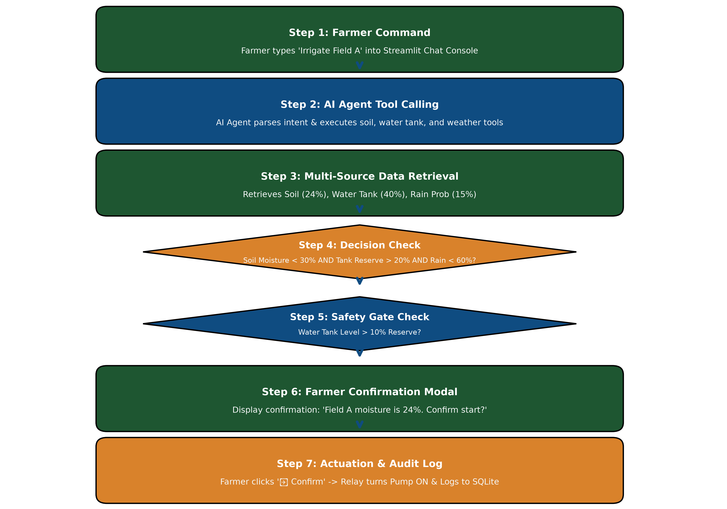

Slide 7
6. Technology Stack Architecture
Presentation Layer
Streamlit Framework
HTML/CSS Styling
Live Telemetry Cards
Interactive Chat Console
Agentic Orchestrator
OpenAI gpt-4o-mini API
Function Calling Tool Schemas
Resilient Fallback Intent Router
Context Processing
Tools & Decision Services
Python Modular Tools
OpenWeatherMap REST API
Rule-Based Decision Engine
SafetyValidator Engine
Data & Hardware Layer
SQLite afocc.db
ESP32 Modbus WSN Sensors
Xilinx FPGA Edge Controller
Solenoid Relay Actuator

Slide 8
7. Core Modules & Functional Components
1. Modular Tool Suite (app/tools/)
Includes water.py, soil.py, weather.py, and farm_status.py. Fetches live OpenWeather API telemetry & database states.
2. Rule Decision Engine (app/services/decision_engine.py)
Evaluates explainable threshold rules: Soil Moisture < 30%, Water Tank > 20%, and Rain Probability < 60%.
3. Safety Validation Layer (app/services/safety.py)
Acts as an active software safety gate: Blocks pump execution if water tank level is <= 10% reserve capacity.
4. Operation Audit Logger (app/database/database.py)
Permanently records farmer commands, AI tool calls, safety validation outcomes, and pump status in SQLite operation_logs table.

Slide 9
8. Implementation Progress & Automated Test Matrix
Module / Component | Target File / Interface | Implementation Status | Verification Result
SQLite Schema & DB Manager | app/database/database.py | COMPLETED | Passed (4/4 Tests)
FastAPI REST API Routes | app/api/routes.py | COMPLETED | Passed (3/3 Tests)
7 Modular Farm Tools | app/tools/*.py | COMPLETED | Passed (5/5 Tests)
OpenWeatherMap Live API | app/tools/weather.py | COMPLETED | Passed (1/1 Test)
Rule-Based Decision Engine | app/services/decision_engine.py | COMPLETED | Passed (2/2 Tests)
Mock Actuator Interface | app/services/actuator.py | COMPLETED | Passed (2/2 Tests)
OpenAI Tool Calling Agent | app/agent/agent.py | COMPLETED | Passed (4/4 Tests)
Safety Validation Layer | app/services/safety.py | COMPLETED | Passed (3/3 Tests)
Streamlit Command Dashboard | streamlit_app.py | COMPLETED | Live Port :8501
ESP32 Sensors & Xilinx FPGA | Modbus & Zynq/Vivado | PLANNED (V2 Roadmap) | In Progress

Slide 10
9. Execution Traces & System Demonstration
Trace 1: Command & Telemetry Execution
• Live Dashboard Telemetry: Displays Water Tank (40.0%), Field A Moisture (24.0%), Field B Moisture (48.0%), Weather (31°C, 15% rain prob).
• Farmer Natural Language Input: 'Should I irrigate Field A?'
• Agent Processing: Agent executes get_soil_moisture, get_water_tank_status, and get_weather tools automatically.
• System Recommendation: Decision engine returns RECOMMENDED with interactive confirmation buttons.
Trace 2: Safety Interception & Audit Logging
• Safety Interception Test: Water Tank slider set to 10.0% reserve.
• Farmer Command: 'Irrigate Field A'
• Safety Gate Action: SafetyValidator intercepts command before actuation and outputs warning: 'Safety Hazard: Water tank level is critically low (10.0%). Irrigation blocked to prevent pump damage.'
• Audit Log Record: Operation logged in SQLite operation_logs with status BLOCKED_HAZARD.

Slide 11
10. Comparative Analysis: Existing Systems vs. AFOCC
System Feature / Capability | IoT WSN (Katkoori '25) | Task ML (Khaliq '25) | Q&A Bots (Koopman '24) | AFOCC V1/V2 (Surya M S '26)
Sensor Telemetry Acquisition | Full WSN | Manual Input | None | Full (ESP32 + Weather API)
Live Weather API Integration | None | Included | None | Integrated (OpenWeatherMap)
Predictive Decision Support | Threshold | High Accuracy ML | Text Q&A | Explainable Rule Engine
Natural Language Interaction | None | None | Text Q&A Only | Dynamic Agentic Tool Calling
Operational Tool Dispatch | None | None | None | Dynamic Function Calling
Active Safety Validation Layer | None | None | None | Active (Hazard Block <=10%)
Interactive Farmer Confirmation | None | None | None | Interactive Confirmation Modal
Operation Audit Logging | None | None | None | Persistent SQLite Audit Log
Unified Web Command Dashboard | Separate | None | Separate Bot | Unified Streamlit Dashboard

Slide 12
11. Technical Scope & Current V1 Boundaries
Implemented V1 Boundaries
✅ Software Actuation Simulation: Uses MockActuator software state mutations for pump ON/OFF control.
✅ Rule-Based Decision Logic: Uses explicit threshold rules (Soil <30%, Tank >20%) to maintain 100% explainability.
✅ Single Farm Configuration: Designed for single farm operation (Demo Farm) in V1 phase.
✅ Verified Test Suite: 23 automated tests verifying API, tools, database, and safety layer.
Academic & Design Constraints
• Academic Framing Rule: We do NOT claim AFOCC is the first smart farming system or that we invented AI agents.
• Focus Area: Contribution is strictly focused on Unified Operational Integration and Bounded LLM Safety.
• Deterministic Safety Gate: Demonstrates that Generative AI models can safely manage farm operations when bounded by deterministic safety checks.

Slide 13
12. Future Enhancement Roadmap (V2 Hardware)
1. Real-Time ESP32 Sensor Nodes
Connect physical ESP32 microcontrollers with Modbus/RS485 sensor buses for live soil NPK, pH, moisture, and tank ultrasonic levels.
2. Xilinx FPGA Edge Controller
Integrate Xilinx (Zynq / Vivado) FPGA hardware acceleration for sub-millisecond sensor signal filtering and hardware safety interlocks.
3. Streamlit Dashboard WebSockets
Implement WebSocket real-time sensor streaming charts to display live telemetry dynamics without page refreshes.
4. n8n Multi-Device Automation Engine
Deploy n8n workflow engine for automated multi-device relay switching, SMS alert dispatch, and scheduled irrigation tasks.

Slide 14
13. Conclusion & Key Academic Contributions
SUMMARY OF PROJECT CONTRIBUTIONS
1. Resolved Operational Fragmentation: Successfully unified separate smart farming tools into a single natural language operational interface.
2. Implemented Agentic Architecture: Built working prototype using OpenAI tool calling, 7 modular farm tools, live OpenWeather API, and SQLite database.
3. Demonstrated Bounded LLM Safety: Validated that an AI agent, when governed by an active Safety Validation Gate (hazard block <=10% tank level), provides safe and reliable farm actuation.
4. Complete System Verification: Verified with 23 passing automated tests and deployed live on Streamlit Cloud.

Slide 15
14. References (Part 1: Papers 1–11)
1. Khaliq, A., et al. (2025). AI-Driven Smart Agriculture: Integrated Approach for Soil, Irrigation & Fertilizer. IEEE Access, 13.
2. Katkoori, A. K., et al. (2025). Real-Time Multisensor Data Acquisition using FreeRTOS. IEEE ICITEICS.
3. Mehedi, M., et al. (2024). Remote Sensing and Decision Support System Applications in Precision Agriculture. IEEE Access.
4. Gupta, M., et al. (2020). Security and Privacy in Smart Farming: Challenges and Opportunities. IEEE Access, 8.
5. Mahmoud, M. A., & Blankson, C. (2026). AI-driven sustainable agriculture: market-oriented strategies. Mgmt Research Review.
6. Sitharthan, R., et al. (2023). A novel autonomous irrigation system using 6G-enabled IoT network. Microprocessors & Microsystems.
7. Romera, A., et al. (2024). Digitalization in agriculture. Towards an integrative approach. Agricultural Systems, 215.
8. Raouhi, E., et al. (2023). AIDSII: An AI-based digital system for intelligent irrigation. Computers & Electronics in Agriculture, 208.
9. Martin, A., et al. (2024). XAI-Powered Smart Agriculture Framework for Crop Recommendation. IEEE Trans. AgriFood Electronics.
10. Singh, P., et al. (2025). Enabling Data Collection and Analysis in Precision Agriculture. IEEE Access.
11. Muhammed, A., et al. (2024). Artificial Intelligence of Things (AIoT) for smart agriculture: A review. IEEE IoT Journal.

Slide 16
15. References (Part 2: Papers 12–22)
12. Mohyuddin, S., et al. (2024). Evaluation of Machine Learning Approaches for Smart Agriculture. Springer Applied Intelligence.
13. Araújo, S. O., et al. (2024). Smart Agricultural System Using Proximal Sensing and LoRa Technology. IEEE Access, 12.
14. Reddy, K., et al. (2025). Agri Assist: An AI Integrated Farmer Assistant using Stacked Ensemble ML. IEEE Access.
15. Zhang, Y., & Yadav, V. (2025). Generative AI as an Interface Between Farmers and AI Algorithms. Elsevier Comp. Electr. Agric.
16. Jeya, R., et al. (2024). Agriconnect: A Data-Driven Platform for Precision Agriculture Advice. IEEE Trans. AgriFood Electr.
17. Mowla, N. I., et al. (2023). Internet of Things and Wireless Sensor Networks for Smart Agriculture Applications. IEEE Access.
18. Koopman, B., et al. (2024). AgAsk: An agent to help answer farmer's questions from scientific documents. Int. J. Digital Lib.
19. Prakash, C., Singh, L. P., Gupta, A., & Lohan, S. K. (2023). Advancements in smart farming: A review of IoT, sensors, and hardware. Sensors & Actuators A: Physical, 362, 114605 (Elsevier).
20. Elijah, O., et al. (2024). An Intelligent IoT-Enabled Edge Computing Framework for Autonomous Irrigation. IEEE TASE.
21. Sharma, R., et al. (2024). Real-Time Multimodal Sensor Fusion and AI Assistant for Precision Monitoring. Springer NC&A.
22. Villa-Henriksen, A., et al. (2024). Interactive Web-Based IoT Dashboard and Cloud DSS for Precision Agriculture. Elsevier Biosystems Engineering.

Slide 17
THANK YOU!
AI FARM OPERATIONS COMMAND CENTRE (AFOCC)
Presenter: Surya M S (Reg. No: 22MIA1098)
Department of Computer Science and Business Analytics
Guide: Dr. VIVEKANANDAN M

