Slide 1
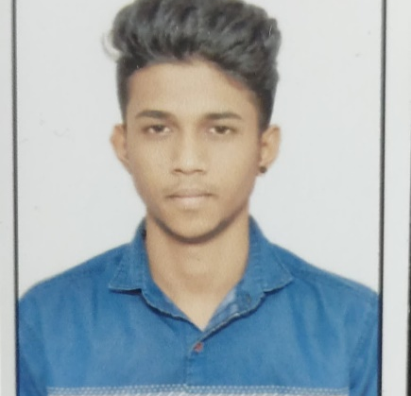
Surya P S
Bachelor of Technology, Computer Science : 2017 - 2021
Analyst/Software Engineer
Skills
Java | Java Basics, OOPS, Generics, Collections, java8 features
J2EE | JDBC, Servlets, JPA
Database | PostgreSQL, MySQL
Web Technology | HTML5 & CSS and JavaScript, Typescript, Bootstrap, Angular.
Tools | Git, Postman, Swagger, Visual Studio Code SonarQube, Jenkins, Spring Tool
Frameworks | Hibernate & spring
Add On skills | Problem Solving, Adaptability, Leadership skills, Communication skill, Team management, work ethic persuasion, Time Management
Bangalore
surya.p-s@capgemini.com
+91 7892243721
A4
Electronic Voting System Application
Developed Electronic Voting System application to automate the process of planning and managing the voting system, as well as the actual voting activity.
We Used HTML,CSS, Boostrap and TypeScript for the UI designing and Java & Spring Boot as a middleware and PostgreSQL as backend.
Trained on JEE Full Stack with Angular
Core java, java8 features(stream API , Lambda Expressions, java date time API, Optional class)
J2EE
Git and GitHub
SQL and RDBMS
Hibernate and Spring Frameworks
HTML, CSS , JavaScript , Typescript
Proficient in creating Single page Web Application in Angular with Authentication with routing.

