Slide 1
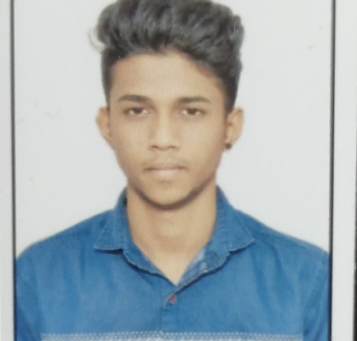
Surya P S
Bachelor of Technology, Computer Science : 2017 - 2021
Analyst/Software Engineer
Skills
Java | Java Basics, OOPS, Generics, Collections, java8 features Lambda Exp, Stream API Junit, Mockito, Servlet
J2EE | JDBC, Servlets, JPA
Database | PostgreSQL,MongoDB No Sql Basics, My SQL RDBMS
Web Technology | HTML5 & CSS and JavaScript, Typescript, Bootstrap, Angular.
Tools | Git, Postman, Swagger, Visual Studio Code SonarQube, Jenkins, Spring Tool
Spring | REST controllers, Implementation of GET, POST, PUT & DELETE, Bean Validation & Exception Handling, Testing Services, Controller & Repository layer
Add On skills | Problem Solving, Adaptability, Leadership skills, Communication skill, Team management, Time Management
Bangalore
surya.p-s@capgemini.com
+91 7892243721
A4
Electronic Voting System Application
Developed Electronic Voting System application to automate the process of planning and managing the voting system, as well as the actual voting activity.
We Used HTML,CSS, Boostrap and TypeScript for the UI designing and Java & Spring Boot as a middleware and PostgreSQL as backend.
Online Railway Reservation
Completed end to end case study of Online Railway Reservation with microservice architecture java and Spring Boot as (middleware), JWT authentication, Swagger and payment testing using Paytm ,eureka server, MongoDB as database (backend)and Angular for frontend (UI).
Trained on JEE Full Stack with Angular
Core java, java8 features(stream API , Lambda Expressions, java date time API, Optional class)
Git and GitHub
SQL and RDBMS
Hibernate and Spring Frameworks
HTML, CSS , JavaScript , Typescript
• Hands on experience in creating microservices with Spring boot, Spring Security with JWT, Spring Cloud API Gateway, Eureka server, Hystrix.
Proficient in creating Single page Web Application in Angular with Authentication with routing.
Completed AWS CP
Completed JEE Full Stack 2.0 with Angular (duration:3 months) from Capgemini India

