Slide 2
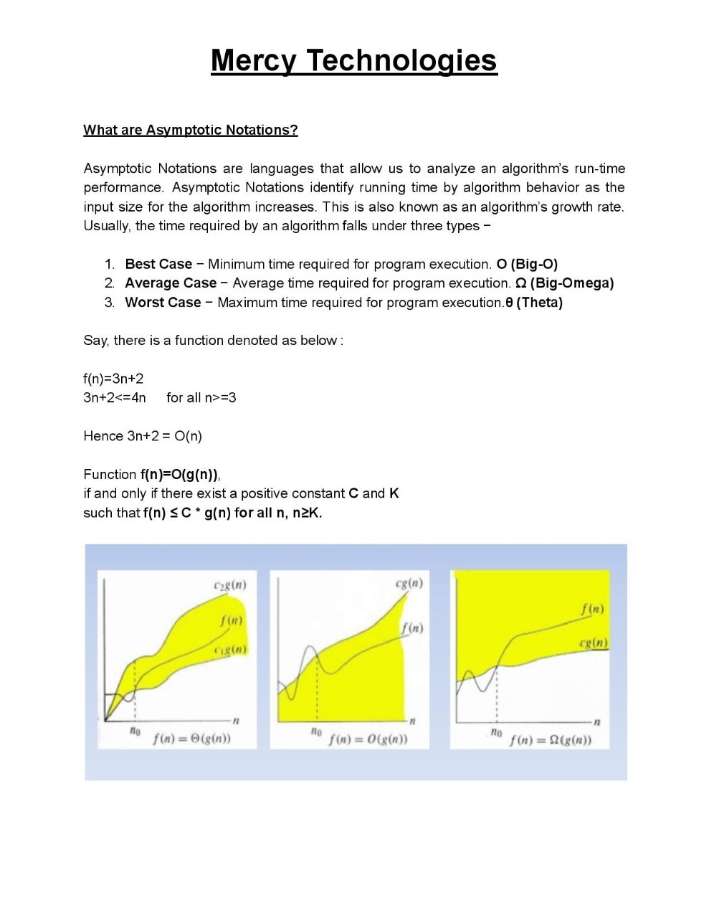

Slide 3


Slide 4


Slide 5
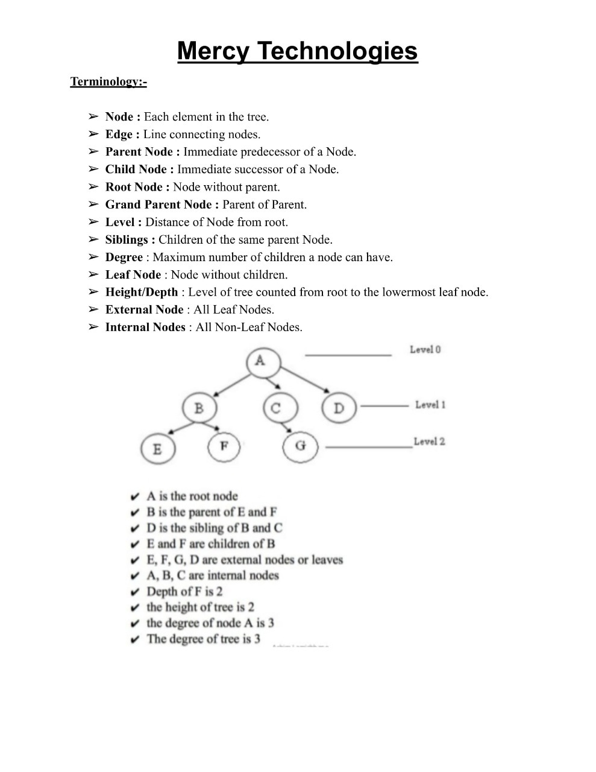

Slide 6


Slide 8
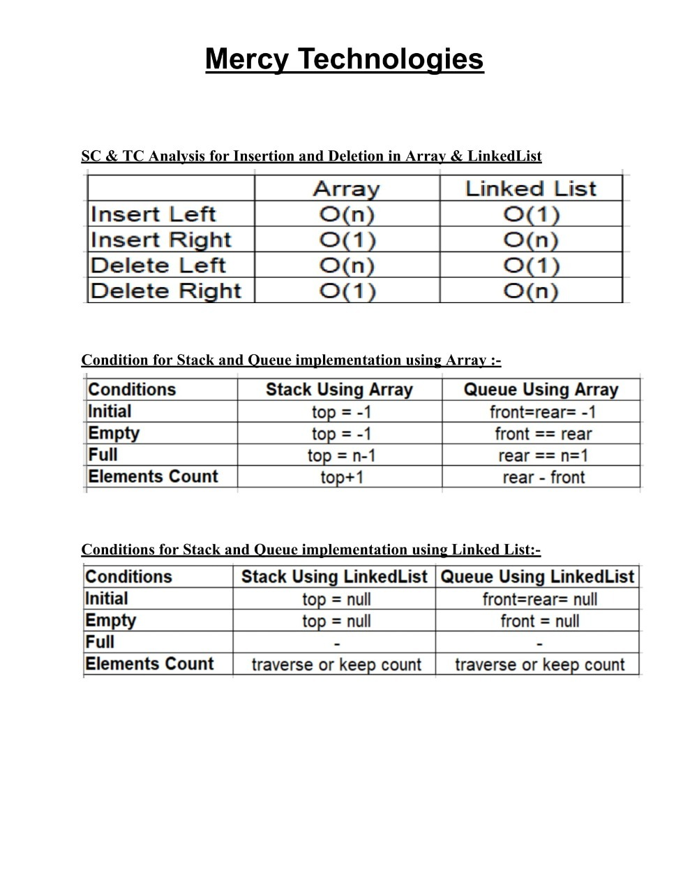

Slide 9
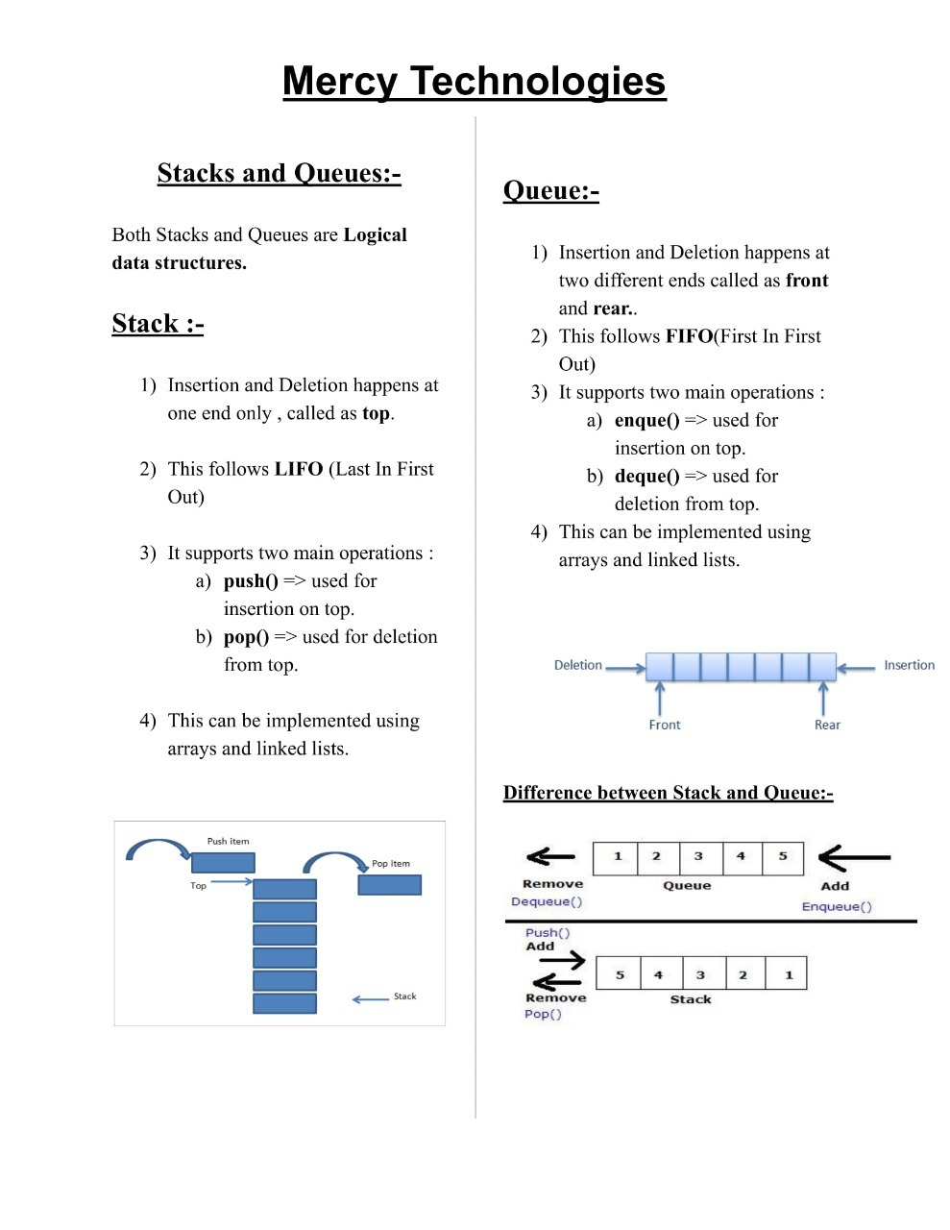

Slide 10
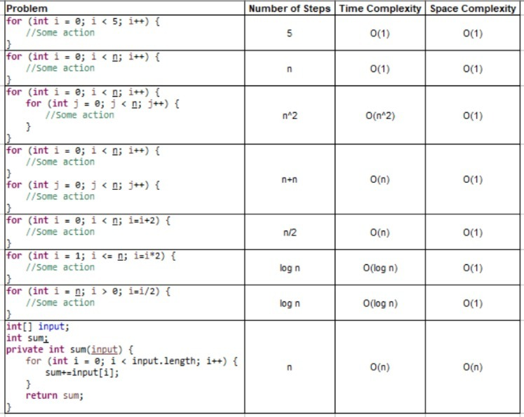

Slide 11
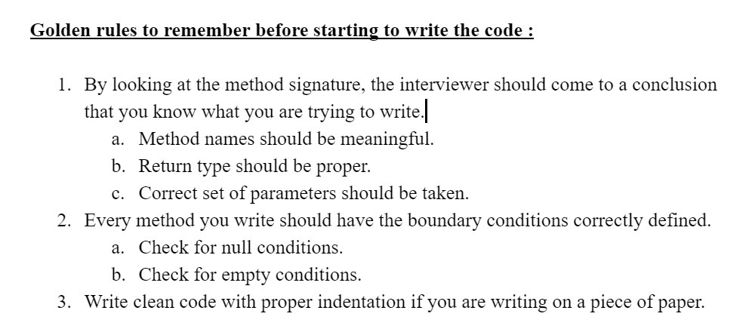

Slide 12
Hi All,Let's learn something new today 😊In any interview, interviewer expects the best possible answer. But, what is the best answer?In simple words, that should be the best possible solution present for the given problem.Let's see one such problem and try finding the best possible solution.Question:- Find the middle element of a Linked List. The length of the LinkedList is an odd number.Algorithm 1:-1- Take a variable length and initialize it to 02- Iterate over the LinkedList and keep incrementing length variable.3- Again start iterating over the LinkedList until length/2 and return the corresponding node's value.Time Complexity :- O(n)+O(n/2)= O(n)Space Complexity :- O(1)Algorithm 2:-1- Take two pointers say p,q. p increments once and q increments twice for every iteration.2- Iterate over the LinkedList until q is not null.3- At the point where q is null, p should be pointing to the middle of the LinkedList, so return the node value pointing to p.Note : p is also called slow pointer and q is also called as fast pointer.Time Complexity :- O(n)Space Complexity :- O(1)Conclusion :- Both approaches have the same TC and SC, but Algorithm 2 is better as we need not iterate twice.Codeprivate int getMiddleElementOfLinkedList(Node head) { if (head != null) return 0; Node p = head;// slow pointer Node q = head;// fast pointer while (q != null) { p = p.next; q = q.next.next; } return p.data;}

