Slide 1
FANDANGO SCORE ANALYSIS
CAPSTONE PROJECT
Presented By:
1.SUSAI MARTIN .A (2021306302) – ALAGAPPA COLLEGE OF TECHNOLOGY, ANNA UNIVERSITY – DEPARTMENT OF LEATHER TECHNOLOGY

Slide 2
OUTLINE
Problem Statement
Proposed System/Solution
System Development Approach
Algorithm & Deployment
Result
Conclusion
Future Scope
References

Slide 3
Problem Statement
This topic is regarding the Fandango Case. Fandango is a movie ticket booking website.
Develop a user-friendly online platform that allows customers to easily search for movie showtimes, purchase tickets, and access relevant information such as movie reviews and theater locations, aiming to enhance the overall moviegoing experience and streamline the ticketing process
This model will help in making a decision on whether the film is really good or not.

Slide 4
Proposed Solution
User-Friendly Interface: Design an intuitive and visually appealing website and mobile app interface that allows users to easily search for movies, view showtimes, and purchase tickets. Comprehensive Movie Information: Provide comprehensive movie details including trailers, synopses, cast and crew information, reviews, ratings, and theater locations to help users make informed decisions. Seamless Ticketing Experience: Implement a seamless ticketing system with various payment options, seat selection, and digital ticket delivery to streamline the ticket purchasing process. Personalized Recommendations: Utilize algorithms to offer personalized movie recommendations based on users’ viewing history, preferences, and location. Integration with Partners: Collaborate with theaters, studios, and other partners to ensure accurate showtime listings, exclusive deals, and promotions. Mobile Accessibility: Ensure full functionality and responsiveness across various devices, providing a consistent experience for users on desktops, smartphones, and tablets. Customer Support: Offer reliable customer support channels such as live chat, email, and phone support to assist users with inquiries, ticketing issues, and feedback. Security and Privacy: Implement robust security measures to protect users’ personal and payment information, adhering to industry standards and regulations. Feedback Mechanism: Incorporate a feedback mechanism to gather user opinions, ratings, and reviews to continuously improve the platform and address any issues promptly. Community Engagement: Foster a community of movie enthusiasts through forums, social media integration, and exclusive events to enhance user engagement and loyalty.

Slide 5
System Approach
Building the proposed solution will involve a lot of data processing. For achieving this we need certain system and library requirements:
System Requirements:
1. Hardware:
A computer with sufficient processing power, preferably with multiple cores or a GPU for faster training of machine learning models.
Sufficient amount of RAM is needed to handle the large data sets.
2. Software:
An operating system compatible with the required machine learning libraries (e.g., Windows, Linux, macOS).

Slide 6
System Approach – CONT.
Library Requirements:
Data Processing and Analysis:-
Pandas: For data manipulation and analysis.
NumPy: For numerical operations on data.
Data Visualization:-
Matplotlib and Seaborn: For creating visualizations to understand data patterns.

Slide 7
Algorithm & Deployment
Algorithm Selection
Data Exploration:
Explore the dataset's structure (both Fandango and other movie ticket booking sites)
Identify potential patterns, correlations, and outliers.
Problem Formulation:
Define the problem: Plot difference between Fandango ratings and true user ratings, Also in between Fandango ratings and other movie ticket booking websites, Find average hike in ratings, Find the outliers.
Algorithm Selection:
Plots:
To compare values, So that it is easy for the user to understand the difference in ratings.
Seaborn and Matplotlib are the two libraries used for creating plots i.e for data visualization.
Plots like scatterplot, count plot, histplot, kdeplot and cluster map is used.

Slide 8
Algorithm & Deployment – CONT.
Data Input:
Data Collection:
Gather data of movies from Fandango website and other movie ticket booking website which has data like the movie name, year of release, rating given by user, rating given by critics and any other information regarding it.
Data Cleaning:
Check for misinformation in the dataset and remove or correct if present.
Take only those data which is going to be useful for the project.
Feature Engineering:
Create new features from the existing data that could improve the performance of the algorithm.

Slide 9
Algorithm & Deployment – CONT.
Processing:
Plotting:
Use functions to plot various figures which represents relation or scale of difference in data (In this case we take movie ratings).
Interpreting Information from Plot and Data:
Finding average hike in rating. Finding movies which has got very high rating.
Help user make decision in choosing movies by showcasing the discrepancy in rating in the websites.
And showing users how well they can prefer other movie ticket booking websites.

Slide 10
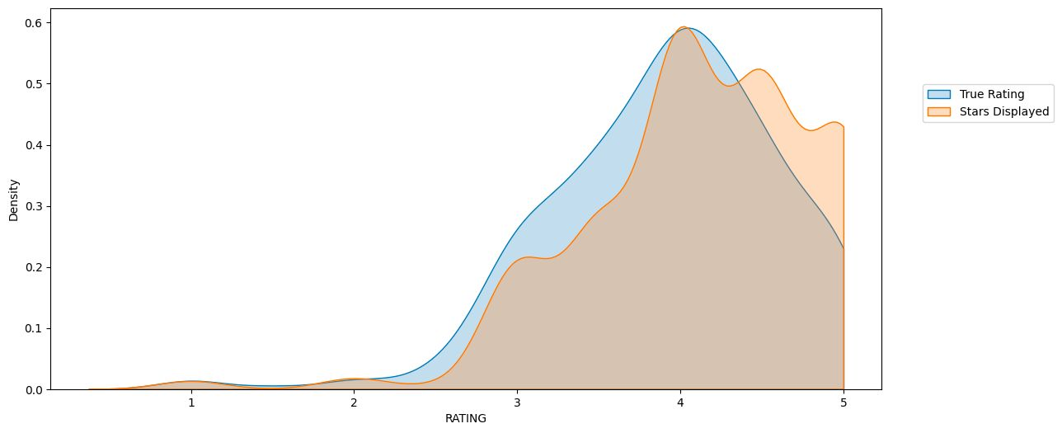
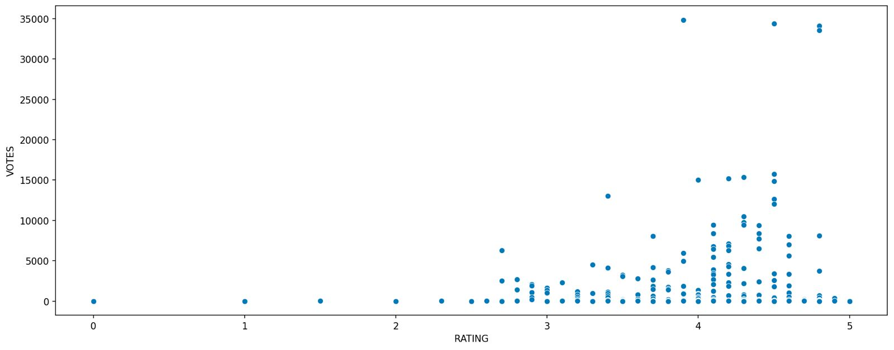
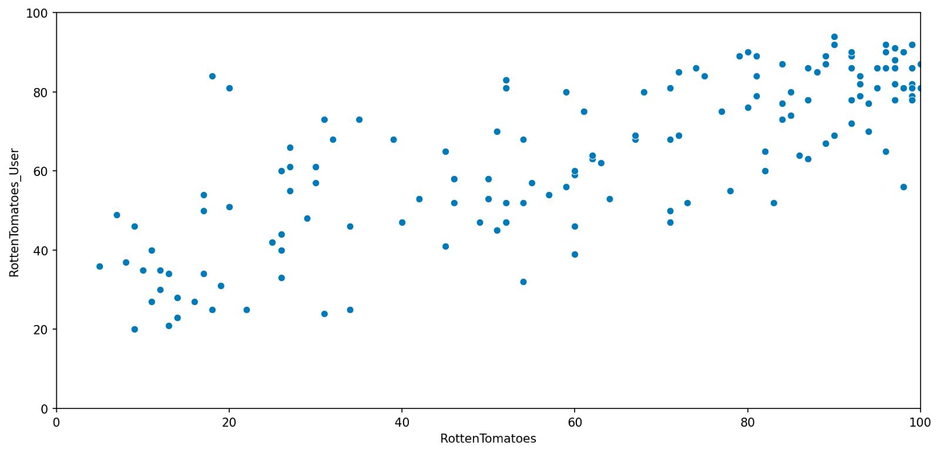
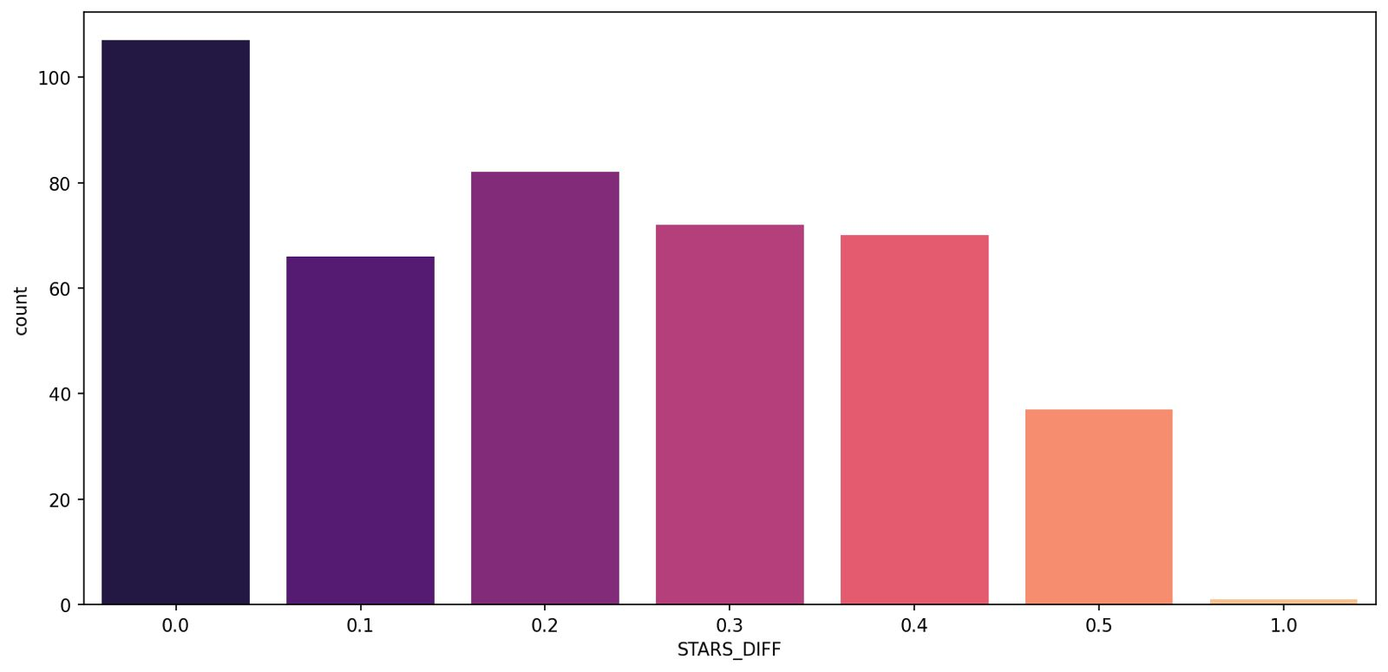
Result
A KDE Plot showing true rating v/s star displayed in Fandango Website
No. of votes a particular rating has got in Fandango Website
A plot showing relation between Rotten Tomatoes critics reviews and user reviews
No. of movies with particular star diff. i.e. Diff. between true user and star displayed

Slide 11
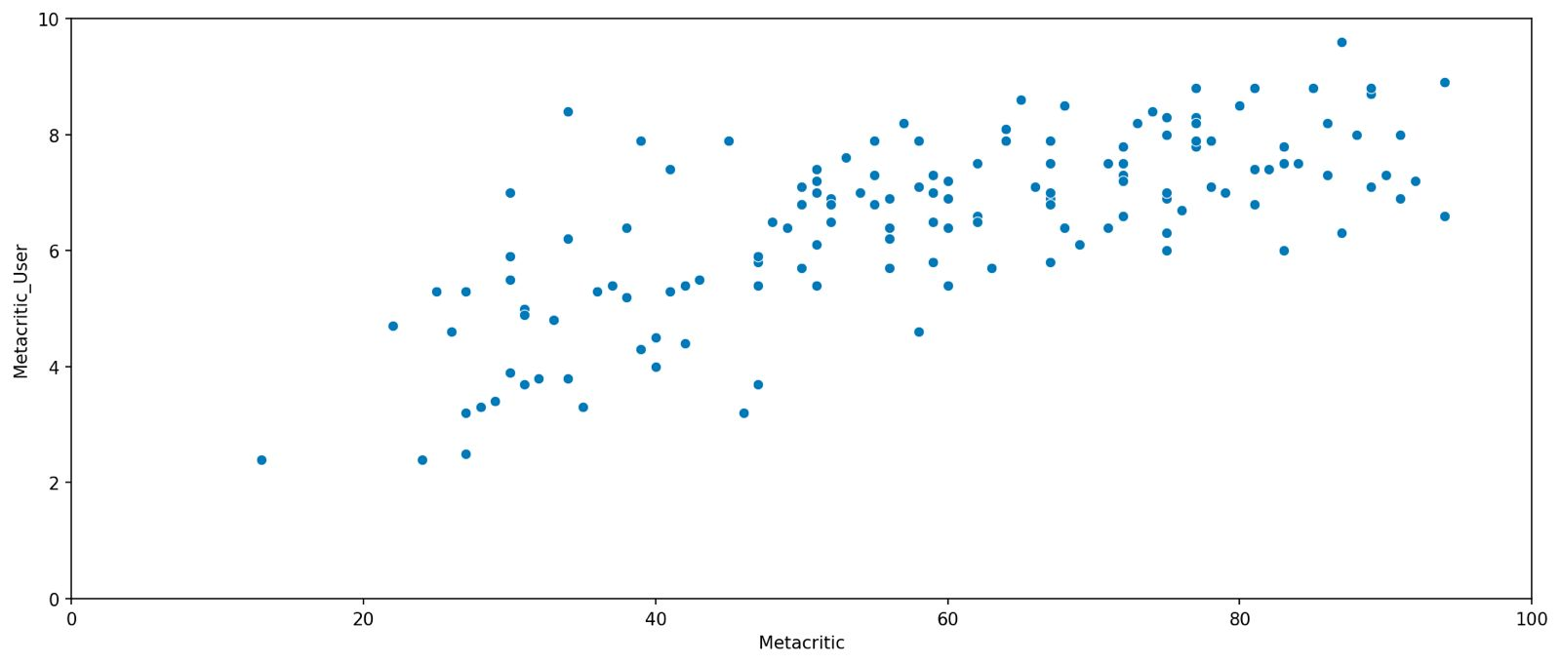
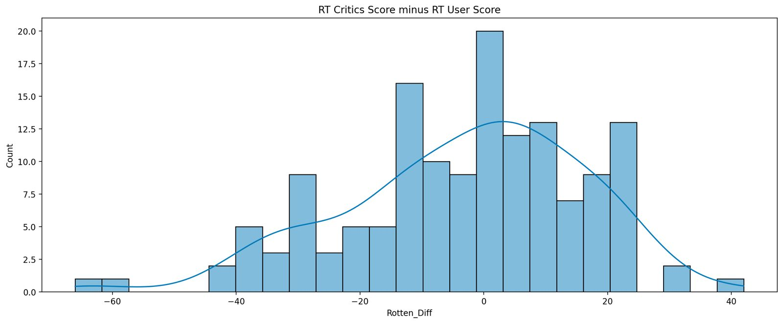
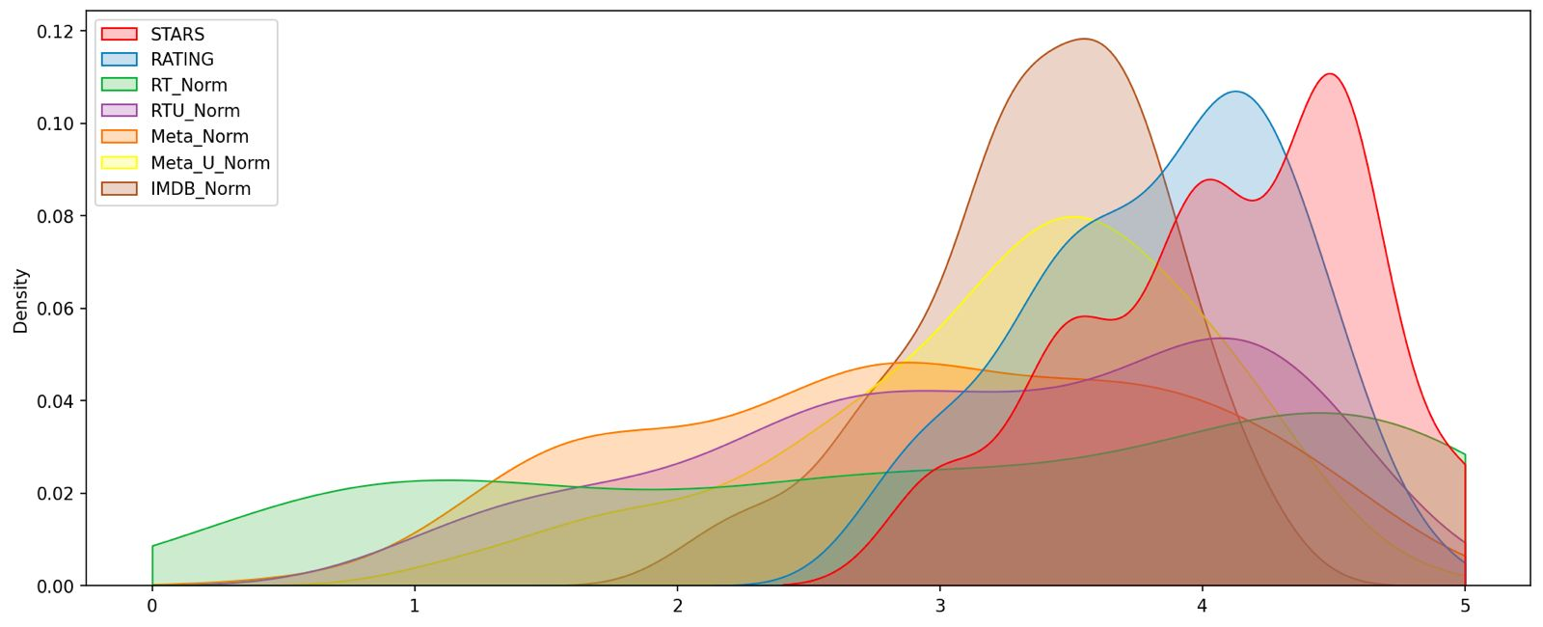
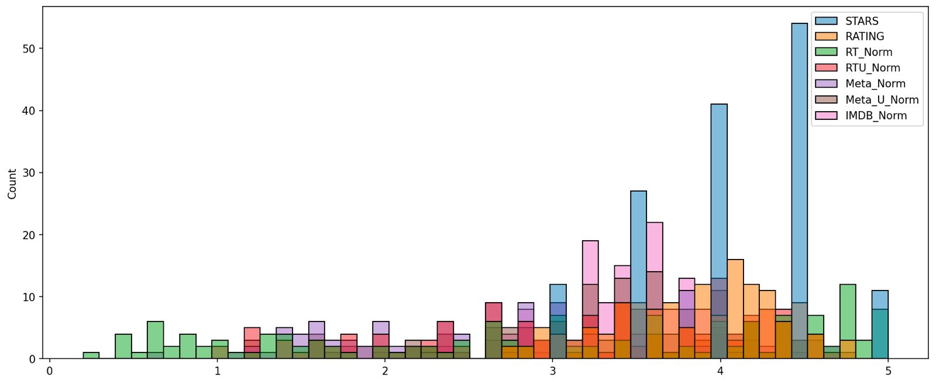
Result – CONT.
A plot showing relation between Metacritic rating v/s Metacritic User rating
Difference between Rotten Tomatoes Critics Score and User Score
A plot comparing distribution of normalized ratings of other movie websites and Fandango website
A histplot comparing all normalized scores

Slide 12
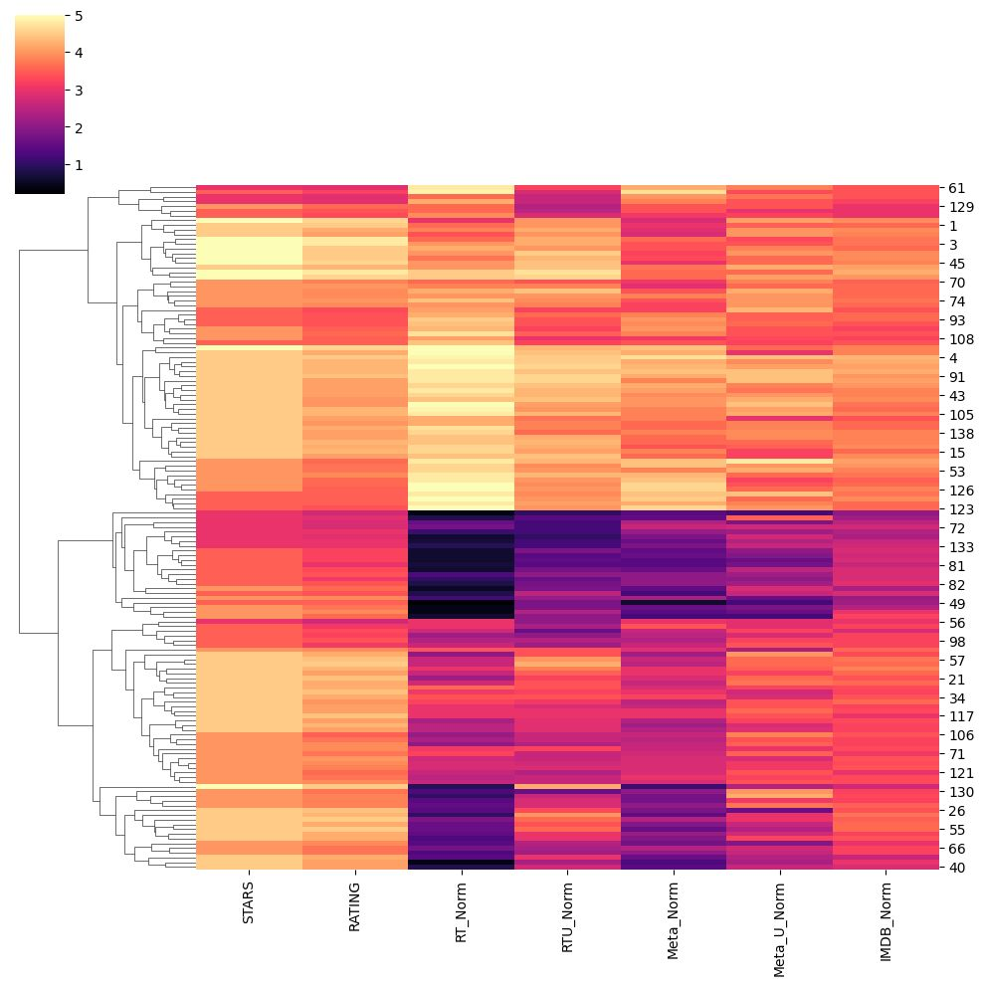
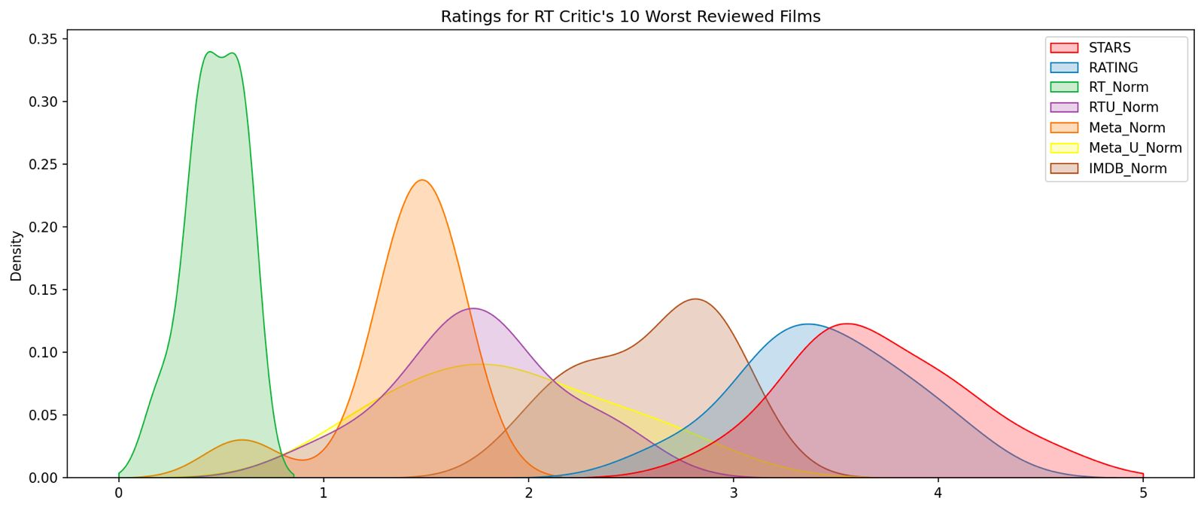
Result – CONT.
A Clustermap visualization of all normalized scores
Visualization of Distribution of Ratings across all sites for the top 10 worst movies

Slide 13
Conclusion
In conclusion, the Fandango Capstone Project has provided valuable insights into the intricacies of movie rating systems. Through rigorous analysis and application of data science techniques, we have uncovered patterns that suggest potential biases in the way movies are rated on the platform. The project highlights the importance of transparency and accountability in rating systems, which have a significant impact on consumer choices and industry revenues.

Slide 14
Future scope
Some key areas for future Exploration and Enhancement:
Data Expansion:
Incorporating a broader dataset which includes user demographics, geographic distribution and trends to understand the audience better.
Algorithm Improvement:
By the use of Extra Data, We can enhance the predictive algorithms for movie ratings by using more sophisticated machine learning models and incorporating real-time data.
Real Time Prediction:
Much better prediction in ratings were we are able to compare the interest of people in different geographical locations for the movies and make more better decisions.

Slide 15
References
https://www.kaggle.com/datasets
https://seaborn.pydata.org/
https://matplotlib.org/stable/contents.html

Slide 16
THANK YOU

