Slide 1

EMOTIONAL INTELLIGENCE
INFLUENCE + PERSUASION

Slide 2
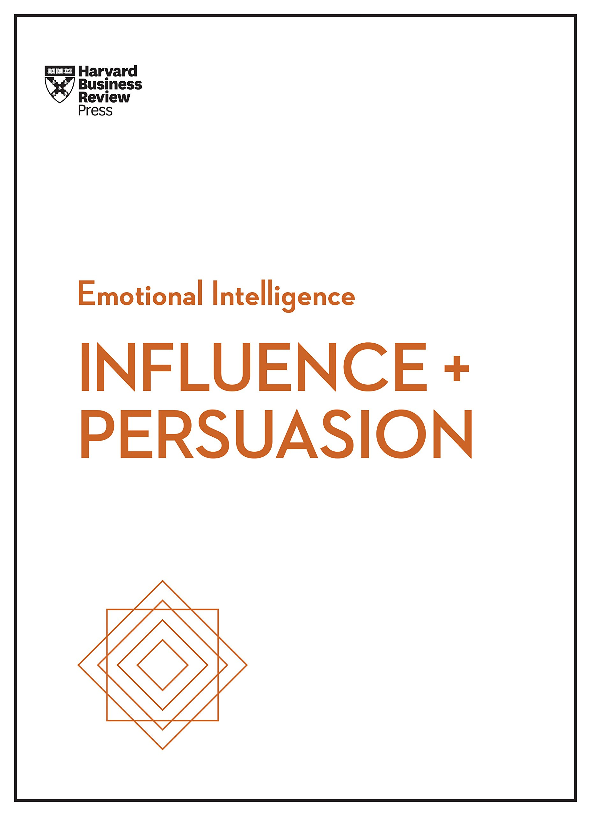

Slide 3
About the Authors & Publishers
Highlights of the Book
* 4 components of Influence
* Harness the science of persuasion
Conclusion
OUTLINE

Slide 4


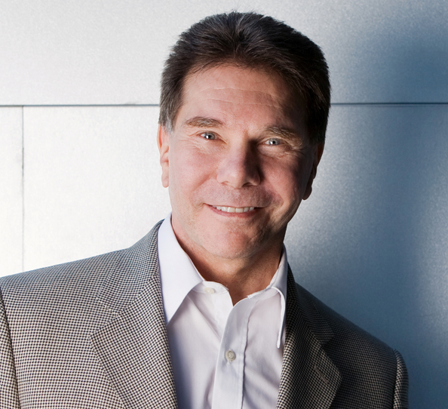
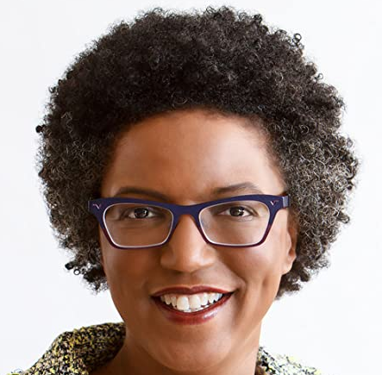
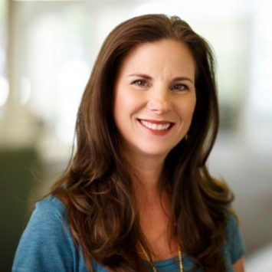
ABOUT THE AUTHORS AND PUBLISHERS
Nick Morgan
Robert Cialdini
Linda A. Hill
Nancy Duarte

Slide 5
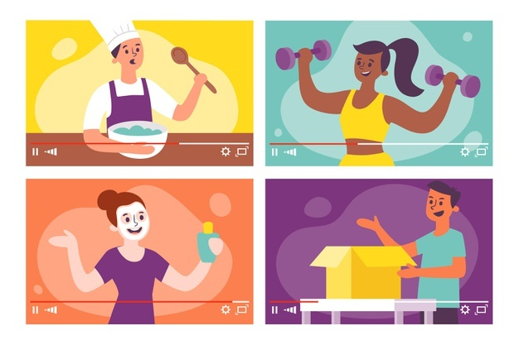
HIGHLIGHTS OF THE BOOK
4 COMPONENTS OF INFLUENCE

Slide 6
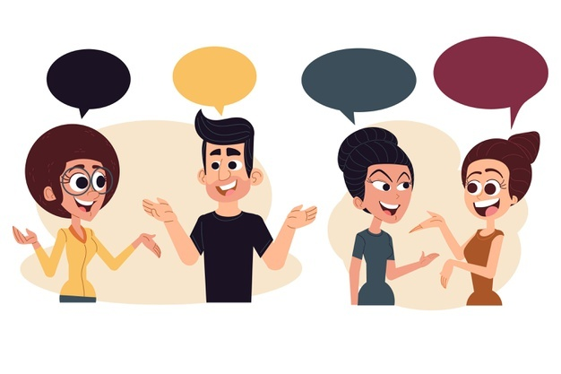


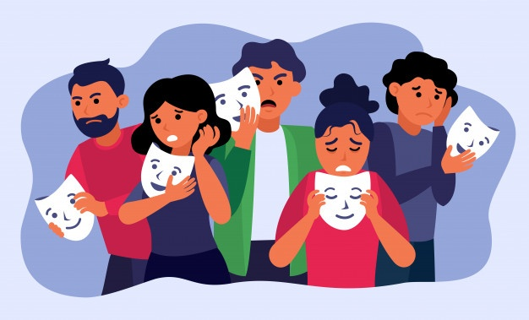
POSITIONAL POWER
NONVERBAL SIGNALS
EMOTION
EXPERTISE

Slide 7
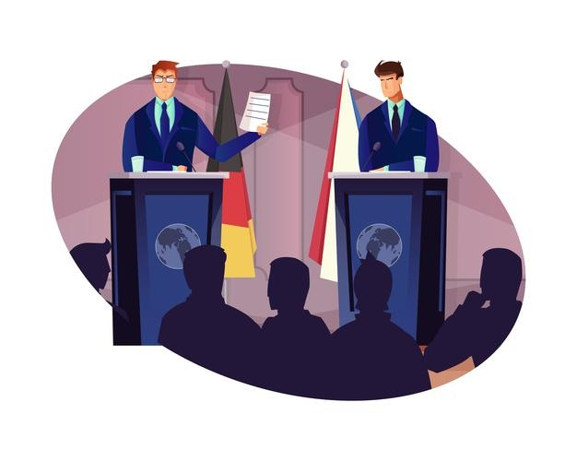
HIGHLIGHTS OF THE BOOK
HARNESS THE SCIENCE OF PERSUASION

Slide 8
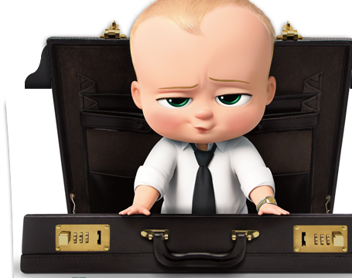
WHAT IF YOU’RE NOT A BORN PERSUADER ?

Slide 9




Principle of Liking
Principle of Reciprocity
Principle of Authority
Principle of Scarcity

Slide 10

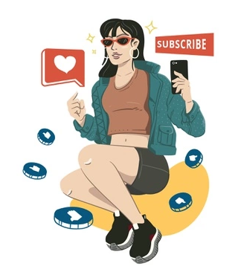
CONCLUSION
Limited set of human drives and needs
INFLUENCE
PERSUASION

Slide 11
PREFERRENCES
https://hbr.org/
https://hbr.org/2015/04/how-emotional-intelligence-became-a-key-leadership-skill
https://www.perlego.com/book/837406/influence-and-persuasion-hbr-emotional-intelligence-series-pdf
https://www.duarte.com/presentation-skills-resources/book-review-influence-persuasion-hbr-emotional-intelligence-series/
https://www.goodreads.com/book/show/34773703-influence-and-persuasion

Slide 12


