Slide 1
DICE – an introduction
Desktop Integrated Collaboration Environment
  Brady Anderson

Slide 2
Definition
  DICE presents documents, tasks and calendar entries contained in web based workspace environments natively within the Gnome Desktop.
  The goal is to provide SLED Desktop users additional benefits and features not afforded to the standard web portal users in these environments.

Slide 3
High Level Features
Off-line access to documents and calendar entries contained in Workspaces the user is a member of
Authoring and storing of documents using familiar desktop applications
Eliminates time consuming, error prone manual steps in managing a document
Simple desktop tools for managing document work flow such as: locking and versions
Workspace calendar entries available in Evolution
Support for Microsoft's SharePoint Server 2007
Support for Novell's Teaming Server v1.0

Slide 4
Document Management
Documents contained in a remote workspace are cached locally on the user's desktop
Remote updates are automatically updated on the user's desktop
Any changes the user makes to a cached copy are automatically pushed back to the remote workspace
User's can force a synchronization at the document level
User's can checkout the current version of a document and then manually check the document back in when they are satisfied with their changes
A configured number of versions are also cached to the desktop where the user can view, make a previous version current or drag a version out onto the desktop

Slide 5
Workspace Calendars
All calendar entries contained in a remote workspace are cached locally in Evolution's Data Server
Remote workspace calendar's show up in Evolution
A user can manage their calender while disconnected
A user can force the calendar to synchronize now

Slide 6
Software Components
Synchronization Daemon
GVFS (Gnome Virtual File System) Provider
Nautilus Property Page Extension

Slide 7
Software Components cont.
DICE Daemon
  Public DBus API for other components
    GVFS
    Nautilus Extension
  Synchronization Engine
    Synchronizes workspace documents to the local file system
    Synchronizes document meta-data to a local database
    Synchronizes calendar entries to Evolution Data Server
    Generates and persists feed events based on workspace activity

Slide 8
Software Components cont.
GVFS Provider
  Remote Mount
    Visible in Nautilus
    File Chooser Dialog
  Presents a hierarchical view of the documents
    Provider->Workspace->Folder->Documents
  Fuse File System
    Visible throughout the operating system
    Posix file api

Slide 9
Software Components cont.
Nautilus Extension
  Display document versions
  Make a document version current
  Drag a version of the document on to the Desktop
  Lock and unlock a document
  Force document synchronization

Slide 10
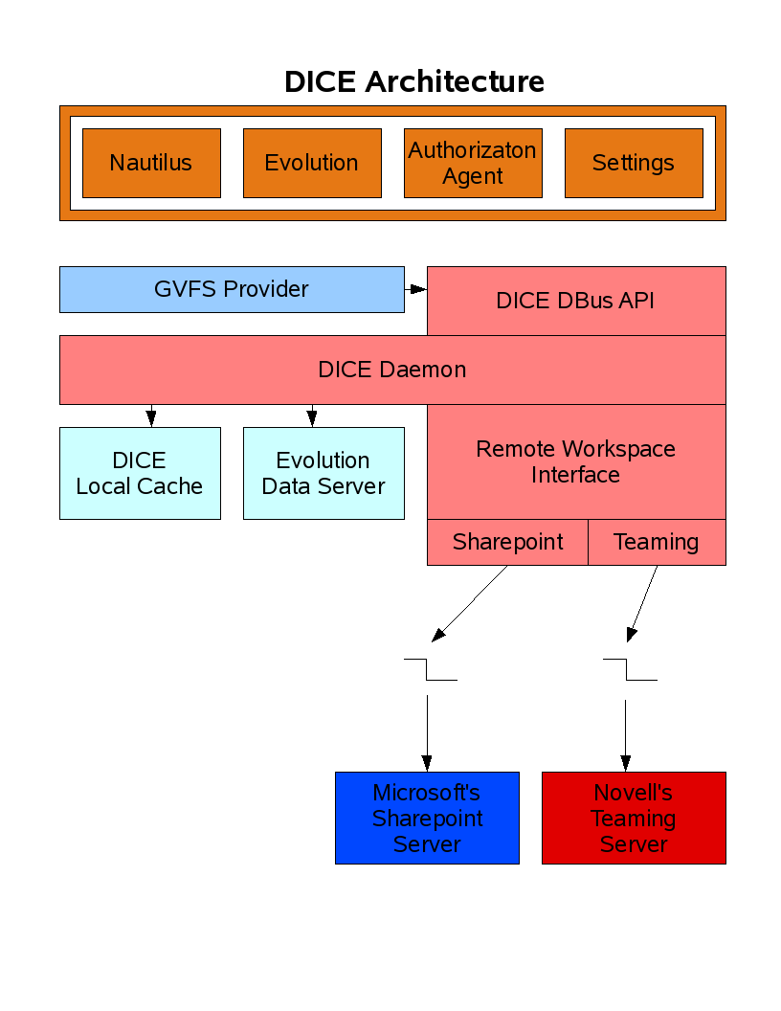

Slide 11
Future Features
Perform simple workflows found in most of document management environments from your desktop ie. sign off
Seamless access to cached and remote documents from the same view
Smart top level mounts ie. Most Recent, Most Active
A simple feed engine to keep the user informed of Workspace activity
Support for Novell's next version of the Teaming server.
Task management
Contact management
Better Open Office integration ie. versions

Slide 13
Unpublished Work of Novell, Inc. All Rights Reserved.
This work is an unpublished work and contains confidential, proprietary, and trade secret information of Novell, Inc. Access to this work is restricted to Novell employees who have a need to know to perform tasks within the scope of their assignments. No part of this work may be practiced, performed, copied, distributed, revised, modified, translated, abridged, condensed, expanded, collected, or adapted without the prior written consent of Novell, Inc. Any use or exploitation of this work without authorization could subject the perpetrator to criminal and civil liability.
General Disclaimer
This document is not to be construed as a promise by any participating company to develop, deliver, or market a product. It is not a commitment to deliver any material, code, or functionality, and should not be relied upon in making purchasing decisions. Novell, Inc. makes no representations or warranties with respect to the contents
of this document, and specifically disclaims any express or implied warranties of merchantability or fitness for any particular purpose. The development, release, and timing of features or functionality described for Novell products remains at the sole discretion of Novell. Further, Novell, Inc. reserves the right to revise this document and to make changes to its content, at any time, without obligation to notify any person or entity of such revisions or changes. All Novell marks referenced in this presentation are trademarks or registered trademarks of Novell, Inc. in the United States and other countries. All third-party trademarks are the property of their respective owners.

