Slide 1
SLED 11 Desktop Technology
JP Rosevear
Desktop Engineering Manager
Novell, Inc.

Slide 2
SLED 10 to SLED 11
3 years between feature freezes
Enhancement of hardware detection and management
  HAL
Maturation of a number of technologies like search
  Lots of incremental improvements
Solutions to larger problems like PolicyKit, remote file systems

Slide 3
Privilege Escalation and Permissions

Slide 4
Privilege Escalation and Permissions
PolicyKit
  general privilege escalation system
  removes need for all-or-nothing root user privileges
  configurable by administrator
  PAM authentication
ConsoleKit
  system for determining active console user

Slide 5
ConsoleKit Sessions
Console sessions are active or not
ck-list-sessions shows full list of sessions

Slide 6
PolicyKit Authentication
Three base user states
  Anyone, Console, Active Console
Four base types of authentication
  Yes, No, Admin Auth, User Auth
Four modifiers of authentication
  normal, one-shot, retain for session, keep indefinitely
Optional user states
  defining user specific privilege escalation
  defining an admin group

Slide 7
PolicyKit Administration
polkit-auth on the command line
  --show-obtainable
  --user <user>
polkit-default-privs
  implicit privilieges
  /etc/polkit-default-privs.local
/etc/PolicyKit/PolicyKit.conf
  explicit privileges

Slide 8
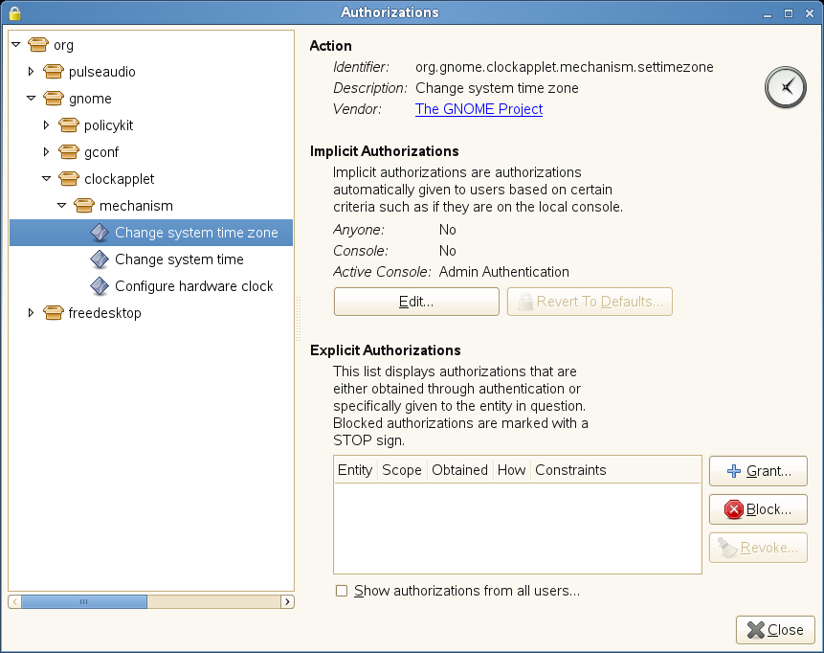
PolicyKit Adminstration (II)
polkit-gnome-authorization as a GUI

Slide 9
PolicyKit Privileges
PolicyKit
  org.freedesktop.policykit.*
Device Access and Mounting
  org.freedesktop.hal.device-access.*, org.freedesktop.hal.storage.*
  resmgr is removed from the distribution
Package Management
  org.freedesktop.packagekit.*
Power Management
  org.freedesktop.consolekit.*
  org.freedesktop.org.hal.powermanagement.*

Slide 10
PolicyKit Privileges (II)
Printing
  In progress
Time
  org.gnome.clockapplet.mechanism.*
and more...

Slide 11
Login and Authentication

Slide 12
GDM
a significant re-write over SLED 10
gdm.conf files for configuration
integration with PolicyKit and ConsoleKit
gconf for configuration
moving towards better multi-factor authentication

Slide 13
GDM Authentication Types
Passwords
Fingerprint
  expanded support
Active Directory
  UPN support
Smart cards
  For Active Directory too

Slide 14
GDM Login
Accessibility availability at main screen
Power management availability at main screen
Session support to run other items easily at login screen
gnome-keyring can be unlocked at login time

Slide 15
GNOME Session
Also heavily re-workd
Improved progress information
Simpler auto start management
  Serial phases
  Use .desktop files to define start
/etc/xdg/autostart and ~/.config/autostart

Slide 16
Security

Slide 17
Certificate Store
Certificate store
  One shared NSS database
  Enabling key apps first
    OpenOffice, Evolution, NetworkManager

Slide 18
Key Management
Seahorse
  key management (GPG, ssh)
  keyring management

Slide 19
Package Management

Slide 20
Libzypp
satsolver for fast dependency resolution

Slide 21
PackageKit
Package management abstraction layer
  libzypp, yum, smart
Uses libzypp
Daemon is activated when needed
/etc/PackageKit/PackageKit.conf
PolicyKit enabled

Slide 22
gnome-packagekit
unified GUI frontend
updating
  tray icon, update viewer
  automatic update installation
preferences
  gpk-prefs
easy to use utilities
  gpk-application
  hardware/firmware installation

Slide 23
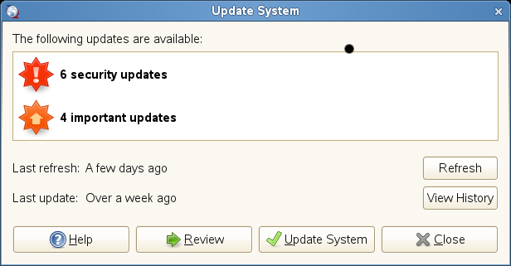
gnome-packagekit (II)
Tray icon → Show Updates

Slide 24
Networking

Slide 25
NetworkManager Hardware
Ethernet
Wireless
3G Card
  ModemManager
    Unified vendor interface
    Vodafone, Telefonica
DSL Modems

Slide 26
NetworkManager Configuration
Still try to do the right thing as much as possible but
  Allows for more specialized configurations
Multiple device support
Custom routing
Static and DHCP profiles for same device
802.1x authentication
Sync to system setting
  PolicyKit enabled
Connection sharing

Slide 27
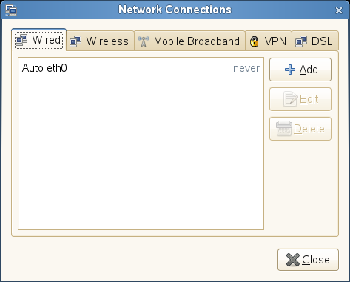
NetworkManager Configuration
Access with riight-click on NetworkManager icon → Edit connections...

Slide 28
Remote File Systems

Slide 29
GVFS
Replaces gnome-vfs
Provides FUSE mounts for legacy applications
  ~/.gvfs
Command line tools to provide scripting
  gvfs-mount, gvfs-monitor-dir, gvfs-monitor-file

Slide 30
Printing

Slide 31
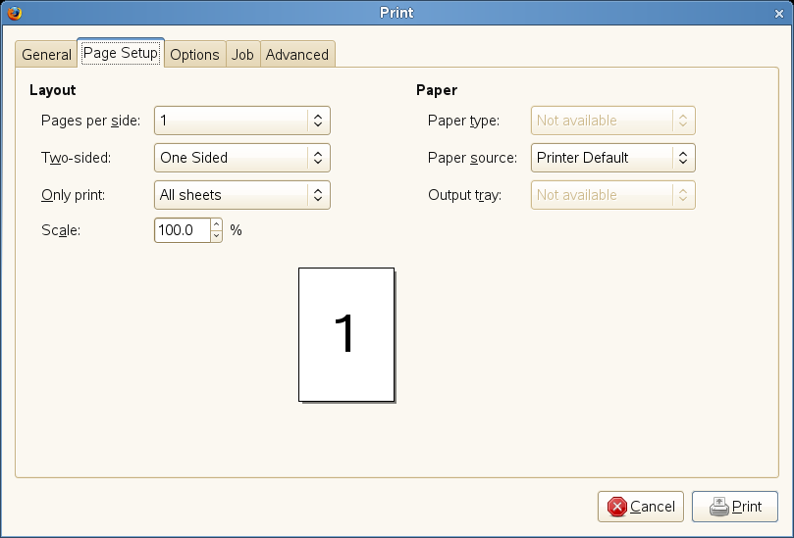
Printing in Applications
New application dialogs for printing
Expose a lot more printer functionality directly

Slide 32
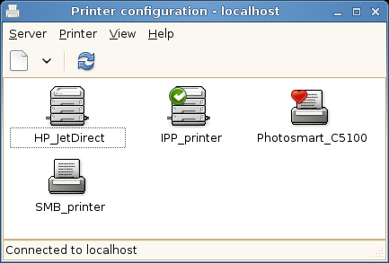
Printing Setup and Administration
System config printer
  Easier to use
  SMB printer discovery

Slide 33
Sound

Slide 34
Sound
Pulseaudio
  Network forwarding
  Per app volume switching
  Glitch free playback
  Dynamic switching of audio input and output
Sound themes

Slide 35
Bluetooth

Slide 36
Bluetooth
Fully certified 2.1 stack
Input Devices
Printers
Sound
  alsa and gstreamer

Slide 37
Multi Screen

Slide 38
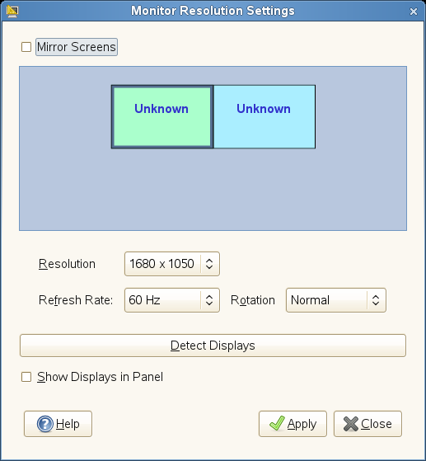
Multiscreen Support
Support for rotation, dynamic resizing
  unifying control center resolution capplets and resapplet
External monitor detection

Slide 39
Desktop Effects

Slide 40
Desktop Effects
Xgl dropped
  replaced by AIGLX and direct use of nVidia drivers
Compiz-fusion
  merger of compiz and beryl projects
  many more plugins
Defaulting to compiz when possible
  Hardware testing to determine suitability

Slide 41
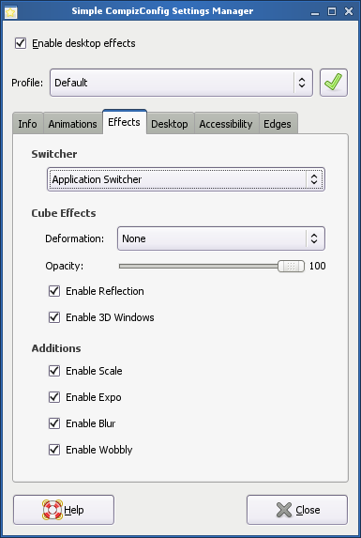
Desktop Effects Configuration
simple-ccsm
  Computer → Control Center → Desktop Effects

Slide 42
Laptops

Slide 43
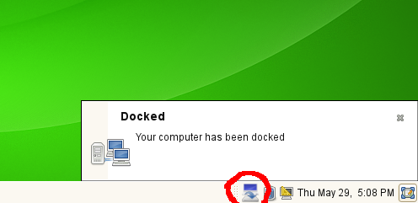
Docking Stations
Gnome-docker
  notification with icon about dock status
  allows software undocking of laptop
    hotkeys like Fn-F9 on ThinkPads

Slide 44
Key Applications and Software

Slide 45
Web Browsing
Firefox 3.0
“Awesome Bar”
Spell checking
Zooming
Security
  anti-phishing, anti-malware
Better platform integration
  print, vfs
Accessibility
  zooming, screen readers

Slide 46
Instant Messaging
Empathy 2.24.1
  Default
  Based on the telepathy framework
  Better framework for integrated text/voice/video chat
  Some small regressions versus pidgin
Pidgin 2.5.1
  Renamed from 'gaim
  UI Improvements
    Error handling

Slide 47
Search
Beagle 0.3.8
Speed, memory and disk use improvements
  Text caching
Improved and new backends
  Firefox, Thunderbird, Epiphany, Opera, Nautilus
Improved configuration
  Enhanced white/black list
  Backend enable/disable
  System config and crawl /etc/beagle/
Better stemming and text analysis

Slide 48
tsclient
Improved protocol support
  TN3270, web, ssh
Autostart connections on login
Connections can be saved in the Places tab of the Main Menu

Slide 49
Yast Gtk
Gtk native UI for yast
  stock icons
  button order

Slide 50
Utilities
Tomboy 0.11.3
  Plugin system
    Evolution mail, synchronization
  Auto bulleting
    '- <text><enter>'
Deskbar Applet 2.24.1
  live search interface
  many plugins: beagle, window switcher, computer actions
GNOME Do 0.6.0
  take actions on well known bits of data
  many plugins: banshee, vinagre, screenshot, firefox

Slide 51
Beta Call In Depth
OpenOffice 3.0
Banshee 1.4
Evolution and Evolution Exchange 2.24.2

Slide 52
General Desktop
Accessibility
  Orca, mouse accessibility
Alarcarte Menu Editing
Control Center Capplet UI improvements
  Preferred Applications, Appearance, Keyboard
Evince Document Viewer
  PDF form handling
File Dialog
  Location bar, Recently Used/Search

Slide 53
General Desktop (II)
Nautilus improvements
  property dialog, compact view
Synchronization
  Conduit
VNC
  vinagre, vino

Slide 54
General Desktop
Localization and Internalization
90%+ translation coverage for the following languages
  Spanish, French, Brazilian Portuguese, German, Russian, Chinese (Taiwan), Chinese (Hong Kong), Japanese, Portuguese, Finnish, Galician, Swedish, Italian, Vietnamese, Turkish, Slovenian, Korean, German, Catalan, Russian, Dutch, Macedonian, Norwegian, Hungarian, Japanese, Bulgarian, Polish, Arabic, British English
Expect several more to reach that by final release:
  Chinese (China), Danish, Punjabi, Ukranian, Czech and more
CJK and RTL improvements

Slide 55
Administration and Configuration

Slide 56
Language Packs
bundle-lang-*
  common, gnome other major pieces
hold a set of commonly installed app languages
  default installation set
cut down on required space

Slide 57
xdg-user-dirs
Provide a set of well know user directories
Translations for directory names
Configurable set /etc/xdg/user-dirs.defaults

Slide 58
Desktop Items
Can place .desktop files in a directory
  Specify directory with gconf
    /apps/nautilus/desktop/predefined_items_dir
Mandatory and optional items
  Mandatory cannot be removed by user

Slide 59
Branding - Artwork
branding-<product> meta package
  *-branding-<product> for individual branding pieces
    bootsplashing-branding-SLED
  provides various pieces
    Provides: bootsplash-branding
Can create own set of branding packages for various art work pieces
  bootsplash
  gdm, screensaver
  gimp, OpenOffice

Slide 60
Branding - Policy
configuration pieces are also branding where different from defaults
  glib2-branding-SLED
    file type handing defaults
  gconf2-branding-SLED
    all gconf based defaults
  Mozilla-Firefox-branding-SLED
    bookmarks

Slide 61
Q & A

Slide 63
Unpublished Work of Novell, Inc. All Rights Reserved.
This work is an unpublished work and contains confidential, proprietary, and trade secret information of Novell, Inc. Access to this work is restricted to Novell employees who have a need to know to perform tasks within the scope of their assignments. No part of this work may be practiced, performed, copied, distributed, revised, modified, translated, abridged, condensed, expanded, collected, or adapted without the prior written consent of Novell, Inc. Any use or exploitation of this work without authorization could subject the perpetrator to criminal and civil liability.
General Disclaimer
This document is not to be construed as a promise by any participating company to develop, deliver, or market a product. It is not a commitment to deliver any material, code, or functionality, and should not be relied upon in making purchasing decisions. Novell, Inc. makes no representations or warranties with respect to the contents
of this document, and specifically disclaims any express or implied warranties of merchantability or fitness for any particular purpose. The development, release, and timing of features or functionality described for Novell products remains at the sole discretion of Novell. Further, Novell, Inc. reserves the right to revise this document and to make changes to its content, at any time, without obligation to notify any person or entity of such revisions or changes. All Novell marks referenced in this presentation are trademarks or registered trademarks of Novell, Inc. in the United States and other countries. All third-party trademarks are the property of their respective owners.

