Slide 1
NOMAD, a quick intro
Novell Open Mobile Agile Desktop
  David Reveman - Hubert Figuiere
  Team Meeting June 3rd 2008

Slide 2

What?

Slide 3
What?
A Linux desktop environment
Remotely accessible
Shareable
Virtualised

Slide 4
How?
X11
  With a proxy
  With hardware acceleration
A virtual machine on both ends
  Xen
  KVM
  Anything else

Slide 5
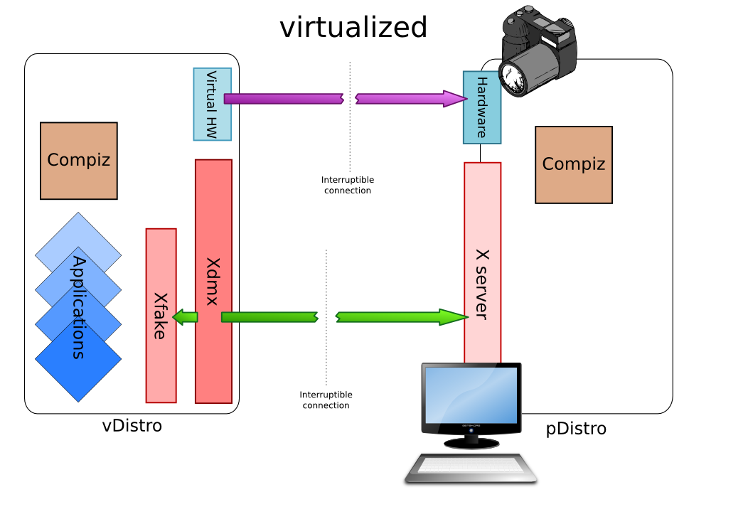

Slide 6
Why?
High degree of flexbility
  Agile
    The use can interrupt his work session
    Move to another terminal
    Resume where it was
  Mobile
    The currently running environment can be just copied to a mobile device (laptop)
Security
  The virtual machine isolate each user from the other
  You can isolate sensitive or untrusted application into their own VM

Slide 7
Why? (cont.)
Lower TCO
  The virtualisation allow using thin client for the workstations
  Consolidating the CPU power into powerful application servers
    Easier to balance the load as moving a complete virtual machine to a new host is easy
Lower Maintenance
  Much easier to backup
  Much easier to restore
  Much easier to install new systems
    Virtualised hardware: only one kind

Slide 8
Why? (cont.)
Shared desktop
  For collaboration
    While each use keep it own view of the workspace
  For remote control and administration
  For training

Slide 10
Unpublished Work of Novell, Inc. All Rights Reserved.
This work is an unpublished work and contains confidential, proprietary, and trade secret information of Novell, Inc. Access to this work is restricted to Novell employees who have a need to know to perform tasks within the scope of their assignments. No part of this work may be practiced, performed, copied, distributed, revised, modified, translated, abridged, condensed, expanded, collected, or adapted without the prior written consent of Novell, Inc. Any use or exploitation of this work without authorization could subject the perpetrator to criminal and civil liability.
General Disclaimer
This document is not to be construed as a promise by any participating company to develop, deliver, or market a product. It is not a commitment to deliver any material, code, or functionality, and should not be relied upon in making purchasing decisions. Novell, Inc. makes no representations or warranties with respect to the contents
of this document, and specifically disclaims any express or implied warranties of merchantability or fitness for any particular purpose. The development, release, and timing of features or functionality described for Novell products remains at the sole discretion of Novell. Further, Novell, Inc. reserves the right to revise this document and to make changes to its content, at any time, without obligation to notify any person or entity of such revisions or changes. All Novell marks referenced in this presentation are trademarks or registered trademarks of Novell, Inc. in the United States and other countries. All third-party trademarks are the property of their respective owners.

