Slide 1
Locomotion Control
Module Specification

Slide 2
Module Purpose
Control the locomotion system so that it responds to high level manoeuvre commands
Monitor locomotion to ensure those commands are being executed
Make actuator data available to modules that require it
Manoeuvre Demand
Locomotion Control
Actuator Demand
Actuator Telemetry
Actuator Telemetry

Slide 3
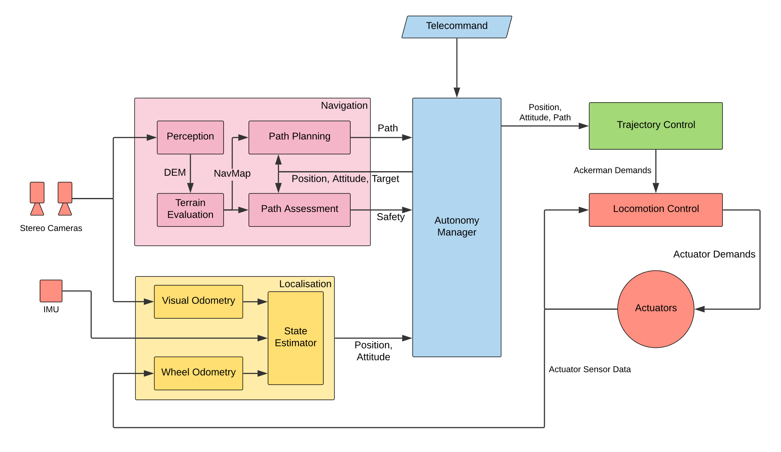
Functional Architecture

Slide 4
Locomotion capability
6 drive wheels, 4 corner wheels have steering capability
Limits manoeuvres to those where the vehicle’s centre of rotation lies along the normal to the middle wheels
This gives three possible manoeuvres:
Skid Steering “tank”
Ackerman “car”
Point Turn “turret”
Interesting paper: https://www.ri.cmu.edu/pub_files/pub1/shamah_benjamin_1999_1/shamah_benjamin_1999_1.pdf

Slide 5


Skid Steering Definition
Two parameters to describe a skid steer manoeuvre:
Curvature, $k$ [1/m]
Rover body speed, $v$ [m/s]
In this configuration, the rover will drive in a circle, radius $r$, around the centre of rotation
Wheels are not steered, instead both sides are driven at different speeds
The speed of the rover, $v$, is limited by the max/min speed of rotation of the wheels
Wheels on the “outside” of the circle must turn faster than those on the “inside”
$$r=\frac{1}{k}$$

Slide 6

Ackerman Definition
Two parameters to describe an Ackerman manoeuvre:
Curvature, $k$ [1/m]
Rover body speed, $v$ [m/s]
In this configuration, the rover will drive in a circle, radius $r$, around the centre of rotation
Corner wheels steered to point towards the centre of rotation
The speed of the rover, $v$, is limited by the max/min speed of rotation of the wheels
Wheels on the “outside” of the circle must turn faster than those on the “inside”
$$r=\frac{1}{k}$$

Slide 7
Point Turn Definition
One parameter to define a “turn on the spot” manoeuvre:
Rotation rate, $r$ [rad/s]
In this configuration, the rover will turn about its centre
Corner wheels are pointed at the centre of the rover
Rotation rate limited by speed of the wheels

Slide 8
Motor Specs
Drive Axes:
Datasheet: https://www.active-robots.com/springrc-high-torque-continuos-rotation-servo.html
Rotation rate of 360 deg / sec
With 10cm wheels, covers ~30 cm per second
No position data, limits wheel odometry:
Get encoders for these servos
Get new DC motors with encoders built in
Steer Axes:
Datasheet: https://www.pololu.com/file/0J1431/FS5103B-specs.pdf
PWM output signal controls position, is only input to Servos
Rotation rate of 0.18 sec / 60 deg (= 1.08 s for full revolution)

Slide 9
Input Specification
[GROUP DISCUSSION]

Slide 10
Output Specification
[GROUP DISCUSSION]

Slide 11
Internal Control Flow
[GROUP DISCUSSION]

